Slide 1



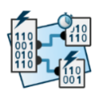
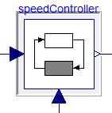

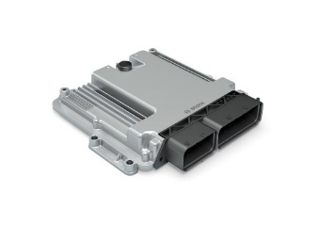





eFMU Manifest
Behavioral Model*
testing HiL
CATIA DBM
Algorithm Code
Software Production Engineering
Production Code*
Modelica
model
Dymola
Binary Code*
AUTOSAR Builder
testing
MiL
testing
SiL
system integration

