Slide 1



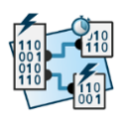
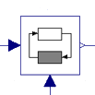

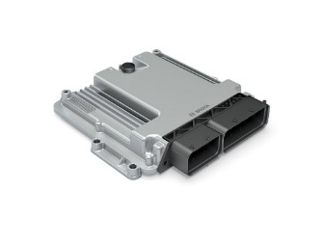





eFMU Manifest
Behavioral Model*
CATIA DBM
Algorithm Code
Software Production Engineering
testing HiL
system
integration
Production Code*
Modelica
model
Dymola
Binary Code*
testing
MiL
AUTOSAR Builder
testing
SiL

