Slide 1



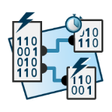
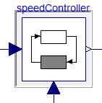


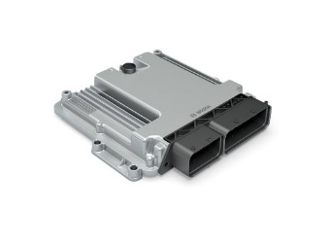
eFMU Manifest
Behavioral Model*
CATIA DBM
Algorithm Code
CATIA ESP
testing &
system integration
Production Code*
Modelica
model
Dymola
Binary Code*

