Slide 1
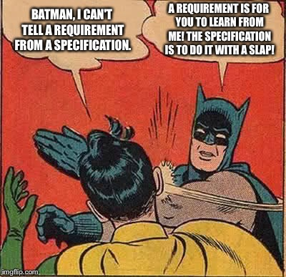
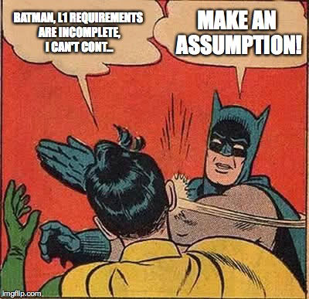
© 2015, Juande Santander-Vela, Attribution-ShareAlike 2.0 Generic (CC BY-SA 2.0)

