Slide 1
Structure proposal for the eFMI webpage
2022-05-16
Leo Gall, Ester Porcellato, MA Backoffice
Christoff Bürger (Dassault Systèmes)

Slide 2



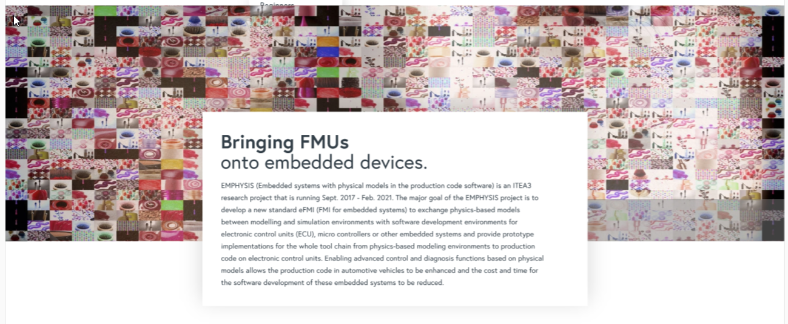
Introduction
eFMI Standard
Tools
Resources
News and Events
FAQ
About
Documentation
Use cases and industrial references
MAP eFMI published tooling
Example eFMUs
Project organization
History
Legal information

Slide 3
Introduction
eFMI Standard
Tools
Resources
News and Events
FAQ
About
About eFMI
Highlights
Project organization &
community
Overview of the eFMI technology and objectives of MAP eFMI.
Overview of highlight of the eFMI Standard.
About the project (bylaws, current members), how to get in touch and contribute.

Slide 4
Introduction
eFMI Standard
Tools
Resources
News and Events
FAQ
About
About the eFMI Standard and its licensing
Release cycle, eFMI versioning and backwards compatibility
Reporting specification issues and new feature proposals
Current stable releases
Candidate-drafts of next release
Old stable releases

Slide 5
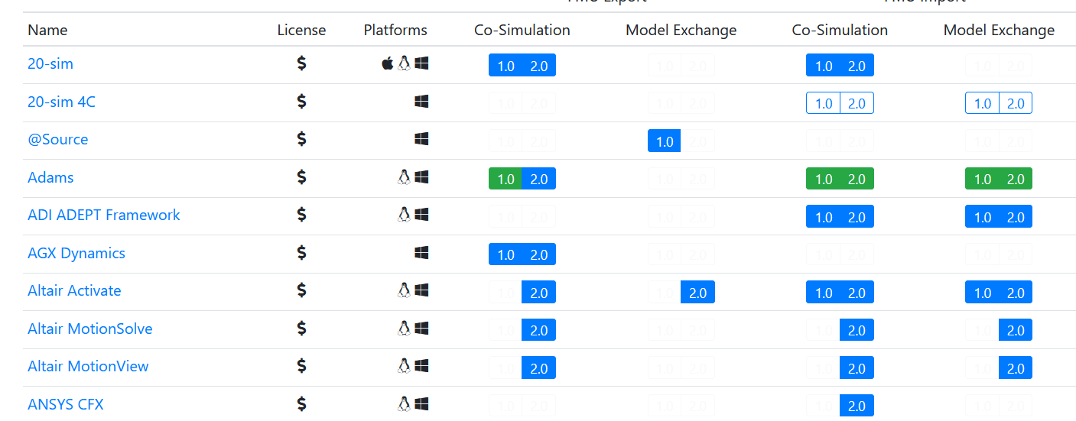
Introduction
eFMI Standard
Tools
Resources
News and Events
FAQ
About
List of Tools

Slide 6
Introduction
eFMI Standard
Tools
Resources
News and Events
FAQ
About
Documentation
Use cases and industrial references
MAP eFMI published tooling
Text and Link to list of publications (conference paper, journal papers, books).
Example eFMUs
Project organization
Logo, bylaws, membership application guidelines.

Slide 7
Introduction
eFMI Standard
Tools
Resources
News and Events
FAQ
About
2021-12-04 Example Event c
Text and Link for More Information
2021-11-20 Example Conference
Text and Link for More Information
2021-11-05 Example Event b
Text and Link for More Information

Slide 8
Introduction
eFMI Standard
Tools
Resources
News and Events
FAQ
About
eFMI Standard FAQs
Project organization FAQs
MAP eFMI published tooling FAQs
Question 1 of category X
I found a bug in the specifications. How do I report the issue?
Answere 1
Question 2 of category X
How can I join the Projects mailing list?
Answere 2

Slide 9
Introduction
eFMI Standard
Tools
Resources
News and Events
FAQ
About
Legal information
History
Contact
Trademark
Logo usage
CLA
Links to modelica.org
The projects background. How did the project come to life before it came under the MA umbrella.

