Slide 1
Structure proposal for the eFMI webpage
2022-03-29
Leo Gall, Ester Porcellato, MA Backoffice

Slide 2



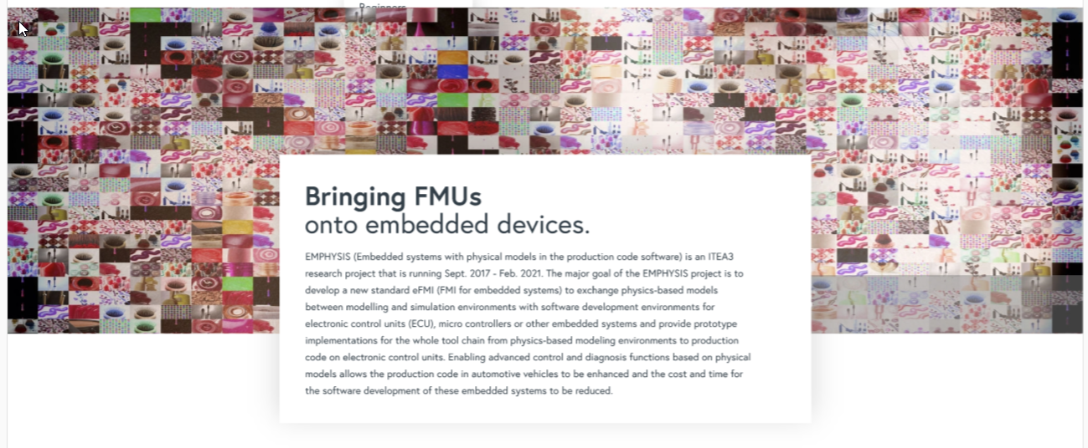
Introduction
Specification
Tools
Resources
News and Events
FAQ
About
Documentation
Education
Professional training
Utilities and SDK
Use cases and industrial references
Consultants
About the Project
History
Community
Membership
Legal information

Slide 3
Introduction
Specification
Tools
Resources
News and Events
FAQ
About
What problem does the standard want to solve and how does it do it. Short explanation of the purpose of the standard (embedded explanatory video?)
Links to resources and use cases
On the long term the Introduction page is ment to be different for different types of users (Target-group specific). It will help the user navigate trough the website according to his/her needs.
For now there will be a singular introduction page that presents the project and its purpose, but there will be the possibility to differenciate between beginner, advanced user, teacher and execuive in the future.

Slide 4
Introduction
Specification
Tools
Resources
News and Events
FAQ
About
Latest release
Link to current release
Latest development build
link to beta specification
Specification issues can be reported here (link to github issues)
Previous versions
Other downloads can be found in resources sdk

Slide 5
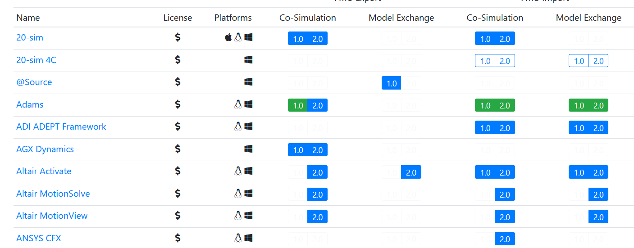
Introduction
Specification
Tools
Resources
News and Events
FAQ
About
List of Tools

Slide 6
Introduction
Specification
Tools
Resources
News and Events
FAQ
About
Documentation
Education
Professional training
Text and Link to list of publications (conference paper, journal papers, books)
Text and Link to list learning materials (lecture slides, videos etc. and list of student lectures)
Text and Link to list of courses (professional training courses)
Utilities and SDK
Use cases and industrial references
Consultants

Slide 7
Introduction
Specification
Tools
Resources
News and Events
FAQ
About
2021-12-04 Example Event c
Text and Link for More Information
2021-11-20 Example Conference
Text and Link for More Information
2021-11-05 Example Event b
Text and Link for More Information

Slide 8
Introduction
Specification
Tools
Resources
News and Events
FAQ
About
Question 1
I found a bug in the specifications. How do I report the issue?
Answere 1
Question 2
How can I join the Projects mailing list?
Answere 2
Question 3
I want to contribute to the Project. What steps do I have to take in order to do so?
Answere 3
Question 4
Answere 4

Slide 9
Introduction
Specification
Tools
Resources
News and Events
FAQ
About
About the Project
History
Community
More detailed information about the project.
Contact information
The projects background. How did the project come to life before it came under the MA umbrella
Text and Links to Github, other community channels (forum and social media), user groups and the Modelica Association Newsletter
Membership
Legal information
Text and list of MAP members
Trademark
Logo usage
CLA
Links to modelica.org

