Slide 1



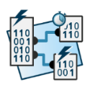
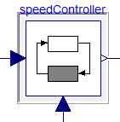



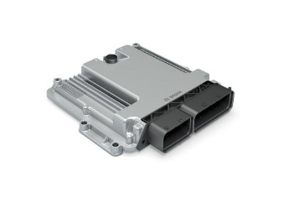
eFMU Manifest
Behavioral Model*
CATIA DBM
Algorithm Code
Software Production Engineering
testing &
system integration
Production Code*
Modelica
model
Dymola
Binary Code*
AUTOSAR Builder

