Slide 1


© 2021-2023, Modelica Association and contributors.
This work is licensed under a CC BY-SA 4.0 license.
Modelica® is a registered trademark of the Modelica Association.
eFMI® is a registered trademark of the Modelica Association.
FMI® is a registered trademark of the Modelica Association.
SSP® is a registered trademark of the Modelica Association.
DCP® is a registered trademark of the Modelica Association.
Third party marks and brands are the property of their respective holders.

Slide 2
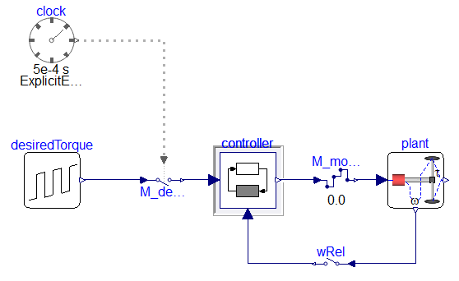
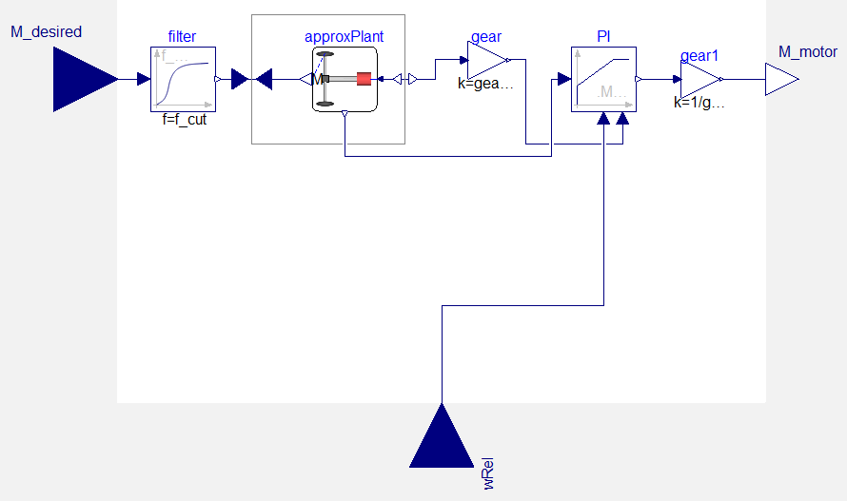
Test scenario
Controller

Slide 3

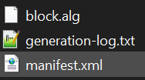
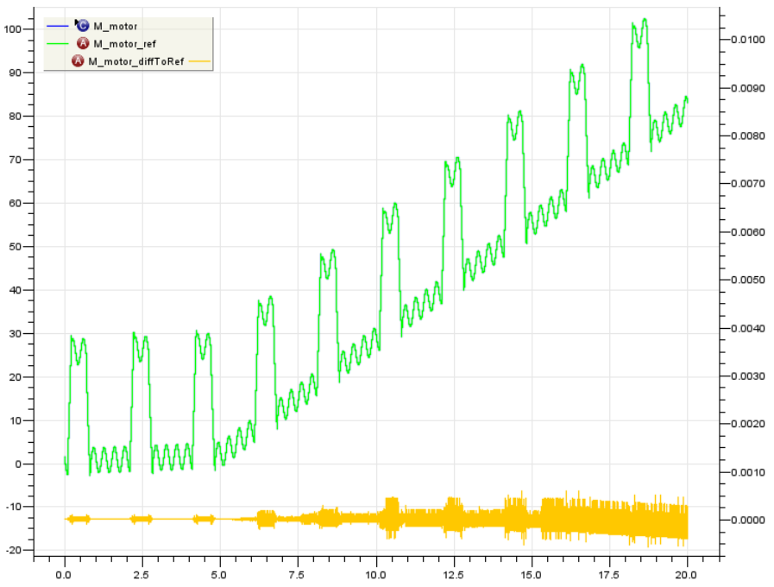
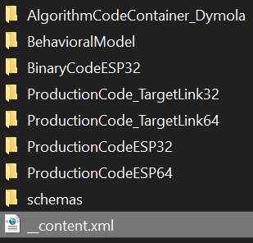

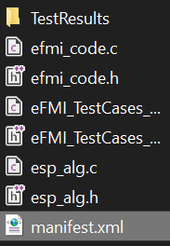
GALEC code
Container
manifest
TPT comparing production code results with expected behaviour, showing the error.

