Slide 1
Into-CPS Application Demo

Slide 2
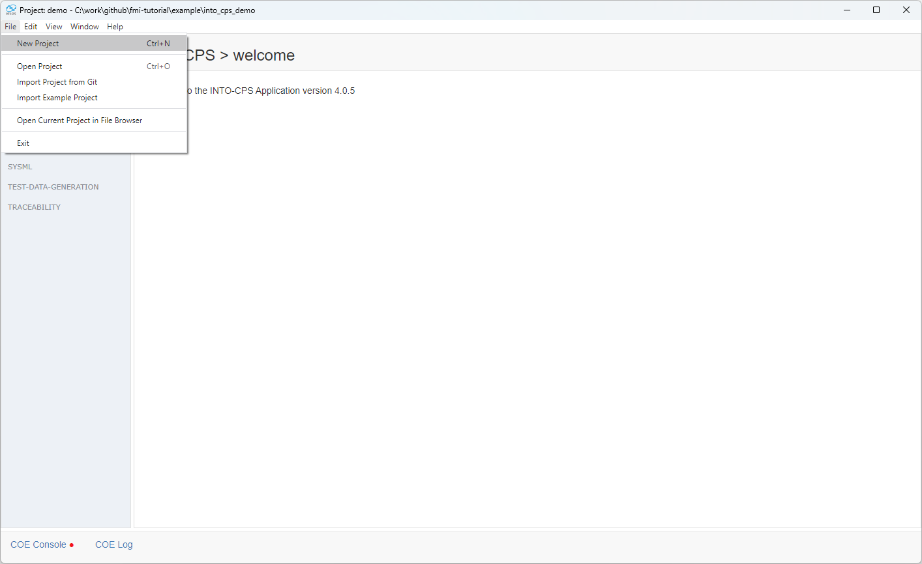
Creating a new project

Slide 3
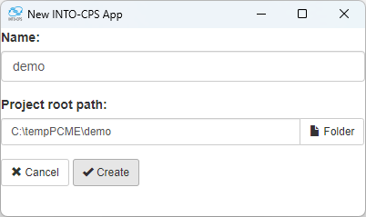
Setting project name

Slide 4
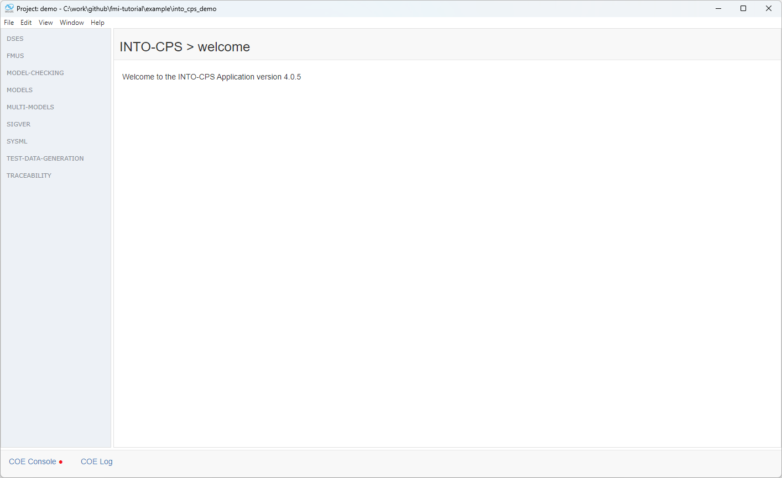
This is how a new empty project looks like

Slide 5
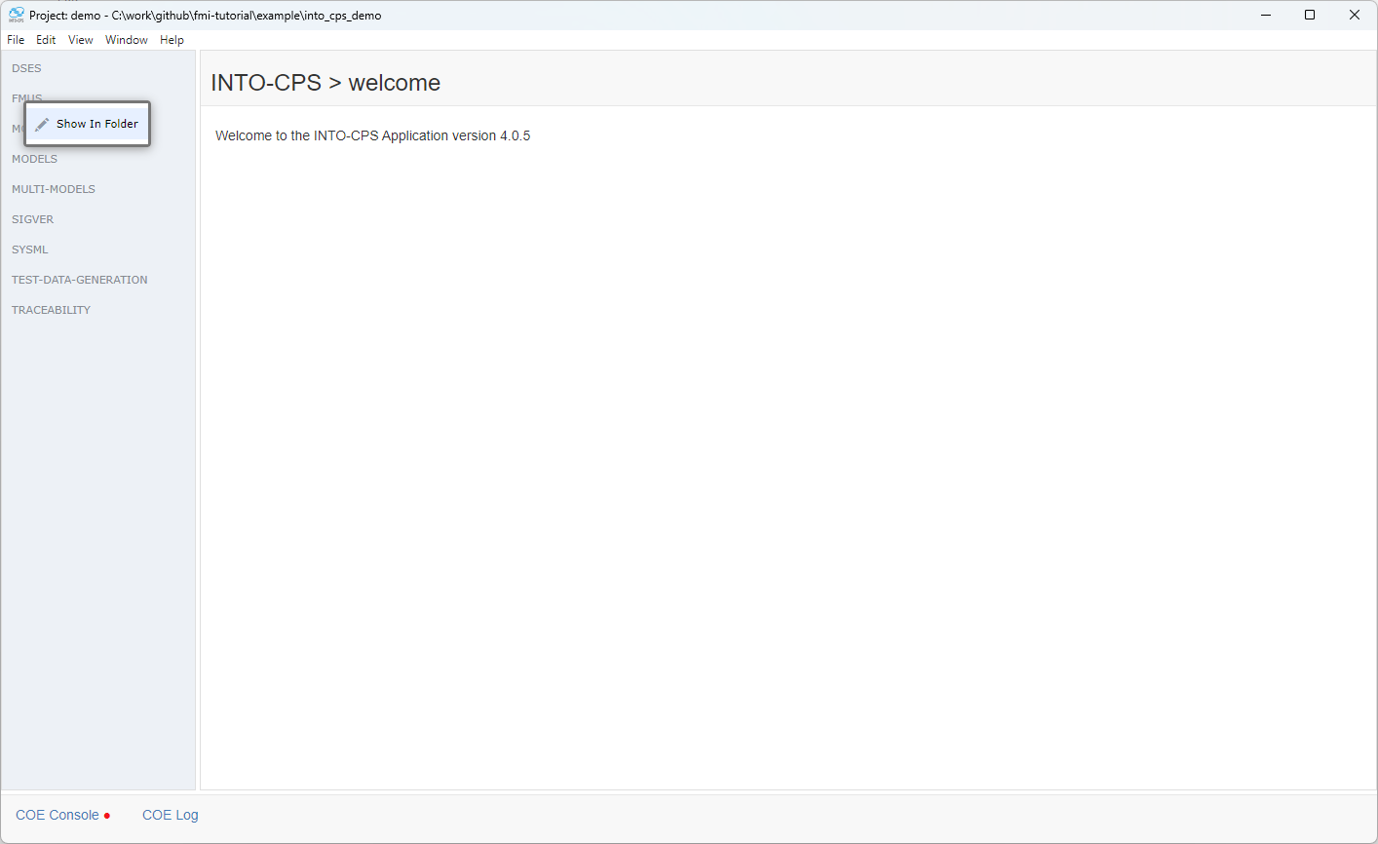
The project contains a folder for storing FMUs

Slide 6
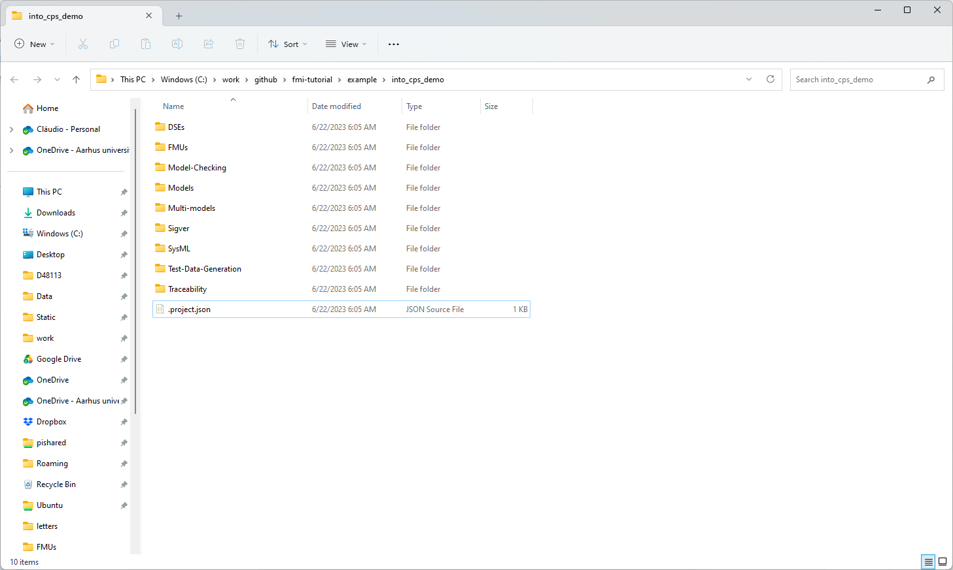
This is how that folder looks like

Slide 7
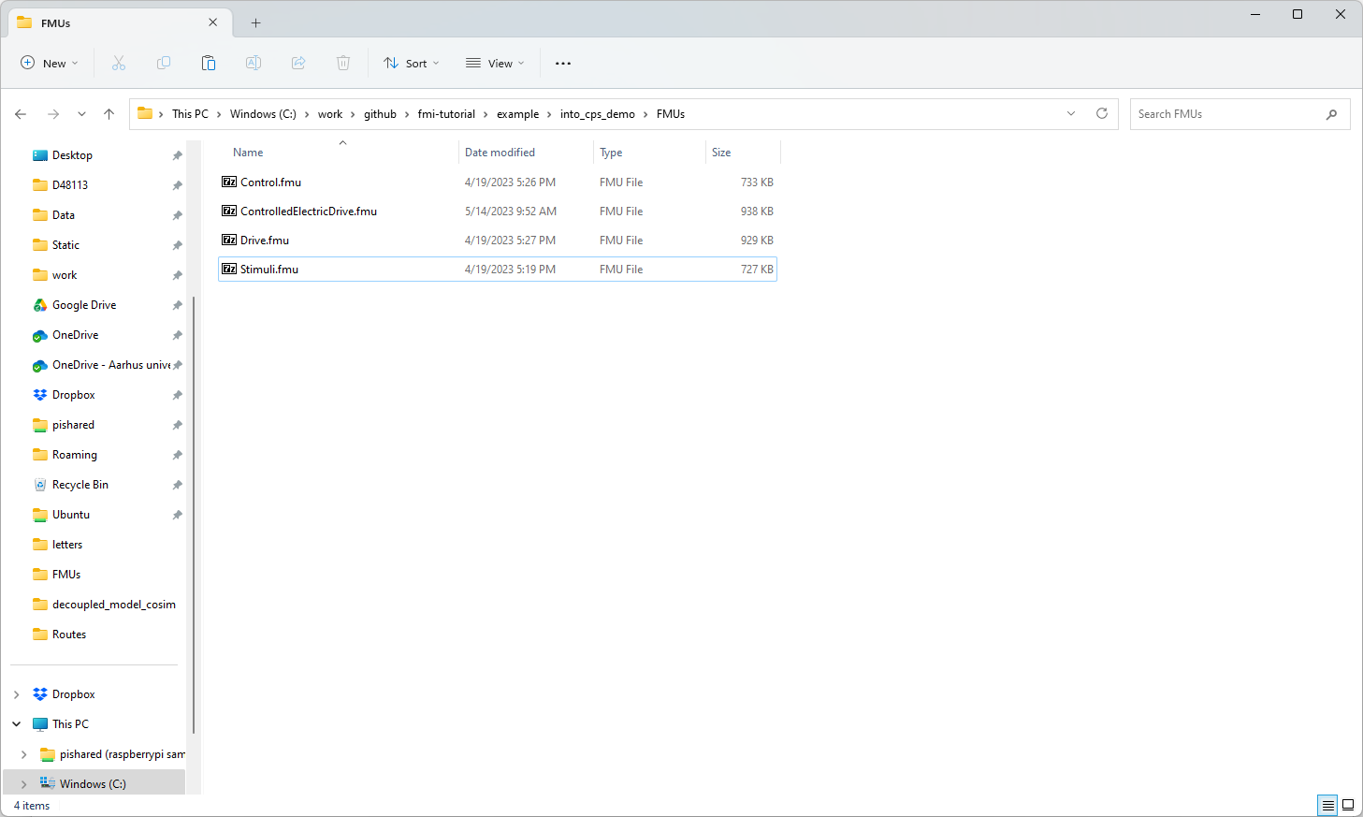
We place the fmus in this folder

Slide 8
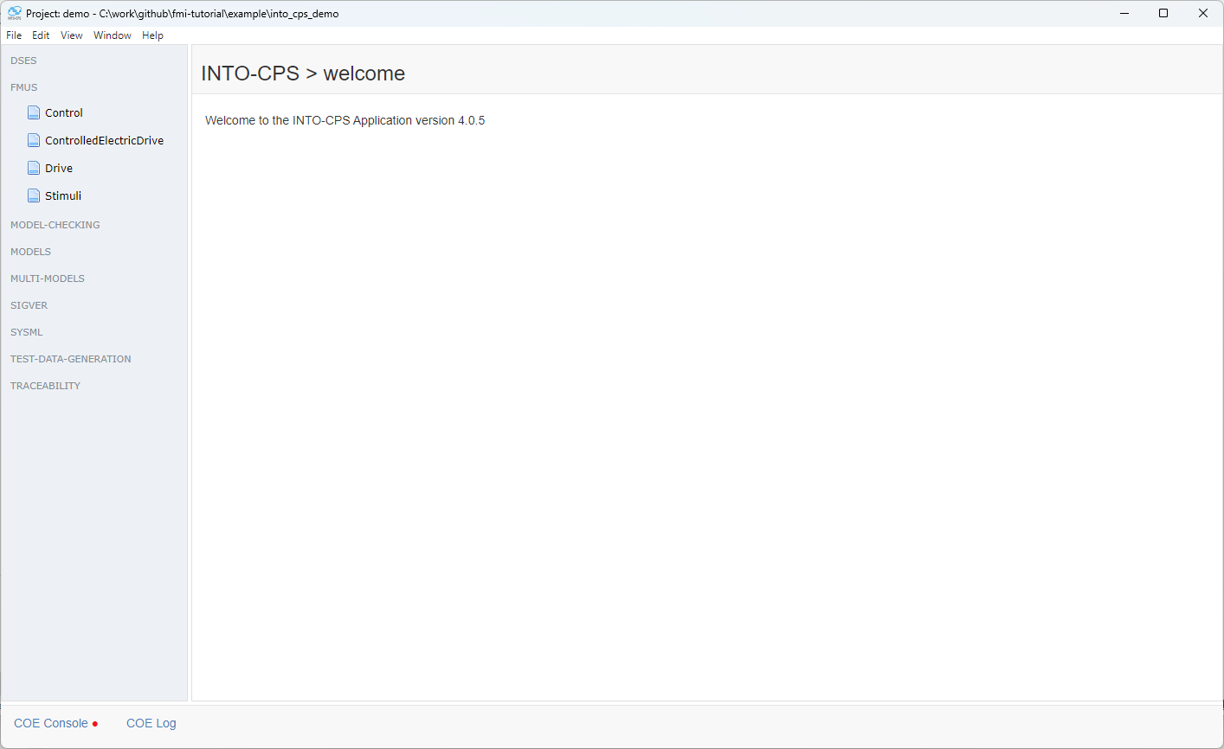
And now they show up on the interface

Slide 9
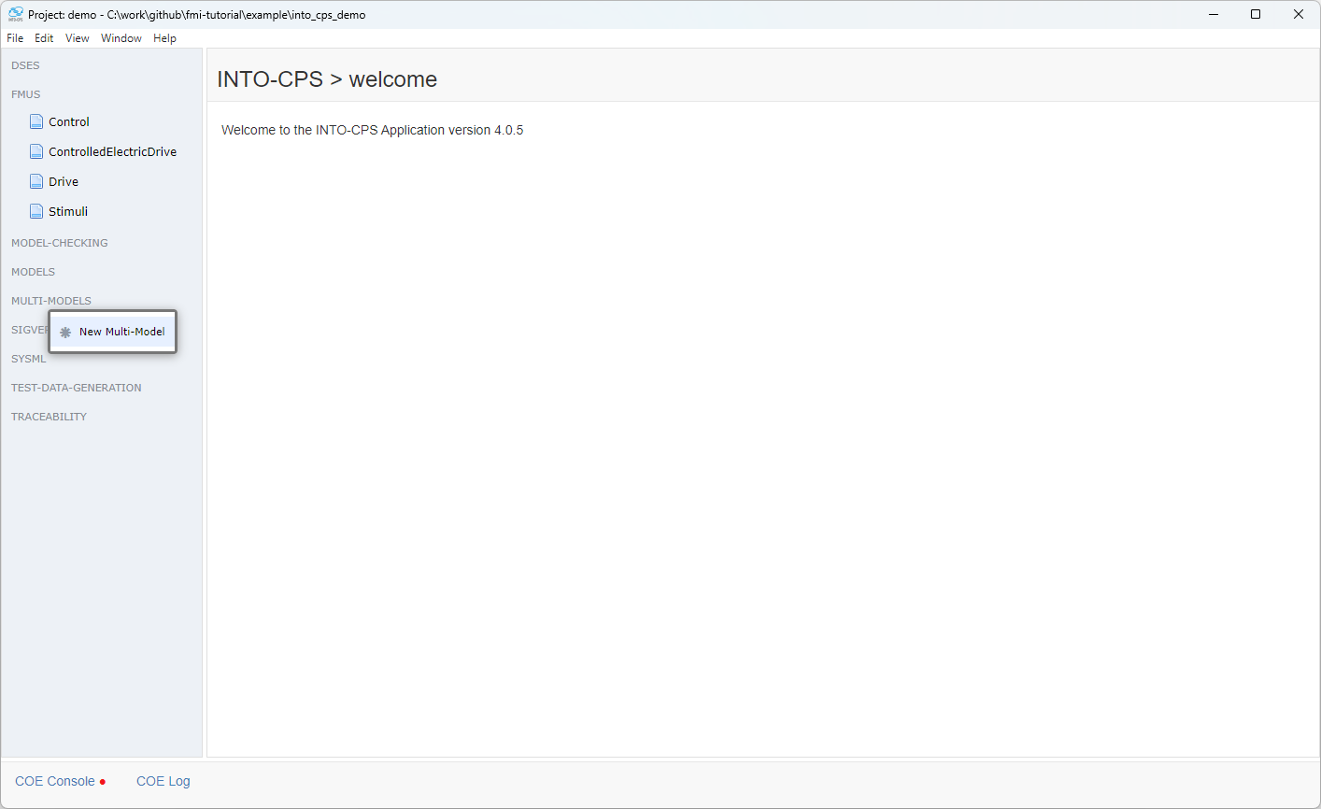
Let’s create a new multi model

Slide 10
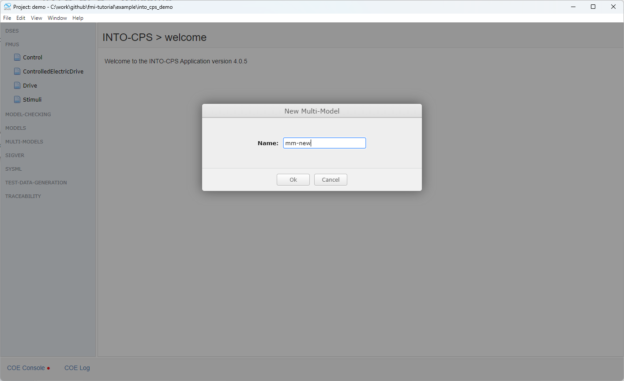
And give it a name

Slide 11
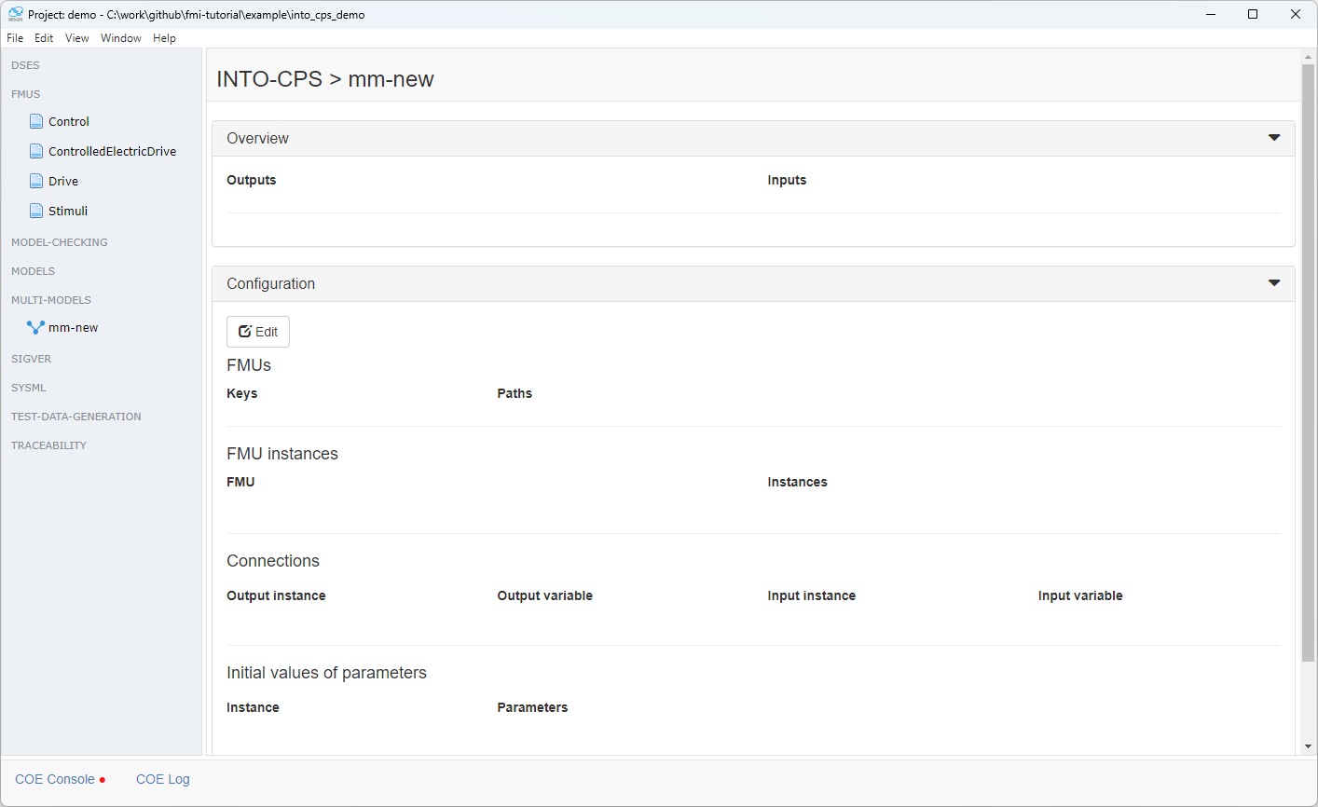
This is what a multi-model looks like. It essentially will describe the FMUs and how they are interconnected as their parameters

Slide 12
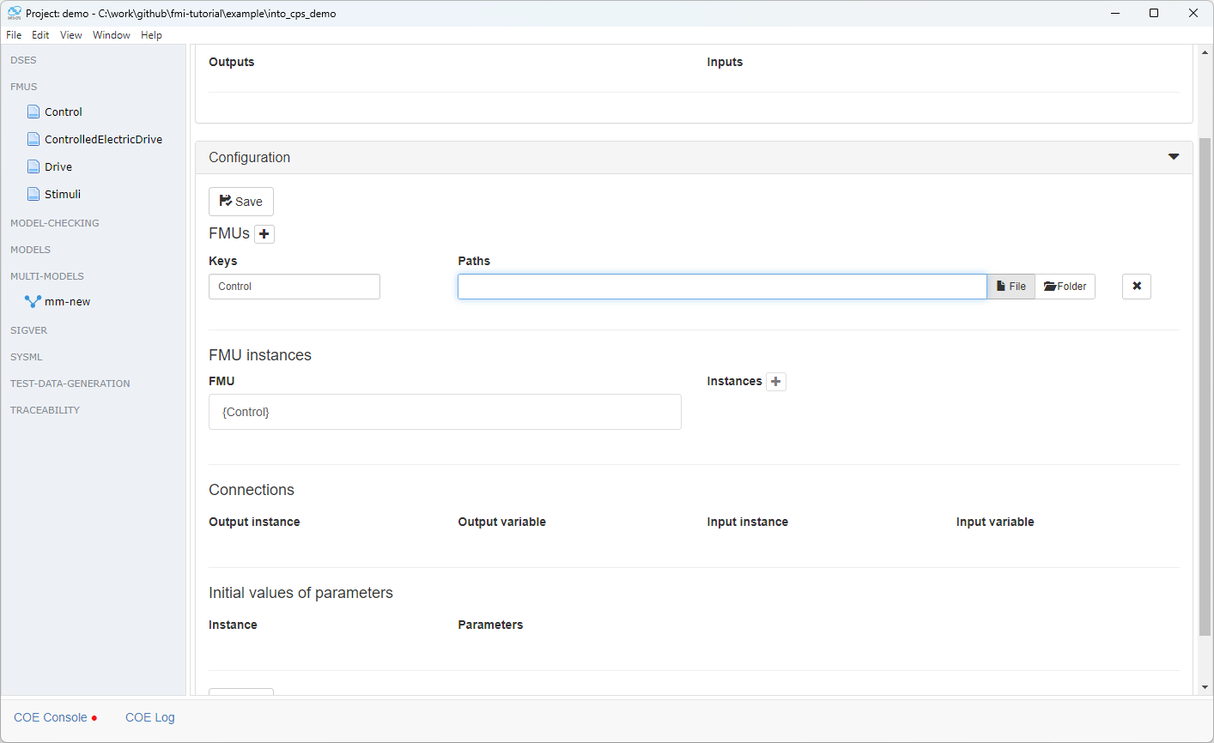
We start adding fmus

Slide 13
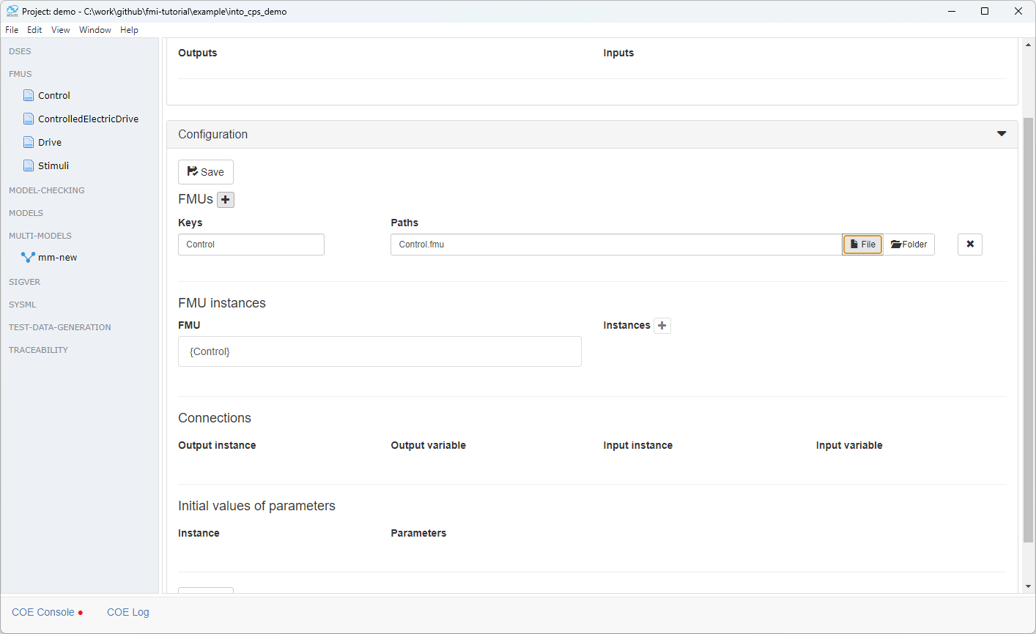
Pointing each to the right file

Slide 14
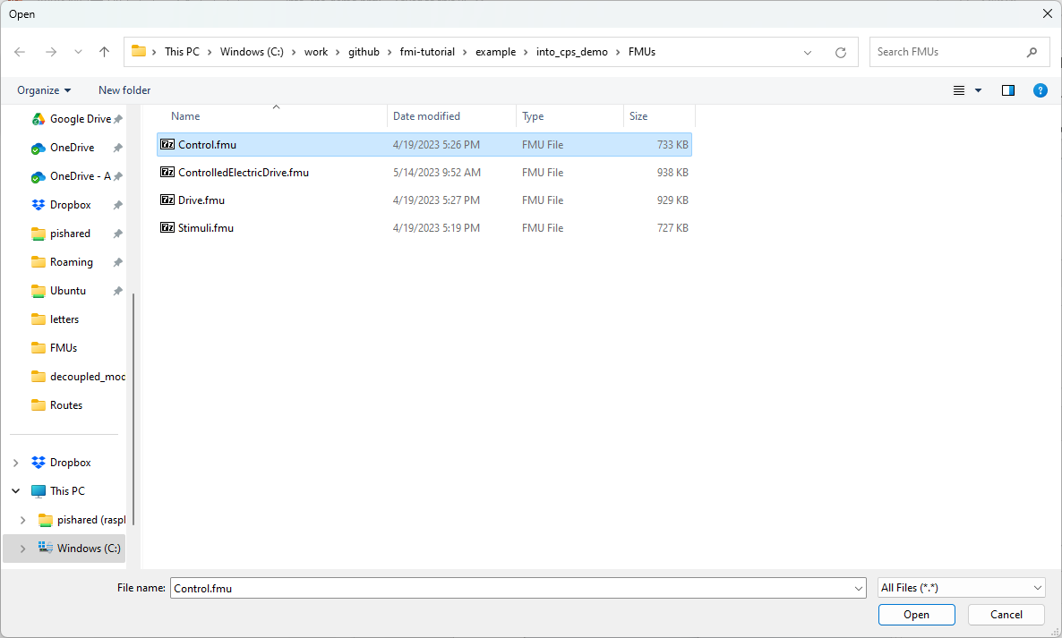
Pointing each to the right file

Slide 15
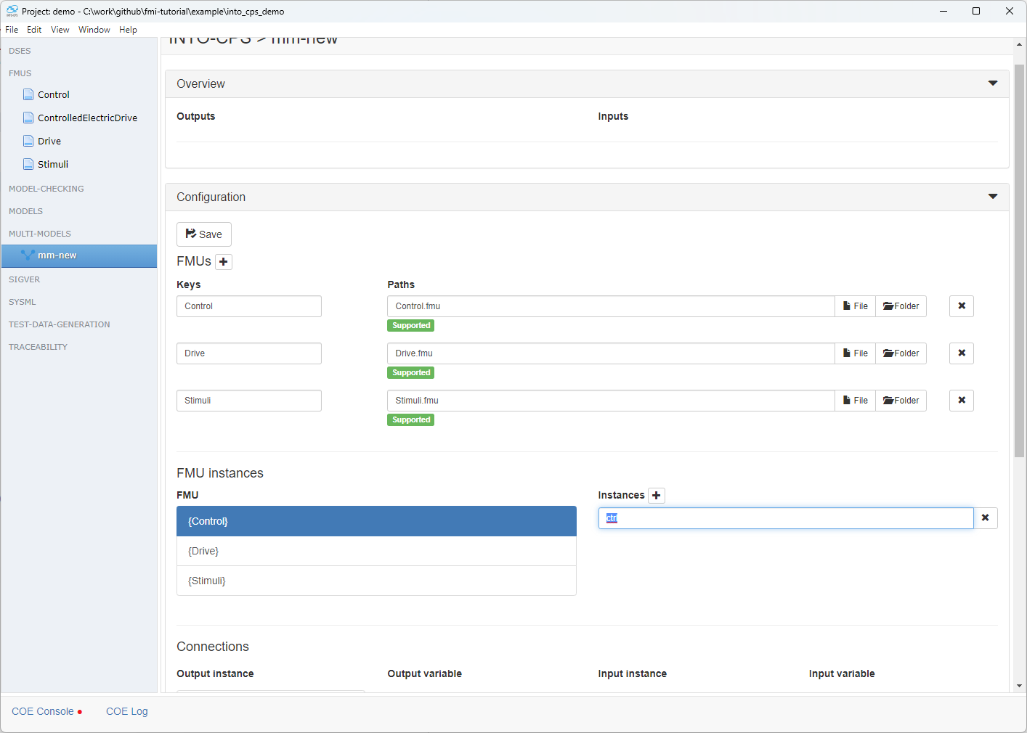
Then we create instances

Slide 16
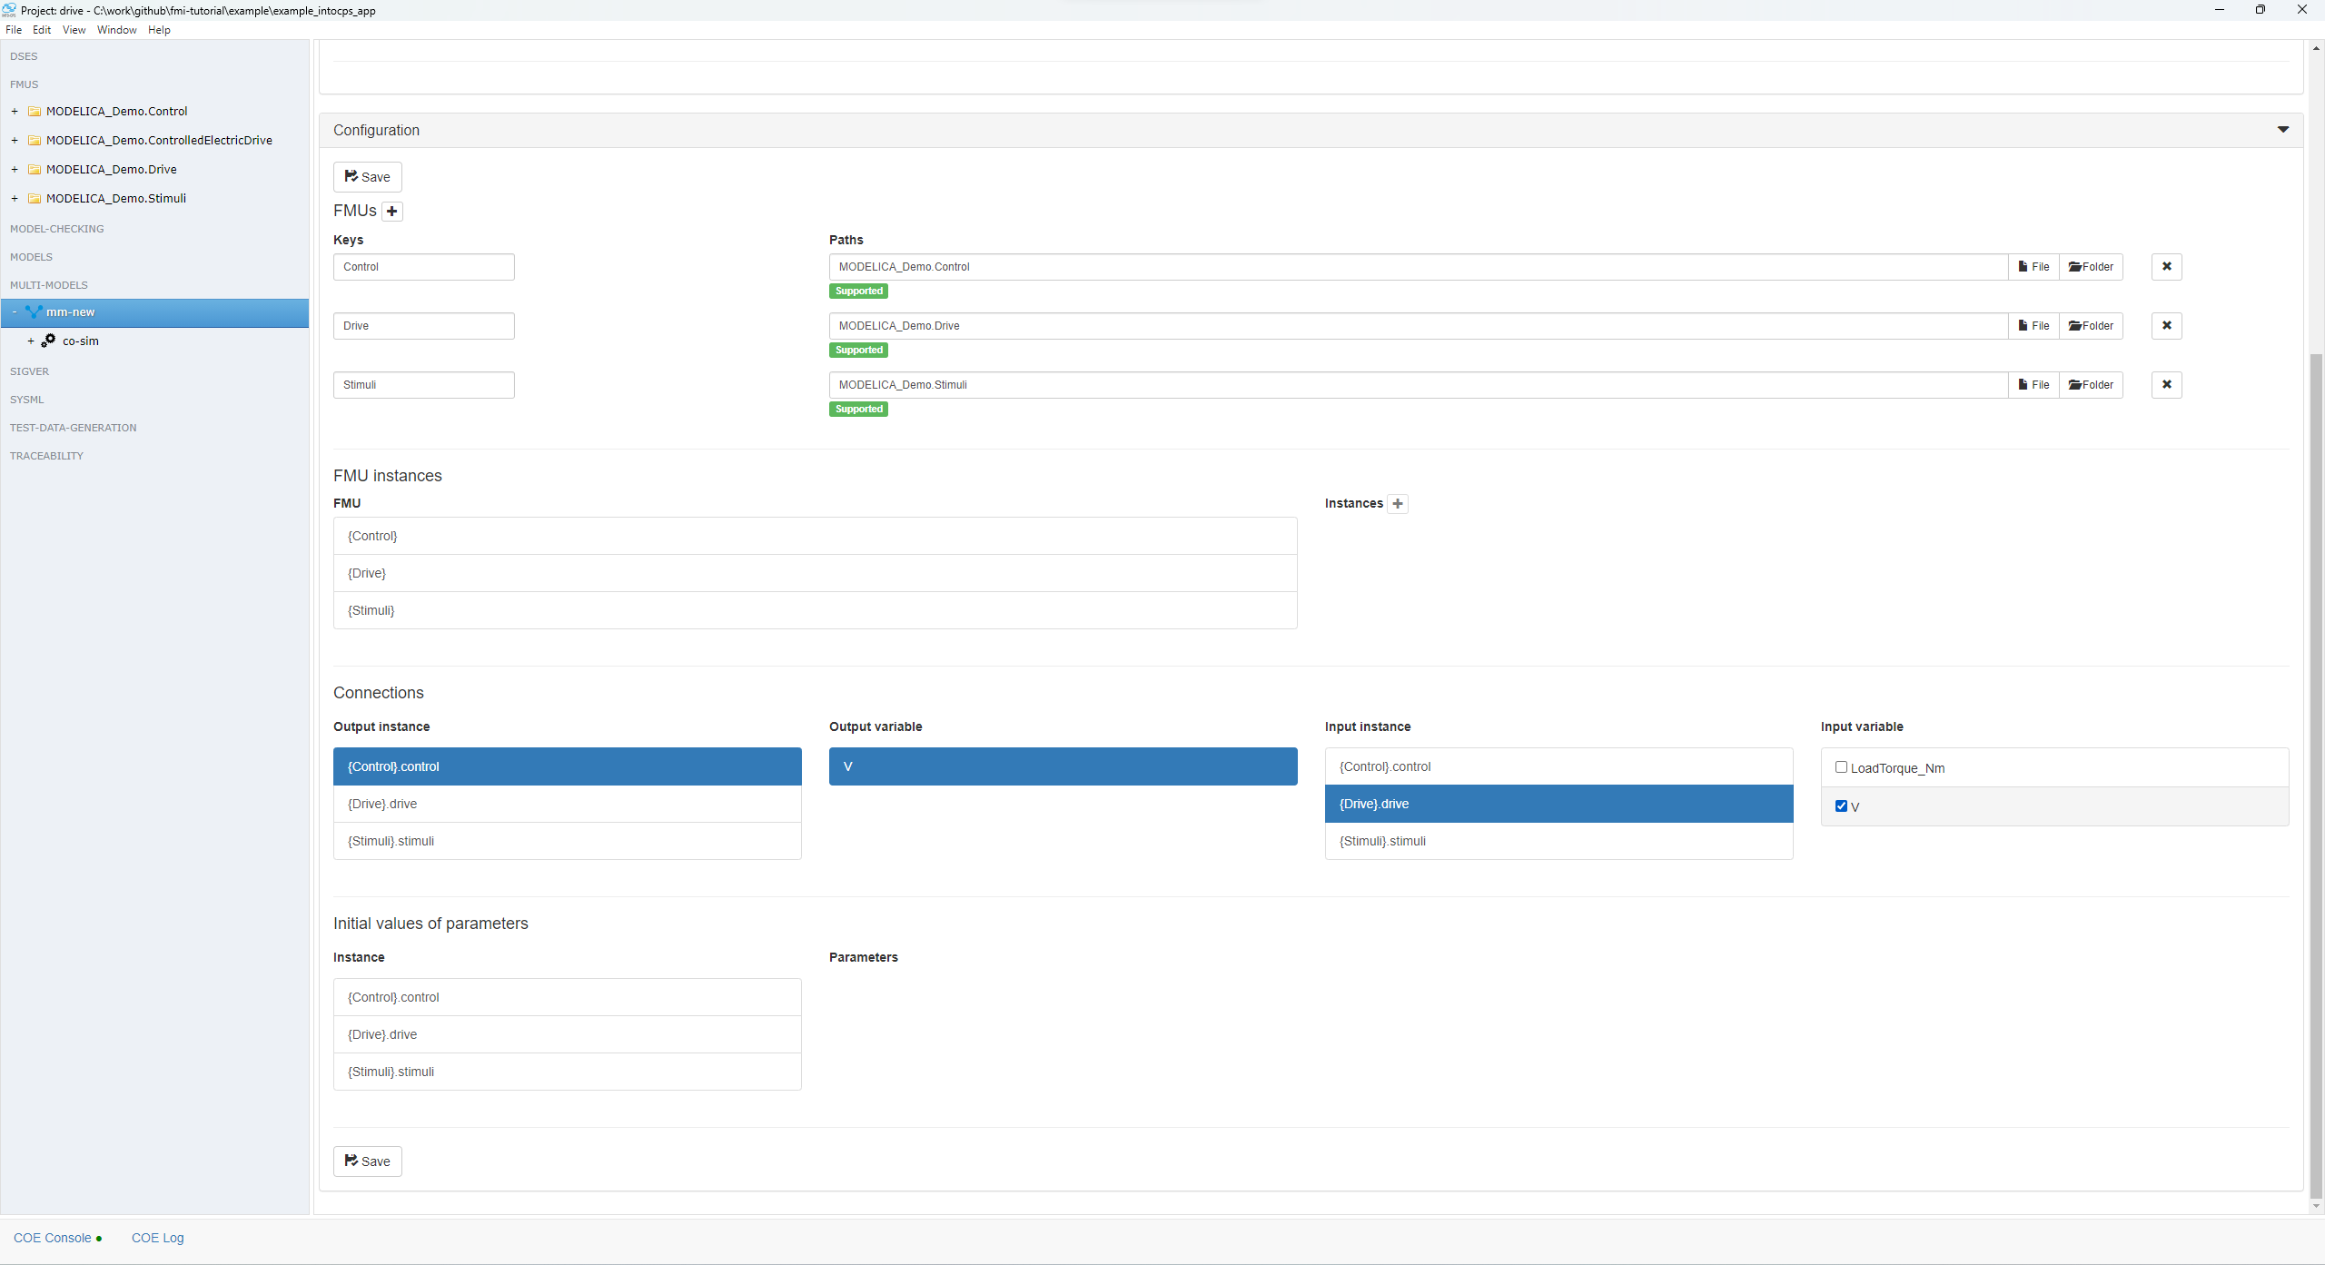
Then we connect those instances.
The following shows from left to right how we connect the output variable V of the control instance to the drive input variable V

Slide 17
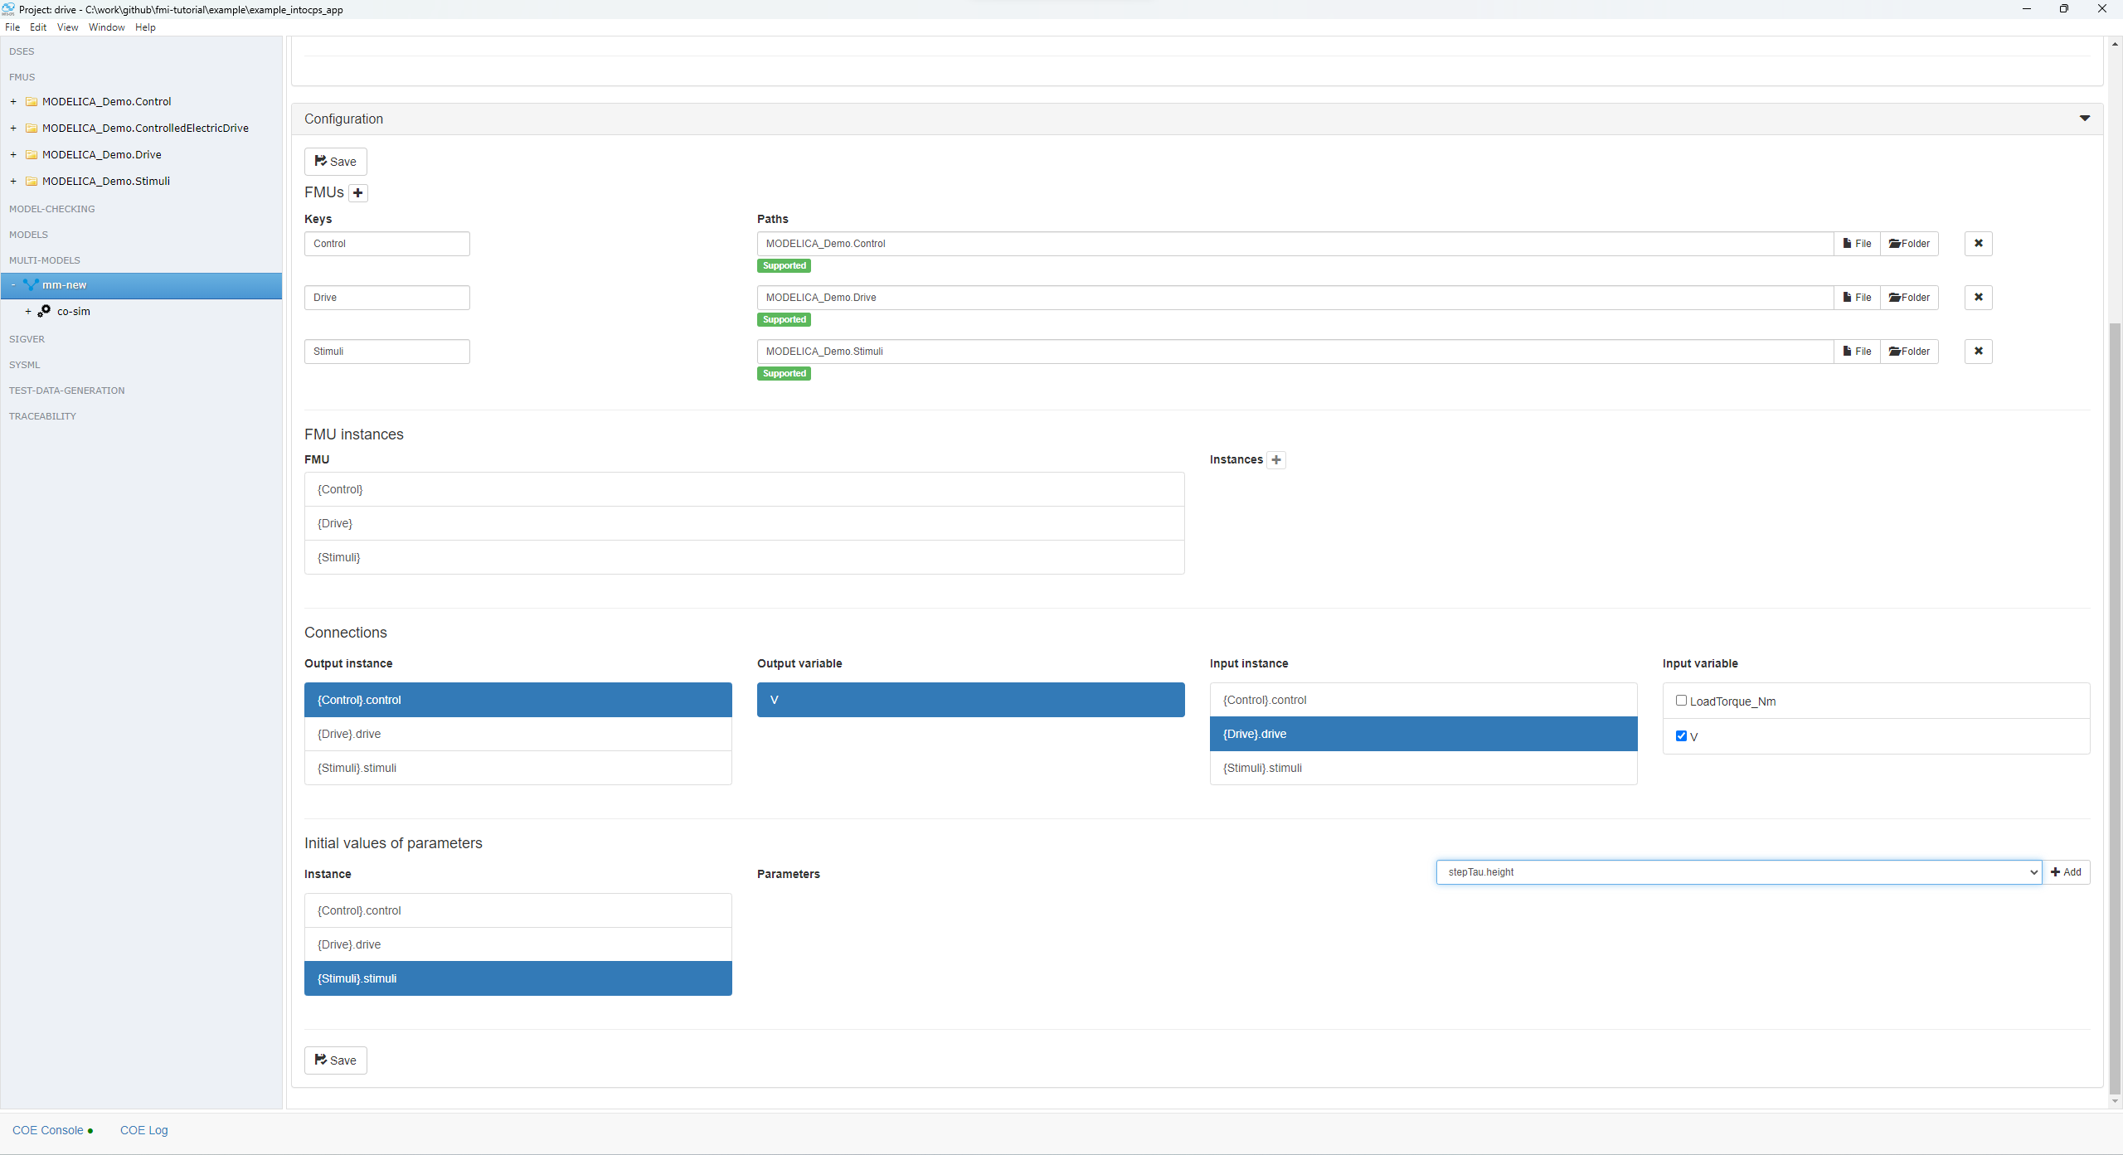
Finally we can declare parameters if we wish to do so

Slide 18
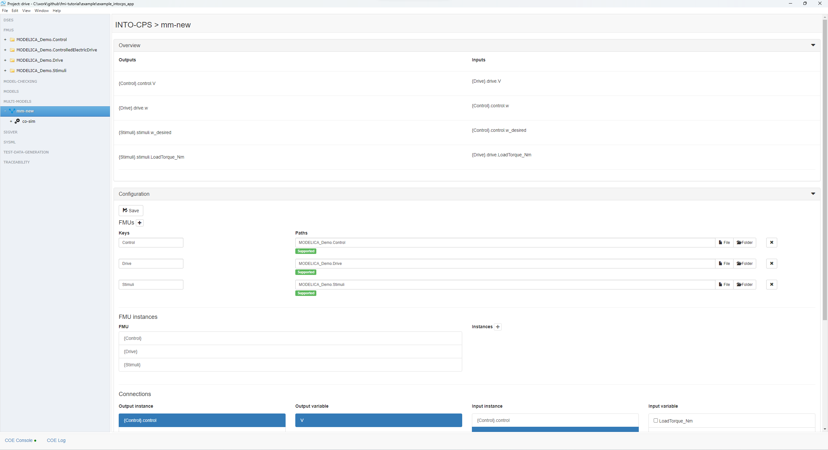
After pressing save it should be possible to see a summary on the top of the cosimulation scenario.

Slide 19
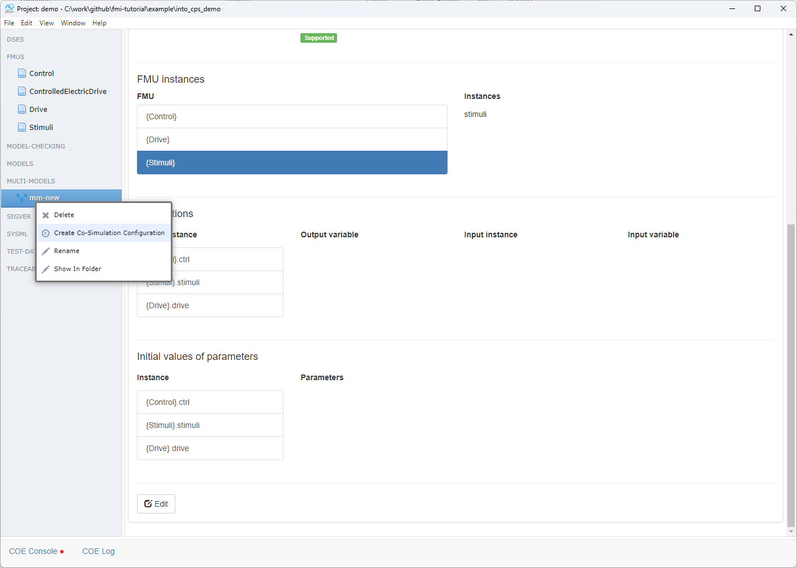
Now we need to create a co-sim configuration of the multi model we just created where we will describe the simulation specific parameters such as start and end time and communication steps

Slide 20
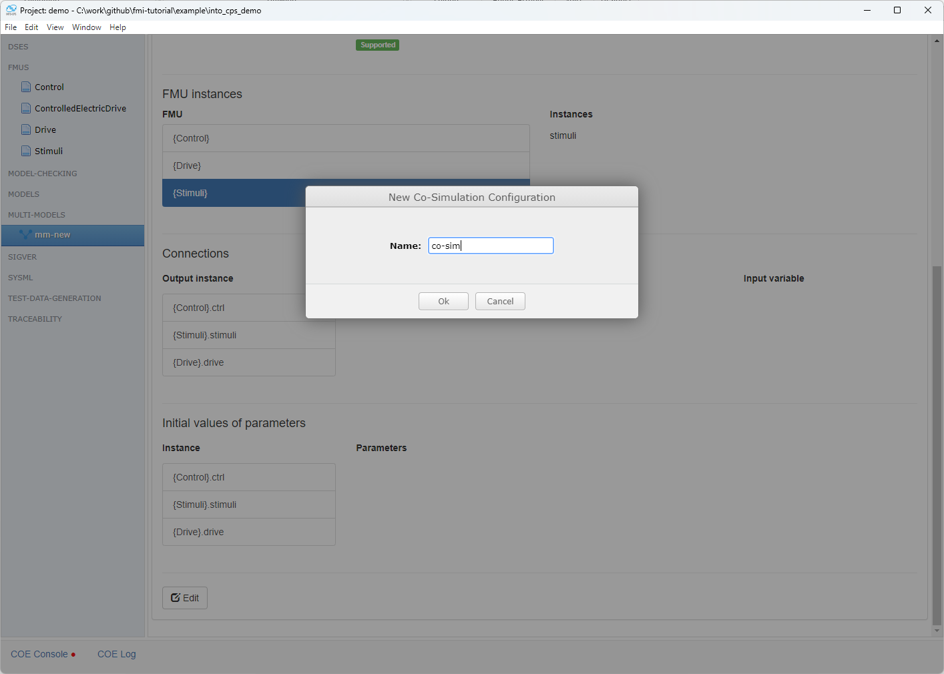

Slide 21
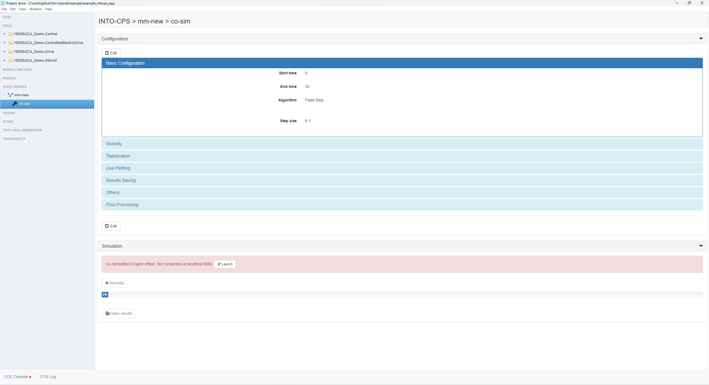
This is a default configuration that we need to edit

Slide 22

Here we set the start, end time, type of algorithm and step size

Slide 23
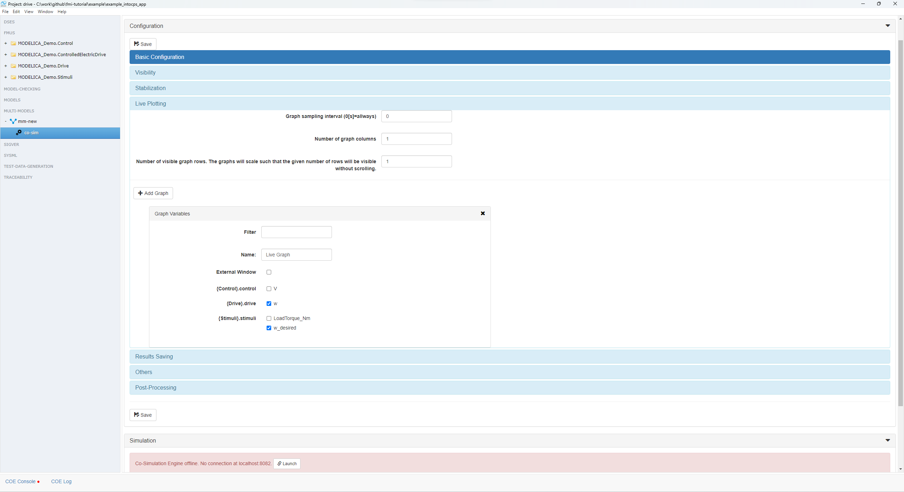
And here we said which variables we wish to plot.

Slide 24
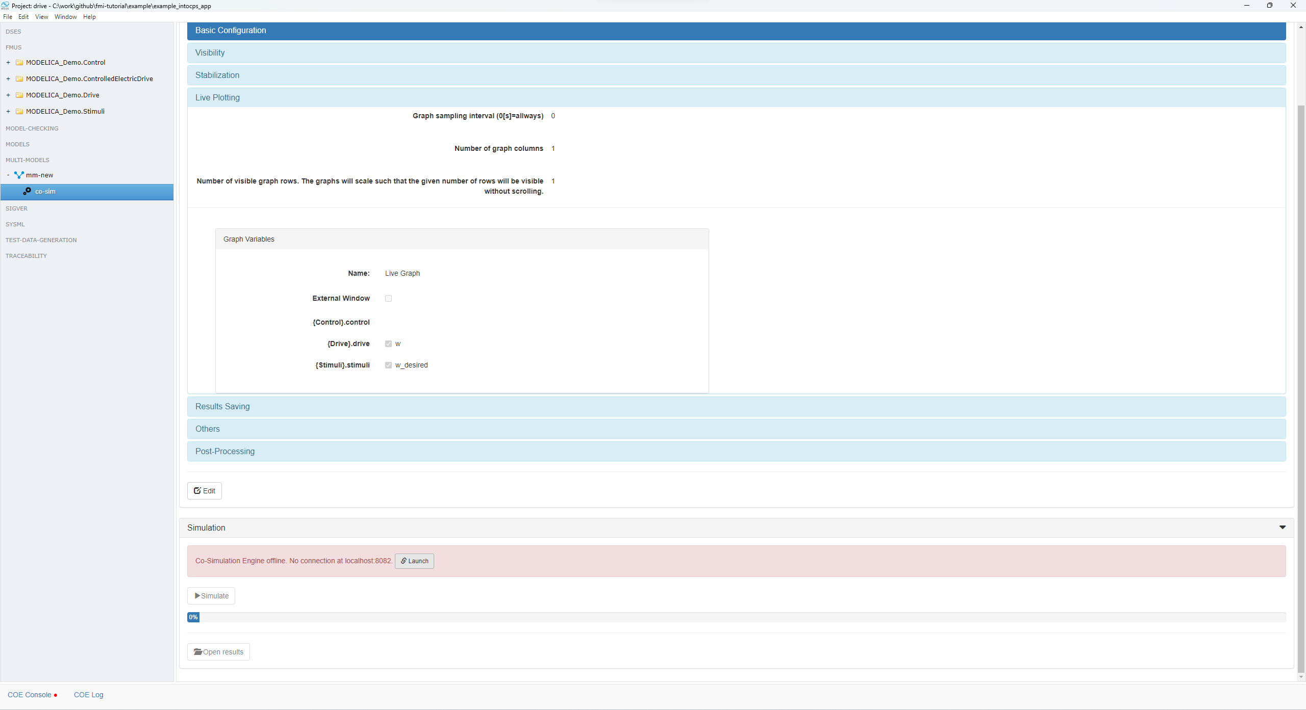
After saving the configuration it’s time to launch the cosim engine

Slide 25
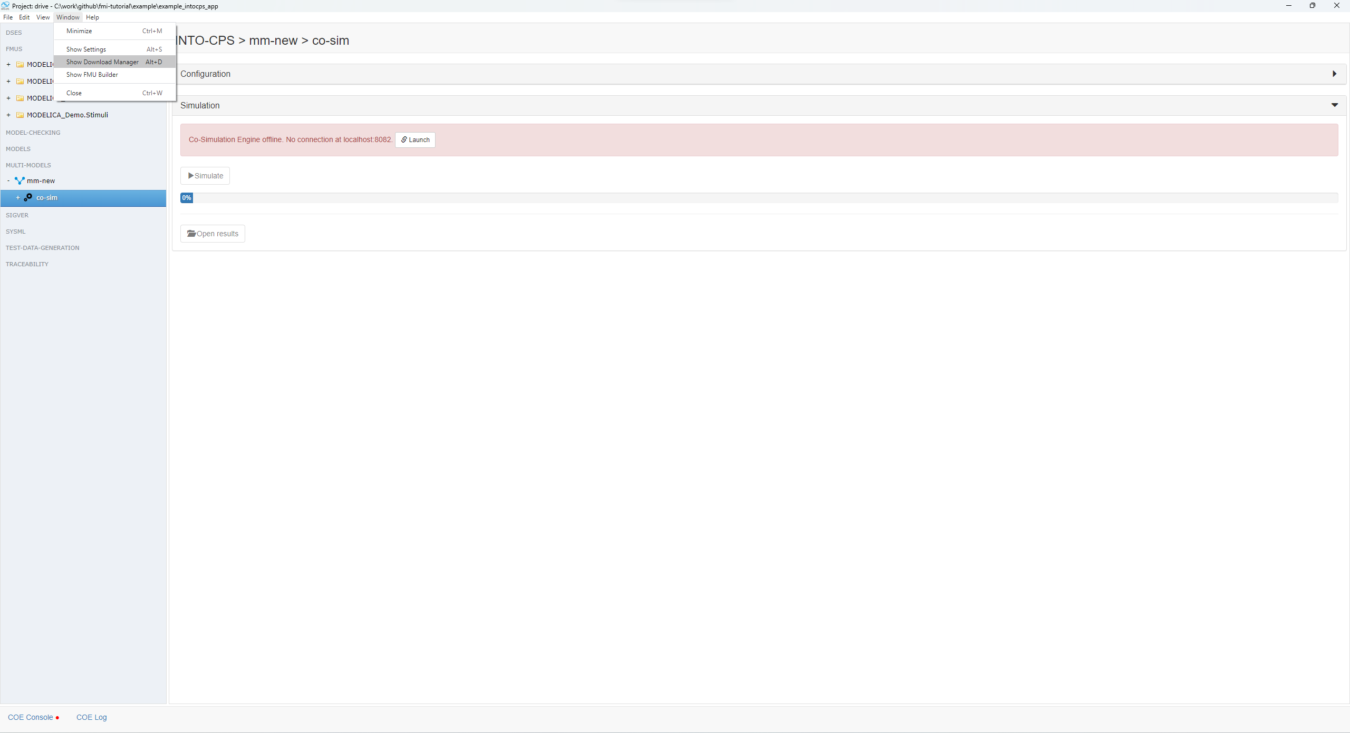
If the code simulation engine is not installed then we can download it directly from the user interface by opening the download manager

Slide 26
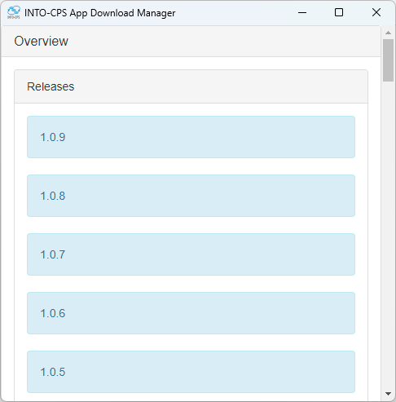
Click on the latest release, to jump to it.

Slide 27
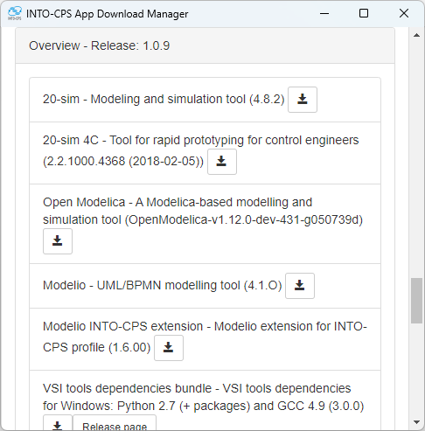
Scroll down to find the Maestrov2

Slide 28
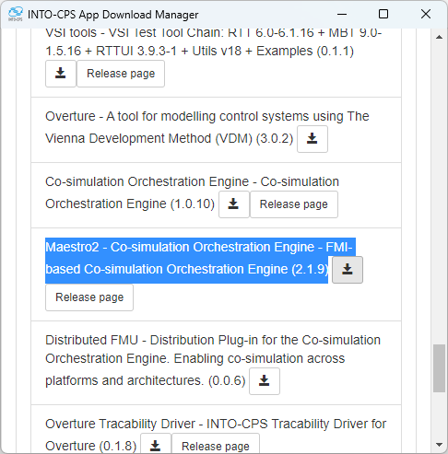
Press to download…

Slide 29
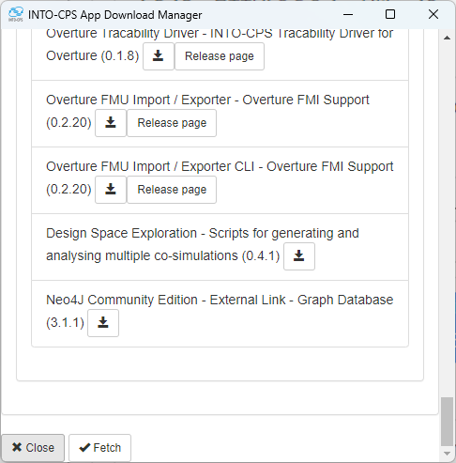
When the download is 100%, close the download manager

Slide 30
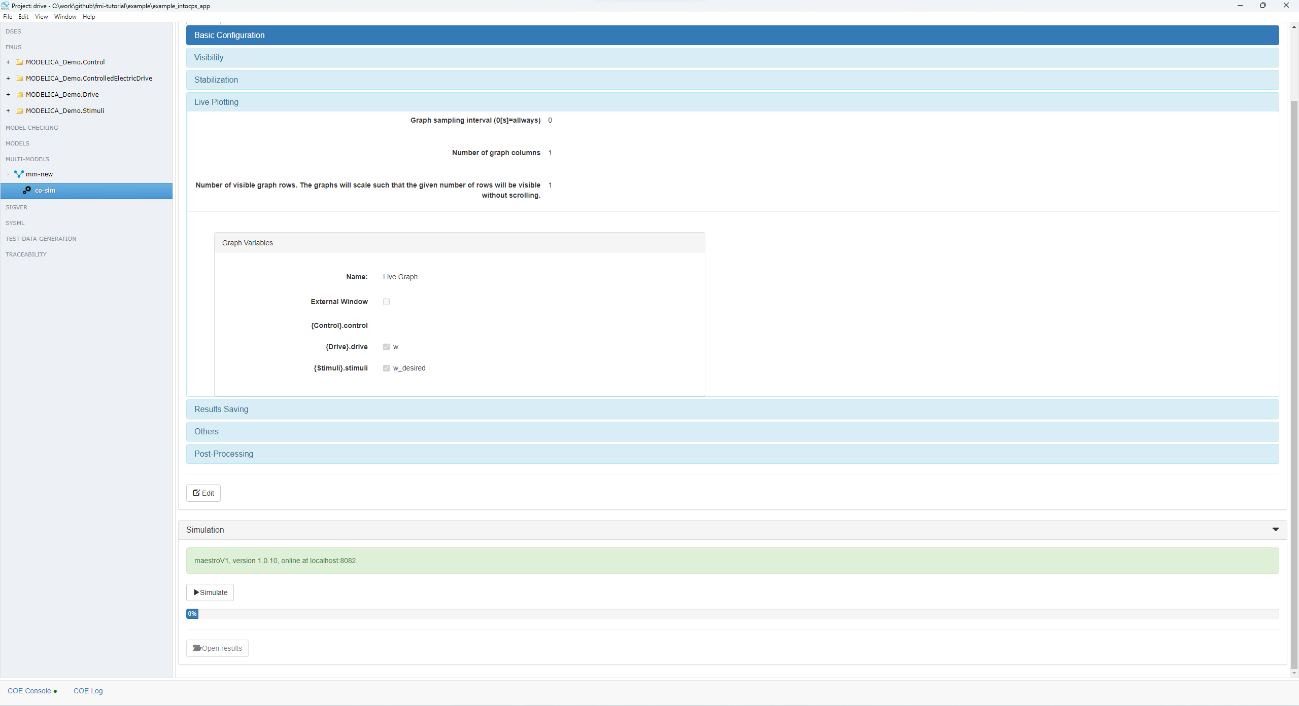
After saving the configuration it’s time to launch the cosim engine

Slide 31
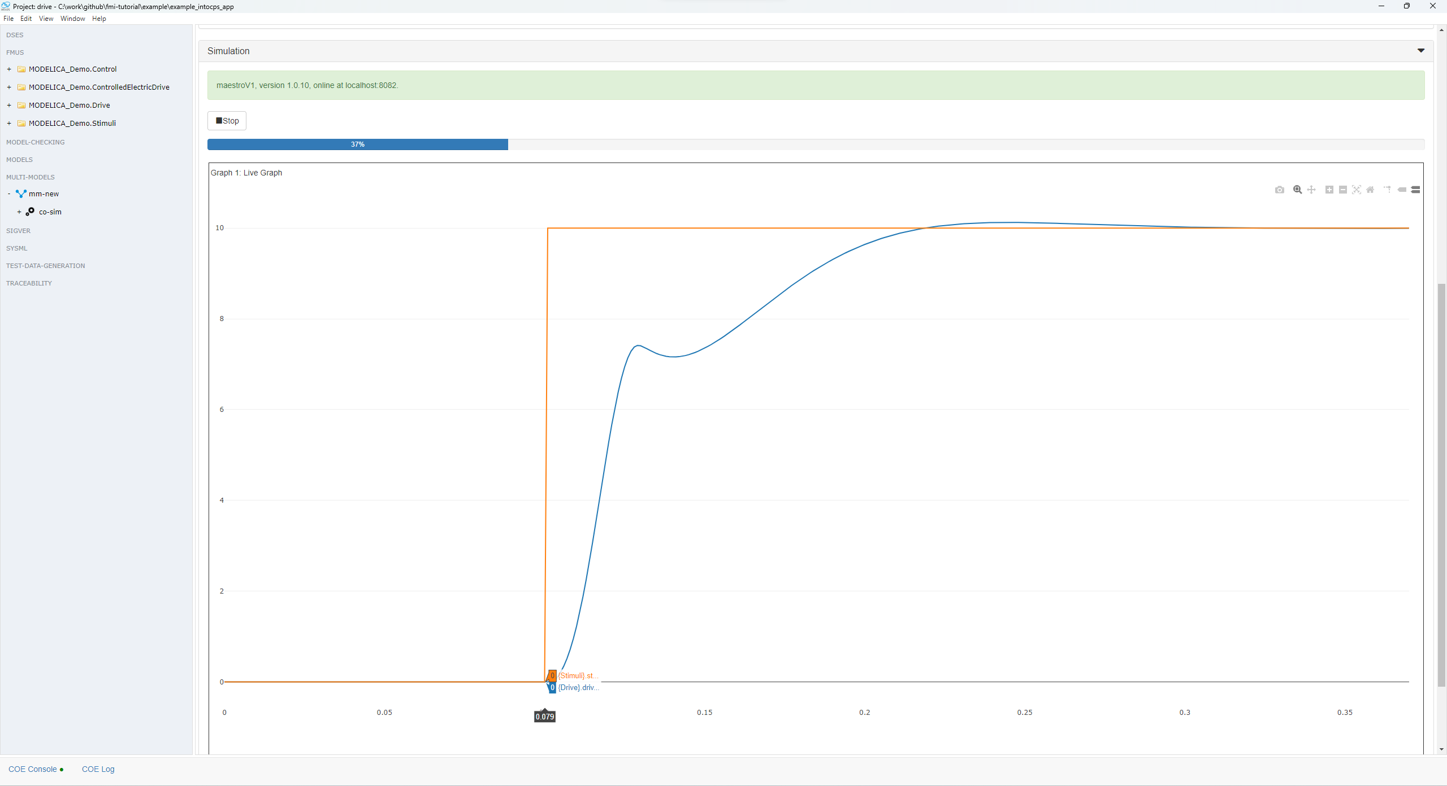
After pressing simulate it should be possible to see a live plot of what’s going on

Slide 32
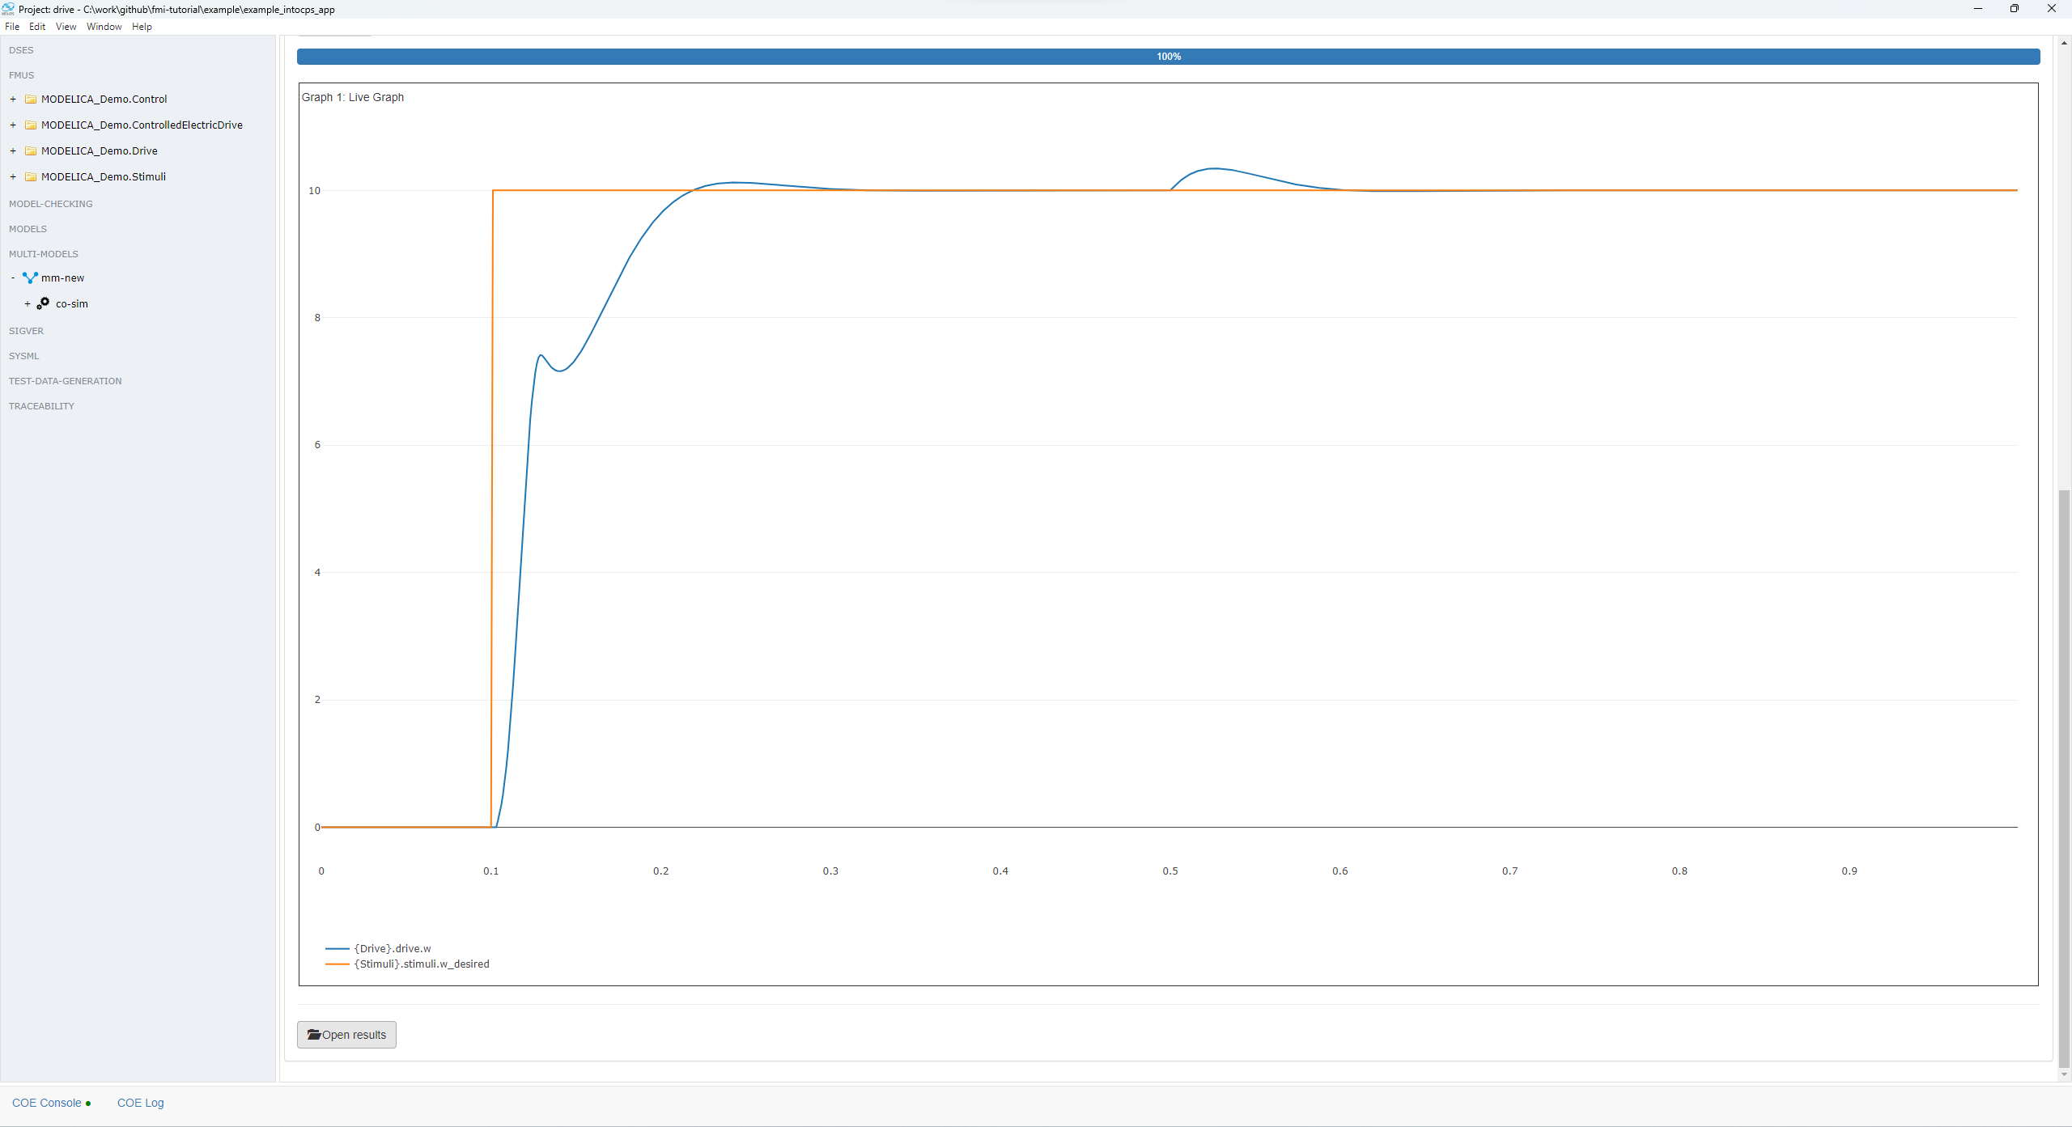
After the co simulation ends it is possible to open the results folder

Slide 33
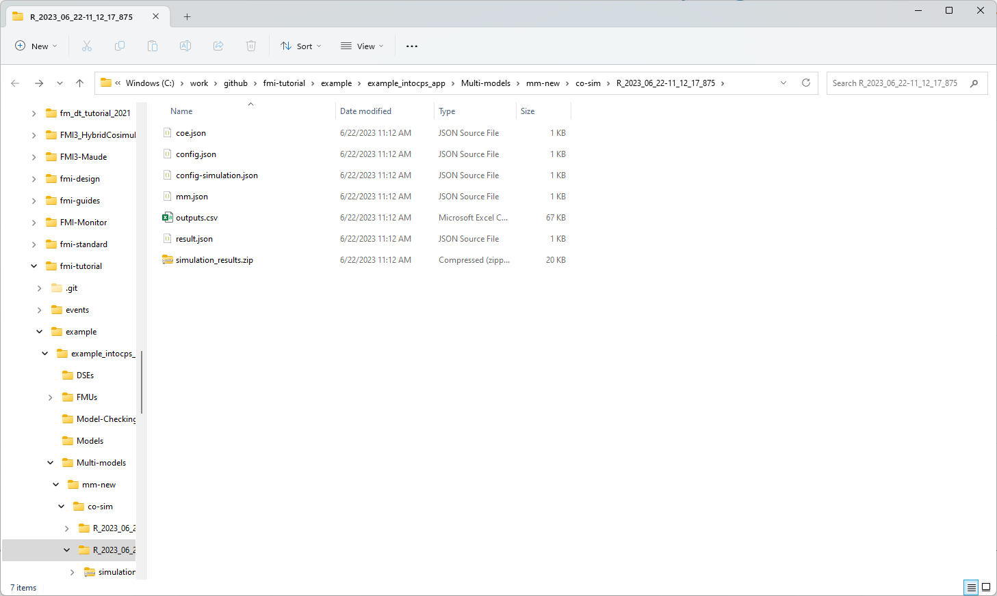
Which contains csvs, configuration used, and so on

