Slide 1
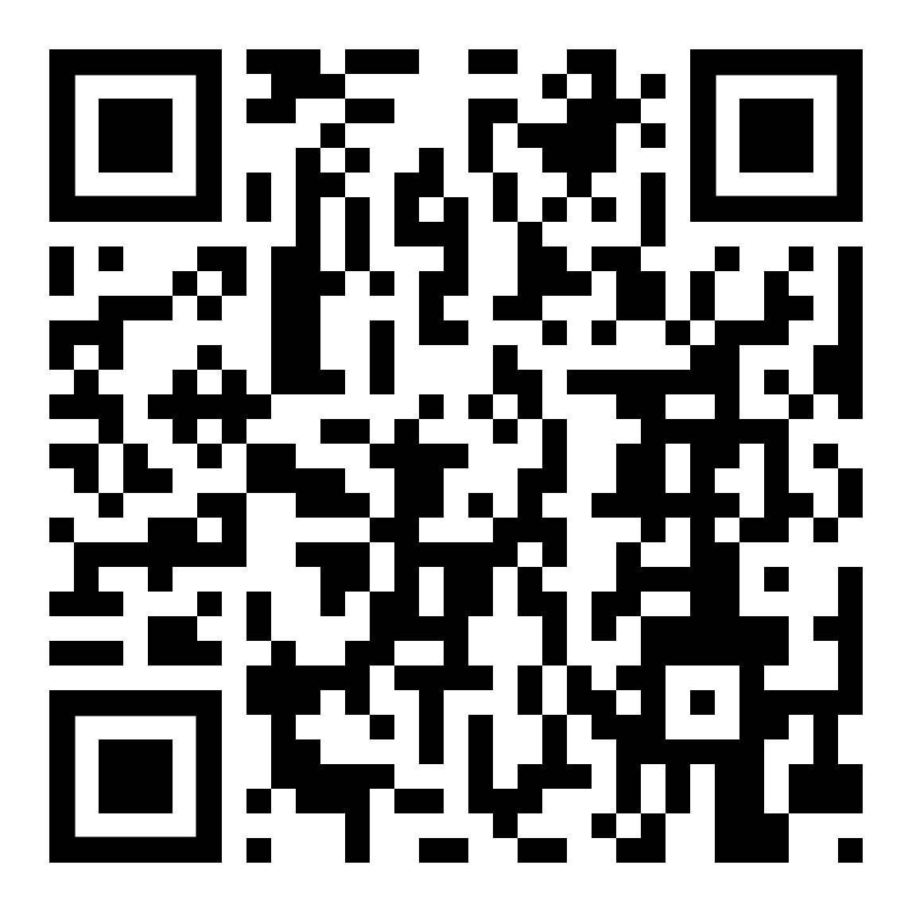
FMI 3.0 advanced topics
Online Materials:
Presenters:
Cinzia Bernardeschi, University of Pisa
Christian Bertsch, Bosch Research
Claudio Gomes, Aarhus University
Maurizio Palmieri, University of Pisa
Torsten Sommer, Dassault Systèmes
Released under Attribution-ShareAlike 4.0 International License
https://github.com/modelica/ fmi-beginners-tutorial-2025/tree/main

Slide 2
Content
FMI 3.0

Slide 3
FMI 3.0: Main Improvements
Performance
Accuracy
Event mode for Co-Simulation
Intermediate variable update
Clocks
New variable types
Array variables
Terminals and icon
FMI for Scheduled Execution (SE)
Preparation for layered Standards
New Application
Notes:
Show co-sim and intermediate output notebooks

Slide 4
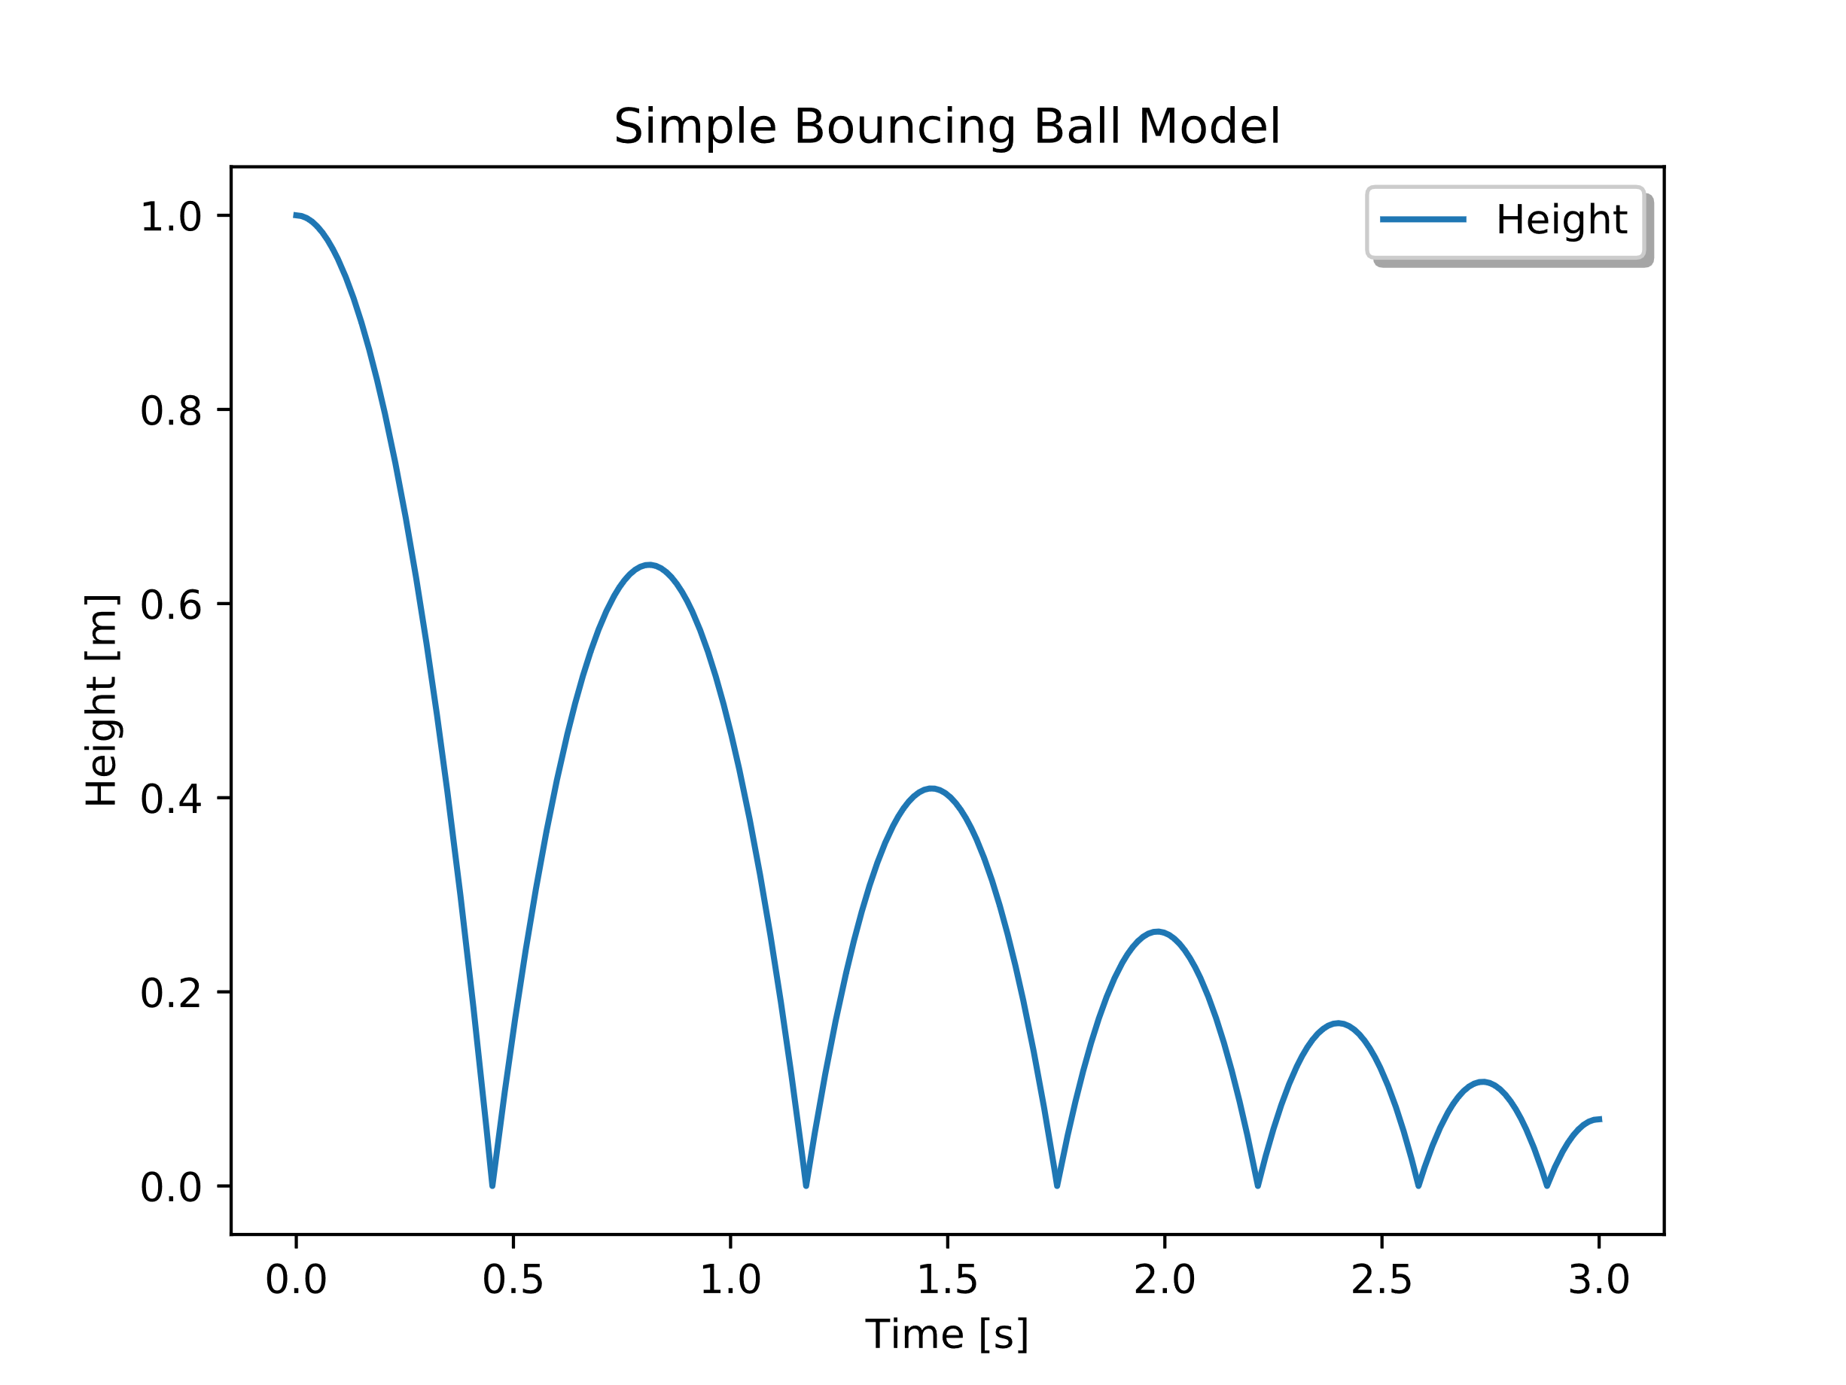

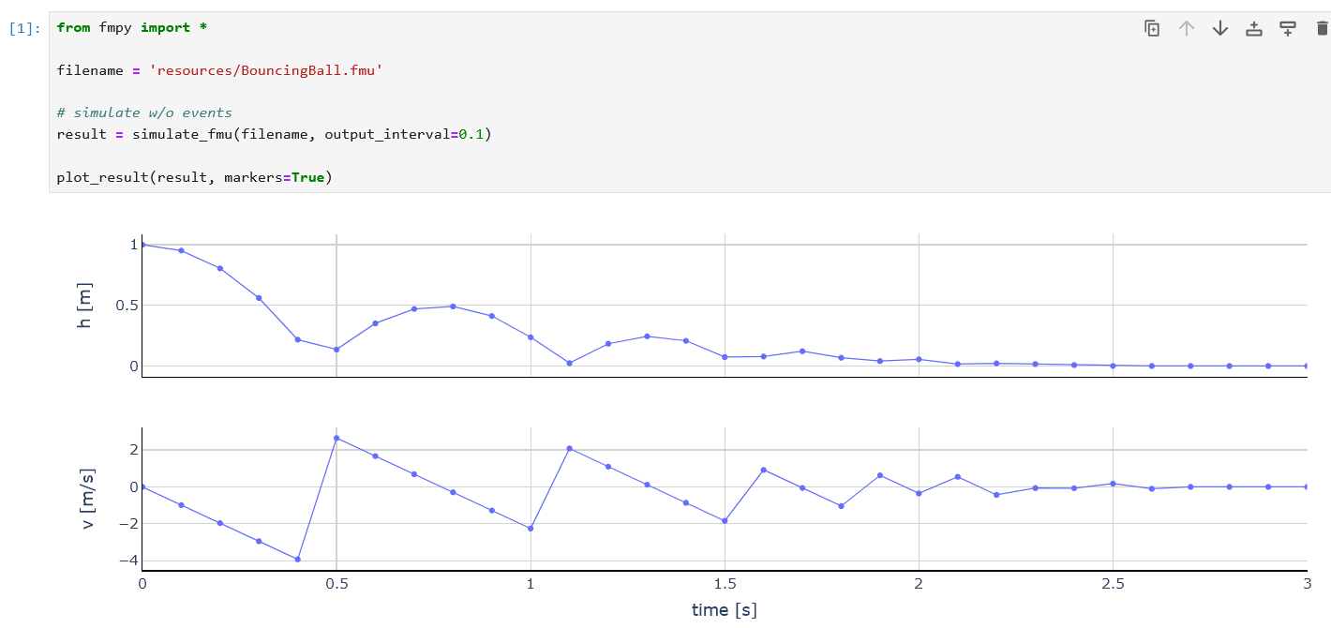
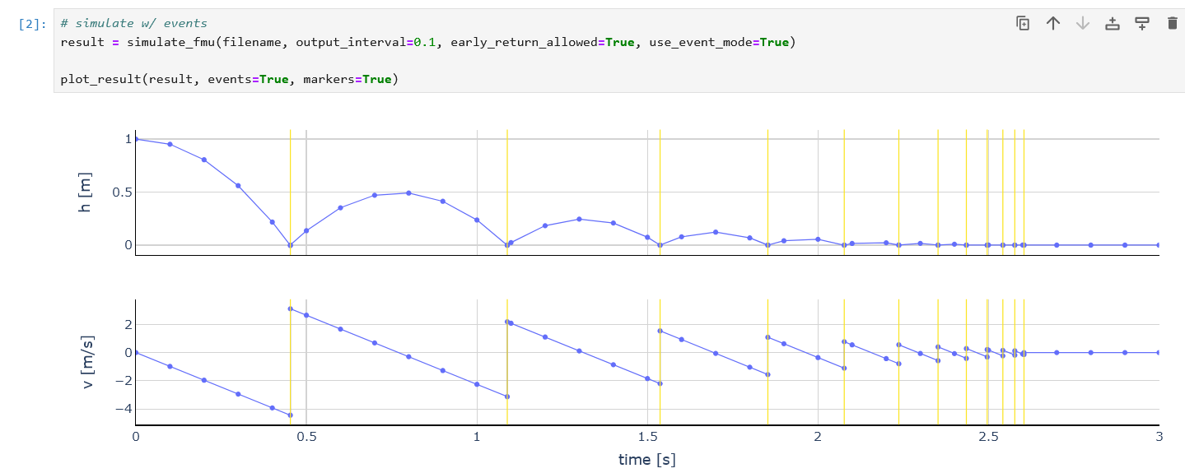
FMI 3.0 Co-Simulation with examples
Example: Bouncing ball
https://github.com/t-sommer/fmi3-features/blob/main/cs_events.ipynb
Simulation with FMI 2.0 CS Exact timepoints where the ball hits the ground missed in Simulation of CS FMU with fixed communication timestep

Slide 5
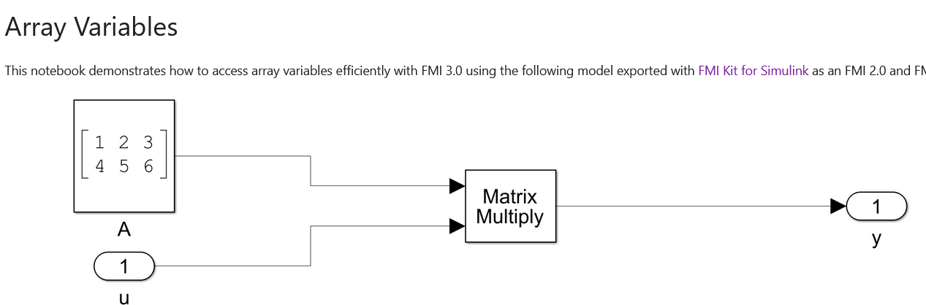
FMI 3.0 Array variables
FMI 2.0 supports arrays only via a naming convention, all variables are serialized
FMI 3.0 brings active array support
https://github.com/t-sommer/fmi3-features/blob/main/array_variables.ipynb

Slide 6
Intermediate variable access

Slide 7
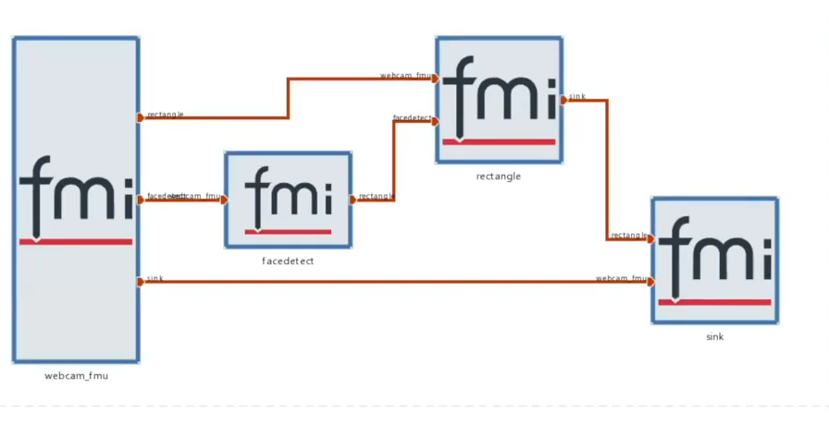
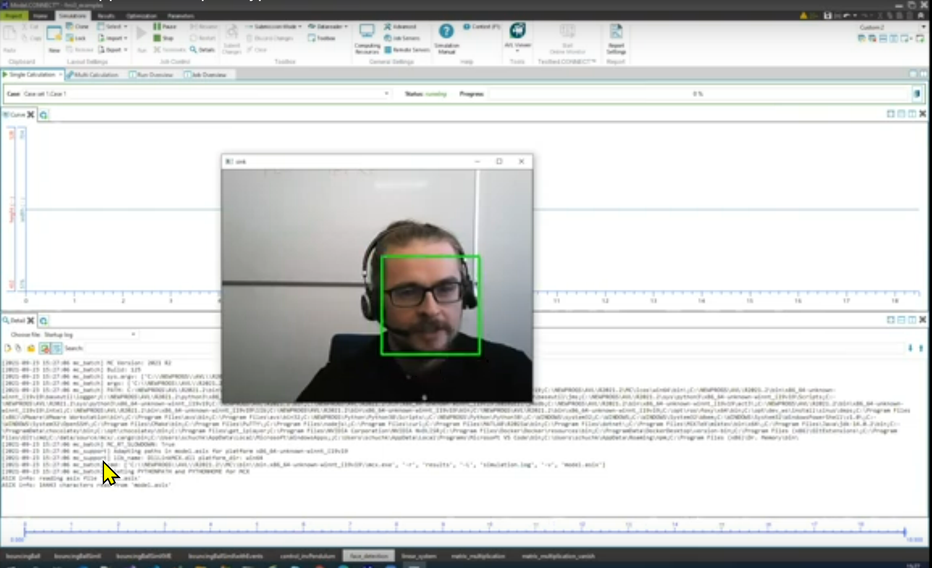
Binary Data
https://github.com/casadi/casadi/blob/main/docs/notebooks/fmu_demo.ipynb
https://www.youtube.com/watch?v=dhp3L6aMaAQ

Slide 8
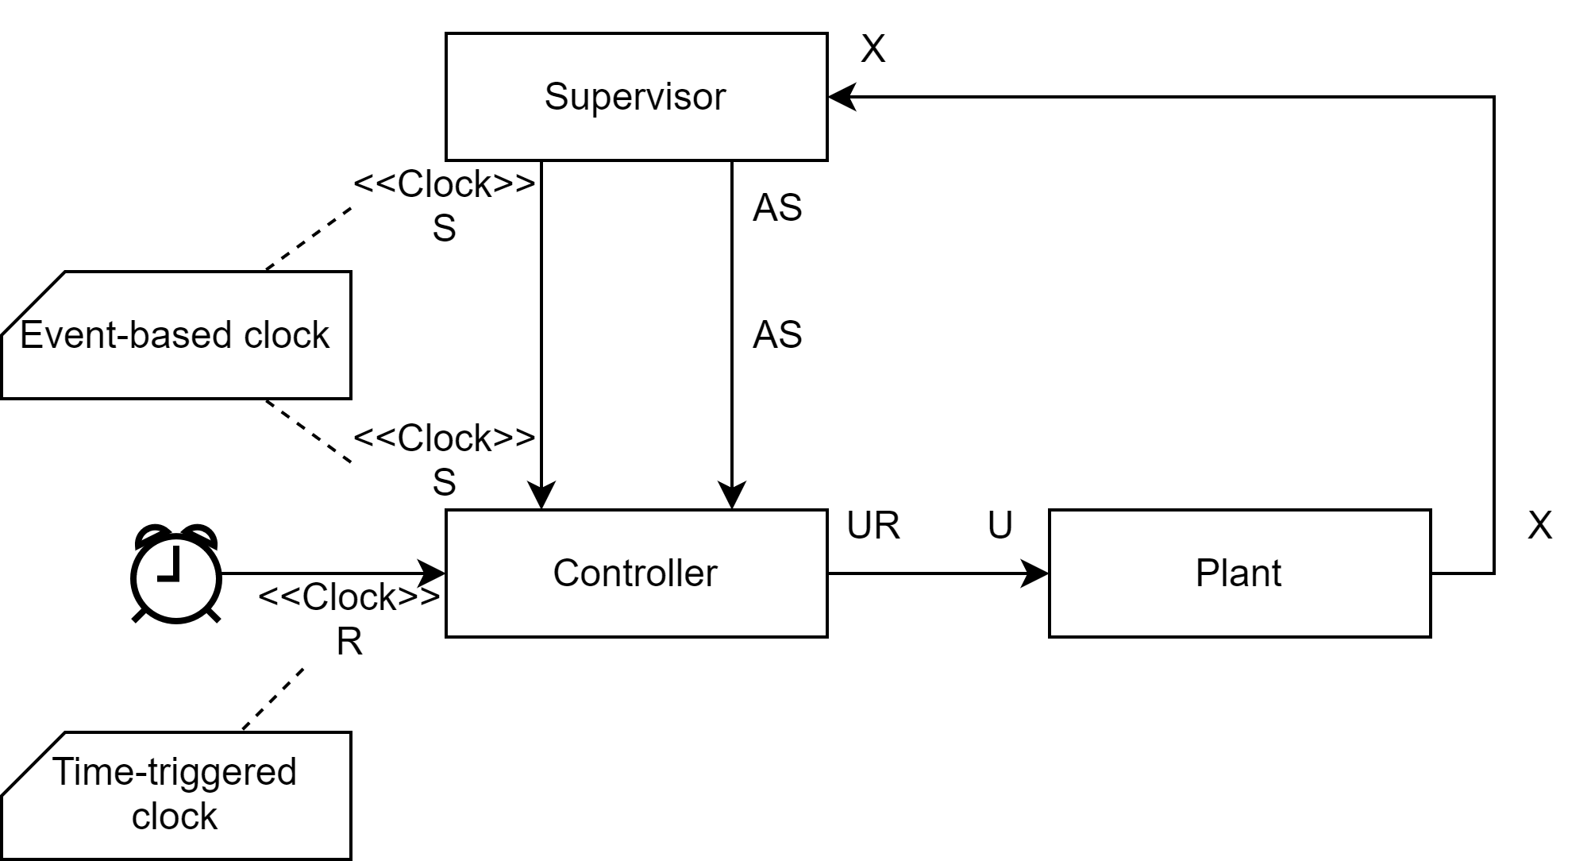
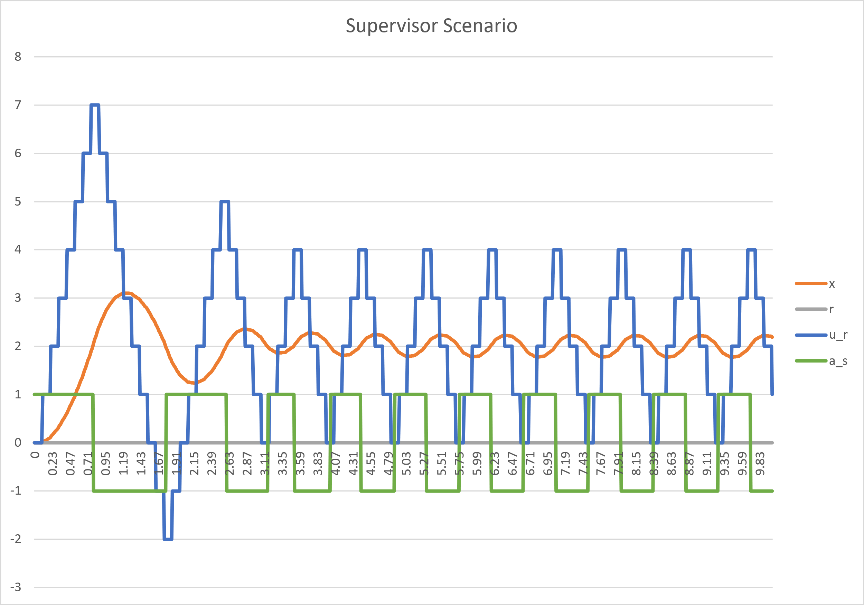
Clocks example
FMI 3.0 features used: event-based, time-triggered Clocks
https://github.com/clagms/synchronous-clock-fmus

Slide 9

Adjoint derivatives
Use FMI in optimization, e.g. with CasADi
FMI 3.0 features used:
- directional, adjoint derivatives
E.g.. Implemented in
https://github.com/casadi/casadi/blob/main/docs/notebooks/fmu_demo.ipynb

Slide 10
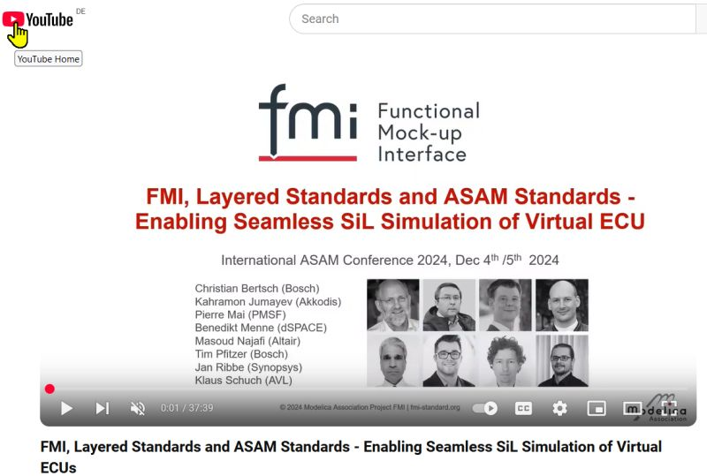
Layered Standards
Concept in FMI 3.0: Layered standards to allow standards from other organizations to be compatible, with embedded data inside an FMU
Layered Standards in development by the FMI Project:
FMI-LS-XCP: https://github.com/modelica/fmi-ls-xcp for XCP support v1.0 released 12/2024
FMI-LS-BUS: https://github.com/modelica/fmi-ls-bus for network communication v1.0 released 07/2025 Demo of interoperability at International ASAM Conference
FMI-LS-STRUCT: https://github.com/modelica/fmi-ls-struct for sampled maps and structuring of variables v1.0.0-alpha.1 available
FMI-LS-REF https://github.com/modelica/fmi-ls-ref for the description of basic validation experiments and other files attached to an FMU

Slide 11
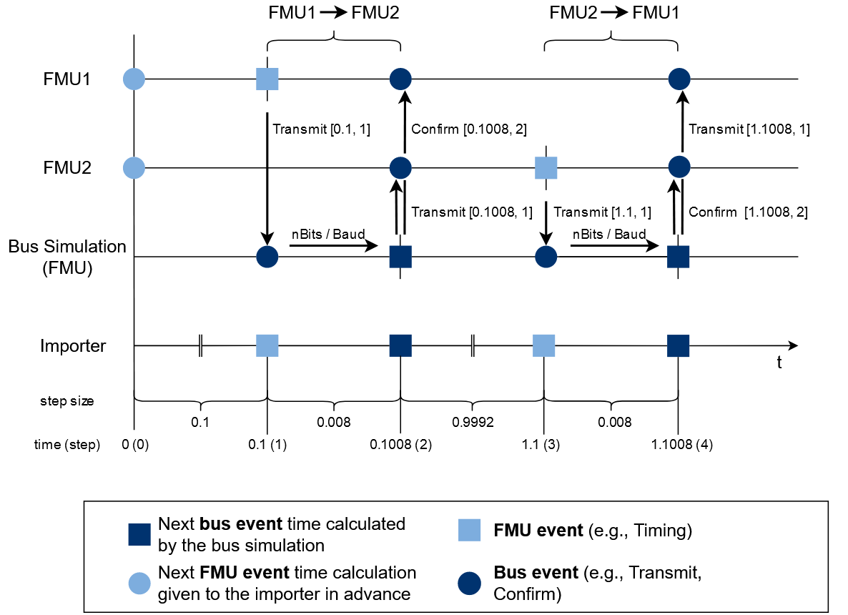

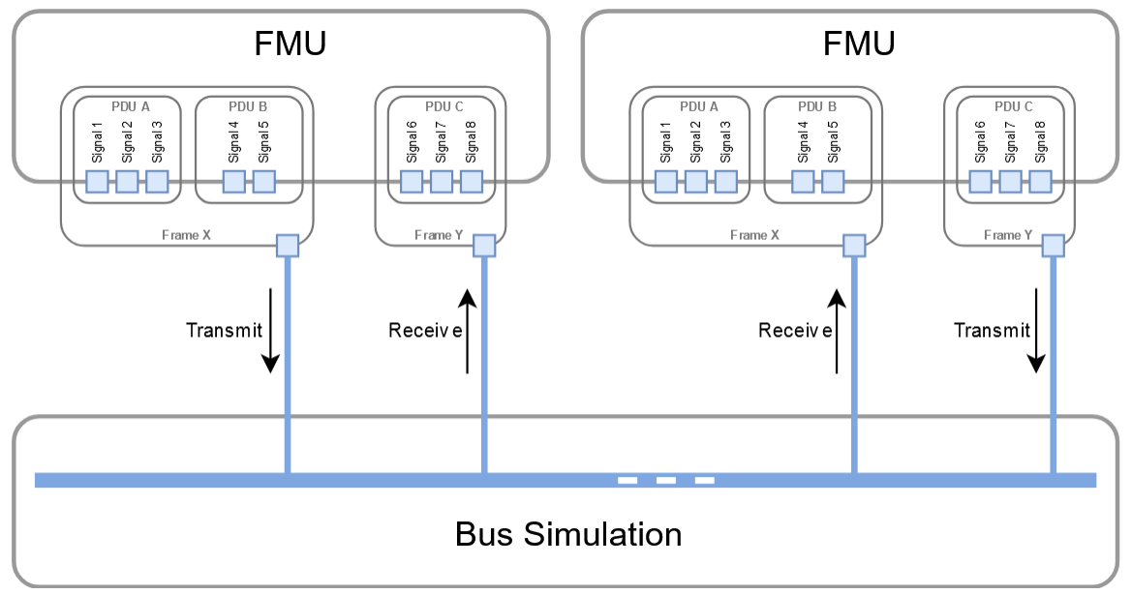
FMI-LS-BUS: Layered Standard Network Communication
Simulation of automotive systems requires network communication between vECUs.
Idea:
Use FMI 3.0 core standard features to specify a common bus interface, using Co-Simulation, Binary Variables, Clocks and Terminals
Support automotive networks protocols and others from different industries (CAN, LIN, FlexRay, Ethernet, …)
Using network description formats DBC, LDF, FIBEX, ARXML
Two variants:
Physical abstraction layer ("high cut"): Simply transport physical signal values between virtual ECUs by using unit-based and clocked variables
Network abstraction ("low cut"): Detailed emulation of a specified bus system to realize virtualized bus driver implementations, including feedback from the physical drivers about transmission status or network node states

Slide 12
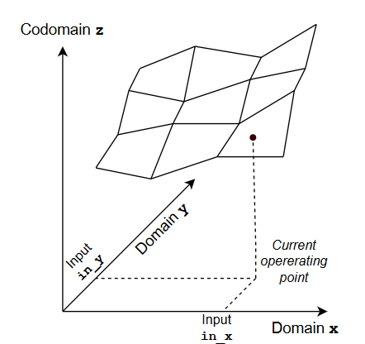
FMI LS-STRUCT: Layered Standard for Variable Structuring
Current scope:
Maps sampled on rectilinear grids using FMI 3.0 arrays by adding meta-data to define
Domains
Codomain
Optionally: Variables referencing current operating point, …
Support for Modelica Standard Library CombiTables
Compatible with -MCD2 MAPs, CURVEs, …
Maps sampled on an irregular grid ("Point Cloud“)
Using “FMI 3.0 Terminals” for grouping

Slide 13
FMI Applications and Its Role in Digital Twins
Online Materials:
Presenters:
Cinzia Bernardeschi, University of Pisa
Christian Bertsch, Bosch Research
Claudio Gomes, Aarhus University
Maurizio Palmieri, University of Pisa
Torsten Sommer, Dassault Systèmes
Released under Attribution-ShareAlike 4.0 International License
https://github.com/modelica/ fmi-beginners-tutorial-2025/tree/main

Slide 14
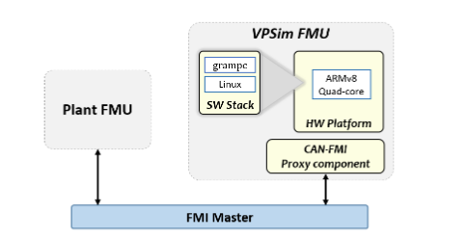
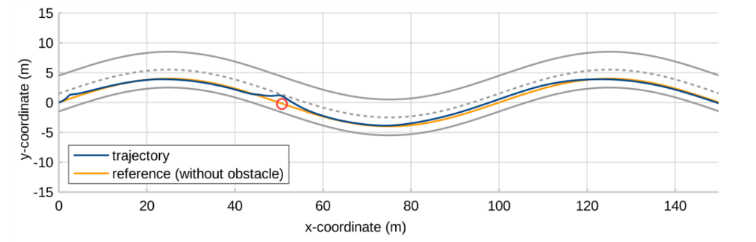



Autonomous Driving Advanced System (SW/HW co-simulation)
Model Predictive Control simulation on selected Hardware platform
Objective:
Validating the controller and assessing the adequacy of the hardware platform with respect to timing constraints and its performance
- GRAMPC
- VPSim - Armv8 Quad-core 64-bit
- Simulink
FMI role: easy validation of deployment of GRAMPC on a simulated architecture
C. Bernardeschi, P. Dini, et al. , Co-simulation of a Model Predictive Control System for Automotive Applications, SEFM 2021 Collocated Workshops, https://link.springer.com/chapter/10.1007/978-3-031-12429-7_15
http://www.european-processor-initiative.eu/ H2020, Grant Agreement No26647
CEA, List, France

Slide 15
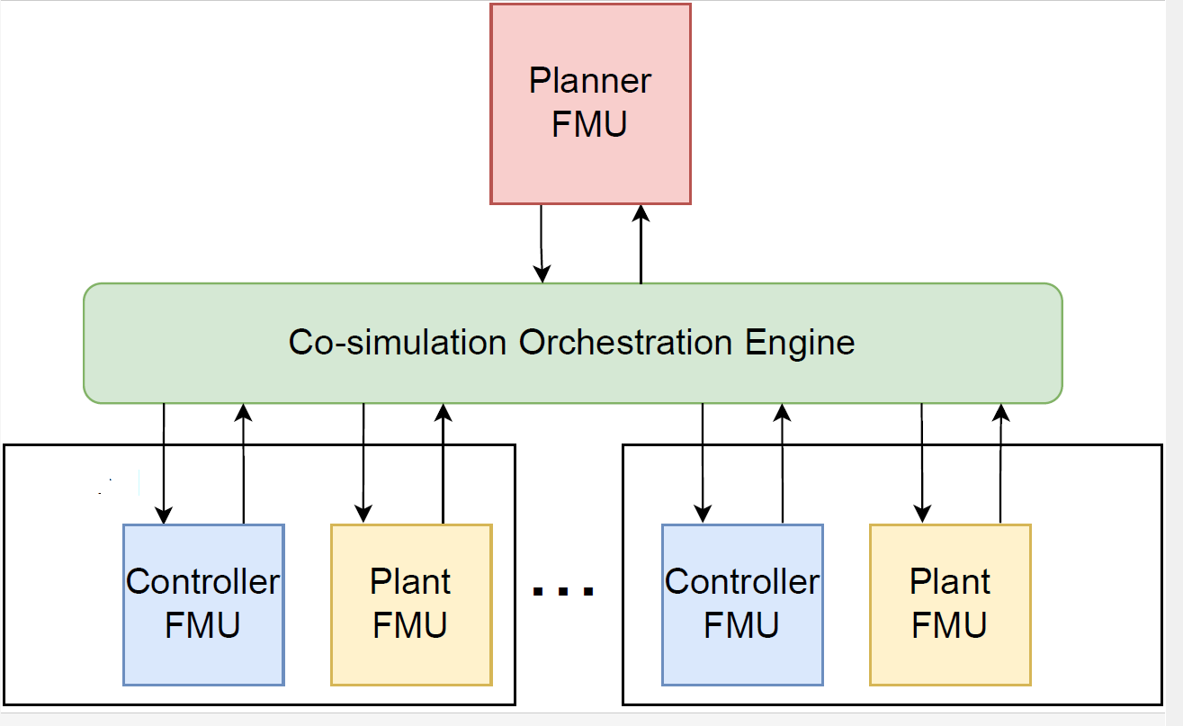
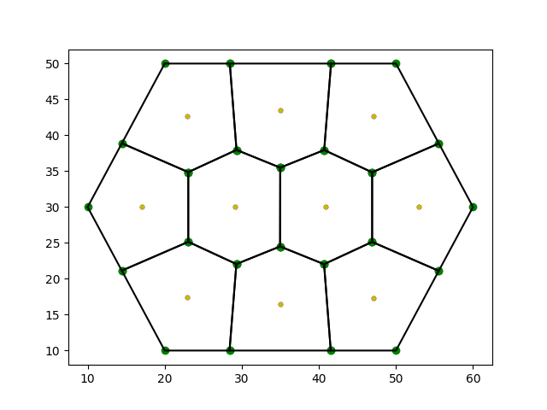
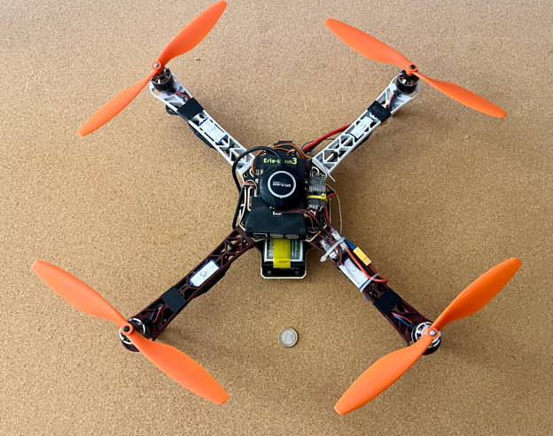

Multi-agent systems: aerial, land vehicles
Multi-UAV system: Planning & Control Objective:
Controller parameters (attitude and position control) calibration for stability in co-operative systems; optimality of values with respect to time to convergence and energy consumption
- Planning algorithm (logic language, python)
- Controller (C)
- Plant (Modelica)
FMI role:
Analysis of the relation between the numeric integration step (co-simulation step) and time discretization interval for planning for stability; analysis of optimality of control parameters value
- https://github.com/INTO-CPS-Association/example-linear-quadcopter - C. Bernardeschi, A. Domenici, et al., Co-simulation and Formal Verification of Co-operative Drone Control With Logic-Based Specifications The Computer Journal, vol. 66, Issue 2, 2023, https://doi.org/10.1093/comjnl/bxab161
Voronoi tesselletion
Erle-robotics quadcopter

Slide 16
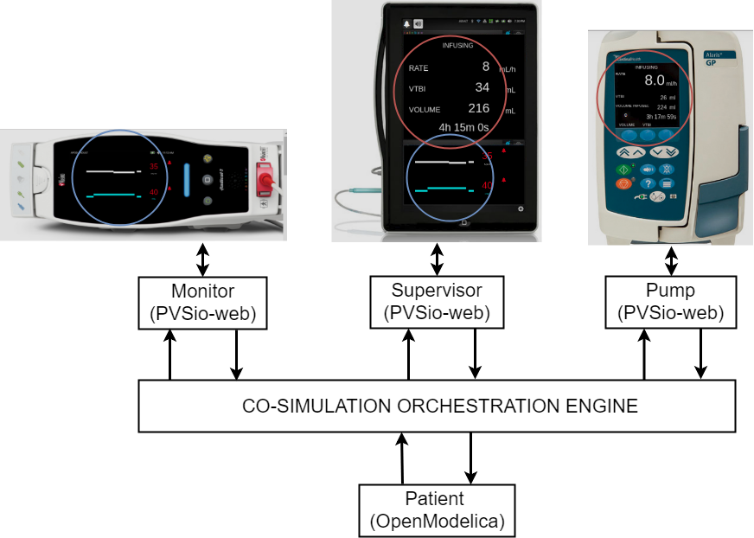
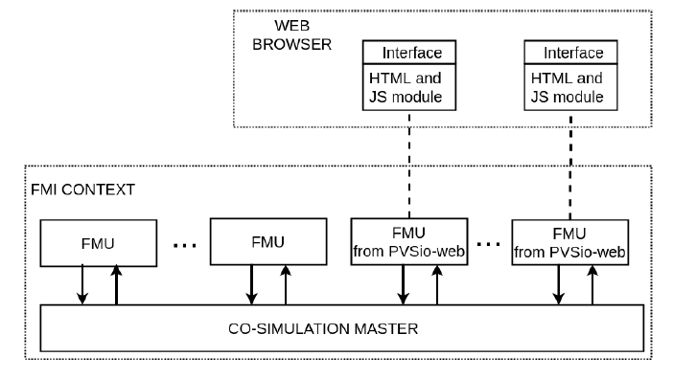


Human-centered systems
Integrated Clinical Environment (ICE)
User interaction with the realistic interfaces of the devices Easy testing and validation of device interaction from different manufactures (use error)
Devices: PVSioweb
Patient: OpenModelica
FMI role:
Validate ICE with respect to patient model. Formal proof of a use-related safety requirement of a device used in the co-simulation
M. Palmieri, C. Bernardeschi, P. Masci. A framework for FMI-based co-simulation of human–machine interfaces, Software and Systems Modeling, vol. 19, Issue 3, 2020, https://dl.acm.org/doi/abs/10.1007/s10270-019-00754-9

Slide 17


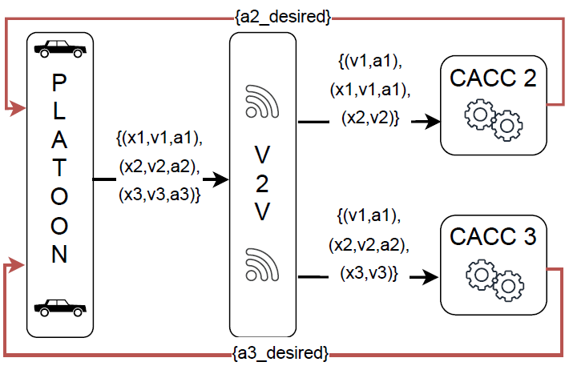
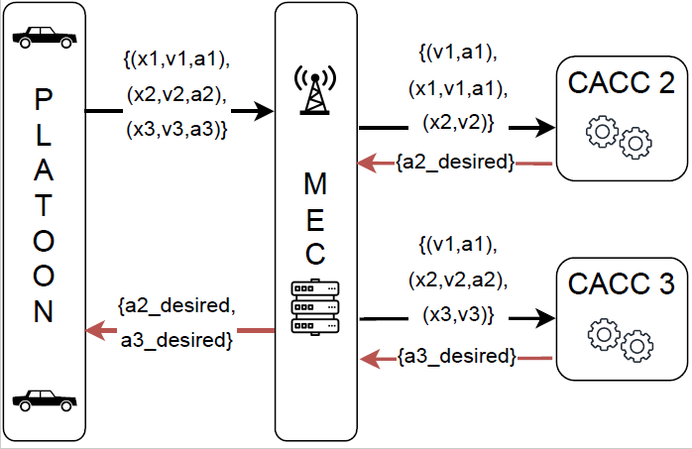
Communications in connected vehicles
Platoon of land vehicles
V2V communication against centralized multi-access edge computing. Performance with vehicle dynamics and different road surface conditions. Strategies to drive safely a platoon in critical road conditions.
3-vehicles
platoon
FMI role: swap from one network architecture to another; analysis of unsafe conditions
M. Palmieri, C. Quadri, et.al, Co-simulated Digital Twin on the Network Edge: the case of platooning, IEEE International Symposium on a World of Wireless, Mobile and Multimedia Networks, 2022, doi:10.1109/WoWMoM54355.2022.00096.

Slide 18
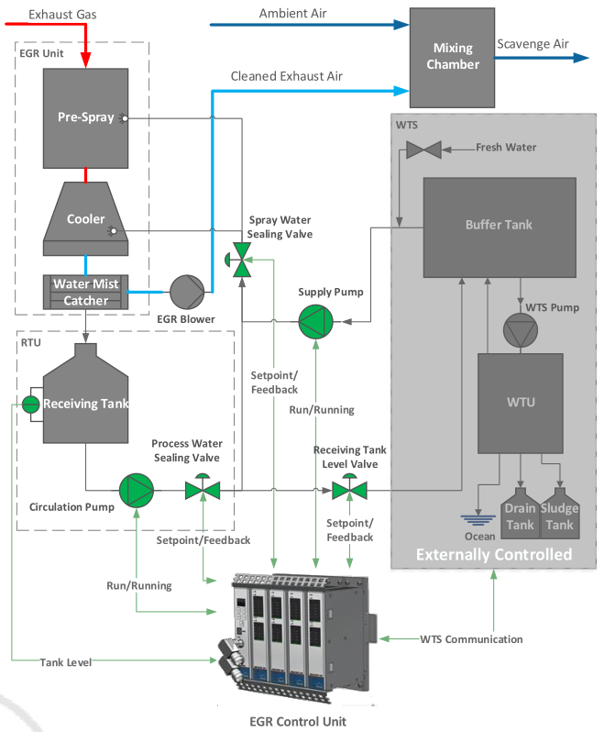
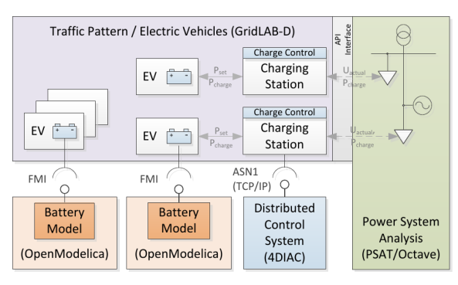
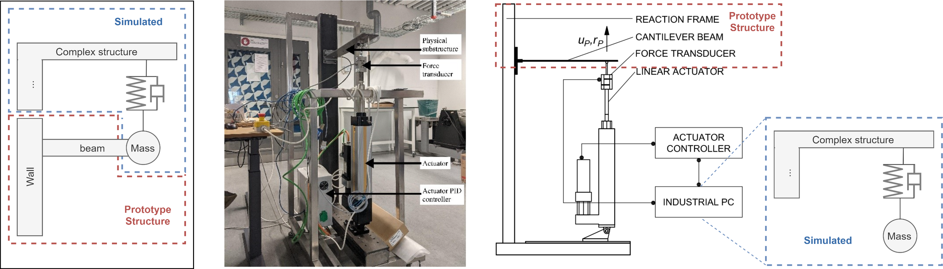
Other applications
Pedersen, N., Lausdahl, et. al (2017). Distributed Co-Simulation of Embedded Control Software with Exhaust Gas Recirculation Water Handling System using INTO-CPS. In 7th International Conference on Simulation and Modeling Methodologies, Technologies and Applications (pp. 73–82).
P. Palensky, E. Widl, M. Stifter and A. Elsheikh, "Modeling Intelligent Energy Systems: Co-Simulation Platform for Validating Flexible-Demand EV Charging Management," in IEEE Transactions on Smart Grid, vol. 4, no. 4, pp. 1939-1947, Dec. 2013, doi: 10.1109/TSG.2013.2258050.
Gomes, Cláudio, Giuseppe Abbiati, and Peter Gorm Larsen. “Seismic Hybrid Testing Using FMI-Based Co-Simulation.” In Proceedings of the 14th International Modelica Conference. online: Linköping University Electronic Press, Linköpings Universitet, 2021. https://doi.org/10.3384/ecp21181287.

Slide 19
FMI & Digital Twins

Slide 20
Definition in this Tutorial: Digital Shadow
Physical Twin (CPS)
Digital Shadow
Plant
Communication
Visualization
Monitoring
Predictive maintenance
Fault Diagnosis
Support for decision making
Env
Controller

Slide 21
Digital Twin Definition in this Tutorial
Physical Twin (CPS)
Digital Twin
Plant
Visualization
Monitoring
Predictive maintenance
Fault Diagnosis
Support for decision making
Re-configuration of PT
Communication
Env
Controller

Slide 22
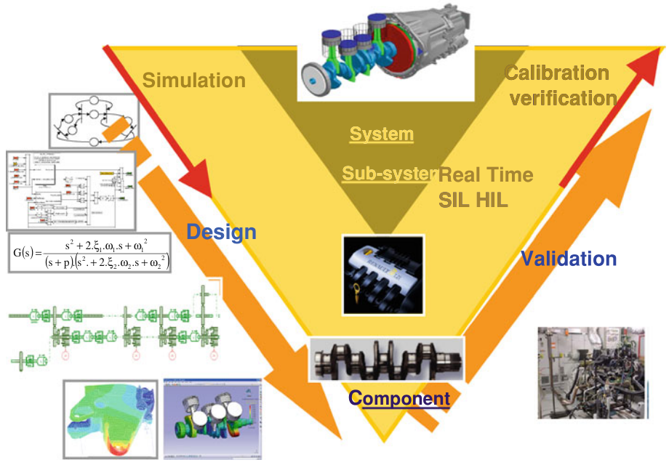
Opportunities of FMI in DTs
Physical Twin
Leverage design time models at deployment time.
Digital Twin
Deploy models without design time tooling.
Development
Deployment

Slide 23
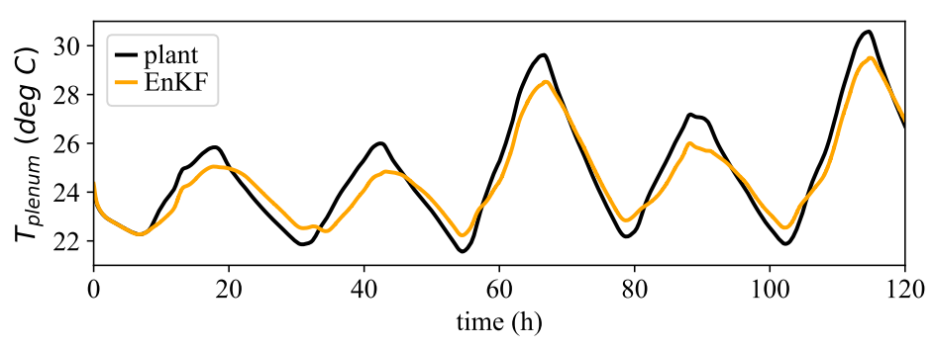
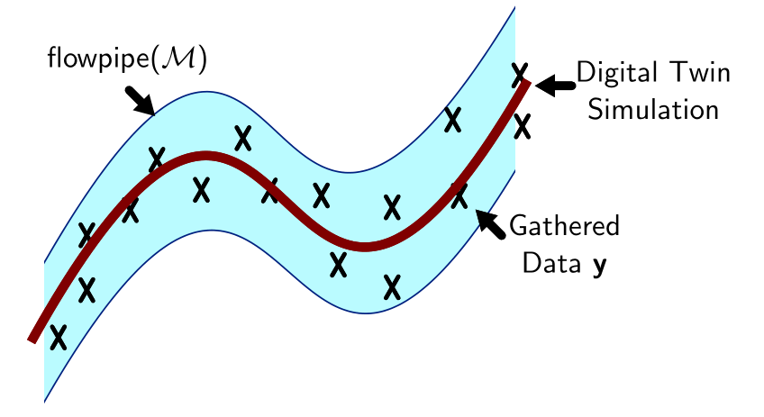
Role of FMI in Digital Twinning
Laughman, Christopher, and Scott A Bortoff. “Nonlinear State Estimation with FMI: Tutorial and Applications,” 23–25, 2020.
Digital Twin
Legaard, Christian Møldrup, Cláudio Gomes, Peter Gorm Larsen, and Frederik F. Foldager. “Rapid Prototyping of Self-Adaptive-Systems Using Python Functional Mockup Units.” In Proceedings of the 2020 Summer Simulation Conference, 1–12. SummerSim ’20. Virtual Event. https://doi.org/10.5555/3427510.3427532.
Visualization
Monitoring
Predictive maintenance
Fault Diagnosis
Support for decision making
Re-configuration
Communication
Models
Bogomolov, Sergiy, Cláudio Gomes, Carlos Isasa, Sadegh Soudjani, Paulius Stankaitis, and Thomas Wright. “Reachability Analysis of FMI Models Using Data-Driven Dynamic Sensitivity.” SIMULATION, Special Issue: Engineering of Dependable Digital Twins, 2023, accepted.

Slide 24
Wrap up

Slide 25
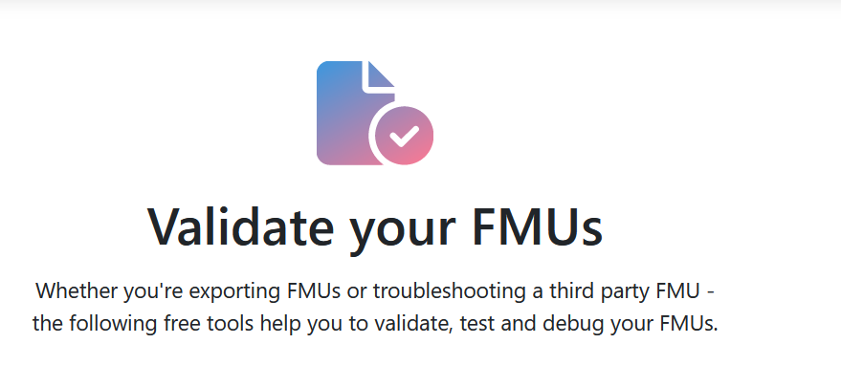


Resources
FMI Webpage
FMI tools list
FMU validation
Publications
Reference FMUs
A set of hand-coded FMUs for development, testing and debugging of FMI.
In case of questions we recommend to use StackOverflow with tag „fmi“
You are welcome to join the (unofficial) FMI LinkedIn Group

Slide 26
Thank you!
Any questions or comments?
Presenter Contacts
Christian.Bertsch Christian.Bertsch@de.bosch.com, contact@fmi-standard.org
Maurizio Palmieri maurizio.palmieri@ing.unipi.it
Cláudio Gomes claudio.gomes@ece.au.dk

