Slide 1


The Functional Mock-up Interface Beginners’ Tutorial
Online Materials:
Contributors:
Cinzia Bernardeschi, University of Pisa
Christian Bertsch, Bosch Research
Claudio Gomes, Aarhus University
Maurizio Palmieri, University of Pisa
Torsten Sommer, Dassault Systèmes
Released under Attribution-ShareAlike 4.0 International License
https://github.com/modelica/ fmi-beginners-tutorial-2024/tree/main

Slide 2
Agenda
Part 1: Introduction to FMI (40Min)
Motivation / History
How does FMI work?
Tool support
New features in FMI 3.0
Part 2: Working with (single) FMUs (45 min)
Part 3: Interacting with multiple FMUs (45 min)
Part 4: Closing Session (10 min)
Q&A

Slide 3
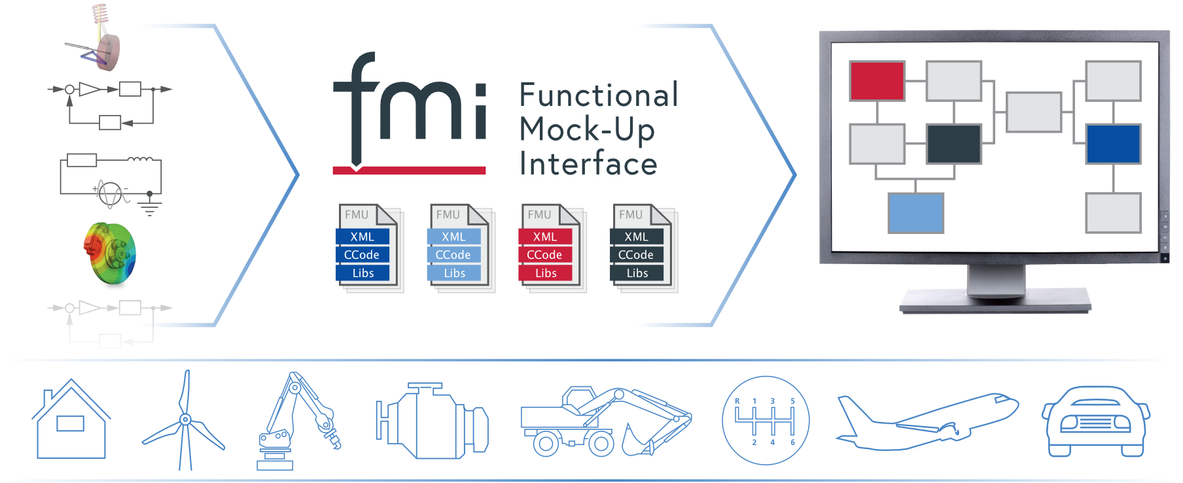
Introduction to FMI
Presenter: Christian Bertsch, Bosch Research
Online Materials:
https://github.com/modelica/ fmi-beginners-tutorial-2024/tree/main

Slide 4
Motivation, Timeline

Slide 5
Motivation
Define a tool-independent, free-to-use standard for exchange and co-simulation of models between different simulation tools
Provide models in a containerized form that allow for the deployment to different targets
Decouple Know-How
between producers and users of FMUs
between different specialized engineers and software programmers
Massive Re-use of modelling investment
IP Protection possible vial black-box model exchange

Slide 6
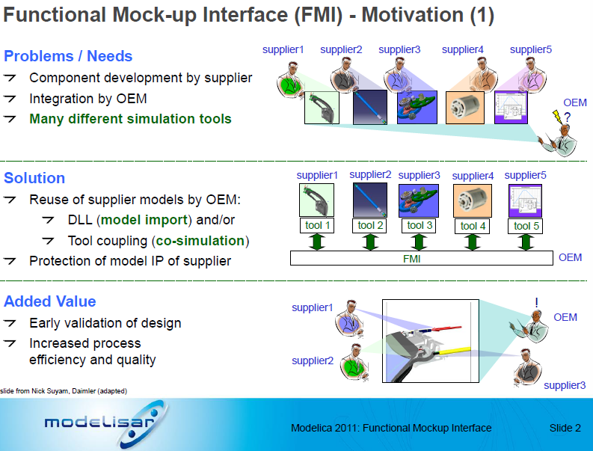

Timeline : Modelisar Project → Modelica Association Project FMI
FMI 1.0 (and most part of FMI 2.0) was developed in the publicly funded project Modelisar
2008-2011: MODELISAR project
2011: Release of FMI 1.0
2012: Foundation of MAP FMI in MA Members: see FMI Webpage
2013: Release of FMI 2.0 → focus of this tutorial
2021: Release of FMI 3.0

Slide 7
Versioning of FMI
FMI uses semantic versioning:
Major releases
not backwards or forward compatible changes
e.g. „FMI 2.0.4“
Minor releases
Can introduce new features
Backwards compatible „FMI 3.0 FMUs will be valid FMI 3.1 FMUs“
Bugfix/Maintenance releases
No new features, only bugfixes and clarifications possible
Backwards and forward compatibility

Slide 8
FMI: Technical Fundamentals
“How does FMI work?”

Slide 9
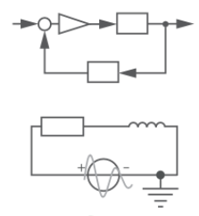
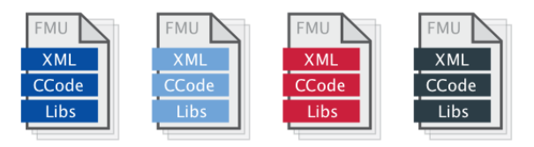
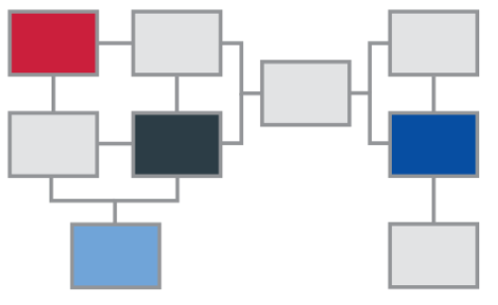
Exporting vs. Importing tool
Exporting tools
develop model
export as Functional Mockup Unit (FMU) accordingg to the FMI Standard
FMU
import FMU
(co-) simulate model
Importing tool

Slide 10
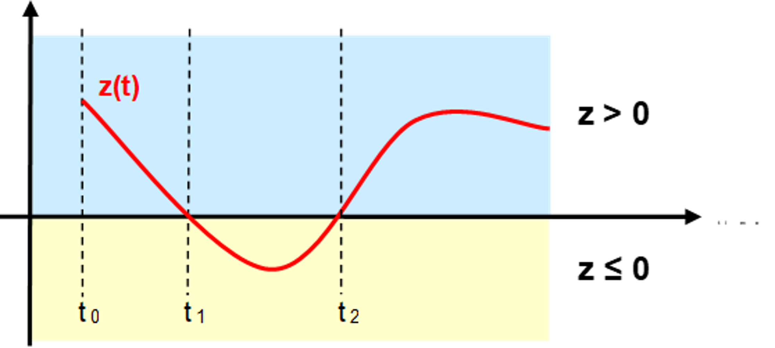
Models in Scope
Original Scope of FMI:
Ordinary differential equations (ODEs) with events
You need a numerical solver for their solution
Distinction between continuous and discrete variables
There is a notion of time (or more general „independent variabl2)
Extended scope:
Purely algebraic equations
Complex discrete behavior with clocks and model partitions (FMI 3.0)
A very broad scope of use cases such as
virtual electronic control units (ECUs),
AI models
…

Slide 11
Co-Simulation (CS)
Co-Simulation: (from the FMI 3.0.1 glossary)
Coupling of several simulation programs in order to compute the global behavior of a system that consists of several subsystems.
Subsystems are coupled in the sense that the behavior of each subsystem depends on the behavior of the remaining subsystems, so that the co-simulation must be computed in a step-by-step fashion.
Each simulation program is responsible for computing the behavior of a subsystem, using the outputs produced by the other simulation programs.
There can be an additional error introduced by the co-simulation, that has to be limited to an acceptable size by using a suitable co-simulation algorithms and communication pattern (e.g. step size)

Slide 12
The FMI Standard
The FMI Standard defines the “Functional Mock-up Interface” FMI, an interface between a model and a simulation environment.
It consists of the definition of
a C-API (application programming interface)
an interface description (modelDescription.xml) according to a defined schema
the definition of an exchangeable unit, an “FMU” (Functional Mock-up Unit), technically a zip file
The FMI Standard only defines the interface of a single FMU, not the co-simulation algorithm or solver for multiple FMUs!

Slide 13

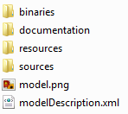
FMU – „Functional Mock-up Unit“
myModel.fmu
A model container, that can be distributed
Technically it is realized a zip File, with ending „.fmu“
Content:
modelDescripotion.xml: meta-data with information on the model variables, interface, capabilities and to a limited extent model structure
Model representation
Binaries for one or multiple platforms and/or (“black box”), and/or
Source code (e.g C-Code)
Optionally: Resources, documentation, Icons, port definitions
/extra information (defined in layered standards)
modelDescription.xml
model.dll

Slide 14


FMU for Model Exchange vs. Co-Simulation (FMI 2.0)
Model Exchange (ME)
Importing tool provides the solver.
Properties:
Very tight integration of model in simulation tool
Complex interface between importing tool and model
Importing tool must provide a suitable solver for the model
Used e.g. for inclusion of Modelica support in non-Modelica tools (using the solver of the importing tool)
Co-Simulation (CS)
Exporting tool provides the solver.
Properties:
Tight coupling of model and a suitable solver
Simpler interface between importing tool and model
Freedom in the selection of a co-simulation algorithm and communication timestep to reach a stable and accurate solution
Used in most industrial applications
Tool
FMU
FMU
Tool
Solver
Model
Model
Solver

Slide 15
Co-Simulation (CS) Interface
Communication timestep can be different from internal steps (e.g. Variable step solver)
Calling sequence CS
Set inputs: fmi2SetXXX(...)
Trigger calculation until next communication point: fmi2doStep(...)
Get outputs: fmi2GetXXX(...)
For an implementation in C, see e.g. fmusim in the Reference FMUs: https://github.com/modelica/Reference-FMUs/blob/main/fmusim/fmusim_fmi2_cs.c
You can view the calling sequence with fmusim --log-fmi-calls
The co-simulation algorithm is not part of the FMI standard. It is responsible for:
advancing the overall simulation time,
exchange input and output data,
triggering of input clocks, and handling events.
Internally the FMU can have different timesteps (e.g. a variable step solver)

Slide 16
Model Exchange (ME) Interface
Main idea: the ME interface exposes the right hand side (RHS) of a hybrid ODE to the external solver.
The importer controls the data exchange and the synchronization between FMUs.
The solver algorithm itself is not part of the FMI standard. It is responsible for:
advancing the overall simulation time,
exchange input and output data,
computation of continuous state variables by time integration,
triggering of input clocks, and
handling events.

Slide 17
Simulation of multiple FMUs
Exported by: Tool 1
Tool 2
Tool 3
Tool n
FMU
FMU
FMU
FMU
…
Functional Mock-up Interface
Numerical Solver (ME) or Co-Simulation Algorithm (CS)
or
Scheduler (SE, FMI 3.0)
Not defined by FMI Standard, but by the importing tool

Slide 18
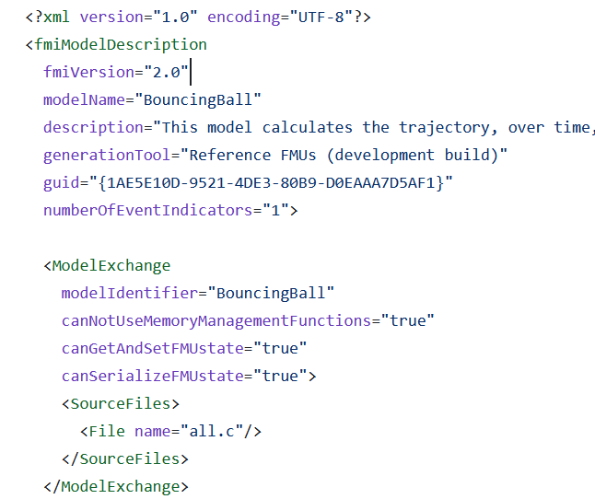
The modelDescription.xml
It contains all static information about the FMU
Definition of supported interface kinds (ME, CS, SE)
Model variables
Inputs, outputs, parameters
Certain information on the model structure
Example: https://github.com/modelica/Reference-FMUs/blob/main/BouncingBall/FMI2.xml
Attributes and capability flags, such as
“needsExecutionTool”
…

Slide 19
FMI for Co-simulation Tool Wrapper Variant
Co-simulation stand-alone FMU
self-contained FMU
Co-simulation FMI Tool Wrapper
FMU dependent on an existing tool installation
Attribute: “needsExecutionTool”

Slide 20
FMI Tool Support
https://fmi-standard.org/tools/: FMI supported by >= 180 Tools
Exporting tools
Modeling and simulation tools
Model-based software creation
Wrapping of algorithms, virtual ECUs
…
Importing tools
Modeling and simulation tools
Co-simulation tools and integration platforms
Implementations for programming and scripting languages
….

Slide 21
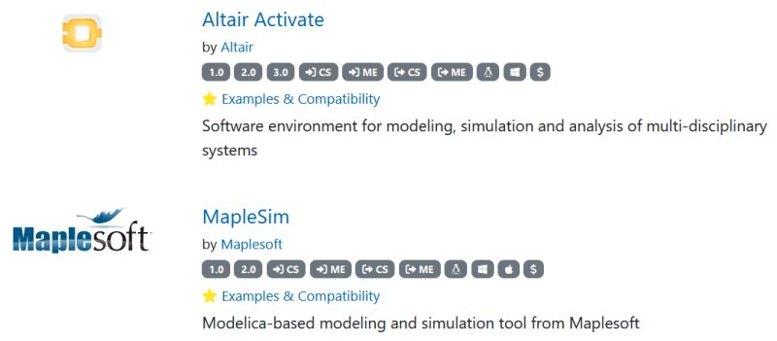
Compatibility Information
Replaces the cross-check that helped to improve he maturity of FMI 1.0 and 2.0 supporting tools.
Information on on how FMI export and import have been tested provided by the tool vendors and linked in the tools list
Tools providing compatibility information are marked with a golden star and listed on top of the tools list https://fmi-standard.org/tools/:

Slide 22
Licenses and licensing mechanism
The FMI standard deals with the technical part of model-exchange and co-simulation only.
There might be other legal or technical restrictions
Exporting tools might use a licensing mechanism such as FlexNet
Other legal obligations, e.g., w.r.t. to the distribution of FMUs might be imposed by the exporting tools.
License information can be stored in the documentation folder

Slide 23
New features in FMI 3.0

Slide 24
Motivation for FMI 3.0
180+ tools support FMI now: many users now, many new use-case requests:
Virtual Electronic Control Units (vECUs):
FMI 2.0 works well for physics simulations: better support for vECUs is needed
Advanced Co-Simulation
Co-Simulation is the more popular interface type: improved co-simulation methods are needed to improve performance and accuracy
Multi-FMU simulations are getting more common
Events are necessary in complex control systems
Events must be synchronized across FMUs
New ML and AI applications
More derivatives computations is required
vECU
Co-Sim
Events
AI
API Efficiencies

Slide 25
FMI 3.0: New Interface Type – Scheduled Execution
vECU
Events
FMI 2.0
Model Exchange
Co-Simulation
FMI 3.0
Model Exchange
Co-Simulation
Scheduled Execution
Scheduled Execution allows coupling several FMUs with one, external scheduler (OS)
Notes:
This is necessary for collaborative development of complex system controllers

Slide 26
FMI 3.0: Main Improvements
Performance
Accuracy
Event mode for Co-Simulation
Intermediate variable update
Clocks
New variable types
Array variables
Terminals and icon
FMI for Scheduled Execution (SE)
Preparation for layered Standards
New Application
Notes:
Show co-sim and intermediate output notebooks

Slide 27
Example model for hands-on part

Slide 28
Example model: Controlled Motor Drive
Motor Drive with PI control modelled in Modelica
Desired torque
Step at time 0,1s
Load Step
at time 0,5s
Reference solution
Angular speed

Slide 29
Example model: Controlled Motor Drive
Model exported as one overall FMU or split as three FMUs.
Drive FMU
Overall FMU
Stimuli FMU
Desired torque
Step at time 0,1s
Control FMU
Load Step
at time 0,5s

Slide 30
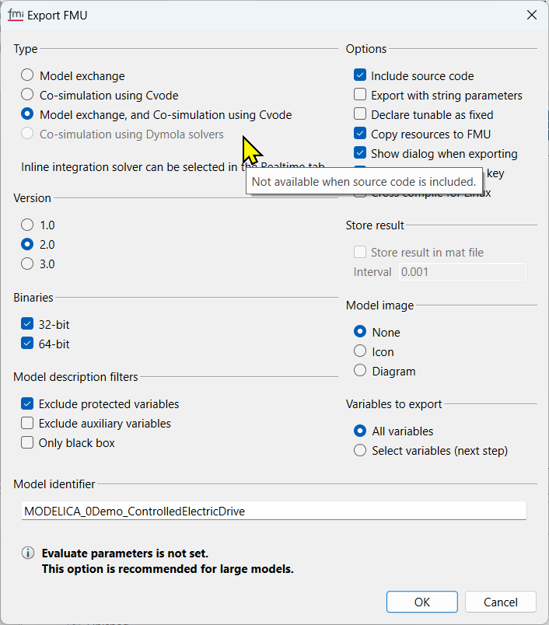
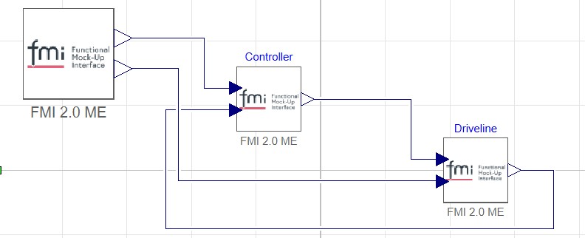
Demo: FMU Export and import
FMU Export from Modelica-tool Dymola:
Configure options
FMU Import and Simulation in Dymola:

Slide 31
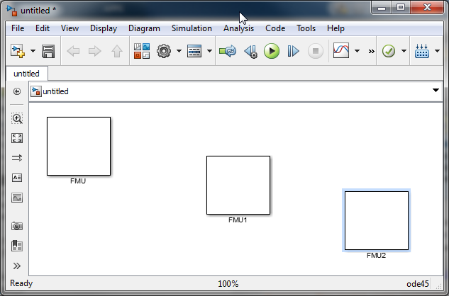
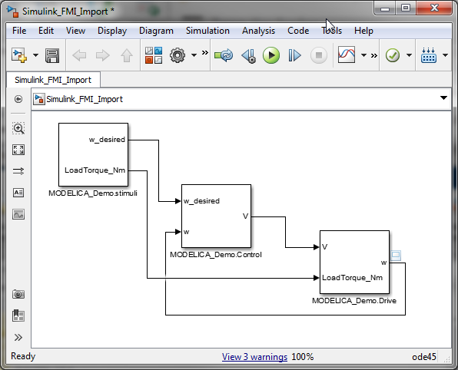
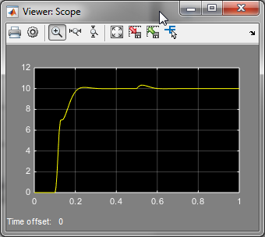
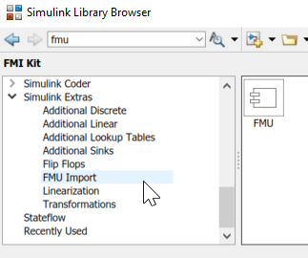
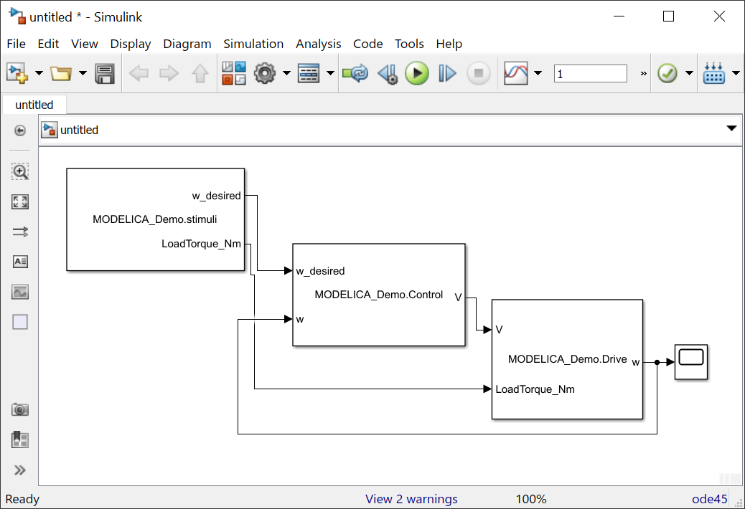
FMU Import and Simulation in MATLAB Simulink
FMI-Kit by Dassault Systèms (available on Github) for older ML/SL version
Native FMI import by Mathworks FMU import Block available in Simulink/extras

