Slide 1

FMI 3.0 advanced topics
Online Materials:
Presenters:
Christian Bertsch, Bosch Research
Claudio Gomes, Aarhus University
Maurizio Palmieri, University of Pisa
Special thanks to
Torsten Sommer, Dassault Systèmes
Released under Attribution-ShareAlike 4.0 International License
https://github.com/modelica/ fmi-beginners-tutorial-2025/tree/main

Slide 2
Content
FMI 3.0 news features
New data types
Binary Variables
Co-Simulation with Events
Intermediate variable access
Clocks
Adjoint derivatives
Layered Standards using FMI 3.0 features
Layered Standard for Network Communication (FMI-LS-BUS)
Layered Standard for structured Data (v1.0.0alpha) FMI-LS-STRUCT
Outlook

Slide 3
FMI 3.0: Main Improvements
Performance
Accuracy
Event mode for Co-Simulation
Intermediate variable update
Clocks
New variable types
Array variables
Terminals and icon
FMI for Scheduled Execution (SE)
Preparation for layered Standards
New Application
Notes:
Show co-sim and intermediate output notebooks

Slide 4
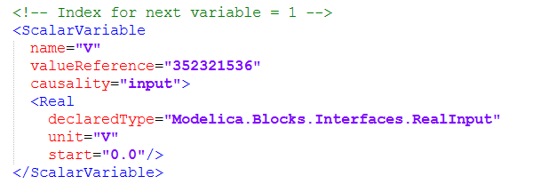
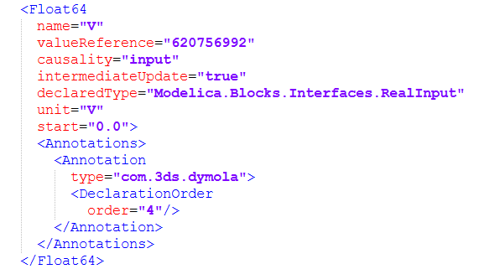
New Variable types
FMO 2.0 abstract types (e.g. “Real”) FMI 3.0 Concrete types (e.g. Float64)
.fmi-beginners-tutorial-2025\part2\Drive.fmu
Drive_FMI3.fmu

Slide 5
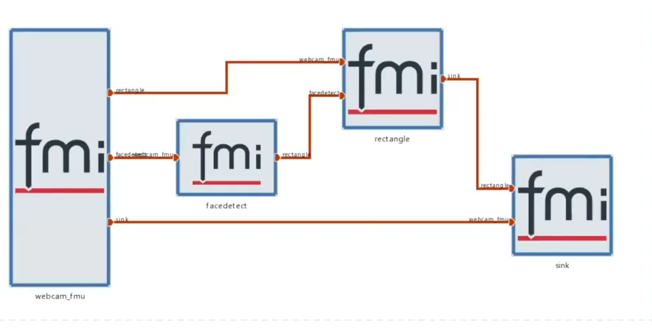
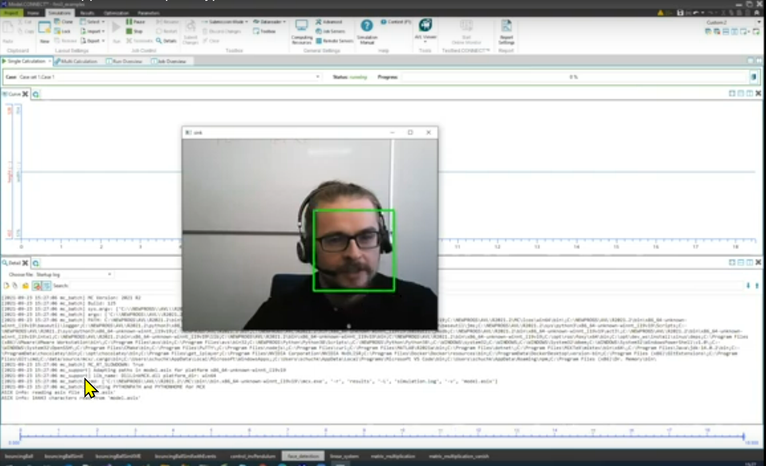
FMI 3.0 Binary Data
https://www.youtube.com/watch?v=dhp3L6aMaAQ FMI 3.0 Demo

Slide 6
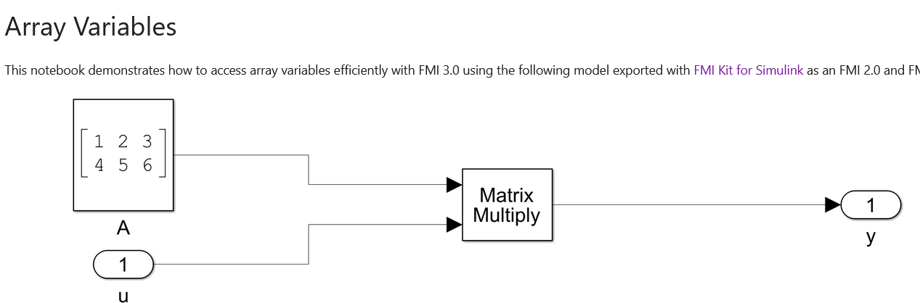
FMI 3.0 Array variables
FMI 2.0 supports arrays only via a naming convention, all variables are serialized
FMI 3.0 brings active array support
https://github.com/chrbertsch/fmi3-features/blob/main

Slide 7
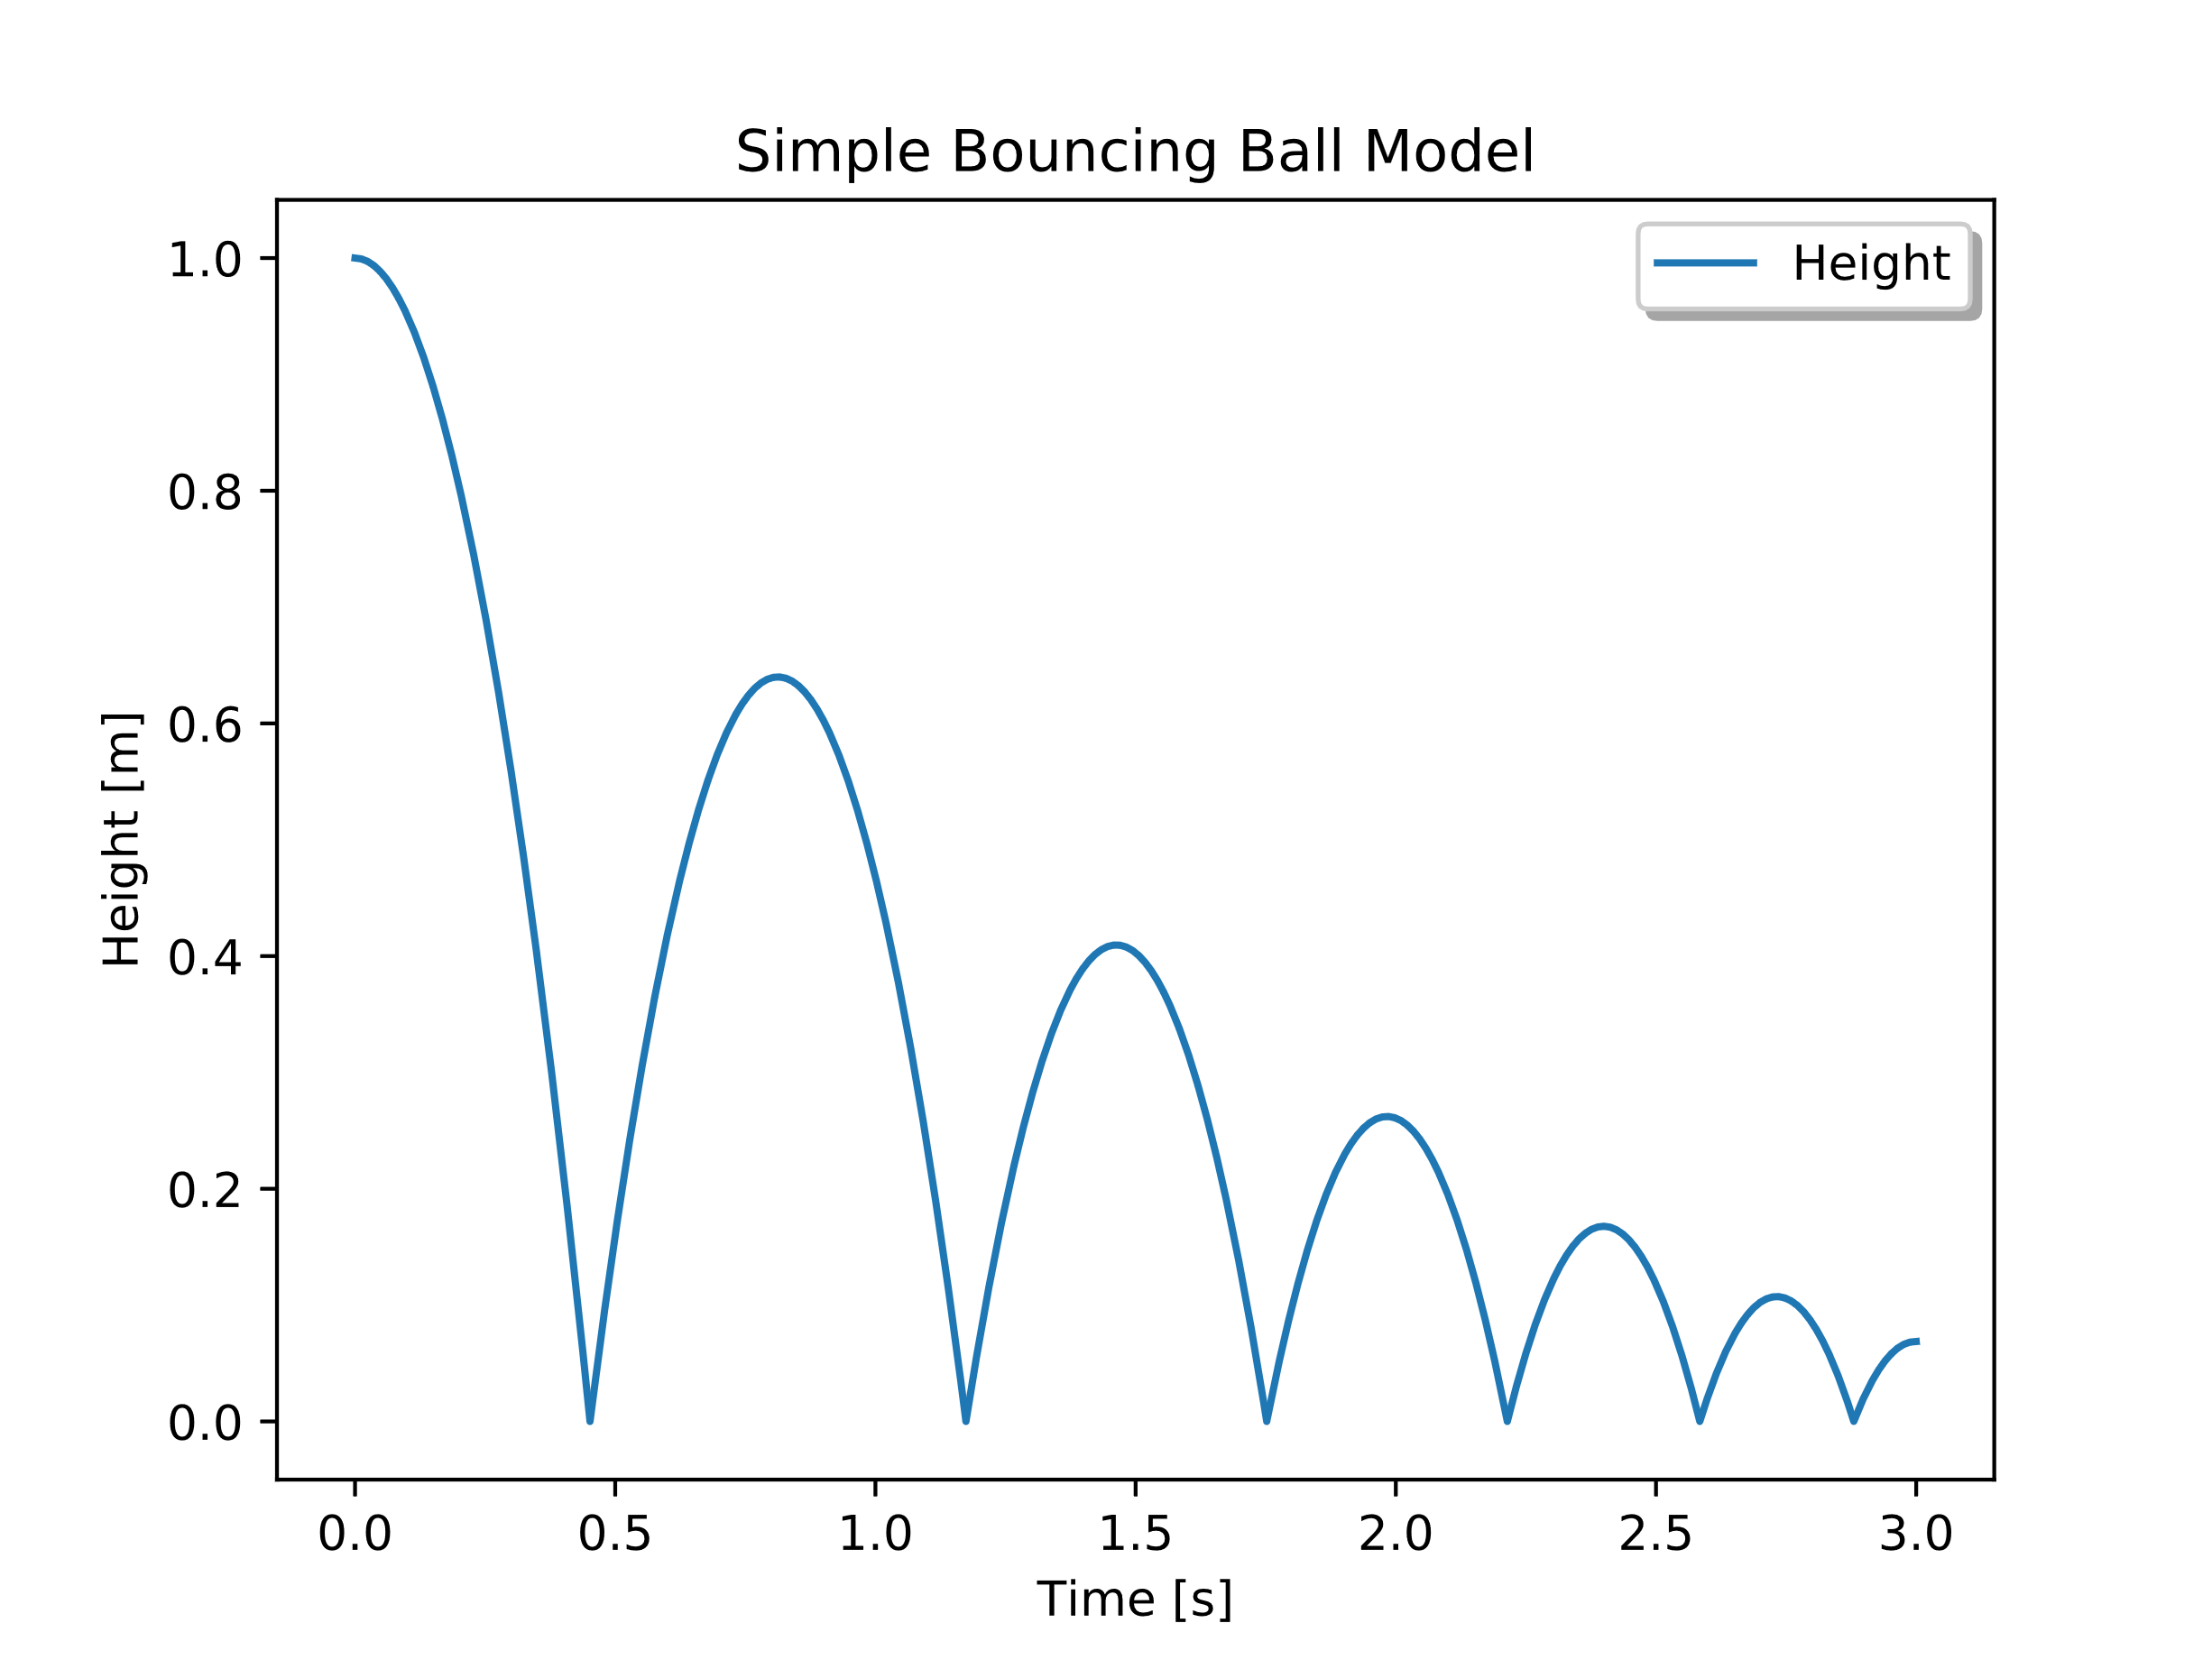

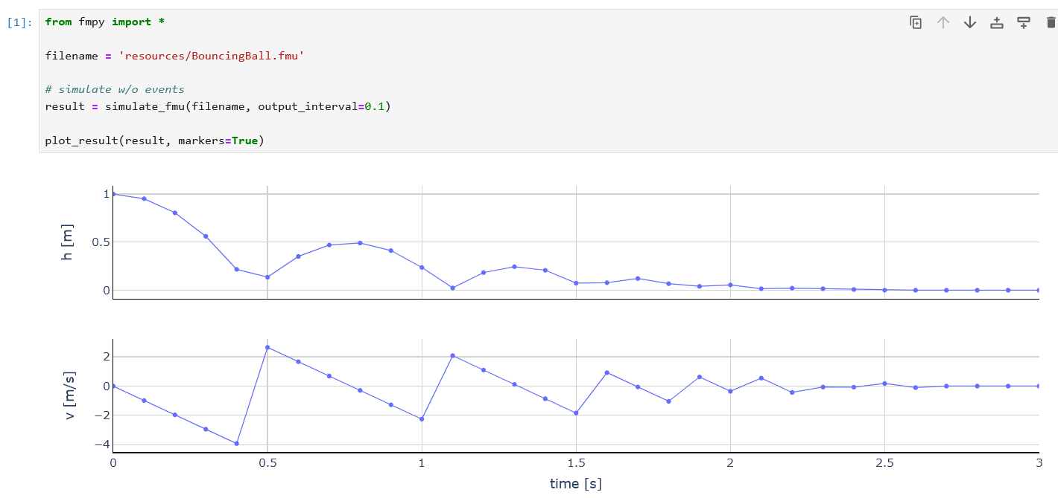
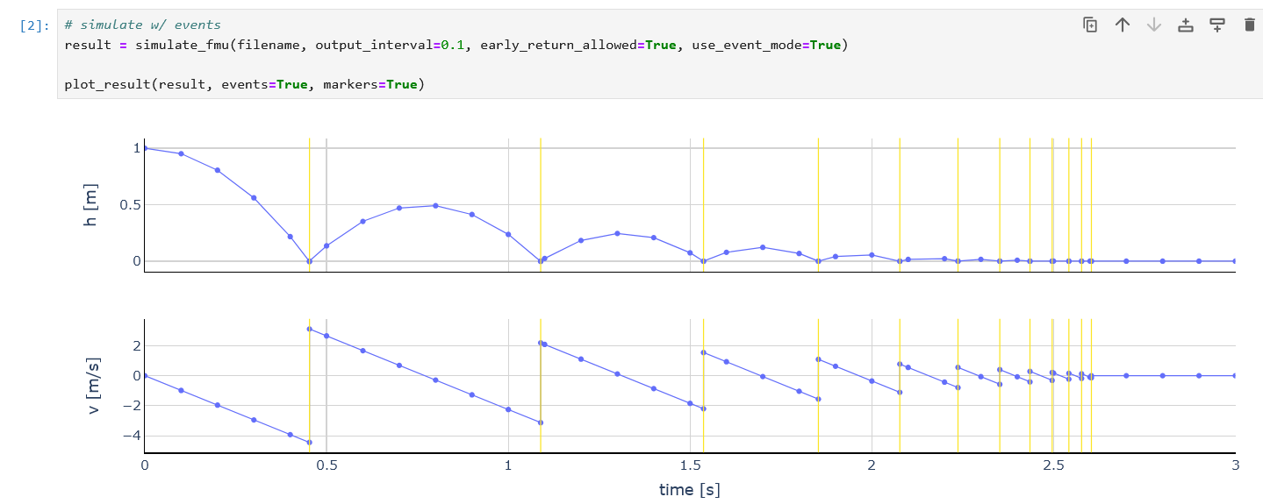
FMI 3.0 Co-Simulation with examples
Example: Bouncing ball
https://github.com/t-sommer/fmi3-features/blob/main/cs_events.ipynb
Simulation with FMI 2.0 CS Exact timepoints where the ball hits the ground missed in Simulation of CS FMU with fixed communication timestep
https://github.com/chrbertsch/fmi3-features/blob/main

Slide 8
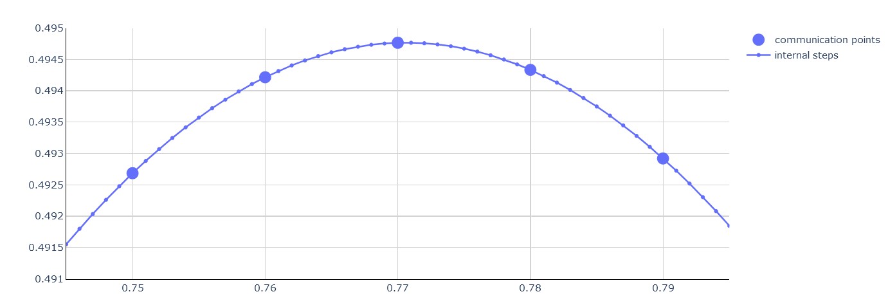
Intermediate variable access
https://github.com/chrbertsch/fmi3-features/blob/main

Slide 9
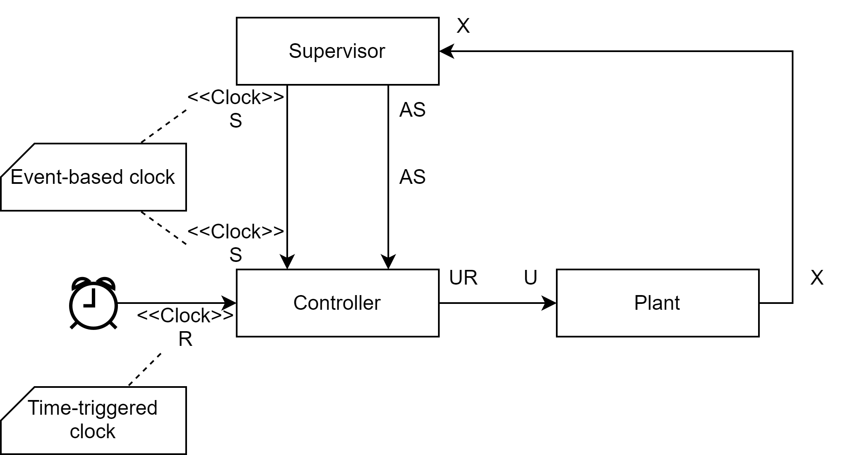
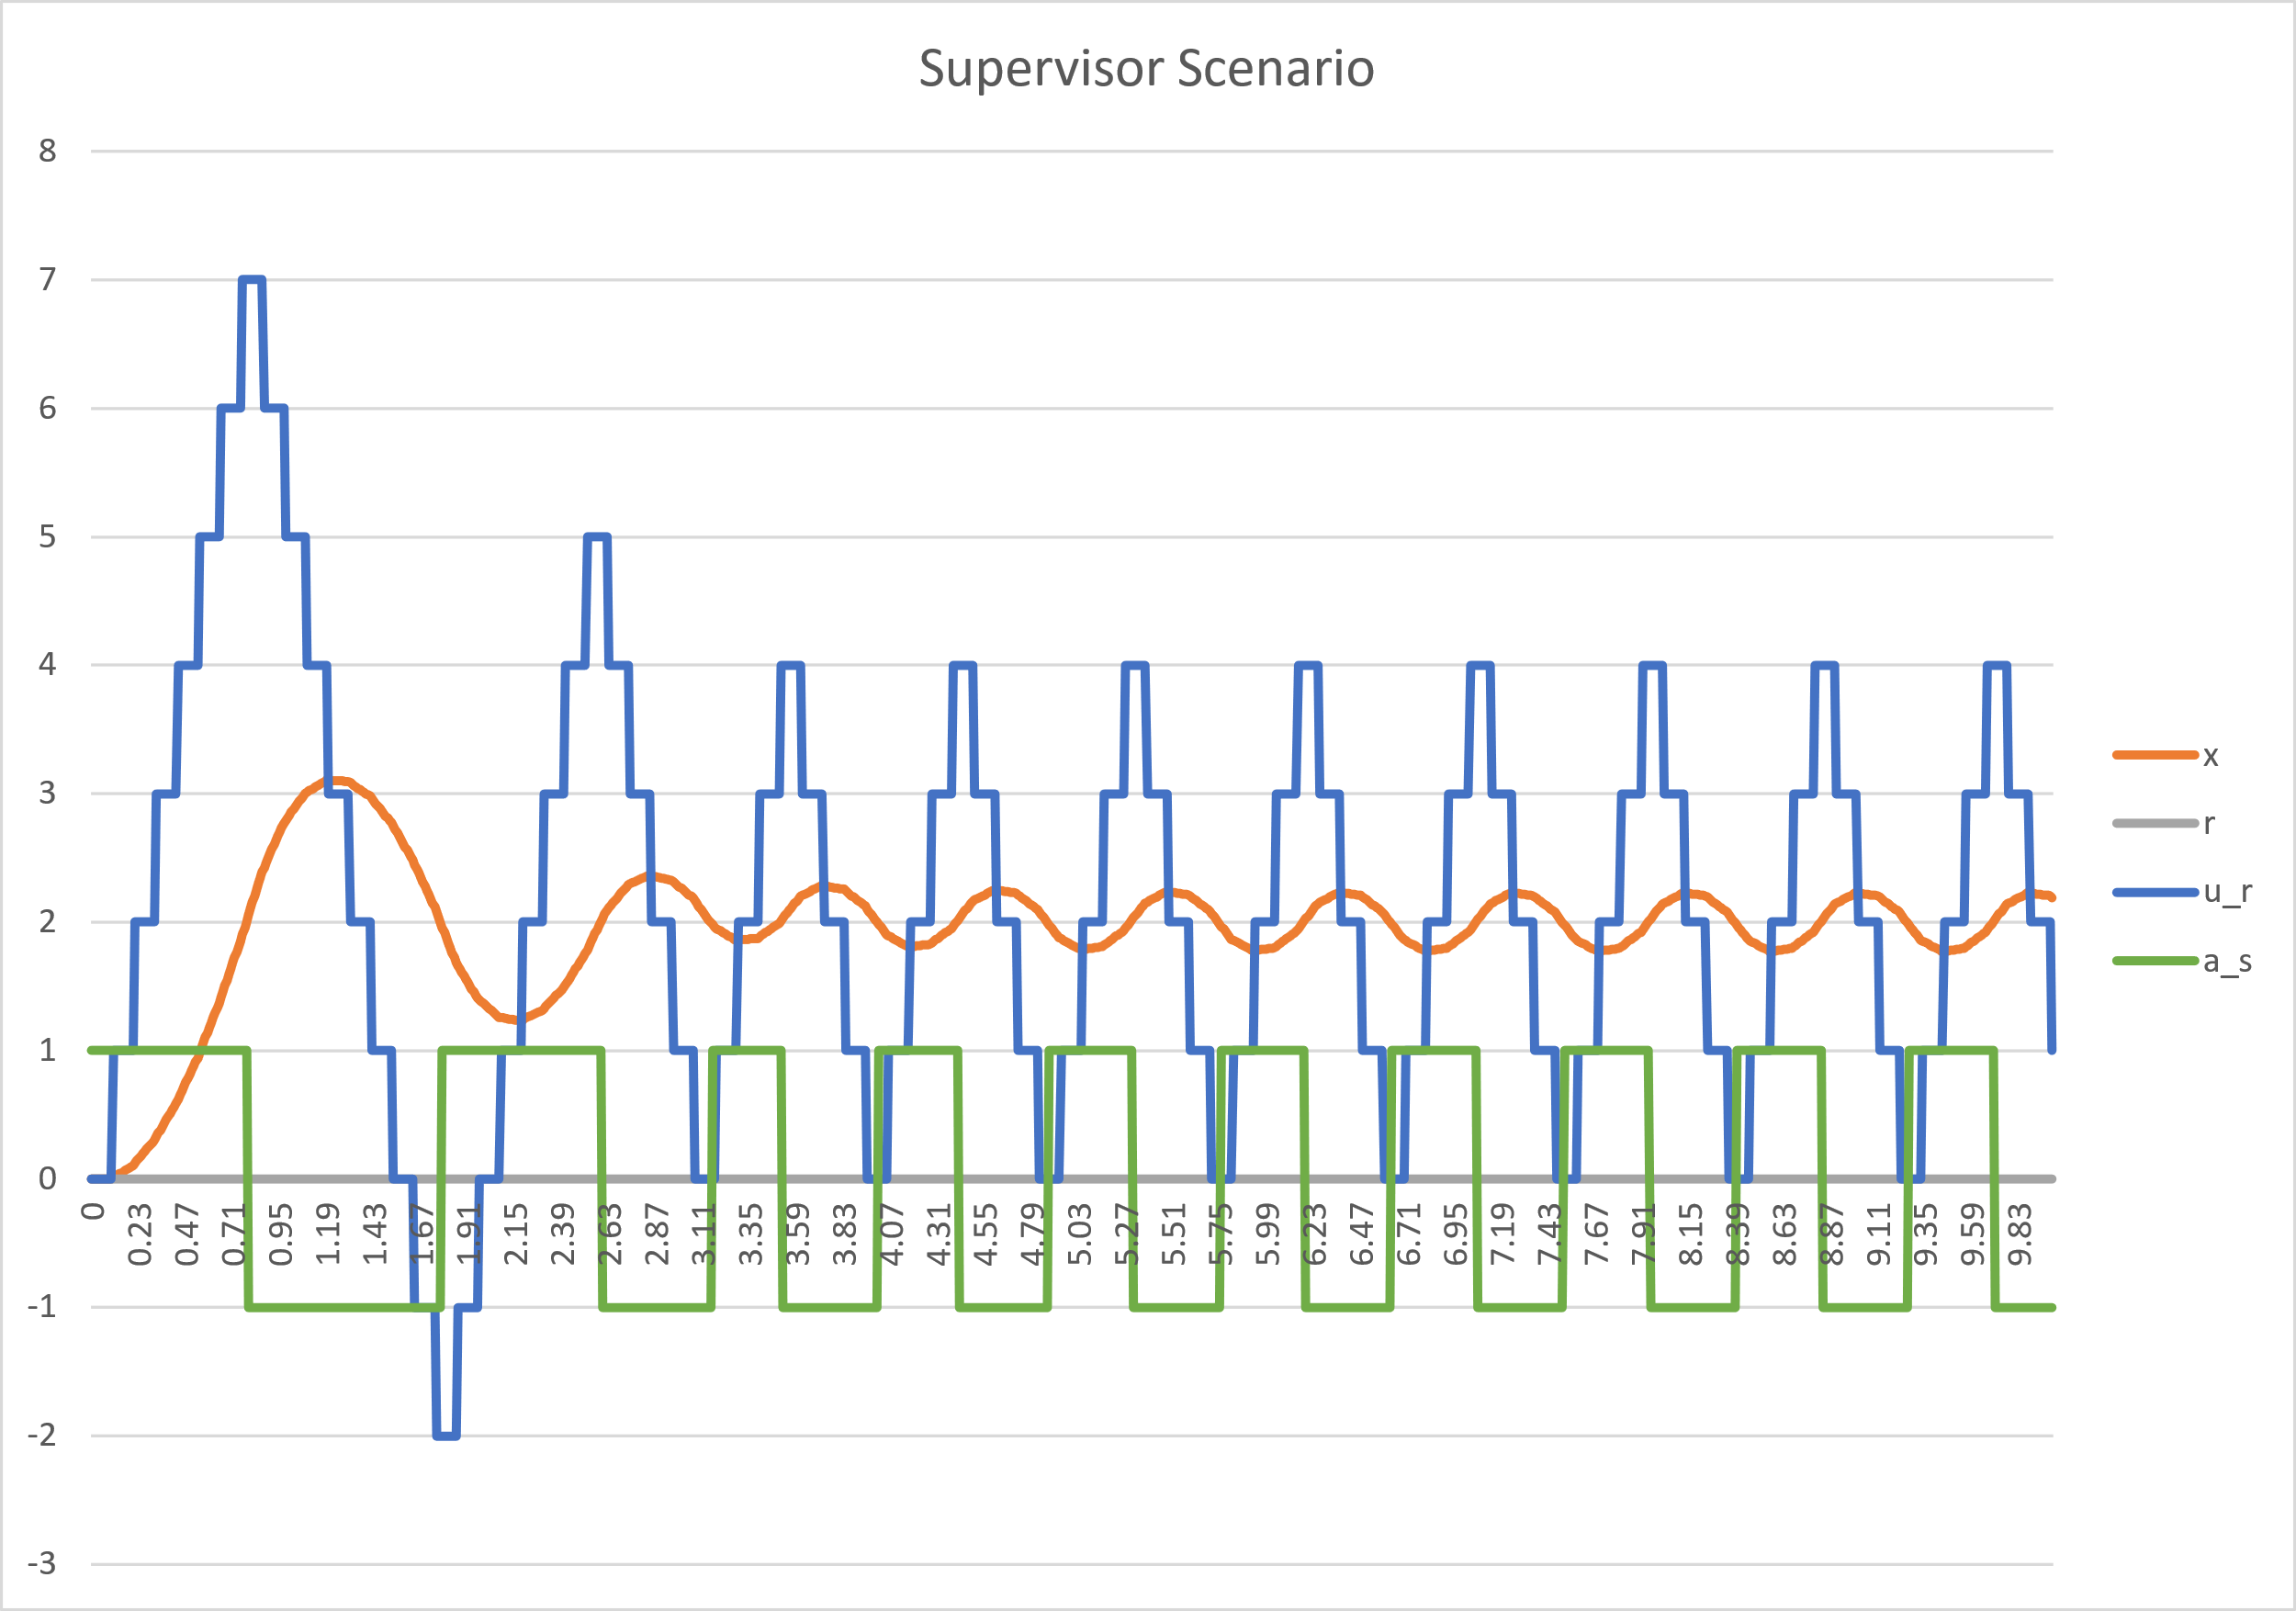
Clocks example
Clocks are used to synchronize events between different systems
FMI 3.0 features used: event-based, time-triggered Clocks
https://github.com/clagms/synchronous-clock-fmus

Slide 10
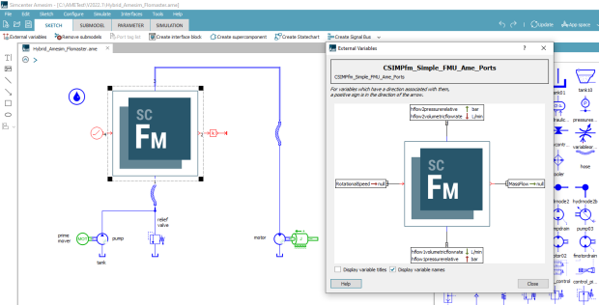
FMI Terminals
Grouping multiple signals into a new entity.
Source: https://newsletter.modelica.org/2021-03/index

Slide 11

Adjoint derivatives
Use FMI in optimization, # retrive v^T * J with a single callsensitivity = fmu_instance.getAdjointDerivative(unknowns, knowns, seed)
FMI 3.0 features used:
https://github.com/t-sommer/fmi3-features/blob/main/adjoint_derivatives.ipynb
- directional, adjoint derivatives
# retrive v^T * J with a single callsensitivity = fmu_instance.getAdjointDerivative(unknowns, knowns, seed)
E.g.. Implemented in
https://github.com/casadi/casadi/blob/main/docs/notebooks/fmu_demo.ipynb

Slide 12
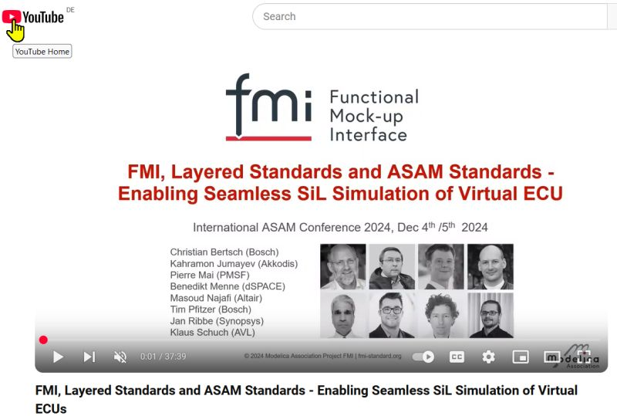
Layered Standards
Concept in FMI 3.0: Layered standards to allow standards extending FMI 3.0 Means: /extra directory, standardized annotations
Layered Standards in development by the FMI Project:
FMI-LS-XCP: https://github.com/modelica/fmi-ls-xcp for XCP support v1.0 released 12/2024
FMI-LS-BUS: https://github.com/modelica/fmi-ls-bus for network communication v1.0 released 07/2025 Demo of interoperability at International ASAM Conference
FMI-LS-STRUCT: https://github.com/modelica/fmi-ls-struct for sampled maps and structuring of variables v1.0.0-alpha.1 available
FMI-LS-REF https://github.com/modelica/fmi-ls-ref for the description of basic validation experiments and other files attached to an FMU

Slide 13
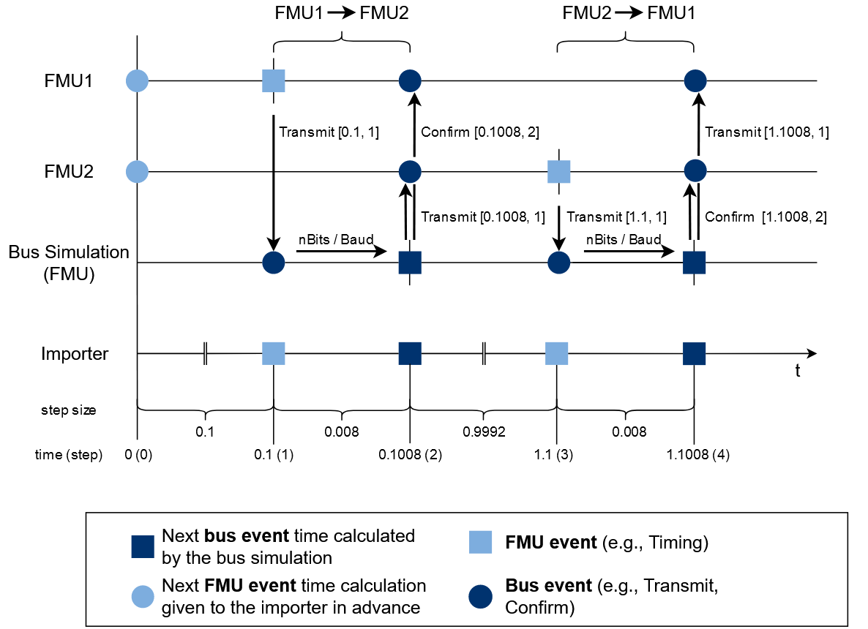

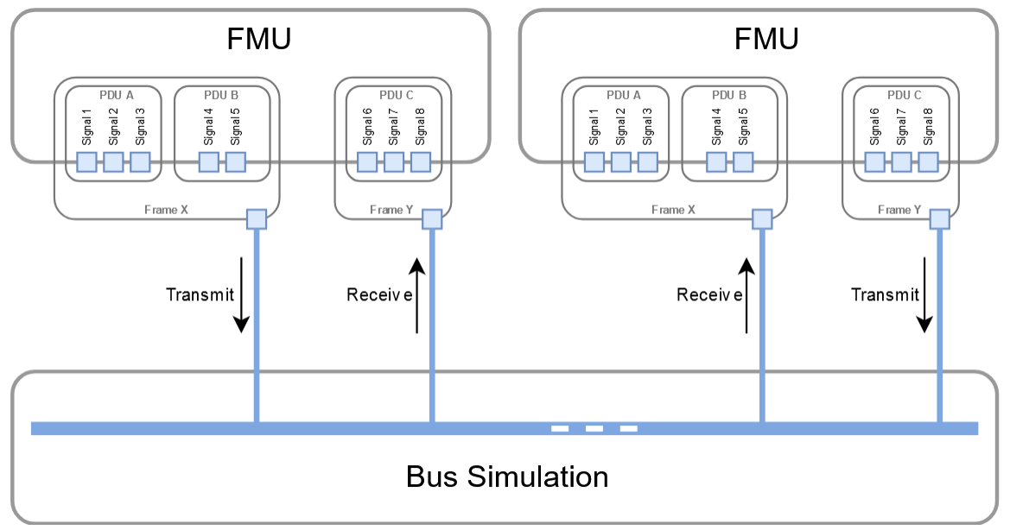
FMI-LS-BUS: Layered Standard Network Communication
Simulation of automotive systems requires network communication between vECUs.
Idea:
Use FMI 3.0 core standard features to specify a common bus interface, using Co-Simulation, Binary Variables, Clocks and Terminals
Support automotive networks protocols and others from different industries (CAN, LIN, FlexRay, Ethernet, …)
Using network description formats DBC, LDF, FIBEX, ARXML
Two variants:
Physical abstraction layer ("high cut"): Simply transport physical signal values between virtual ECUs by using unit-based and clocked variables
Network abstraction ("low cut"): Detailed emulation of a specified bus system to realize virtualized bus driver implementations, including feedback from the physical drivers about transmission status or network node states

Slide 14
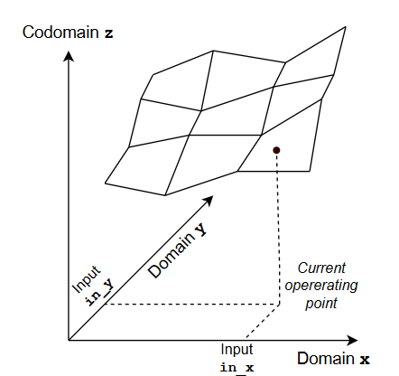
FMI LS-STRUCT: Layered Standard for Variable Structuring
Current scope:
Maps sampled on rectilinear grids using FMI 3.0 arrays by adding meta-data to define
Domains
Codomain
Optionally: Variables referencing current operating point, …
Support for Modelica Standard Library CombiTables
Compatible with -MCD2 MAPs, CURVEs, …
Maps sampled on an irregular grid ("Point Cloud“)
Using “FMI 3.0 Terminals” for grouping

Slide 15
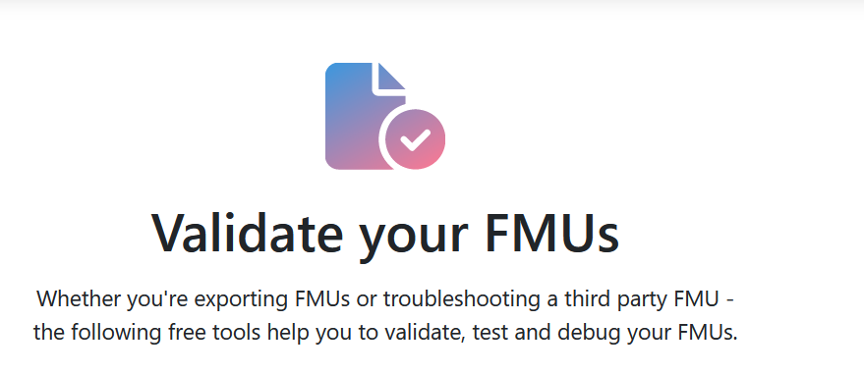


Resources
FMI Webpage
FMI tools list
FMU validation
Publications
Reference FMUs
A set of hand-coded FMUs for development, testing and debugging of FMI.
In case of questions we recommend to use StackOverflow with tag „fmi“
You are welcome to join the (unofficial) FMI LinkedIn Group

Slide 16
Thank you!
Any questions or comments?
Presenter Contacts
Christian.Bertsch Christian.Bertsch@de.bosch.com, contact@fmi-standard.org
Maurizio Palmieri maurizio.palmieri@ing.unipi.it
Cláudio Gomes claudio.gomes@ece.au.dk

