Slide 1


The Functional Mockup Interface for Tool independent Exchange of Simulation Models
Torsten Blochwitz (ITI), Martin Otter (DLR-RM)
M. Arnold University of Halle
C. Bausch, M. Monteiro Atego Systems GmbH
C. Clauß, S. Wolf Fraunhofer IIS EAS, Dresden
H. Elmqvist, H. Olsson Dassault Systèmes, Lund
A. Junghanns, J. Mauss QTronic, Berlin
T. Neidhold ITI, Dresden,
D. Neumerkel Daimler AG, Stuttgart
J.-V. Peetz Fraunhofer SCAI, St. Augustin
Modelica 2011, 21st,22nd March

Slide 2





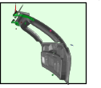
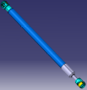
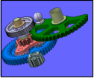

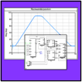
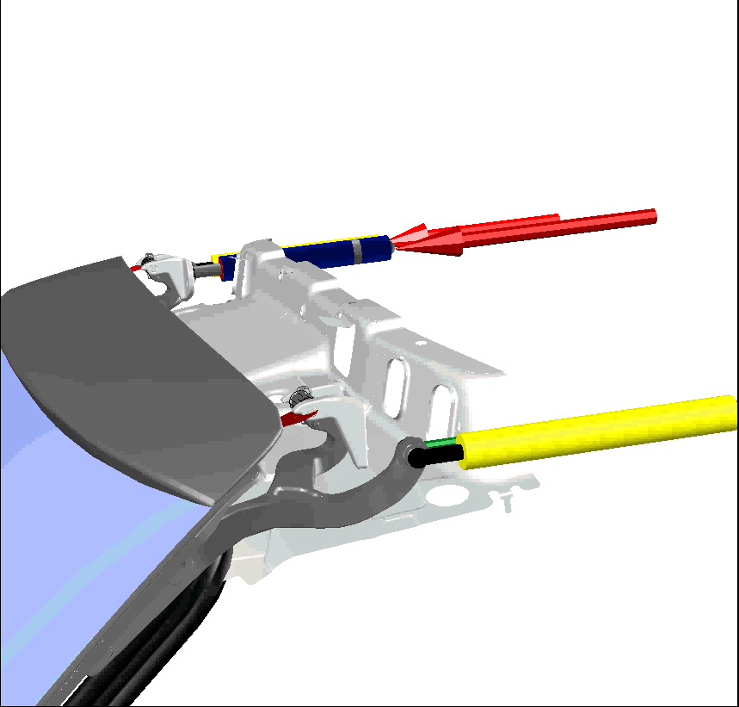

Functional Mock-up Interface (FMI) - Motivation (1)
Problems / Needs
Component development by supplier
Integration by OEM
Many different simulation tools
supplier1
supplier2
supplier3
supplier4
supplier5
OEM
?
Solution
Reuse of supplier models by OEM:
  DLL (model import) and/or
  Tool coupling (co-simulation)
Protection of model IP of supplier
supplier1
supplier2
supplier3
supplier4
supplier5
tool 1
tool 2
tool 3
tool 4
tool 5
FMI
OEM
Added Value
Early validation of design
Increased process
efficiency and quality
!
supplier1
OEM
supplier2
slide from Nick Suyam, Daimler (adapted)
supplier3

Slide 3
FMI - Motivation (2)
No standards available for:
  Model interface based on C or binaries
  Co-simulation between simulation tools
Lots of proprietary interfaces:
  Simulink: S-function
  Modelica: external function, external object interface
  QTronic Silver: Silver-Module API
  SimulationX: External Model Interface
  NI LabVIEW: External Model Interface, Simulation Interface Toolkit
  Simpack: uforce routines
  ADAMS: user routines
  …

Slide 4
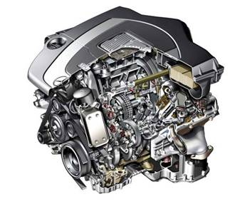
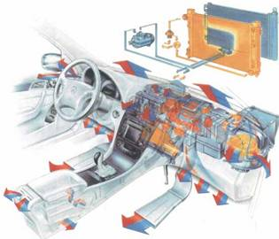

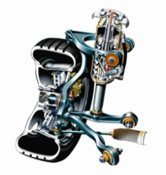
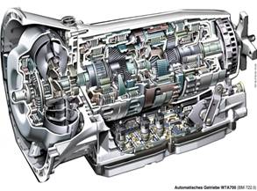
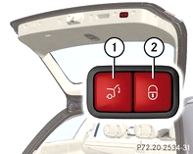



FMI – Overview
The FMI development is part of the ITEA2 MODELISAR project
(2008 - 2011; 29 partners, Budget: 30 Mill. €)
FMI development initiated, organized and headed by Daimler AG
Improved Software/Model/Hardware-in-the-Loop Simulation,
of physical models from different vendors.
Open Standard
14 Automotive Use-Cases to evaluate FMI.
etc.
Engine
with ECU
Gearbox
with ECU
Thermal
systems
Automated
cargo door
Chassis components,
roadway, ECU (e.g. ESP)
functional mockup interface for model exchange and tool coupling
courtesy Daimler

Slide 5


FMI - Main Design Idea (1)
FMI for Model Exchange:
    Version 1.0 released in January 2010
FMI for Co-Simulation:
  Reuses as much as possible from FMI for Model Exchange standard
  Version 1.0 released in October 2010
Tool
FMU
Solver
Model
FMU
Tool
Model
Solver

Slide 6
FMI - Main Design Idea (2)
A component which implements the interface is called
Functional Mockup Unit (FMU)
Separation of
  Description of interface data (XML file)
  Functionality (C code or binary)
A FMU is a zipped file (*.fmu) containing the XML description file and the implementation in source or binary form
Additional data and functionality can be included
Interface specification: www.functional-mockup-interface.org

Slide 7
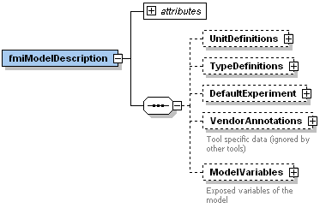
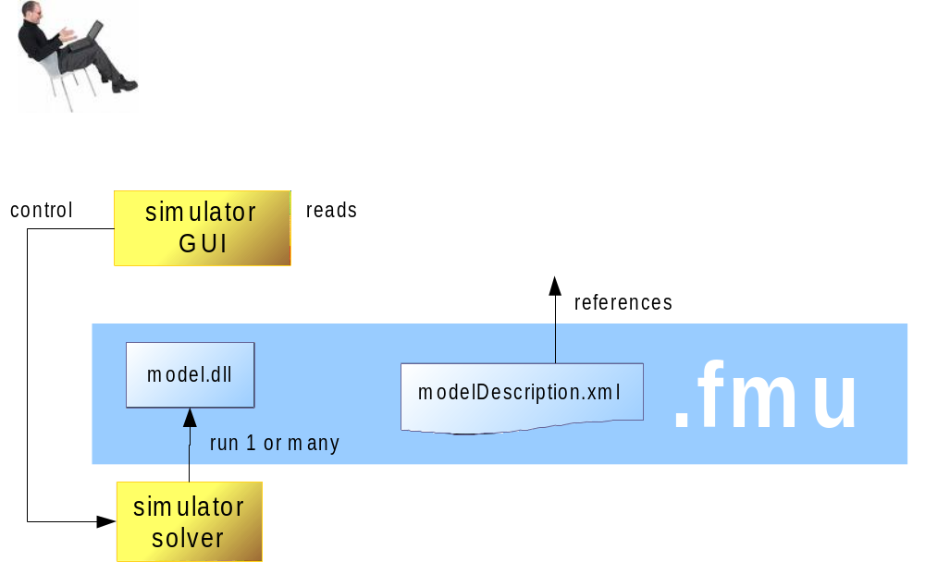
XML schema (.xsd)
defined by the
FMI specification

Slide 8
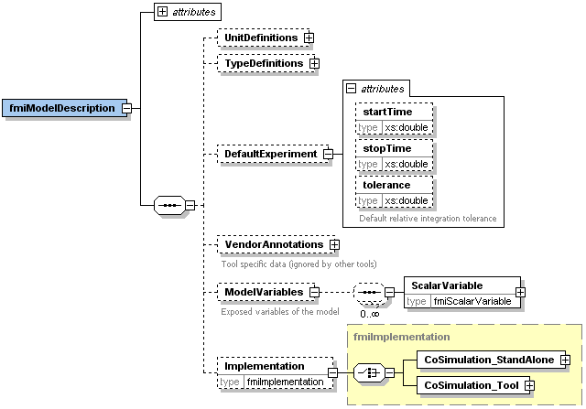
FMI XML Schema
Information not needed for execution is stored in one xml-file:
  Complex data structures give still simple interface.
  Reduced overhead in terms of memory.
Definition of display units
Definition of type defaults
Default stop time, tol. etc.
Tool specific data
Variable names and attributes

Slide 9
Example
modelDescription.xml
<?xml version="1.0" encoding="UTF8"?>
<fmiModelDescription
fmiVersion="1.0"
modelName="Modelica.Mechanics.Rotational.Examples.Friction"
modelIdentifier="Modelica_Mechanics_Rotational_Examples_Friction"
guid="{8c4e810f-3df3-4a00-8276-176fa3c9f9e0}"
...
numberOfContinuousStates="6"
numberOfEventIndicators="34"/>
<UnitDefinitions>
<BaseUnit unit="rad">
<DisplayUnitDefinition displayUnit="deg" gain="57.2957795130823"/>
</BaseUnit>
</UnitDefinitions>
<TypeDefinitions>
<Type name="Modelica.SIunits.AngularVelocity">
<RealType quantity="AngularVelocity" unit="rad/s"/>
</Type>
</TypeDefinitions>
<ModelVariables>
<ScalarVariable
name="inertia1.J"
valueReference="16777217"
description="Moment of inertia"
variability="parameter">
<Real declaredType="Modelica.SIunits.Torque" start="1"/>
</ScalarVariable>
...
</ModelVariables>
</fmiModelDescription>

Slide 10
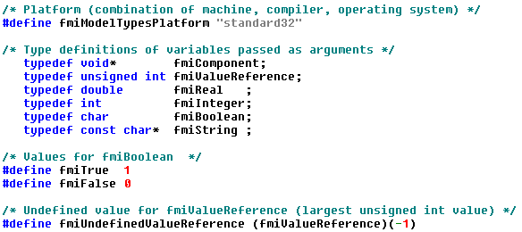
C-Interface
Two C-header files:
  Platform dependent definitions (basic types):
  C-functions:
    18 core functions
    6 utility functions
    no macros
    C-function name: <ModelIdentifier>_<name>, e.g. Drive_fmiSetTime"

Slide 11
C-Interface
Instantiation:
fmiComponent fmiInstantiateXXX(fmiString instanceName, ...)
Returns an instance of the FMU. Returned fmiComponent is a parameter of the other interface functions. It is of type void* for the master. The FMU uses it to hold all necessary information.
Functions for initialization, termination, destruction
Support of real, integer, boolean, and string inputs, outputs, parameters
Set and Get functions for each type:
fmiStatus fmiSetReal (fmiComponent c,
const fmiValueReference vr[], size_t nvr,
const fmiReal value[])
fmiStatus fmiSetInteger(fmiComponent c,
const fmiValueReference vr[], size_t nvr,
const fmiInteger value[])
Identification by valueReference, defined in the XML description file for each variable

Slide 12
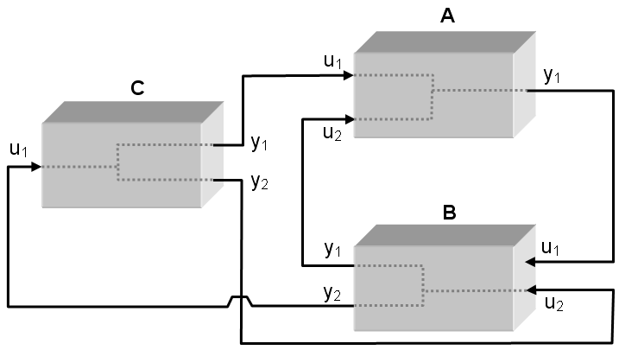
FMI for Model Exchange (1)
Import and export of input/output blocks (FMU – Functional Mock-up Unit)
described by
  differential-, algebraic-, discrete equations,
  with time-, state, and step-events
FMU can be large (e.g. 100000 variables)
FMU can be used in an embedded system (small overhead)
FMUs can be connected together

Slide 13
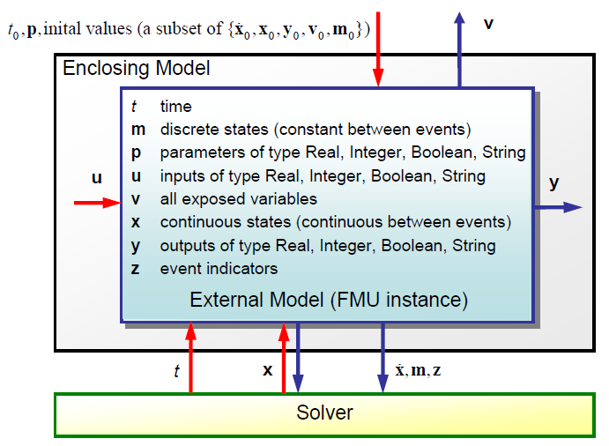
FMI for Model Exchange
Signals of an FMU
For example: 10 input/output signals (u/y) for connection and
100000 internal variables (v) for plotting

Slide 14
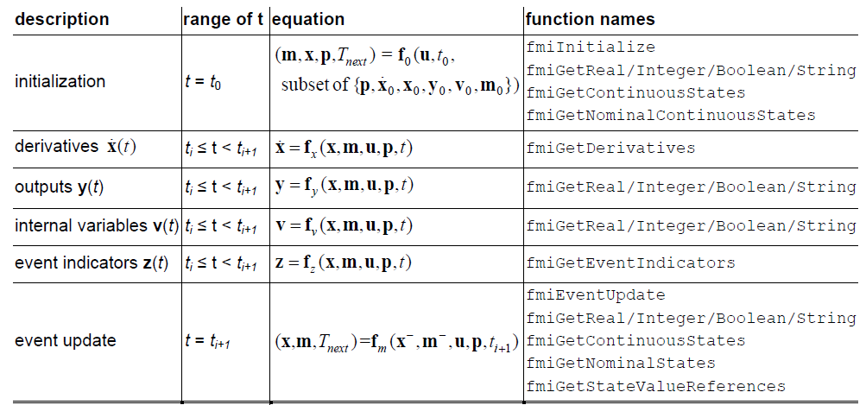
Example:
// Set input arguments
fmiSetTime(m, time);
fmiSetReal(m, id_u1, u1, nu1);
fmiSetContinuousStates(m, x, nx);
// Get results
fmiGetContinuousStates(m, derx, nx);
fmiGetEventIndicators (m, z, nz);

Slide 15
Co-Simulation
Definition:
  Coupling of several simulation tools
  Each tool treats one part of a modular coupled problem
  Data exchange is restricted to discrete communication points
  Subsystems are solved independently between communication points
Motivation:
  Simulation of heterogeneous systems
  Partitioning and parallelization of large systems
  Multirate integration
  Hardware-in-the-loop simulation

Slide 16
FMI for Co-Simulation
Master/slave architecture
Considers different capabilities of simulation tools
Support of simple and sophisticated coupling algorithms:
  Iterative and straight forward algorithms
  Constant and variable communication step size
Allows (higher order) interpolation of continuous inputs
Support of local and distributed co-simulation scenarios
FMI for Co-Simulation does not define:
  Co-simulation algorithms
  Communication technology for distributed scenarios

Slide 17
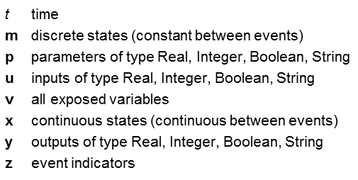

FMI for Co-Simulation
Signals of an FMU for Co-Simulation
  Inputs, outputs, and parameters, status information
  Derivatives of inputs, outputs w.r.t. time can be set/retreived for supporting of higher order approximation
t₀, p
v
Enclosing Model
Co-Simulation Master
u
y
Model
t
External Model (FMU instance)
Solver
Co-Simulation Slave (FMU instance)
t
x
Solver

Slide 18
FMI for Co-Simulation
C-Interface
Execution of a time step:
fmiStatus fmiDoStep(fmiComponent c,
fmiReal currentCommunicationPoint,
fmiReal communicationStepSize, fmiBoolean newStep)
communicationStepSize can be zero in case of event iteration
newStep = fmiTrue if last step was accepted by the master
It depends on the capabilities of the slave which parameter constellations and calling sequences are allowed
Depending on internal state of the slave and the function parameters, slave can decide which action is to be done before the computation
Return values are fmiOK, fmiDiscard, fmiError, fmiPending
Asynchronous execution is possible

Slide 19
FMI for Co-Simulation
Use Case
Co-Simulation stand alone:
Co-Simulation tool:
Executable
Library (DLL)
Master
Slave
Slave
Model
Model
Solver
Solver
Process
Executable
Library (DLL)
Simulation tool
FMI Wrapper
FMI Wrapper
FMI Wrapper
Master
FMI Wrapper
Slave
Model
Solver
Process 1
Process 2

Slide 20
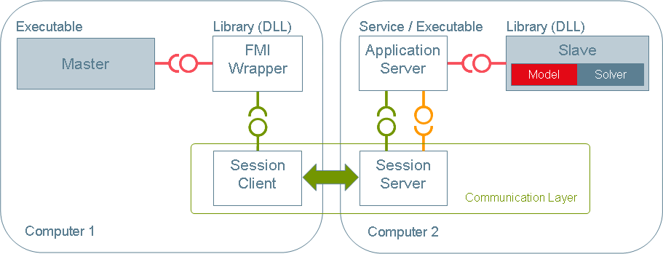
FMI for Co-Simulation
Use Case
Distributed co-simulation scenario
Data exchange is handled by a communication layer which is implemented by a special FMI wrapper
Master and slave utilize FMI for Co-Simulation only

Slide 21
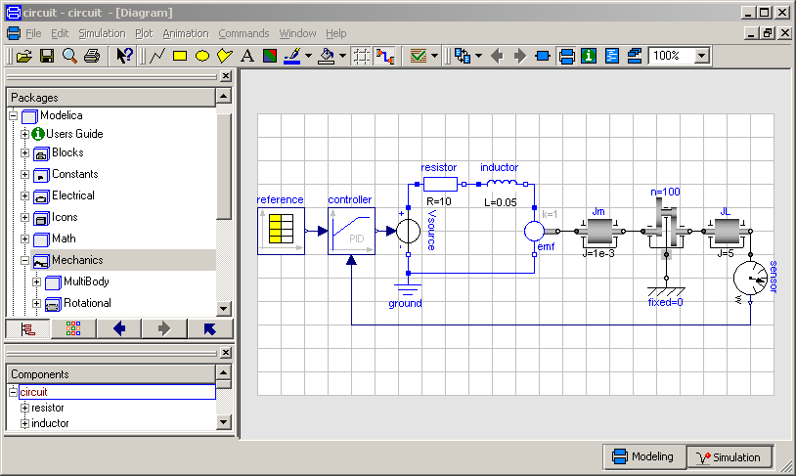
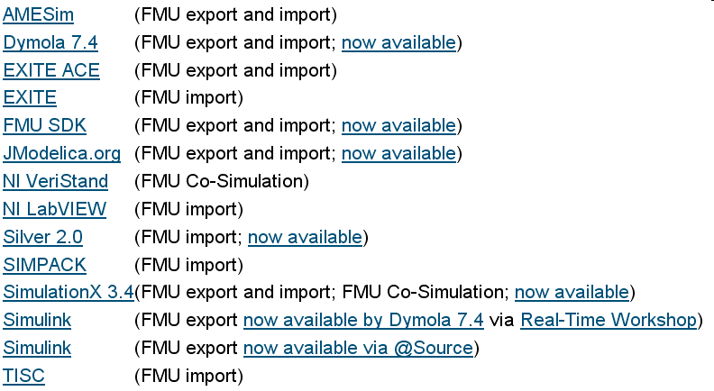
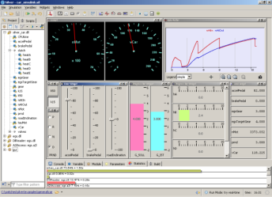
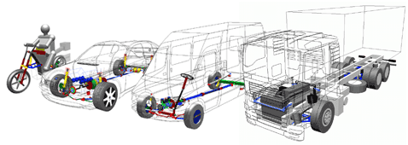
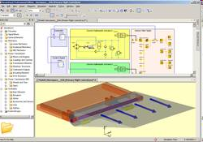
Tools supporting FMI (from FMI web site)

Slide 22
Conclusions and Outlook
FMI has a high potential being widely accepted in the CAE world:
  Initiated, organized and pushed by Daimler to significantly improve the exchange of simulation models between suppliers and OEMs.
  Defined in close collaboration of different tool vendors.
  Industrial users were involved in the proof of concept.
  FMI can already be used with several Modelica tools, Simulink, multi-body and other tools.
FMI is maintained and further developed:
  Unification and harmonization of FMI for Model Exchange and Co‑Simulation (FMI 2.0) within Modelisar.
  Improved handling of time events.
  Clean handling of changeable parameters.
  Efficient interface to Jacobian matrices.

Slide 23
Acknowledgments
FMI initiated and organized: Daimler AG (Bernd Relovsky, ....)
Head of FMI development: Dietmar Neumerkel (Daimler AG)
Head of FMI-for-Model-Exchange: Martin Otter (DLR-RM)
FMI-for-Model-Exchange Torsten Blochwitz (ITI)
Core-Design by: Hilding Elmqvist (Dassault Systèmes -Dynasim)
Andreas Junghanns (QTronic)
Jakob Mauss (QTronic)
Hans Olsson (Dassault Systèmes -Dynasim)
Martin Otter (DLR-RM)
Other MODELISAR contributors: Ingrid Bausch-Gall, Bausch-Gall GmbH
Alex Eichberger, SIMPACK AG
Rainer Keppler, SIMPACK AG
Gerd Kurzbach, ITI GmbH
Carsten Kübler, TWT
Johannes Mezger, TWT
Thomas Neidhold, ITI GmbH
Dietmar Neumerkel, Daimler AG
Peter Nilsson, Dassault Systèmes-Dynasim
Antoine Viel, LMS International
Daniel Weil, Dassault Systèmes
Other contributors: Johan Akesson, Lund University
Joel Andersson, KU Leuven
Roberto Parrotto, Politecnico di Milano

Slide 24
Acknowledgments
FMI for Co-Simulation Martin Arnold, University Halle, Germany
Core-Design by: Constanze Bausch, Atego Systems GmbH, Wolfsburg, Germany
Torsten Blochwitz, ITI GmbH, Dresden, Germany
Christoph Clauß, Fraunhofer IIS EAS, Dresden, Germany
Manuel Monteiro, Atego Systems GmbH, Wolfsburg, Germany
Thomas Neidhold, ITI GmbH, Dresden, Germany
Jörg-Volker Peetz, Fraunhofer SCAI, St. Augustin, Germany
Susann Wolf, Fraunhofer IIS EAS, Dresden, Germany
Contributors: Jens Bastian, Fraunhofer IIS EAS, Dresden, Germany
Christoph Clauß, Fraunhofer IIS EAS, Dresden, Germany
Dietmar Neumerkel, Daimler AG, Böblingen, Germany
Martin Otter, DLR, Oberpfaffenhofen, Germany
Tom Schierz, University Halle, Germany
Wolfgang Trautenberg, Simpack AG, Germany
Klaus Wolf, Fraunhofer SCAI, St. Augustin, Germany
Partially funded by: BMBF, VINNOVA, DGCIS, organized by ITEA2

