Slide 1

Progress in MAP „System Structure and Parameterization"

Slide 2
Agenda
1.
Use-cases for FMI in ZF
2.
Motivation / Planning MAP System Structure and Parameterization
3.
Defined Use-cases
4.
The SSD approach
5.
First prototypes
6.
7.
8.

Slide 3
Agenda
1.
Use-cases for FMI in ZF
2.
Motivation / Planning MAP System Structure and Parameterization
3.
Defined Use-cases
4.
The SSD approach
5.
First prototypes
6.
7.
8.

Slide 4
Modularization on cycle-simulations
ICE
Bremse
Drive
Getriebe
-
E
BM
Batterie
Leistungs
-
elektronik
DC/DC

Slide 5
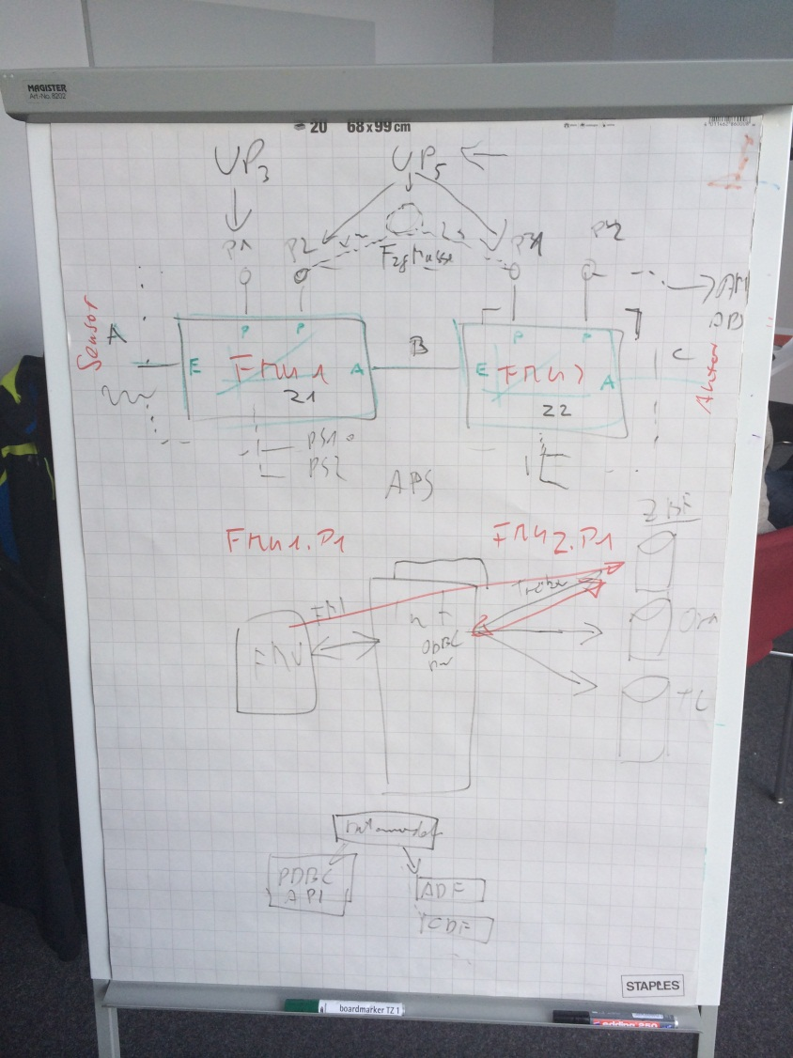
Motivation II
Workshop with Bosch, BMW, ZF was held to specify requirements to overcome existing problems (26.02.2014)
Concentration on parameterization of FMUs (and “normal” models)

Slide 6
Status of parameterization of FMUs
What is possible now:
FMI enables encapsulation of models
Disclosed model parameters are visible by the „modelDescription.xml“ file with definition of type, name etc. and are set with default values.
Integration environment can modify parameters with the FMI interface.
.

Slide 7
Status of parameterization of FMUs
Realized issues (I):
No Separation of parameter data from the FMUs
No possibility to handle intellectual property of parameters
No namespaces in a network of FMUS, no „virtual parameters“
No possibility to change parameters in a unique way independently from the integration environment for single FMUs
No possibility to define what parameters of the FMU are visible before and after the export
Handling of Data types
Lookup tables, structures etc. are represented only in a flat non-dynamical matter
Loading time of large lookup tables

Slide 8

Basic idea
Develop a standard for parameterizing FMUs and models independently from tool (and data format)

Slide 9

Goals of a standardized parameterization
Dynamic behavior is separated from parameterization
One FMU can be parameterized (in a standardized way)
Better: One model that is used to generate a FMU, can be parameterized (in a standardized way) too
FMUs in a network (connected with each other) can be parameterized (in a standardized way)
Parameterization is available on all simulation platforms (MiL, SiL, HiL)
FMUs in a network, combined with other models and ECU modules can be parameterized by one „parameter set“
Mechanisms to configure and transform parameters (e.g. changing units)
Structural information (connections and relations between parameters of different FMUs)
Namespaces, Using hierarchies / structures / packaging parameters to „parameter sets“
Modification of parameters within the integration tool is available

Slide 10
Agenda
1.
Use-cases for FMI in ZF
2.
Motivation / Planning MAP System Structure and Parameterization
3.
Defined Use-cases
4.
The SSD approach
5.
First prototypes
6.
7.
8.

Slide 11

Motivation for initiating MAP System Structure and Parameterization (SSP)
Origin of SSP
Workshop with BMW, Bosch, ZF 02/2014 – Collecting “missing” features around FMI standard
Presentation “Proposal for a standardized parameterization of FMUs / Models” and “FMI Mapping” on Modelica-Conference (2014, Lund)
Initiating the Modelica-Association Project “System Structure and Parameterization”
Purposes of MAP-SSP
Define a standardized format for the connection structure for a network of components.
Define a standardized way to store and apply parameters to these components.
The developed standard / APIs should be usable in all stages of development process (architecture definition, integration, simulation, test in MiL, SiL, HiL).
This work in this project shall be coordinated with other standards and organizations (FMI, ASAM, OMG).

Slide 12


Planned Goals for MAP SSP in 2015
Working schedule
Draft definition of data model for system structures exists (as XML schema).
Representative reference system structure is defined. ( )
FMUs are exported from different generators.
At least two running prototypes (with co-simulation) exist for exchanging application packages in a round trip use-case based on the draft definition.
Draft definition of data model for parameter sets exists.

Slide 13
Agenda
1.
Use-cases for FMI in ZF
2.
Motivation / Planning MAP System Structure and Parameterization
3.
Defined Use-cases
4.
The SSD approach
5.
First prototypes
6.
7.
8.

Slide 14
Defined Use-Cases
UC 01 Exchange of one FMU / Model with multiple different Parameter Sets
UC-03 Exchange of Parameter Sets with Restricted Visibility / Changeability of Parameters
UC-04 Encryption and Authentication of Parameter Sets
UC-05 Describing parameter sets for system architecture
UC-06 Handling parameter sets independently from FMUs/Models
UC-07 Use of one parameter set for parameterization of several FMUs
UC-08 Meta information for parameters
UC-09 Describing a system structure
UC-10 Handling different parameter set formats
UC-11 Handling parameters within an authoring tool
UC-12 Providing parameters sets for simulation
UC-13 Standard parameter handling plugin
UC-14 System architectures with signal-adoption-layers
UC-15 Parameter Data Model

Slide 15
Exchange of one FMU / Model with multiple different Parameter Sets
FMU1
Authoring Tool
Integration Tool
Param-Set1
Std Plugin
SSD

Slide 16
Handling different parameter set formats
SSD
FMU1
FMU2
Authoring Tool
Param-Set1
Param-Set2
Param-Set2
SSD
Std Plugin
Plugin A
SSP
Parameter Tool
2

Slide 17


Handling parameters within an authoring tool
SSD
FMU1
FMU2
Authoring Tool
Param-Set1
Param-Set2
Param-Set2
ParamSet1.c=100
ParamSet1.d=0.01
ParamSet2.alfa=0.3
ParamSet2.beta=5.2
SSD
Std Plugin
Plugin A
SSP
Parameter Tool

Slide 18
Describing parameter sets for system architecture
SSD
FMU1
FMU2
Authoring Tool
Integration Tool
Sys Param-Set
SSP
Param-Set1
Param-Set2
ParamSet1.c := SysParamSet.c
ParamSet2.alfa := 0.5*SysParamSet.alfa
SSD
Std Plugin
Parameter Tool

Slide 19
Describing a system structure
Complete SSP
FMU1
FMU2
Authoring Tool
Integration Tool
SSD
Sys Param-Set
SSP
Param-Set1
Param-Set2
ParamSet1.c := SysParamSet.c
ParamSet2.alfa := 0.5*SysParamSet.alfa
SSD
Std Plugin
SSP

Slide 20
System architectures with signal-adoption-layers
Complete SSP
FMU1.u1 := pi/30*u1
FMU1
FMU2
FMU1.u2 := u2
FMU2.u := 0.01*FMU1.y
y1 := 100*FMU2.y1
Authoring Tool
y2 := FMU2.y3
Integration Tool
SSD
Sys Param-Set
SSP
Param-Set1
Param-Set2
ParamSet1.c := SysParamSet.c
ParamSet2.alfa := 0.5*SysParamSet.alfa
SSP
Std Plugin

Slide 21
Agenda
1.
Use-cases for FMI in ZF
2.
Motivation / Planning MAP System Structure and Parameterization
3.
Defined Use-cases
4.
The SSD approach
5.
First prototypes
6.
7.
8.

Slide 22
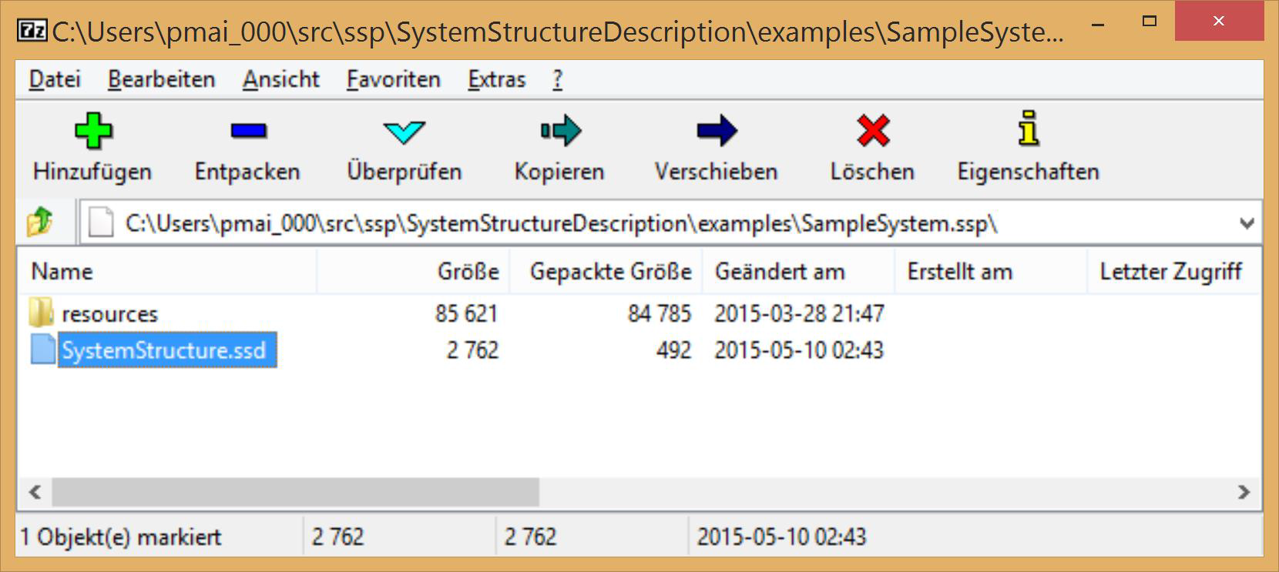

Design Goals and Basic Package
Design Goals
Minimize additional semantics, rely on FMI as far as possible
Fit into FMI world (use FMI-like design choices where reasonable)
System Structure Package (SSP)
SSP is a „ZIP“ container with standardized content (System Structure Package)
‘SystemStructure.ssd’ is main system structure description file
Referenced FMUs, SSPs, etc. packaged in resources directory
SSD
FMU
SSP
*.SSP

Slide 23
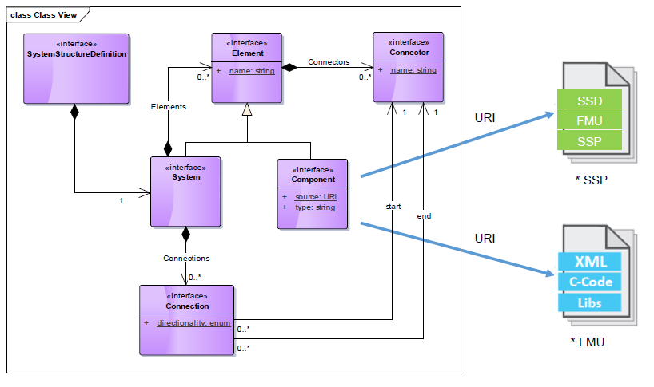
Basic Data Model (UML)
https://svn.modelica.org/projects/ssp/trunk/SystemStructureDescription/SystemStructureDescription.xsd

Slide 24
Agenda
1.
Use-cases for FMI in ZF
2.
Motivation / Planning MAP System Structure and Parameterization
3.
Defined Use-cases
4.
The SSD approach
5.
First prototypes
6.
7.
8.

Slide 25
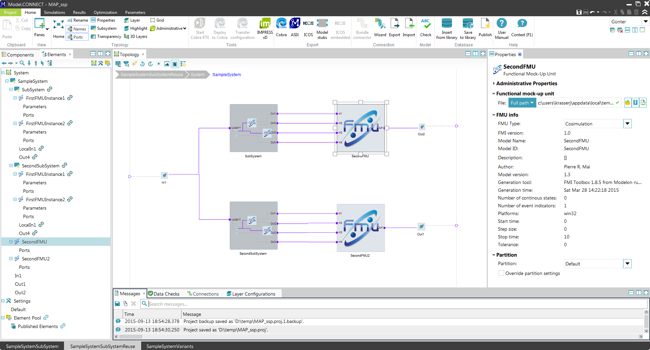

Prototype from AVL – in Model.CONNECT™
Model.CONNECTTM is a platform to set up and execute system simulation models which are composed of subsystem and component models from multiple model authoring environments.

Slide 26
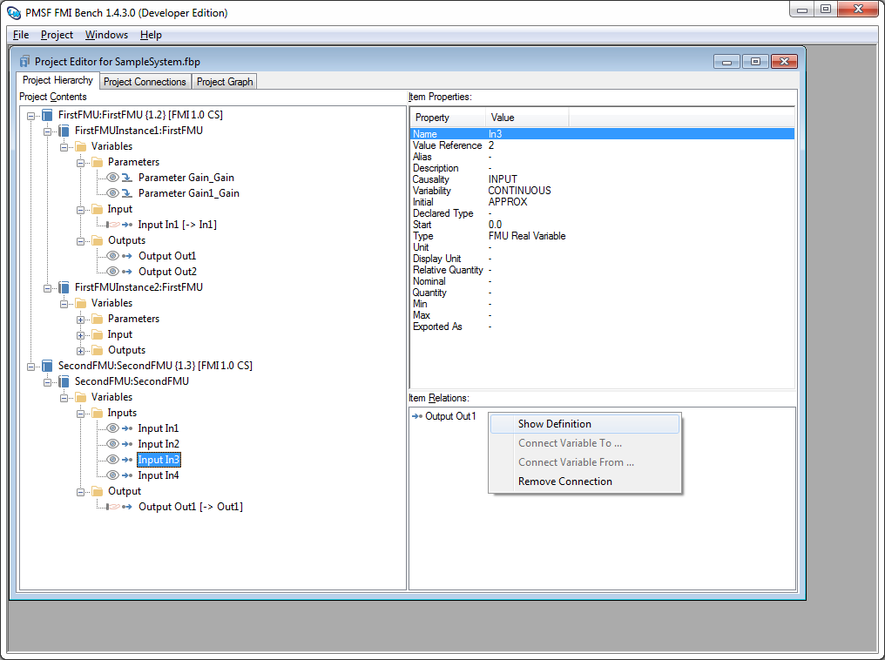

Prototype PMSF FMI Bench: Workbench for FMUs
FMU Inspector
FMU Pre-Integration
FMU Debugging
FMU Customization

Slide 27

Thank you

