Slide 1





MA-Project “System Structure and Parameterization” – Early Insights
presented by Jochen Köhler (ZF)
Japanese Modelica Conference 2016-05-23/24
Tokyo / Japan
M. Deppe
J. Köhler
J. Krasser
P. R. Mai
M. Nagasawa

Slide 2
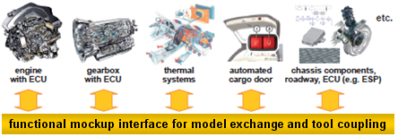
Motivation for initiating MAP “System Structure and Parameterization” (SSP) – Using FMI as Basis
FMI is basically a great technology to make exchanging models inside and among companies much easier
Typical use-case is a network of FMUs (System structure) …
… Therefore, some features are missing …

Slide 3
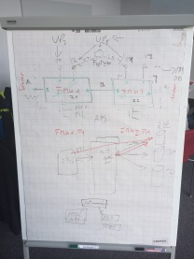
Motivation for initiating SSP – Missing features
Collected on a meeting with BMW, Bosch, ZF, PMSF (2014):
No possibility to separate parameter data from the FMUs
No possibility to change parameters in a consistent way independently from the integration environment for single FMUs.
No possibility to handle intellectual property of parameters
No possibility of mapping parameters in a network of FMUS
No possibility to store a network of FMUs tool independently

Slide 4
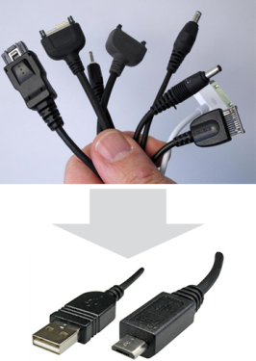
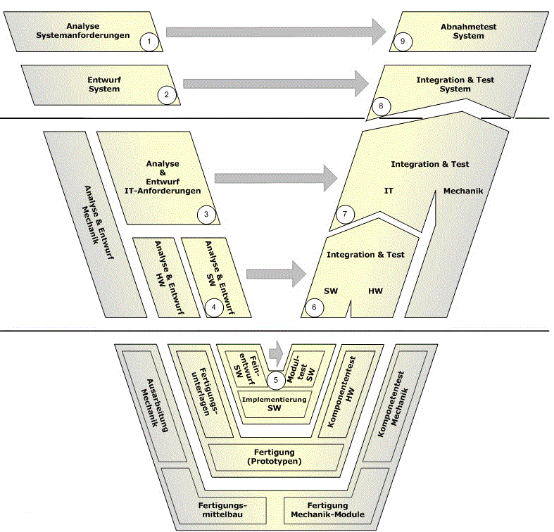
Main Purposes of SSP
Define a standardized format for the connection structure of a network of components.
Define a standardized way to store and apply parameters to these components.
The developed standard / APIs should be usable in all stages of development process (architecture definition, integration, simulation, test in MiL, SiL, HiL).
The work in this project shall be coordinated with other standards and organizations (FMI, ASAM, OMG).
Notes:
ASAM (Association for Standardization of Automation and Measuring Systems) is an incorporated association under German law. Our members are primarily international car manufacturers, suppliers and engineering service providers from the automotive industry.
ASAM coordinates the development of technical standards, which are developed by working groups composed of experts from our member companies. We pursue the vision that the tools of a development process chain can be freely interconnected and allow a seamless exchange of data.
The Object Management Group® (OMG®) is an international, open membership, not-for-profit technology standards consortium, founded in 1989. OMG standards are driven by vendors, end-users, academic institutions and government agencies. OMG Task Forces develop enterprise integration standards for a wide range of technologies and an even wider range of industries. OMG’s modeling standards, including the Unified Modeling Language® (UML®) and Model Driven Architecture® (MDA®), enable powerful visual design, execution and maintenance of software and other processes

Slide 5

Overview of XML Schema Definitions
SSD
Par1
Parameter
Binding
Parameter
Mapping
Map1
System
Structure
Definition
Par2
Map2
ParameterMappings
Par…
source :URI
0..*
source :URI
Trans
type :string
type :string
0..*
*.SSV
*.SSM
ParameterBindings
Element
Connector
name :string
Connectors
name :string
0..*
0..*
kind :enum
Elements
1
1
Signal
Dictio
nary
SignalDictio
nary
Reference
Compo
nent
1
System
*.FMU
0..*
source :URI
start
type :string
end
1
SignalDictionaries
0..*
Connections
SSD
0..*
Connection
FMU
suppressUnitConversion :boolean
0..*
SSP
0..*
*.SSP
Notes:
Four Defined Formats:
SSD for Structure
FMU as fundamental Building Block
SSV for Param Values
SSM for Param Bindings
SSP for Packaging/Variant-Handling

Slide 6
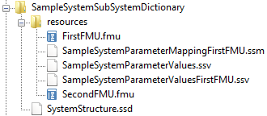
XML Schema Description - System Structure Package
Use case
Exchange of Complete Systems with Variants
Features
All information (FMUs, system structure definition, parameters) can be stored in one archive (zip-file)
Multiple SSDs in one SSP allows for variant modeling
SSD
FMU
SSP
*.SSP

Slide 7
XML Schema Description - System Structure Definition
SSD
Use case
Defining a Network of FMUs
Features
Hierarchical sub-systems
Empty components/FMUs as interface templates
External resources via URIs: Both relative to SSD/SSP or absolute, e.g. via HTTP(S).
Connections with unit conversions and optional linear/map transformations
Optional: Diagram geometry
System
Structure
Definition
Parameter
Binding
Parameter
Mapping
ParameterMappings
source :URI
0..*
source :URI
type :string
type :string
0..*
ParameterBindings
Element
Connector
name :string
Connectors
name :string
0..*
0..*
kind :enum
Elements
1
1
Signal
Dictio
nary
SignalDictio
nary
Reference
Compo
nent
1
System
0..*
source :URI
start
type :string
end
1
SignalDictionaries
0..*
Connections
0..*
Connection
suppressUnitConversion :boolean
0..*
0..*

Slide 8
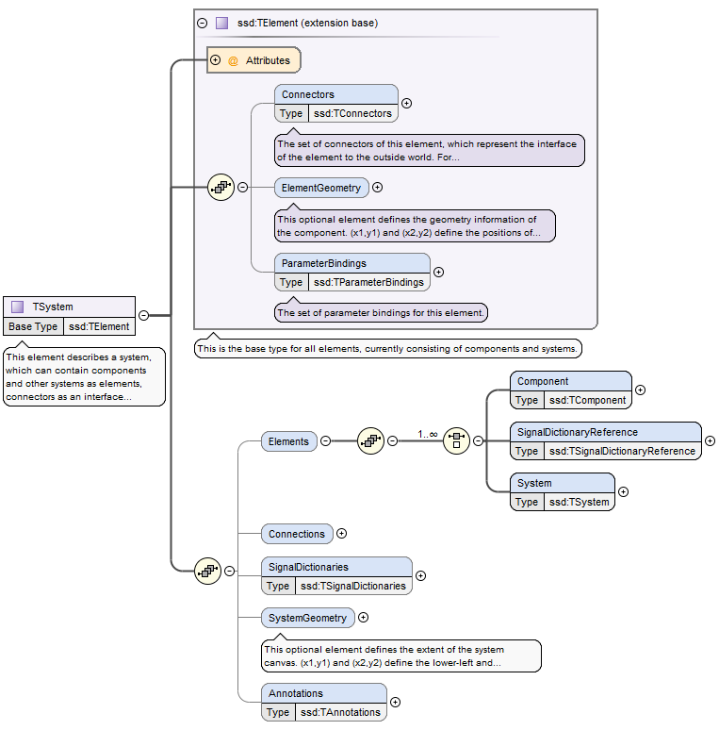
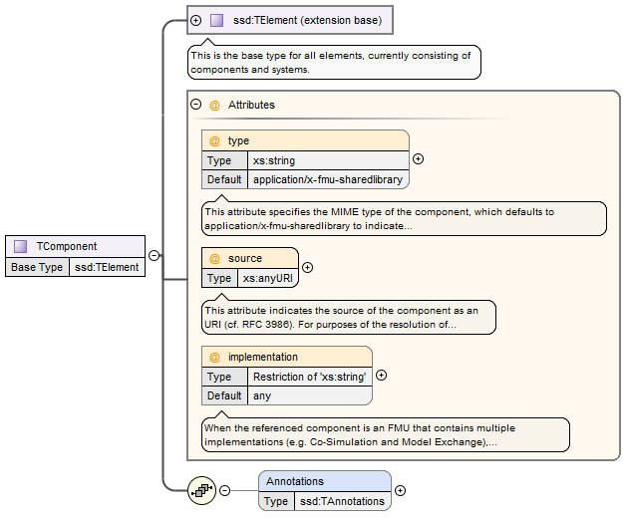
XML Schema Description - System Structure Definition
Notes:
System consists of Elements (Component, SignalDictionaryReference, System), Connections and optional SignalDictionaries and Geometry Information
Elements all contain Connectors and optional ParameterBindings and Geometry Information
Components are atomic elements, they reference FMUs or other SSPs/SSDs
Components could also support other modeling entities, like Modelica Models, …

Slide 9
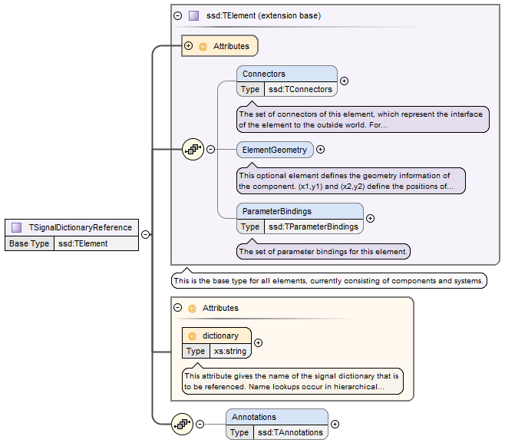
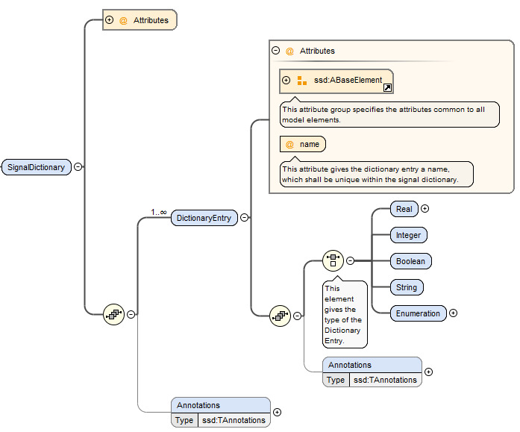
XML Schema Description - Signal dictionaries
Use cases
Collecting Control Signals in a Central Location
Features
Causality is checked by tool automatically
Crosses hierarchies without need for downward passing
Well-suited for e.g. ECU control busses
Notes:
SignalDictionaries define the actual signals in the dictionary
SignalDictionaryReferences at the same or lower hierarchy levels can directly reference those, crossing intermediate levels without notice

Slide 10
XML Schema Description – Parameter Values Data
SSV
Use case
Tool-independent Exchange of Parameter Data
Features
Neutral exchange format between parameter sources
Compatible to FMI standard
Provides some meta data
Access to param DBs via HTTP (-> Parameter API)
ParameterSet
Units
+
name :string
0..*
Unit
+
name :string
Parameters
Annotations
0..*
Parameter
Annotations
0..*
Annotation
+
name :string
0..*
+
type :string
BaseUnit
+
body :XML
+
kg :int
unit
+
m :int
+
s :int
+
A :int
+
K :int
«choice»
+
mol :int
Type
+
cd :int
+
rad :int
Real
Integer
Enumeration
Boolean
String
+
value :double
+
value :int
+
value :string
+
value :boolean
+
value :string
Notes:
Simple Format, Easy to use as a lingua franca
Same Format used to access sources via Parameter Get API, can be used for Parameter DBs or Parameter Converters from other formats (e.g. ASAM MCD -> SSV)

Slide 11
XML Schema Description - Parameter Mapping
SSM
Use case
Mapping Parameters to FMUs when the Parameter Names differ or Parameter Values require Transformations
Features
Can be stored separately from System Structure and Parameter Data
Can be inlined into SSD
Optional manual linear and mapping transformations
Parameter
Mapping
0..*
MappingEntry
+
source :string
+
target :string
+
suppressUnitConversion :boolean
0..1
Transfor-
mation
Linear
Transformation
+
factor :double
IntegerMapping
Transformation
EnumerationMapping
Transformation
+
offset :double
1..*
1..*
MapEntry
MapEntry
+
source :int
+
source :string
+
target :int
+
target :string
Notes:
- Only needed when names differ (other than prefixes) or transformations other than automatic unit conversions are needed and SSV source shall remain unchanged.

Slide 12
Parameter API Get Mechanisms
General Idea:
Access to external parameter sources via HTTP(S) GET Requests
Request URI is the source attribute
Type attribute passed via accept request header
Updates handled efficiently via ETag/Conditional GET/HEAD
Returns Parameter Data in the format requested:
application/x-ssp-parameter-set -> SSV file format
Sources and tools can support other formats
Authoring Tool
Editing Assignments with direct access to parameters
Model
P1 P2 P3
Editing Parameters directly
ParamSet
HTTP GET Requests
Data Source

Slide 13
Parameter API Get Mechanisms
GET /context/ParamSetA HTTP/1.1
Host: pardb.example.com:80
Accept: application/x-ssp-parameter-set
HTTP/1.1 200 Ok
Content-Type: application/x-ssp-parameter-set
Content-Length: …
ETag: "3f80f-1b6-3e1cb03b"
<?xml version="1.0" encoding="UTF-8"?> <ssv:ParameterSet version="Draft20151124" name="SystemParams" …>
<ssv:Parameters>
…
Future extension:
Request version/ variant Descriptor for Resources
Query for alternative versions/ variants based on descriptor with wild-cards
Full parameter management API for editing, managing parameters and parameter Sets

Slide 14
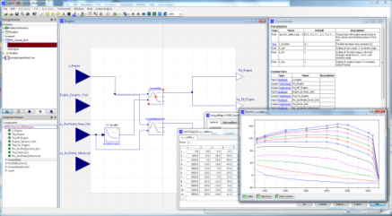
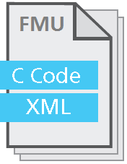
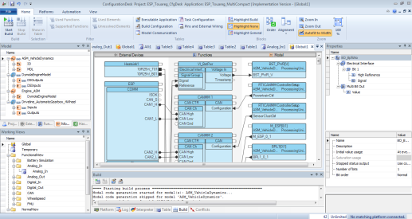
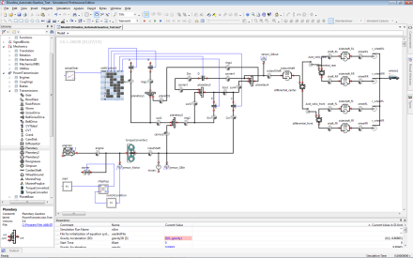
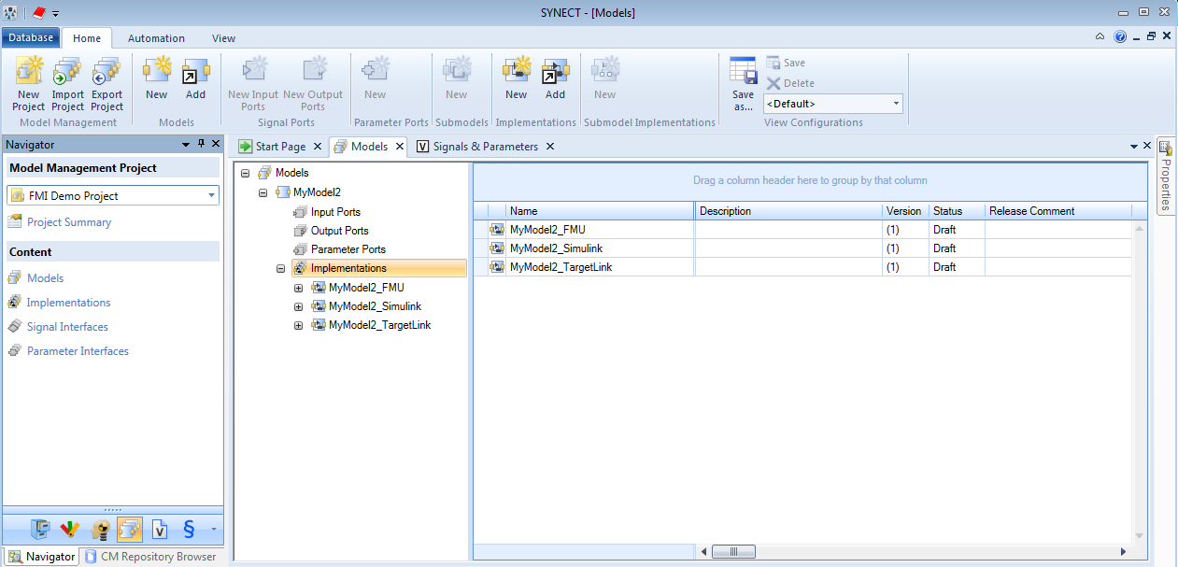
Integration of FMUs for HIL Testing
HIL configuration tools are importing FMUs to integrate them with other FMUs, Simulink-based models and real ECUs
Data Management tools are managing the lifecycle of the FMUs
Modeling
Export
Import
HIL Integration
HIL Configuration
Model A
Data Management
Model B
Model Management
Notes:
FMUs are imported into HIL configuration tools to integrate them with other FMUs, Simulink-based models, Virtual-ECUs or real ECUs
Data Management environments import the FMU metadata (incl. interfaces) and allow consistent version control of the metadata and the FMU container file to manage the lifecycle of the FMUs.

Slide 15
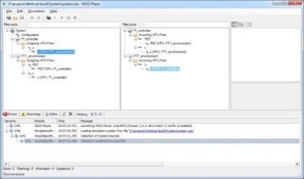
Reuse of the System Structure for SIL, MIL and HIL
Data Management
Integration and Data Management tools share a vendor independent system description (SSP)
Reuse of tools, configurations, models, tests, layouts and parameters at system level is supported
Model Management
Integration
HIL Integration
SSD
FMU
Configuration Offline Simulation
SSP
HIL Configuration
*.SSP
Notes:
There is an increasing desire to reuse environment models to provide proven, consistent solutions for the validation of controller models in different projects and development stages (e.g., for virtual validation and HIL simulations).
Data Management environments provide capabilities for managing model compositions, handling variants of systems and managing the parameter and signal interfaces of the different model systems.
The SSP approach allows to share a standardized system structure description between data management, integration and configuration tools for SIL, MIL and HIL scenarios

Slide 16
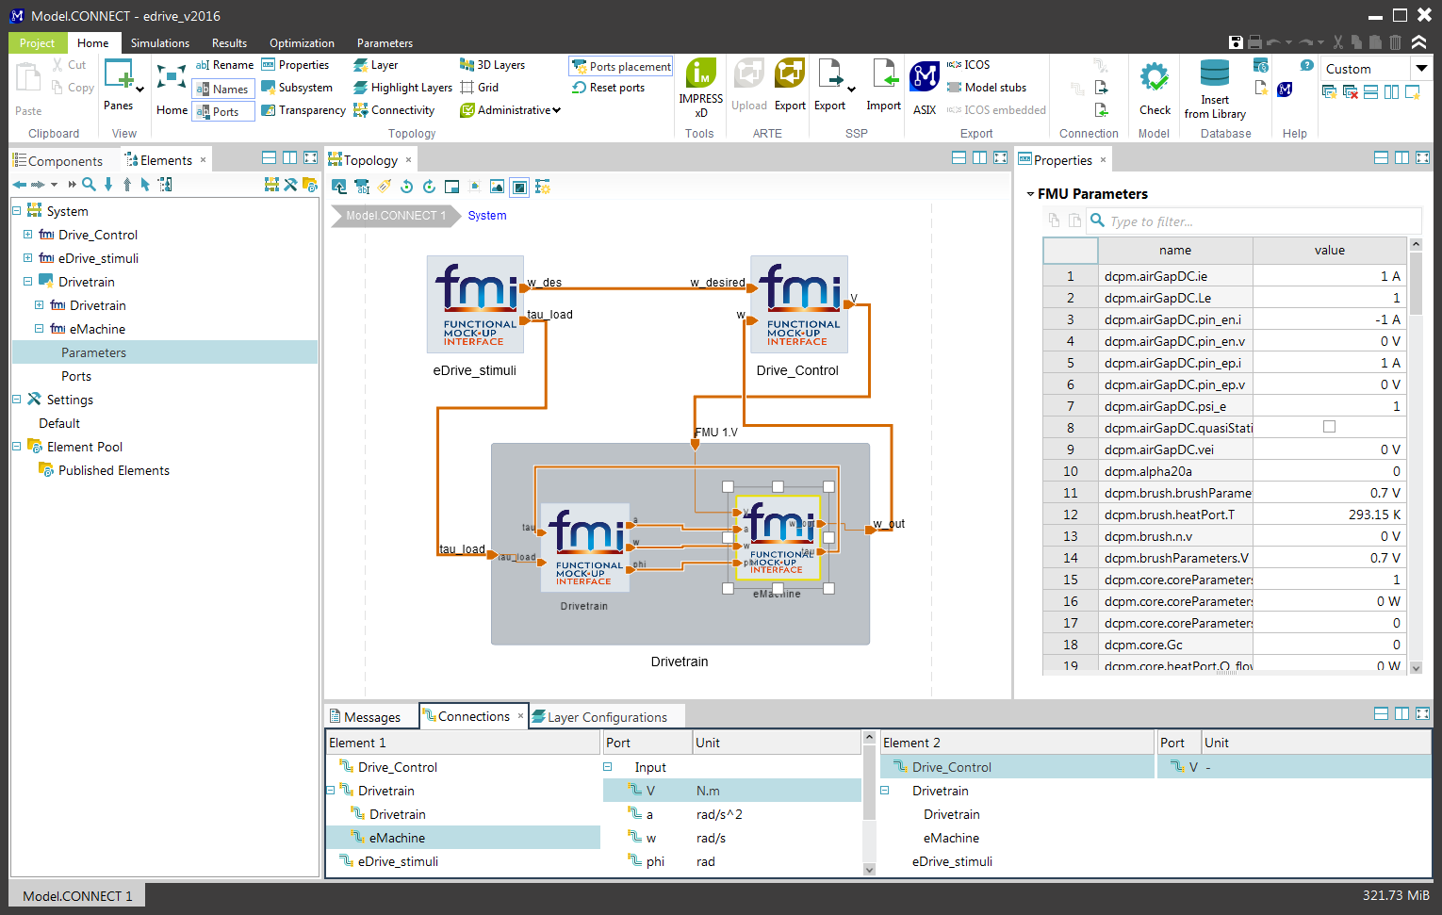
Prototypes – Integration Tool
Model.CONNECTTM by AVL – Scope:
Simulation architecture set-up
Model integration (FMI and dedicated interfaces)
Execution (office and lab)
Model management
Handling system structure and parameter variants

Slide 17
Prototypes – Integration Tool
Model.CONNECTTM by AVL – SSP prototype:
Import and export of system structure (SSP packages)
Prototype supports multiple structure variants in the package
Mapping between the SSP variant handling and the tool-specific variant handling had to be implemented
Import-export roundtrip does not re-produce original ssp content
This is a consequence of the deliberately simple SSP variant handling concept
Import and export of graphical information
Overall layout information can be transferred via SSP. Intention is not to have pixel-by-pixel reproduction in any tool

Slide 18

Prototypes: Integration Tool FMI Bench
FMI Bench by PMSF: Workbench for FMUs
FMU Inspector & Editor
FMU Profiling and Debugging
FMU Integration
Automated Workflows
Export FMU Networks as Integrated FMUs or Stand-alone Simulators
Supports Remote FMU Execution, FMU-internal Parallelization

Slide 19
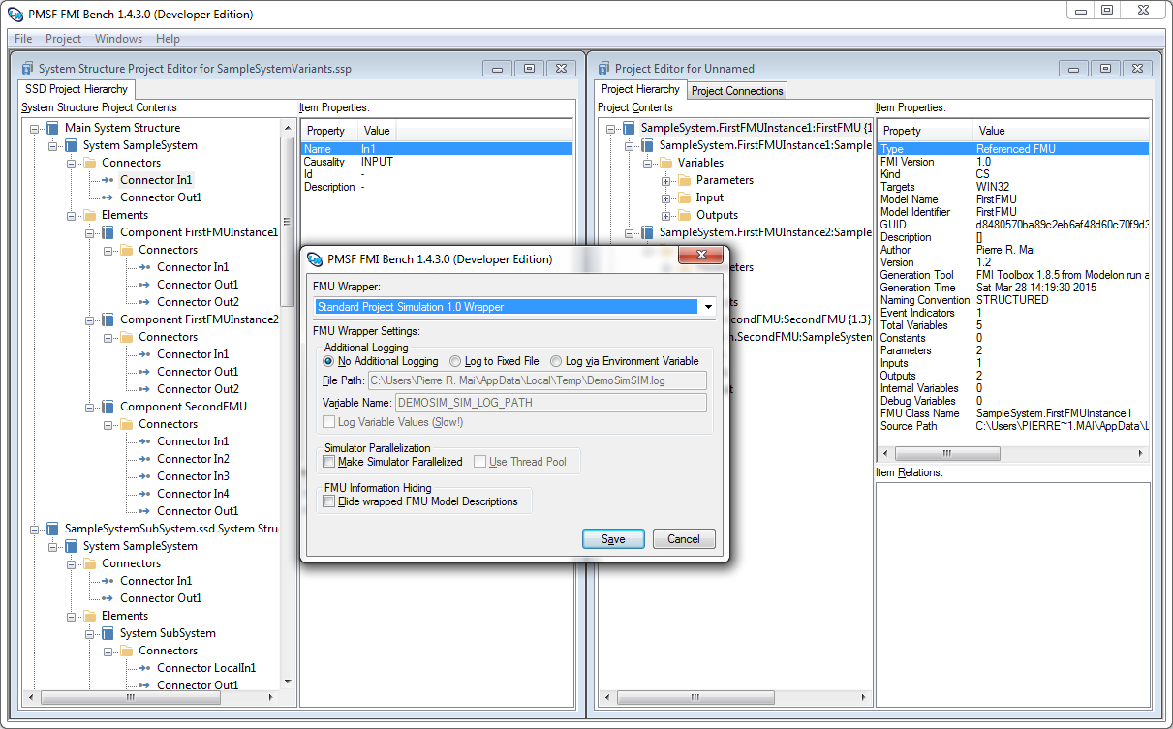
Prototypes: Integration Tool FMI Bench
FMI Bench SSP Prototype
Direct Editing of SSDs, SSPs, incl. Variants
Generation of Native FMI Bench Projects from SSP Projects
Generation of FMU or Stand-alone Sim. from SSP
Parallelization

Slide 20
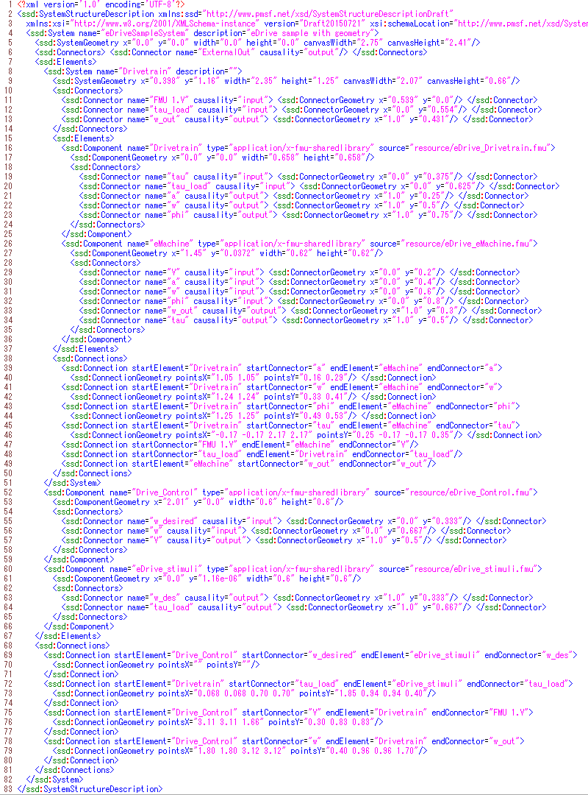
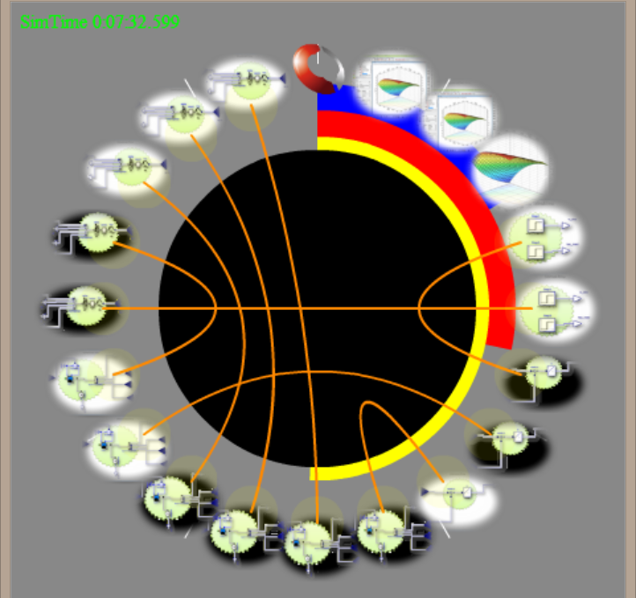
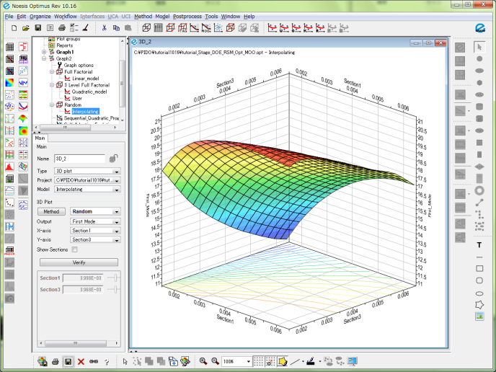
Prototypes – Online Testing Tool
Scalablility of <ssd:Connectors>
Ring configuration at a glance
3D Flash UI for <ssd:Component>
Time integration control master
Unit Test with default parameter
Synchronized Co-Simulation Test
Parameter database as FMU
FMU of (sqlite.DB + sql.DLL)
exported by Optimus®
Notes:
In the SSP project, we define three-tool category: Authoring tool, Integration tool, and Simulation tool.
This prototype (by Cybernet Japan) is a light-weight simulation tool
suitable for "Online Testing Environment" among multi-organizational users.
The merit of open Standard is to connect people, engineers and users freely and INTERNATIONALLY!
Design of Co-simulation experiments would be easier, as FMI and SSP standards are getting popular.
Even a small Database such as “sqlite” and its IO library can be included as a single FMU,
compatible with FMI standard, in our SSP platform paradigm.

Slide 21
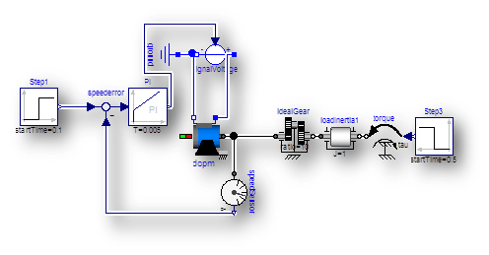
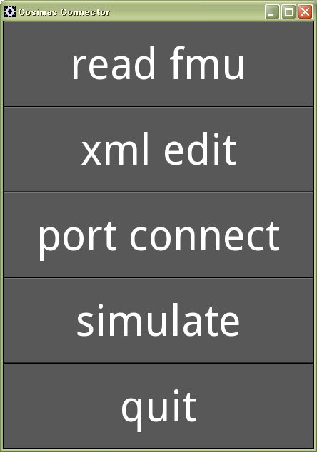
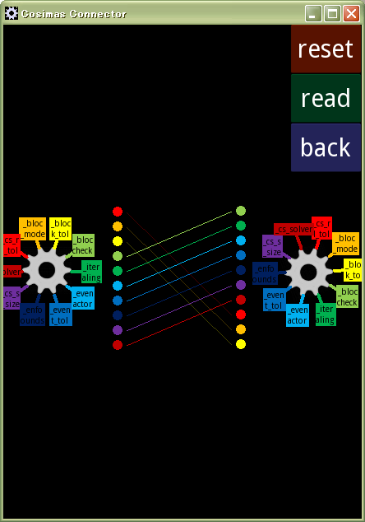
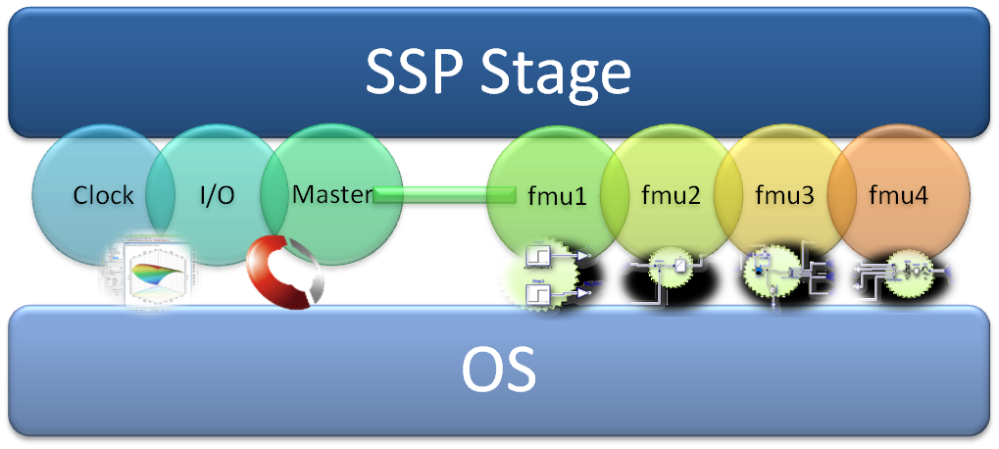


Prototypes – “Co-Simulation Browser” concept
Mobile co-Simulation environment
SSP(.zip) as online content
Minimal GUI
Notes:
Another merit of SSP is to accelerate the multi-user collaborations among OEM and suppliers, with multi-domain expertise.
As Internet Browser of HTML content opened the new world of Information Distribution,
SSP would be able to enlarge the Model Distribution World.
The concept of "Co-Simulation browser of SSP package" would be useful to explain the
future roles and possibilities of SSP to increase the popularities of Co-Simulations
among younger generations who are accustomed with Smart device operations.
The Cybernet R&D prototype is in pursuit of this direction of Smart User Interface.

Slide 22
Future work / Outline
Further Development of API for parameter handling
Try to involve providers of simulation data management systems in this project
Evaluate approaches with „real-world examples“
Publish first release soon
Any contribution is very appreciated!

Slide 23
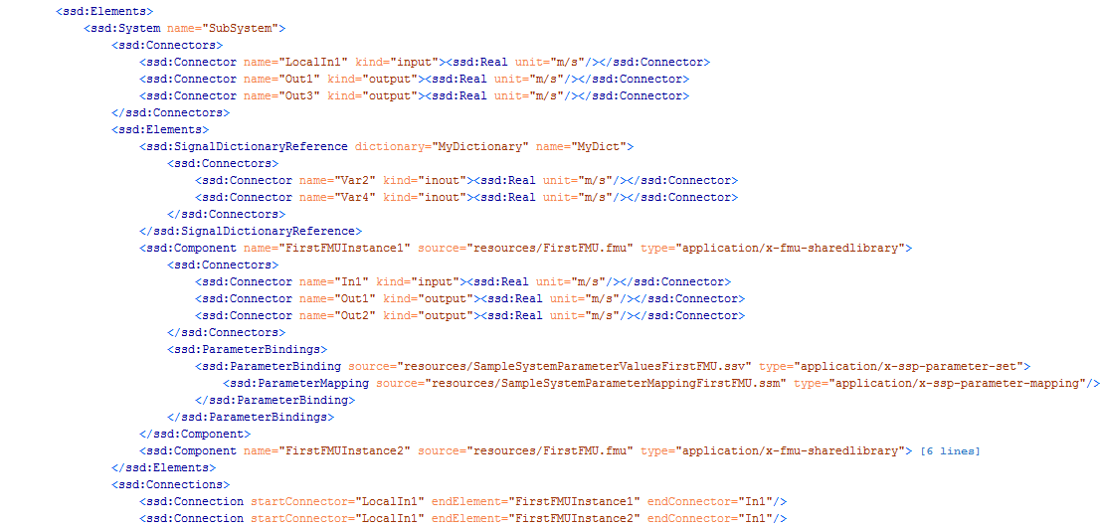
XML Schema Description - System Structure Definition
Notes:
Show Parameter Bindings at System and at Component Level
SignalDictionaryReference, Connectors, Connections
SignalDictionaryReferences are analogue to instances of SignalDictionaries where you can specifiy also causality of connectors

