Slide 1







MA-Project “System Structure and Parameterization” – Current Status and Plans
presented by Jochen Köhler (ZF), Pierre R. Mai (PMSF)
FMI User Meeting 2017-05-15
Prague / Czech Republic
T. Sommer
M. Najafi
Modelon Logo
TLK Thermo
M. Deppe
J. Köhler
J. Krasser
P. R. Mai
M. Nagasawa
M. Henningsson
J.N. Jäschke

Slide 2
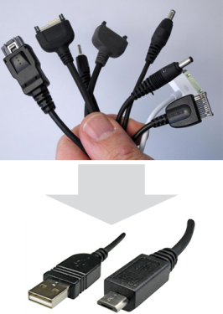
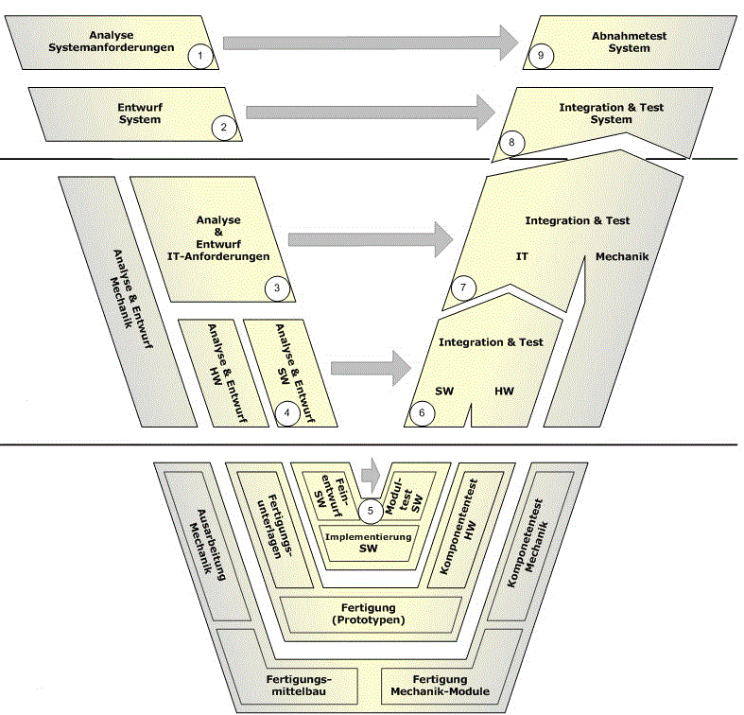
Main Purposes of SSP – Based on FMI standard
Define a standardized format for the connection structure of a network of components (FMUs in particular).
Define a standardized way to store and apply parameters to these components.
The developed standard / APIs should be usable in all stages of development process (architecture definition, integration, simulation, test in MiL, SiL, HiL).
The work in this project shall be coordinated with other standards and organizations (FMI, ASAM, OMG).
Notes:
ASAM (Association for Standardization of Automation and Measuring Systems) is an incorporated association under German law. Our members are primarily international car manufacturers, suppliers and engineering service providers from the automotive industry.
ASAM coordinates the development of technical standards, which are developed by working groups composed of experts from our member companies. We pursue the vision that the tools of a development process chain can be freely interconnected and allow a seamless exchange of data.
The Object Management Group® (OMG®) is an international, open membership, not-for-profit technology standards consortium, founded in 1989. OMG standards are driven by vendors, end-users, academic institutions and government agencies. OMG Task Forces develop enterprise integration standards for a wide range of technologies and an even wider range of industries. OMG’s modeling standards, including the Unified Modeling Language® (UML®) and Model Driven Architecture® (MDA®), enable powerful visual design, execution and maintenance of software and other processes

Slide 3

Overview of File Definitions
SSD
Par1
Parameter
Binding
Parameter
Mapping
Map1
System
Structure
Definition
Par2
Map2
ParameterMappings
Par…
source :URI
0..*
source :URI
Trans
type :string
type :string
0..*
*.SSV
*.SSM
ParameterBindings
Element
Connector
name :string
Connectors
name :string
0..*
0..*
kind :enum
Elements
1
1
Signal
Dictio
nary
Signal Dictionary
Reference
Compo
nent
1
System
*.FMU
0..*
source :URI
start
SSD
type :string
end
FMU
1
SignalDictionaries
0..*
Connections
SSP
0..*
Sig1
Connection
Sig2
*.SSP
suppressUnitConversion :boolean
0..*
Sig…
0..*
*.SSB
Notes:
Four Defined Formats:
SSD for Structure
FMU as fundamental Building Block
SSV for Param Values
SSM for Param Bindings
SSP for Packaging/Variant-Handling

Slide 4
List of features
Hierarchical description of systems of connected components
Components: FMUs and external SSPs/SSDs, extensible to models, …
Parameter bindings both at component and system-level, including transformations and name/unit-mapping
Signal dictionaries support cross-hierarchical data pools (e.g for busses)
Packaging of SSDs, FMUs, Parameters, … into one bundle (SSP)
Light-weight support for variant handling at SSP level (multiple SSDs sharing components, parameters, resources)
Optional exchange of graphical information (similar display across tools)
URI references to all resources: Integration with other systems via URIs

Slide 5
Parameter Handling with Simulation Data Management Systems and Authoring Tools
Results from workshop with SDM vendors:
Direct connection between SDM and authoring tools is not the preferred way
Parameter and system structure exchange could be done via file transfer (SSP standard)
Further measures will be taken to make a proof of concept

Slide 6
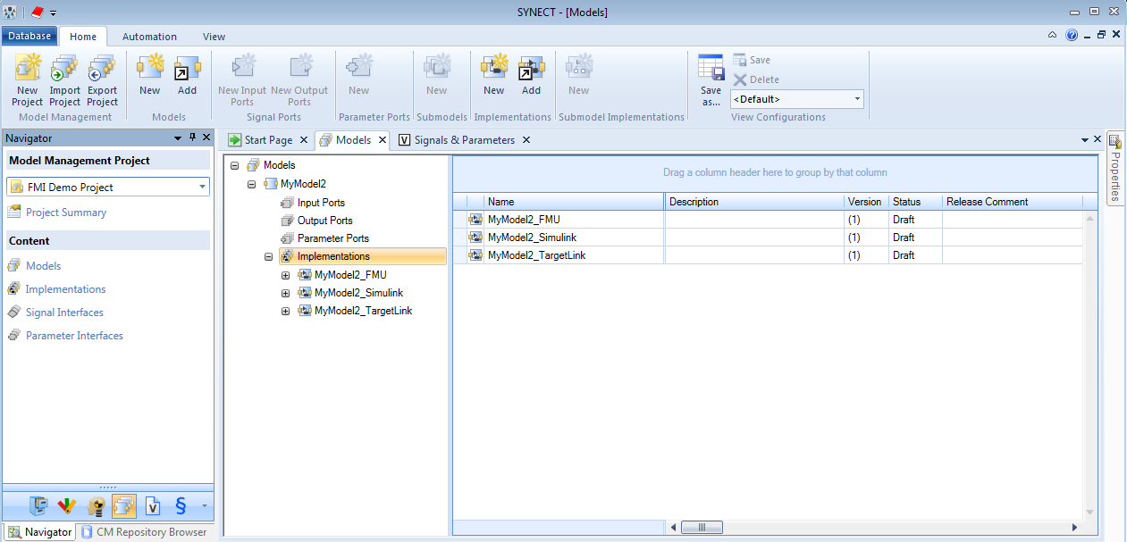
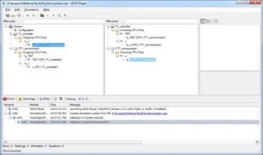
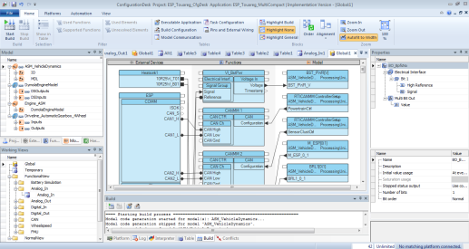
Integration of FMUs for SIL & HIL with SSP: Reuse of the System Structure
The System Structure defined for SIL can be reused for HIL testing
It becomes possible to reuse more models, configurations, tests, layouts and parameters
A Data Management tool controls the lifecycle of the SSP
Data Management
Model Management
SIL Integration
HIL Integration
SSD
FMU
SSP
SIL Configuration
*.SSP
HIL Configuration
Notes:
There is an increasing desire to reuse environment models to provide proven, consistent solutions for the validation of controller models in different projects and development stages (e.g., for virtual validation and HIL simulations).
Data Management environments provide capabilities for managing model compositions, handling variants of systems and managing the parameter and signal interfaces of the different model systems.
The SSP approach allows to share a standardized system structure description between data management, integration and configuration tools for SIL, MIL and HIL scenarios

Slide 7
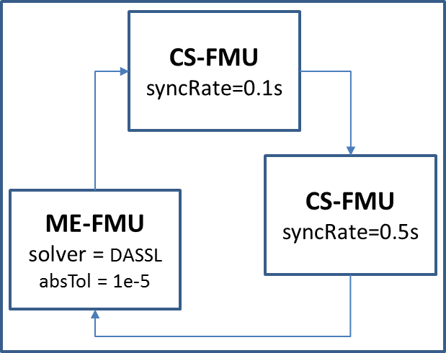
Potential further work
Components can support more than FMUs/SSPs:
New ADAS Sensor Interfaces currently in development (Object Lists)
Open Issues in SSP
Start values for Inputs
Subsystems / t=0
Initial state of the system
Experiment setup
Start time, stop time, selected results
Selection of solver, -settings, subsystem handling
FMU-instance specific settings
e.g. Sync rate, (Co-)Simulation mode, Import Settings
Reliability check
Similar to FMI Crosschecks
Notes:
Initial / Start values for Inputs needed for initialization
Defining the initial state of the system (eg ModelExchange)
Experiment setup
Orientate on how Modelica does it
Reliability checks:
Provide reference results
Allow the user to validate the SSP after importing

Slide 8
Existing prototypes with support of SSP
Model.CONNECTTM by AVL – Scope
Integration Tool FMI Bench by PMSF
Co-Simulation Player” (Cybernet)
TLK MoBA Lab by TLK
FMI Composer by Modelon
FMI Kit – FMI Library for Simulink by Dassault
SSP support by solidThinking Activate® by Altair

Slide 9
Requested Features from FMI
Nice support of vectors / arrays for parameters and signals
Notes:
Initial / Start values for Inputs needed for initialization
Defining the initial state of the system (eg ModelExchange)
Experiment setup
Orientate on how Modelica does it
Reliability checks:
Provide reference results
Allow the user to validate the SSP after importing

Slide 10
Current Roadmap for First Release
Topic | Due Date
Presenting on Modelica Conference | 2017-05-15/17
End of Beta test phase | 2017-09-30
Initiate website | 2017-05-31
Review of existing documents | 2017-05-31
Release Beta version | 2017-06-01
Review of existing documents | 2017-10-14
Release version 1.0 | 2017-11-30

Slide 11
BACKUP

Slide 12
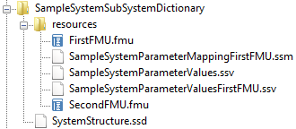
File Definitions - System Structure Package (*.SSP)
Use case
Exchange of Complete Systems with Variants
Features
All information (FMUs, system structure definition, parameters) can be stored in one archive (zip-file)
Multiple SSDs in one SSP allows for variant modeling
SSD
FMU
SSP
*.SSP

Slide 13
File Definitions - System Structure Definition (*.SSD)
SSD
Use case
Defining a Network of FMUs
Features
Hierarchical sub-systems
Empty components/FMUs as interface templates
External resources via URIs: Both relative to SSD/SSP or absolute, e.g. via HTTP(S).
Connections with unit conversions and optional linear/map transformations
Optional: Diagram geometry
System
Structure
Definition
Parameter
Binding
Parameter
Mapping
ParameterMappings
source :URI
0..*
source :URI
type :string
type :string
0..*
ParameterBindings
Element
Connector
name :string
Connectors
name :string
0..*
0..*
kind :enum
Elements
1
1
Signal
Dictio
nary
SignalDictio
nary
Reference
Compo
nent
1
System
0..*
source :URI
start
type :string
end
1
SignalDictionaries
0..*
Connections
0..*
Connection
suppressUnitConversion :boolean
0..*
0..*

Slide 14
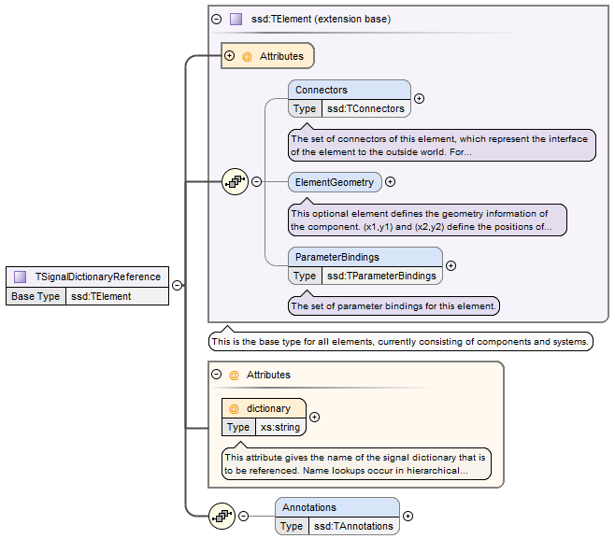
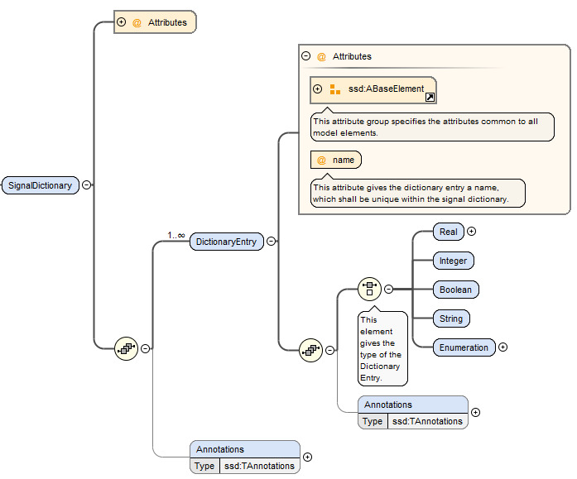
File Definitions - Signal Dictionaries (*.SSB)
Use cases
Collecting Control Signals in a Central Location
Features
Causality is checked by tool automatically
Crosses hierarchies without need for downward passing
Well-suited for e.g. ECU control busses
Can be inline or in external file
Notes:
SignalDictionaries define the actual signals in the dictionary
SignalDictionaryReferences at the same or lower hierarchy levels can directly reference those, crossing intermediate levels without notice

Slide 15
File Definitions – Parameter Values Data (*.SSV)
SSV
Use case
Tool-independent Exchange of Parameter Data
Features
Neutral exchange format between parameter sources
Compatible to FMI standard
Provides some meta data
Access to param DBs via HTTP (-> Parameter API)
ParameterSet
Units
+
name :string
0..*
Unit
+
name :string
Parameters
Annotations
0..*
Parameter
Annotations
0..*
Annotation
+
name :string
0..*
+
type :string
BaseUnit
+
body :XML
+
kg :int
unit
+
m :int
+
s :int
+
A :int
+
K :int
«choice»
+
mol :int
Type
+
cd :int
+
rad :int
Real
Integer
Enumeration
Boolean
String
+
value :double
+
value :int
+
value :string
+
value :boolean
+
value :string
Notes:
Simple Format, Easy to use as a lingua franca
Same Format used to access sources via Parameter Get API, can be used for Parameter DBs or Parameter Converters from other formats (e.g. ASAM MCD -> SSV)

Slide 16
File Definitions - Parameter Mapping (*.SSM)
SSM
Use case
Mapping Parameters to FMUs when the Parameter Names differ or Parameter Values require Transformations
Features
Can be stored separately from System Structure and Parameter Data
Can be inlined into SSD
Optional manual linear and mapping transformations
Parameter
Mapping
0..*
MappingEntry
+
source :string
+
target :string
+
suppressUnitConversion :boolean
0..1
Transfor-
mation
Linear
Transformation
+
factor :double
IntegerMapping
Transformation
EnumerationMapping
Transformation
+
offset :double
1..*
1..*
MapEntry
MapEntry
+
source :int
+
source :string
+
target :int
+
target :string
Notes:
- Only needed when names differ (other than prefixes) or transformations other than automatic unit conversions are needed and SSV source shall remain unchanged.

Slide 17
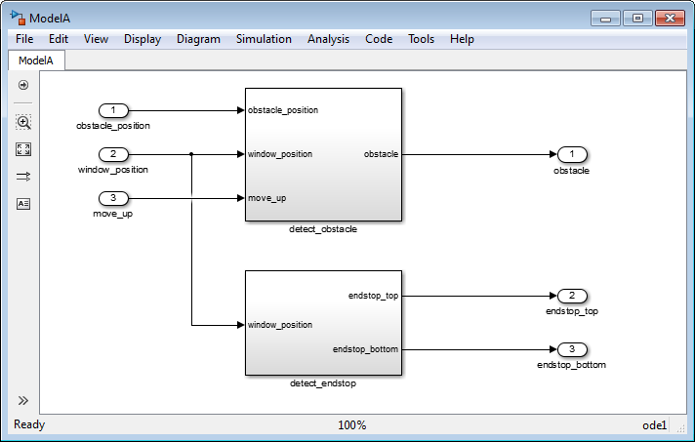
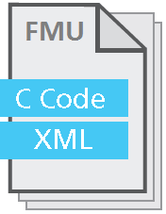
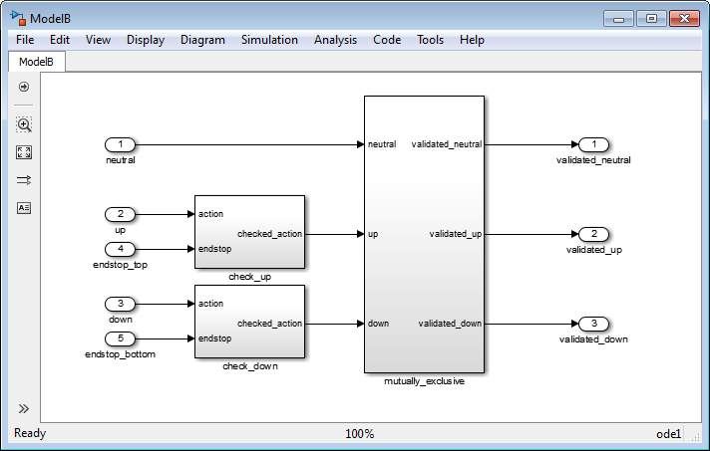
State of the Art: Integration of FMUs for SIL & HIL
Integration tools are importing FMUs, Simulink-based models and ECU code
A Data Management tool controls the lifecycle of all models
The SIL/HIL integration results (System Descriptions) can not be exchanged easily among the tools
Modeling
SIL/HIL Integration
Export
Import
Model A
Data Management
Model B
Model Management
Notes:
FMUs are integrated with other FMUs, Simulink-based models, Virtual-ECUs or real ECUs
Data Management environments import the FMU metadata (incl. interfaces) and allow consistent version control of the metadata and the FMU container file to manage the lifecycle of the FMUs.
The individual integration results (System Descriptions) can not be reused easily in the toolchain. Especially not if the tools are provided by different vendors.
A step-wise transition from the SIL to the HIL test is time consuming.

Slide 18
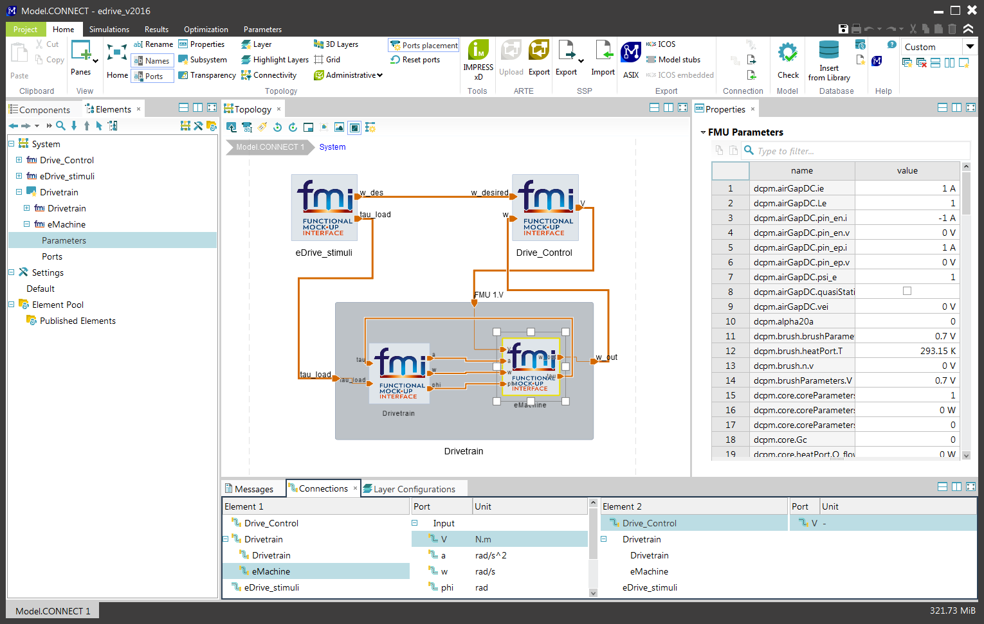
Prototypes – Integration Tool
Model.CONNECTTM by AVL – Scope:
Simulation architecture set-up
Model integration (FMI and dedicated interfaces)
Execution (office and lab)
Model management
Handling system structure and parameter variants
OLD

Slide 19
Prototypes – Integration Tool
Model.CONNECTTM by AVL – SSP prototype:
Import and export of system structure (SSP packages)
Prototype supports multiple structure variants in the package
Mapping between the SSP variant handling and the tool-specific variant handling had to be implemented
Import-export roundtrip does not re-produce original ssp content
This is a consequence of the deliberately simple SSP variant handling concept
Import and export of graphical information
Overall layout information can be transferred via SSP.

Slide 20

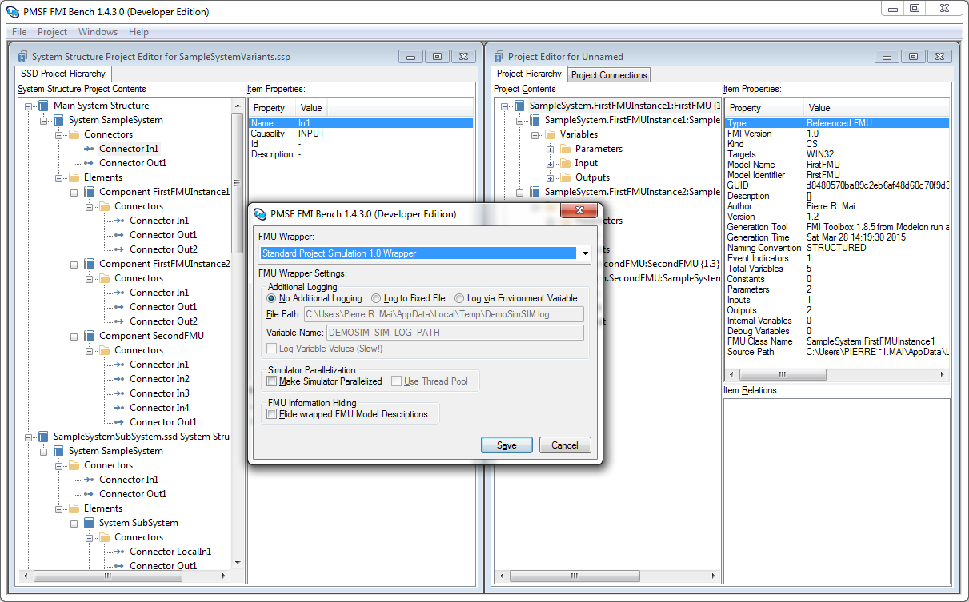
Prototypes: Integration Tool FMI Bench
FMI Bench by PMSF: Workbench for FMUs
FMU Inspector & Editor, Integration, Automation
Export Integrated FMUs, Simulators, Remote FMU Execution, FMU-internal Parallelization, IP-Protection
FMI Bench SSP Prototype
Direct Editing of SSDs, SSPs, incl. Variants
Generation of Native FMI Bench Projects from SSP Projects
Generation of FMU or Stand-alone Sim. from SSP
Parallelization
IP Protection

Slide 21
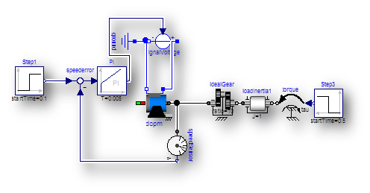
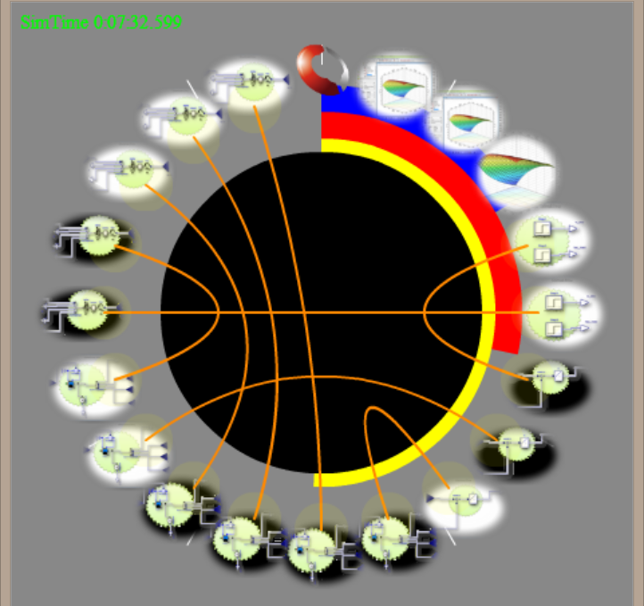
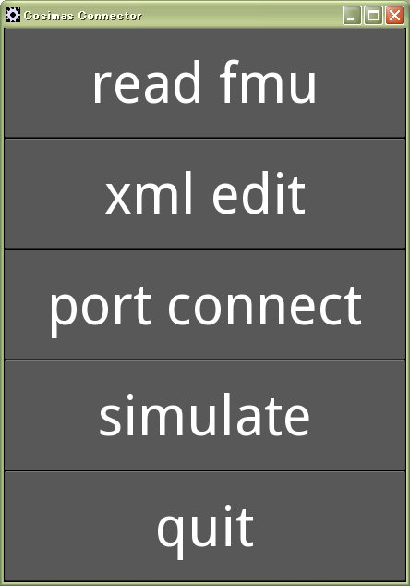
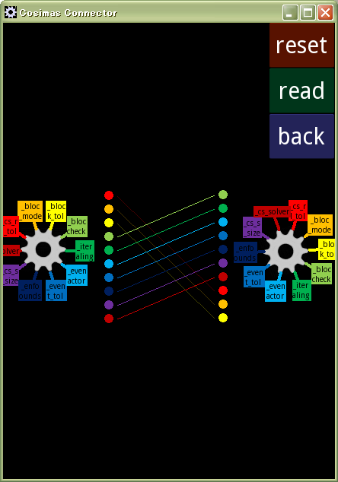


Prototypes – “Co-Simulation Player” (Cybernet)
For Mobile Co-Simulation
SSP as an Online AP Package
Flash client and Python server
Natural Interface
Ring connection geometry
Flexible 2D/3D Layout
Parameter repository
Load sqlite.DB as a FMU
URI online access
Notes:
SSP could enlarge the Model Distribution World
over the Internet Web Content Distribution world.
One of the merits of SSP is to facilitate the multi-user collaborations among
multi-domain experts as OEM s and suppliers,
through various environment.
The concept of “Online Co-Simulation Player by Cybernet”
suggests the possibility of SSP format as an Online Simulation Package for
“Anyone, Anytime, Anywhere”
The Cybernet prototype is characterized with the pursuit of Smart User Interface.
This strategy may increase the popularities of SSP Co-Simulations
among younger Engineers who love the Smart device operations.

Slide 22
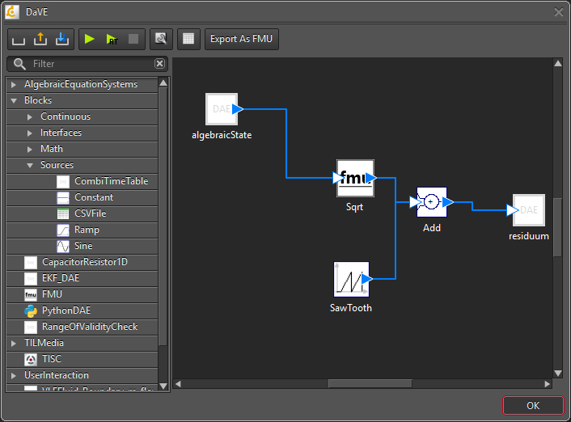
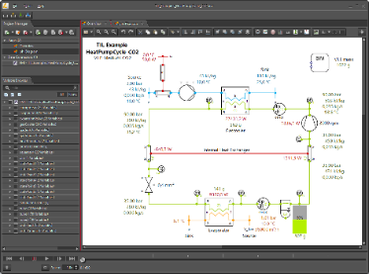

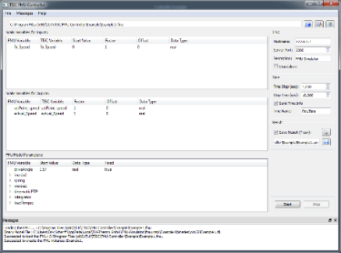

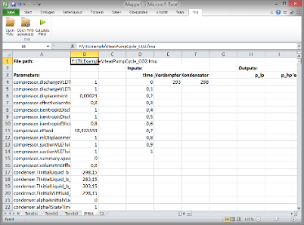
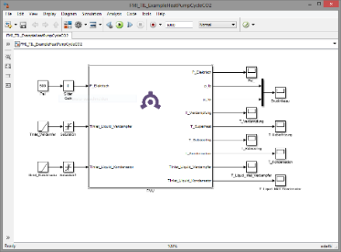


Prototypes – TLK MoBA Lab
Focus:
FMI-based models
physical connections
thermodynamic environment
Features
System Design & Model management
Simulation & virtual test bench
Optimization & parameter fitting
Prototype for im-/export support of SSP in development
DaVE
TISC
SSP
Excel

Slide 23
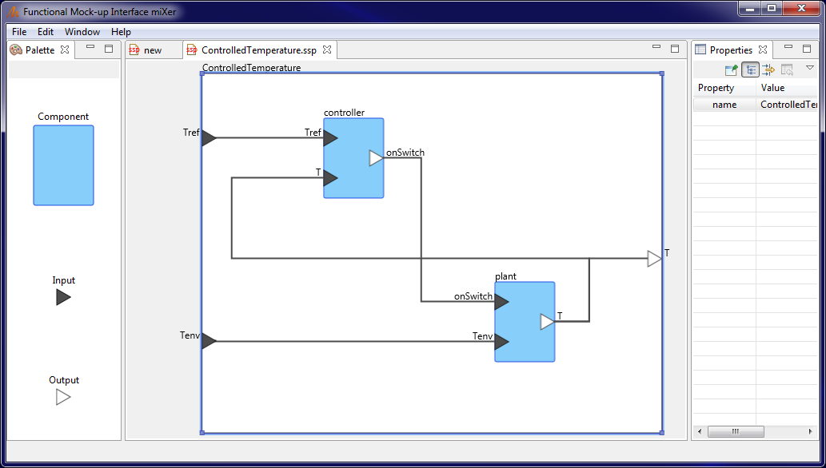
fMIXer by Modelon
Connect FMUs graphically
Save as .ssp or export to FMU for simulation in any FMI-compliant tool
View FMU information
Manage parameters
Convert ME to CS FMUs
MA-Project “System Structure and Parameterization” – Current Status
– FMI User Meeting, Prague 2017-05-15

Slide 24
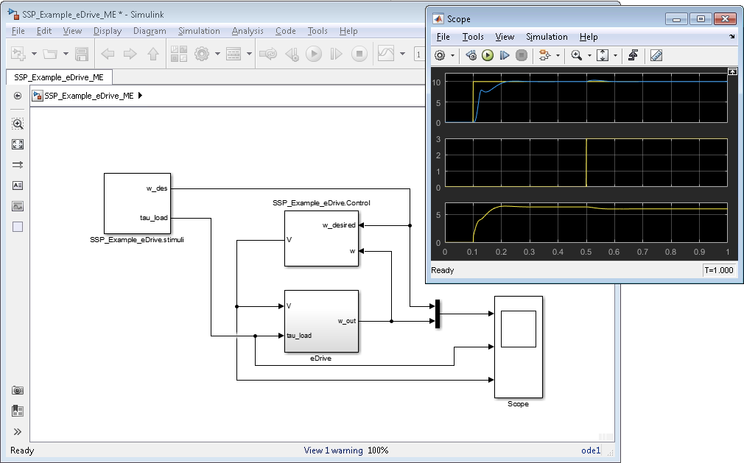
FMI Kit – FMI Library for Simulink
FMI Kit by Dassault Systèmes
Export models as FMUs
Import of FMUs into Models
Initial support of SSP

Slide 25
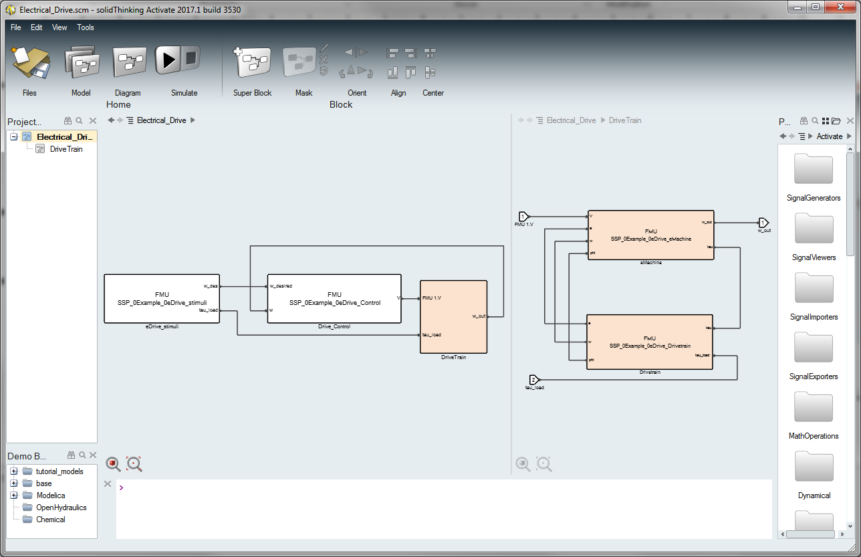
SSP support by solidThinking Activate®
Leverage complete FMI 2.0 support (import/export, ME and CS)
Simulation of connected FMUs, with handling of parameters
Support of SSP format for both import and export (WIP)
MA-Project “System Structure and Parameterization” – Current Status
– FMI User Meeting, Prague 2017-05-15

