Slide 1
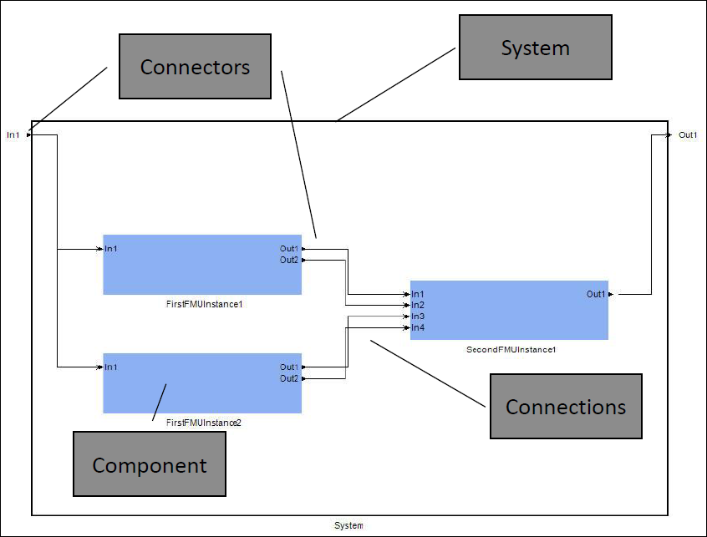
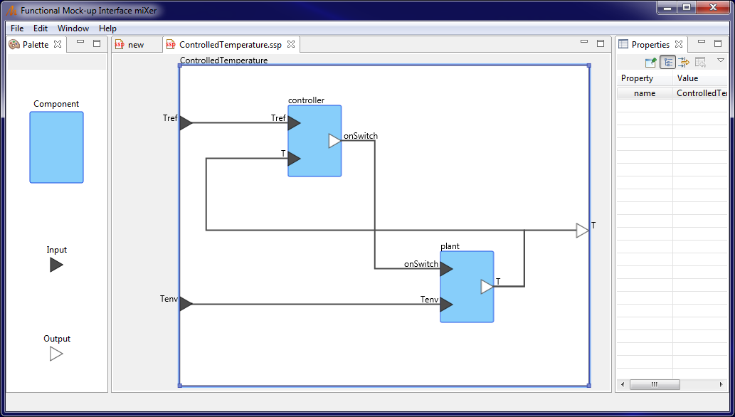
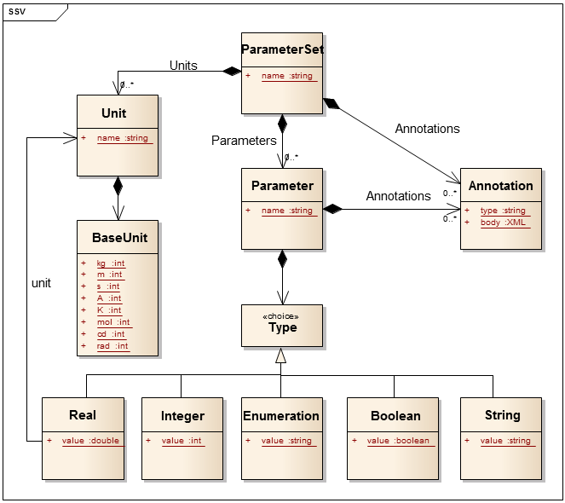
System Structure and Parameterization (SSP)
(project leader: Jochen Köhler)
Started in June 2014
Standardize exchange of connected
FMUs with parameter sets.
Status
  22 uses cases defined
  Beta version in development
  7 prototypes
Plans
  SSP web page (near future)
  First release (end of the year)
Connectors
System
Connections
Component

