Slide 1









MAP “System Structure and Parameterization” – Current Status and Plans
presented by Pierre R. Mai (PMSF)
MA User Meeting 2018-10-11
Cambridge, MA
T. Sommer
M. Najafi
M. Deppe
J. Köhler
J. Krasser
P. R. Mai
M. Nagasawa
M. Henningsson
J.N. Jäschke

Slide 2
MA Project “System Structure and Parameterization”
Initial kick-off of discussions in 2014, start of MA project
Use case definitions in 2015
Major technical design work during 2016-2017
Refining, prototypes, documentation, review during 2017-2018
Currently ~2-3 face-to-face meetings per year
Major work now being done via git, web-meetings
Mostly European participants, but some Japanese, US members
Notes:
ASAM (Association for Standardization of Automation and Measuring Systems) is an incorporated association under German law. Our members are primarily international car manufacturers, suppliers and engineering service providers from the automotive industry.
ASAM coordinates the development of technical standards, which are developed by working groups composed of experts from our member companies. We pursue the vision that the tools of a development process chain can be freely interconnected and allow a seamless exchange of data.
The Object Management Group® (OMG®) is an international, open membership, not-for-profit technology standards consortium, founded in 1989. OMG standards are driven by vendors, end-users, academic institutions and government agencies. OMG Task Forces develop enterprise integration standards for a wide range of technologies and an even wider range of industries. OMG’s modeling standards, including the Unified Modeling Language® (UML®) and Model Driven Architecture® (MDA®), enable powerful visual design, execution and maintenance of software and other processes

Slide 3
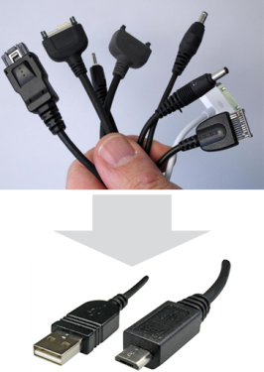
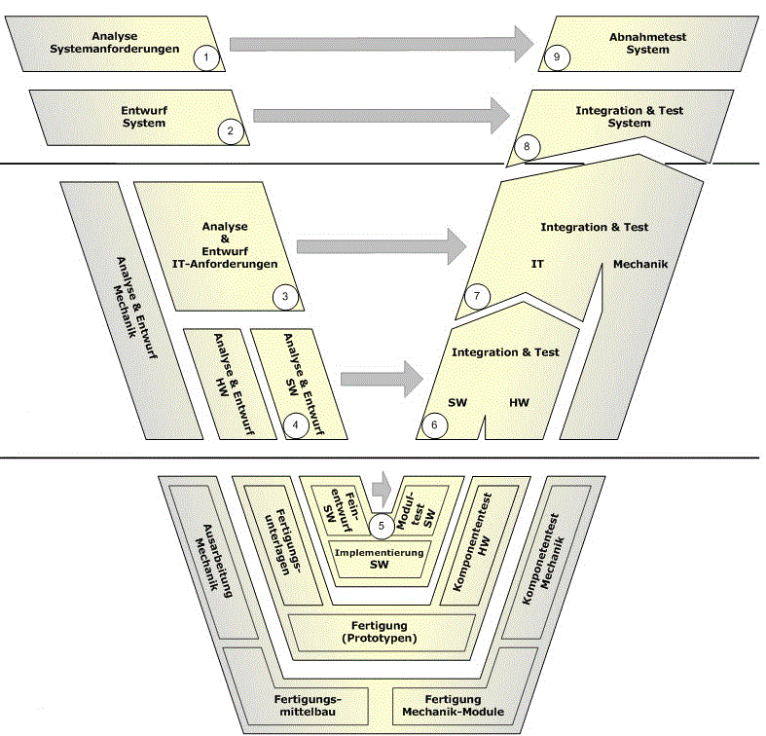
Main Purposes of SSP – Based on FMI standard
Define a standardized format for the connection structure of a network of components (FMUs in particular).
Define a standardized way to store and apply parameters to these components.
The developed standard / APIs should be usable in all stages of development process (architecture definition, integration, simulation, test in MiL, SiL, HiL).
The work in this project shall be coordinated with other standards and organizations (FMI, ASAM, OMG).
Notes:
ASAM (Association for Standardization of Automation and Measuring Systems) is an incorporated association under German law. Our members are primarily international car manufacturers, suppliers and engineering service providers from the automotive industry.
ASAM coordinates the development of technical standards, which are developed by working groups composed of experts from our member companies. We pursue the vision that the tools of a development process chain can be freely interconnected and allow a seamless exchange of data.
The Object Management Group® (OMG®) is an international, open membership, not-for-profit technology standards consortium, founded in 1989. OMG standards are driven by vendors, end-users, academic institutions and government agencies. OMG Task Forces develop enterprise integration standards for a wide range of technologies and an even wider range of industries. OMG’s modeling standards, including the Unified Modeling Language® (UML®) and Model Driven Architecture® (MDA®), enable powerful visual design, execution and maintenance of software and other processes

Slide 4

Overview of File Definitions
SSD
Par1
Parameter
Binding
Parameter
Mapping
Map1
System
Structure
Definition
Par2
Map2
ParameterMappings
Par…
source :URI
0..*
source :URI
Trans
type :string
type :string
0..*
*.SSV
*.SSM
ParameterBindings
Element
Connector
name :string
Connectors
name :string
0..*
0..*
kind :enum
Elements
1
1
Signal
Dictio
nary
Signal Dictionary
Reference
Compo
nent
1
System
*.FMU
0..*
source :URI
start
SSD
type :string
end
FMU
1
SignalDictionaries
0..*
Connections
SSP
0..*
Sig1
Connection
Sig2
*.SSP
suppressUnitConversion :boolean
0..*
Sig…
0..*
*.SSB
Notes:
Four Defined Formats:
SSD for Structure
FMU as fundamental Building Block
SSV for Param Values
SSM for Param Bindings
SSP for Packaging/Variant-Handling

Slide 5
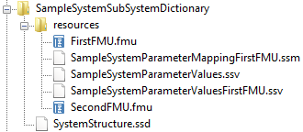
File Definitions – System Structure Package (*.SSP)
Use case
Exchange of Complete Systems with Variants and all Related Resources
Features
All information (FMUs, system structure definition, parameters) can be stored in one archive (zip-file)
Multiple SSDs in one SSP allows for variant modeling
Common relative URI addressing of content for unified access, integration into PLM/PDM
SSD
FMU
SSP
*.SSP

Slide 6
File Definitions – System Structure Definition (*.SSD)
SSD
Use case
Defining a Network of FMUs/Models
Features
Hierarchical sub-systems
Empty components as interface templates
SignalDictionaries for flexible connection definitions (e.g. bus databases, non-hierarchical connection setup)
External resources via URIs
Connections with unit conversions and optional linear/map transformations
Optional: Diagram geometry
Optional: Basic simulation settings
All Formats: Extension via Domain-Specific Annotations
System
Structure
Definition
Parameter
Binding
Parameter
Mapping
ParameterMappings
source :URI
0..*
source :URI
type :string
type :string
0..*
ParameterBindings
Element
Connector
name :string
Connectors
name :string
0..*
0..*
kind :enum
Elements
1
1
Signal
Dictio
nary
Signal Dictionary
Reference
Compo
nent
1
System
0..*
source :URI
start
type :string
end
1
SignalDictionaries
0..*
Connections
0..*
Connection
suppressUnitConversion :boolean
0..*
0..*

Slide 7
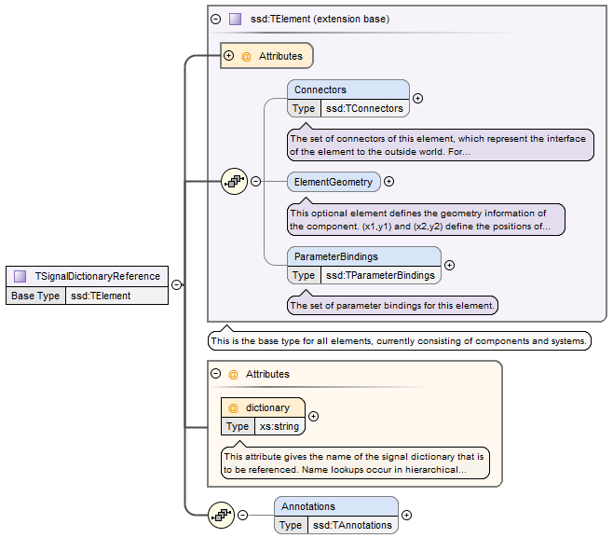
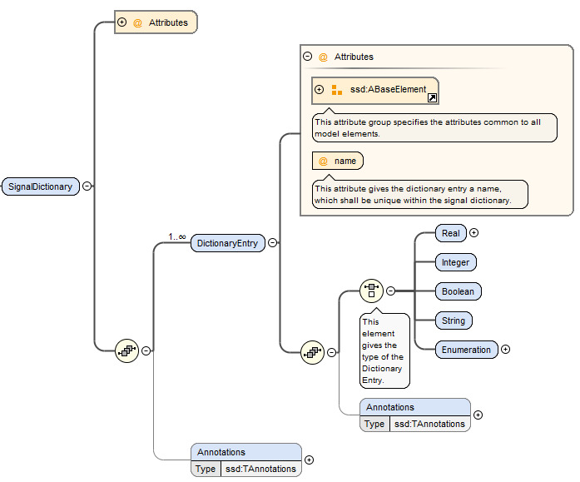
File Definitions – Signal Dictionaries (*.SSB)
Use case
Collecting Control Signals in a Central Location with Reuse across Projects
Features
Causality is checked by tool automatically
Connections expandable to actual point-to-point connections prior to runtime
Crosses hierarchies without need for downward passing of signals
Well-suited for e.g. ECU control busses
Can be inline or in external file

Slide 8
File Definitions – Parameter Values (*.SSV)
Use case
Tool-independent Exchange of Parameter Data with Reuse across Projects
Features
Neutral exchange format between parameter sources
Compatible to FMI standard data types
Provides some meta data
Access to Parameter DBs via HTTP/S (-> Parameter REST API)
Can be inline or in external file
SSV
ParameterSet
Units
+
name :string
0..*
Unit
+
name :string
Parameters
Annotations
0..*
Parameter
Annotations
0..*
Annotation
+
name :string
0..*
+
type :string
BaseUnit
+
body :XML
+
kg :int
unit
+
m :int
+
s :int
+
A :int
+
K :int
«choice»
+
mol :int
Type
+
cd :int
+
rad :int
Real
Integer
Enumeration
Boolean
String
+
value :double
+
value :int
+
value :string
+
value :boolean
+
value :string

Slide 9
File Definitions – Parameter Mapping (*.SSM)
Use case
Mapping Parameters to FMUs / Components when Parameter Names differ or Parameter Values require Transformations (e.g. due to Reuse)
Features
Neutral exchange format between tools
Optional manual linear and mapping transformations
Can be inline or in external file
SSM
Parameter
Mapping
0..*
MappingEntry
+
source :string
+
target :string
+
suppressUnitConversion :boolean
0..1
Transfor-
mation
Linear
Transformation
+
factor :double
IntegerMapping
Transformation
EnumerationMapping
Transformation
+
offset :double
1..*
1..*
MapEntry
MapEntry
+
source :int
+
source :string
+
target :int
+
target :string

Slide 10
List of features
Hierarchical description of systems of connected components
Components: FMUs and external SSPs/SSDs, extensible to models, …
Parameter bindings both at component and system-level, including transformations and name/unit-mapping
Signal dictionaries support cross-hierarchical data pools (e.g for busses)
Packaging of SSDs, FMUs, Parameters, … into one bundle (SSP)
Light-weight support for variant handling at SSP level (multiple SSDs sharing components, parameters, resources)
Optional exchange of graphical information (similar display across tools)
URI references to all resources: Integration with other systems via URIs

Slide 11
Existing prototypes with support of SSP
Model.CONNECTTM by AVL – Scope
Integration Tool FMI Bench by PMSF
Co-Simulation Player (Cybernet)
TLK MoBA Lab by TLK
FMI Composer by Modelon
FMI Kit – FMI Library for Simulink by Dassault
SSP support by solidThinking Activate® by Altair
FMPy – Open Source Python FMI/SSP Library/Tool by Dassault

Slide 12
Current Roadmap for First Release
Topic | Due Date
Limited Distribution “Final Committee Draft” w.r.t. technical contents | Q1/2018
Publicly available “Beta Version”, Website | Q4/2018
End of Beta Phase, Release Candidate | Q1/2019
Release version 1.0 (aligned with FMI 1.0/2.0, partial support for FMI 3.0) | Q2/2019
Tentative 1.1 follow up release, full alignment with all of FMI 3.0 | Q4/2019 – Q1/2020

Slide 13
Q&A

