Slide 1
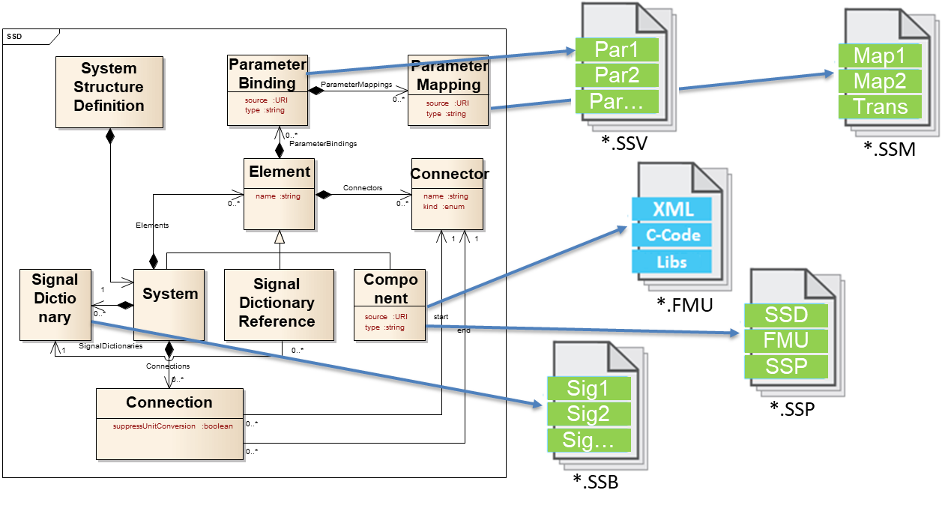
SSP: System Structure and Parametrization
Standard for description of systems of connected components and their parameters using XML schemas and packaging of components
Main focus is easy transport between tools (optionally with graphical information)
Usage of URI references for reuseabilty

Slide 2
SSP: System Structure and Parametrization
First Release 1.0 published NOW!
Supporting tools:
SYNECT (dSpace)
OMSimulator (OpenModelica)
Model.Connect (AVL)
FMIBench (PMSF)
…. More can be added soon – hopefully ☺
Next Release (1.1) will follow shortly after release of FMI 3.0
Find more on www.ssp-standard.org
Contact: map-ssp_projectlead@googlegroups.com

