Slide 1
Ivan I. Kossenko and
Maia S. Stavrovskaia
How One Can Simulate Dynamics of Rolling Bodies via Dymola:
Approach to Model Multibody System Dynamics Using Modelica

Slide 2
Key References
Wittenburg, J. Dynamics of Systems of Rigid Bodies. — Stuttgart: B. G. Teubner, 1977.
Booch, G., Object–Oriented Analysis and Design with Applications. — Addison–Wesley Longman Inc. 1994.
Cellier, F. E., Elmqvist, H., Otter, M. Modeling from Physical Principles. // in: Levine, W. S. (Ed.), The Control Handbook. — Boca Raton, FL: CRC Press, 1996.
Modelica — A Unified Object-Oriented Language for Physical Systems Modeling. Tutorial. — Modelica Association, 2000.
Dymola. Dynamic Modeling Laboratory. User's Manual. Version 5.0a — Lund: Dynasim AB, Research Park Ideon, 2002.
Kosenko, I. I., Integration of the Equations of the Rotational Motion of a Rigid Body in the Quaternion Algebra. The Euler Case. // Journal of Applied Mathematics and Mechanics, 1998, Vol. 62, Iss. 2, pp. 193–200.

Slide 3
Object-Oriented Approach:
Isolation of behavior of different nature: differential eqs, and algebraic eqs.
Physical system as communicative one.
Inheritance of classes for different types of constraints.
Reliable intergrators of high accuracy.
Unified interpretation both holonomic and nonholonomic mechanical systems.
Et cetera …

Slide 4
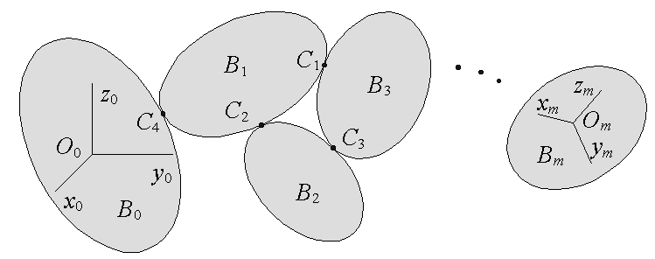
Multibody System

Slide 5
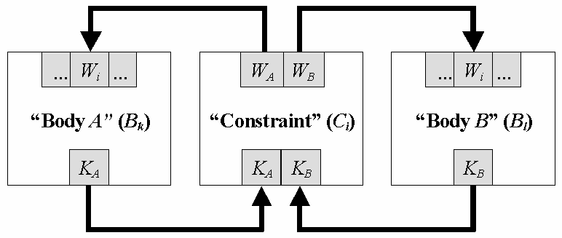
Architecture of
Mechanical Constraint

Slide 6
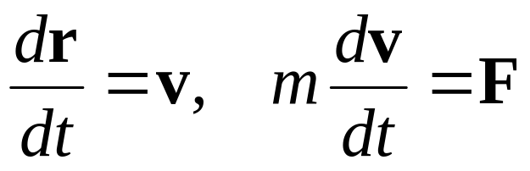
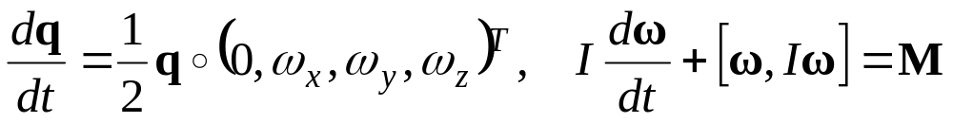
Rigid Body Dynamics
Newton’s ODEs for translations (of mass center):
Euler’s ODEs for rotations (about mass center):
with: quaternion q = (q₁, q₂, q₃, q₄)^{T} ∈ H ≅ R⁴,
angular velocity ω = (ω_{x}, ω_{y}, ω_{z})^{T} ∈ R³,
integral of motion |q| − 1 = const,
surjection of algebras H ≅ SU(2) → SO(3).

Slide 7
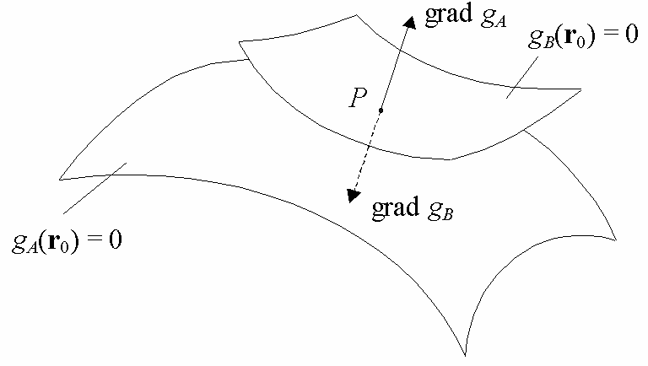
Kinematics of Rolling
Equations of surfaces in each body:
f_{A}(x_{k},y_{k},z_{k}) = 0, f_{B} (x_{l},y_{l},z_{l}) = 0
Current equations of surfaces with respect to base body:
g_{A}(x₀,y₀,z₀) = 0, g_{B}(x₀,y₀,z₀) = 0
Condition of gradients collinearity:
grad g_{A}(x₀,y₀,z₀) = λ⋅grad g_{B}(x₀,y₀,z₀)
Condition of sliding absence:

Slide 8
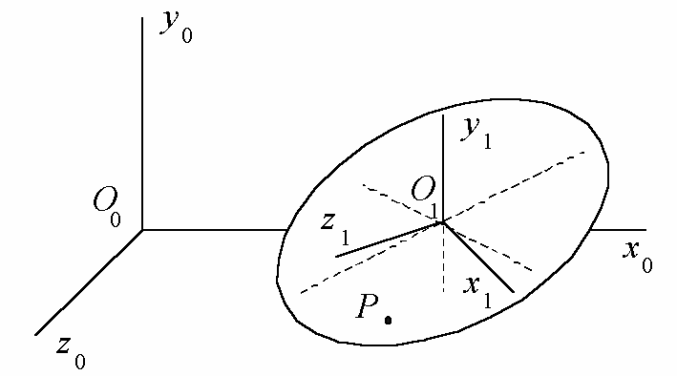
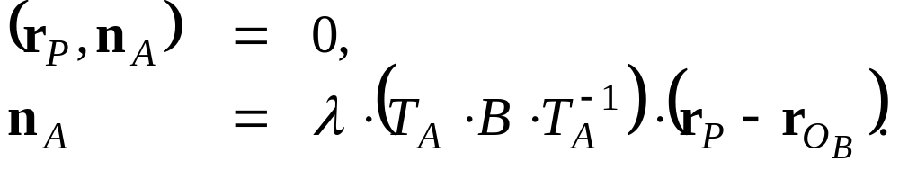
Dynamics of Rattleback
Inherited from superclass Constraint:
F_{A} + F_{B} = 0, M_{A} + M_{B} = 0
Inherited from superclass Roll:
Behavior of class Ellipsoid_on_Plane:
Here n_{A} is a vector normal to the surface g_{A}(r_{P}) = 0.

Slide 9
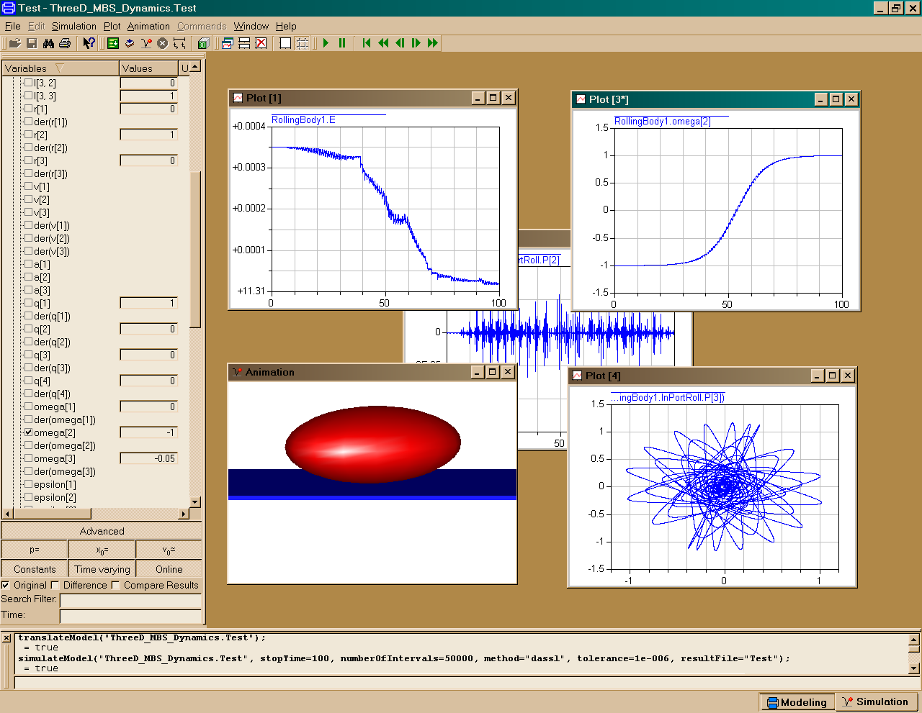
General View of the Results

Slide 10
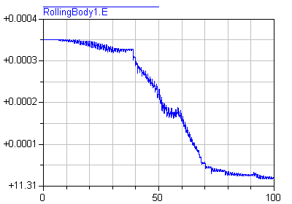
Preservation of Energy

Slide 11
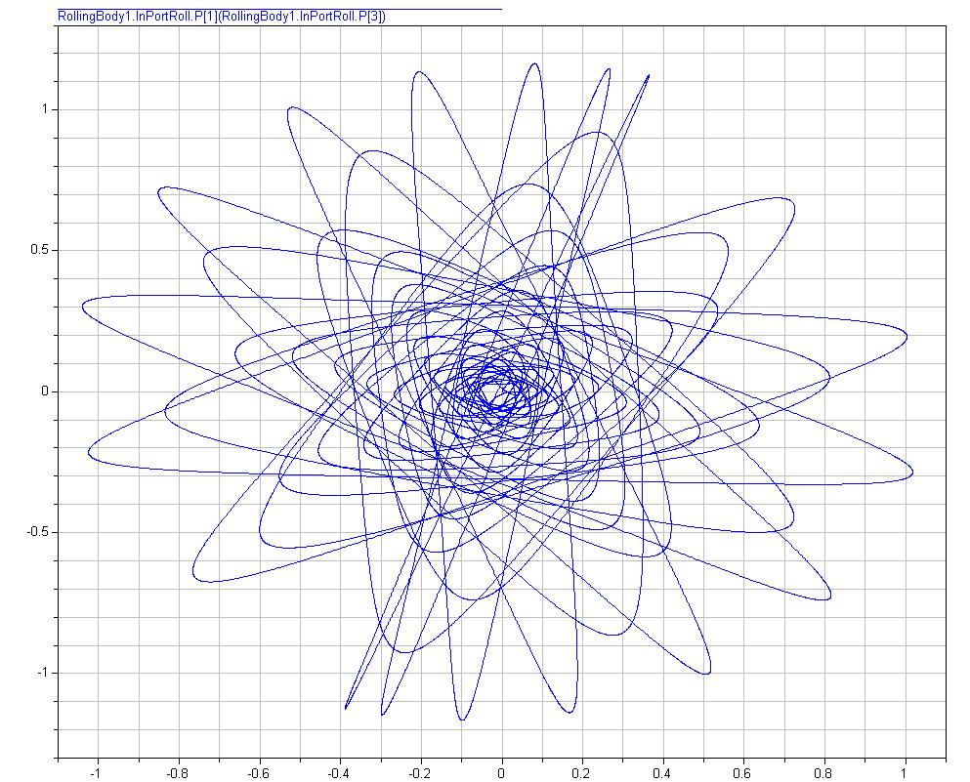
Point of the Contact Trajectory

Slide 12
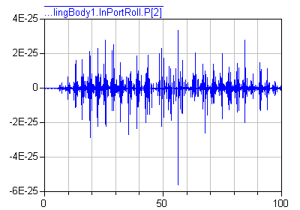
Preservation of Constraint Accuracy

Slide 13
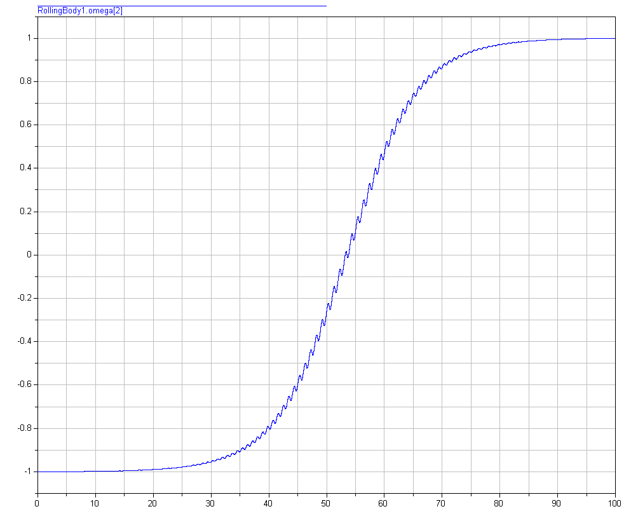
Behavior of the Angular Rate

Slide 14
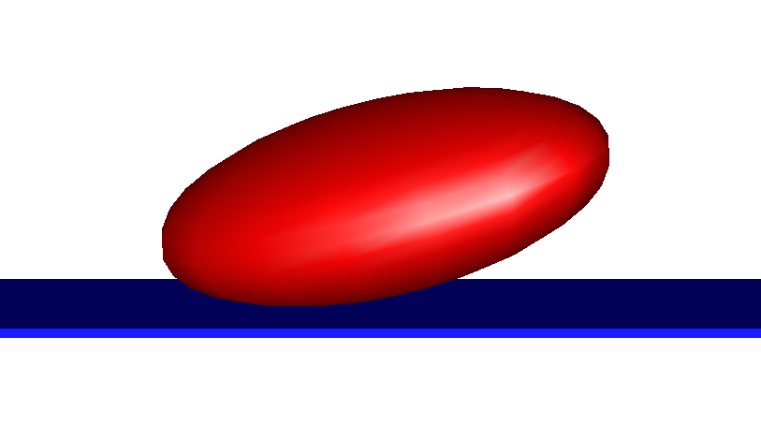
3D Animation Window

Slide 15
Exercises:
Long time simulations.
Verification of the model according to:
Kane, T. R., Levinson, D. A., Realistic Mathematical Modeling of the Rattleback. // International Journal of Non–Linear Mechanics, 1982, Vol. 17, Iss. 3, pp. 175–186.
Investigation of compressibility of phase flow according to:
Borisov, A. V., and Mamaev, I. S., Strange Attractors in Rattleback Dynamics // Physics–Uspekhi, 2003, Vol. 46, No. 4, pp. 393–403.

Slide 16
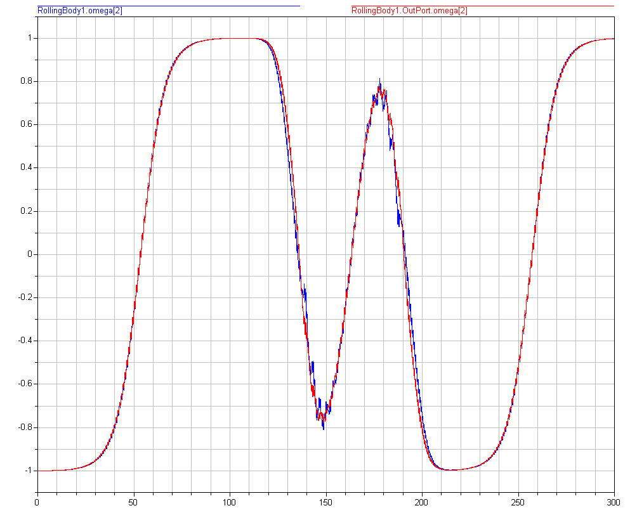
Long Time Simulations. 1.
Behavior of angular velocity projection to:
O₁y₁ (blue) in rattleback, O₀y₀ (red) in inertial axes

Slide 17
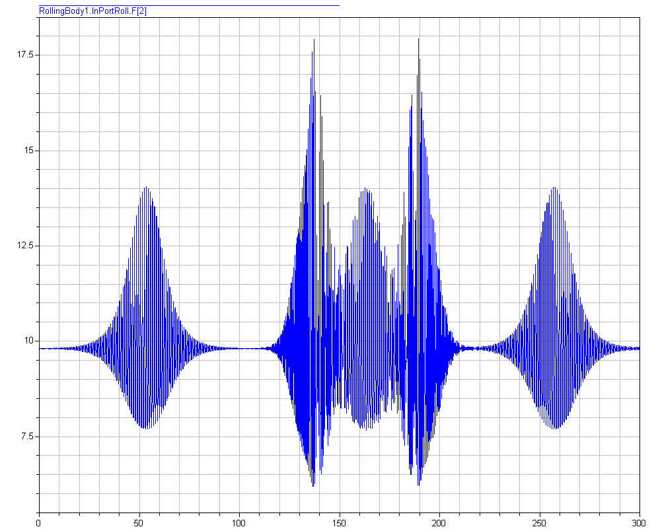
Long Time Simulations. 2.
Behavior of normal force of surface reaction

Slide 18
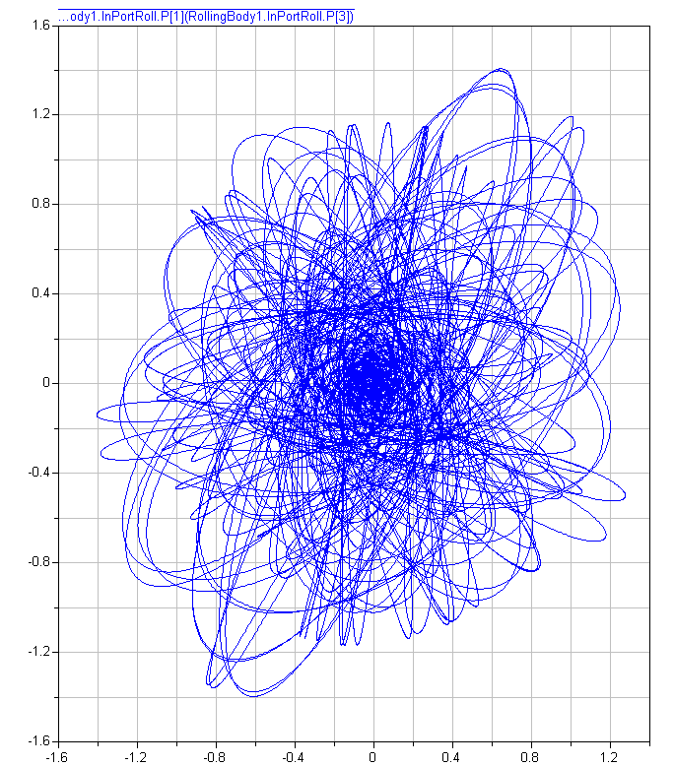
Long Time Simulations. 3.
Trajectory of a contact point

Slide 19
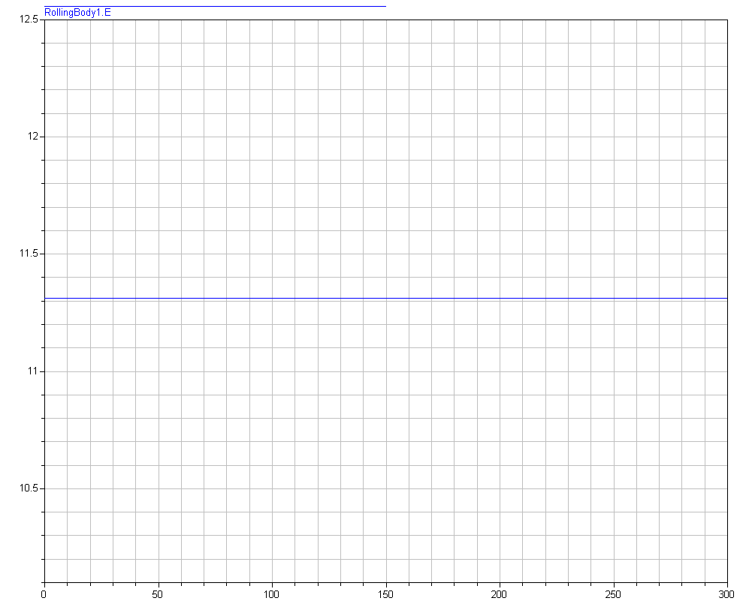
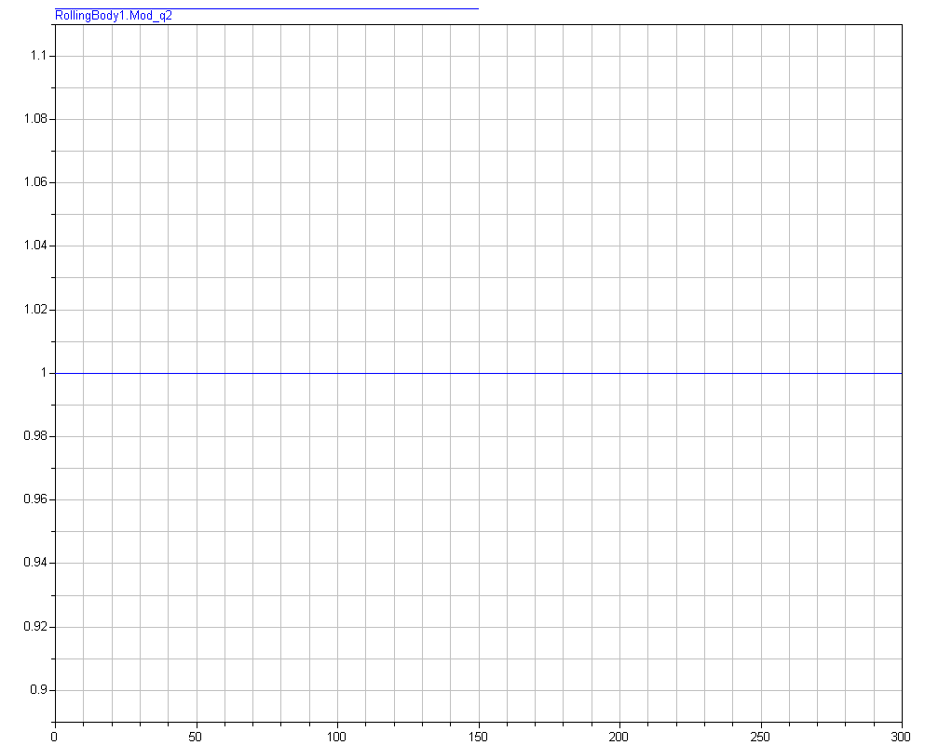
Long Time Simulations. 4.
Preservation of energy and quaternion norm
(Autoscaling, Tolerance = 10⁻¹⁰)

Slide 20
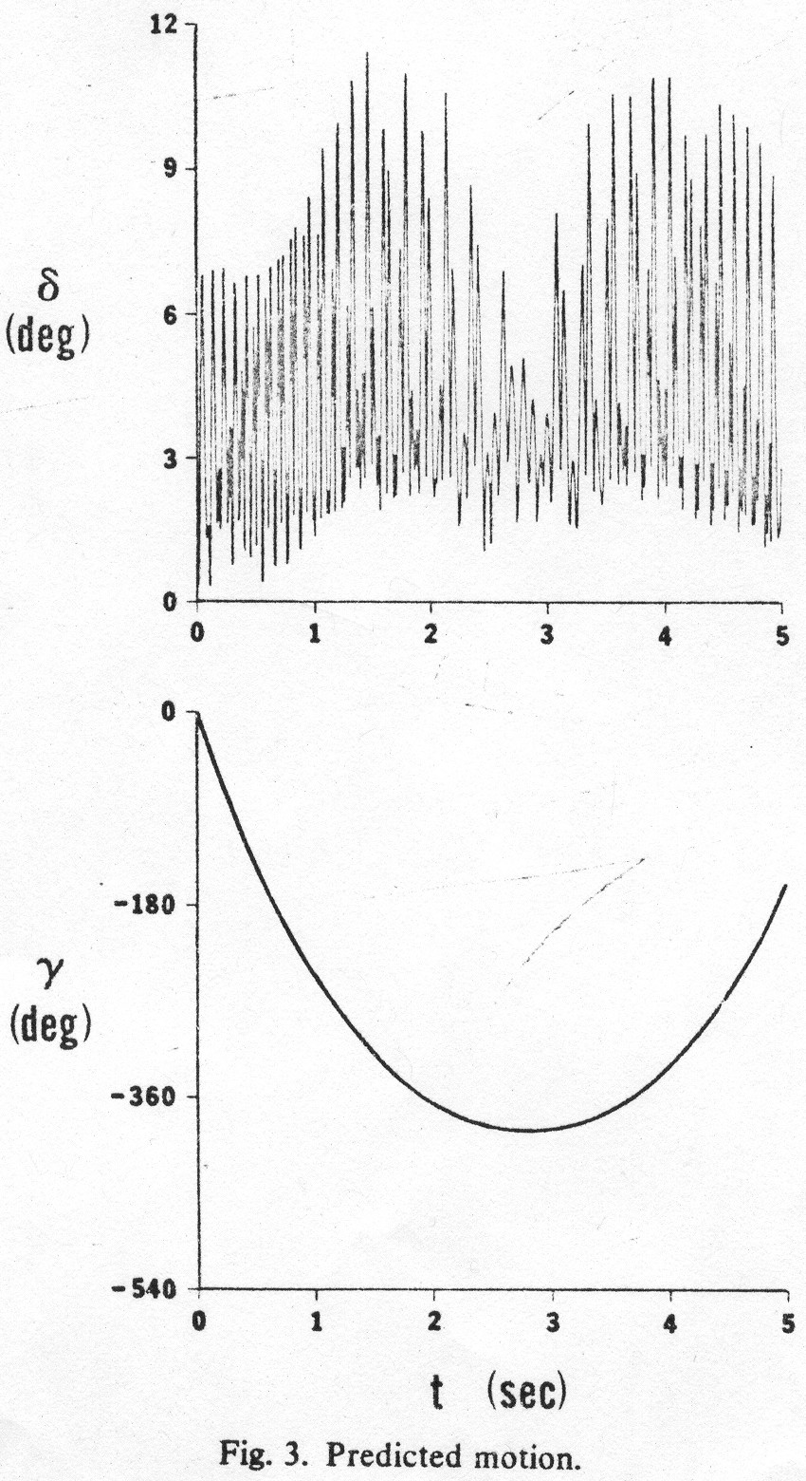
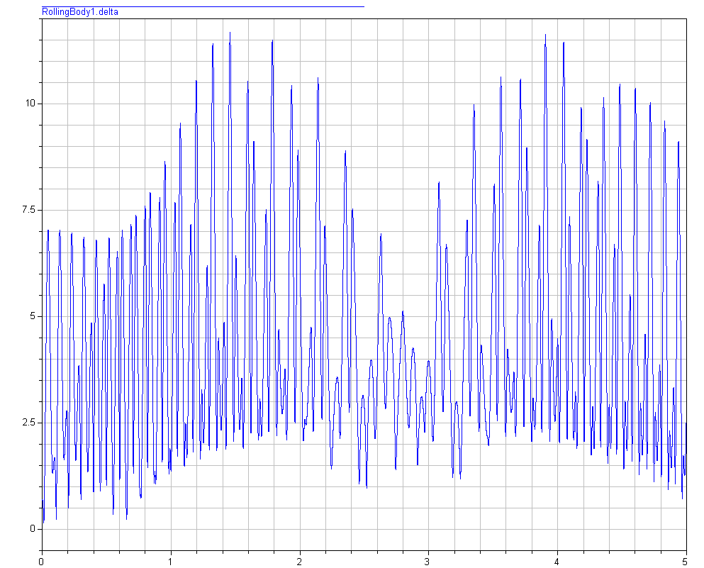
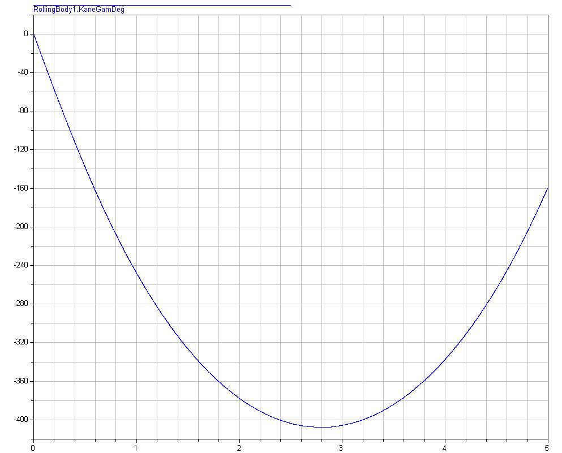
Case of Kane and Levinson. 1.
(Time = 5 seconds)
Kane and Levinson:
Our model:

Slide 21
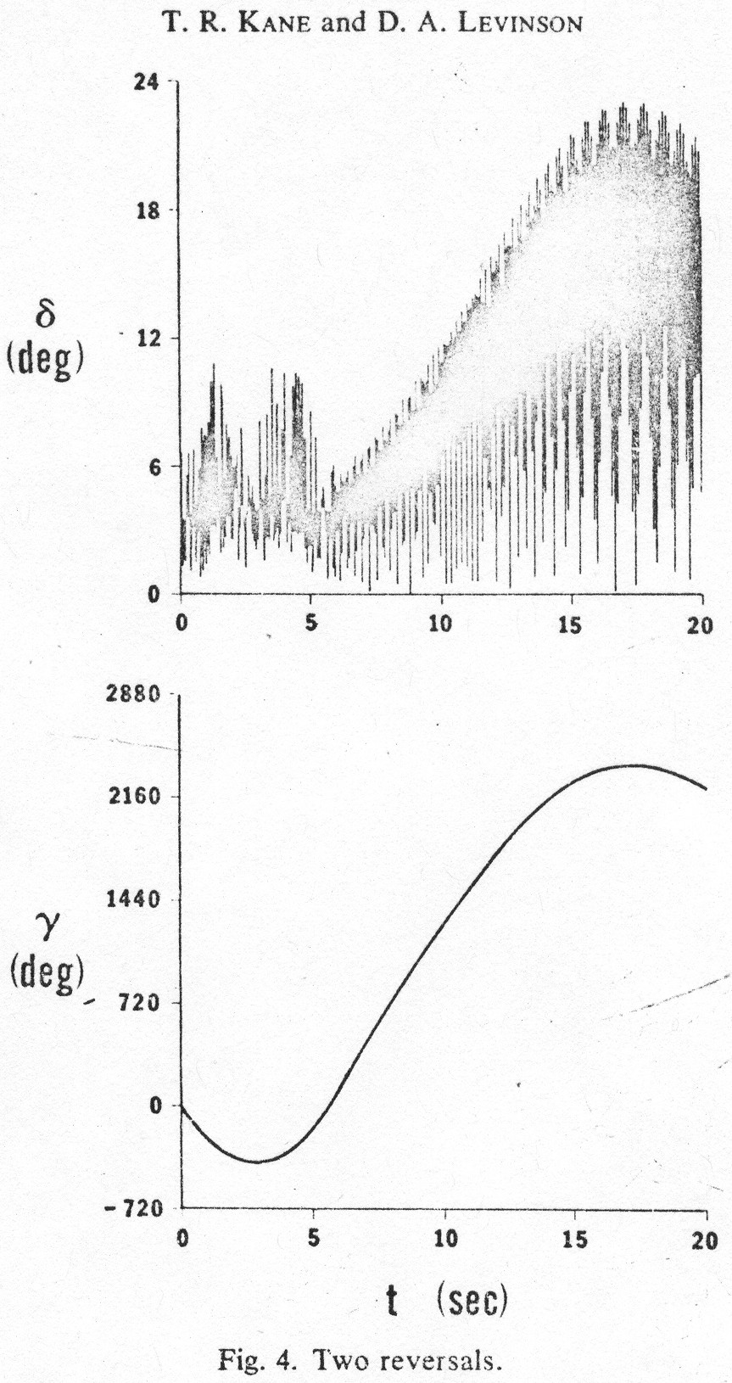
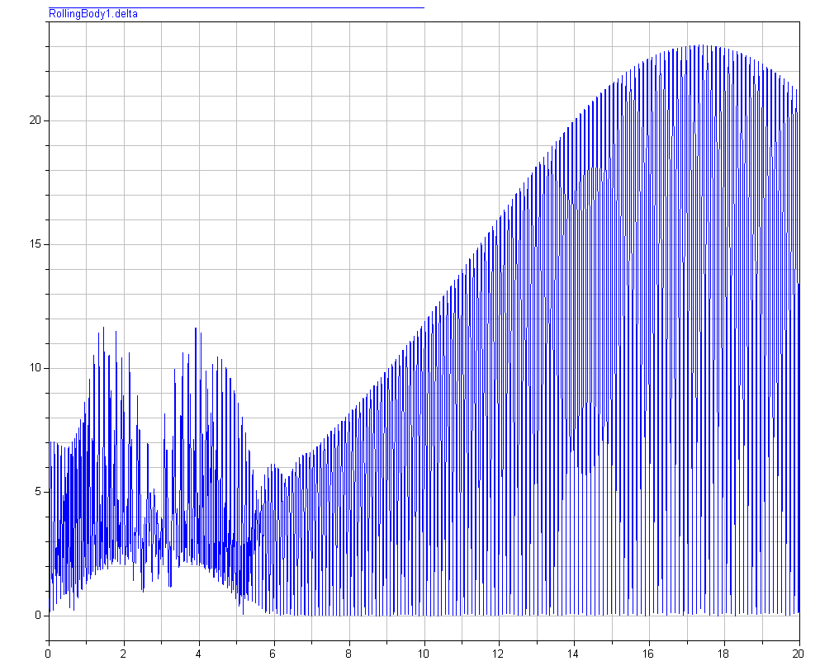
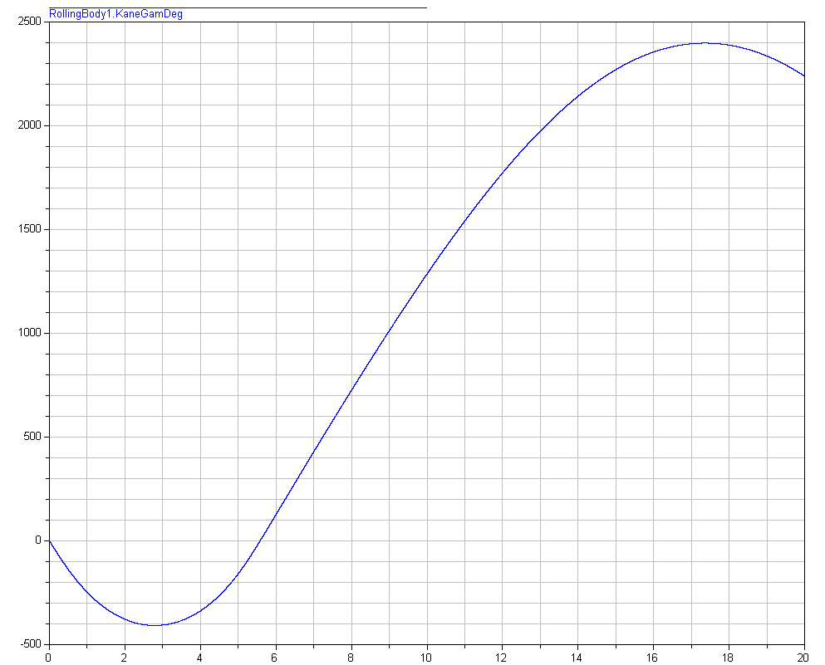
Case of Kane and Levinson. 2.
(Time = 20 seconds)
Kane and Levinson:
Our model:

Slide 22
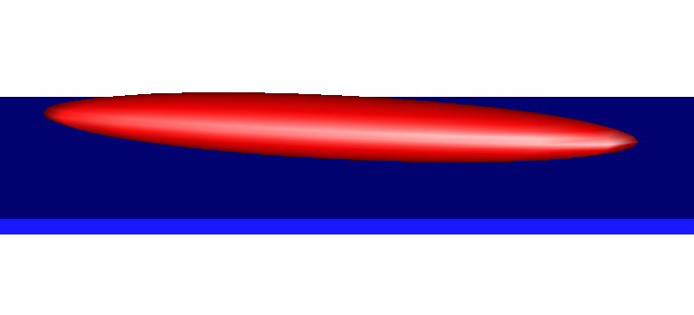
Case of Kane and Levinson. 3.
Shape of the stone

Slide 23
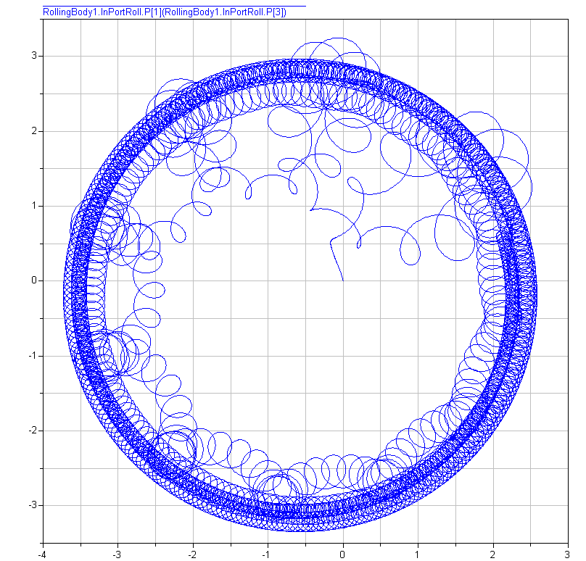
Case of Borisov and Mamaev. 1.
Converging to limit regime: trajectory of a contact point

Slide 24
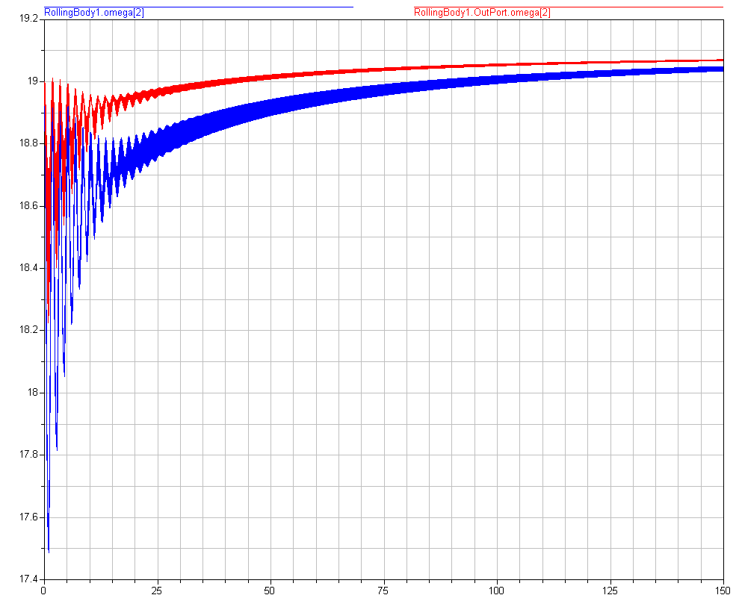
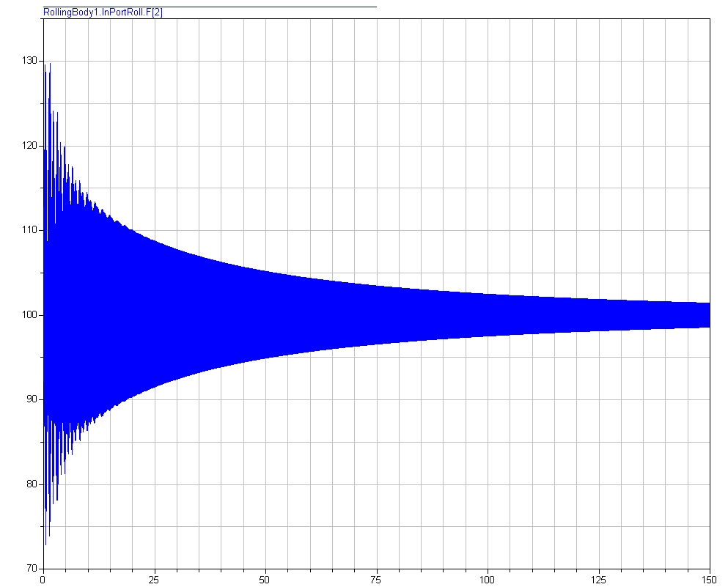
Case of Borisov and Mamaev. 2.
Converging to limit regime: angular velocity projections and normal force of reaction

Slide 25
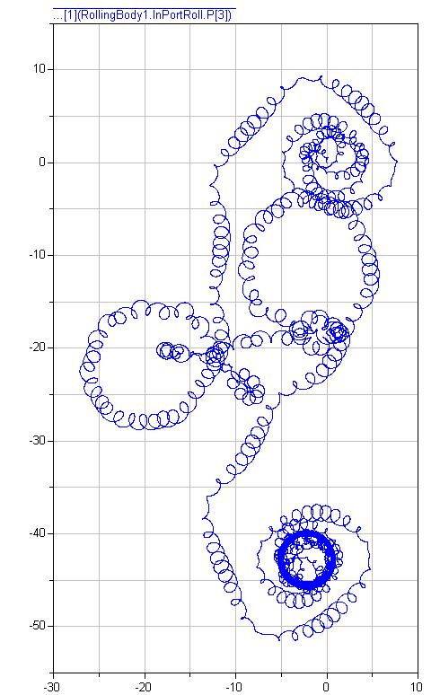
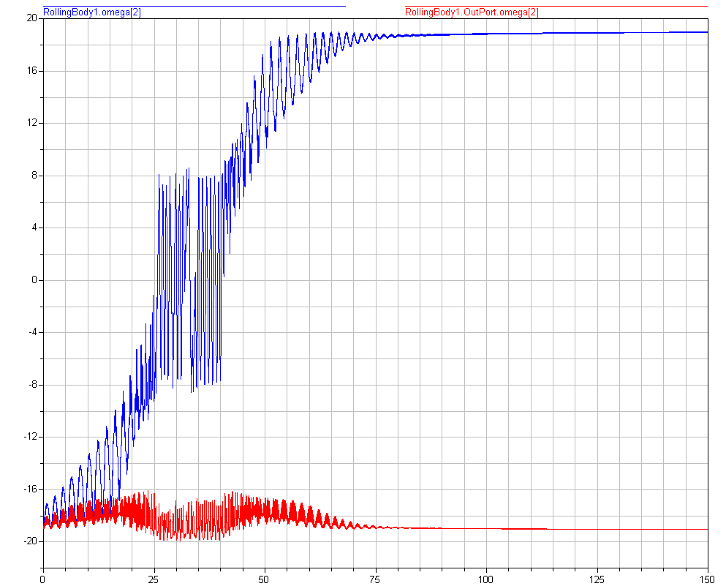
Case of Borisov and Mamaev. 3.
Behavior Like Tippy Top: contact point path and angular velocity projections

Slide 26
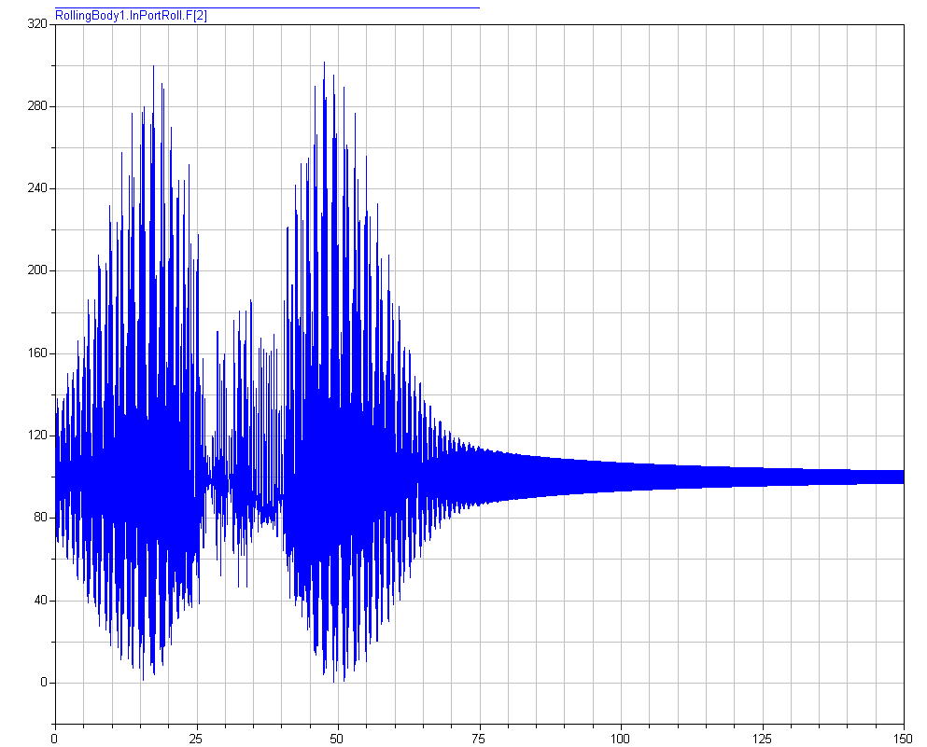
Case of Borisov and Mamaev. 4.
Behavior Like Tippy Top: normal force of reaction

Slide 27
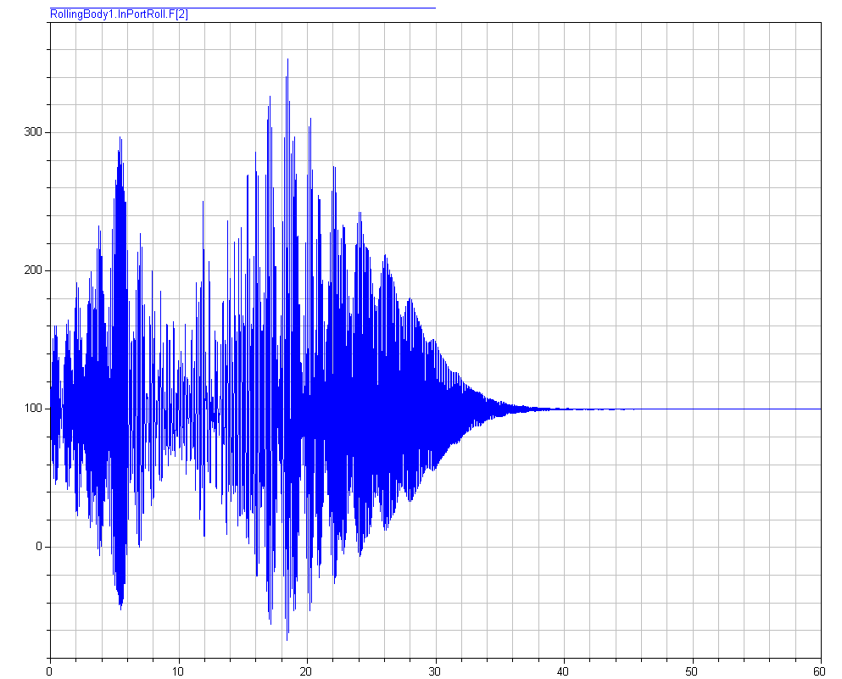
Case of Borisov and Mamaev. 5.
Behavior like Tippy Top: jumping begins (normal force)

Slide 28
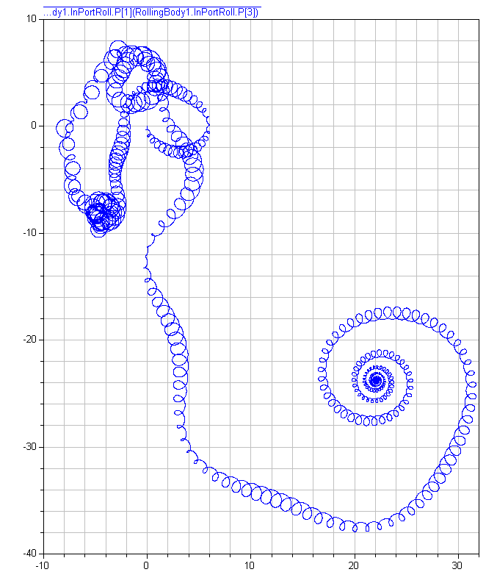
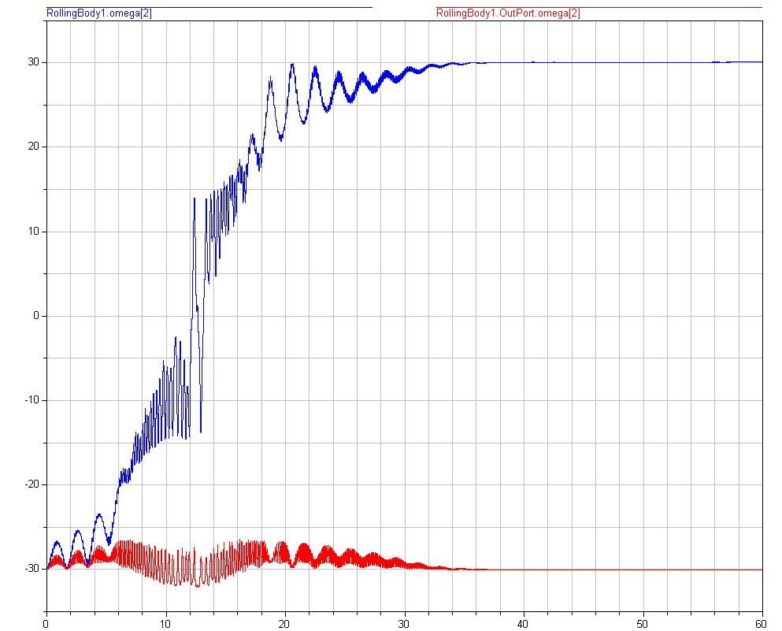
Case of Borisov and Mamaev. 6.
Behavior like Tippy Top with jumps: if constraint would be bilateral (contact point trajectory and angular velocity)

