Slide 1
Model Management
Tools and Technologies
Michael Tiller
Powertrain Research Department
Ford Motor Company

Slide 2
Overview
Development Tools
  Version Control
  Web-based Tools
Modelica – Open Standard
  Representing behavior
  Translation
  Modelica-based applications

Slide 3
Tools

Slide 4

Choosing Tools
Tools are like houses:
  They need a solid foundation to build on
  You can always add a coat of paint later

Slide 5
Key Principles (for us)
Cheap
Tools and technologies should be
  Open – Non-proprietary and well-documented
  Proven – Scales for real-world applications
  Mature – Relatively bug-free
Treat model development like software development
  Leverage tools/libraries as appropriate
  “Redundancy is the root of all evil”

Slide 6
Tools – Version Control

Slide 7
Version Control Requirements
Archive previous versions
Archive developer comments on changes
Allow branching for parallel development
Allow merging for coherent code base
Ability to “diff” changes
Tag (or label) releases
Retrieve versions by tag, branch or date
Cross-platform
Keyword substitution
Binary file support

Slide 8
Version Control Tools
ClearCase – used extensively
  Excellent features
  Expensive
  High maintenance
CVS – used extensively
  Good features (missing a few nice ones)
  Free
  Fairly simple to install and maintain
Perforce – never used
  Good compromise

Slide 9
CVS User Interfaces
Command line
Ancillary Tools
  TkDiff, CSDiff – Diffing and merging
Several GUIs
  WinCVS – primary user interface
  TkCVS – Works on Windows/Unix
  CVSWeb – Web based access
Good example of an open system

Slide 10
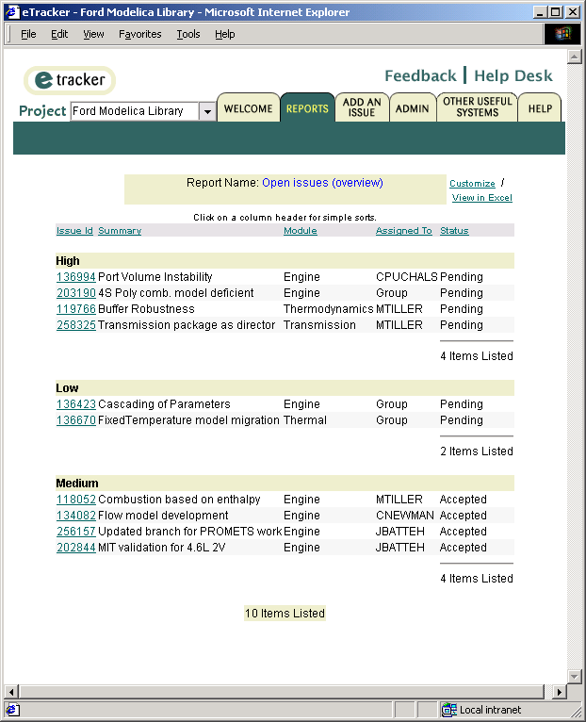
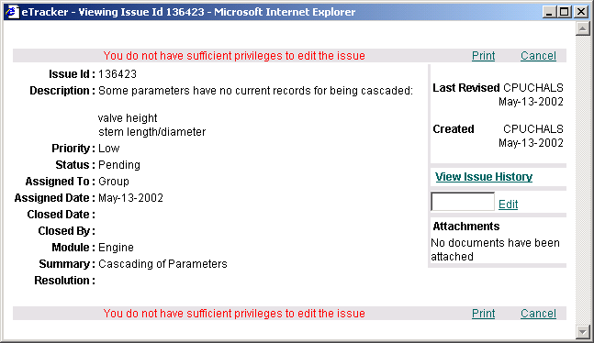
Typical Usage
Create a branch for either a bug fix or enhancement
  We use eTracker
  Bug fix branch names use eTracker Ids
Work in parallel
  Clearly identifies all changes
  Avoid “stepping on toes”
Merge changes

Slide 11
WinCVS
Create branches and tags
View local changes and/or conflicts
View “version tree” for a given file
Review check-in comments
“Sandbox” approach
http://www.wincvs.org/

Slide 12
Tools - Utilizing the Intranet

Slide 13
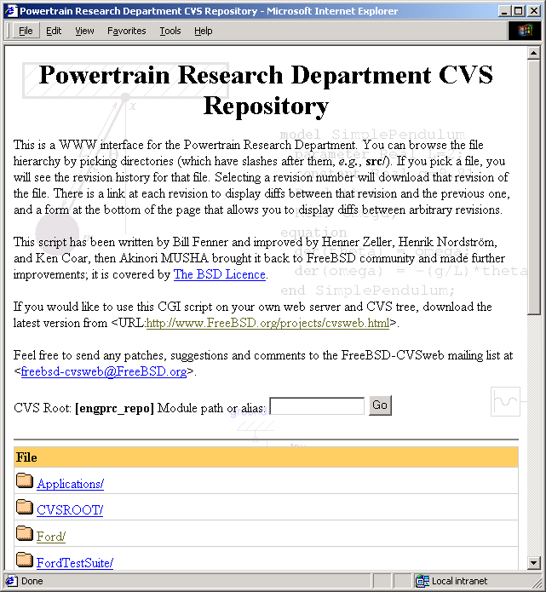
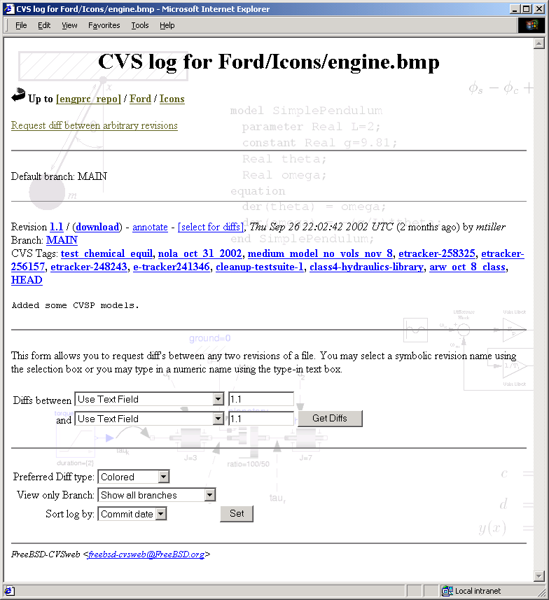
CVS Web
Overview of the filesystem
Download specific versions of files
View differences between files
http://www.freebsd.org/projects/cvsweb.html

Slide 14
Wiki – Collaborative Tool
Collaborative environment
  FAQs, user and developer information
  Technical discussions
Web-based
Searchable
Active server-side scripting
Customizable
Free
Change tracking, version control and diff-ing
http://twiki.org/

Slide 15
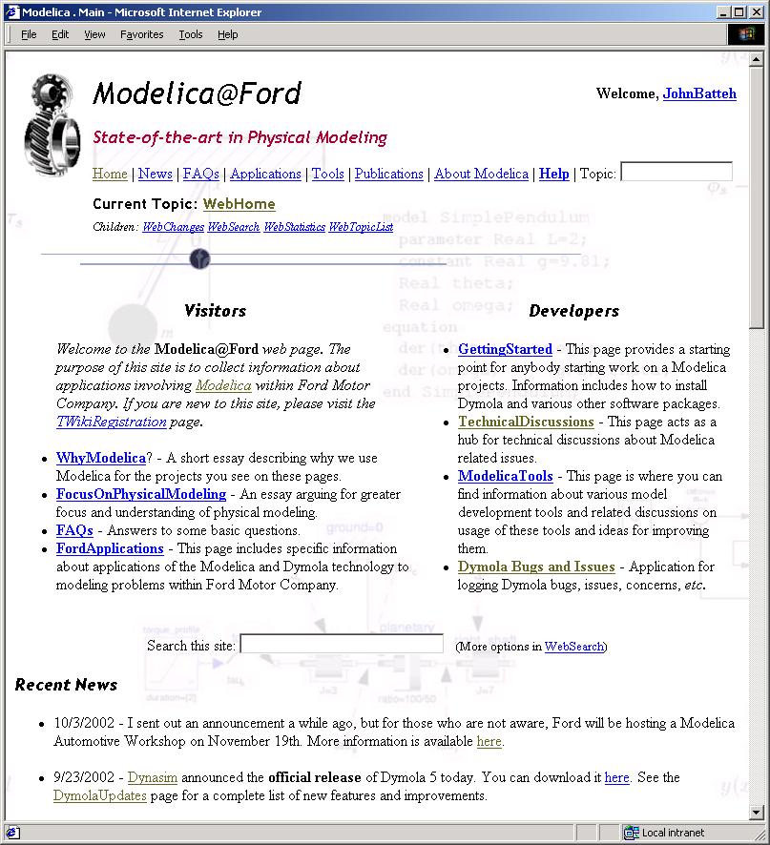
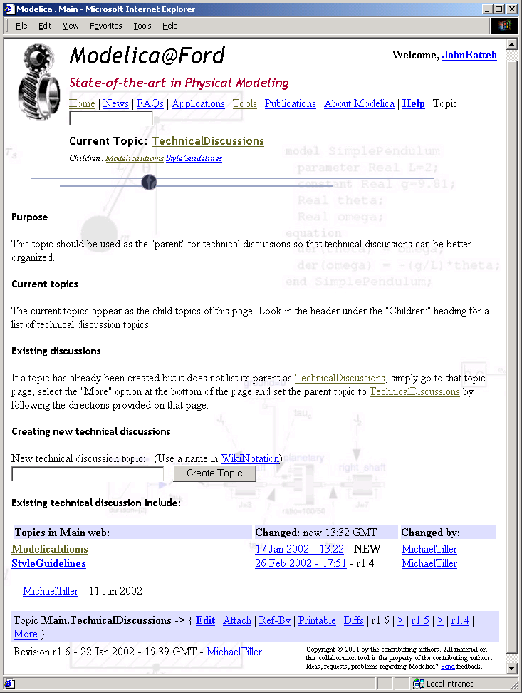
Wiki Screen Shots

Slide 16
CORBA
Used to allow programs to communicate and interact over networks
Open standard
Cross-platform
Supports every major language
Have not needed this functionality yet
Typical example of thought out solution

Slide 17
Modelica

Slide 18

Unclear Message
Not (strictly) about physical modeling
Interest in an open specification
Format for model storage and exchange
Features beyond behavioral descriptions
  Data handling
  Code maintenance
Non-proprietary
Scalable
blah blah Modelica blah blah causality
blah blah Modelica blah blah Simulink
Modelica blah blah index reduction blah

Slide 19
Development Effort
It requires a considerable effort to identify all the issues and then develop solutions
We wanted to leverage work already done
The diverse composition of the Modelica Organization provided many views

Slide 20
Capturing Information
Encapsulation (protected, public, encapsulated)
Built-in types capture
  Units, min & max values, nominal values
Annotations – Meta Data
  Non-behavioral (e.g. graphical)
  All tools must preserve this data
  Structured/Hierarchical (conceptually like XML)
  Avoids “kitchen sink” approach
  Useful for other applications (e.g. FMEA)

Slide 21
Meta-Data
Annotations
  Currently used for several things including
    “Masks”
    Laying out components and connections
    Documentation
  Completely open-ended
  Can be associated with models, functions, packages, model instances, etc
Structured comments
Possible to store arbitrary data files in the Modelica model hierarchy

Slide 22
Configuration Management
Example: Level of fidelity
“Redundancy is the root of all evil”
Version control provides different dimension sometimes misused, e.g.
      Version 1.3 – Model with base halfshafts
      Version 1.4 – Model with stiff halfshafts
      Version 1.5 – Model with slip clutch
We build this into the model
  Parametrically change whether shaft is rigid or compliant
  Swap one component for another with a comparable interface

Slide 23
“Variant” Control
Using “Save As” is problematic
Variants are nice because they
  Reference other classes (not copy)
  Do not alter the “base” model
  They explicitly list exactly what has changed (called modifications)
Type safe

Slide 24
Example
Reuse another
model
Parametric
modification
model TransmissionWithFriction
extends Transmission(rigidShaft=true, damping=0.72,
redeclare Ford.Mechanical.Gears.PlanetaryWithLosses
planetary(ratio=Nr/Ns, efficiency=efficiency));
end TransmissionWithFriction;
Topological
modification
New component
type

Slide 25
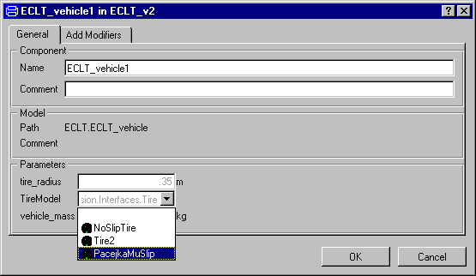
GUI Handling
Variations are handled similarly to LSM
Annotations are used for choices

Slide 26
Representing Behavior
Modelica includes both declarative and procedural semantics
    Can be used for scripts and functions
Can handle both continuous and discrete behavior
    Can be used for things like Petri nets, digital circuits and state charts
Different GUIs might be required to build models
Different simulators may provide different performance for different problem types

Slide 27
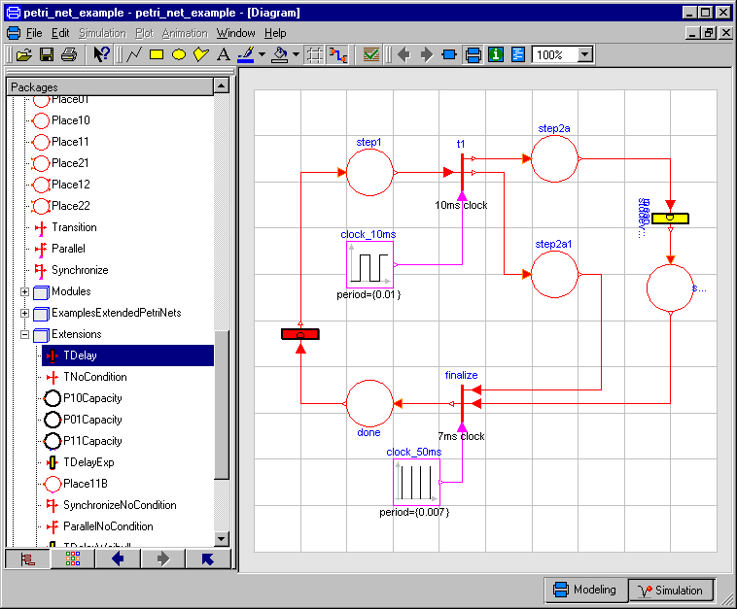
Control Logic
Discrete behavior

Slide 28
Control Logic (cont.)
model Tdelay "Transition with one input and one output connection"
parameter Real delay=5;
protected
Boolean activated;
Boolean delay_passed;
Boolean fire;
Real last_activation_time;
equation
//activation of transition
activated = inTransition.state;
//set activation time
when activated then
last_activation_time = time;
end when;
//activated and delay passed
delay_passed = activated and ((time - delay) > last_activation_time);
//fire command
fire = activated and delay_passed and not outTransition.state;
//propagate firing to in and output places
inTransition.fire = fire;
outTransition.set = fire;
end TDelay;

Slide 29
Modelica Applications

Slide 30
Sample Package Structure
Libraries
definition
(e.g. package)
definition
(e.g. package)
definition
definition
definition
definition
definition
parameter
annotation
component
component
constant
equation
component
equation
annotation
component
equation
definition
modifications
definition
component
equation
…
annotation
annotation
Model
definition
component
component
component

Slide 31
Modelica Tools
Simulate models
Generate documentation
Bundle models for distribution
Style guideline reporting
Other possibilities
  Specialized diffing/merging
  Code generator
  Obfuscation/shrouding
  Conversion/transformation utilities
  Formal verification

Slide 32
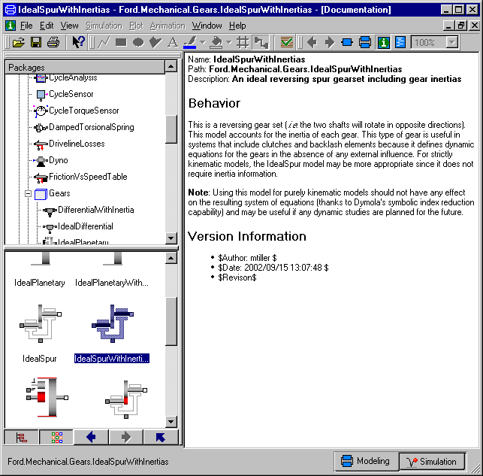
Example: Dymola Layers
Dymola uses annotations for:
  Icon graphics
  Diagram layout (and drawing elements)
  Documentation
Result
  All captured in the model
  Viewable in Dymola
  Used to generate HTML documentation

Slide 33
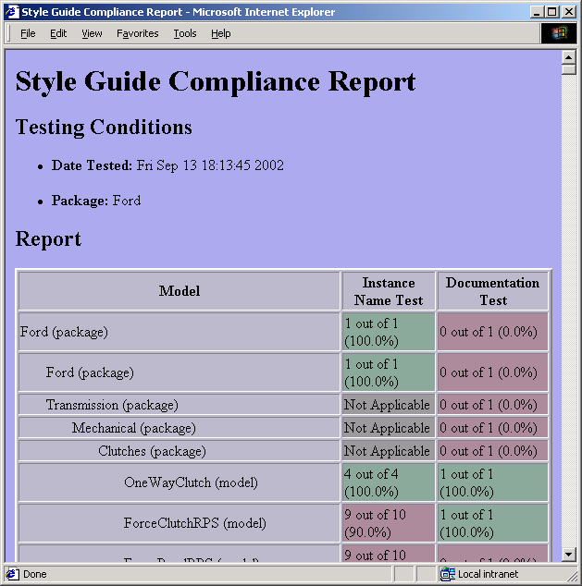
Style Guidelines
Typical requirements
  Naming conventions
  Documentation requirements
  Avoid confusing constructs
  Make code more reusable/maintainable
Possible to automate the process of checking these guidelines
  Report Generator

Slide 34
Translating Representations
Example: (simple) Simulink diagrams
Read “.mdl” file, generate an AST
Process AST and then generate Modelica code
Components involved:
  Continuous: Sum, Sin, Gain
  Discrete: Triggered Subsystem

Slide 35
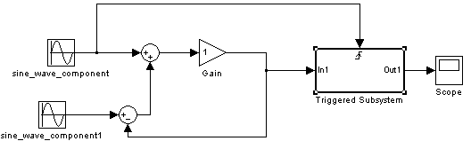
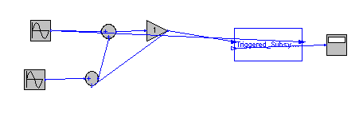
Toplevel System

Slide 36
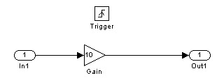
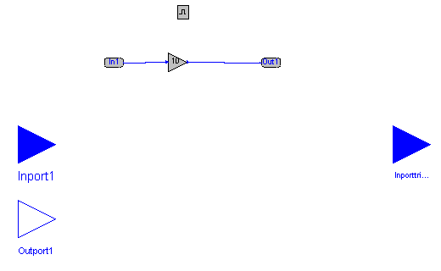
Subsystem

Slide 37
Preserving Information
Block {
BlockType Sin
Name “sine"
Position [120, 70, 150, 100]
SineType “Time-based"
Amplitude "1"
Bias "0"
Frequency "10"
Phase “0“
Samples “10"
Offset "0"
SampleTime "0"
VectorParams1D on
}
Simulink.Sin sine(
Bias=0, Amplitude=1, Phase=0,
Frequency=10) annotation(
Simulink(Offset="0",
SampleTime="0",
VectorParams1D=on,
Samples="10",
SineType="Time-based"),
extent=[-82,74;-72,84]);

Slide 38
Conclusions

Slide 39
Summary – Tool Philosophy
Handle version control and configuration management differently
Use open and mature tools and technologies as a foundation
Be prepared to customize, this requires
  Open standards
  Application Programmer Interfaces (APIs)

Slide 40
Summary – Modelica
Captures all kinds of behavior
Fairly mature and scalable
Handles meta-data
Avoids the “Save As” syndrome
Room for more than simulation tools
  Doesn’t have to be a monolithic system

