Slide 1
Translating the WETS Model
Part I, Mike’s Take

Slide 2
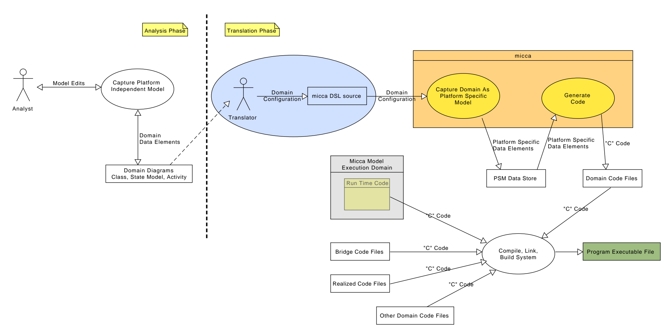
Micca Workflow

Slide 3
Topics
Micca DSL syntax
Specifying Domains
Specifying Classes
Specifying Relationships
Specifying External Entities
Specifying Population

Slide 4
Micca DSL syntax
Micca uses a Domain Specific Language to populate the Platform Specific Model
Micca DSL is an internal DSL coded in Tcl
Syntax is TCL
  Tcl syntax has 12 rules
  For micca, you need only a few of the rules.
  Importantly, Tcl is a command language – think shell-script like

Slide 5
Specifying Domains
# WETS domain – 2025-03-31
domain wets {
# Place a single domain in a file
# Define data types, classes, relationships, external entities,
# and domain operations
…
}
No real order dependency in the domain definitions.
Entire domain is specified as part of a single transaction on the platform-specific meta-model.

Slide 6
Domain Commands
  class – defines classes
  association – defines associations between classes
  generalization – defines generalization hierarchies
  domainop – defines domain operations
  eentity – defines external entities
  typealias, interface, prologue, and epilogue – additional constructs

Slide 7
Specifying Classes
typealias Direction_t {enum {
dir_up,
dir_down,
}}
class VesselGroup {
attribute direction Direction_t
attribute awaitingAssignment bool
statemodel {
# state model commands are used to define
# the states, events, transitions, initial state,
# default transition and final states
...
}
}

Slide 8
Class Commands
attribute name type ?-default value?
  ?-dependent formula? ?-zeroinit?
statemodel model-definition
polymorphic event ?argname argtype?
classop
instop
constructor
destructor

Slide 9
Specifying State Models
statemodel {
initialstate WaitingForOpenGate
defaulttrans CH
transition WaitingForOpenGate - clearedToCrossGate -> CrossingGate
…
transition CrossingGate - lockRequested -> Mooring
…
state WaitingForOpenGate {} {
// Put your “C” code here
// Use micca embedded commands for model level activities
}
…
}

Slide 10
State Model Commands
state name parameters body
transition currstate – event -> newstate
event name ?argname argtype?
initialstate state
defaulttrans transition
final ?state …?

Slide 11
Translating Classes
1st Approximation – remove all identifying and referential attributes
  micca does not enforce identity constraints
  micca internally uses pointers to navigate relationships
2nd Approximation – retain identifying attributes for classes that interact outside of the domain.
  classes that are proxies for External Entities require identifiers

Slide 12
Class Examples
Vessel interacts with an External Entity
class Vessel {
attribute License VesselLicense_t
attribute Transfer_direction TransferDirection_
}
Assigned Vessel is a subclass of Vessel
class Assigned_Vessel {
attribute Status MotionStatus_t
}

Slide 13
Translating Associations
micca semantics for relationships are a close match to xUML relationship semantics
micca uses a direction notion for associations
  for association that are functions, the association command is written from left to right as the domain to the codomain.
  1 – 1 (bijective), ? – 1 (injective), + -- 1 (surjective), * -- 1 (non-surjective)
all partial function associations must have an associative class
  the left to right / domain to codomain direction applies here
  ? -- ?, + -- ?, * -- ?

Slide 14
Translating Associations
all set valued function associations must have an associative class
  here the choice of which class is the domain and which is the codomain is arbitrary
  + -- +, + -- *, * -- *
The direction idea shows up in the traversal syntax
  R1 => traverse from domain to codomain
  ~R1 => traverse from codomain to domain

Slide 15
Translating Associations
An association may be marked as -static or -dynamic.
A static association does not change the number of association instances at run time.
A dynamic association allows for changing the association instances at run time.
The default is -dynamic.
micca uses the static / dynamic nature of an association to choose better data structures, i.e. it can use an array as opposed to a linked list.

Slide 16
Translating Associations
An association may be specified as -multiple.
Multiple associations support Many to Many to Many associations.

Slide 17
Association Examples
association R3 Waiting_Vessel *--1 Wets
association R6 -static Gate 1--1 Culvert
association R5 -associator Transit_Lane_Gate -static\
Gate +--1 Transit_Lane

Slide 18
Translating Generalizations
Generalization relationships can be specified as either -union or -reference.
A union generalization is implemented by a union data structure.
A reference generalization is implemented by pointers.
Multiple generalization, where one subclass is a subclass in multiple generalization hierarchies may only be a union generalization in one of the hierarchies.

Slide 19
Generalization Examples
generalization R2 -union Vessel\
Waiting_Vessel Assigned_Vessel

Slide 20
Translating State Models
micca State Model semantics match xUML state model semantics.
No special consideration are necessary.
Translating is a matter of expressing the semantics of the State Diagram in micca syntax.

Slide 21
Translating Activities
Activities in micca are written in “C”.
To account for differing static data types, model level operations are embedded into the “C” code.
There is an embedded micca DSL.
The embedded commands are surrounded by “<%” and “%>” markers.
Micca pull out the embedded command and replaces them with the appropriate “C” code.

Slide 22
Activity Example
Translating ordinal associations.

