Slide 1


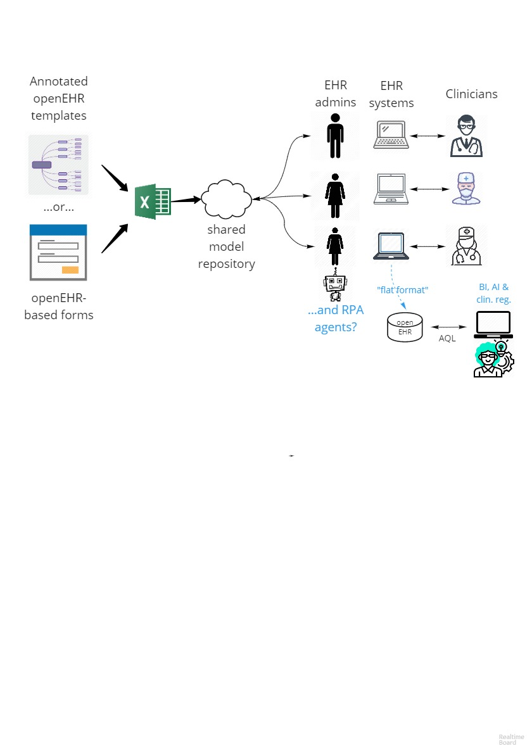




Configuration of input forms in EHR systems using spreadsheets, openEHR archetypes and templates Erik Sundvall^{a,b}, Annika Terner^{c}, Helen Broberg^{d}, Carrick Gillespie^{e} ªDepartment of Biomedical Engineering, Linköping University, Linköping, Sweden, ^{b}Region Östergötland, Linköping, Sweden ^{c}Department of Public and Caring Sciences, Uppsala University, Uppsala, Sweden ^{d} Department of Digitalization and IT, Region Skåne, Lund, Sweden ^{e} Omniq AB, Stockholm, Sweden Differences in structure and semantics of data captured using screen forms in different Electronic Health Record (EHR) products and configurations is the root cause of many interoperability problems. We present a workaround enabling reuse of openEHR archetype and template semantics to configure forms in four surveyed, insufficiently standardized, EHR-products used in Sweden: Cerner Melior, Cerner Millennium, Cambio Cosmic and CGM TakeCare. Admins of these systems often use spreadsheets to prepare EHR form configurations, so we made a version that can be shared over system and region boundaries. In a proof of concept test, data from a non standardized EHR was then easier to export and query using openly standardized (openEHR AQL) query mechanisms.
More details in 2-page poster abstract in Medinfo 2019 proceedings, pages 1781-1782 http://dx.doi.org/10.3233 /SHTI190645
Spreadsheet example and more info available at https://github.com/ modellbibliotek/standin/tree/master/ehr-form-config
Figure 1 illustrates the workflow; templates of shared interest are collaboratively created and annotated (using normal openEHR toolchains) to fit use-cases and then (algorithmically) converted to the suggested spreadsheet format and uploaded to a shared repository (e.g. on GitHub) When the EHR administrators configure forms based on the spreadsheet they make sure to also carry over information regarding which openEHR template-ID the form is based on into the EHR. Information about which archetype-based path each spreadsheet row is associated with also needs to be stored in the EHR configuration or some other place that export mechanisms later can use to re-associate the EHR data with the path. Exact association mechanism may vary between systems, shorter Dewey-compressed or hashed paths an also be used instead of full paths in EHR data.

