Slide 1















Strategic
Reception
Staging
Onward Movement
Kilkoola
Port Albert
180miles
240miles
Zwillinge
80miles
80miles
Weema
40miles
60miles
60miles
North of Ttaala
Kiwonvu
Sitoovu
60miles
320miles
40miles
Kuloto
Jabali
Sitoovu

Slide 2
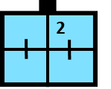






Strategic
Reception
Staging
Onward Movement
Belawan
National Staging Points
Kuala Lumpar
Medan

