Slide 1
NATO (Logistics) Operational Doctrine
NATO UNCLASSIFIED

Slide 2
Agenda
Introduction, Allied Joint Doctrine Architecture
Roles & responsibilities
NATO Doctrine Lifecycle
Logistics doctrine
NATO Standardization Office (NSO) portal
NATO UNCLASSIFIED

Slide 3


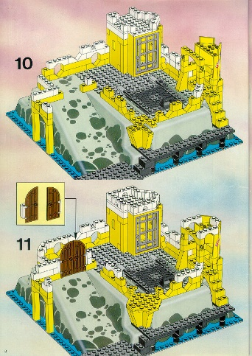
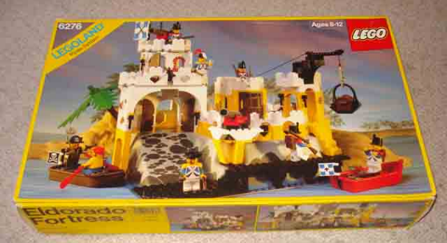
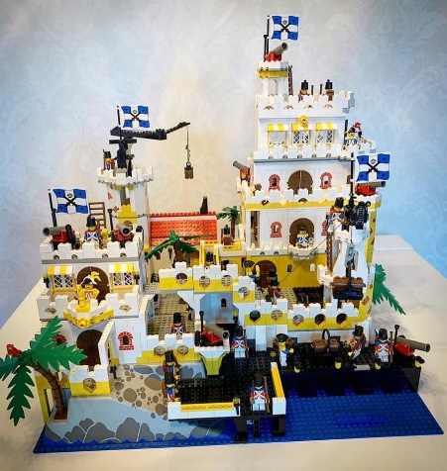
Doctrine
“Fundamental principles by which the military forces guide their actions in support of objectives. It is authoritative but requires judgement in application.” (NATO Term)
→ Doctrine focuses on how to think, not what to think.
NATO UNCLASSIFIED

Slide 4
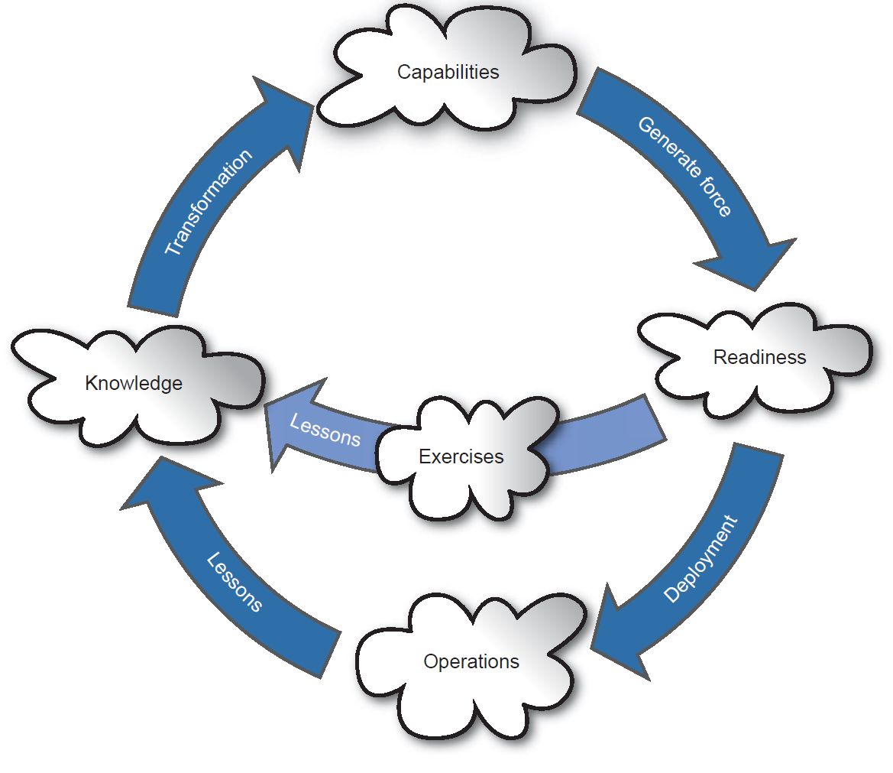
Doctrine
Allied joint doctrine:
enhances the interoperability of Alliance forces
promotes a common perspective from which to plan, train and conduct operations
provides insights and wisdom gained from operations.
Allied joint doctrine is based on extant capabilities, current force structures, equipment, …
AAP-47 (and AAP-03)
Joint force development cycle
NATO UNCLASSIFIED

Slide 5
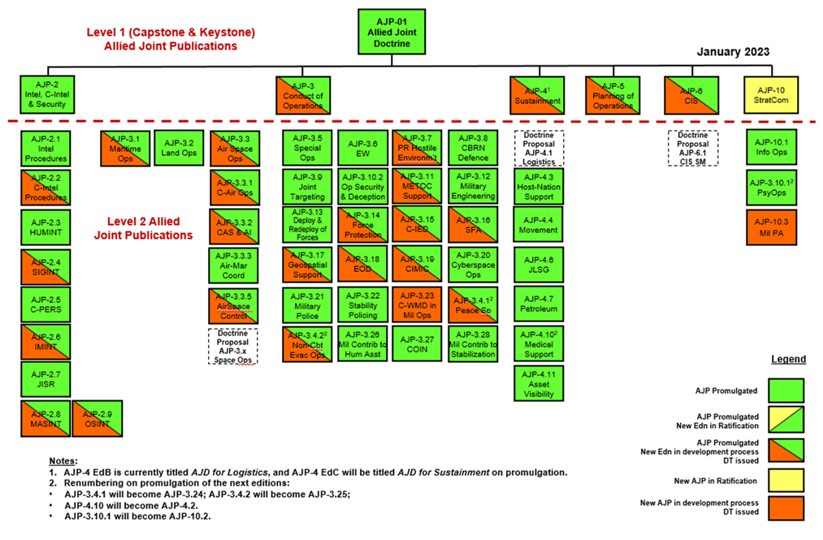
Allied Joint Doctrine Architecture
NATO UNCLASSIFIED

Slide 6
Roles & responsibilities
Allied Command Transformation (ACT)
Allied Command Operations (ACO)
Military Committee Joint Standardization Board (MCJSB)
Allied Joint Operations Doctrine Working Group (AJOD WG)
NATO Standardization Office (NSO)
Nations
Centres of Excellence (COE)
Custodians
International Military Staff doctrine sponsors
NATO UNCLASSIFIED

Slide 7
NATO Doctrine Lifecycle
Originator
New Doctrine proposal
ACT
Review doctrine proposal and issue RFI
AJOD WG/MCJSB
Cancellation
5 year lifecycle
Detailed in the Allied Joint Doctrine Campaign Plan (AJDCP)
ACT
Data Fusion
ACT
Review iaw AJDCP issue RFF
ACT
Draft Doctrine Task
NATO/Nations
Educate, Train, Exercise and Assess
AJOD WG/MCJSB
Endorse/Approve Doctrine Task
NATO/Nations
Implementation
AJOD WG/Custodian
Study Draft(s)
NSO
Promulgation
AJOD WG/Custodian
Harmonization Draft
Nations
Ratification
MCJSB
Ratification Draft
NATO UNCLASSIFIED

Slide 8
Logistics doctrine
MC 0319
MC 0326
MC 0334
MC 0336
MC 0473
DIRECTIVES
AJP-4 (B) Logistics
Promulgation date : Dec 2018 Custodian : ACT - Mr. Twose Will be titled Sustainment. SD2 now anticipated Jun 23
LEVEL 1
LEVEL 2
Custodian : ACT - Mr. Twose New Level 2 Logistic publication DFW delayed due to delay MC 0319/4 SD1 anticipated Q4 23
AJP-4.1 Logistics
AJP-4.7 (B) Petroleum
Promulgation date : Oct 2017 Custodian : ACT - OF-4 Billerey On hold to be subsumed into AJP-4.1
AJP-4.3 (A) Host Nation Support
Promulgation date : Apr 2021 Custodian : ACT - OF-4 Rades Assessed in 2023
AJP-4.10 (C) Medical Support
Promulgation date : Sep 2019 Custodian : ACT - OF-4 Sell Renumbering to AJP-4.2. SD1 anticipated Q3 23
AJP-4.4 (C) Movement
Promulgation date : Sep 2022 Custodian : ACT - OF-4 Vogrin Assessed in 2024
AJP-4.11 Asset Visibility
Promulgation date : Feb 2011 Custodian : ACT - OF-4 Macias On hold - Review of level of doctrine possible level 3
AJP-4.6 (C) JLSG
Promulgation date : Dec 2018 Custodian : ACT - Mr. Twose On hold to be subsumed into AJP-4.1
LEVEL 3 (APs)
ALP-1
ALP-4.2
ALP-4.3
ALP-4.16
AJMEDP
AJMEDP
NATO UNCLASSIFIED

Slide 9
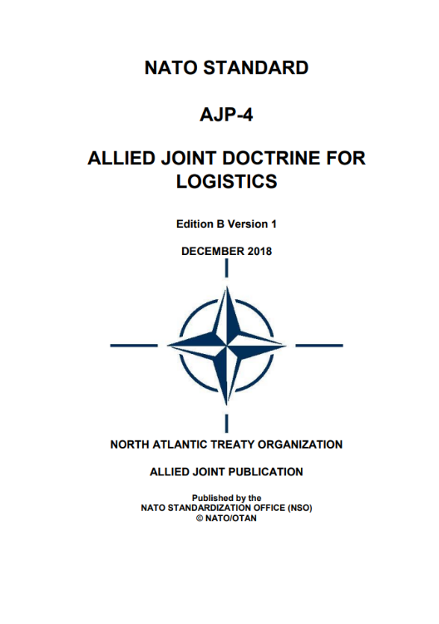
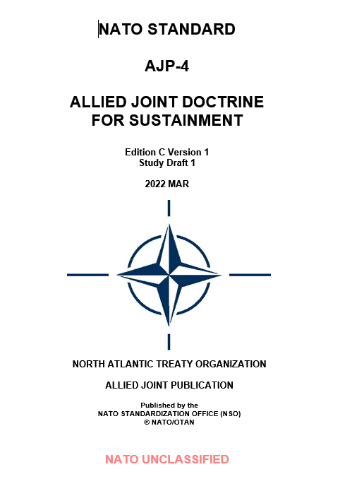
Logistics doctrine
Sustainment activities:
Personnel support
Logistics
Medical support
Military engineering
Finance
Contracts
NATO UNCLASSIFIED

Slide 10
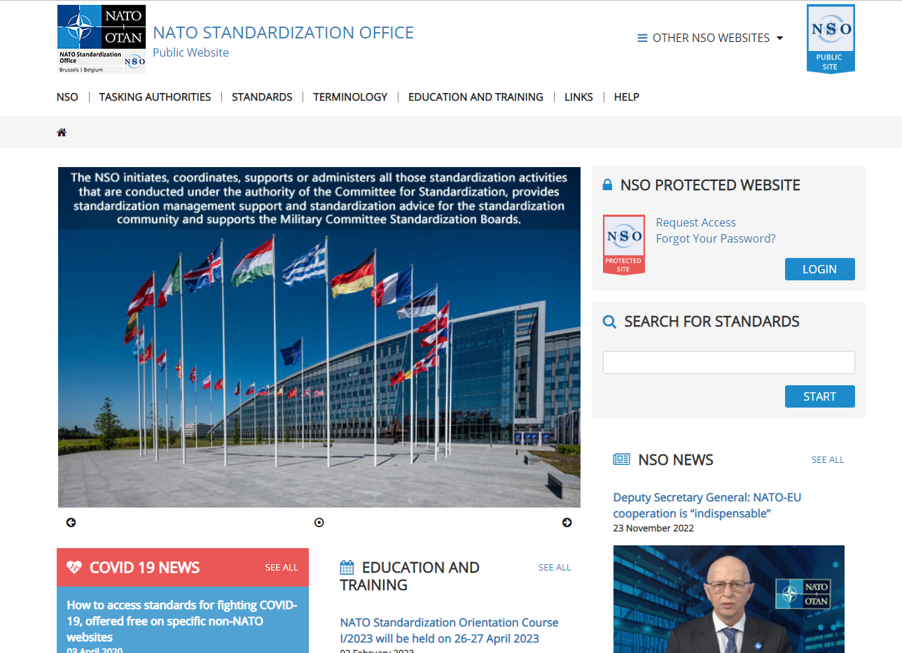
NSO portal
https://nso.nato.int/
Promulgated standards
Custodians
AJDCP
Forums to join
Custodian Support Forum
NATO UNCLASSIFIED

Slide 11
QUESTIONS
NATO UNCLASSIFIED

