Slide 1
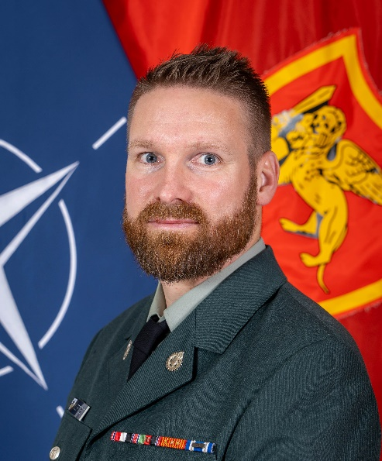
Who am I?
Age: 40
Years in service: 15
Branch: Military Logistics
Rank: OR-7 / Staff Sargent
International
Environment: - 6 months NOR NSE AFGH 2011-2012
- 6 months NOR NSE AFGH 2012-2013
- 6 months KTCC IRAQ 2017
Deployments: 2x ISAF, 1x KTCC,
At JFC Naples: since 1 Aug 2022 (until Aug 2025)
1st NATO Assignment

Slide 2
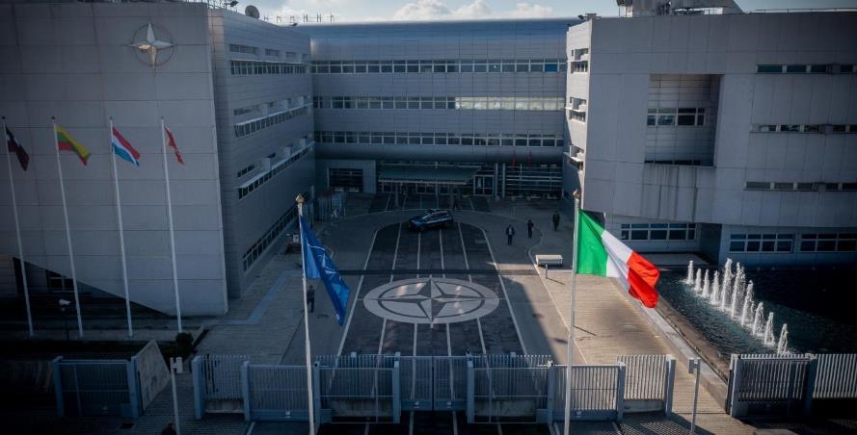
Allied Joint Force Command Naples Command Mission Brief
NATO UNCLASSIFIED
Notes:
Good morning ……………..,
My name is ……………………. from ………………………..
I will spend the next 20 minutes presenting you the Allied Joint Force Command Naples Command Brief.
NEXT SLIDE

Slide 3
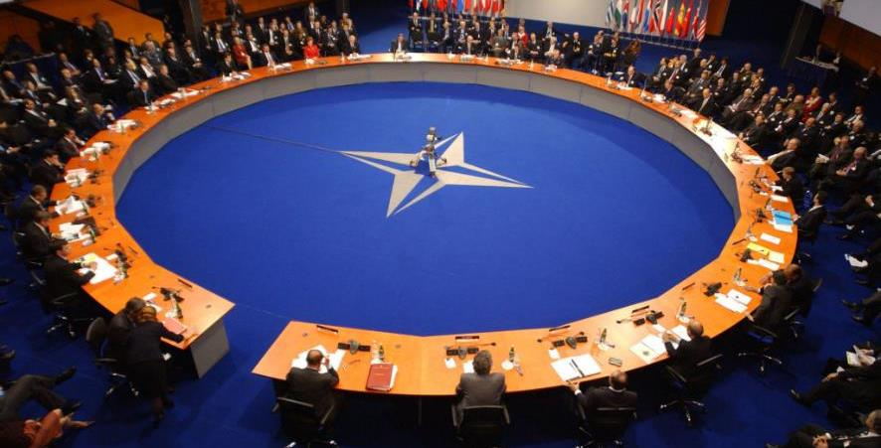
Overview
Our Allied History
History of JFCNP
Mission and Tasks
Enduring Operations
NSD-S HUB
Cooperative Security Efforts
NATO UNCLASSIFIED
Notes:
NEXT SLIDE

Slide 4
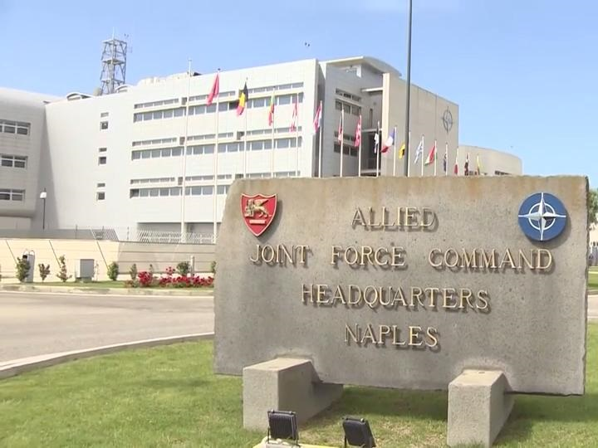

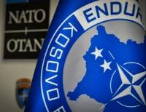

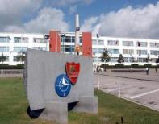



Allied JFC HQ Naples: An historical overview
​
5/28/2018
1951
​
​
Founded as Allied Force Southern Europe (AFSOUTH)
​
1954
Transfer of the HQ to Bagnoli
Renamed - Joint Force Command Naples (JFCNP)
1999
2004
2011
2018
​
2012
Transfer of the HQ from Bagnoli/ Naples to Lago Patria
2021
Operation Allied Solace
NATO UNCLASSIFIED
26/02/2023 | PAGE 4
Notes:
Our HQ at Naples dates back to the Allied Force Southern Europe Headquarters (AFSOUTH), founded in 1951.
An expansion of the structure, responsibility and the re-naming of the HQ to Allied Joint Force Command NAPLES occurred in 2004.
The present headquarters, moved from BAGNOLI, to here in LAGO PATRIA in 2012.
Also important to note: On 18 January 2001, AFSOUTH assumed operational responsibilities for "Joint Guardian," which included the Kosovo Force. KFOR at the time was comprised from 39 nations, 20 of which were not part of NATO;
Operation Unified Protector was a NATO operation in 2011 enforcing United Nations Security Council resolutions in 1970 and 1973, concerning the Libyan Civil War. The Joint Force Command Naples was the Leading HQs of the Operation and a dedicated Task Force settled and co-located in BAGNOLI. The operation officially ended on 31 October 2011, after the rebel leaders, formalized in the National Transitional Council, declaring Libya liberated on 23 October.
Since 2018 JFCNP has been leading NATO MISSION in IRAQ (NMI), a Non-combat mission with both Military and Civilian components. The mission is demand-driven and built to answer specific requirements, as expressed by the Government of Iraq to provide trainings and advise to the Ministry of Defense. It involves delivering train-the-trainer activities and advising at the tactical level, providing specific schools and Professional Military Education (PME) institutions.
It is worth noting that the emblem of JFCNP is the lion of St. Mark, the traditional symbol of the Republic of Venice, the epicenter of Sea Power during past centuries. It was adopted by this Headquarters as a symbol of power, holding open the book of peace and a raised sword.
NEXT SLIDE

Slide 5

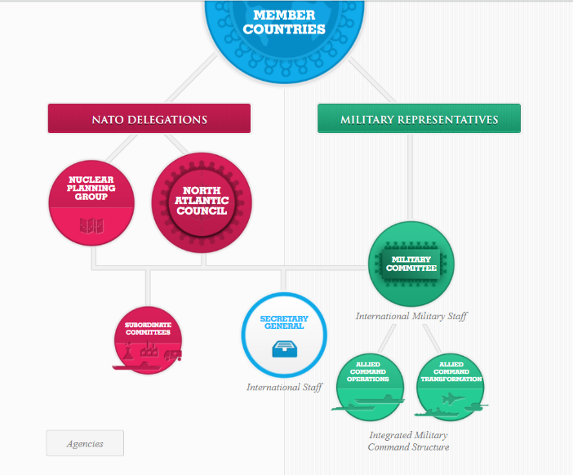
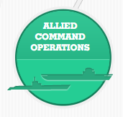
NATO’s Operational Force Commanders
NATO UNCLASSIFIED
26/02/2023 | PAGE 5
Notes:
The North Atlantic Treaty Organization is a political and military alliance. The North Atlantic Council (NAC) is NATO’s main political decision-making body.
The North Atlantic Treaty gave the NAC the power to set up subsidiary bodies for various policy functions, including a Military Committee to implement parts of the treaty.
The NATO Military Command Structure consists of two strategic commands placed under the control of the Military Committee.
These are Allied Command Transformation (ACT) and Allied Command Operation (ACO).
NEXT SLIDE

Slide 6



Our focus is on:
Russia
Aggressive actions and willingness to attain political goals by threat and use of force.
Terror Groups (TGs)
Instability across the Middle East and North Africa is fuelling terrorism.
NATO UNCLASSIFIED
Notes:
Our Mission,
In an ever-evolving security environment NATO faces two key threats.
The first is Russia and the second are Terror Groups (ITGs), each aiming to destabilize NATO’s alliance and gain the military advantage.
Instability across the Middle East and North Africa is fueling terrorism and contributing to migration and human trafficking.
The threat from both is persistent from peacetime… though crisis… to conflict.
NEXT SLIDE

Slide 7




Our responsibility Plan, prepare and conduct operations across all domains
DDA
(Collective Defence)
Crisis prevention and management
Cooperative Security
NATO UNCLASSIFIED
Notes:
Our responsibilities,
JFCNP, as a joint operational level HQ, is responsible for planning, preparing and conducting the full spectrum of joint activities, missions and operations within the assigned geographic area, across all domains, from Baseline Activities and Current Operations (BACO) and through crisis and conflict in order to support NATO’s 3 core tasks; collective defence, crisis management, and cooperative security
The Concept for Deterrence and Defense of the Euro-Atlantic Area (DDA) underpins all our planning and preparation for conducting activities and operations. It details the Alliance's military goals, intended approaches, and resource requirements to address the current and future threat environments.
The need to significantly strengthen our deterrence and defence as the backbone of Article 5.
NEXT SLIDE

Slide 8
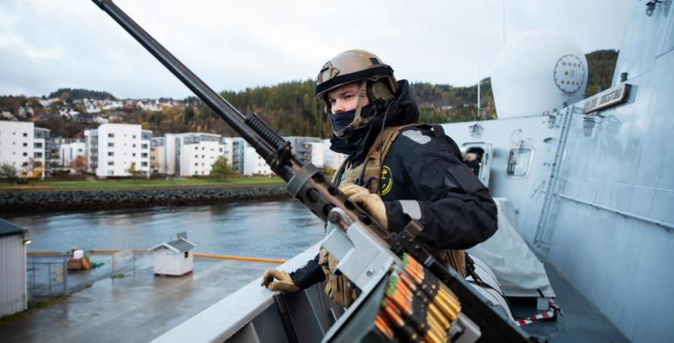
JFCNP Focus
Be ready to fight
Prepare for the future fight
Deter to defend
NATO UNCLASSIFIED
Notes:
In light of this, we must:
Be Ready to Fight Tonight.
We will accelerate the operationalization of JFCNP as a warfighting HQ.
This imperative ensures our HO maintains the highest readiness if called upon for defense of the EuroAtlantic area.
Prepare for the Future Fight.
We will innovate by transforming operational level concept development across NATO. We will continue the critical work of advancing and evolving our Regional Plan (RP) by
integrating the Subordinate Strategic Plans and existing Graduated Response Plans in light of the adversary's ways and posture. We will support the Secretary General's NATO 2030 initiatives, forge new relationships within the construct of the NATO African Union Cooperation Plan (NAUCP) to project influence and promote stability.
Deter to Defend.
We will maximize Peacetime Vigilance Activity within Vigilance Area South and East and adapt NATO's Military Instrument of Power for the future. We must seek to 'win without
fighting' in collaboration with our Allies and partners
To illustrate our resolve, please look to the screen for another video by our Public Affairs team
NEXT SLIDE

Slide 9
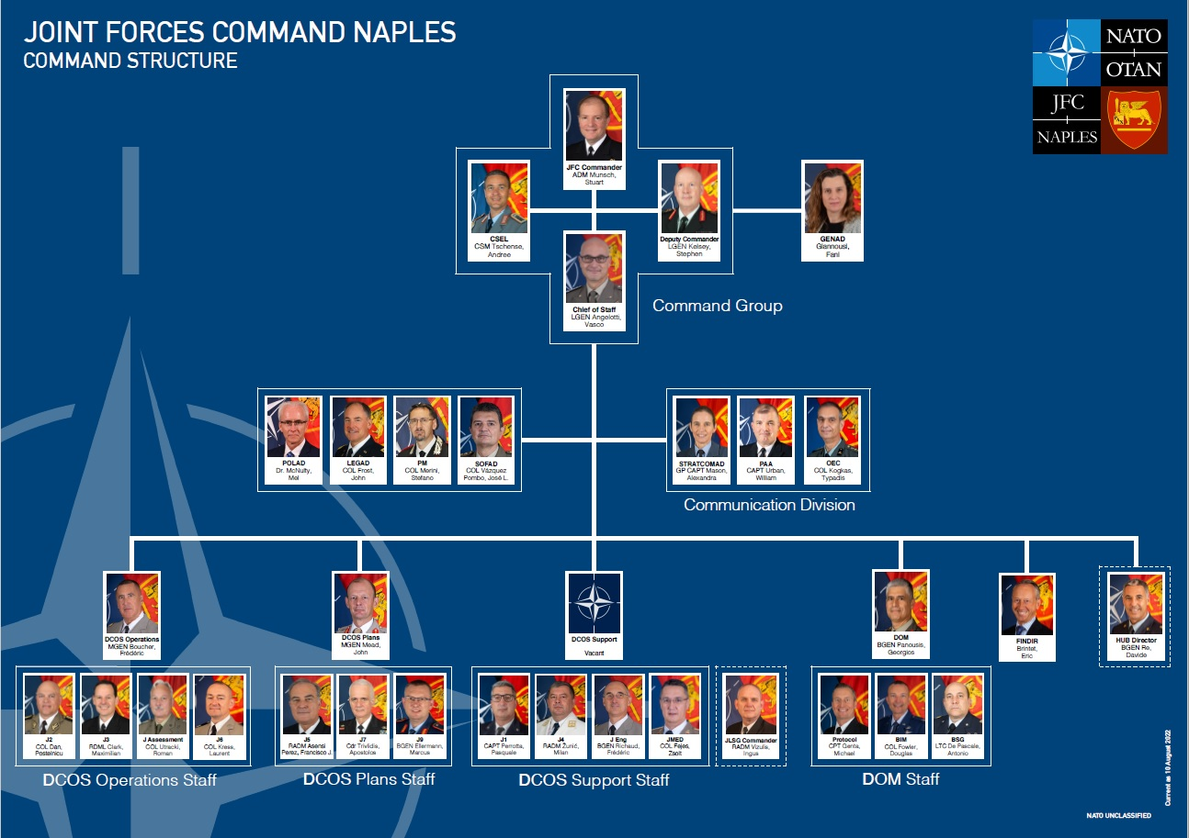

Slide 10
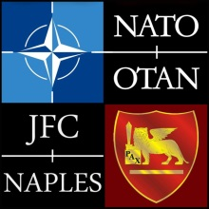
J4 ORGANISATION, ROLES AND RESPONSIBILITIES
JFCNP J4
Notes:
10
Presentation:
I am …
I am at the J4 division in Logistic Operation & Planning Branch (LOPB) as a ….

Slide 11


J4 Organizational structure
DCOS SPT
Total PE: 49
12 vacant
37 posts are manned from 15 Nations
J4 Division
ACOS J4
Front Office (2)
Movement and Transportation Branch (MTB) (20)
Logistic Operations and Plans Branch (LOPB) (26)
Notes:
The J4 division consists after NCS-A of 2 branches and 49 personnel.

Slide 12
J4 Roles and Responsibilities
The operational-level alliance logistics requirements planning and coordination for JFCNP and assigned Area of Interest,
Logistic support to operations, that covers:
Movement and transportation,
Sustainment support for all classes of supplies,
Planning and coordination of Contracting Support to Operations (CSO) and Host Nation support (HNS),
Use of Logistic Functional Services (LOGFAS)
Planning and coordination of logistic policies, concepts, doctrines, exercises and training,
Participating in the development of doctrines, NATO Command Structure adaptation and new projects,
Notes:
J4 is responsible to DCOS SPT for:
1) All logistics requirements planning in our Area of Interest – at an operational level
This covers:
Movement and transportation,
Sustainment support for all classes of supplies,
Planning and coordination of CSO and Host nation support,
Use of logistic functional services (LOGFAS)
2) We bring to the table the logistic perspective in all Planning and coordination activities.
3) We do participate in different projects and development of doctrines

Slide 13
J4 Big Rocks
Supporting Planning efforts regarding logistic implications.
Regional Plan (RP)
Graduate Response Plans GRP 2 & 3
Alignment of DDA : Sequenced Response Plan (SERP)/ Regional Plan (RP) / Subordinate Strategic Plans (SSPs)
Enablement of SACEUR’s AOR.
Supporting current operations/missions NOSH/KFOR/NMI – RSOM/sustainment/transportation issues.
Supporting current and upcoming exercises.
Mobile Training Teams (MTT)
WGs.
Notes:
These are the big rocks J4 has been dealing and are going to cover next year.
Enablement of SACEUR’s AOR : Enablement means that ‘identification, implementation and maintenance of the conditions for the physical and operational environment to assure the Alliance’s ability to project and sustain combat power across and from SACEUR’s AOR, in pursuit of strategic and operational goals’
There are 3 Enablement Targets to be achieved
(1) enablement of the VJTF already achieved by 31 December 2019;
(2) enablement of the remainder of the NATO Response Force partially achieved by 31 December 2021; and
(3) enablement of the Follow-on Forces by 31 December 2024
In this J4 is the lead and supported by other divisions.
We provide J4 SMEs into the Joint Operations Planning Team RP and GRP and other Plans and develop Annex R/S of the operational plan. Additionally, every year we update and submit the related Reception Staging and onward Movement Plans (RSOM).
We monitor the current operation such as operation Noble Shield and missions KFOR and NMI, provide advice on log issues. For instances, J4 has been coordinating the movement of personnel and NATO equipment in IRAQ.
We support all current and upcoming exercises.
J4 provides up to three MTTs for logistics planning to nations.
We participate in several working groups to provide advice from logistics perspective.

Slide 14

NATO Support and Procurement Agency (NSPA)
NSPA. A NATO chartered Agency which brings together NATO’s non-CIS logistic support and procurement activities, providing integrated multinational support solutions to its stakeholders.
Capability Portfolio: Support to operations & exercises; Strategic transportation & storage; Fuel management; Logistic services & project management & Systems procurement and life-cycle management.
NSPA Planning and Liaison Team. Established and funded by ACO to enable ACO, in partnership with NSPA, to provide integrated contract planning, implementation and management to improve the delivery of logistic support solutions to the NCS, NFS and TCNs for operations and training.
Notes:
NSPA is NATO’s ‘non-CIS’ procurement, logistics and services agency; established to provide collective and multinational contracted solutions for NATO Allies and Partners.
Contractor Support to Operations (CSO) has become an integral part of logistic support. NSPA must be considered at the outset when planning or training for operations and missions. Fortunately we have a planning and liaison officer from NSPA in permanently embedded in the HQ to advise and assist us.

Slide 15


Q & A?
JFCNP J4
Notes:
15

