Slide 1
Securing Tomorrow, Today
How well is Ireland’s intelligence structures responding to 21st-century threats like cyberattacks, espionage, and terrorism, and what are the key challenges and opportunities in building a modern, effective intelligence capability?
Commandant Adam Beatty, Major Romin Pousson
25 November 2025

Slide 2
EXECUTIVE SUMMARY
While Garda NCSIS is legislated as the "security services", in practice IMIS ICCW NSAC are the defensive intelligence arms of the state
Decisive lacuna: Irelands' structures are internationally-comparable, the absence of a national security strategy cripples 'direction'
A notable lacuna exists pertaining to the collection of metadata
Ireland has no dedicated civil service career stream or National Security Adviser role – unlike the UK system we otherwise follow
Ireland's secretive approach is immature and in contrast to others' Janowitzian approach to CMR
National Crime & Security Intelligence Service (NCSIS)
Irish Military Intelligence Service (IMIS)
National Security Analysis Centre (NSAC)

Slide 3
Presentation Structure
Executive Summary
Ireland's threat evolution
Country Comparison
A way forward
Existing structures
Key legislation
Civil servants
Conclusion

Slide 4


Irish Intelligence Structures
Peers task – Ireland liaises
(An Garda Síochána, n.d.)
(An Cosantóir, 2025)
Notes:
https://www.garda.ie/en/about-us/our-departments/garda-national-crime-security-intelligence-service1/
https://digital.jmpublishing.ie/i/1539308-an-cosantoir-july-august-2025/5?

Slide 5
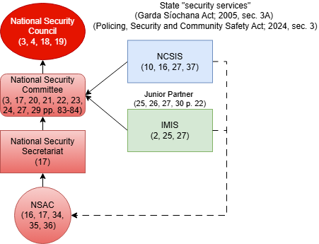
Mapping Existing Structures
Key Deficiency: Unlike other states, Ireland doesn't publish a map of its Intelligence Community
Cannot analyse research question or present our conclusions without elucidation
Research Methodology: We sourced and analysed 37 publications and 9 legislative Acts to map and understand the existing structures
Dáil records, legislation, academic articles & books, government websites, Defence Forces’ officers and newspaper articles
National Crime & Security Intelligence Service (NCSIS)
Irish Military Intelligence Service (IMIS)
National Security Analysis Centre (NSAC)
(Dáil Éireann, 2022)

Slide 6
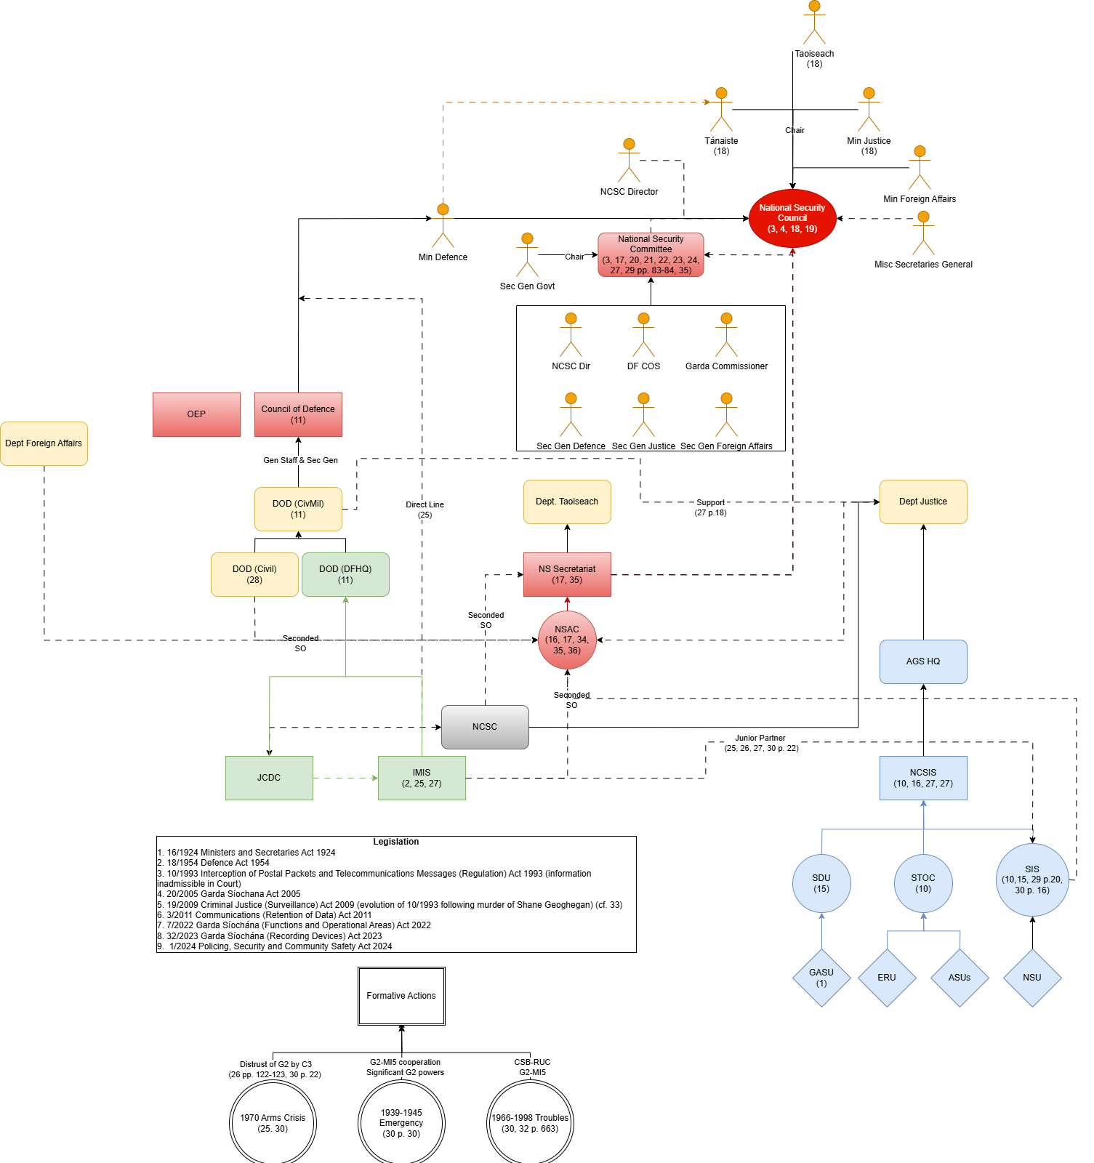
Mapping Intelligence Agencies & Structures
Diagram References
1. Gallagher (2025a)
2. Gallagher (2025b) 3. Department of the Taoiseach (2025) 4. Leahy (2025)
5. An Garda Síochána (2025a) 6. Government of Ireland (1993, pp. 8-9) 7. Government of Ireland (2011, pp. 11-15)
8. Committee of Public Accounts (2013, p. 13, p. 22, p. 46, p. 56)
9. Halloran (2013)
10. Dáil Éireann (2022, q. 127)
11. Government of Ireland (1954, pp. 31-32)
12. Government of Ireland (2023)
13. Government of Ireland (2009)
14. Irish Examiner (2012)
15. An Garda Síochána (2025b)
16. Commission on the Future of Policing in Ireland (2018)
17. Gallagher (2025c)
18. Dáil Éireann (2025a, q. 2)
19. Dáil Éireann (2025a, q. 14-24)
20. Murphy (2014)
21. Government of Ireland (1974, sec. 3.9)
22. Dáil Éireann (1982, q. 412)
23. Dáil Éireann (2004, p. 1153)
24. Dáil Éireann (2005, q. 31)
25. Heney (2020, pp.216-218)
26. Mulqueen (2009)
27. Mulqueen (2013)
28. Government of Ireland (1924)
29. Dunne and Kerrigan (1984)
30. Government of Ireland (2005)
31. Halpin (2002b)
32. Halpin (2010)
33. Dáil Éireann (2009a)
33. Dáil Éireann (2009b)
34. Dáil Éireann (2024, q. 1-5)
35. Walsh (2024)
36. Dáil Éireann (2021, q. 21-23)
37. Government of Ireland (2024, pp. 25-26)
Confer printed poster

Slide 7
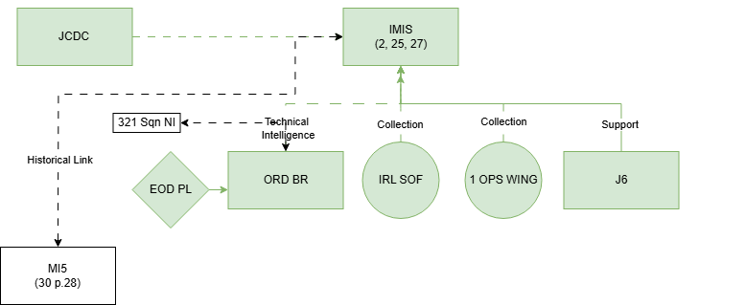
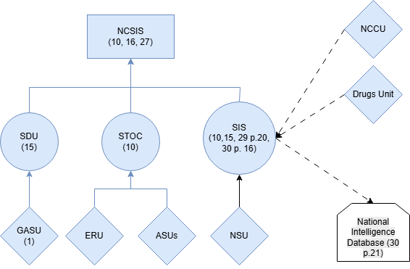
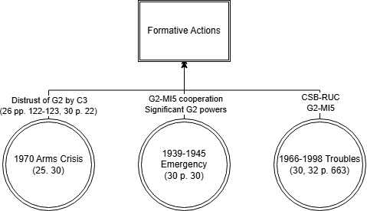
Military and Police Structures
National Crime & Security Intelligence Service (NCSIS) (formerly Crime and Security Branch, formerly C3) (Mulqueen, 2013 pp 19-20)
Special Detective Unit (SDU) (formerly Special Branch)
Security and Intelligence Section (SIS)
Irish Military Intelligence Service (IMIS) (formerly J2, formerly G2) (CODF, 2022)
Joint Cyber Defence Command (JCDC) (CODF, 2022)

Slide 8
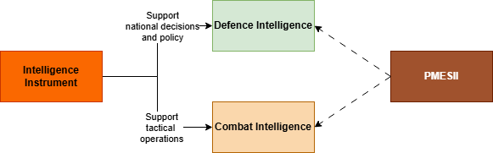
Synthesising SANDA & Intelligence Areas
Kahn’s Law: “Intelligence is the defining characteristic of defence. It is only an accompanying characteristic of offence” (O’Toole, 1990)
Gill and Phythian (2006)
Mulqueen (2008)
Davies (2016)
Strachen-Morris (2024)
Sources and Agencies (SANDA)

Slide 9
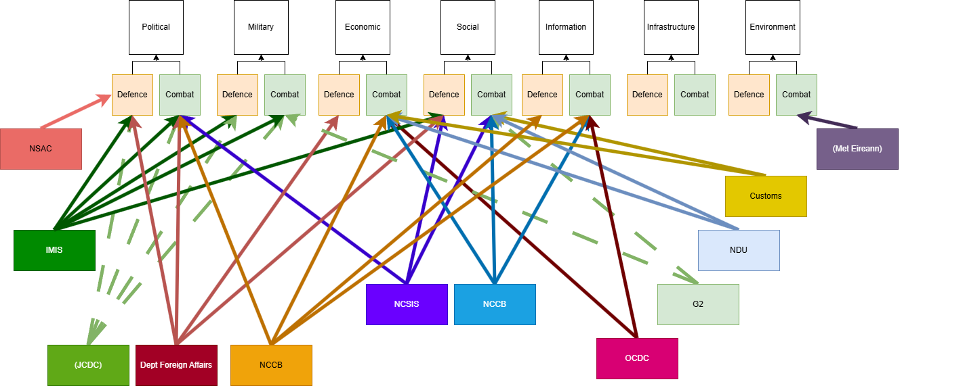
Synthesising SANDA & Intelligence Areas
Sources and Agencies (SANDA)

Slide 10
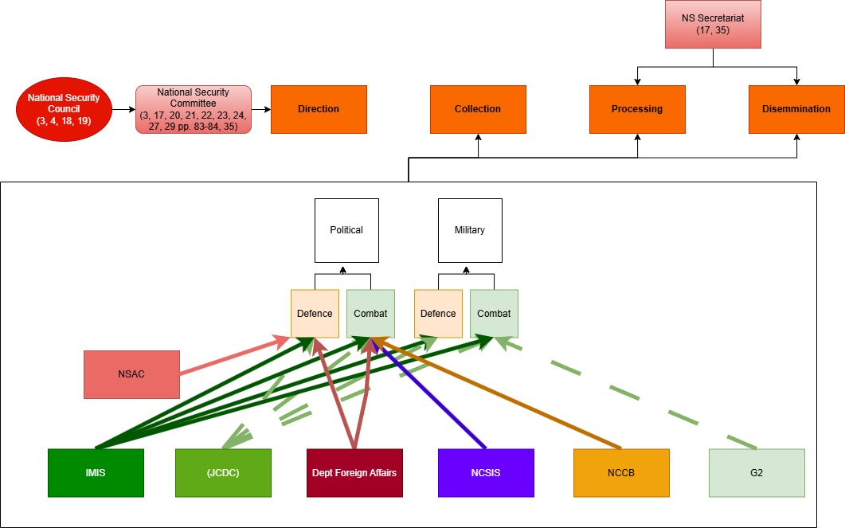
Analysis: National Security Architecture
Legislation
18/1954 Defence Act: "The Minister […] military defence of the State”
20/2005 Garda Síochana Act 2005: "protecting the security of the state […] offences, espionage, sabotage, subvert, foreign interference, foreign capabilities"
Defence Intelligence
IMIS and NSAC quietly act as the national defence intelligence agencies – without legislative authority
UK Gov (n.d., a)

Slide 11
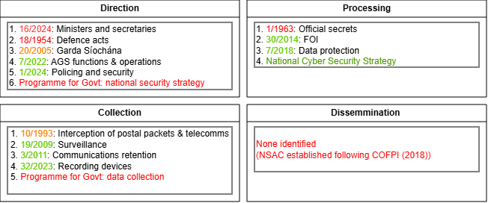
Legislation and Key Lacunae
Key lacunae
Government of Ireland

Slide 12
Decisive Lacuna: National Security Strategy/Agency
We consider that Ireland's national security structures are fit for purpose and almost identical to the UK, Sweden and New Zealand
However, Ireland has no legislative direction (via NSS). This is at odds with international practice
Without legislative direction, the agency heads decide on priorities – which can overlap
E.g., both AGS and IMIS surveilling the same people on-island (per 2009 Act)
In lieu of NSS, Irish security & intelligence governance is through the National Security Committee
The 2009 Act grants IMIS/SIS/Revenue significant powers – however nobody officially sets the threats for which these intrusive powers can be used
DOD (2025), DOJ (2025), AGS (2024), IFG (2020), UK Gov (n.d., b)

Slide 13
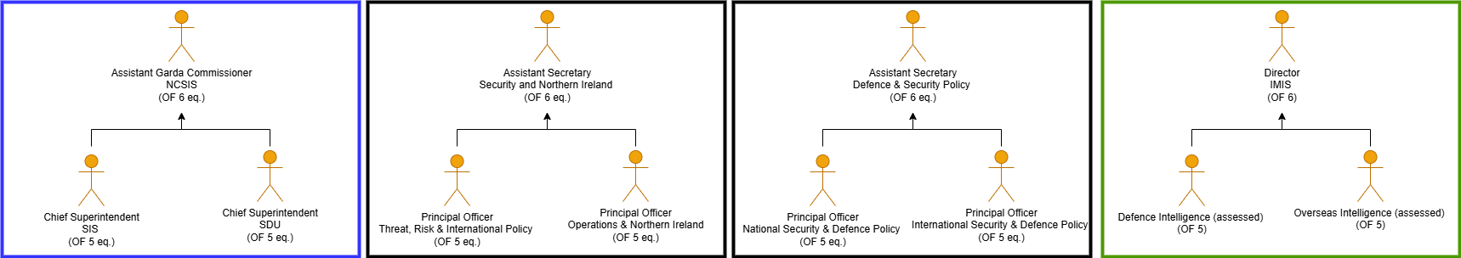
Hidden Expertise: Career Officials
The National Security Committee (NSC) appears balanced in rank and professional experience
In practice the Civil Service does not professionalise security & intelligence. Key posts are filled by rotating generalists as the norm, not the exception (pers. comm., 2025a; pers. comm, 2025b)
NSC gathers senior officials – though the career security & intelligence professionals are backbenchers
Ireland has no dedicated civilian career stream or National Security Adviser role – unlike the UK system we otherwise follow
SIS & IMIS aren't quite 'career intelligence officers' (yet) – though much more so than the civil service
DOD (2025), DOJ (2025), AGS (2024), IFG (2020), UK Gov (n.d., b)

Slide 14
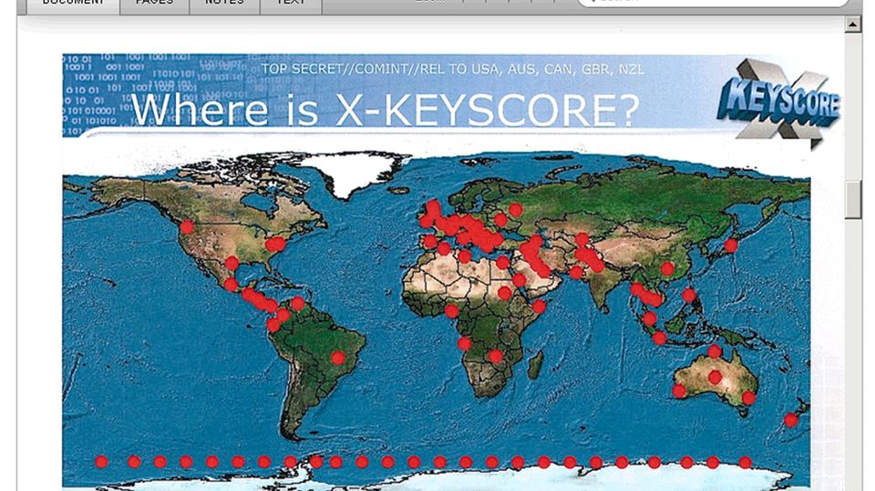
Data Collection and Ireland
Our laws were written for phones and SMS, not big data and fast sharing (Barry, 2010; Shatter, 2013)
No Irish legal equivalent to bulk collection such as PRISM or XKeyscore (Barry, 2010; Petit, 2020)
Data-led targeting is now normal. E.g., IDF tools like “The Gospel” and “Lavender” (Petit, 2020; Sylvia, 2025)
Disconnected laws make it hard to move a live lead from data to device to content, or into court (McIntyre, 2016; Coffey, 2024)
The Programme for Government promises a Communications (Interception and Lawful Access) Bill to modernise data and access rules (Government of Ireland, 2020)
Lischka, K. and Stocker, C (2013)

Slide 15
Future Considerations
(An Garda Síochána, n.d.)
(An Cosantóir, 2025)
Notes:
https://www.garda.ie/en/about-us/our-departments/garda-national-crime-security-intelligence-service1/
https://digital.jmpublishing.ie/i/1539308-an-cosantoir-july-august-2025/5?

Slide 16
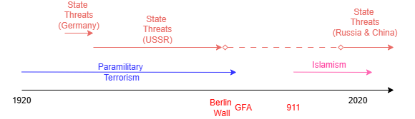
Threat Evolution
In the 21st century, the United States has clearly articulated the evolution to a state-based threat
Ireland's intelligence focus has migrated from terrorism to espionage
Internationally, this focus hasn't arisen since the end of the Cold War
We note that security, police and defence implications persist regarding the increasing short-term likelihood of GFA reunification/boarder poll, per Collins (2025)
Given the post-conflict nature of Northern Ireland's society, the safe conduct of this conversation will require meaningful IMIS/SIS input
(ODNI, 2025)

Slide 17
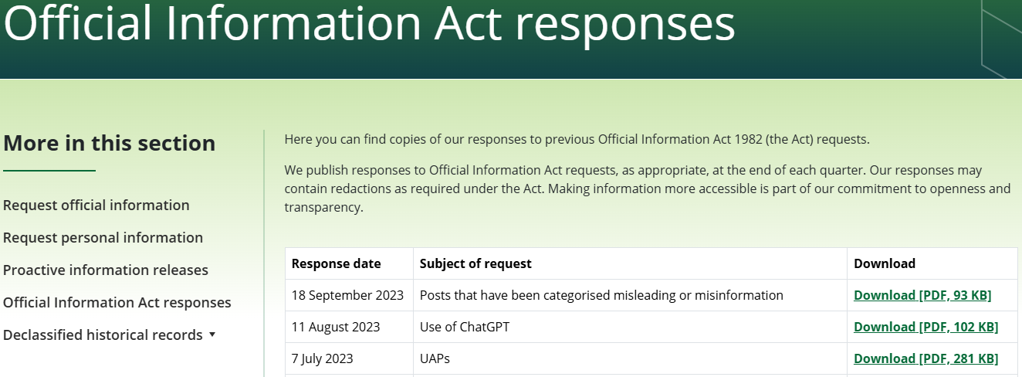
Immature Irish Civil Military Relationships
Partner nations adopt Janowitz's (1960) 'constabulary' model – informing & involving the public
For Ireland, public comment on security and intelligence is shrouded in secrecy
Without public trust, the void is filled with others' information
Foreign states can capitalise via mis and dis information
Well intentioned national academics incorrectly conclude that the structures don't exist
The CIA, UK MI6, NZ SIS etc., publish their assessments and build public trust
UK Parliamentary report (ISCP, 2023) & US National Security Strategy clearly identify the primary threat as from Russian and Chinese espionage (ODNI, 2025)
Ireland's security discussion is constrained by politics – politicians refuse to engage officially for fear of political rhetorical backlash
Vignette: To counter Russian pre-war disinformation, the CIA made all their assessments public
NZ SIS (2025)

Slide 18
Comparative Views: Sweden and NZ
Topic | Ireland | Sweden | New Zealand
Primary Agencies | No central agency Split across Gardai/ Def. Forces/ Various dept. | SÄPO - Domestic MUST – External (Military) | NZSIS – Mitigates threats to national security GCSB – Analyse signal intel to support informed decision making
Strategic Threat Focus | Historically terrorism focused Gradually shifting to state-based espionage | Focus on Russia Cyber threats / Grey Zone | Focus on PRC and Russia Cyber espionage Shaped by Five Eyes priorities
Coordination and Structure | Informal, habit-based National Security Secretariat lacks statutory authority | Structured coordination Established boards Formal interagency processes | Highly integrated under NZIC NAB – central all-of-government assessments
Legislative Framework | Fragmented legislation Political reluctance to reform | Clear laws on intelligence and surveillance Aligned with EU privacy norms | Robust defining collection, access, and use of intelligence
Oversight & Accountability | Limited oversight FOI exemptions limit scrutiny | Multiple oversight agencies Swedish Commission on Security & Integrity Protection Swedish Foreign Intelligence Inspectorate | Inspector-General of Intelligence and Security Dept of Prime Minister and Cabinet Strict review of legality
Transparency & Public Engagement | Very limited public reporting Secrecy culture Low public trust | Publish annual reports Proactive communication High public trust | Publishes threat assessments and declassified findings Among the most transparent globally
(Hefler, 2024; Mulqeen, 2009; NZIC, 2025; NZSIS,2025; Cullen & Reddy, 2016)
Notes:
FOI = Freedom of Infromation
NAB = National Assessments Bureau

Slide 19
Data Collection and European Law
GDPR steps back for national security: ePrivacy + courts set the real limits. (GDPR Art. 2(2)(a), Recital 16; Directive 2002/58/EC Arts 5, 15)
CJEU bars indiscriminate data collection per XKeyscore and PRISM (C-623/17; C-511/18, C-512/18, C-520/18)
Any bill needs narrow criteria, strict retention, independent sign-off (Directive 2002/58/EC Art. 15; Data Protection Act 2018 s. 60)
For Ireland, the legislative question is whether to emulate that kind of centralised surveillance architecture or to design a narrower, more plural model that better reflects entrenched Irish privacy scepticism about “everywhere surveillance” (Petit, 2020)

Slide 20
From Liaison Habits to Statutory Tradecraft
Ireland’s joint analysis remains informal and habit-based, with no public tradecraft doctrine or statutory mandate for the National Security Secretariat (COFPI, 2018; Mulqueen, 2013; Heney,2020).
Secrecy rightly protects methods but has left Irish analysts without the shared cross-government standards taken for granted in New Zealand, the UK and the United States.
A modest civilian post with enterprise authority (modelled on the US Under Secretary of Defense for Intelligence and Security) could enforce common standards and scheduled assessments without compromising neutrality or creating a new agency (Joint Chiefs, 2013 ; UK MOD, 2023; NZ IIP, 2023; NZ SIS, 2025; NZ SIS, 2024, NZ DF, 2017)

Slide 21
CONCLUSION
Ireland's current security and intelligence structure
Current treats: State espionage, hybrid interference, and complex political dynamics
Characterised by: Systematic habits of secrecy, informal coordination, and structures designed for the pre-modern era
=
Strengthen analysis
Enhance transparency
Increased public trust
Protection of Sovereignty
Informed citizens
Modernised security structures
Values – Cost = Utility of the military instrument. (Maxwell 2025)

Slide 22
Securing Tomorrow, Today
Thank you!

Slide 23
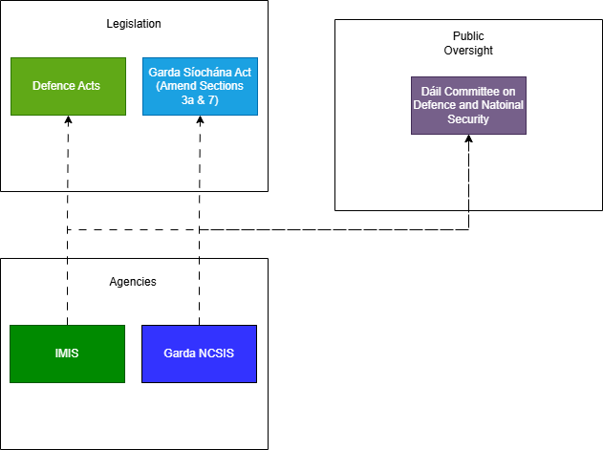
CURRENT STRUCTURES

Slide 24
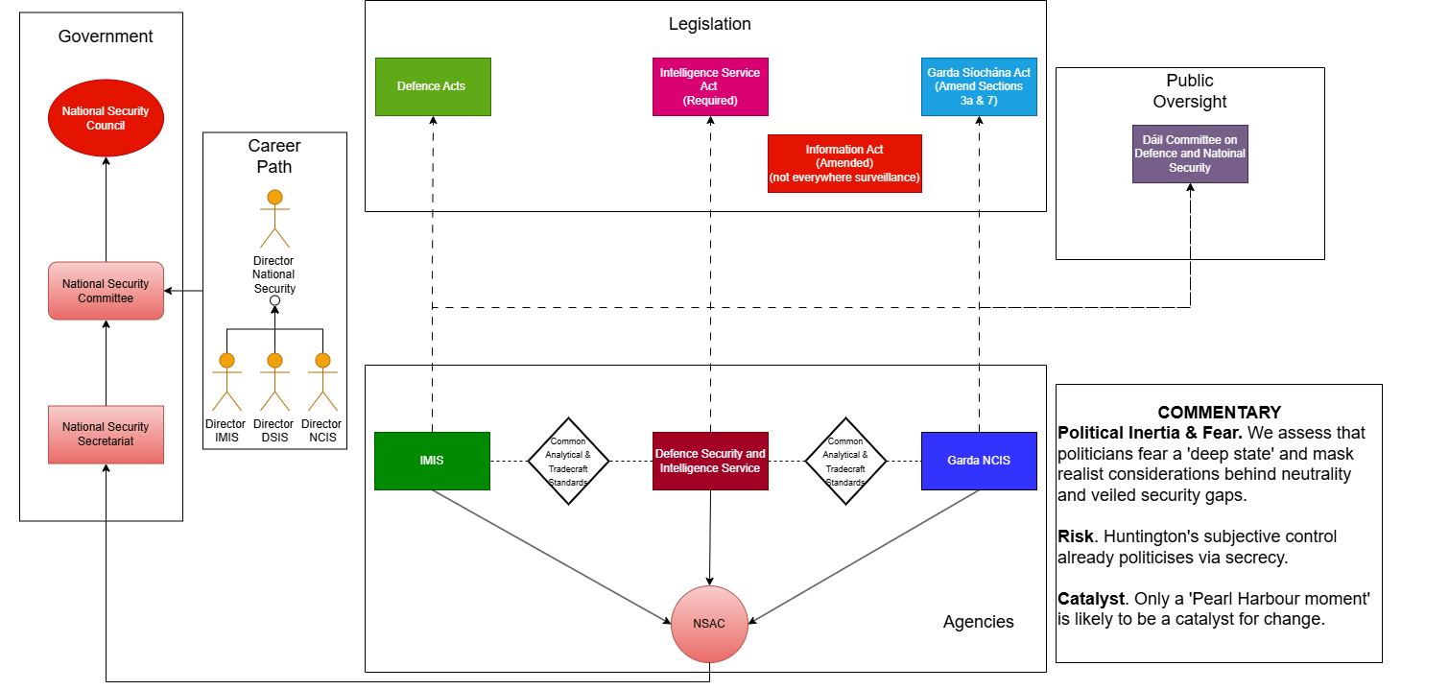
RECOMMENDED FUTURE STRUCTURES

