Slide 1
Predicting Social Anxiety with Application Session Usage Data
Anguel Hristozov, 2255541h
Notes:
Hello, and welcome to my presentation about predicting social anxiety with application session usage data.

Slide 2
Mental Health in Society
In the UK, diagnosed individuals increases yearly (1 in 10 in 2005, 1 in 6 in 2007, 1 in 4 in 2016)
How do individuals with mental health issues feel?
Isolated
Socially unacceptable
A burden on others
Outside of the UK, mental health disorders considered one of the main contributors to overall disease burden
Individuals may be misdiagnosed, or may ignore it
40-60% chance of premature death
Notes:
Mental health issues plague a large portion of the population
In 2016, 1 in 4 individuals in the UK was diagnosed.
Many mental health issues are established by the age of 14.
Outside of the UK, mental health is considered to be a main contributor to overall diseases.
These individuals tend to feel isolated and have trouble with a lot of aspects of everyday life.
Mental health issues can lead to other diseases like cancer and there is a 40-60% chance of premature death.

Slide 3
How has society reacted?
NHS is increasing their investment for mental health care
13 billion pounds estimated to be spent in 2019/20
This is equal to about 14% of the entire NHS fund
Waiting times vary greatly and discourage people
Many health systems are not adequately prepared
Large negative social stigma
Notes:
How has society reacted?
In the uk the nhs has been slowly increasing their investment year by year for mental care care.
There are long waiting times, and people get discouraged or are not treated in time.
Many other health care systems are not prepared.
Additionally, there is still a large negative social stigma surrounding people with mental health issues.

Slide 4
Social Anxiety
Overwhelming fear of social situations
Can be triggered by many circumstances
What goes on in their mind?
Decreased self-confidence
Feel like they are incoherent
Are not interesting individuals
All this leads to
Lower performance in school/work
Strained relationships
Lower economic status
More pressure on health care systems
Notes:
Social anxiety is one of the top mental health disorders.
It is an overwhelming fear of social situations as well as a fear of being observed and judged.
It does not go away on its own and in many cases requires prolonged serious treatment.
Anxiety can be triggered by many circumstances including speaking to a person, speaking to a person with authority, or any kind of public performance.
Individuals with social anxiety have lower self-confidence and feel as if they are being incoherent.
This leads to lower performance in school and work, strain on personal relationships, and lower economic status, to name a few.

Slide 5
Researching Mental Health
Wang et al. (2014)
Combination of self-report questions and data collection
Shows strong connection between student mobility, activity level, sleep, and the mental well-being
Ben-Zeev et al. (2015)
Shows that collected data in the background is enough to analyse user mental health, stress, and depression
Welke et al. (2016)
Shows that it is possible to differentiate between users by their application signature (set of used apps)
Boukhechba et al. (2017)
High accuracy in predicting social anxiety when using location and mobility (call and SMS text) data
Rauber et al. (2019)
Used application usage patterns to accurately differentiate between healthy and cognitively impaired individuals
Notes:
A study in 2014 showed a strong connection between the students’ mobility, activity level, sleep, and the mental well-being.
A study in 2015 showed that collected data in the background is enough to analyse and understand the individual’s mental health, stress, and depression levels.
A study in 2016 showed that 99.67% of smartphone users have a unique application signature, which is their set of used applications.
A study in 2017 showed that using location and mobility data gives high accuracy in predicting social anxiety within users.
A study in 2019 showed that application usage patterns can be used to accurately differentiate between healthy and cognitively impaired individuals.
This past research shows that smartphones are a very capable medium of recording data, and said data is accurate in detecting mental health problems such as social anxiety.
The project took inspiration from all of these studies, among others.

Slide 6
Project Aim
Can an individual’s social anxiety be reasonably predicted by observing how they use their mobile phone?
What can their set of used applications tell us?
Notes:
This leads us to the project aim.
We want to see if an individual’s social anxiety can be reasonably predicted by observing how they use their mobile phone.
More specifically, we want to look at their application session usage data and see what it can tell us.

Slide 7
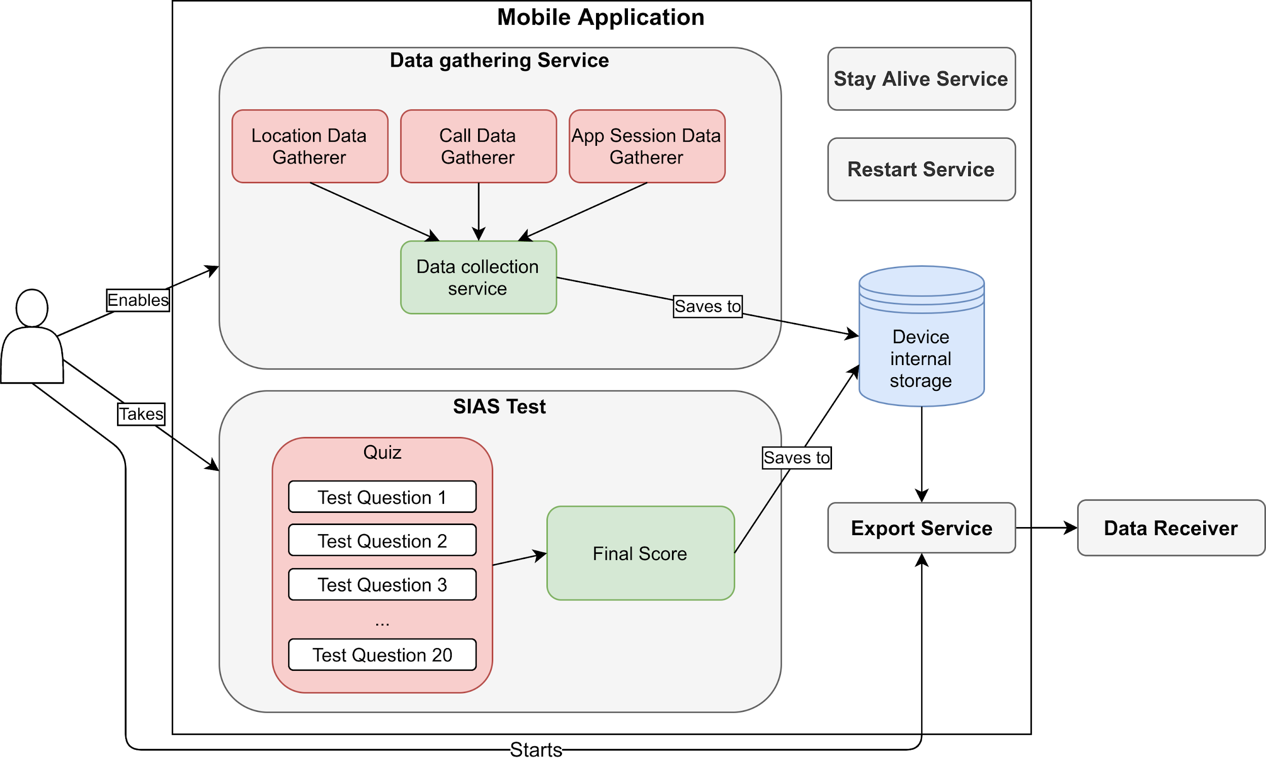
Project Design
Application to collect data in the background
Notes:
We would need an application to collect data in the background as well as allow participants to take the Social Interaction Anxiety Scale exam.
This scale is a clinical self-report made up of 20 questions that aims to assign a score between 0 and 80. A score of 34 and above means that the individual is considered to have symptoms of traditional social anxiety.
There is a session usage data gatherer.
Additionally there are 2 data gatherers for location and call data so that we can compare our results with past research.
All of this data is saved to the device, and then the participant can trigger the data export option, which sends it to the remote database.
To ensure that data is collected reliably, there is a service that attempts to keep the app alive instead of letting the system kill it. There is additionally a restart service that restarts the app if the phone restarts.

Slide 8
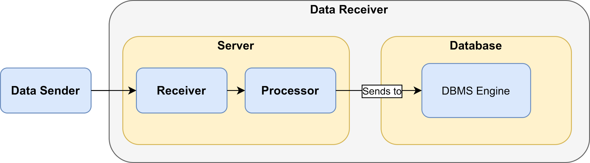
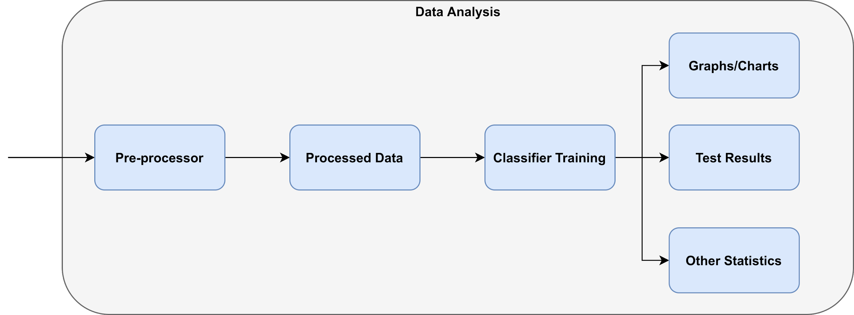
Project Design (cont.)
Remote server and database to receive and store data
Data analysis
Notes:
The remote server and database are in charge of receiving the data from the phones and storing it. The database data is encrypted at-rest and during transit. Additionally, the server has HTTPS enabled with a TLS certificate.
This is to ensure that data is protected and secured.
The data analysis is required for statistical analysis as well as classifier training and graph and chart generating.

Slide 9
Project Implementation
Android application
SIAS test
Location used Fused Location Provider API
Session data used Usage Stats Manager API
Call duration manually tracked
Export service with Okhttp POST requests
Amazon Web Services for server (EC2) and database (RDS)
Data analysis
Python
Pandas and numpy
Scikit-learn
Decision Tree Classifier
Extra Trees Classifier
Random Forest Classifier
Matplotlib and Seaborn
Notes:
To implement the app, Android was chosen. The session data was acquired using the Android Usage Stats Manager API, which records all application usage data on the phone.
Location data was gathered with the Google FusedLocationProvider API. This API aims to be battery friendly as well as provide the most accurate data from all available sensors instead of only GPS.
Call duration data was tracked manually.
The stay alive service was implemented as a persistent notification. This would prevent the system from killing unless the system was running low on memory or battery.
A 3rd party library was used to track the session management.
Okhttp was used to implement the export service. The data would be exported via a series of HTTP POST requests.
Amazon web services was used to host the server and database in the London datacenter.
The data analysis was done with Python. It used Pandas and numpy and used the classifiers from scikit-learn. Matplotlib and seaborn were used to generate charts and graphs.

Slide 10
Evaluation
Decision tree with location data achieved accuracy of 86%
This conforms with Boukhechba et al. (2017) and Wood (2019)
Cross-validation confirms model accuracy.
Most popular location category among socially anxious individuals was home
More research is needed
Care should be taken when processing location data
Notes:
After the data was gathered from the trial, the location data was examined first.
Each set of latitude and longitude coordinate was reverse geocoded and the category of that location was saved.
We trained a decision tree classifier with the location category labels and achieved 86% accuracy in identifying social anxiety.
The most popular location among socially anxious individuals was home. Both the accuracy and most popular category label conform with results from past research.
We conclude that location can be used to identify social anxiety but more research is needed. Additionally, care should be taken with the data. There was a large class imbalance between socially anxious and non-anxious individuals and this suggests that the model may be skewed or biased.

Slide 11
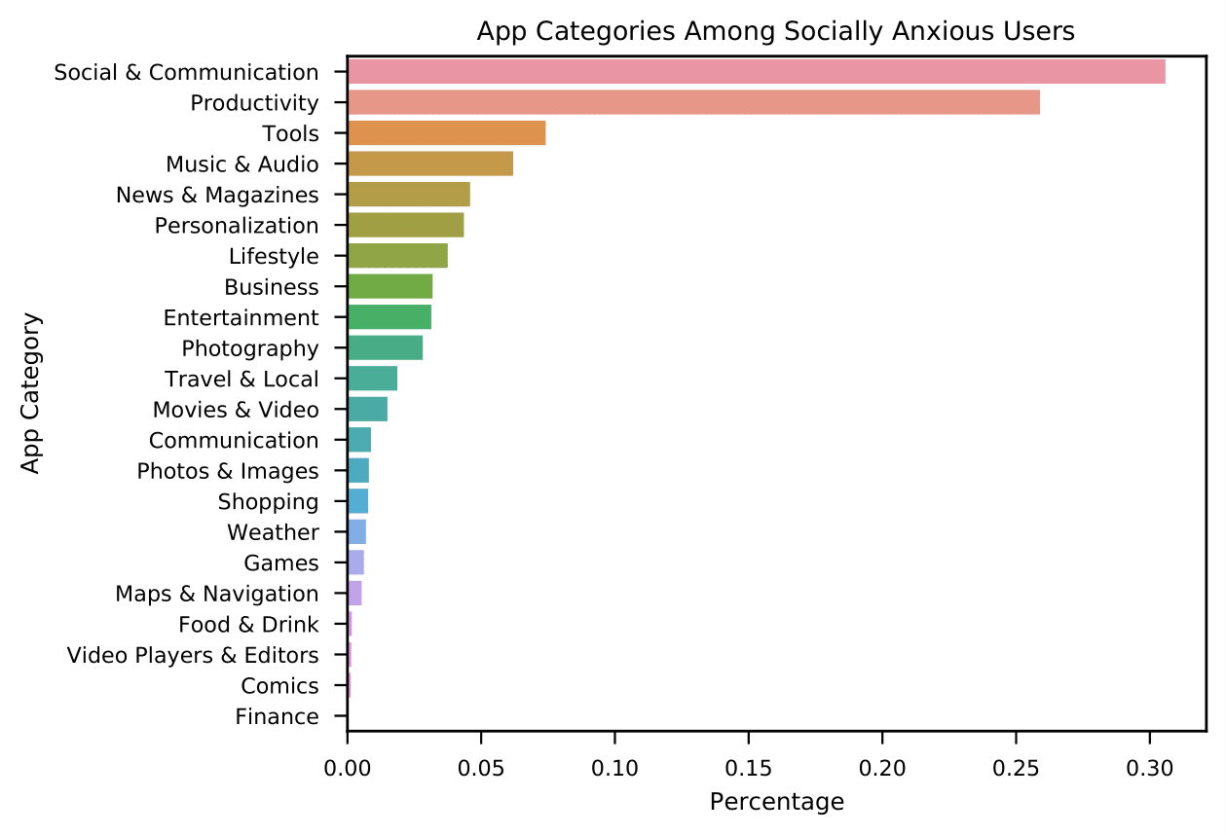
Evaluation (cont.)
Notes:
Next we will examine the session usage data. This chart shows us the breakdown of application categories among socially anxious users.
Social & Communication applications were most popular among socially anxious individuals, followed by Productivity and Tools

Slide 12
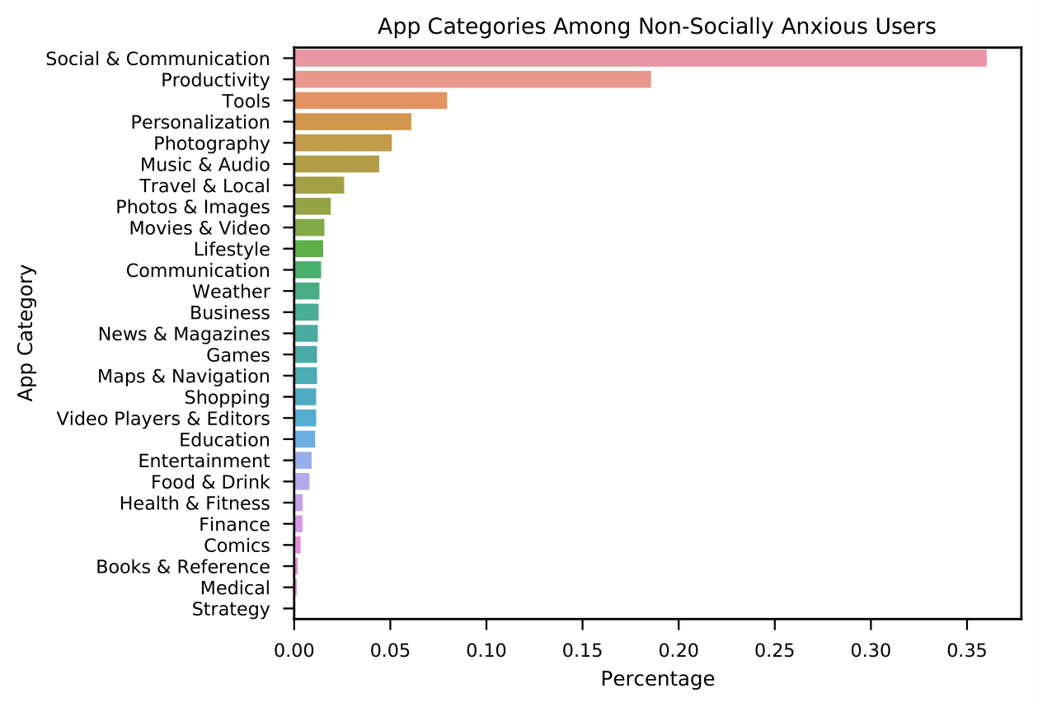
Evaluation (cont.)
Notes:
This graph shows us the app category breakdown among non socially anxious users.
Compared to non-anxious individuals, socially anxious individuals used Social & Communication and Productivity applications less overall
This suggests socially anxious people may avoid applications that are social in nature instead of only avoiding other individuals

Slide 13
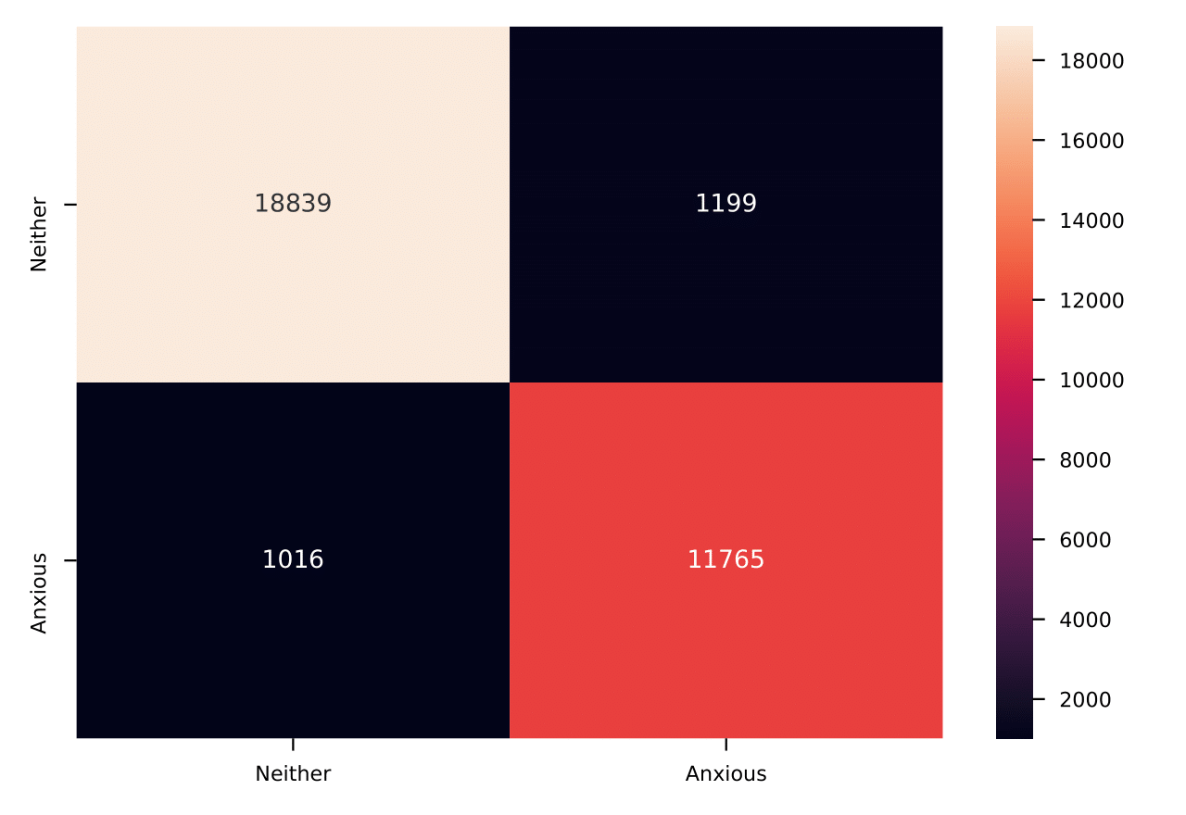
Evaluation (cont.)
Decision tree with app session usage achieved 93% accuracy
Most important indicator is how long application was used
Cross-validation shows that the model is sound but suggests that more features need to be added
Could the decision tree be overfitting?
Notes:
Next we look at the decision tree classifier. We achieved 93% accuracy.
We can see the confusion matrix generated by the classifier shows a very high accuracy in predicting socially anxious and non-socially anxious individuals but the classifier had better accuracy in predicting individuals that do not have social anxiety.
This could be attributed to having a slightly higher number of individuals in the trial that were not socially anxious.

Slide 14
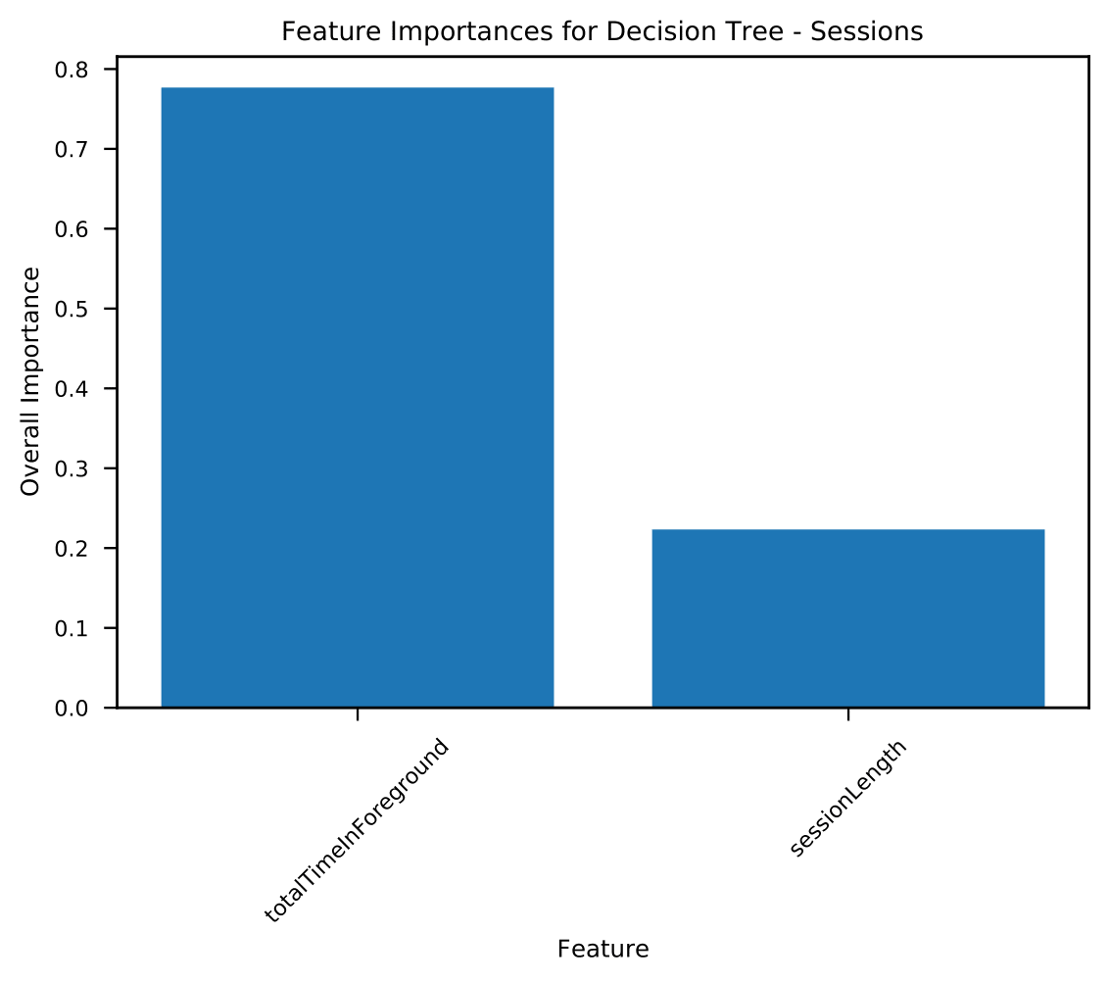
Evaluation (cont.)
Notes:
The most important feature was the total time used in foreground. Due to the large imbalance of feature importance, we believe that the classifier should have more features.

Slide 15
Evaluation (cont.)
Extra Trees and Random Forest classifier models were trained
Deal with overfitting and class imbalance better
Extra trees and random forest accuracy is 86% and 87% respectively
Cross-validation shows the models are sound
The total time is once again the most important indicator
Notes:
We trained two other classifiers on the same data - an Extra Trees and Random Forest classifier.
We achieved 86 and 87% accuracy for the extra trees and random forest classifier respectively.
These models also have total time used as the most important feature.
The implication of comparing the original decision tree classifier to these two is that a more advanced classifier should be used so that data imbalance issues could be handled.

Slide 16
Conclusion
Application session usage data can be an indicator of social anxiety
But...
Notes:
We conclude that session usage data can be an indicator of social anxiety but we believe that more work needs to be done.

Slide 17
Future Work
More data needs to be captured
More classifier features need to be added
A different classifier that can account for data related issues should be used
More participants are needed
Different age groups
Apple users
Text embedding method similar to Rauber et al. (2019) is an alternative way of looking at session data
Can session usage data be used to identify other serious health problems?
Notes:
Other ways of processing session data could be useful.
Additionally, looking at other age groups as well as Apple users would be beneficial in understanding the broader population.

Slide 18
References
Wang, R., Chen, F., Chen, Z., Li, T., Harari, G., Tignor, S., Zhou, X., Ben-Zeev, D. and Campbell, A. T. (2014b), Studentlife: Assessing mental health, academic performance and behavioral trends of college students using smartphones,in ‘Proceedings of the 2014 ACM International Joint Conference on Pervasive and Ubiquitous Computing’, UbiComp ’14, Association for Computing Machinery, New York, NY, USA, p. 3–14.URL:https://doi.org/10.1145/2632048.2632054
Ben-Zeev, D., Scherer, E. A., Wang, R., Xie, H. and Campbell, A. T. (2015), ‘Next-generation psychiatric assessment: Using smartphone sensors to monitor behavior and mental health’,Psychiatr Rehabil J38(3), 218–226.
Welke, P., Andone, I., Blaszkiewicz, K. and Markowetz, A. (2016), Differentiating smartphone users by app usage,in ‘Proceedings of the 2016 ACM International Joint Conference on Pervasive and Ubiquitous Computing’, UbiComp ’16, Association for Computing Machinery,New York, NY, USA, p. 519–523.URL:https://doi.org/10.1145/2971648.2971707
Boukhechba, M., Huang, Y., Chow, P., Fua, K., Teachman, B. A. and Barnes, L. E. (2017),Monitoring social anxiety from mobility and communication patterns,in ‘Proceedings of the 2017 ACM International Joint Conference on Pervasive and Ubiquitous Computing and Proceedings of the 2017 ACM International Symposium on Wearable Computers’, UbiComp’17, Association for Computing Machinery, New York, NY, USA, p. 749–753.URL:https://doi.org/10.1145/3123024.3125607
Rauber, J., Fox, E. B. and Gatys, L. A. (2019), ‘Modeling patterns of smartphone usage and their relationship to cognitive health’.
Taskforce, M. H. (2016), The five year forward view for mental health, Technical report, Mental Health Taskforce.
Strategies, M. H. (2008), The 2007/08 national survey of investment in mental health services,Technical report, Department of Health and Social Care.
WHO (2005), ‘Mental health of children and young people in great britain, 2004’, 20 Avenue Appia, 1211 Geneva 27, Switzerland.
NIMH (2016), ‘Social anxiety disorder: More than just shyness’,https://www.nimh.nih.gov/health/publications/social-anxiety-disorder-more-than-just-shyness/index.shtml. Last accessed: 2020-03-18.
Notes:
Thank you for listening to my presentation about predicting social anxiety with application session usage data.

