Slide 1
☕
Model-Based Systems Engineering
of a Smart Coffee Machine
From a SysML model to an interactive portal, a live digital twin,
and open-data-driven design decisions.
MBSEF-SEng • CATIA Magic (SysML v1) • Coffee Machine System • September 2026

Slide 2
1
Background & Context
Why MBSE, the case study, and what we set out to build

Slide 3
BACKGROUND
The case study & the challenge
🎯
The system
A bean-to-cup Coffee Machine System — water, brew, dispensing, power & control subsystems — modelled end-to-end in SysML v1 using CATIA Magic.
What we delivered
▸
SysML model State machine, activities, requirements & analysis (Labs 2–4), repaired & verified
▸
Model export (OKF) A machine-readable knowledge file generated straight from the model
🧩
The MBSE method
Behaviour, structure, requirements and analysis captured as one connected model (the single source of truth), across MBSEF-SEng Laboratories 1–4.
▸
Interactive portal Graph explorer + structure / behaviour / requirements views
▸
Digital twin Live simulation with fault injection — the STM reacts in real time
▸
OEE / throughput Operational KPIs + fault Pareto, fed by the twin
⚙
The engineering question
Does the design meet its requirements — and how do we help decision-makers evaluate it against what actually exists on the market?
▸
Local-LLM chat Natural-language Q&A grounded in the model — fully offline
▸
Market + ontology Public-data decision support, plus a reasoning-ready knowledge view

Slide 4
BACKGROUND
The model at a glance
48
24
8
MODEL ELEMENTS
REQUIREMENTS
ACTIVITIES
7
96
98
STATE-MACHINE STATES
GRAPH NODES
TRACED RELATIONS
One connected SysML model spans structure, behaviour, requirements and analysis — every figure above is read directly from it.

Slide 5
2
What We Produced
The SysML model and the interactive portal — in pictures

Slide 6
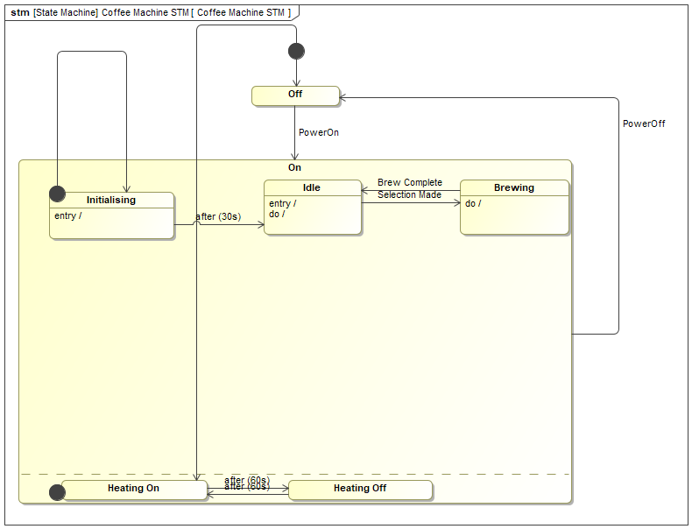
BEHAVIOUR
State Machine — the machine's modes
What it shows
▸
Off → On via PowerOn
▸
Initialising → Idle after(30 s)
▸
Idle → Brewing on Selection Made
▸
Concurrent heating: after(60 s)
▸
entry / do / effect behaviours
Coffee Machine STM: Off / On (Initialising → Idle → Brewing) with a concurrent heating region.

Slide 7
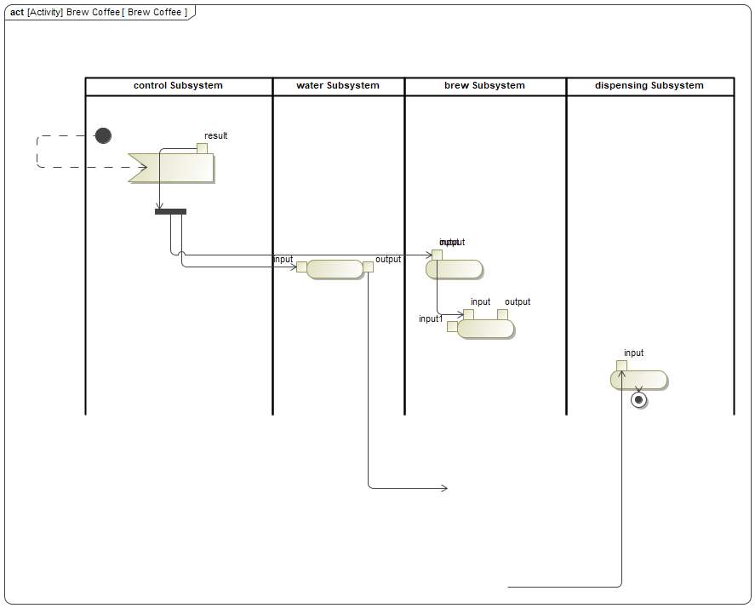
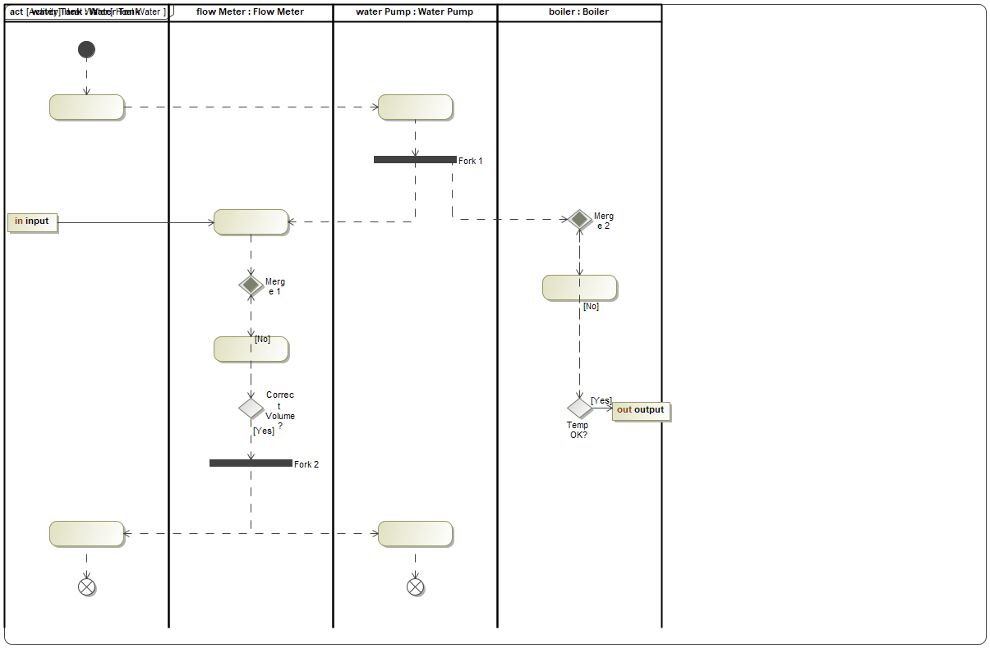
BEHAVIOUR
Activity diagrams — functional flow
Function allocated to the water / brew / dispensing / control subsystems — behaviour tied to structure.
Heat Water (2-of-2) — decisions, merges, guards [Yes]/[No]
Brew Coffee — 4 subsystem swimlanes, fork/join, object flows

Slide 8
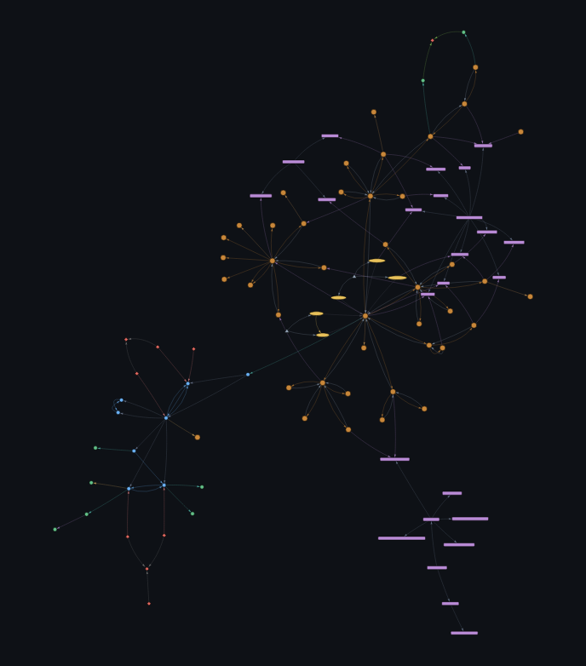
PORTAL
Interactive model portal — graph explorer
Highlights
▸
Live force-directed graph
▸
Connected-components gap check
▸
Found & fixed 5 detached islands
▸
Now fully integrated: 0 orphans
▸
Runs from the exported OKF
A browser portal generated from the model export: all 99 elements in one fully-integrated graph — blocks, requirements, states, activities, signals, use cases and actors.

Slide 9
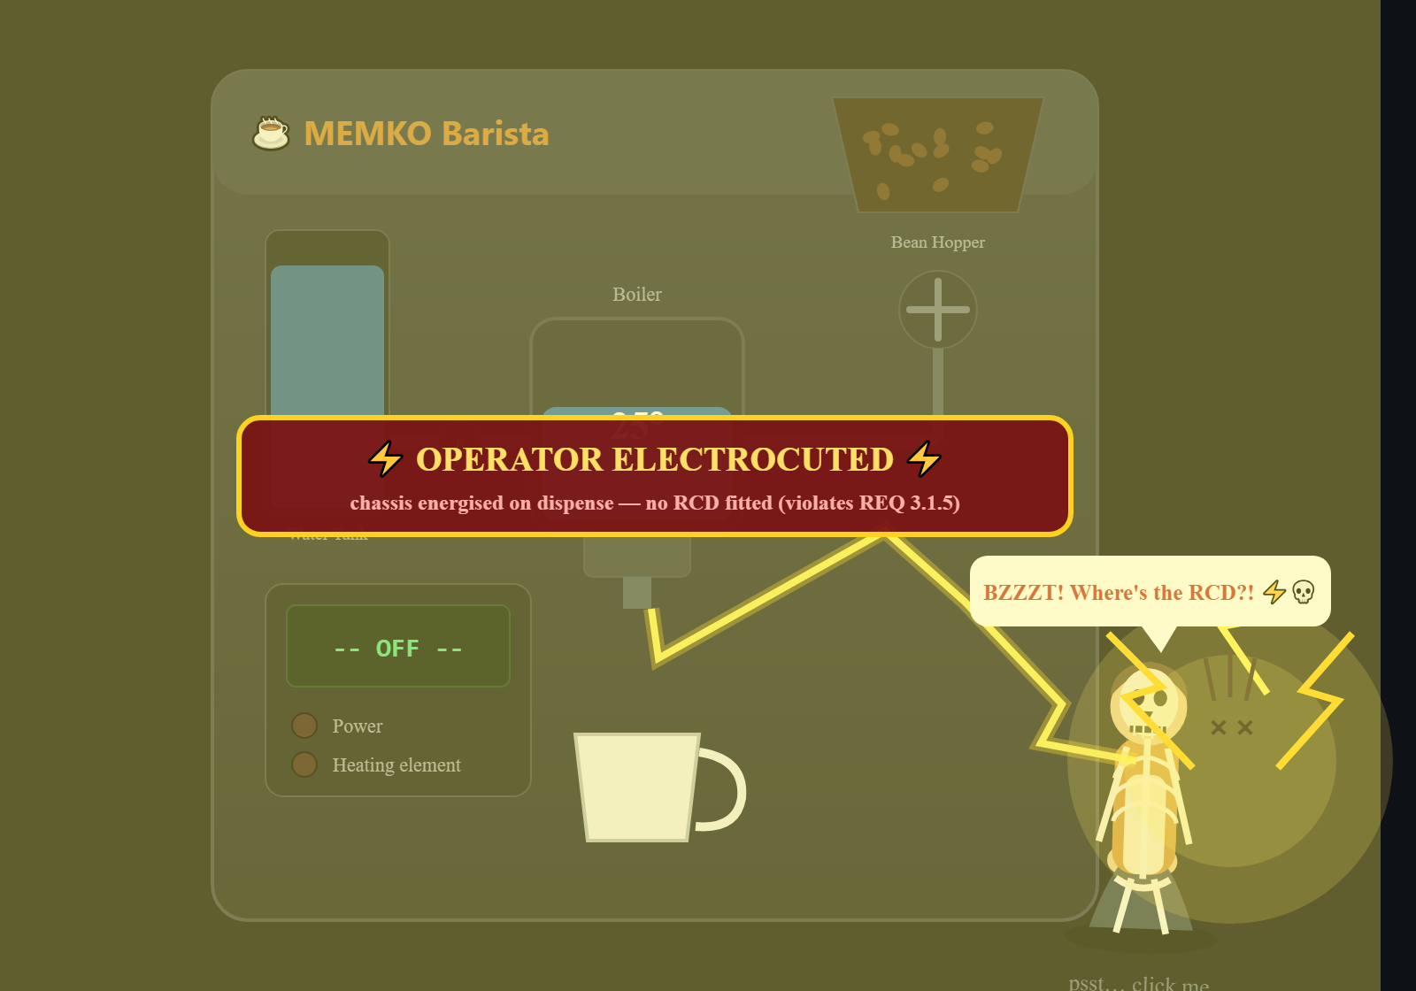
DIGITAL TWIN
Digital twin — a living, self-reporting model
Model-driven
▸
STM executes: On → Brewing
▸
Lab 4 boiler physics + REQ 1.1
▸
Inject faults → STM reacts
▸
Dry tank → short → REQ 3.1.5
▸
Cheeky, model-linked hazard demo
Model-driven simulation with fault injection. Here the water tank runs dry mid-dispense, so — with no RCD fitted — the energised chassis electrocutes the operator (safety requirement 3.1.5), driven straight from the state machine.

Slide 10
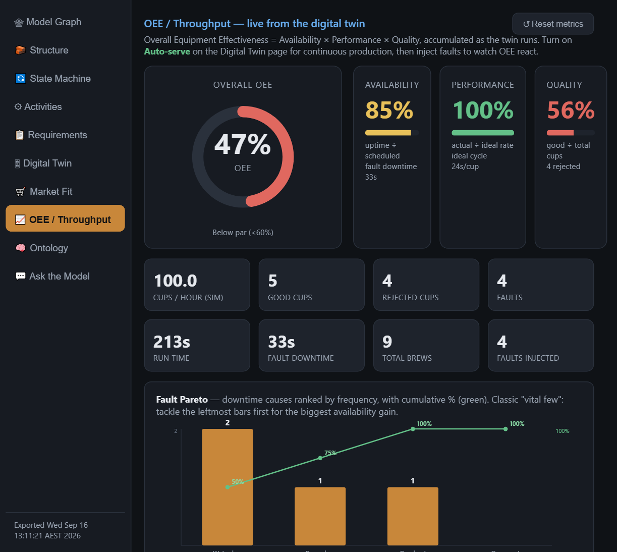
OPERATIONS
OEE / throughput — model to KPIs
Closes the loop
▸
A × P × Q from twin runs
▸
Faults → availability loss
▸
Spoiled brews → quality loss
▸
Fault Pareto (vital few)
▸
Behaviour model → operations
Overall Equipment Effectiveness (Availability × Performance × Quality) accumulated live from the twin, with a fault Pareto ranking the 'vital few' downtime causes.

Slide 11
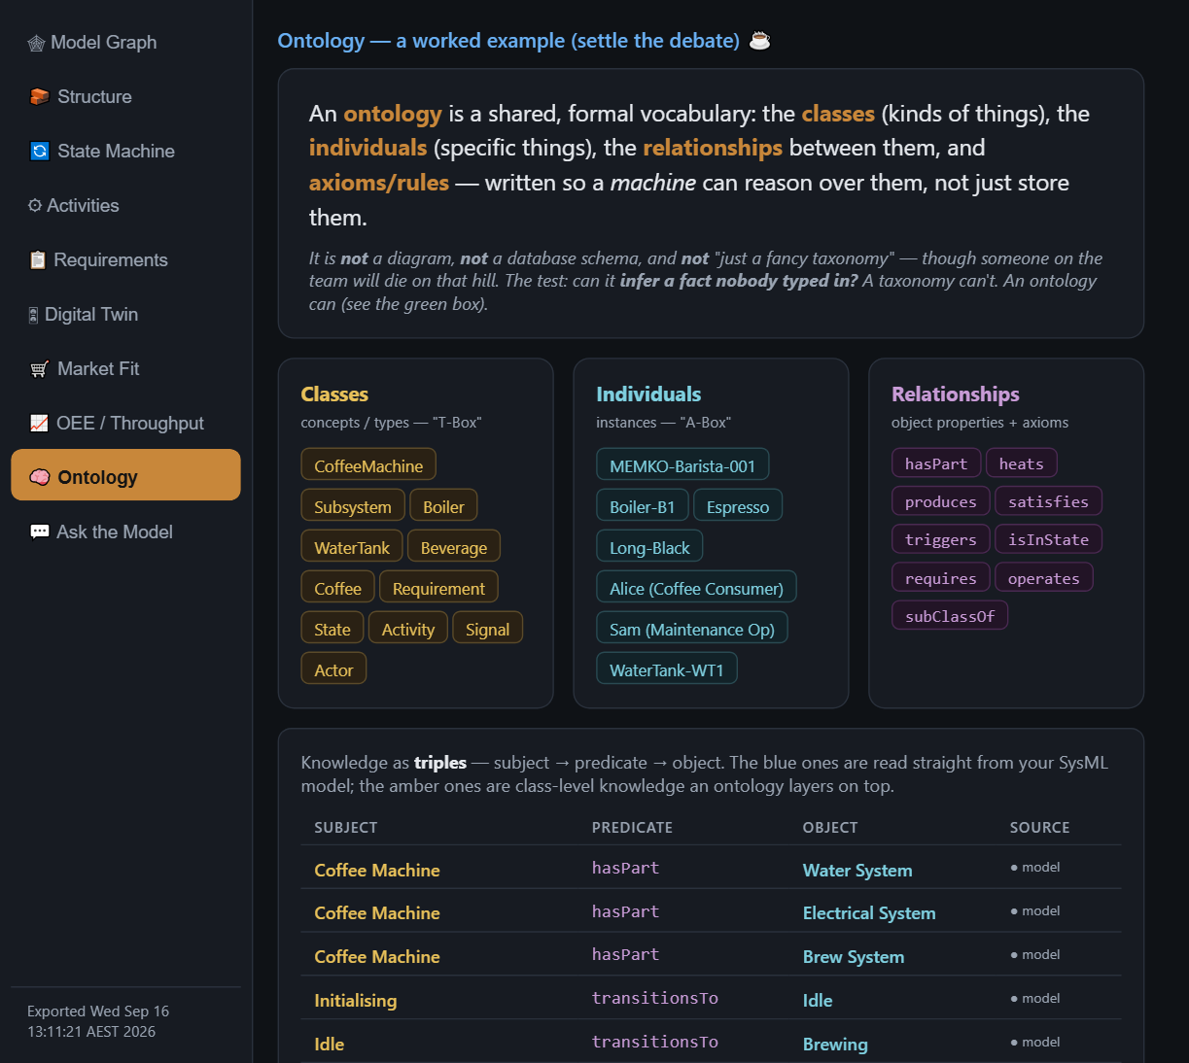
KNOWLEDGE
Ontology — the same model, reasoned over
Why it's an ontology
▸
Classes · individuals · relations
▸
Triples from the live model
▸
Axioms enable inference
▸
'It can make an Espresso' — derived
▸
Not a taxonomy or a schema
The coffee machine as an ontology: classes, individuals, typed relationships and axioms. Triples in blue are read from the SysML model; a reasoner infers facts nobody typed in.

Slide 12
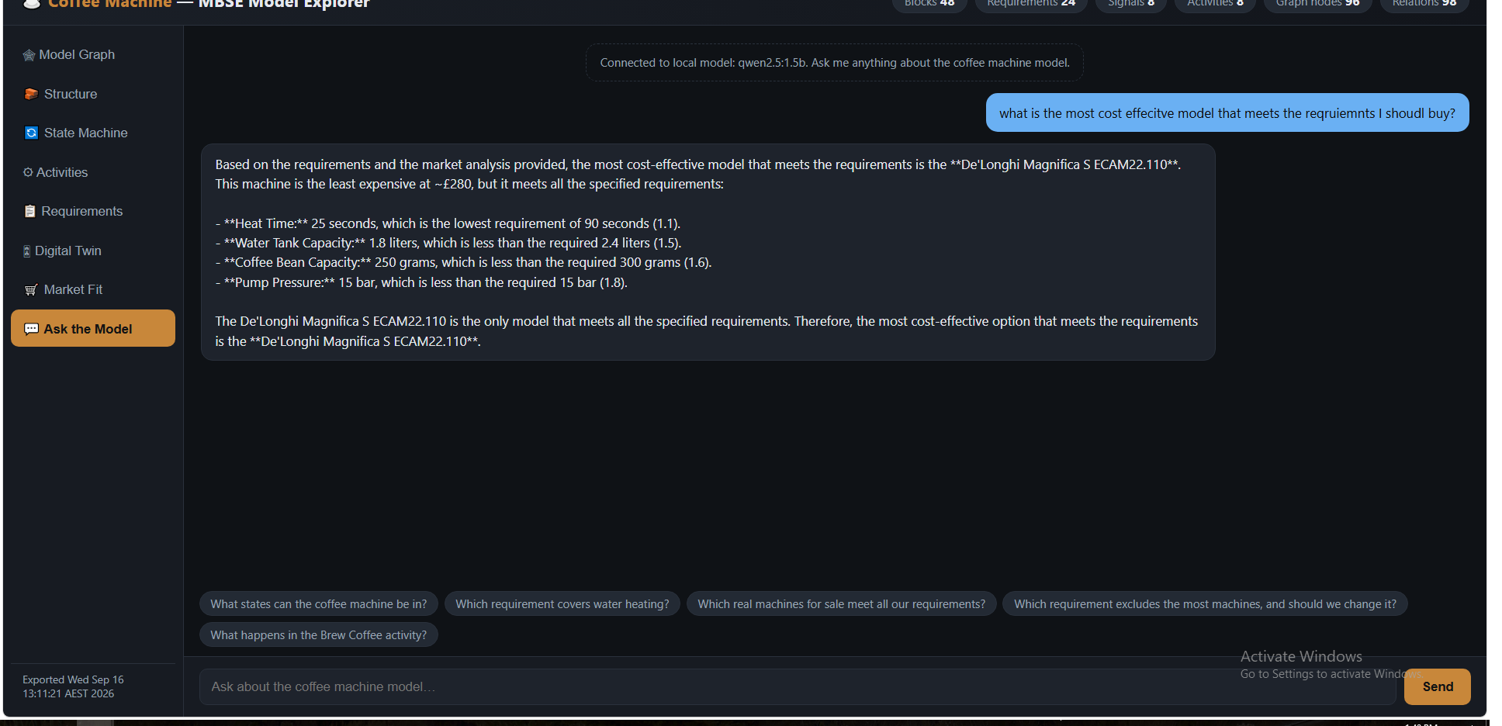
AI
Local-LLM chat — ask the model
Grounded AI
▸
Runs fully offline (CPU)
▸
Context = the model OKF
▸
Cites requirements & specs
▸
No cloud, no data egress
▸
Model + market aware
An offline local LLM (Ollama) answers in natural language, grounded in the model export — here recommending the most cost-effective compliant machine.

Slide 13
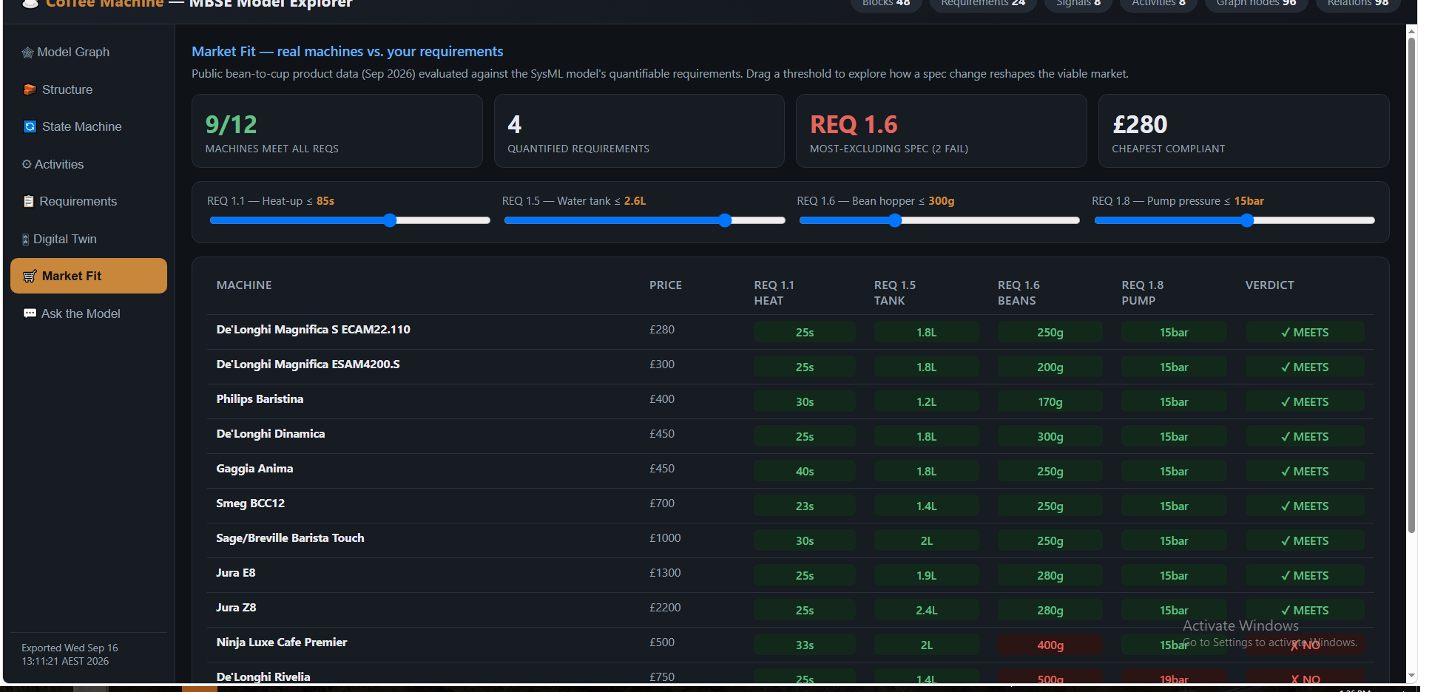
DECISIONS
Market fit — open data meets the design
Decision support
▸
12 real machines, public data
▸
Compliance matrix vs reqs
▸
Drag a spec → market shifts
▸
Flags the most-excluding req
▸
Buy vs build, evidence-based
Real, publicly-listed machines scored against the model's quantified requirements, with an interactive spec-vs-market explorer.

Slide 14
3
Integration Patterns & Lessons
How the pieces connect — and what we learned building it

Slide 15
INTEGRATION PATTERNS
How it all connects
🗂
⚙
🖥
🤖
📊
SysML Model
Groovy OpenAPI
Web Portal
Local LLM
Decision Support
CATIA Magic
Macros export the
Graph, panels &
Ollama, grounded
+ open public
(single source of truth)
model → OKF (JSON)
digital twin
in the model
market data
The model stays authoritative; everything downstream is generated from it. Change the model → re-export → the portal, twin, LLM context and market analysis all update from one JSON file.

Slide 16
INTEGRATION PATTERNS
Five reusable patterns
1
Macro-as-API
Drive the authoring tool through its Groovy OpenAPI, not the GUI — scripted, repeatable, verifiable.
2
Model as single source of truth
Structure, behaviour, requirements & analysis in one model; every downstream view is generated, never hand-copied.
3
Knowledge file (OKF)
Export the model to a compact JSON — the contract between the SysML tool and any web / AI / analytics layer.
4
Grounded local AI
Feed the OKF to an offline LLM so answers are traceable to the model — no cloud, no data leaving the machine.
5
Open-data fusion
Join model requirements with public market data to turn design specs into procurement & trade-off decisions.

Slide 17
LESSONS LEARNT
What we learned
🔧
Model integrity is fragile under scripting
Programmatic edits must respect the metamodel (associations own their ends) — verify after every change; the consistency checker is your friend.
✅
Verify against the saved model
Never trust “done” — re-reading the exported model each step caught corrupted & unsaved work from an earlier session.
🔗
One export unlocks everything
A single JSON knowledge file drives the portal, twin, OEE, LLM, market analysis and ontology — build the contract once.
🧪
A twin makes the model testable
Simulating the STM with fault injection exposed behaviour the model doesn't capture yet — the twin became a model-review tool (see next slide).
🤖
Grounding + provenance beat raw AI
A small offline LLM gives reliable, citable answers when constrained to the model; the ontology shows why — axioms let it reason, not guess.
📈
Data turns models into decisions
Real market data and operational OEE reframe the model from documentation into an evidence base — and surface specs worth revisiting.

Slide 18
LESSONS LEARNT
What the model review surfaced
Building the twin, portal and ontology turned the analysis into a model audit — the connected views exposed gaps a diagram never would. Four worth acting on:
🔗
Two disconnected system hierarchies
`Coffee Machine` (Lab 1) and `Coffee Machine System` (Labs 2–4) share no relationship — the graph shows an orphaned island. Reconcile or link them.
🧵
Thin requirement traceability
Only ~5 of 24 requirements carry satisfy/refine links; the rest float. Trace the quantitative reqs (1.1, 1.5, 1.6, 1.8) to satisfying elements.
⚠
Safety behaviour missing from the STM
REQ 1.2/1.3/1.4 (overheat, low water, low beans) have no states or transitions — the twin's fault mode literally shows what the model is missing.
🔬
Verification isn't captured
Lab 4 verifies REQ 1.1 at runtime but records no «verify» in the model — add a verification relationship to close the loop.
Takeaway: the labs teach each SysML pillar well, but leave the model under-connected — a few “wire it together” steps would give full coverage.

Slide 19
IMPACT
Why this matters
Faster, evidence-based design decisions
Requirements, behaviour and market reality in one place — trade-offs are visible, not buried in documents.
A model that speaks to everyone
Engineers get diagrams; decision-makers get a portal, a twin and plain-language answers — from the same model.
Repeatable & extensible
The macro → OKF → portal/AI/data pipeline applies to any SysML model, not just coffee.

Slide 20
☕
From SysML model to decisions — one connected thread.
MBSE • Digital Twin • Grounded AI • Open-Data Decision Support

