Slide 1
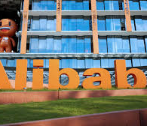
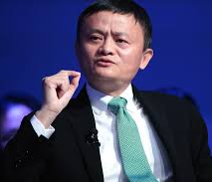

Longxiang Mei
LEADERSHIP
Jack Ma

Slide 2
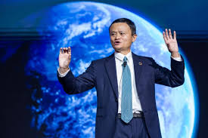
Who is Jack Ma ?
Jack Ma is the co-founder and former
executive chairman of Alibaba Group
A prominent business leader, Ma is
seen as a global ambassador for Chinese business
As of 2 February 2019, he is China's richest man,
with a net worth of $41.1 billion,

Slide 3
Market Share
2016
2017
2018
2019
20%
35%
40%
45%
In fiscal year 2018, Alibaba Group's revenue was 250.266 billion yuan, up 58% year on year, the highest growth rate since IPO. Core e-commerce business revenue reached 214.02 billion yuan, up 60% year-on-year, also the highest annual growth since IPO. Tmall continues to increase its market share and expand its B2C market leadership, with physical Gmv up 45% compared with the same period last year.

Slide 4
The key to success is leadership

Slide 5
Jack Ma’s strengths
Smart
Unremitting
Brave
Optimistic
Visionary

Slide 6
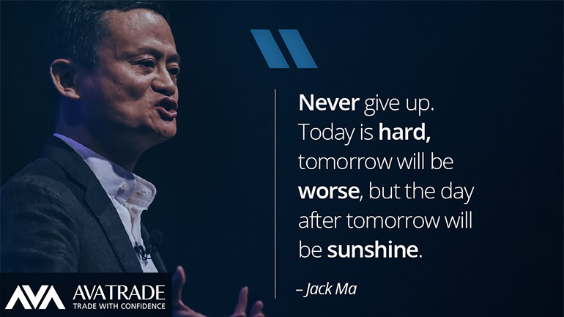
Media publicity
Jack Ma knows how to use the media to publicize himself

Slide 7

Principles of mass communication
Jack Ma likes to talk nonsense, or say some "amazing remarks".
People who don't know think Jack Ma is pretending to be forced, boasting and talking nonsense. In fact, this shows that Ma Yun is well versed in the skills of mass communication. Because the principle of mass communication is: the simpler the content, the more people understand, the wider the communication; on the contrary, the less people understand, the narrower the communication.

Slide 8
THANKS

