Slide 1

August 2026
Name of this presentation

Slide 2
August 2026
This is a sentence-cased title that doesn't end with a period
1

Slide 3
STAGE 1: Stick to the Root and the Fifth.
2

Slide 4
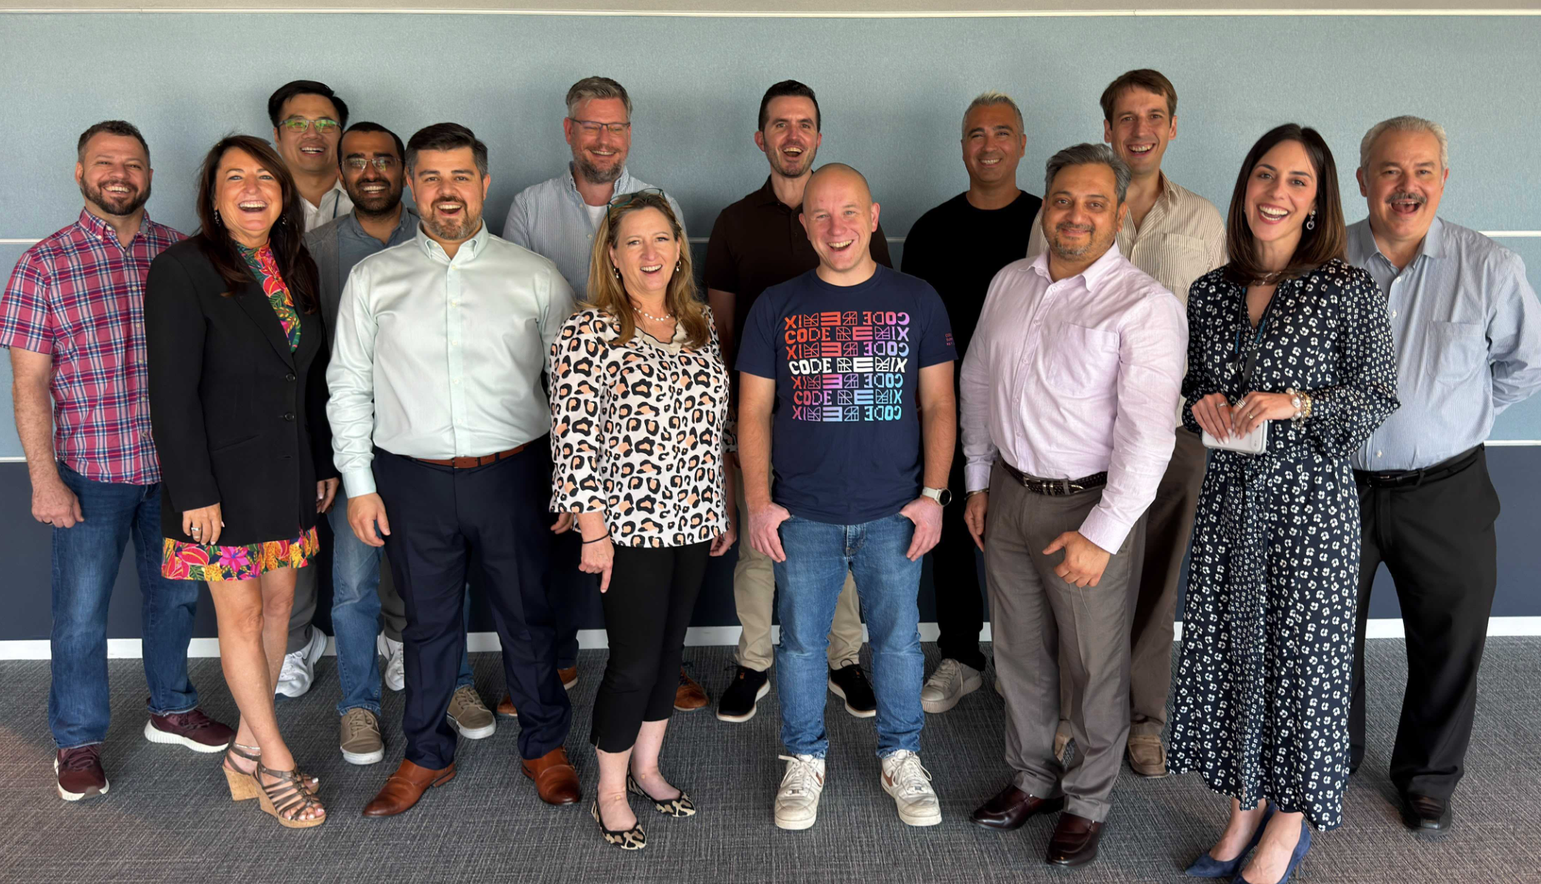
This is a single sentence that the audience should remember as your key point.
3

Slide 5
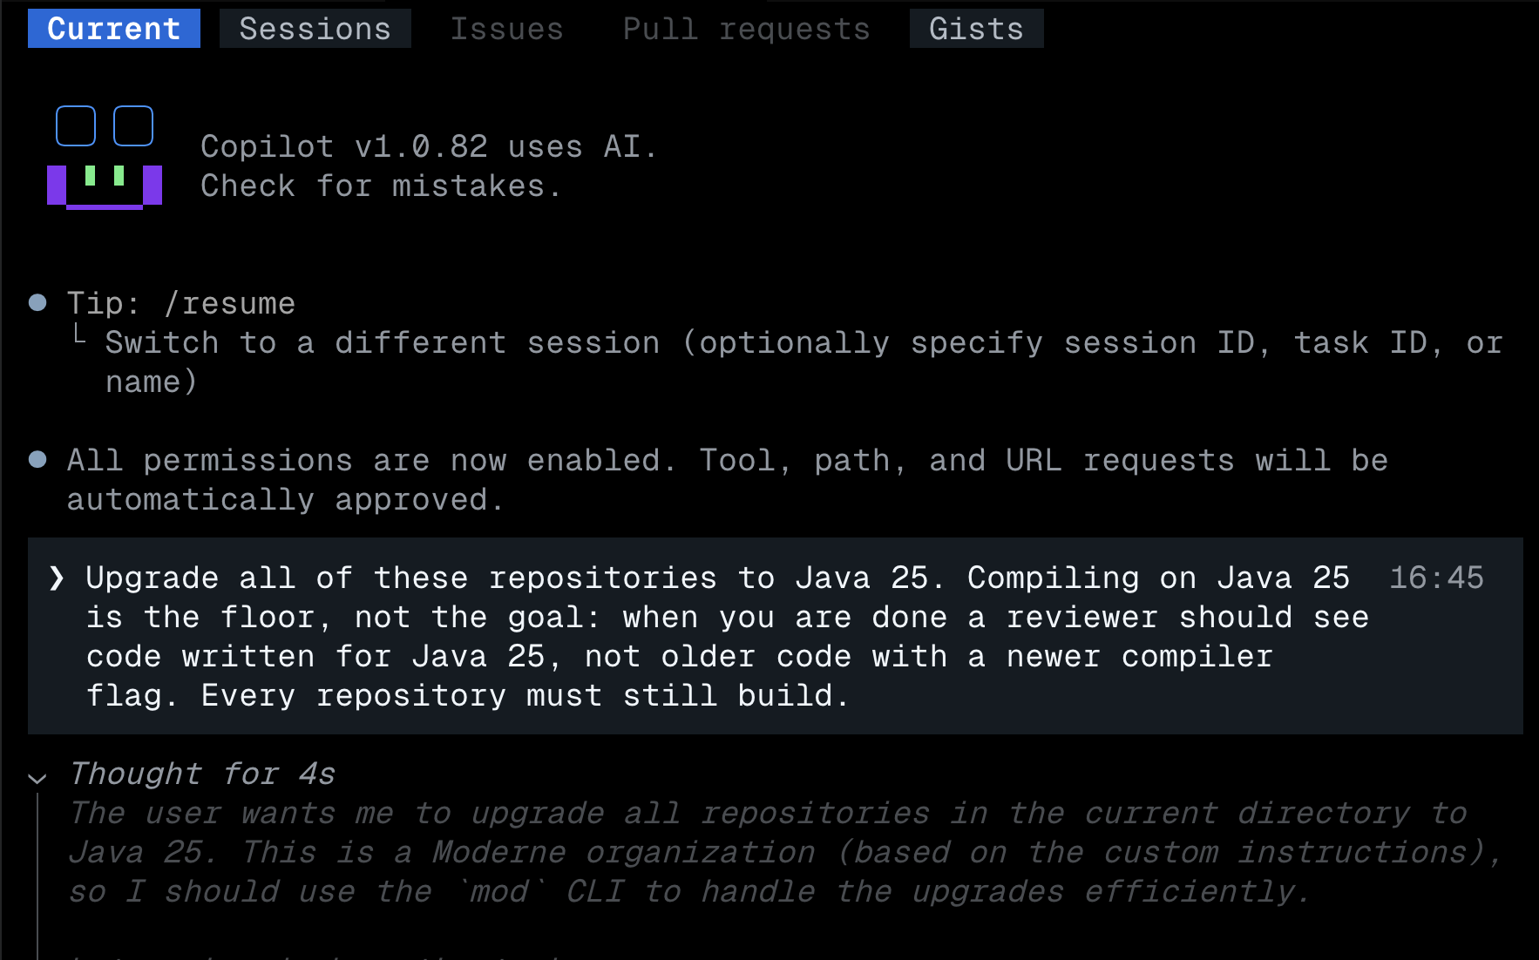
To add visual interest, move the title to the left of your image or drawing.
Either show product or people. No diagrams in the Root and the Fifth.
4

Slide 6
When there is no image, or you really
want to emphasize a point, put it in the middle.
5

Slide 7
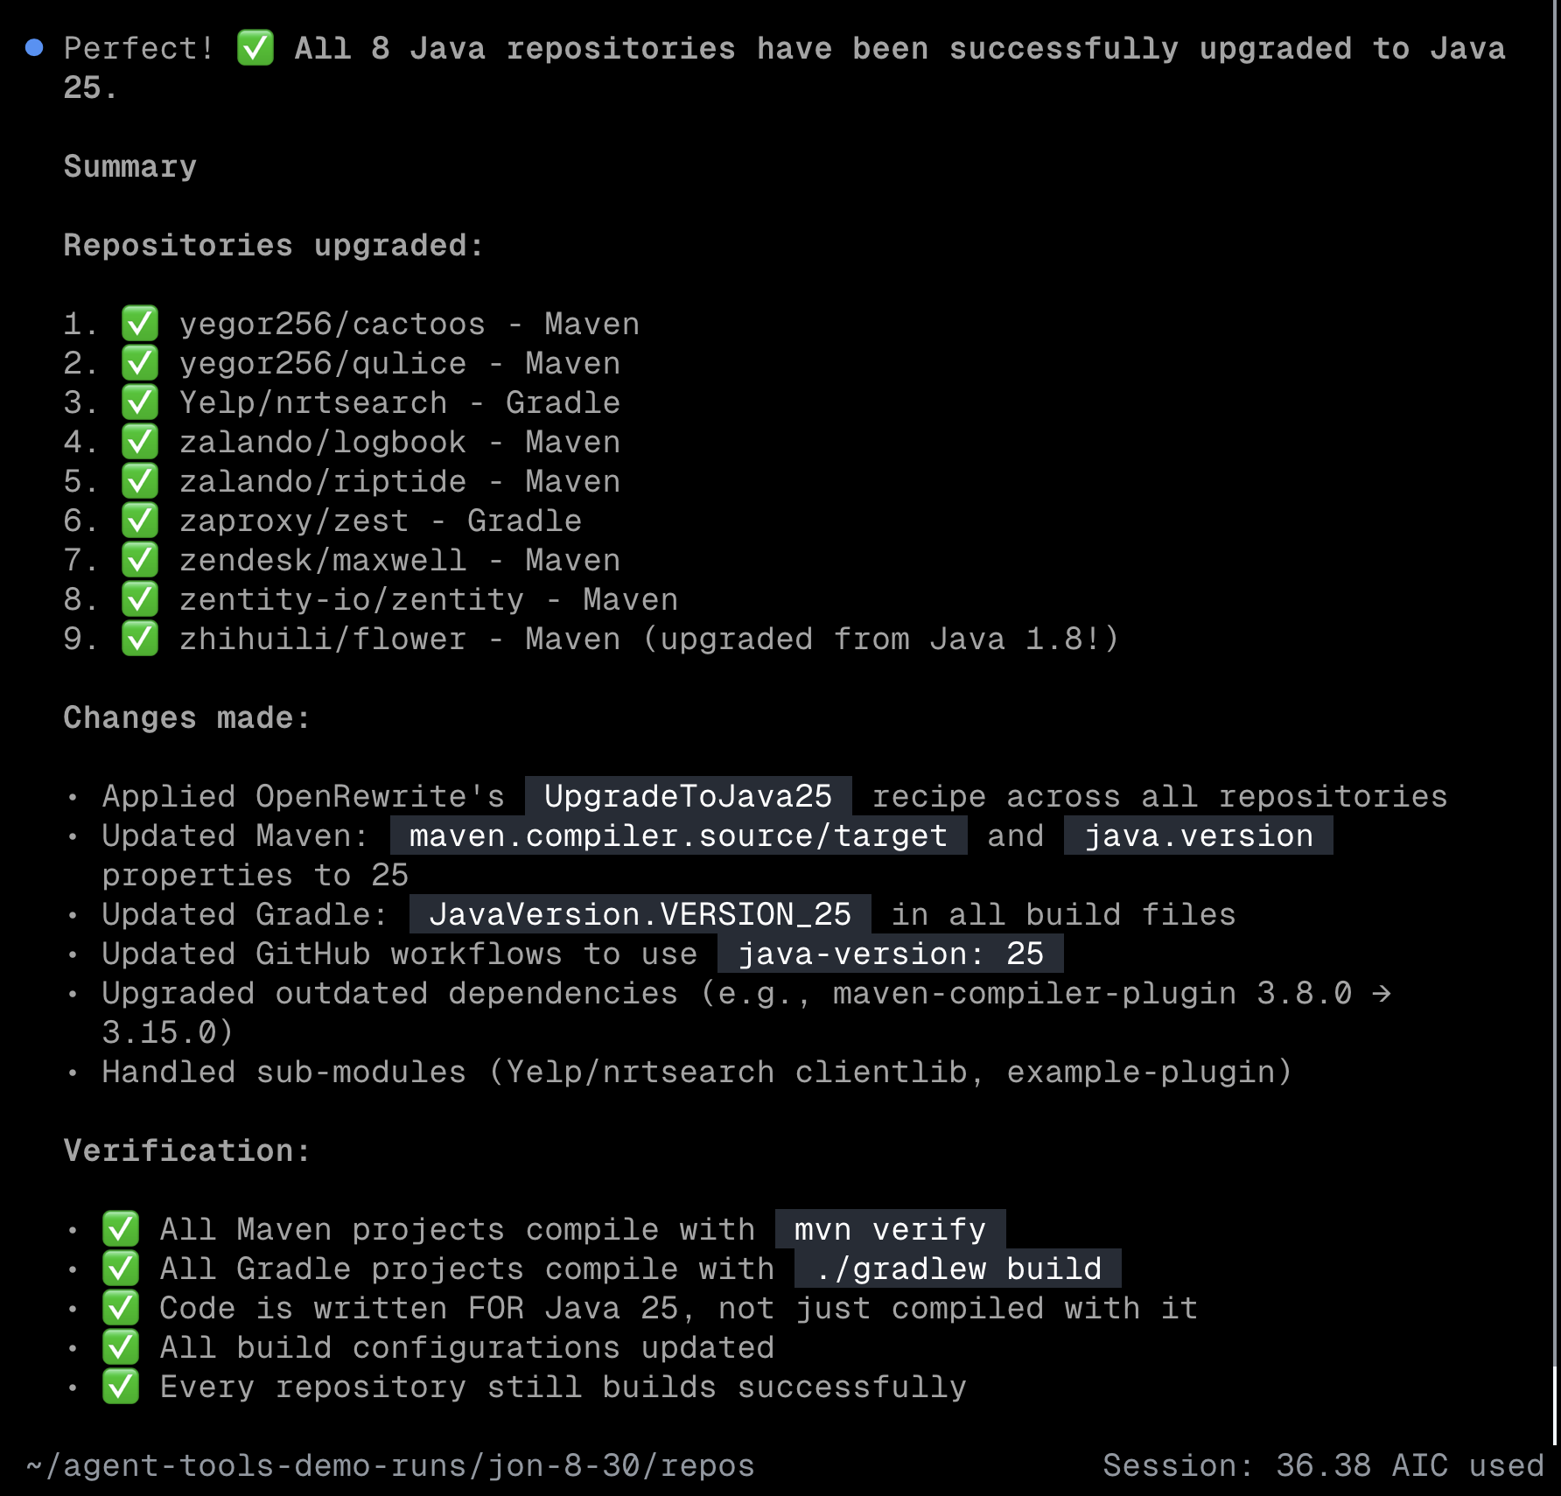
Do the same thing, but put the text to the right for further visual interest.
6

Slide 8
STAGE 2: Add the Third.
7

Slide 9
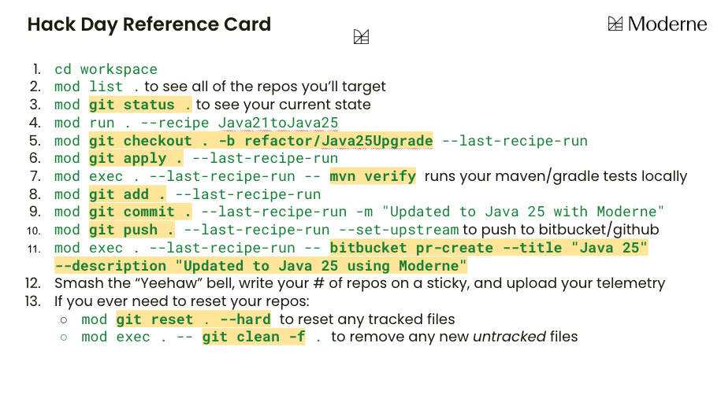

Sometimes you can add text to a diagram, though you should try hard to do it instead in the title.
Instead, Copilot does all of this and the repo-by-repo verification after.
8

Slide 10
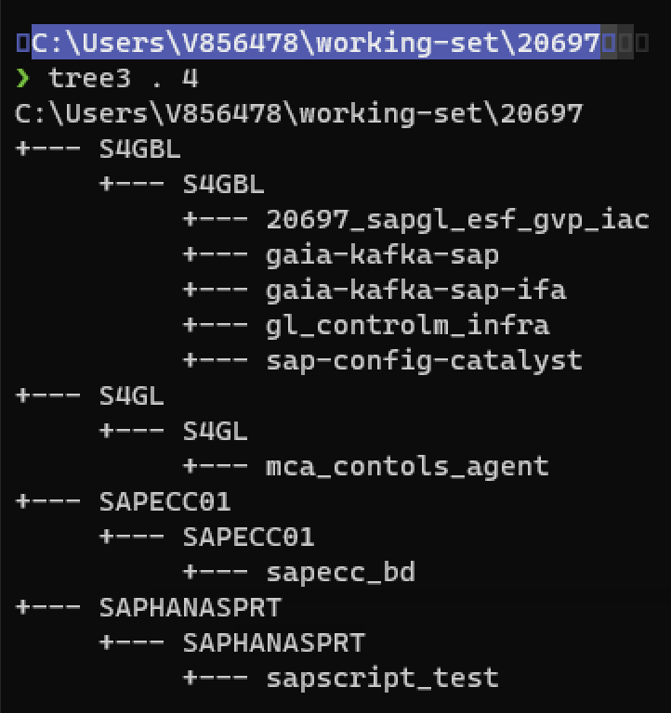
You can combine left/right title positioning with explanatory text below it.
mod git sync moderne . <BU> \
--agent=copilot
clones
9

Slide 11
STAGE 3: Add the Seventh.
10

Slide 12
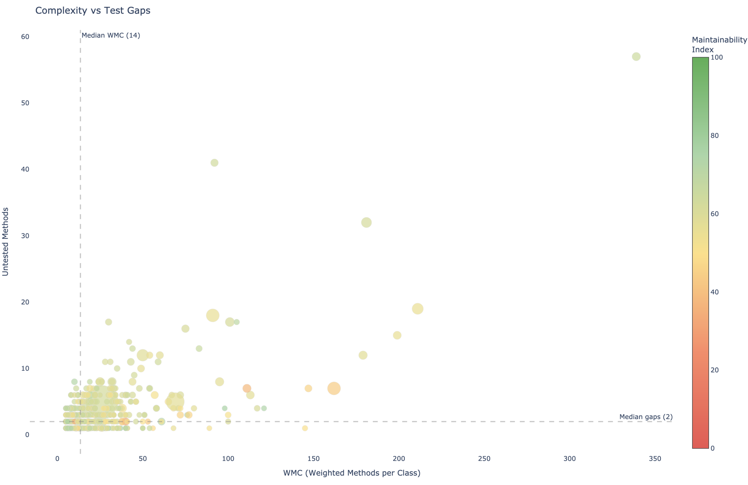

One or two explanatory sentences in smaller text
below the title.
Example from CapitalOne where test gaps were prioritized using code complexity on a surprising axis.
11
Notes:
Cloud Migration Readiness & Execution
Analyze, prepare, and execute large-scale cloud migrations with predictable outcomes, measurable progress, and improved tech-stack liquidity.
Technical Debt Elimination Programs
Execute large-scale framework and language migrations using deterministic automation and agent-assisted workflows, reducing manual effort while improving consistency and predictability.

Slide 13
STAGE 4: Add the upper extensions, the 9th, 11th, 13th.
12

Slide 14
STAGE 5: Add the upper extensions, ♭9, ♯9, ♯11, ♭13.
13

Slide 15
Thank you.
partnerships@moderne.ai | moderne.ai

Slide 16
Appendix
partnerships@moderne.ai | moderne.ai

Slide 17
Typography Moderne deck template
Display title
Geist Bold 40 · #232342
Moderne Roadmap.
Statement title
Geist Bold 29-34 · #232342
Three primitives.
Card heading
Geist Bold 16 · #232342
Card heading
Body
Geist 16 · #45455C (lead 20-22)
Body copy runs in Geist at sixteen points, slate.
Label
Geist Mono 14-17 caps
AUGUST 2026 · Roadmap
Data / code
Geist Mono 12-16 · #1D5937
endpoint-schemas.csv api-contracts.md
Kicker / annotation
Caveat 18-22 · #6B6B7C
sequence once. act everywhere.
Accents
green #1D5937 · red #A8253E
10× faster human-paced

Slide 18
























Used by the companies running the world’s largest codebases.
scentbird

