Slide 1
Turning the Crank on Streaming Algorithms 20 Nov 2013, Markham, ON IBM CASCON 2013
Sean Baxter

Slide 2
Productivity with CUDA
Out the door and on to the next problem.

Slide 3
Agenda
Streaming algorithm overview
Two-phase decomposition.
Scan
Parallel communication.
Merge
Parallel partitioning.
Join
Leverage merge-like streaming primitives.

Slide 4
Streaming algorithms
Array-processing functions with 1D locality:
Reduce
Scan
Merge
Merge sort
Radix sort
Vectorized sorted search
Relational joins (sort-merge-join)
Inner, left, right, outer
Multiset operations
Intersection, union, difference, symmetric difference
Segmented reduction
Sparse matrix * dense vector (Spmv)

Slide 5
Streaming algorithms
Streaming algorithms:
*** Bandwidth-limited *** (if we do it right).
One or two input sequences.
One output sequence.
1D locality.
Low flops/byte.
Runs great on GPU!
Modern GPU for details:
Text: http://www.moderngpu.com/
Code: https://github.com/NVlabs/moderngpu

Slide 6
The Goal
Achieve a high fraction of peak bandwidth.
192 GB/s on Geforce GTX 680. 2012.
336 GB/s on Geforce GTX 780Ti. 2013.
Bandwidth keeps going up.
1 TB/s target for Volta with Stacked DRAM. The future.
Scan-like and merge-like functions run nearly as fast as cudaMemcpy.
Lots of useful functions look like merge.
Opens a lot of possibilities.

Slide 7
Don’t think about these before thinking about your problem
Warp-synchronous programming.
e.g., Intra-warp shfl instruction.
Shared-memory bank conflicts.
Control divergence.
Doing your own buffering.
Trust the cache.
Streams and events.
CUDA Nested Parallelism.
GPUDirect/RDMA.
Focus on the algorithm!
Notes:
Early CUDA literature focused on hardware implementation details rather than algorithm designed, and it shows in early CUDA code. Put the algorithm first.

Slide 8
The Challenge
Massive parallelism needed to saturate bandwidth.
High arithmetic efficiency.
Only a dozen arithmetic ops per LD/ST.
Coalesced memory access.
Use the entire cache line.
Issue many outstanding loads.

Slide 9
Latency hiding
Core design of throughput-oriented processor.
Execute instructions until we hit data dependency.
Memory op (high-latency)
Arithmetic op (low-latency)
__syncthreads (depends on other threads)
GPU context switches to available threads.
More threads = better latency hiding.

Slide 10
Hitting peak bandwidth
Must have more outstanding loads to DRAM than threads supported by GPU.
28,672 threads is 100% occupancy on K20X.
Still not enough loads to hit peak for most problems.
Register block for instruction-level parallelism.
Parallelism = Num threads * ILP.
Each thread issues many loads before doing arithmetic.
Bunch of loads. Sync.
Bunch of arithmetic. Sync.
Bunch of stores. Sync. Next tile.

Slide 11
Challenges of manycore
30,000 concurrent threads plus ILP.
How to produce this parallelism?
Program state must fit in on-chip memory.
Small state per thread when divided 30,000 ways.
48KB shared @ 2048 threads = 24 bytes/thread.
Register blocking uses more state; reduces occupancy.
Exploit data locality.
Neighboring threads load/store neighboring addresses.
Write tunable code.
Find balance between work per thread and parallelism.

Slide 12
Streaming on manycore
Challenges:
Many dimensions of design, optimization.
Satisfy demands of manycore while solving problem?
Deal with intricacies of GPU and focus on algorithm?
Success:
Patterns for streaming algorithms.
Parallel aspects will feel like boilerplate.
Algorithmic details contained in small, clear sections.
GPU programming made unexpectedly possible.

Slide 13
Streaming algorithms

Slide 14
Sequential and parallel
Parallel computation is difficult and inefficient.
Difficulty with PRAM methods show this.
Parallel scan:
Barriers each step.
Parallel is O(n log n). Sequential is O(n).
Parallel merge:
PRAM lit says “transform to ANSV.”
Lose sight of actual algorithm.
Parallel full-outer join:
Too hard to contemplate.

Slide 15
Two-phase decomposition
Sequential computation.
Work-efficient.
Clearly express algorithmic intent.
And…
Parallel communication.
Parallel process only results of sequential computation.
Eg: parallel scan on reductions of sequential computation.
Or…
Parallel partitioning.
Exact mapping of VT work-items to each thread.

Slide 16
Two-phase decomposition
Register blocking
Assign a grain-size of “work-items” to each thread.
Grain-size is fixed, statically-tunable parameter.
VT = Values per Thread (grain-size).
NT = Num Threads per tile.
NV = NT * VT = Num Values per tile.
Size grid to data
If N = 10M, CTA of 128x7 launches 1.4M threads.
GPU does load balancing.

Slide 17
Performance tuning
Grain-size VT is best tuning parameter.
Increase for more sequential work
Improved work-efficiency.
Decrease for less state per thread.
More concurrent threads per SM.
Higher occupancy = better latency-hiding.
Throughput-oriented processor built with lots of arithmetic and I/O, very little cache.
Finer control over how on-chip memory is utilized.

Slide 18
Grain-size tuning
Optimal setting depends on:
Data-type (int, double, etc).
Input size.
Instruction mix.
On-chip memory capacity (shared, L1, L2).
Memory latency.
Execution width.
Too many factors for analysis
Empirical selection.

Slide 19
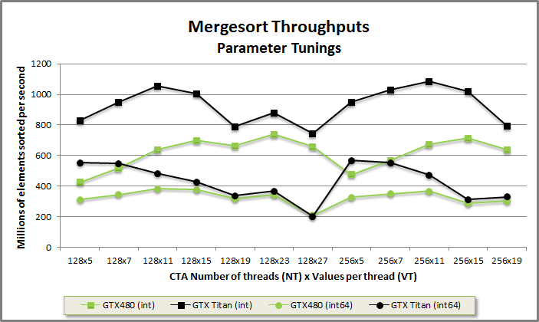

Performance tuning
Choose optimal tunings empirically.
 | GTX 480 (Fermi) | GTX Titan (Kepler)
32-bit int | 128x23 | 256x11
64-bit int | 128x11 | 256x5
Notes:
Reason we have good performance at all is because of register blocking. Doing a scalar per thread would have very poor throughput.

Slide 20
Scan

Slide 21
Scan workflow
Load tile of NT x VT inputs into smem or register.
DOWNSWEEP: Sequential reduction.
VT elements per thread.
SPINE: Parallel communication.
O(log NT) per tile.
UPSWEEP: Sequential scan.
VT elements per thread.
Store results to global.

Slide 22
Kernel: Reduce a tile
Sequential work
Parallel communication

Slide 23
Reduce a tile
// Schedule VT overlapped loads from off-chip memory into register.
T values[VT];
#pragma unroll
for(int i = 0; i < VT; ++i) {
int index = gid + NT * i + tid;
values[i] = (index < count) ? data_global[index] : (T)0;
}
// Sequentially reduce within threads to a scalar.
// Use commutative property of addition to fold non-adjacent inputs.
T x;
#pragma unroll
for(int i = 0; i < VT; ++i)
x = i ? (x + values[i]) : values[i];
// Cooperatively reduce across threads.
T total = CTAReduce<NT, mgpu::plus<T> >::Reduce(tid, x, reduce_shared);
// Store tile’s reduction to off-chip memory.
if(!tid)
reduced_global[block] = total;

Slide 24
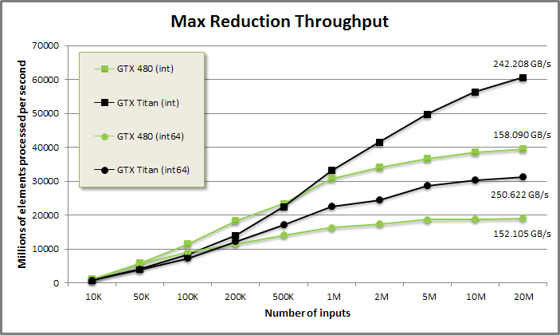
Reduce
242 GB/s for int reduction.
250 GB/s for int64 reduction.
288 GB/s theoretical peak GTX Titan.

Slide 25
Kernel: Scan a tile
Transpose through on-chip memory
Sequential work
Parallel communication

Slide 26
Transpose
Load data in strided order.
Data[NT * i + tid] for 0 <= I < VT.
Coalesced.
Threads cooperatively load full cache lines.
Transpose through shared memory to thread order.
Store to shared memory.
Load back with x[i] = shared[VT * tid + i].
Each thread has VT consecutive items.
May load in thread order with __ldg/texture.
Still need to manually transpose to store.

Slide 27
Scan a tile (1) – Load inputs
// Schedule VT overlapped loads from off-chip memory into register.
// Load into strided order.
T values[VT];
#pragma unroll
for(int i = 0; i < VT; ++i) {
int index = gid + NT * i + tid;
values[i] = (index < count) ? data_global[index] : (T)0;
}
// Store data in shared memory.
#pragma unroll
for(int i = 0; i < VT; ++i)
shared.data[NT * i + tid] = values[i];
__syncthreads();
// Load data into register in thread order.
#pragma unroll
for(int i = 0; i < VT; ++i)
values[i] = shared.data[VT * tid + i];
__syncthreads();

Slide 28
Scan a tile (2) – The good parts
// UPSWEEP: Sequentially reduce within threads.
T x;
#pragma unroll
for(int i = 0; i < VT; ++i)
x = i ? (x + values[i]) : values[i];
// SPINE: Cooperatively scan across threads. Return the exc-scan.
x = CTAScan<NT, mgpu::plus<T> >::Scan(tid, x, shared.scanStorage);
// DOWNSWEEP: Sequentially add exc-scan of reductions into inputs.
#pragma unroll
for(int i = 0; i < VT; ++i) {
T x2 = values[i];
if(inclusive) x += x2; // Inclusive: add then store.
values[i] = x; // x is the scan
if(!inclusive) x += x2; // Exclusive: store then add.
}

Slide 29
Scan a tile (3) – Store outputs
// Store results to shared memory.
#pragma unroll
for(int i = 0; i < VT; ++i)
shared.scanStorage[VT * tid + i] = values[i];
__syncthreads();
// Load results from shared memory in strided order and make coalesced
// stores to off-chip memory.
#pragma unroll
for(int i = 0; i < VT; ++i) {
int index = NT * i + tid;
if(gid + index < count)
output_global[gid + index] = shared.data[index];
}

Slide 30
Tuning considerations
Increasing VT:
Amortize parallel scan for better work-efficiency.
Support more concurrent loads.
Decreasing VT:
Reduces per-thread state for better occupancy.
Fit more CTAs/SM for better latency hiding at barriers.
Better utilization for small inputs (fewer idle SMs).

Slide 31
Tuning considerations
Choose an odd VT:
Avoid bank conflicts when transposing through on-chip memory.
((VT * tid + i) % 32) hits each bank once per warp per step.
When transposing with VT = 8, 8-way conflicts:
0->0 (0), 4->32 (0), 8->64 (0), 12->96 (0),
16->128 (0), 20->160 (0), 24->192 (0), 28->224 (0)
When transposing with VT = 7, no bank conflicts:
0->0 (0), 1->7 (7), 2->14 (14), 3->21 (21)
4->28 (28), 5->35 (3), 6->42 (10), 7->49 (17)
8->56 (24), 9->63 (31), 10->70 (6), 11->77 (13)…

Slide 32
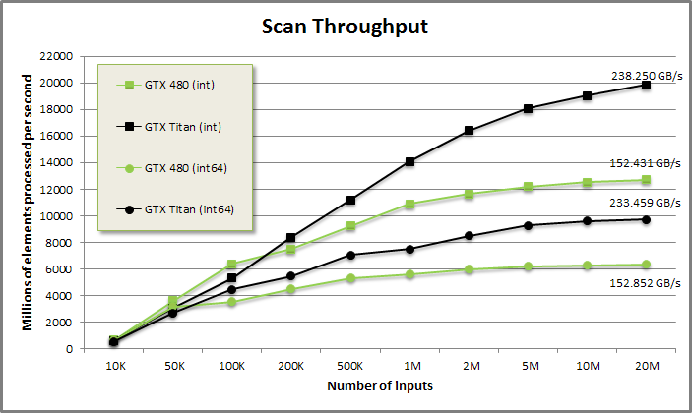
Scan
238 GB/s for int scan.
233 GB/s for int64 scan.
288 GB/s theoretical peak GTX Titan.

Slide 33
Merge

Slide 34
Sequential Merge
template<typename T, typename Comp>
void CPUMerge(const T* a, int aCount, const T* b, int bCount,
T* dest, Comp comp) {
int count = aCount + bCount;
int ai = 0, bi = 0;
for(int i = 0; i < count; ++i) {
bool p;
if(bi >= bCount) p = true;
else if(ai >= aCount) p = false;
else p = !comp(b[bi], a[ai]); // a[ai] <= b[bi]
// Emit smaller element.
dest[i] = p ? a[ai++] : b[bi++];
}
}
Examine two keys and output one element per iteration. O(n) work-efficiency.

Slide 35
Naïve parallel merge
Naïve parallel merge
Low-latency when number of processors is order N.
One item per thread. Communication free.
Two kernels:
KernelA assigns one thread to each item in A.
Insert A[i] into dest at i + lower_bound(A[i], B).
KernelB assigns one thread to each item in B.
Insert B[i] into dest at i + upper_bound(B[i], A).

Slide 36
Naïve parallel merge
Parallel version is concurrent but inefficient.
Serial code is O(n).
Parallel code is O(n log n).
Each thread only does one element. How to register block?
Parallel code doesn’t resemble sequential code at all.
Hard to extend to other merge-like operations.
Parallel code tries to solve two problems at once:
Decomposition/scheduling work to parallel processors.
Merge-specific logic.

Slide 37
Two-phase decomposition
Design implementation in two phases:
PARTITIONING
Maps fixed-size work onto each tile/thread.
Expose adjustable grain size parameter (VT).
Implement with one binary search per partition.
WORK LOGIC
Executes code specific for solving problem.
Resembles CPU sequential code.
More efficient and more extensible.

Slide 38
Merge Path multi-select
Find k-smallest inputs in two sorted inputs.
Partitions problem into n / NV disjoint interval pairs.
Coarse-grained partition:
k = NV * tile.
Load interval from A and B into on-chip memory.
Fine-grained partition:
k = VT * tid.
Sequential merge of VT inputs from on-chip memory into register.

Slide 39
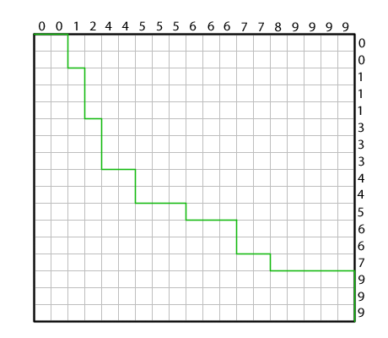
Merge Path

Slide 40
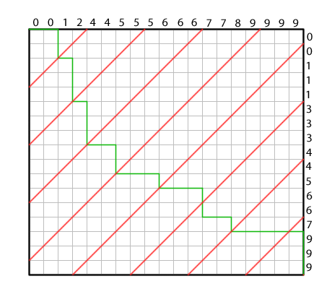
Merge Path (2)

Slide 41
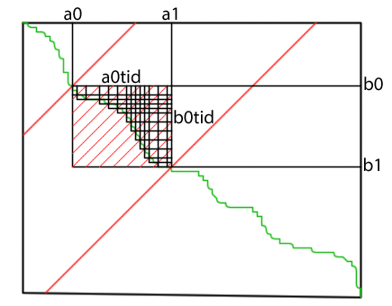
Merge Path

Slide 42
Device code: Merge
Parallel decomposition
Sequential work

Slide 43
Merge Path search
template<typename T, typename It1, typename It2, typename Comp>
int MergePath(It1 a, int aCount, It2 b, int bCount, int diag,
Comp comp) {
int begin = max(0, diag - bCount);
int end = min(diag, aCount);
while(begin < end) {
int mid = (begin + end)>> 1;
bool pred = !comp(b[diag - 1 - mid], a[mid]);
if(pred) begin = mid + 1;
else end = mid;
}
return begin;
}
Simultaneously search two arrays by using constraint ai + bi = diag to make problem one dimensional.

Slide 44
Serial Merge
#pragma unroll
for(int i = 0; i < Count; ++i) {
T x1 = keys[aBegin];
T x2 = keys[bBegin];
// If p is true, emit from A, otherwise emit from B.
bool p;
if(bBegin >= bEnd) p = true;
else if(aBegin >= aEnd) p = false;
else p = !comp(x2, x1); // p = x1 <= x2
// because of #pragma unroll, merged[i] is static indexing
// so results is kept in RF, not smem!
results[i] = p ? x1 : x2;
if(p) ++aBegin;
else ++bBegin;
}

Slide 45
Serial Merge
Fixed grain-size VT enables loop unrolling.
Simpler control.
Load from on-chip shared memory.
Requires dynamic indexing.
Merge into register.
RF is capacious.
After merge, __syncthreads.
Now free to use on-chip memory without stepping on toes.
Transpose in on-chip memory and store to global.
Same as Scan kernel…

Slide 46
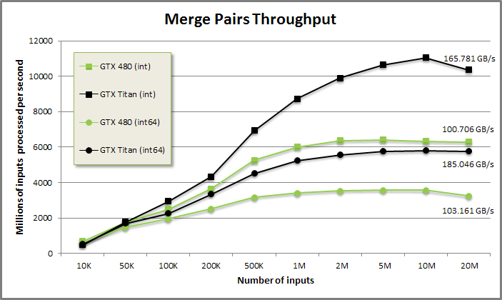
Merge performance
288 GB/s peak bandwidth GTX Titan.
177 GB/s peak bandwidth GTX 480.

Slide 47
Relational Joins

Slide 48
Relational Joins
We join two sorted tables (sort-merge join).
Equal keys in A and B are expanded with outer product.
Keys in A not found in B are emitted with left-join (null B key).
Keys in B not found in A are emitted with right-join (null A key).
Called “merge-join” because it’s like a merge.

Slide 49
Relational Joins
Row | A index | A key | B key | B index | Join type
0 | 0 | A⁰ | A⁰ | 0 | inner
1 | 0 | A⁰ | A¹ | 1 | inner
2 | 1 | A¹ | A⁰ | 0 | inner
3 | 1 | A¹ | A¹ | 1 | inner
4 | 2 | B⁰ | B⁰ | 2 | inner
5 | 2 | B⁰ | B¹ | 3 | inner
6 | 2 | B⁰ | B² | 4 | inner
7 | 3 | E⁰ | --- | -1 | left
8 | 4 | E¹ | --- | -1 | left
9 | 5 | E² | --- | -1 | left
10 | 6 | E³ | --- | -1 | left
11 | 7 | F⁰ | F⁰ | 7 | inner
12 | 8 | F¹ | F⁰ | 7 | inner
13 | 9 | G⁰ | G⁰ | 8 | inner
14 | 9 | G⁰ | G¹ | 9 | inner
15 | 10 | H⁰ | H⁰ | 10 | inner
16 | 11 | H¹ | H⁰ | 10 | inner
17 | 12 | J⁰ | --- | -1 | left
18 | 13 | J¹ | --- | -1 | left
19 | 14 | M⁰ | --- | -1 | left
20 | 15 | M¹ | --- | -1 | left
21 | -1 | --- | C⁰ | 5 | right
22 | -1 | --- | C¹ | 6 | right
23 | -1 | --- | I⁰ | 11 | right
24 | -1 | --- | L⁰ | 12 | right
25 | -1 | --- | L¹ | 13 | right
Use two-phase decomposition to implement outer join with perfect load-balancing.
 | 0 | 1 | 2 | 3 | 4 | 5 | 6 | 7 | 8 | 9 | 10 | 11 | 12 | 13 | 14 | 15
A: | A⁰ | A¹ | B⁰ | E⁰ | E¹ | E² | E³ | F⁰ | F¹ | G⁰ | H⁰ | H¹ | J⁰ | J¹ | M⁰ | M¹
B: | A⁰ | A¹ | B⁰ | B¹ | B² | C⁰ | C¹ | F⁰ | G⁰ | G¹ | H⁰ | I⁰ | L⁰ | L¹

Slide 50
Vectorized sorted search
Consider needles A and haystack B.
Binary search for all keys from A in sorted array B.
O(A log B).
What if needles array A is also sorted?
Use each found needle as a constraint on the next.
Increment A or B on each step.
Searching for sorted needles in sorted haystack is a merge-like function.
O(A + B).

Slide 51
Vectorized sorted search
template<typename T, typename Comp>
void CPUMerge(const T* a, int aCount, const T* b, int bCount,
T* dest, Comp comp) {
int count = aCount + bCount;
int ai = 0, bi = 0;
for(int i = 0; i < count; ++i) {
bool p;
if(bi >= bCount) p = true;
else if(ai >= aCount) p = false;
else p = !comp(b[bi], a[ai]); // a[ai] <= b[bi]
#ifdef defined(MERGE)
// MERGE: Emit smaller element.
dest[i] = p ? a[ai++] : b[bi++];
#elif defined(SEARCH)
// SEARCH: Save value of haystack cursor bi when advancing needles
// cursor ai.
if(p) dest[ai++] = bi;
else ++bi;
#endif
}
}

Slide 52
Vectorized sorted search
Important primitive for parallel computing.
Searches sorted needles A into sorted haystack B.
Simple usage:
Lower/upper-bound of A into B.
Power usage:
Lower-bound of A into B.
Upper-bound of B into A.
Flags for all matches of A into B.
Flags for all matches of B into A.
All this with a single pass!
Implemented just like merge.
Parallel partitioning.
Sequential work.

Slide 53
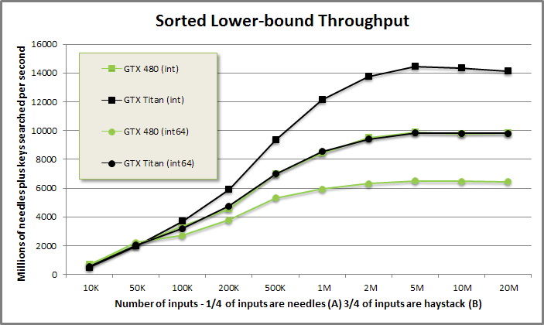
Vectorized sorted search
For 25% needles/75% haystack:
Int: 14 billion inputs/s .
Int64: 10 billion inputs/s.

Slide 54
Load-balancing search
Load-balancing search is a special decomposition
… Or a change of coordinates
… Or a kind of inverse of prefix sum
… Or a flattening transform
Really a tool for mapping irregular problems to a regular domain.
Take N objects
Each object generates variable number of outputs.
We match each output with its generating object.
Alternatively, CSR format for Spmv:
Expand CSR -> COO.

Slide 55
Load-balancing search
Work-item counts:
0: 1 2 4 0 4 4 3 3 2 4
10: 0 0 1 2 1 1 0 2 2 1
20: 1 4 2 3 2 2 1 1 3 0
30: 2 1 1 3 4 2 2 4 0 4
Exc-scan of counts:
0: 0 1 3 7 7 11 15 18 21 23
10: 27 27 27 28 30 31 32 32 34 36
20: 37 38 42 44 47 49 51 52 53 56
30: 56 58 59 60 63 67 69 71 75 75
Load-balancing search:
0: 0 1 1 2 2 2 2 4 4 4
10: 4 5 5 5 5 6 6 6 7 7
20: 7 8 8 9 9 9 9 12 13 13
30: 14 15 17 17 18 18 19 20 21 21
40: 21 21 22 22 23 23 23 24 24 25
50: 25 26 27 28 28 28 30 30 31 32
60: 33 33 33 34 34 34 34 35 35 36
70: 36 37 37 37 37 39 39 39 39

Slide 56
Load-balancing search
Each output is paired with its generating object.
A rank for the work-item within the generating object is inferred.
LBS is computed as upper_bound(counting_iterator(0), scan(counts)) - 1.
Use vectorized sorted search (upper-bound) pattern with some optimizations.
Same two-phase decomposition:
Parallel partitioning.
Sequential work.

Slide 57
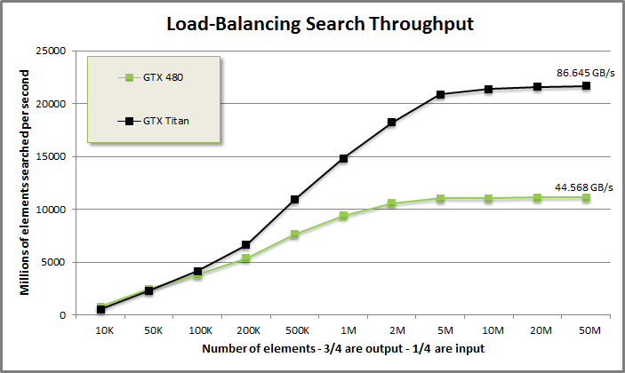
Load-balancing search
Search 20 billion elements per second.

Slide 58
Inner Join Logic
INPUT DOMAIN
0 1 2 3 4 5 6 7 8
A: A A B D F F F F G
B: A A A B C E E F F
LB: 0 0 3 5 7 7 7 7 9 Sorted search LB A->B
UB: 3 3 4 5 9 9 9 9 9 Sorted search UB A->B
COUNTS: 3 3 1 0 2 2 2 2 0 Component-wise UB - LB
SCAN: 0 3 6 7 7 9 11 13 15 (15) Exc-Scan COUNTS
8 INPUTS + 15 OUTPUTS. Launch threads for 23 items. Load-balancing search
provides scheduling
OUTPUT DOMAIN
INDICES 0 1 2 3 4 5 6 7 8 9 10 11 12 13 14
LBS: 0 0 0 1 1 1 2 4 4 5 5 6 6 7 7 aIndices
SCAN[LBS]: 0 0 0 3 3 3 6 7 7 9 9 11 11 13 13
RANK: 0 1 2 0 1 2 0 0 1 0 1 0 1 0 1 INDICES – SCAN[LBS]
LB[LBS]: 0 0 0 0 0 0 3 7 7 7 7 7 7 7 7
LB[LBS] + RANK: 0 1 2 0 1 2 3 7 8 7 8 7 8 7 8 bIndices
A-KEY: A0 A0 A0 A1 A1 A1 B0 F0 F0 F1 F1 F2 F2 F3 F3
B-KEY: A0 A1 A2 A0 A1 A2 B0 F0 F1 F0 F1 F0 F1 F0 F1

Slide 59
Relational Joins
Novel decomposition for easy implementation.
Don’t map fixed inputs to tile.
Outputs might not fit in on-chip memory.
Don’t map fixed outputs to tile.
Inputs might not fit in on-chip memory.
Map fixed count of inputs + outputs to tile.
Avoids load-imbalance.
Inputs + outputs fixed exactly in on chip memory.
Loop unwinding; static indexing; promotion to register.

Slide 60
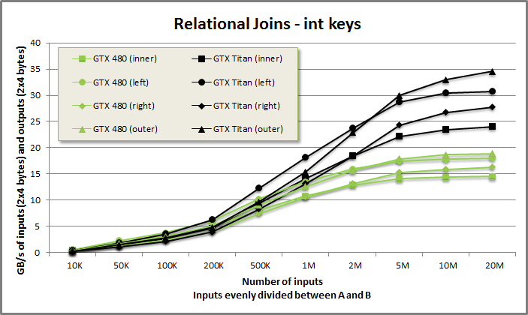
Relational Joins
Flexible merge-join at ~30 GB/s.
Composed from merge-like sorted searches.
Supports any key-type with < comparator.

Slide 61
Wrap-up
Decomposition:
Parallel partition/communication.
Sequential work.
Large grain size for ILP.
More concurrent loads = more throughput.
Expose grain size and empirically tune.
Streaming functions mostly the same.
Write a lot to make it mechanical.
Start with merge and hack it up.

Slide 62

Questions?
Sean Baxter
sbaxter@nvidia.com
www.moderngpu.com

