Slide 1
Linux Foundation Open-Source Climate (OS-C) Transition Analysis Technical Overview
January 5, 2023

Slide 2
Transition Analysis: Typical questions that could be answered
Is it possible to achieve a below 2 degree world working on decarbonisation right now?
What could be the technological choices and investments necessary to achieve a 2 degree world?
What would be the economic conditions and energy mix in a 2 degree world?
What is the effect of technological effectiveness on the speed of energy transition?
How to split investments in the different energy technologies to achieve a low carbon world?
What would happen to the economy and human population if the world temperature goes much above 2 degree?

Slide 3
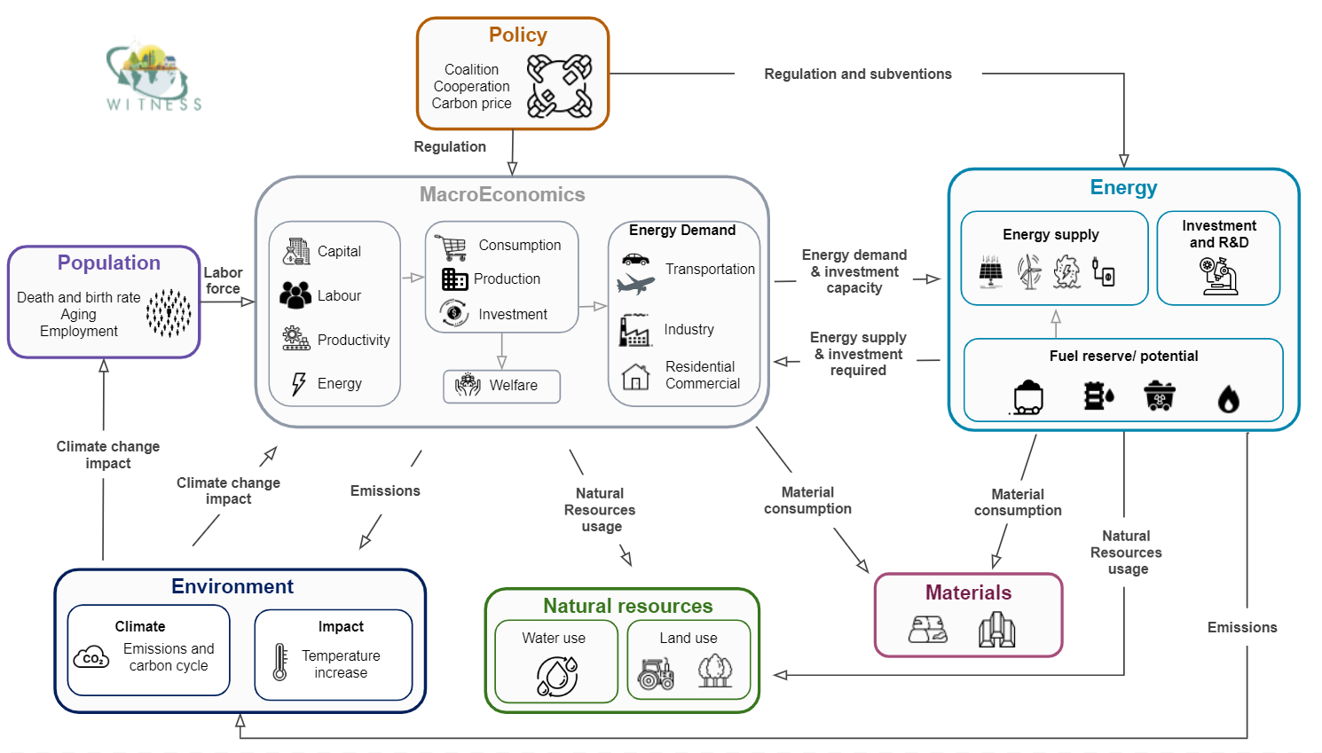
Transition Analysis: WITNESS model

Slide 4
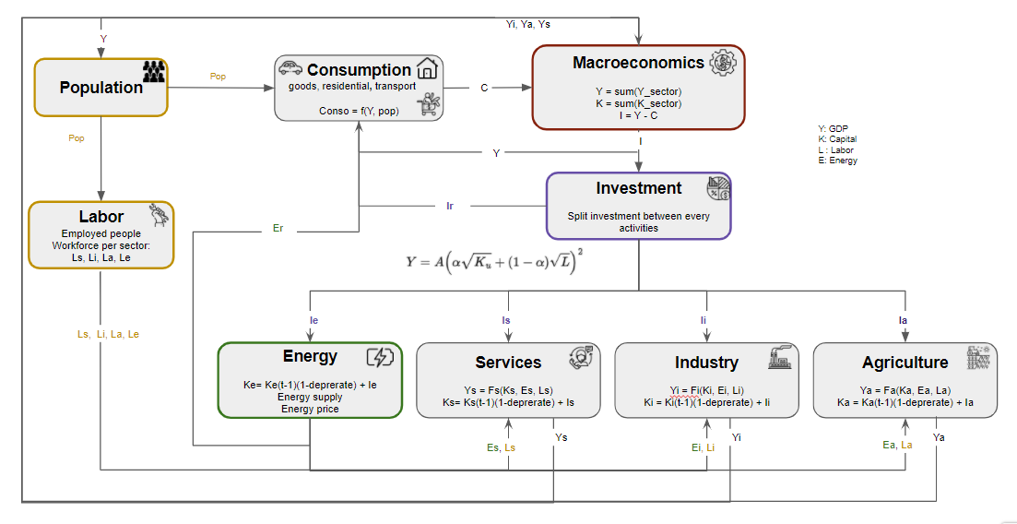
Sectorization v0 Principles
* transport in services

Slide 5
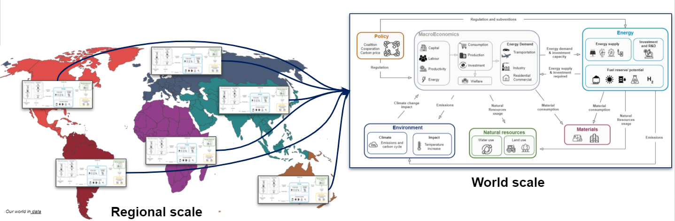
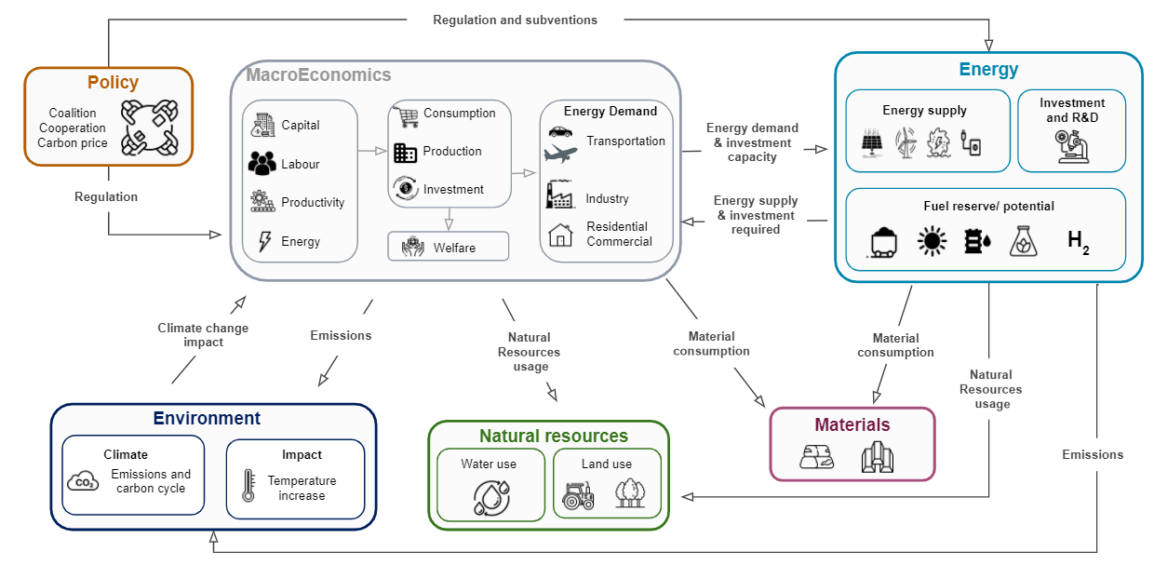
WITNESS Roadmap Detailed Concepts
Global WITNESS
Regional WITNESS
Begin sectorization of economy
- Add missing technos
- Calibration
- Post processing
Regional database
Step by step regionalisation:
Regionalisation of models (energy, economics, resources, land use…)
Exchanges between regions
Problem formulation
Improve land use model
Implement missing models for ressources: water, materials…

Slide 6
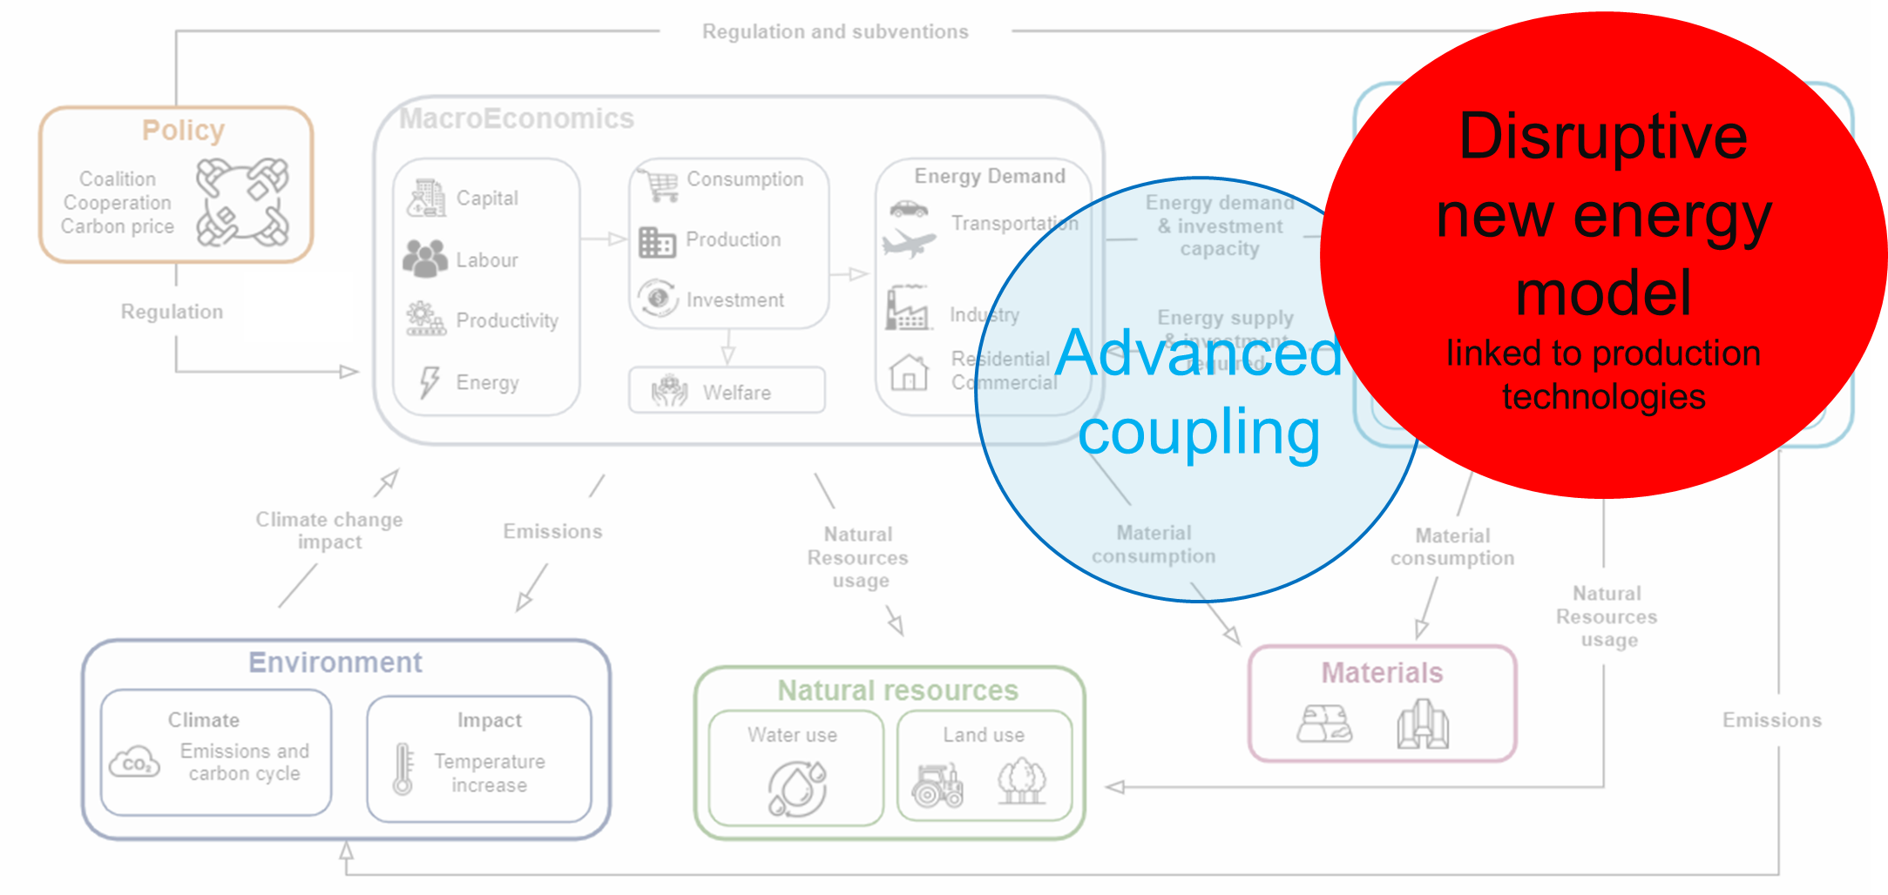
Zooming on Energy Model
Valentin
2’30
40+ technologies
10+ Energies
Techno Prices
Techno Production/consumption
Techno CO2 emissions
Natural resource usage
Design variables in blue
Invest per techno (M$)
Electrolysis
Hydrogen mix
Invest Mix for each techno (%)
WaterGasShift
For a given investment plan
Hydrogen Prices
Hydrogen Production/consumption
Hydrogen CO2 emissions
Macroeconomics
Energy mix Investments distribution
Multi-Disciplinary Analysis (MDA)
Invest (M$)
For each techno
Each energy mix
Techno Prices
Techno Production/consumption
Techno CO2 emissions
Natural resource usage
Total Energy Net production (TWh)
Final Energy prices ($/MWh)
Energy CO2 emissions (kg/MWh)
Energy prices ($/MWh)
Overall energy mix
MacroEconomics
The energy model is a MDA
Total production and CO2 emissions are computed following a given investment plan
Electrolysis will be net zero emissions only if electricity mix is zero emissions
Material/Natural resources usage
Total CO2 emissions (Gt)
Ressources
Environment

Slide 7
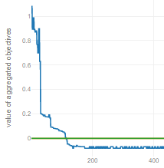
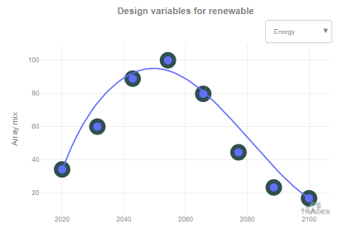
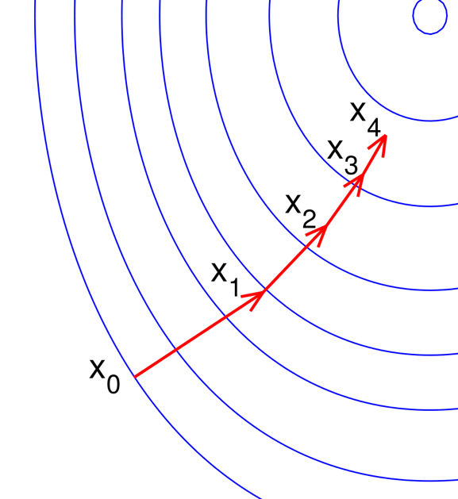
WITNESS Optimization Example
PJ
+3’
key numbers
Objective | maximize welfare and minimize CO2 emissions
Design Variables | technology investment mixes (from 2020 to 2100)
Constraints | (from 2020 to 2100): total energy production > energy lower bound net energies production > energies demand liquid fuel + H2 prod + H2 liquid production > % total production solid fuel + electricity + biomass production > % total production hydropower production < hydropower production in 2020 H2 liquid production > %H2 total production available land > land demand (for forest, agriculture,… )
MDO
65 disciplines
4240 design variables
265383 variables
1200 constraints
MDA
63 disciplines
25064 coupling variables
262715 variables
Adjoint based gradient computation
Lagrangian objective formulation
1 function evaluation
1 adjoint system
instead of
241 functions evaluations per iteration
B-splines
MDA Analysis
8 poles per variable vector
instead of
80 components per variable vector
NewtonRaphson solver
~30 iterations
~8 minutes
1 scalar objective
instead of
1200 constraints and 160 objectives
MDO
65 disciplines
424 design variables
265383 variables
0 constraint
Optimization solver
MDA
63 disciplines
25064 coupling variables
262715 variables
DesignVar
WITNESS model
FuncManager
solved in ~10 hours
L-BFGS-B
Notes:
We introduced WITNESS, with a focus on the energy model.
Here we will present the optimization problem built over the WITNESS multidisciplinary analysis.
The objective is to maximize the welfare while minimizing the CO2 emissions

Slide 8

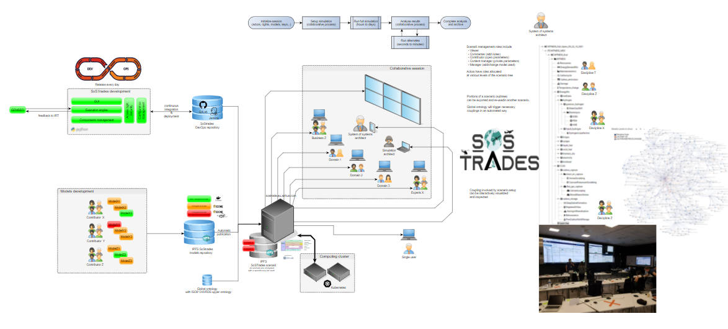
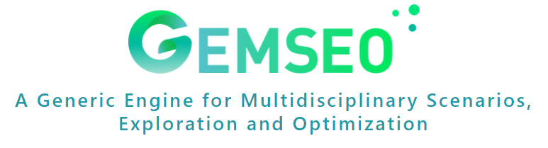
SoSTrades Collaborative Solution Overview
Thierry
based on:
https://gemseo.readthedocs.io/en/stable/
Notes:
Use Sozi prez here to navigate
https://idlvsrv203.eu.airbus.corp/SoziPrez/SoSTrades/CONOPS%20simple%20diagram.sozi.html#frame8956

Slide 9
Wrapping | Key SoSTrades Objects
PJ
3’
visible in GUI
Studies (or instance of processes)
Studies
SOSDiscipline 1
SOSDiscipline 2
A Study is a process instantiated with given input data, and output data if the study has run
3
x
Model 1
a
Model 2
alpha
100
0.1
y
b
beta
0.98
16
z
implements
Process
Process
SOSDiscipline 1
SOSDiscipline 2
A Process is used to couple multiple disciplines together inside SoSTrades
x
Model 1
a
Model 2
alpha
y
b
beta
z
composed of
SoSDiscipline (model wrapper)
A SoSDiscipline is used to wrap a model inside SoSTrades
SoSDiscipline
SOSDiscipline 1
x
Model 1
a
y
b
z
wraps
Model
A user model is available
Model
x
y
Model 1
a
z
b
Notes:
As explained before, SoSTrades is a simulation platform where (under the simulation perspective) we can open, run and see post-processings.
In SoSTrades, 4 main concepts (3 objects in SoSTrades) are involved to make a study available in the GUI:
in order to perform studies, we need a model, this one is brought by the user/dev. The idea is, how to build a process and make it visible in the GUI (launch the study, change inputs etc).
the first step is to integrate the model into SoSTrades : we wrapp the model using the SoSDiscipline Object
the second step consists in defining the process, composed of one or several disciplines (we provide a list of disciplines, with associated namespaces). Once the process is instantiated and configured, the disciplines are coupled (if they need to be) and the execution sequence is computed.
the study is made of a data set of inputs and outputs (if the process has run), and associated with a process.
So when we open a study in the GUI, we see a process with associated data. If we run it, the process is executed (with the execution sequence defined during the configuration) and successively executes the models with updated inputs.

Slide 10
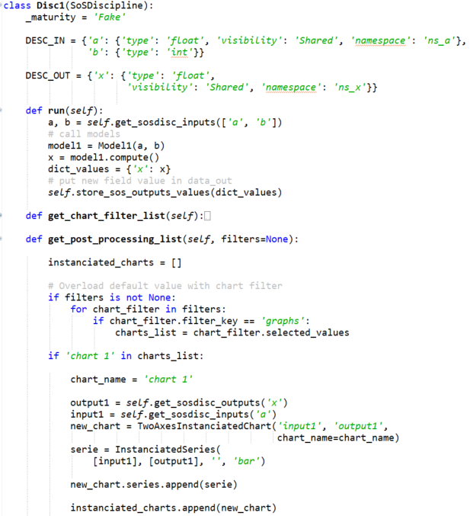
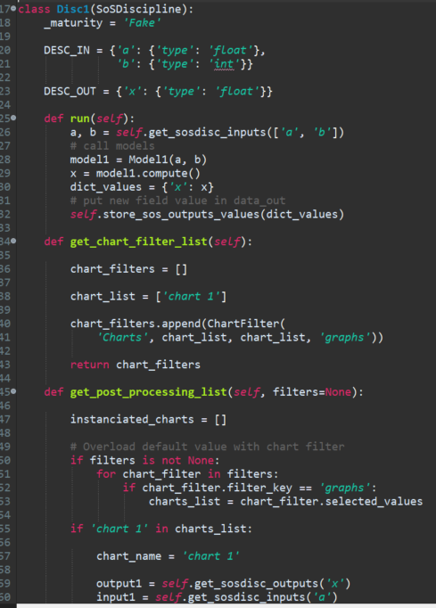
Wrapping | Make your first SoSTrades wrapper of model
PJ
2’
I/O variables definition
User model call
Post-processing definition
Notes:
‘type’ : mandatory could be : ‘float’, ’int’, ‘dict’, ‘dataframe’, ‘float_list’, ‘int_list’, ‘bool’
‘default’ : if the variable has a default value.
‘unit’ : (string) unity of the variable used for the ontology
‘user_level’ : (optional) to filter the display in the GUI (1=Standard by default, 2=Advanced, 3=Expert)

Slide 11
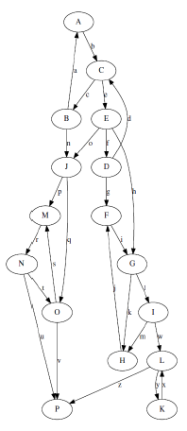
Coupling | Multi-Disciplinary Analysis (MDA)
PJ
2’
local variables Model 1
local variables Model 2
shared variables
Model 1
Model 2
According to the discipline I/O names, couplings variables are automatically identified and multi-disciplinary analyses automatically built.
couplings variables
Notes:
Now that we know how to wrap a model, it is possible to build processes.
But how are handled disciplines coupling?
First, here is a reminder concerning the different types of variables:
local variables, that are inputs only “seen” or “needed” by individual models
a shared variable, that is an input of several models
couplings variables are variables that are inputs and outputs of models
When a process is implemented, we do not need to provide explicitly the links between all the models.
Thanks to GEMSEO, couplings variables are automatically identified and multi-disciplinary analyses automatically built according to the models I/O names exposed in the SoSDisciplines.
Since the SoSTrades core has been implemented as an overload (in the sense of a Python inheritance) of GEMSEO, it inherits from GEMSEO capabilities and the graph computation for MDAs is part of it.

Slide 12
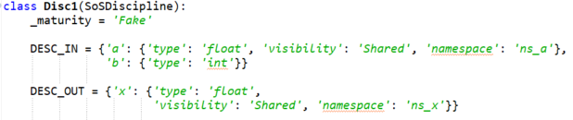
Coupling | Introduction to Namespaces
PJ
3’
In order to be able to distinguish different i/o with the same names and avoid undesired couplings, the namespace definition has been introduced
Example without namespaces definition
Example with namespaces definition
Hydrogen production
Electricity production
Methane production
Hydrogen production
Electricity production
Methane production
prod
prod
prod
hydrogen.prod
electricity.prod
methane.prod
prod?
<energy>.prod for all energies
Energy mix
Energy mix
Namespace declaration in discipline i/o grammars
Notes:
To this automated coupling capability, SoSTrades introduces the definition of namespaces.
To explain the need, we will consider the following situation.
We have several SoSDisciplines that output the production of a given energy. The name is thus the same for all the models.
However, we need to aggregate all these outputs in one, to make a sum for example.
Thus in order to ensure consistent links, we need to change the variables names.
Intuitively a developer would rename the variables by adding information on the context: he would add a prefix to the variable names.
For example, ….
In SoSTrades, has been introduced the possibility to define this namespace at once for all the disciplines that have the variable as input or output.
There is a property “namespace” where the value is the label of the namespace.
The value of the namespace is defined in the processes, so that the same discipline wrapper discipline can be used in different contexts, and the prefix of the variable is changed dynamically.
This also means that GEMSEO will automatically disciplines according to variables that belong to the same namespace.

