Slide 1

My Weather App
Asande Ngubane
ST10322821

Slide 2
The Purpose Of My App
For consumers looking for accurate and comprehensive weather information, my weather app is a valuable resource. It is designed to provide users with up-to-date information on a range of meteorological characteristics in real-time, enabling them to make well-informed decisions based on the present and predicted weather. The software meets a wide range of user demands, from arranging outdoor activities for the upcoming week to monitoring the temperature before heading outside.
One of the key features of my weather app is its intuitive interface, designed for ease of use. Users can navigate effortlessly through the app, accessing essential data such as temperature trends. The app presents this information in a visually appealing manner, ensuring that users can quickly grasp the current weather situation and forecasted changes.
Moreover, my weather app provides detailed forecasts for the upcoming days, allowing users to anticipate weather patterns and plan their schedules accordingly. Whether it's a weekend getaway, a morning jog, or a picnic with friends, users can rely on the app to provide accurate predictions, helping them make the most of their time outdoors.
In addition to standard weather updates, my app also includes advanced features such as the ability to clear and reset data. This functionality enables users to refresh the app's content easily, ensuring that they always have access to the latest weather information. Furthermore, the app integrates a unique random temperature generation feature, facilitating testing and development processes while maintaining a realistic user experience.

Slide 3

Splash Screen
Picture this: when you first open my weather app, you're greeted with a splash screen. It's like the welcome mat, setting the mood for what's to come. And on this splash screen, you'll see a soothing light blue background with a friendly blue owl as the logo. I chose blue because it feels calm and trustworthy, perfect for a weather app. Plus, owls are smart, so it's like saying, "Hey, this app knows its stuff!" Keeping everything blue throughout the app makes it look nice and neat, and the owl logo makes it memorable. It's all about giving users a good vibe and making them feel like they can rely on the app for accurate weather info.

Slide 4
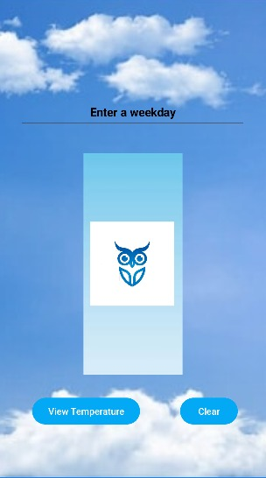
Main Screen
On this second page, you'll find the enchanted realm where the magic unfolds. Here, you hold the privileged key to enter the day of your choice, unveiling the weather forecast that awaits. Once more, you're greeted with the serene and tranquil ambiance, setting the stage for your exploration. For the interface, I've opted for a soothing shade of blue, reminiscent of clear skies and gentle breezes. I've implemented a textbox feature that prompts users to input a specific weekday, allowing the system to generate results tailored to the selected day. There are two buttons at your disposal, both adorned in the same calming hue. The first button beckons you to summon the results, unveiling the atmospheric mysteries of your selected day. The second button offers solace for the indecisive, granting the power to clear the slate, should you wish to venture forth and explore the forecast for another weekday.

Slide 5
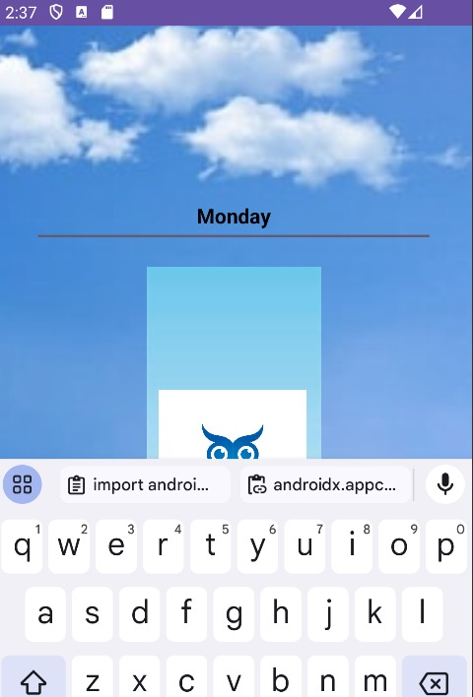
Here is where you enter the day in which you wish to see the weather for. As an example this is what it would look like once you enter the day on the “Enter a weekday”

Slide 6
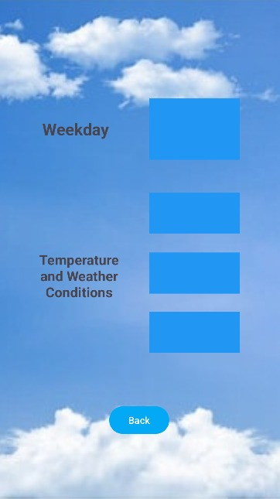
This what it will look like before the results show. This is the DetailActivity. As shown it will display the temperature and the weather conditions.

Slide 7
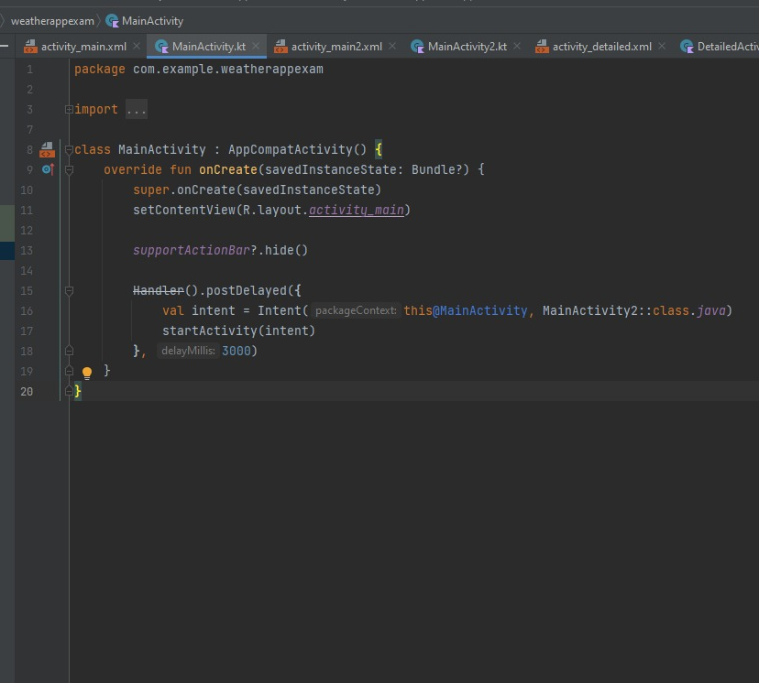
Codes For The Three Screens
Here you can see the code for the splash screen. For the splash screen(MainActivity) I used a handler and used the code to link the splash screen with MainActivity2

Slide 8
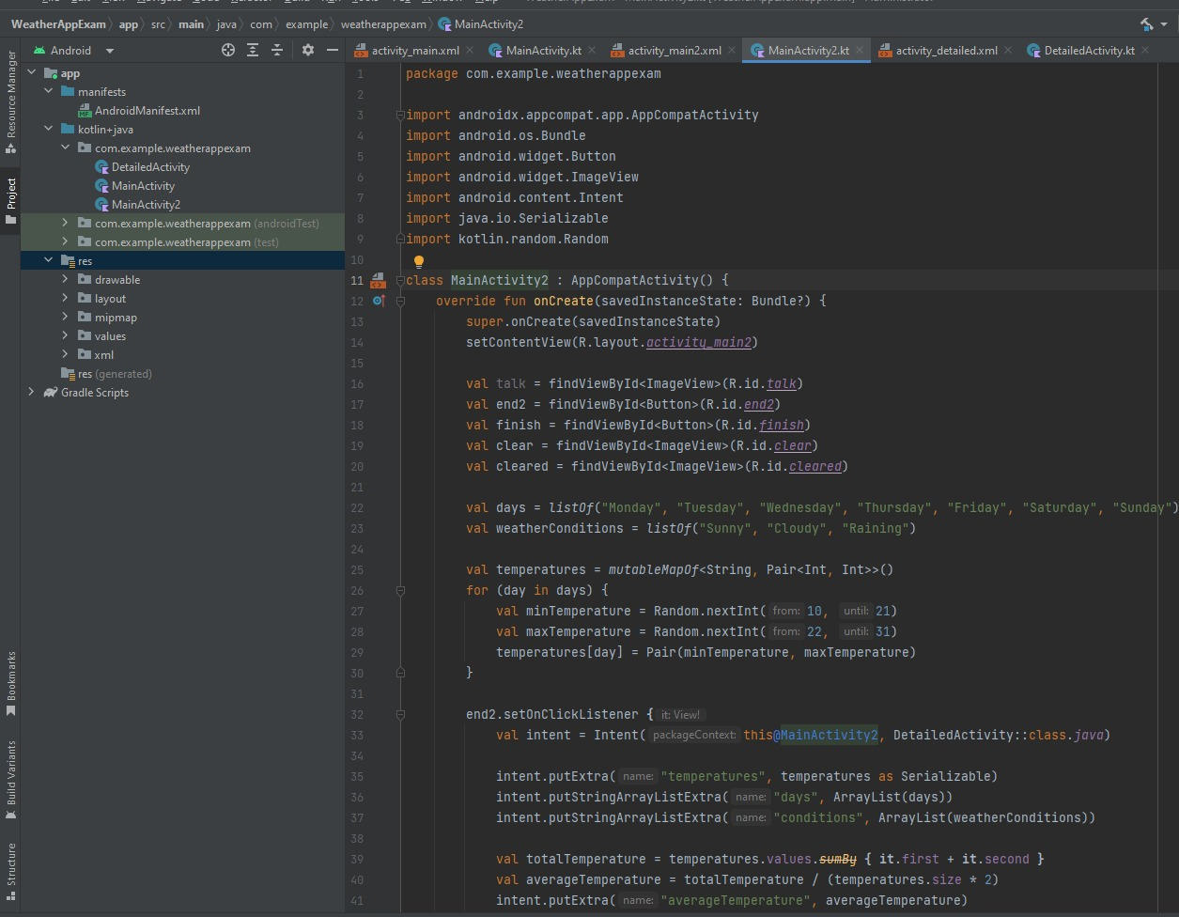
MainActivity2
This is the code for MainActivity2 where I used parallel arrays and a loop to store the data of the weekdays and be able to used any weekday to view its weather forecast. This is where I also coded my app to perform the function of showing the minimum, maximum and average of the temperature

Slide 9
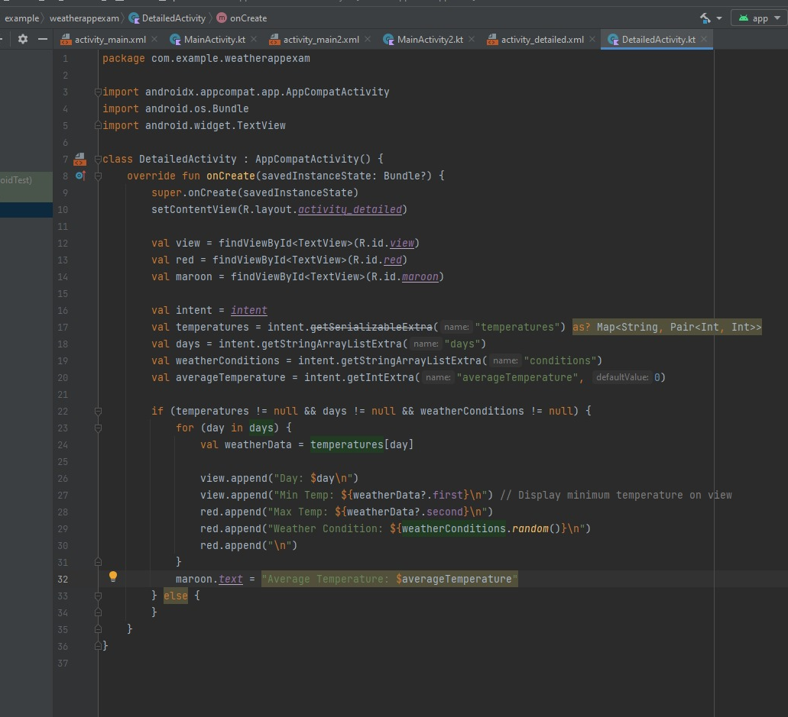
DetailActivity
This is the DetailedActivity that is for displaying the detailed information for each days temperature. Here what is included is the code behind the feature of the app showing the results of the minimum, maximum and average temperature. There is also a code that allows the user to go back to the main page where the user can re-enter another day to view the weather for that weekday

Slide 10
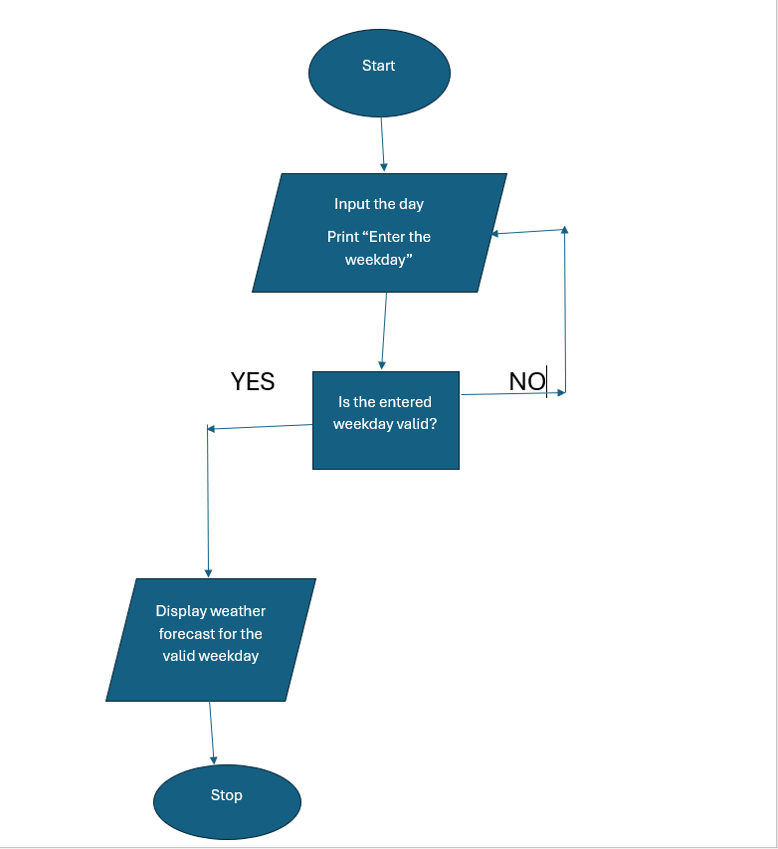
Flowchart
This is the flowchart that’s displaying the process of the pseudocode

Slide 11
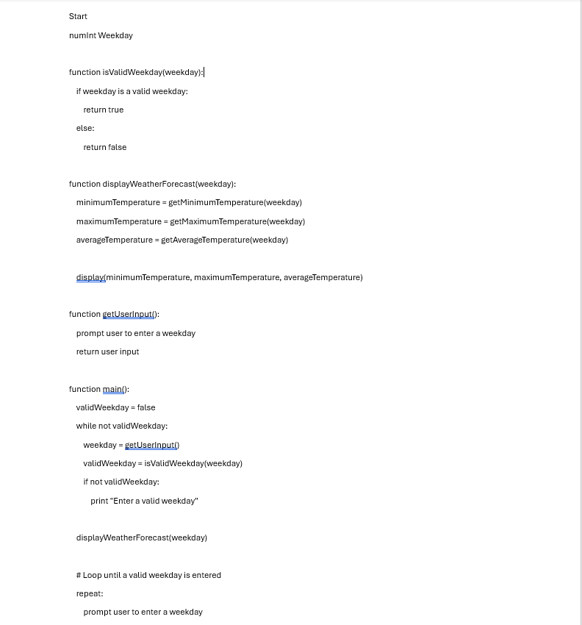
Pseudocode
This is the pseudocode that for describing how the flowchart and the app was constracted,

Slide 12
