Slide 1
NEXTDOOR
PREPARED BY :-
CHIRAG MODI
KAUSHIK PRAJAPATI
CHINTAN VANKAR

Slide 2
PROBLEM STATEMENT
In our day to day life tenant face lot of issues related to find house or shop. For this they have to talk with brokers and sometimes they have to search whole city to find house and shop.
So these result in spending lots of money as well as time.

Slide 3
PROJECT DESCRIPTION
NextDoor is a website in which If some tenant is looking for house or shop then through this they can choose best possible house or shop based on amount of rent and location.
NextDoor is useful to owner of house or shop as through this they can communicate to renter and make deal efficiently.
Through this website owner and renter communicate without intermediate person or broker

Slide 4
Feature of project
Renter find immediate solution for finding house or shop without wasting money and time.
Renter see houses or shops based on various filters like location, price, area.
There is one to one communication between renter and owner
Owner can also give his/her property to rent right person in less time and without wasting money.

Slide 5
Modules
User Registration and Login
SignUp
Login and Validation
Edit Personal Information
Admin
Login
User View
Complaint From Customers
Delete User
Add and Remove Advertisement
View List of Houses and Shops
View List
Add To Favorite

Slide 6
Modules
Add House and Shop
Add House or Shop
Edit Information
One to One Conversation
Feedback
Add Feedback
Improve system Using Feedback

Slide 7
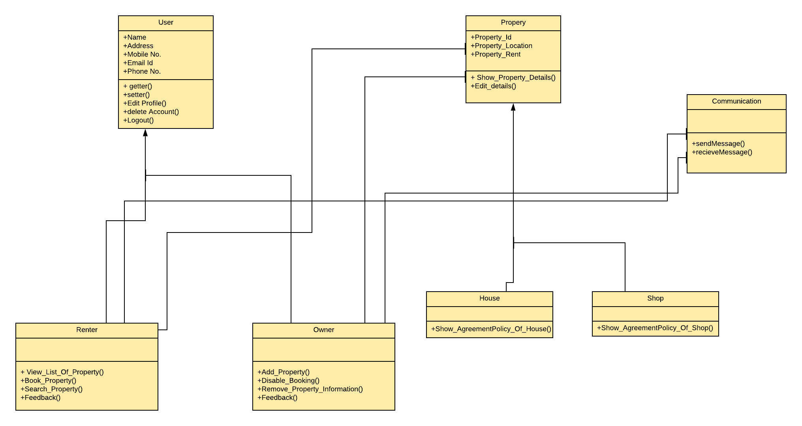
Class diagram

Slide 8
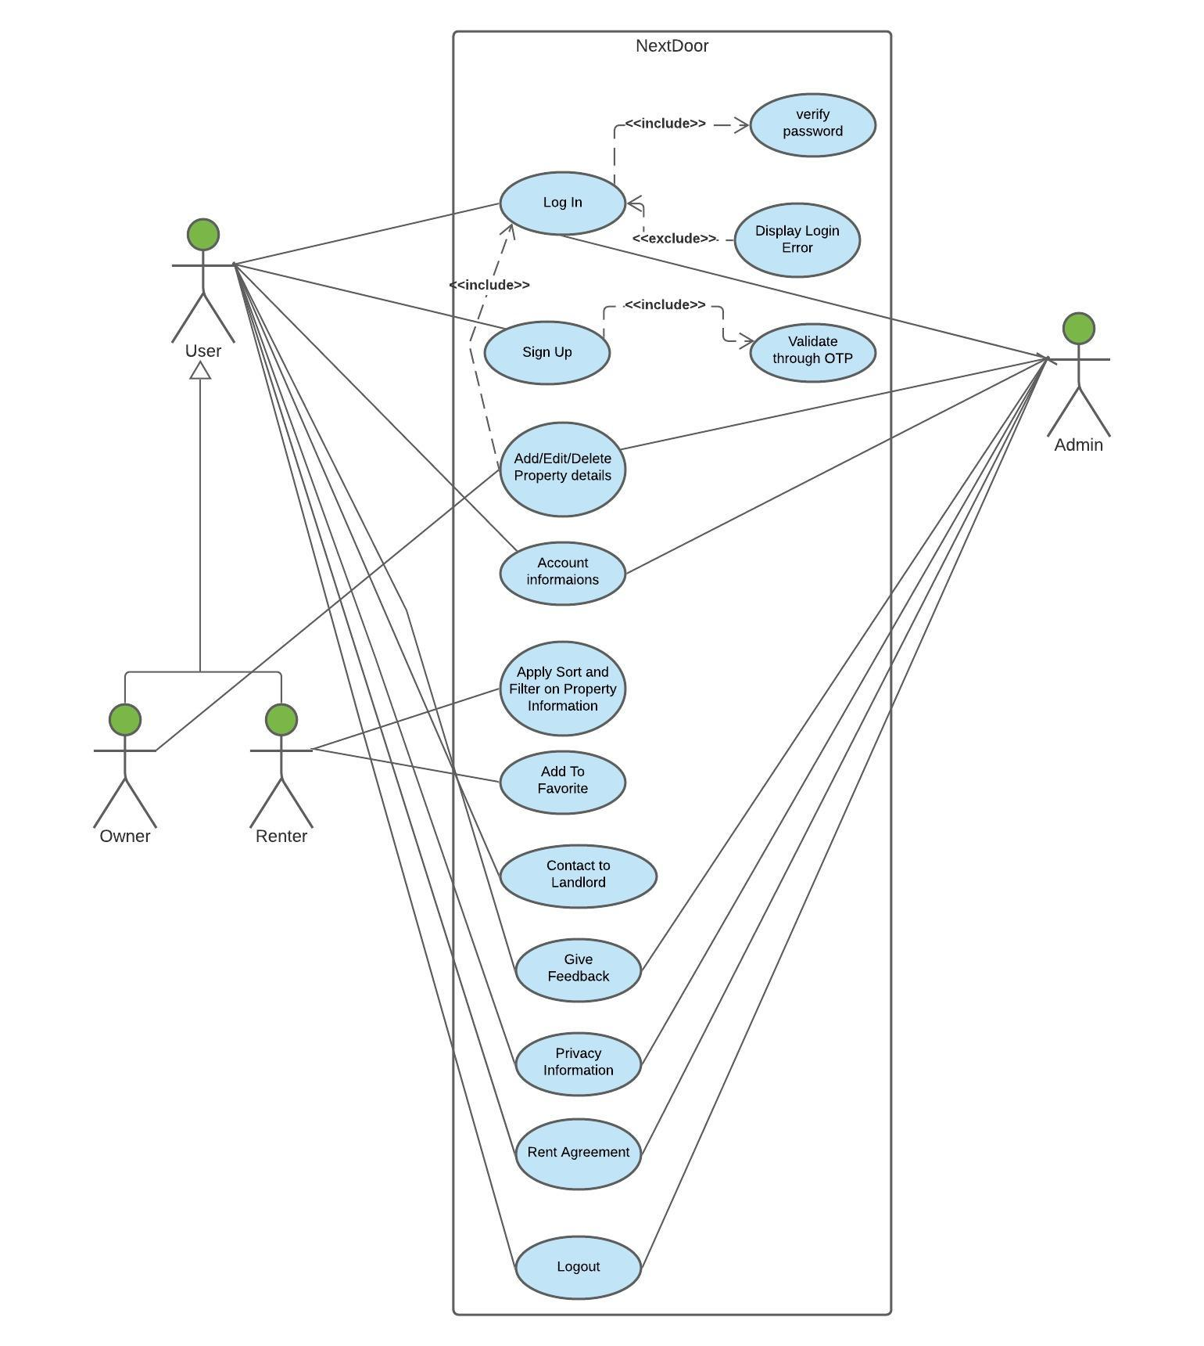
Use Case Diagram

Slide 9
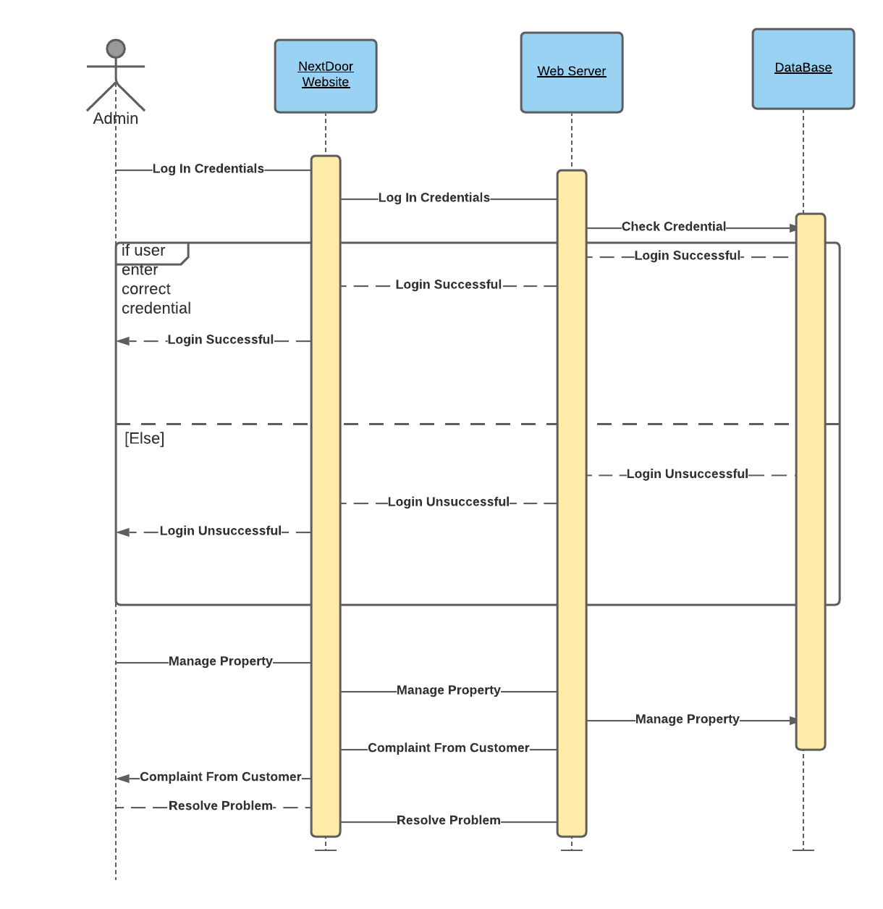
Sequence Diagram (Admin)

Slide 10
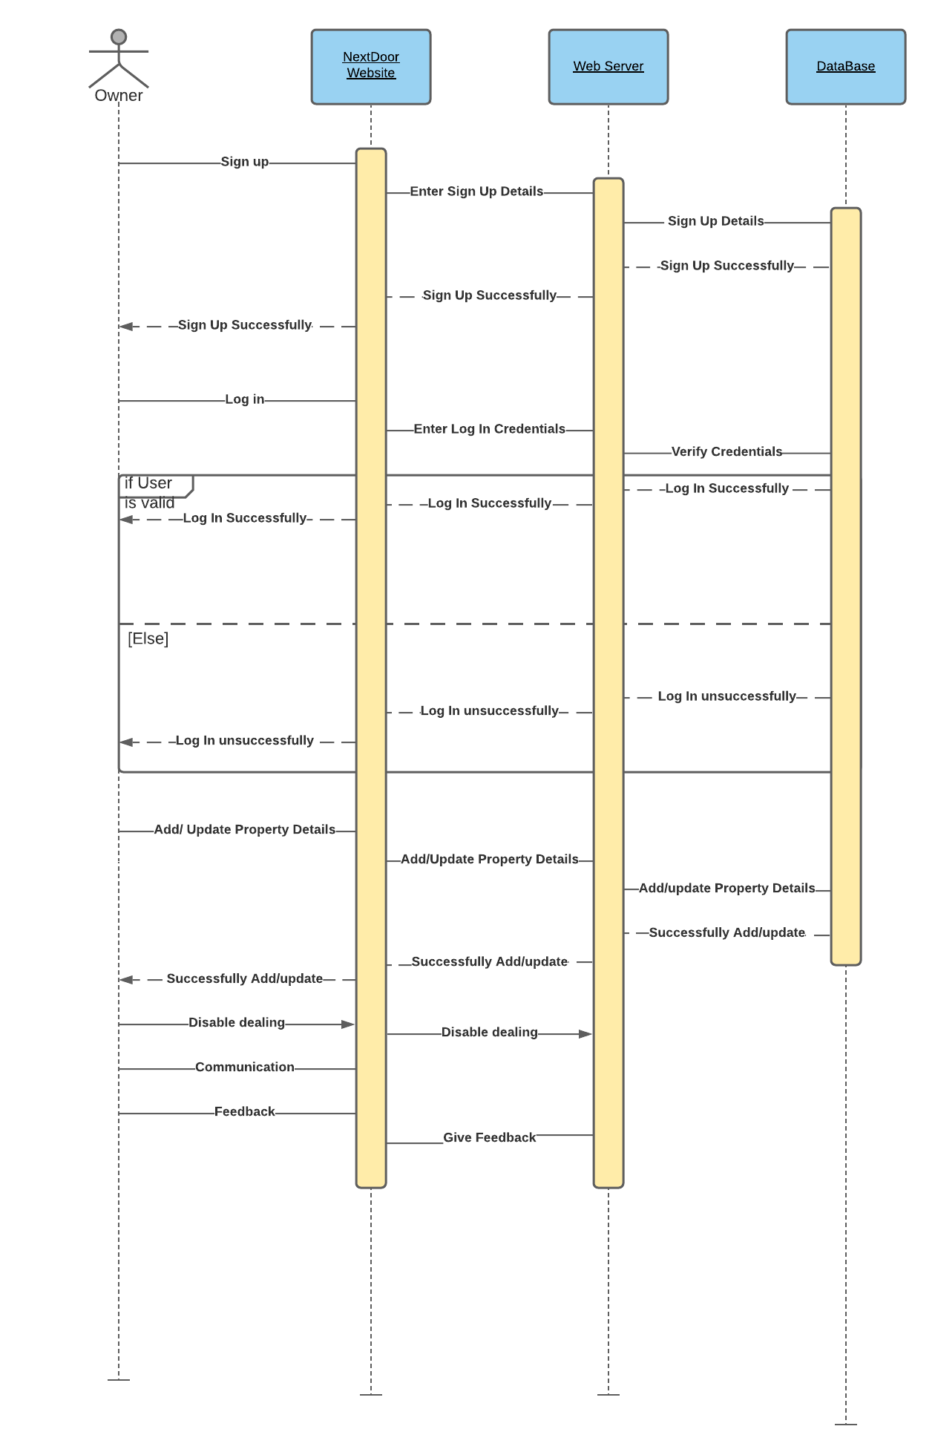
Sequence Diagram (Owner)

Slide 11
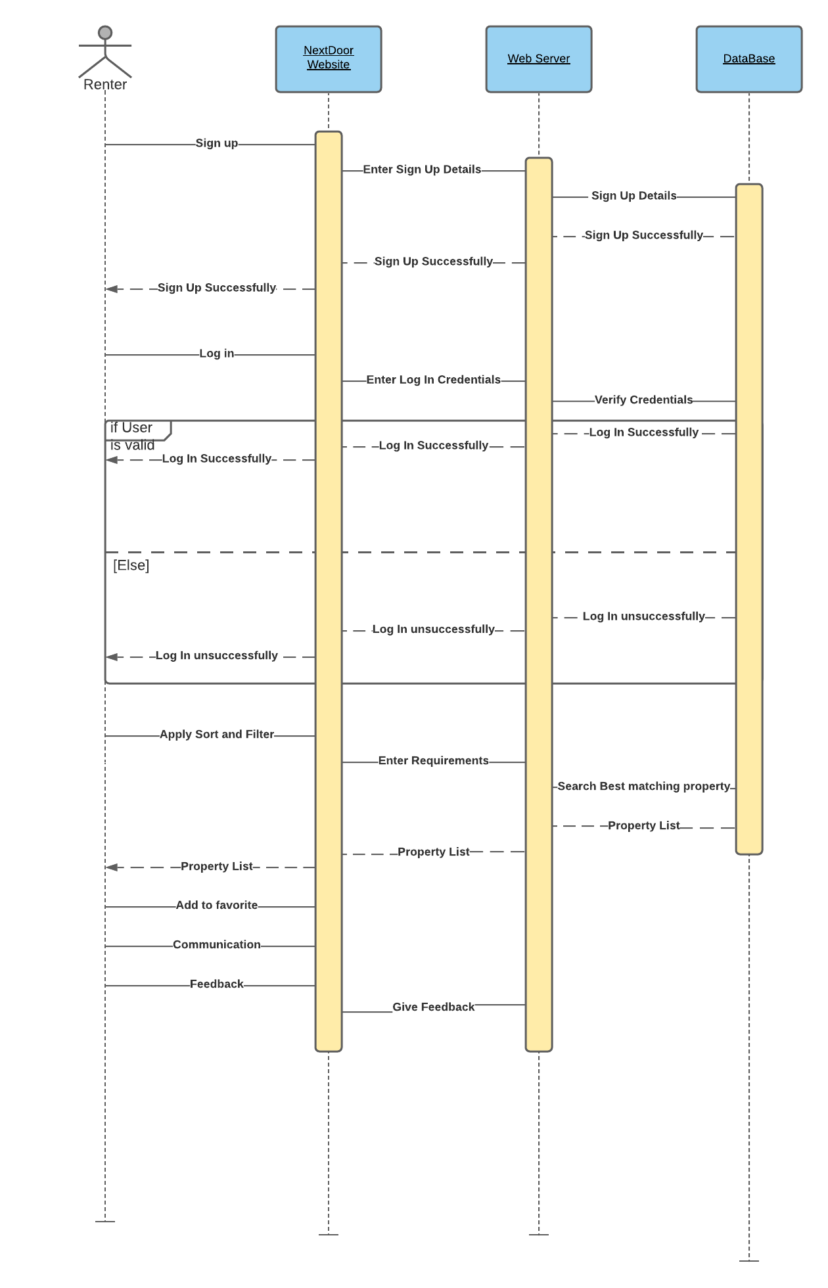
Sequence Diagram (Renter)

Slide 12
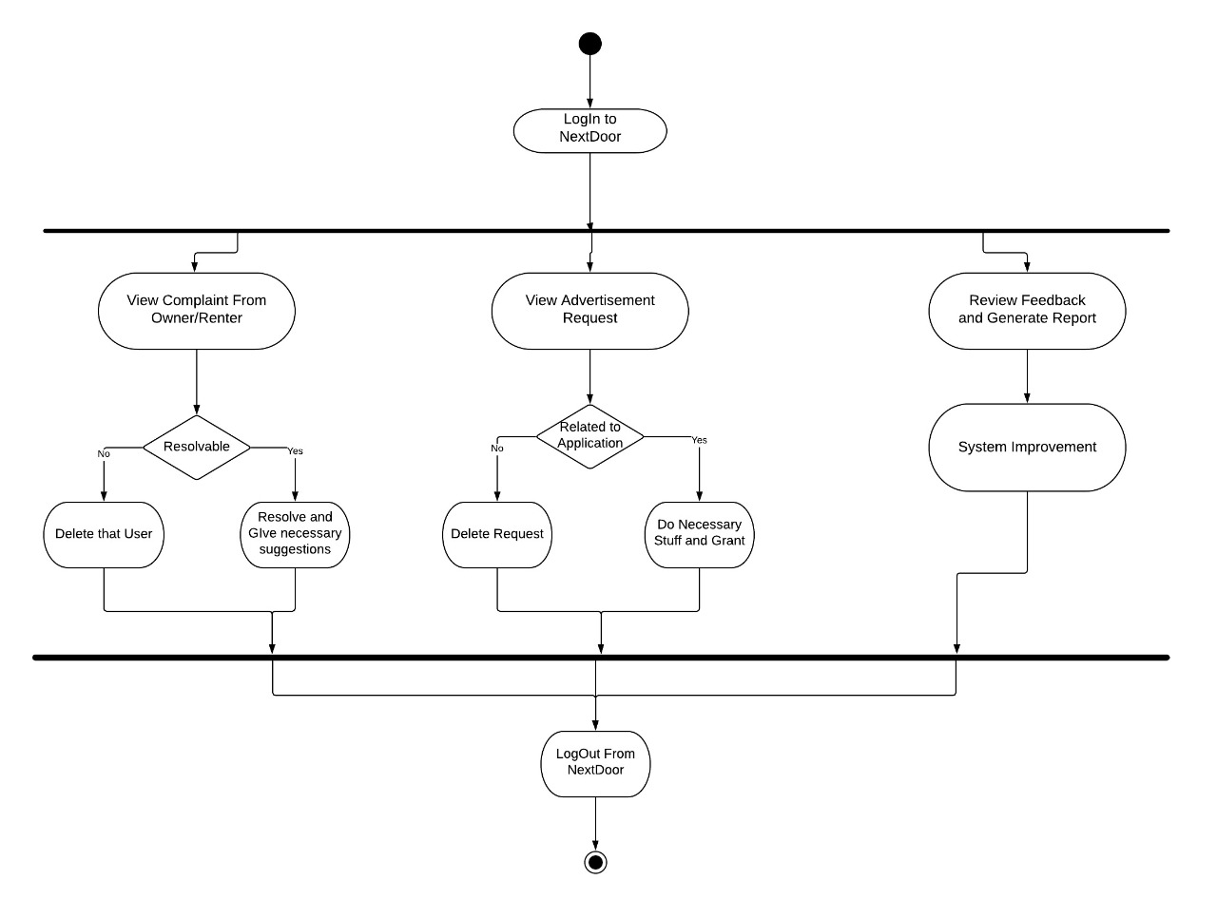
Activity Diagram (Admin)

Slide 13
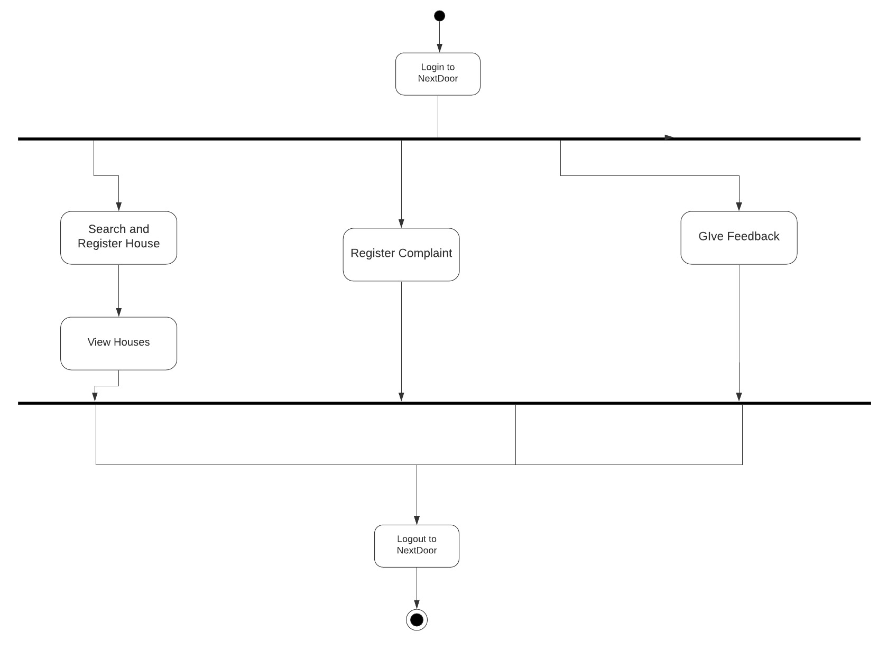
Activity Diagram (Renter)

Slide 14
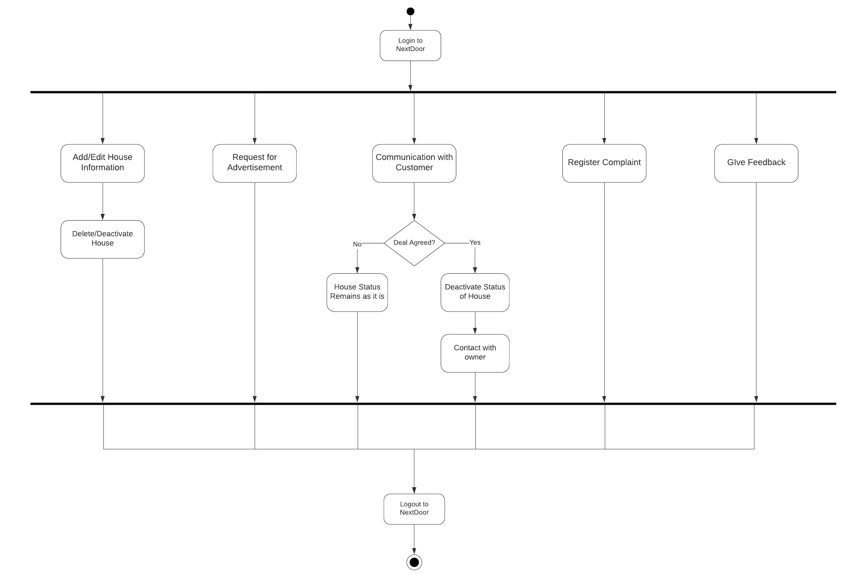
Activity Diagram (Owner)

Slide 15
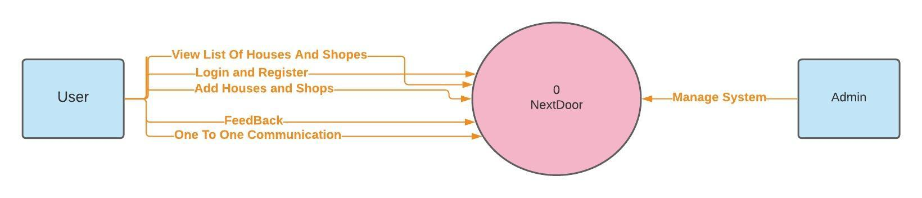
Data Flow Diagram (Level 0)

Slide 16
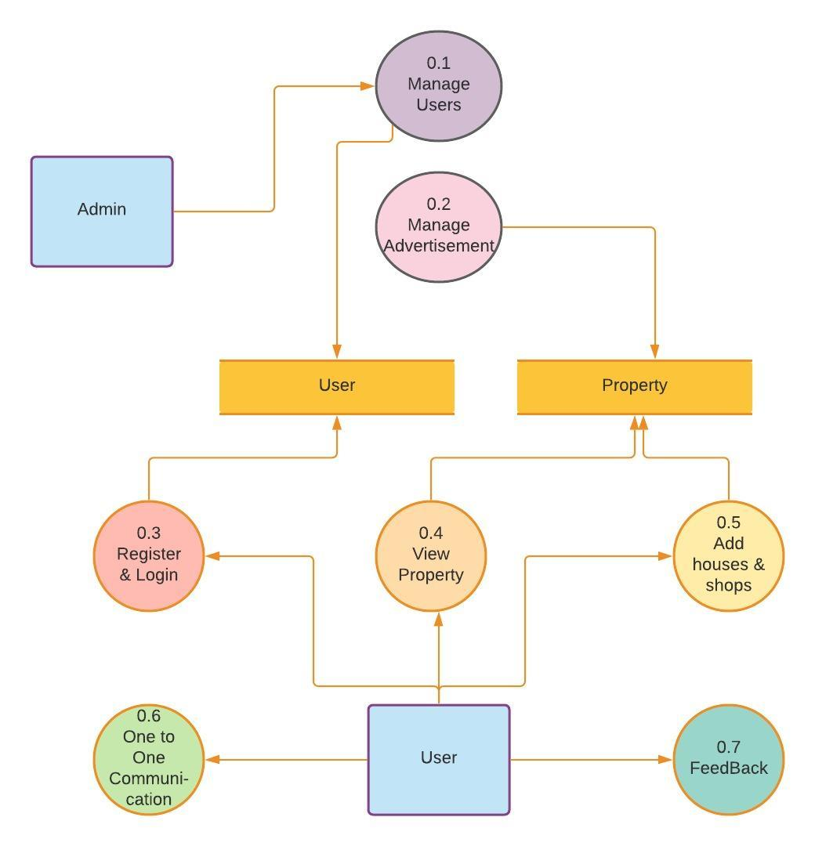
Data Flow Diagram (Level 1)

Slide 17
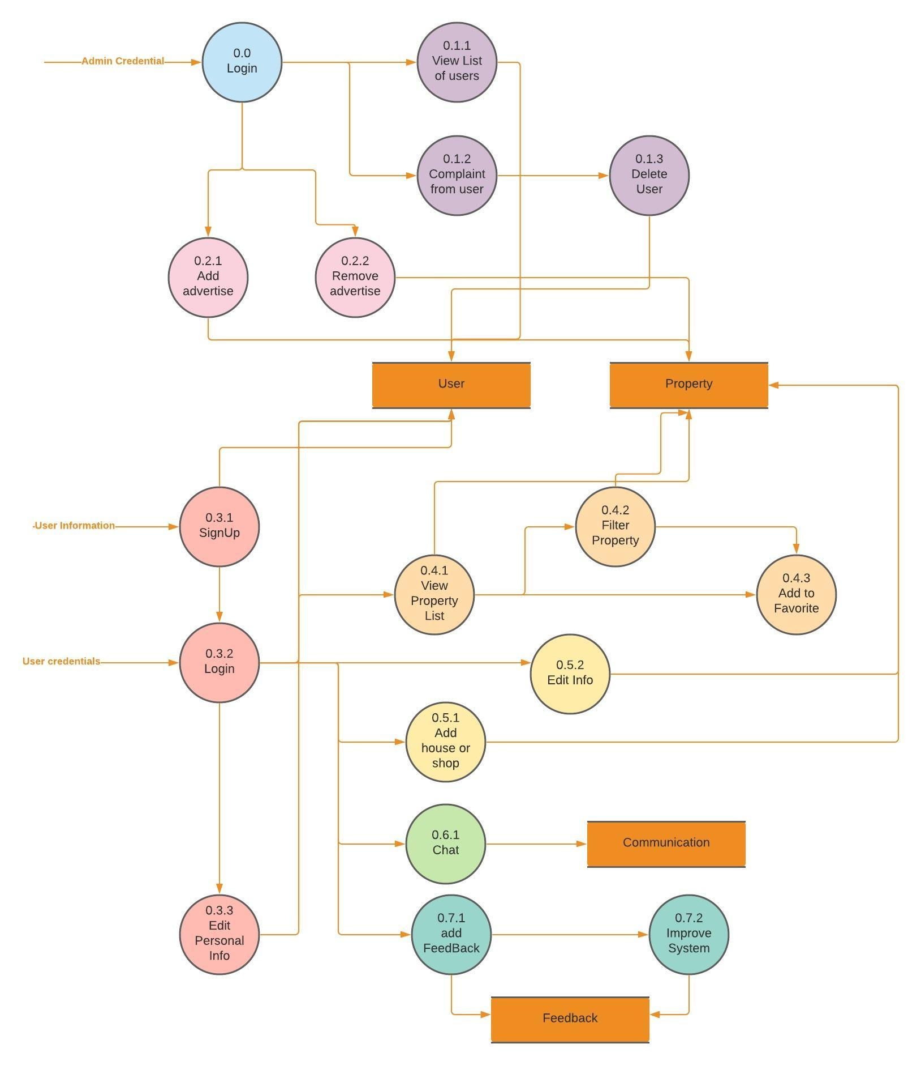
Data Flow Diagram (Level 2)

Slide 18
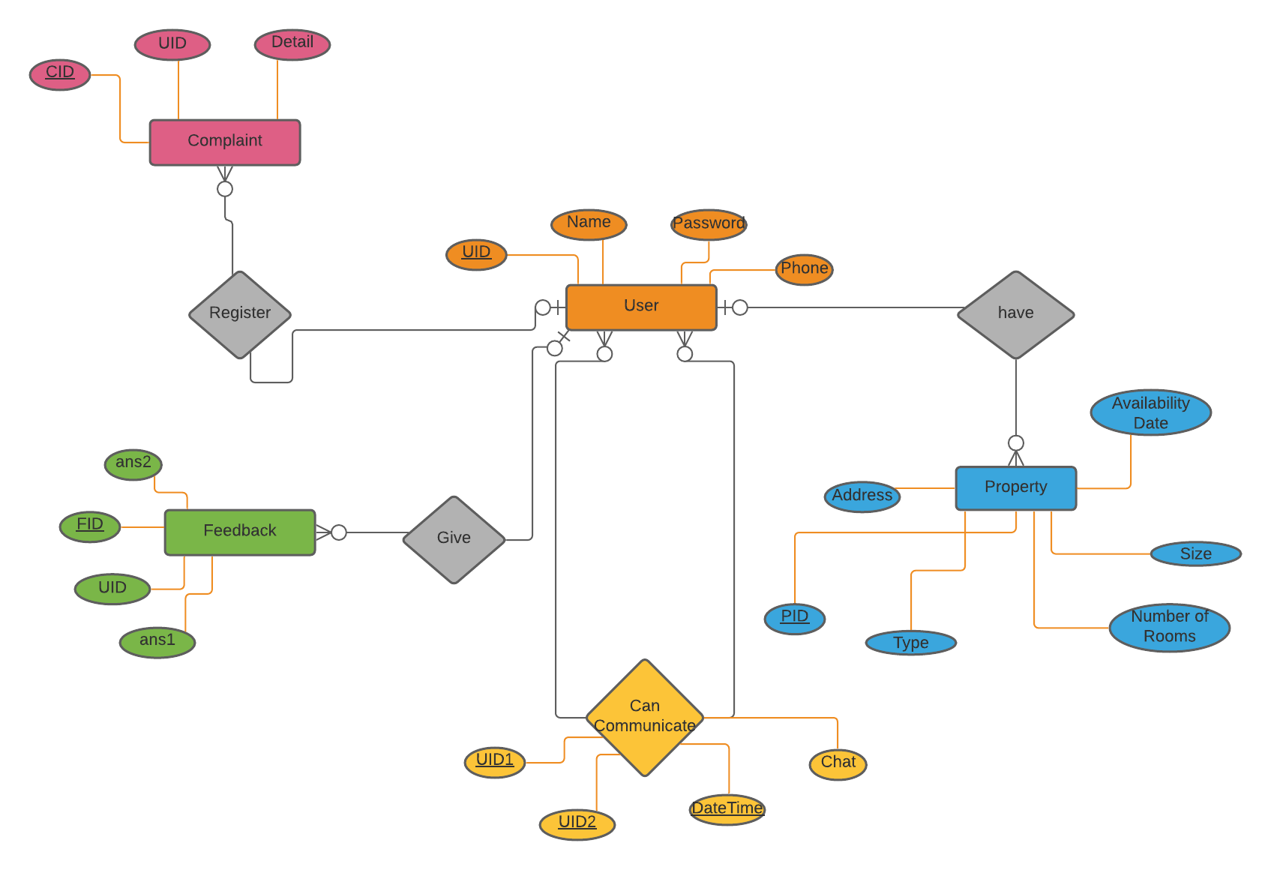
ER Diagram

Slide 19
Tables
User: (Uid, Name, Password, Phone)
Property: (Pid, Availability Date, Size, Number of Rooms, Type, Address, Rent, Floor, Images)
Feedback: (Fid, UId, ans1, ans2, ans3)
Communication: (UId1, UId2, Chat, DateTime)
Complaint: (Cid, UId, Details)

Slide 20
Tools and Technology
Java Servlets
JSP
HTML, CSS, JavaScript
MySQL

Slide 21
THANK YOU

