Slide 1

Population for the month of October Analysis (2023) Source: https://www.data.gov.in/ Dataset: Population for the month of October 2023
Indian Government Dataset Analysis
Bharadwaj Kollepara

Slide 2
Introduction
This presentation provides an analysis of the population of people dataset, covering:
Current Year (Upto Review Month),
Previous Year (Same Month),
Previous Month,
Current Month.

Slide 3
Initial Analysis of the Dataset
Dataset Overview:
The Crime Review for October 2023 dataset contains records of various crimes reported during the month. It provides insights into crime trends by categorizing offenses under major and minor heads, helping to understand the nature and frequency of crimes.
Total Records: 692
Columns: 8
Data Types:
Numerical: 4 columns (Crime counts, Serial Number)
Categorical: 3 columns (Crime categories and descriptions)
Float: 1 column (Crime counts for the previous year)

Slide 4
Dataset Overview
Crime Trends Over Time:
The dataset provides crime statistics across different months and years, helping to identify whether crime rates are increasing or decreasing for specific categories.
Comparing the current month's crime numbers with the previous month and same month last year can reveal patterns or seasonal variations in crime rates
2. Major vs. Minor Crime Categories:
The dataset classifies crimes into major and minor heads, allowing authorities to understand the severity and nature of offenses.
Some crimes (e.g., murder) are further divided based on motives such as property disputes, personal vendetta, or dowry-related cases.
3. Data Gaps & Limitations:
The "MINOR HEAD" column has missing values (some rows do not have specific crime subcategories).
The dataset does not include location-based information, which limits a more detailed crime pattern analysis.

Slide 5
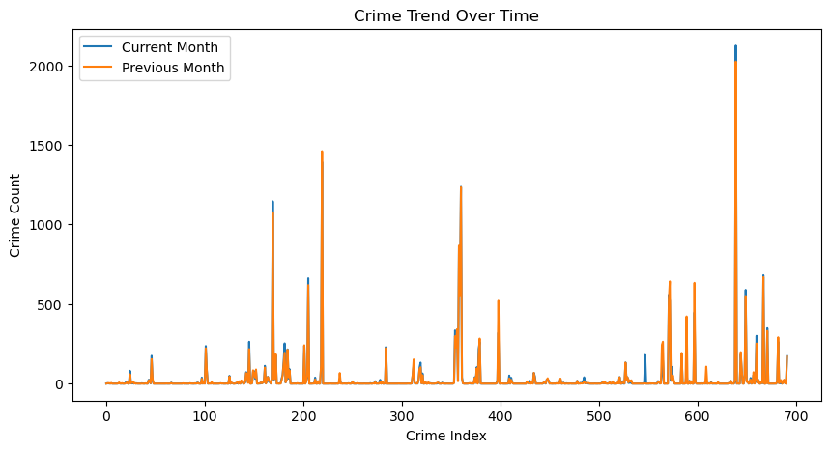
Population of crime trends over time
comparing crime trends for the current and previous months and crime counts fluctuate over time.

Slide 6
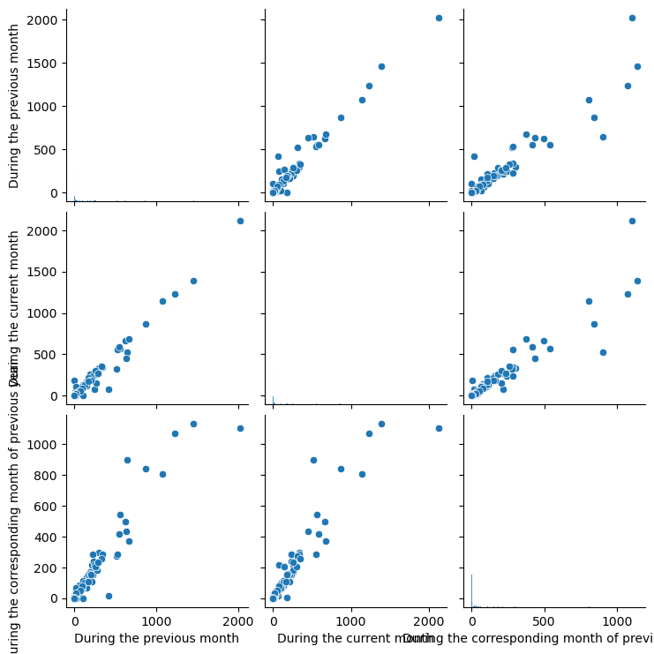
Distribution of population over previous and corresponding month
To visualize relationships between crime counts in different months.

Slide 7
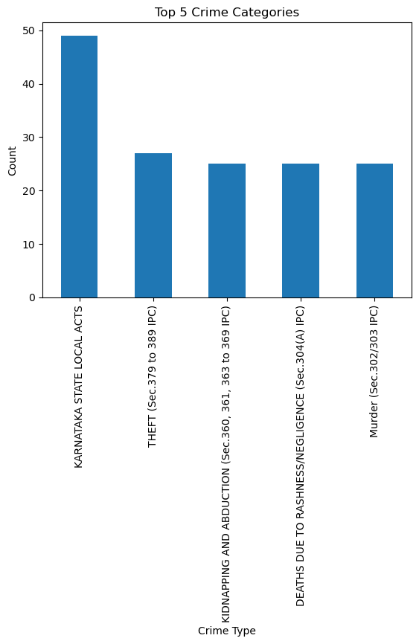
Top 5 crime categories to cause deaths
Karnataka has the more crime category compared to other crime types

Slide 8
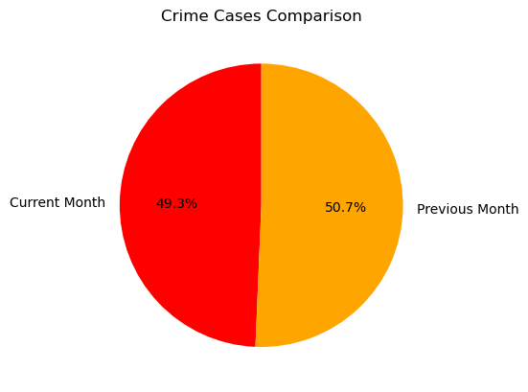
Month-to-Month Comparison of Crime Cases
This line plot shows tells the comparison of current and previous month.
Crime cases comparison we observe previous month has higher cases compared to current month

Slide 9
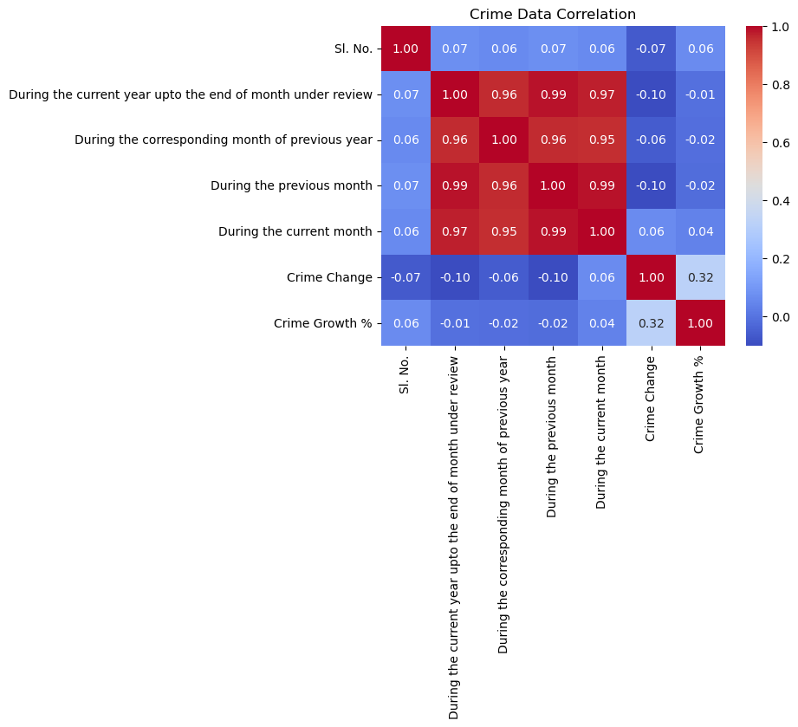
Heatmap of Crime data Correlation
This heatmap shows the correlation between years and months in terms of average population.
show the correlation between different numerical crime data points.

Slide 10
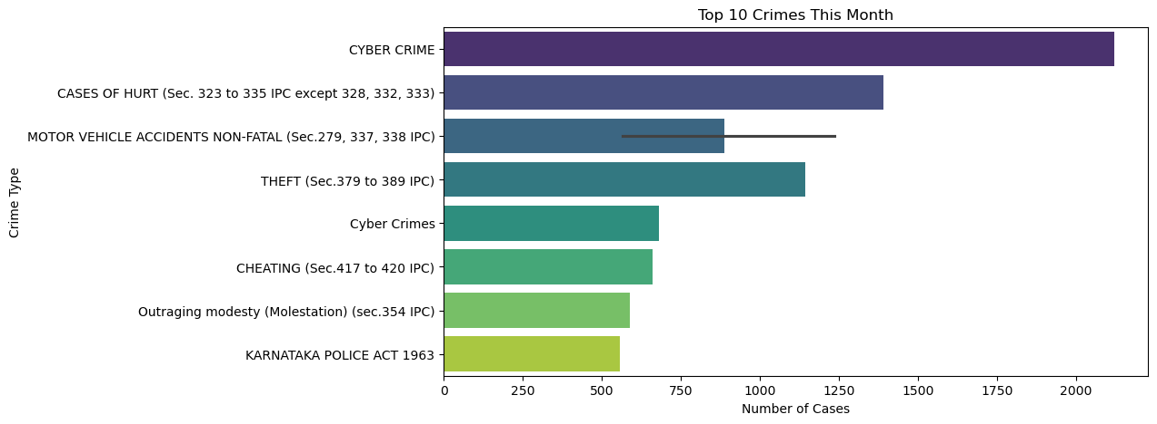
Top 10 Crimes Cases and its types
This bar plot shows the crime cases of the month and crime types.
the top 10 crimes with the highest cases in the current month
[55]:

Slide 11
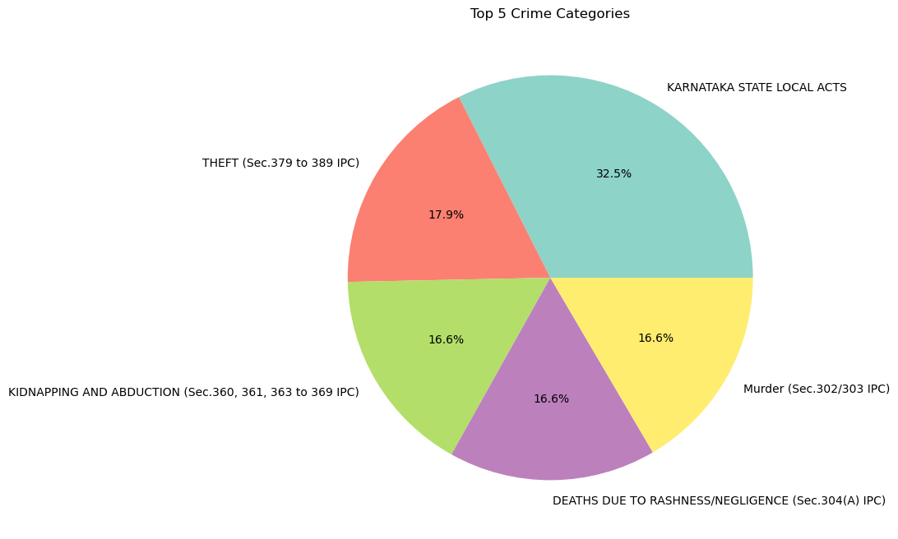
Crime Categories Distribution
This pie chart displays the top 5 Crime Categories of causing
death based on frequency.

Slide 12
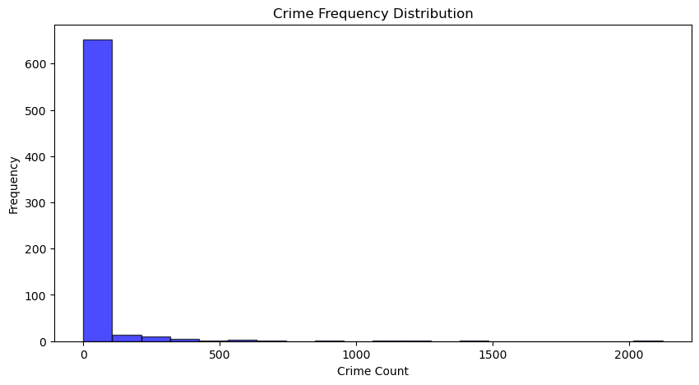
Crime Frequency Distribution
This bar plot shows the frequency of Crimes Count.
different crime counts occurred in the current month.

Slide 13
Conclusion
The dataset provides crime statistics across different months and years,
helping to identify whether crime rates are increasing or decreasing
for specific categories.
Comparing the current month's crime numbers with the
previous month and same month last year can reveal patterns or
seasonal variations in crime rates.

