Slide 1
Product Sales For
Electronic company
analyze sales performance
and how to improve sales in one month?

Slide 2
Company Background (Scenario)
Electronics company (E) is Saudi Arabia-company based on sales different types of electronics such as Apple Air pods Headphones, Batteries, USB-C Charging Cable and laptops etc..

Slide 3
Methodology
Problem understanding
Data exploration
Data analysis
Conclusion

Slide 4
Describe Problem
Electronic company want to do analyze sales performance for improving sales for the future months.
To solve this problem, we need to answer three questions:
Q1. What product ordered the most?
Q2. At any day orders are increased?
Q3. What week have the highest earning in this month?

Slide 5
Data description
database that has been used is (Sales Product Data ) and it's provided by Kaggle. this data provided in .CSV format.
it contains of 18383 rows and set of columns:
● Order ID - An Order ID is the number system that uses to keep track of orders (unique number).
● Product - The product that have been sold.
● Quantity Ordered - Ordered Quantity is the total item quantity ordered in the initial order.
● Price Each - The price of each product .
● Order Date - This is the date the customer is requesting the order be shipped.
● Purchase Address – is shipping address.
And we added four columns date, total, week and week number.

Slide 6
Data Analysis

Slide 7
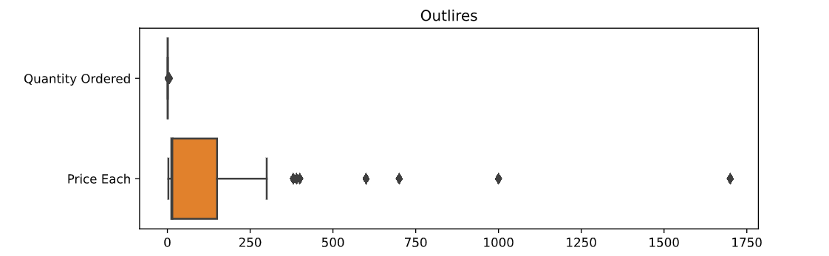
Outliers
Based on dataset we have 1700 as price for MacBook Pro Laptop product .

Slide 8
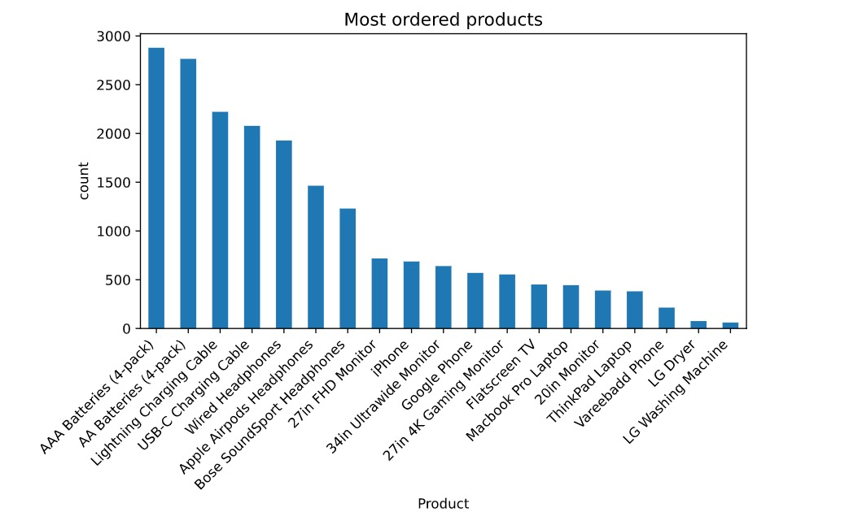
What product ordered the most?

Slide 9
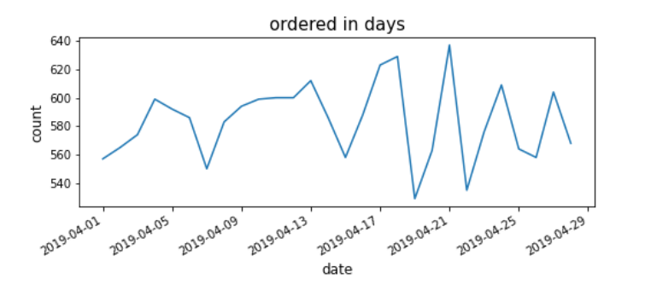
At any day orders are increased?

Slide 10
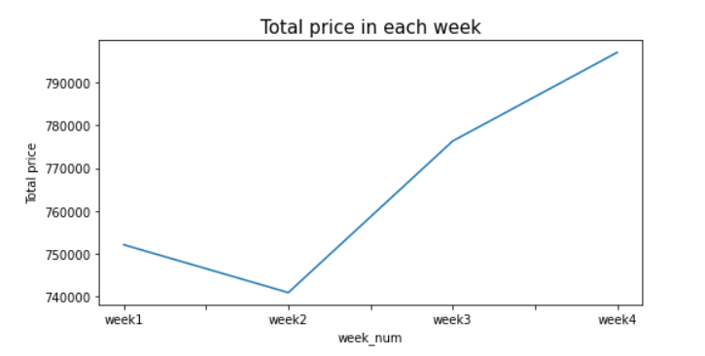
what week have the highest earning in this month?
As we can see in the chart, the earnings start rising from the second week until it meets the highest price level in the fourth week with more than 790000.

Slide 11
Conclusion
Based on previous analysis, earnings does not depend on how many orders in the day, but It depends on orders total price . By knowing that we can improving performance by reduce the price of some products and we can improve sales by offering products based on the best-selling products.

Slide 12
Thak you!

