Slide 1
STORYBOARD: PYTHON GAME

Slide 2
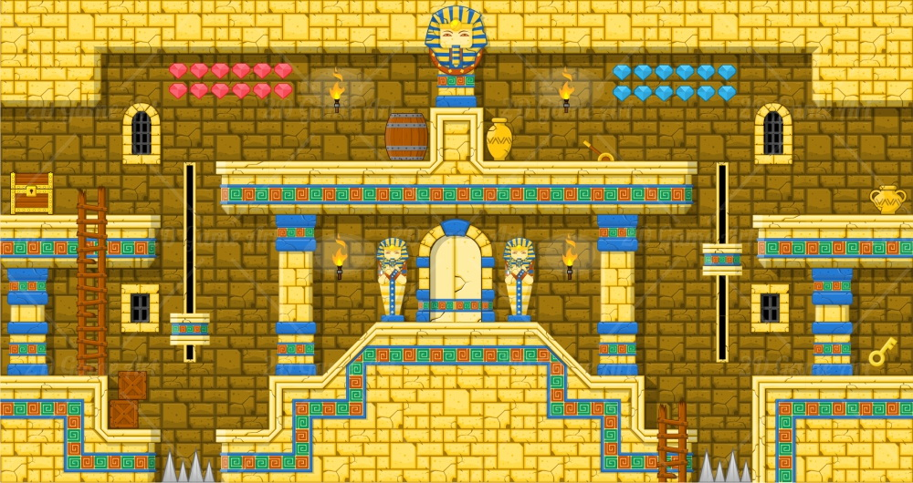

Intro Nice, but not necessary
Snek is lost in the tomb of an ancient civilization! Snek needs to learn the ancients secret programming techniques to escape!

Slide 3
Variable Valley 1
Path1
2nd_path
third_path
Snek learns about variables and Pythonic variable conventions via ancient hieroglyphs and uses that knowledge to progress forward

Slide 4
Variable Valley 2
x =
y =
z =
Snek learn about assigning data to variables and about data types, specifically integers. The Ancients programmed spike traps that are only disarmed when the variables are assigned the correct value.

Slide 5
Variable Valley 3
Snek learns about the string data type. Snek has to be careful about the difference between similar seeming data (i.e. 5 & 'five') in order to escape Variable Valley! Snek has to choose the correct data types to put into the passcode to leave Variable Valley

Slide 6
Transition to BBG Nice, but not necessary
To Boolean Burial Grounds
Snek puts Variable Valley behind him. He is ready for whatever comes next

Slide 7
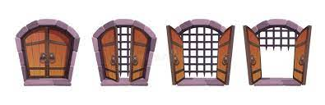
BBG 1
Snek is out of the deepest part of the tomb, but is now in the Boolean Burial Grounds. The tomb was locked down long ago, and Snek is stuck behind several locked doors and gates. Snek learns about AND, OR, and NOT. And not a moment too soon, because that's the secret to start escaping the burial grounds
1 AND 6
1
2
3
4
5
6
7
8

Slide 8
BBG 2
The button combinations get more difficult with compound logic statements! Will Snek ever get out of here?

Slide 9
BBG 3
The Ancients were very crafty people. Not only are there more keypads than before, but the last door requires specific keypads be activated to return power to the door. But which keypads? Good thing Snek is a Boolean Logic expert! Snek uses the knowledge to know which keypads to activate and the buttons to press on each one!

Slide 10
If Falls 1 Is water doable? Discuss with the team. Possibly brainstorm other ways to gamify if/else statements
Snek ascends from the burial grounds into the cavernous If Falls - there are so many waterways and waterfalls, Snek isn't sure how to navigate them. Ancient hieroglyphs inform Snek that with the knowledge of if/else statements, the flow of the water can be controlled and lead Snek towards the exit.

Slide 11
If Falls 2
Snek has to navigate pulling the right levers to ensure that the waterways are flowing the proper way. Snek learns the difference between multiple sequential if statements and multiple sequential if/else statements.

Slide 12
If Falls 3
Oh man, the Ancients aren't making leaving easy. But Snek is determined to flow into the next area.

Slide 13
For-ward Exit 1
The Ancients have set up a system of powered up and down doors to keep would be thieves from leaving the tomb. Snek learns about lists and for loops and how the Ancients have used them to supply or cut off power to the doors. Armed with this knowledge, Snek creates for loops to get power to the proper doors and get out of the tomb

Slide 14
For-ward Exit
More of the same. A little bit harder, though

Slide 15
For-ward Exit 3
Oh wow. The biggest challenge yet. Snek can see sunlight on the other side of the portcullis! But getting out is going to require Snek to use all of the knowledge of the Ancients to open the final door.

