Slide 1
Final Project
Notes:
Alyssa: Intro: Our team name is the 5Doppelgangers and our team members are Kayla, Raquel, Jennifer, Yolanda

Slide 2
Topic
How sustainable is your portfolio? Are the companies in your portfolio enviromentally, socially , governing (ESG) good?
Stock market Prediction with an emphasis on sustainable or high ESG stocks.
Can our enviromental and social initiatives work togther will our profit.
Notes:
Alyssa: talk about the topic

Slide 3
Why did we pick this topic?
Biggest challenges in the world today:
Environment (E): 56% of population lives in cities and towns and account for 70% of CO₂ emissions by 2050 70% will live in towns and cities. The global temperature will rise by 1.5◦ C if we have Net Zero Emissions of CO₂ by 2050 otherwise may be more than 3.5◦ C.
Social (S): The global population is 8 billion set to rise to 8.5 billion by 2030 and 9.7 billion by 2050. Community Relations and Human Rights, Workplace Health and Safety, Diversity and Inclusion cannot be overlooked.
Governance(G): With a population of more than 8.5 billion and global temperatures rising the need for innovation in Policy and Code of Conduct, Supply Chain Management, CSR initiatives is a must for any company.
Notes:
Alyssa: Talk about why we picked this topic

Slide 4
The Data Source
Our data was found on Marketbeat and Yahoo Finance.
Where we scrapped the sustainabilty parameters like environment, social, even public sentiment from marketbeat for various stocks which have been rated highly based on their ESG initiatives.
Collected the time series historical data on stocks going back five years using Yahoo Finance to predict the stock prises using machine learning.
Notes:
Alyssa: Talk about how we got the data source from Kaggle

Slide 5
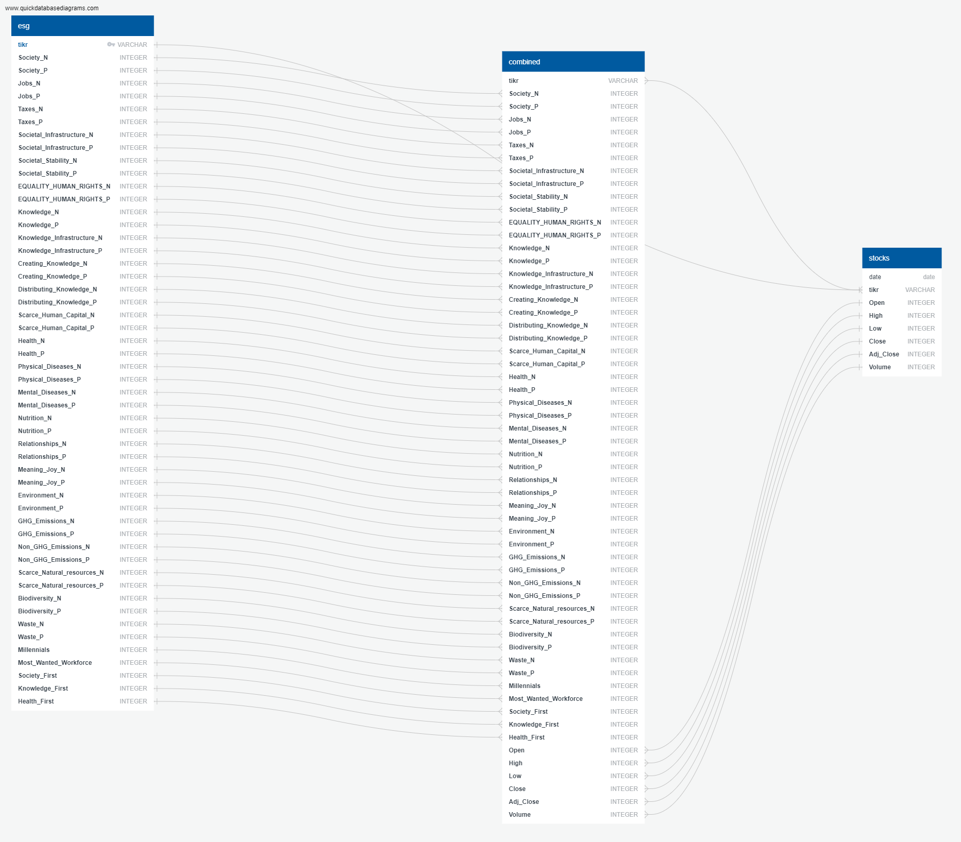
ERD diagram Postgres
Three tables:
esg table for esg data
stocks table for stocks data
join on esg and stocks table
Notes:
Raquel: We looked at relationship between data and mapped it out in ERD diagram on quickdatabasediagrams.com and we used this information to determine primary keys and whatnot.

Slide 6
What do we hope to answer?
Questions that we hope to answer with the data include, but are not limited to, the following:
Are there some companies whose have a bright future in stock market doing well with ESG goals?
How are companies which have high ESG scores and what is their perception?
Can we create a portfolio of the stocks that will do well in future as well as work towards ensuring that we all have a better future in a few years from now by being sustainable?
Notes:
Kayla: The questions we hoped to answer with our data set are as follows (read from the slide)

Slide 7
Data Exploration
Preliminary Data Preprocessing
Remove duplicate/null data.
Break the data into smaller tables for best visualizations and analysis.
Remove noisy data that isn’t useful for the analysis.
Preliminary Feature Engineering
We need to identify features for optimal performance.
Our feature data was categorical, which we changed using OneHotEncoder /get dummies/Label Encoders
Training and testing sets
Split our data into training and testing sets using test_train_split from sklearn.
After splitting our training data needs to be scaled.
Notes:
Yolanda: Talk about how we cleaned the data and what we did for hypothesis and splitting into training/testing.
The first steps we took towards our analysis phase was to implement good ETL processing techniques to make sure the data was clean.
We kept our analysis and model focused on mainly school type and the Starting Median Salary data since we wanted to predict a person’s initial salary after leaving college.
We used this basis as our focus into how we would train and test the data.

Slide 8
Machine LearningModel
We will choose LSTM. Long short-term memory (LSTM) is an artificial recurrent neural network (RNN) architecture^{[1]} used in the field of deep learning.
LSTM is able to store past information which is important because previous price is crucial in predicting a stock’s future price.
Vanilla RNN suffer from vanishing gradient problem that making them unable to establish long term dependencies. LSTM overcomes that problem.
Notes:
Kayla: Talk about the model we chose.

Slide 9
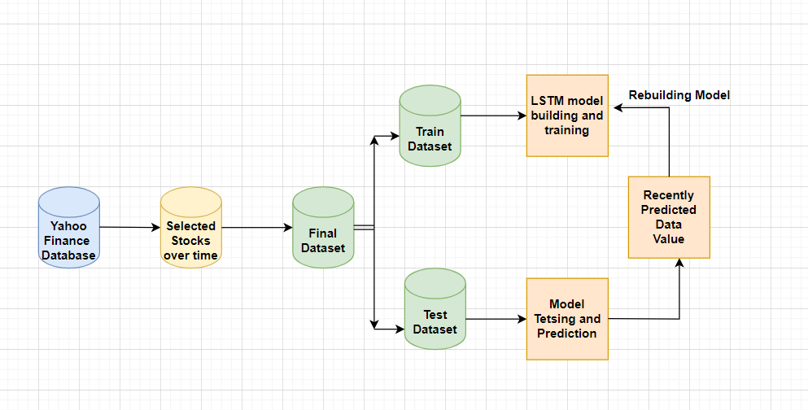
LSTM FLOW DIAGRAM
LTSM FLOW DIAGRAM
Notes:
Kayla: Talk about the model we chose.

Slide 10
Analysis

Slide 11
Technologies & Languages
Technologies used in this project include:
Jupyter Notebook
Google Slides
PGAdmin
Tableau
Languages used in the project include:
Python
SQL
Notes:
Alyssa: quickly cover briefly over what tools we used

Slide 12
Tools & Algorithms
Algorithms
LSTM Model
Visualizations
Tableau Public
Database
PgAdmin
Notes:
Similar to slide 17

Slide 13
Roles of team members
Square Role - Monica Dodds
Triangle Role - Yicong Luo
Circle Role - Sachin Nabbar
X Role – Sucharita Bhattacharjee

Slide 14
Thank you

