Slide 1
Is your portfolio ESG sustainable?

Slide 2
Problem Statement
Environmental, Social, and Gonvernance (ESG) is hot topic for many companies today. Our Machine Learning module will help provide valuable insight into your company’s current ESG ratings and stock values compared to your competitors. Using our Dashboard you can:
Make a stock market prediction with an emphasis on sustainable or high ESG stocks.
Review a portfolio of stocks to determine how stustainable your market portfolio can be.
Compare your stock pretections and ESG scores against your competitors.
Create a profitable stock portfolio centred around positive ESG.

Slide 3
Why being ESG complaint effects you
Biggest challenges in the world today:
Environment (E): 56% of population lives in cities and towns and account for 70% of CO₂ emissions by 2050 70% will live in towns and cities. The global temperature will rise by 1.5◦ C if we have Net Zero Emissions of CO₂ by 2050 otherwise may be more than 3.5◦ C.
Social (S): The global population is 8 billion set to rise to 8.5 billion by 2030 and 9.7 billion by 2050. Community Relations and Human Rights, Workplace Health and Safety, Diversity and Inclusion cannot be overlooked.
Governance(G): With a population of more than 8.5 billion and global temperatures rising the need for innovation in Policy and Code of Conduct, Supply Chain Management, CSR initiatives is a must for any company.

Slide 4
What do we hope to answer?
Questions that we hope to answer with the data include, but are not limited to, the following:
Is there a coorelation between stock market performance and ESG score?
How well do companies with high ESG scores perform and what is the perception of these companies?
Can we create a stock portfolio that will perform well and be ESG sustainable?

Slide 5
The Data Source
Our data was found on Marketbeat and Yahoo Finance.
Where we scrapped the sustainability parameters like environment, social, even public sentiment from marketbeat for various stocks which have been rated highly based on their ESG initiatives.
Collected the time series historical data on stocks going back five years using Yahoo Finance to predict the stock prices using machine learning.

Slide 6
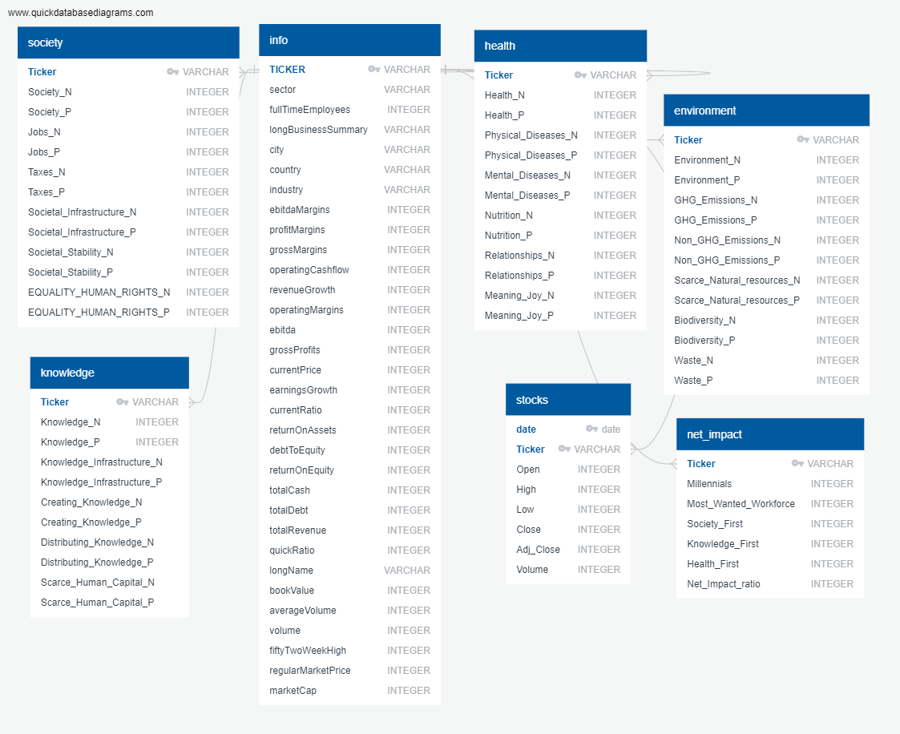
ERD diagram Postgres
Three tables:
ESG table for ESG data
stocks table for stocks data
join on ESG and stocks table
Notes:
Raquel: We looked at relationship between data and mapped it out in ERD diagram on quickdatabasediagrams.com and we used this information to determine primary keys and whatnot.

Slide 7
Data Exploration
Preliminary Data Preprocessing
Remove duplicate/null data.
Break the data into smaller tables for best visualizations and analysis.
Remove noisy data that isn’t useful for the analysis.
Preliminary Feature Engineering
We need to identify features for optimal performance.
Our feature data was categorical, which we changed using OneHotEncoder /get dummies/Label Encoders
Training and testing sets
Split our data into training and testing sets using test_train_split from sklearn.
After splitting our training data needs to be scaled.

Slide 8
Machine LearningModel
We will choose LSTM. Long short-term memory (LSTM) is an artificial recurrent neural network (RNN) architecture^{[1]} used in the field of deep learning.
LSTM is able to store past information which is important because previous price is crucial in predicting a stock’s future price.
Vanilla RNN suffer from vanishing gradient problem that making them unable to establish long term dependencies. LSTM overcomes that problem.

Slide 9
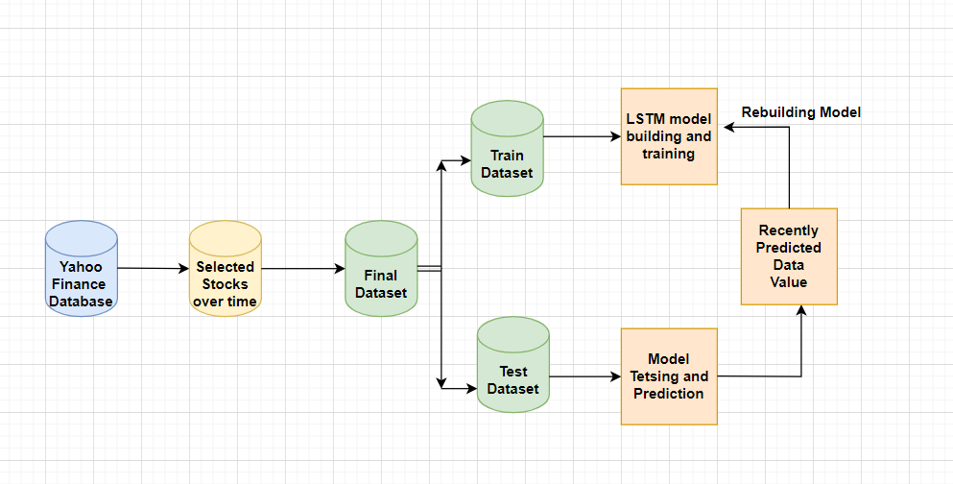
LSTM FLOW DIAGRAM
LTSM FLOW DIAGRAM

Slide 10
Analysis

Slide 11
Technologies & Languages
Technologies used in this project include:
Jupyter Notebook
Google Slides
PGAdmin
Tableau
Languages used in the project include:
Python
SQL

Slide 12
Tools & Algorithms
Algorithms
LSTM Model
Visualizations
Tableau Public
Database
PgAdmin

Slide 13
References
https://www.investopedia.com/terms/e/environmental-social-and-governance-esg-criteria.asp
https://ca.finance.yahoo.com/
https://ca.finance.yahoo.com/

Slide 14
Thank you

