Slide 1
BioSentVec: creating sentence embeddings for biomedical texts
https://arxiv.org/ftp/arxiv/papers/1810/1810.09302.pdf
이명재

Slide 2
pretrain 된 general domain 의
word embedding 이나 sentence encoder 으론
성능이 안 나오는 특정(BIO) 도메인은 어떻게 해결할까 궁금해서
이 논문을 선택 이유

Slide 3
10개 암 분류 모델에서 NLP (문장 데이터, 필기노트) 도 이용해 보자
Sentence embeddings 은 essential part of NLP
But general domain 에는 biomedical texts 가 존재 하지 않음
2가지 방법
처음부터 BIO를 위한 Sentence embeddings 만들자
아니면 이미 만들어진 general sentence embeddings 를 이용하자
(out-of-domain issue)
최적의 성능을 얻을 수 없음
1번 선택

Slide 4
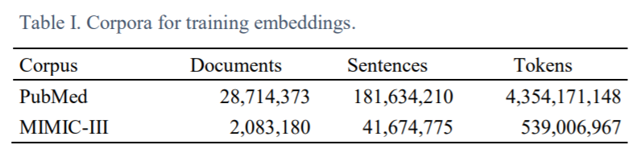
하나의 데이터셋으로 embedding 을 만들어도 비교할 데이터가 없으면 성능 평가를 할 수 없음.
2개의 데이터셋 준비
scholarly articles in PubMed
clinical notes in the MIMICIII Clinical Database
they consist of over 30 million documents, ~223 million sentences, and ~5 billion tokens

Slide 5
전처리
sentence-split
tokenized using NLTK
Sentence Encoding
Continuous Bag-of-Words model (CBOW)
특이점은 단어 레벨이 아닌 문장레벨에서 n-gram 을 함
It adapts the Continuous Bag-of-Words model (CBOW)- known for training word embeddings – at the sentence level, and extends the model by using n-grams of sentences.
bigram model of sent2vec with a window size of 30 and negative examples of 10

Slide 6
모델 요약
Sentence Encoder
Sent2Vec 으로 CBOW 이용해서 만듬
평가는 similarity 로 (pearson correlation coefficient)
The similarity of sentence pairs is annotated in terms of five categories from 0 (not similarity) to 5 (very similar)
The final label a is continuous number ranging from 0 to 5.

Slide 7
CNN으로 multi label classification
input both word and the sentence embeddings and outputs a 10-element probability vector
an embedding layer,
concatenating its own embedding, part of-speech, and chunk features, among others
a convolution layer (window size of 3 and 100 filters),
we apply convolution to input sentences to first obtain local features, and then a global feature through max pooling.
and three fully-connected layers
Precision, Recall and F1-score were used as evaluation metrics for multi-label classifications

Slide 8
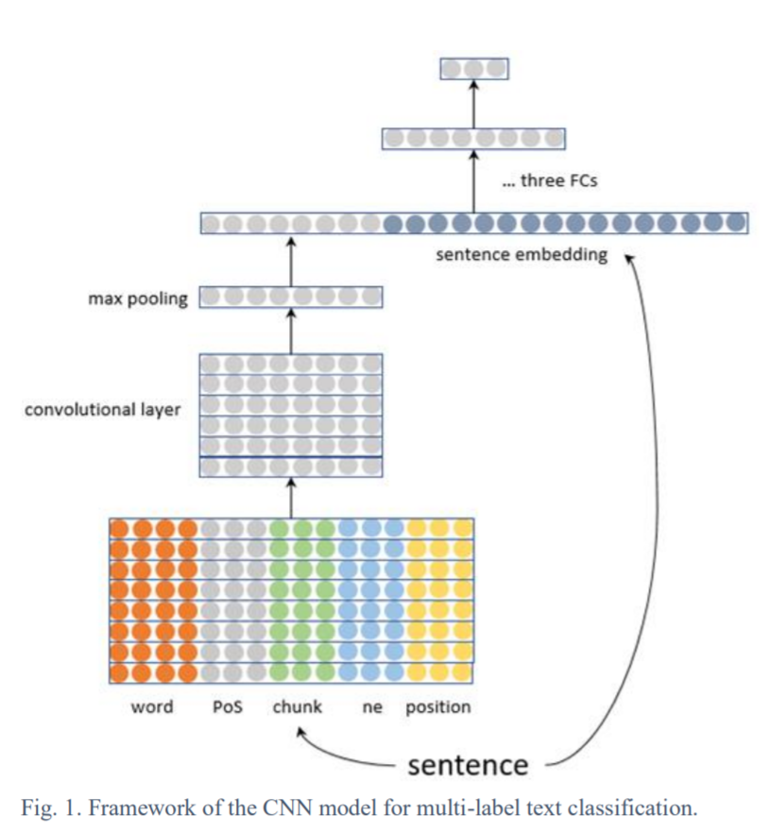

Slide 9
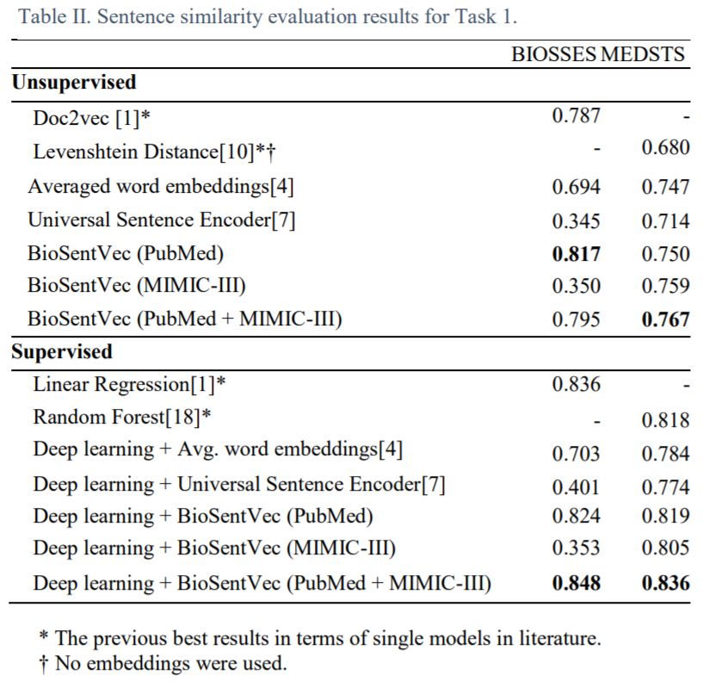
Encoder 평가

Slide 10
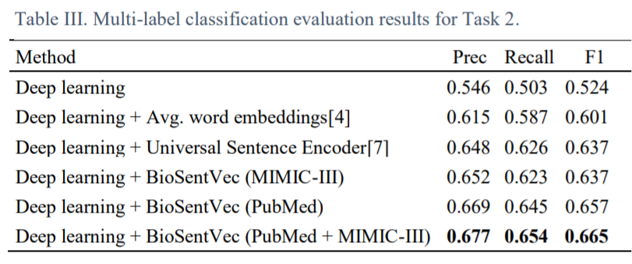
Multi-label classification 평가
22 Oct 2018 논문인데, 많이 낮음…

Slide 11
이 논문의 취지
a limitation of the study is that it does not evaluate sentence embeddings trained from the biomedical domain.
we evaluate using word embeddings trained from biomedical corpora as alternatives.
https://github.com/ncbi-nlp/BioSentVec/blob/master/BioSentVec_tutorial.ipynb

