Slide 1
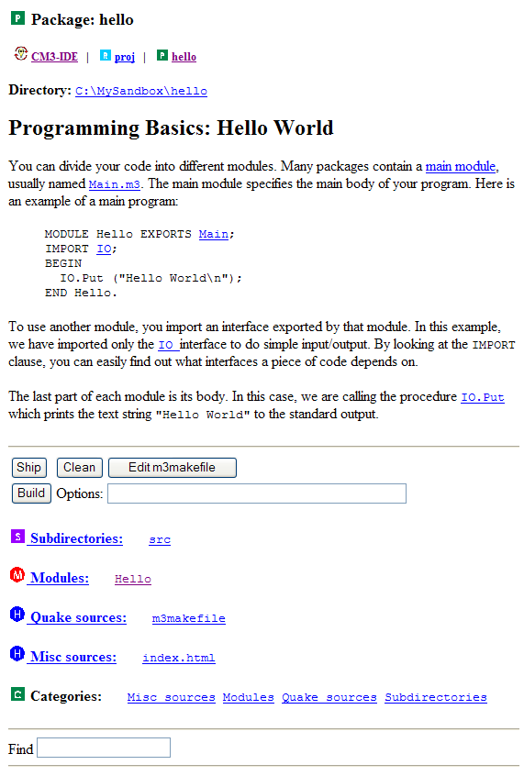
A
Quick Access Icons
Delete old build files
B
C
Edit the makefile
Build the package
D
List all modules
E

Slide 2
A
B
C
D
E
F
Step
G
H
I
J
K
L

Slide 3
IO Interface
(IO.i3)
imports
exports
Hello module
(Hello.m3)
IO module
(IO.m3)

Slide 4
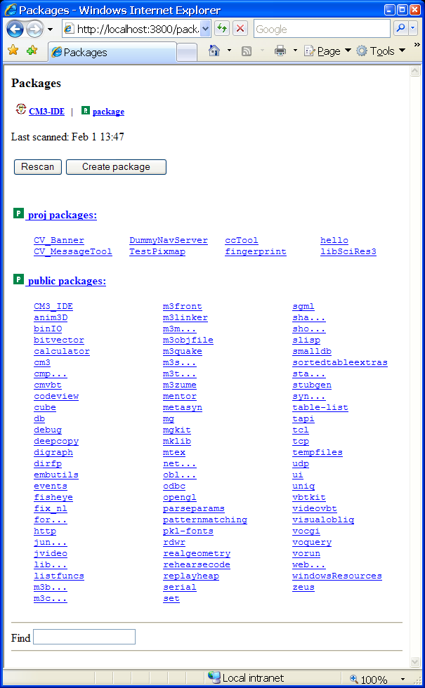
A
Rescan packages
Create a new package
B
Private packages
C
D
Public packages
Find a particular entry
E

Slide 5
Create a new package

Slide 6
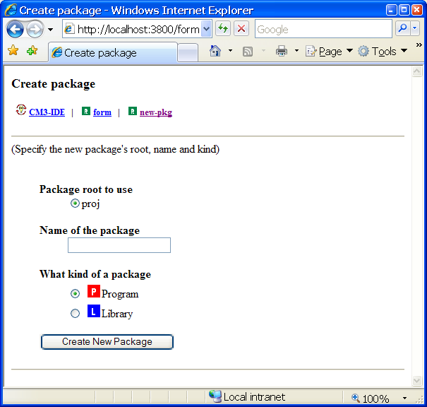
Click here to return to start page
A
Instruct CM3-IDE which package root to use
B
C
Name the package
Assign package type
D

Slide 7
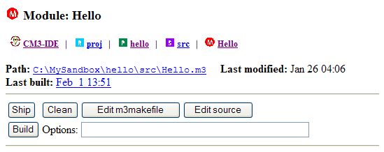
Click here to start your text editor

Slide 8
name of the interface containing the procedure
procedure name
parameters for this call (if any) go between the parentheses
IO.Put(“This is the stuff I want to print to standard output\n.”)

Slide 9
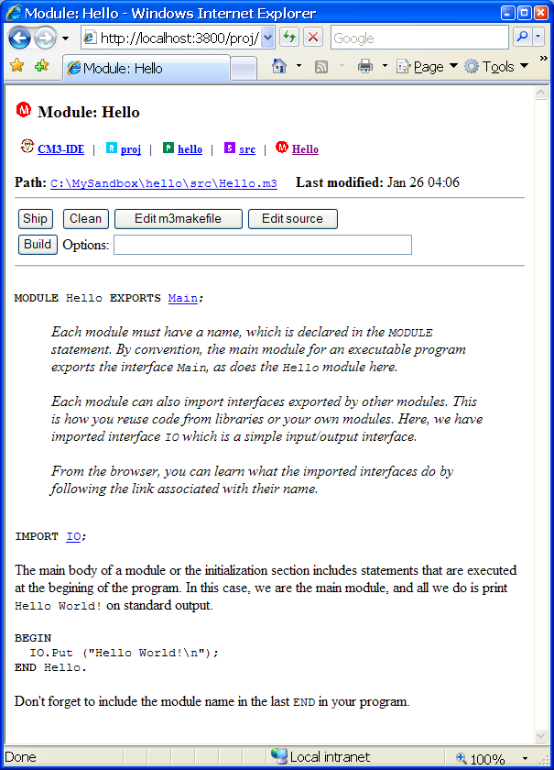
Go to the current module summary
E
Go to the source directory
D
Go to the package summary
C
Go to the current package root
B
Go to CM3-IDE’s start screen
A

Slide 10
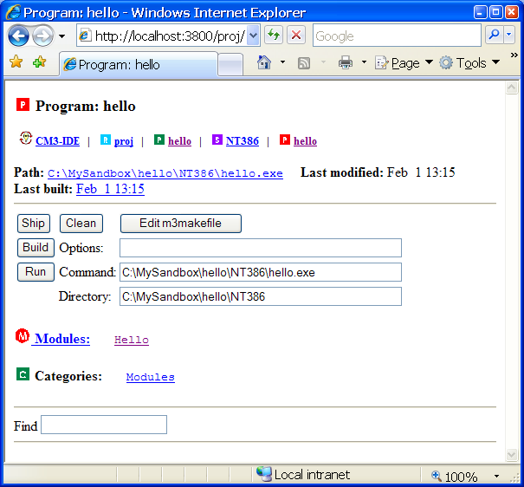

Slide 11
The source subdirectory, “src”.
Source files and makefile reside here.
src
MyPackage
package directory
<derived>
e.g. NT386,
HPPA, …
The derived subdirectory.
The builder generates system-dependent
object files in the “derived” directory.

