Slide 1
Reseach about RL Environments
- OpenAI Gym
- OpenAI Universe
- Arcade Learning Environment(ALE)
- Facebook CommAI
- Deepmind Lab and Etc.

Slide 2
OpenAI Gym
https://gym.openai.com/envs
주로 게임에 특화(Atari, Minecraft, Doom)
  Doom을 풀기 위한 솔루션
    https://www.youtube.com/watch?v=74taQqxYIuM
    Double DQN, VGG Augmentation
    Reward Prediction, Hierarchical RL
Control Problems(Box2D, MuJoCo)

Slide 3
OpenAI Universe
Universe makes it possible for any existing program to become an OpenAI Gym environment
  without needing special access to the program's internals, source code, or APIs.
  https://github.com/openai/universe
Client Side
Remote Side
Gym
I/F
(Env)
VNC
Client
Docker Container
Keyboard/Mouse Input
VNC
Server
APP as
Docker Image
Screen Return

Slide 4
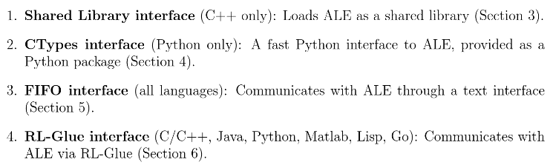
Arcade Learning Environment(ALE)
Atari2600 Emulator(Stella) 기반으로 제작
  https://github.com/mgbellemare/Arcade-Learning-Environment
  http://www.arcadelearningenvironment.org/

Slide 5
Facebook CommAI
Communication-based tasks
  https://github.com/facebookresearch/CommAI-env
  인간과 대화하며 인간이 요청하는 다양한 task를 수행하는 Agent를 실험하는 환경
    완성도 측면에서 확인이 필요

Slide 6
Etc.
Deepmind Lab
  https://github.com/deepmind/lab
  Quake3 게임에 한정되어 있음
  3D 학습환경이라는 장점
Microsoft Malmo
  https://github.com/Microsoft/malmo
  Minecraft 기반
StarcraftAI
  BWAPI : opensource C++ framework for BroodWar
  http://www.starcraftai.com/wiki/Main_Page
MindPark
  https://github.com/danijar/mindpark
  Good implementations of RL Agents and environments

