Slide 1
Using AOP for Enterprise Auditing of J2EE Applications
AOSD Practitioner’s Report
March 17, 2005

Slide 2
Agenda
Background
Framework Components
Audit Data Collection Techniques
Utilizing Aspects
Lessons Learned
Future Direction
Questions

Slide 3
Background
Experiences in this presentation are a result of 1.5 years of product development with AOP
Product idea based on customer experiences
  Auditing is often an afterthought
  Audit implementations are rarely robust
  Audit requirements are not always clear until the system is complete
Development Effort
  Four developers total, two working with AOP
  Initial implementation in AspectJ 1.1 & 1.1.1
  Current implementation in AspectWerkz 2.0

Slide 4
Auditing Framework Solution
Goals of an Auditing Framework
  Consistent information collection across applications
  Common audit data format
  Ability to correlate events between application tiers
  Minimal impact to apps as requirements change
API’s of interest
  JDBC
  EJB
  JNDI
  Servlet

Slide 5
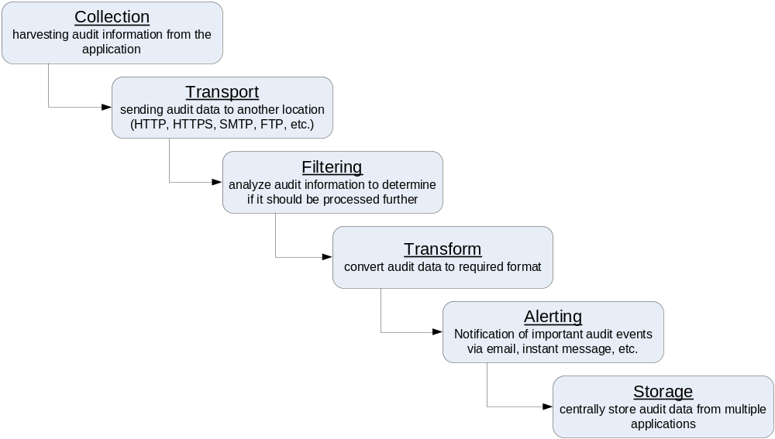
Audit Framework Components

Slide 6
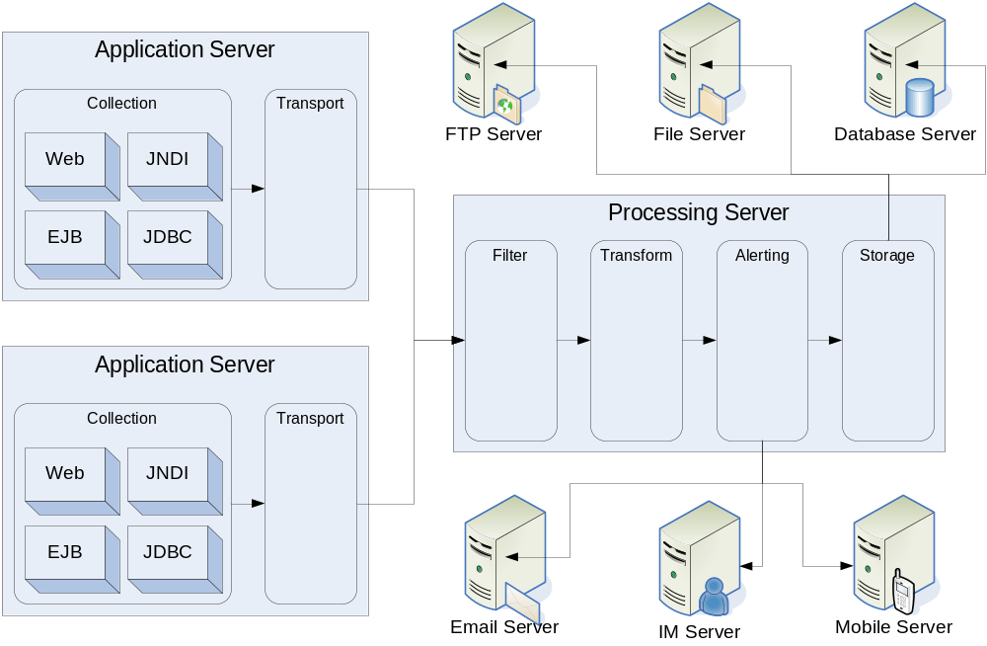
Architecture

Slide 7
Collection Solutions
Audit Logs
Custom API
Aspects

Slide 8
Audit Logs
Advantages
  Many servers create standardized logs
  Little development effort required to use
Problems
  Information collected is minimal
  Logs are not correlated between tiers
    Web access logs
    Database audit logs
  Data is scattered across the network

Slide 9
Custom API
Advantages
  Audit exactly what you want
Problems
  Figuring out what you want to audit is difficult
  Auditing is coded into the application (tightly coupled)
  Time consuming to add audit code
  Boring to add audit code
  Significant impact if auditing requirements change

Slide 10
Aspects
Advantages
  Audit exactly what you want
  Collection of audit data is consistent in all applications
  Easier to change the audit requirements
  Moves audit decisions out of the developers’ hands
  Can go places that a hand coded API can’t
    Generated code
    Third-party libraries
    Dynamic code using reflection
  J2EE interfaces allow reuse of aspects across apps
Problems
  Robust aspect systems not available in all languages

Slide 11
Aspect Solution Criteria
Aspects must use load-time weaving
  Not all of the relevant code is available until runtime
    Entity beans
    JSP’s
  Changing audit requirements shouldn’t force a new build and deploy cycle for all applications
Aspects must be robust
  Can’t assume anything about how the apps are coded
  Application errors may be blamed on the new technology

Slide 12
Auditing JDBC
Database access in Java involves several interfaces. Three are of particular interest
  Statement
  PreparedStatement
  CallableStatement
On these interfaces, audit two types of activities
  Simple SQL can be captured in a single action
    Statement+.execute*(String,..) || Statement+.addBatch(String)
  Parameterized SQL must be constructed over several actions
    Connection.prepare*(String,..)
    PreparedStatement+.set*(int,*)
    PreparedStatement+.execute*() || PreparedStatement+.addBatch()

Slide 13
Auditing JDBC
The simple case…
public aspect SimpleStatementAspect {
pointcut statementExecute(String sql) :
(call(* Statement+.execute*(String, ..)) ||
call(* Statement+.addBatch(String))) && args(sql) &&
!within(com.nearinfinity..*);
after(String sql) : statementExecute(sql) {
AuditAPI.auditSimpleSQL(sql);
}
}

Slide 14
Auditing JDBC
The parameterized case…
public aspect ParameterizedStatementAspect {
pointcut statementPrepare(String sql) :
call(* Connection+.prepare*(String, ..)) && args(sql) &&
!within(com.nearinfinity..*);
pointcut statementParamSet(PreparedStatement stmt, int pos) :
call(* PreparedStatement+.set*(int, *)) && args(pos, *) && target(stmt) &&
!within(com.nearinfinity..*);
pointcut statementExecute(PreparedStatement stmt) :
(call(* PreparedStatement+.execute*()) || call(* PreparedStatement+.addBatch())) &&
target(stmt) && !within(com.nearinfinity..*);
… NEXT SLIDE …
}

Slide 15
Auditing JDBC
The parameterized case (cont.)…
public aspect ParameterizedStatementAspect {
… PREVIOUS SLIDE …
after (String sql) returning (PreparedStatement stmt) : statementPrepare(sql) {
AuditAPI.auditParameterizedSQL(stmt, sql);
}
after (PreparedStatement stmt, int pos) : statementParamSet(stmt, pos) {
Object[] args = thisJoinPoint.getArgs();
AuditAPI.auditParameterizedSQLArgument(stmt, pos, args[1]);
}
after (PreparedStatement stmt) : statementExecute(stmt) {
AuditAPI.finishParameterizedSQL(stmt);
}
}

Slide 16
Auditing EJB’s
Auditing EJB’s is much simpler than JDBC
public aspect EJBExecutionAspect {
pointcut ejbExecution(): (call(* EJBObject+.*(..)) ||
call(* EJBLocalObject+.*(..))) && !within(com.nearinfinity..*);
after() : ejbExecution() {
String method = thisJoinPointStaticPart.getSignature().toLongString();
AuditAPI.auditEJBExecution (method);
}
}

Slide 17
Auditing JNDI
JNDI provides access to J2EE resources
  EJB
  JDBC DataSource
  LDAP
  And more…
Just as easy as auditing EJB’s… but a lot more code
  All auditing is done on the Context interface
  Many methods of interest
    Bind
    List
    Search
    Rename

Slide 18
Auditing JNDI
One example of auditing JNDI…
public aspect LookupAspect {
pointcut lookupByString(String context) :
(call(* Context+.lookup(String)) || call(* Context+.lookupLink(String)))
&& args(context) && !withincode(com.nearinfinity..*);
pointcut lookupByName(Name context) :
(call(* Context+.lookup(Name+)) || call(* Context+.lookupLink(Name+)))
&& args(context) && !withincode(com.nearinfinity..*);
after(String context) : lookupByString(context) {
AuditAPI.auditJNDILookup(context);
}
after(Name context) : lookupByName(context) {
AuditAPI.auditJNDILookup( context==null ? "null" : context.toString() );
}
}

Slide 19
Auditing Web Resources
Decided to use a servlet filter instead of aspects to audit access to web resources
  Implementing in aspects is difficult
    Not all requests are handled by application code
      “Not Found” (404) requests
      Requests for static resources (images, html, css)
    Aspects must weave into container classes to get all requests
      Difficult to figure out which application a request is for
      Difficult to configure applications differently
  Easier to get working in many containers
  Has the downside of requiring a modification to web.xml of audited applications

Slide 20
Sample Data
<audit-record>
<!-- WEB DATA -->
<system-time>Wed Dec 01 22:25:25 EST 2004</system-time>
<url>http://localhost:7001/example/search</url>
<response-code>200</response-code>
<remote-address>192.168.0.100</remote-address>
<method>POST</method>
<request-parameters>
<request-param name="text"><value>my search text</value></request-param>
</request-parameters>
<!-- JDBC DATA -->
<sql-execute sql="SELECT * FROM TABLE WHERE text=?">
<parameter position="1">my search text</parameter>
</sql-execute>
<!-- EJB DATA -->
<ejb-method-call principal="user1“ signature="public String com.nearinfinity.ABean.search(String)" />
<!-- JNDI DATA -->
<jndi-lookup context="ejbs.search“ return-type="com.nearinfinity.ABeanHomeImpl" />
</audit-record>

Slide 21
Lessons Learned
IDE tools are not as helpful when developing aspect libraries
  You don’t have the code you are writing aspects for
  Sample applications provide only a few test cases
Knowledge of J2EE classloader architectures is important when developing aspects
  Drives how the aspects are deployed
  Determines how the pointcuts can be written
Weaving performance is critical in load-time situations

Slide 22

intelliPrintsTM
The concepts discussed today were used in the creation of Near Infinity’s intelliPrints
http://www.nearinfinity.com/display/Products/intelliPrints

Slide 23
Future Directions
Add aspects to audit security related events
  Execution of system commands
  Socket I/O
  File manipulation
Add aspects to audit third party products
  Search engine API’s
  Web frameworks
  Persistence frameworks

Slide 24
Questions?

