Slide 1
Application Security Aspects
Ron Bodkin (rbodkin@newxas pects .com)
New Aspects of Software, AspectMentor
http://www.newaspects.com
AOSD 2005

Slide 2
Application Security
Classic big-A Aspect
  Affects application architecture
  Crosscuts all levels of the stack and systems
  Many stakeholders

Slide 3
Challenges Today…
Enterprises can’t
  consistently enforce security policies across resources
  expose systems for Web services securely
  even see how sensitive data is used…
  let alone assure policy compliance
Consequences
  Risks: damages and loss of reputation
  Expense: manual implementations, audits
  Lost opportunities: build walls not manage use
Enterprises believe it’s intractable so they
  Take risks by not complying fully
  Fight fires
Notes:
Developers responsible for enforcement of business policy, but not accountable (and often unaware!).
Business accountable for policy, but cannot create or manage.

Slide 4
The Promise of AOP …
Correct implementation
Separation of policy from implementation
Defense in depth
Auditability
Fine-grained security
Integration
Pluggability (product lines)

Slide 5

Application Security Architecture
Interaction
Tier
Application
Tier
Resource
Tier
Perimeter
end-user
Service
operations

Slide 6
Application Areas
 | Edge | UI | Domain | Data
Identify
Protect
Manage
Security Servers (AAA)
Web
Ser-
vices
SSL/
PKI
Data-
base
AOP Security
Application
Servers,
JAAS

Slide 7
Many Types of Authorization
 | Class | Instance | Field
UI
Business Logic
Data

Slide 8
Business Model for Example
Employee
EmpRegulation
+ address
+ salary
1
+ calcTax()
*
Manager
US_Regulation
CanadaRegulation
+ bonus
+ ssn
+ state
+ calcTax()
+ sin
+ province
+ calcTax()
0..1

Slide 9
JAAS Authentication for Web
public aspect JaasAuthentication {
private pointcut request(HttpServletRequest request,
HttpServletResponse response) :
execution(* HttpServlet.do*(..)) &&
this(SensitiveServlet) && args(request, response);
private pointcut sensitiveOperations() :
execution(* atrack.model.sensitive.*.* (..));
public pointcut inAuthentication(Worker worker) :
cflow(execution(* run()) &&
within(RoleBasedAuthentication) && this(worker));

Slide 10
AspectJ JAAS Authentication
void around(HttpServletRequest request,
HttpServletResponse response) :
request(request, response) {
LoginContext lc = new LoginContext("WebApp",
new HttpCallbackHandler(request, response));
try {
lc.login();
Subject subject = lc.getSubject();
ImplAction action =
new ImplAction() {
public Object run() throws Exception {
proceed(request, response);
}
}
action.setSubject(subject);
Subject.doAsPrivileged(subject, action, null);
} catch …

Slide 11
Role-Based Authorization
…
before(SensitiveServlet servlet,
HttpServletRequest request,
HttpServletResponse response) :
sensitiveOperations() {
Permission permission =
getPermission(thisJoinPointStaticPart);
AccessController.checkPermission(permission);
}
private Permission getPermission(String methodName) {
// config or database lookup
}
}

Slide 12
Data-Driven Authorization Example
Edit employee data
  Data-driven: employee, manager (transitively) and HR admin role
  UI Filtering: invisible, visible, editable
Possible extension
  Trust delegation: check in domain tier on commit

Slide 13
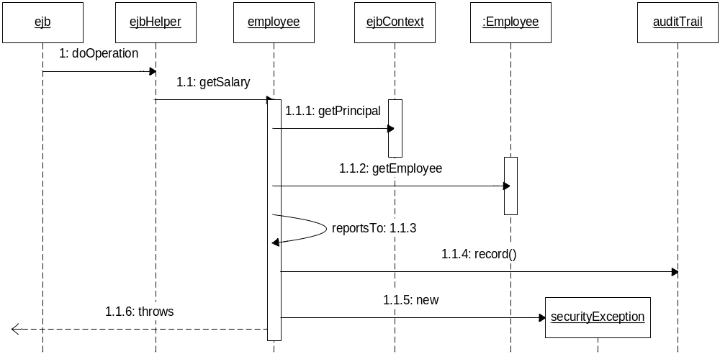
Data-Driven Authorization

Slide 14
Proxy Set Up
public class EmployeeFactory {
public Employee getEmployee(int key, Subject subject) {
InvocationHandler handler =
new EmployeeInvocationHandler(subject);
return (Employee) Proxy.newProxyInstance(
Employee.class.getClassLoader(),
new Class[] { Employee.class }), handler);
}
}
public class EmployeeReviewFactory {
…

Slide 15
Proxy Implementation
public class EmployeeInvocationHandler {
public EmployeeInvocationHandler(Subject subject) {
this.subject = subject;
}
public Object invoke(Object proxy, Method method,
Object[] args) throws Throwable {
if (proxy instanceof Employee &&
isSensitive(method)) {
Employee caller = Employee.getEmployee(subject);
Employee employee = (Employee)proxy;
if (caller==null || !employee.reportsTo(caller))) {
// record attempted security violation
throw new AuthorizationException("…");
}
// and log data access to audit trail
return method.invoke(proxy, args);
}
…
Notes:
The access controller provides the security context, either by threading it as a parameter, or using a global/context somewhere

Slide 16
Data-Driven Authorization
Using Aspects
EmployeeDataAuthorization Aspect

Slide 17
Data Authorization Aspect
public aspect EmployeeDataAuthorization {
pointcut sensitiveDirectOperation(Employee employee) :
(execution(* Employee.getSalary()||
execution(* Employee.getAddress()) ||
execution(* US_Employee.getSSN())) && this(employee);
before(Employee employee, Worker worker) :
JaasAuthentication.Authentication(worker) &&
sensitiveDirectOperation(employee) {
Employee caller =
Employee.getEmployee(worker.getSubject());
if (caller==null || !employee.reportsTo(caller))) {
// record attempted security violation
throw new AuthorizationException("…");
}
// and log data access to audit trail
}
}
Notes:
This uses the sample DefaultEJB aspect and associated ManagedSessionBean interface from the Timer example.

Slide 18
Multi-Class Refactoring
public aspect EmployeeDataAuthorizationV2 {
…
pointcut sensitiveReviewOperation(EmployeeReview r) :
execution(* getInformation()) && this(r);
<refactor>
before(Review reviewr, Worker worker) :
JaasAuthentication.Authentication(worker) &&
sensitiveDirectOperation(review) {
checkAccess(review, worker);
}
}
Notes:
This uses the sample DefaultEJB aspect and associated ManagedSessionBean interface from the Timer example.

Slide 19
Refactoring Auditing Out
public aspect SecurityAuditing {
SecurityAuditor auditor;
void setAuditor(auditor) { … }
pointcut securityCheck() :
// better: @annotation
within(ajee.security..Authorization*) &&
adviceexecution();
after() returning:
securityCheck() && authenticated(worker) {
auditor.recordAccess(worker.getSubject(), tEJPSP);
}
after() throwing (SecurityException se):
securityCheck() && authenticated(worker) {
auditor.recordViolation(worker.getSubject(), tEJPSP,
se); // bug: in AspectJ 1.2 tEJPSP doesn’t refer
} // to the advised join point; work around:
} // find method from se’s stack trace

Slide 20
P3P Annotation, Permissions…
public aspect P3PDataAuthorization {
pointcut p3pDataAccess(P3P prefs) :
(get((* @P3P) *.*) || set((* @P3P) *.*)) &&
@annotation(prefs);
before(P3P prefs) : p3pDataAccess(prefs) {
AccessController.checkPermission(new
P3P_Permission(prefs));
}
}

Slide 21
Database Filtering…
public aspect ToplinkQuerySecurityFilter {
pointcut readingObject(Class clazz, Expression expression) :
(call(* Session.readObject(..)) ||
call(* Session.readAllObjects(..))) &&
args(clazz, expression);
Object around(Class clazz, Expression expression,
AbstractJaasAuthentication.Worker worker) :
readingObject(clazz, expression) &&
AbstractJaasAuthentication.authenticated(worker) {
if (clazz == Employee.class) {
Subject subject = worker.getSubject();
Manager mgr = ManagerDao.findManager(subject);
Vector employees = mgr.getEmployees();
expression = expression.and(new
ExpressionBuilder().get("id").in(employees));
}
return proceed(clazz, expression, worker);
}

Slide 22
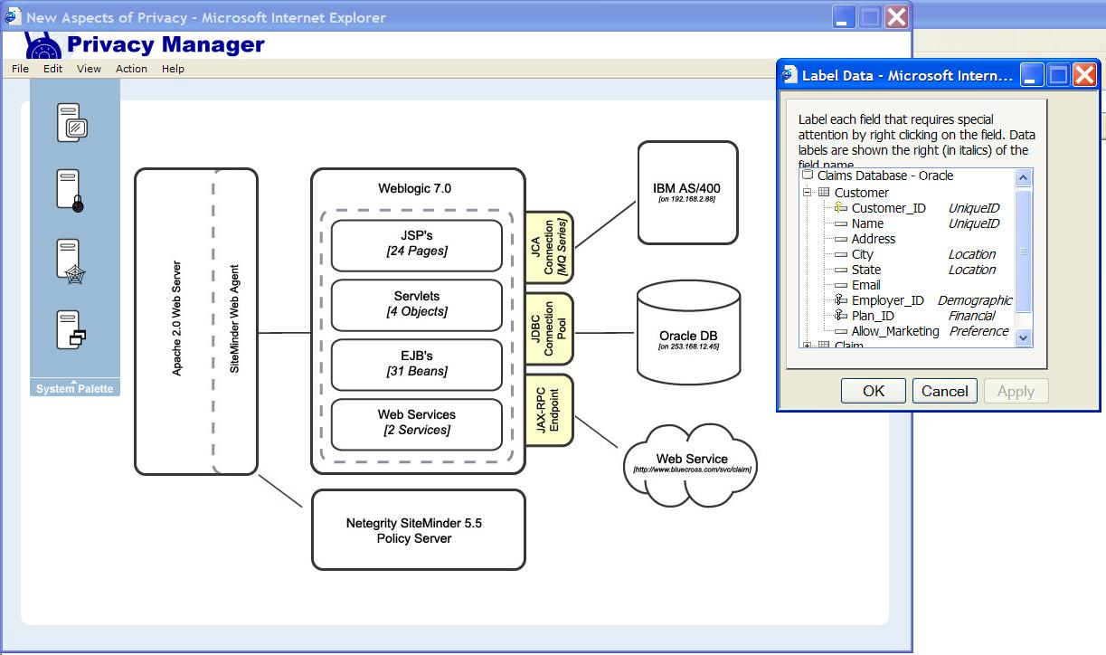
Domain-Specific Tools…

Slide 23
Security: UI Filtering Requirements
Only authorized fields
Only links to authorized resources
Edit field only if authorized
Saved same key as edited
Within JSP, Servlet, etc.
Notes:
Might demo, time permitting

Slide 24
AOP Implementation Strategy for JSP
Advice finds unauthorized field display
  catch SecurityExceptions and flag
Filter removes complete context
  We’ll use a servlet filter
  Can also intercept PageContextFactory to extend PageContext to wrap the PrintWriter
Deployment options:
  precompile JSPs, then link aspects in
  configure container’s JSP compiler to use ajc
  the classloader
Notes:
Weblogic 8.1 will support AspectJ and AspectWerkz classloaders
AspectWerkz supports weaving in any classloader but the system classloader; we expect a future version of AspectJ will allow this too.

Slide 25
Catching Unauthorized Fields in JSP
Object around() throws JspException:
securityChecks() &&
call(* *(..) throws
(Throwable || Exception || JSPException)) {
try {
return proceed();
} catch (JspException je) {
Exception e = (Exception)pageContext.getAttribute(
Globals.EXCEPTION_KEY,
PageContext.REQUEST_SCOPE);
if (e != null && e instanceof SecurityException) {
handleSecurityException(e);
return null; // void or filtered...
}
throw je;
} }
Notes:
When a security exception occurs, we note the fact

Slide 26
Aspect Uses FilteringResponse
Object around() : securityChecks() {
try {
return proceed();
} catch (SecurityException e) {
handleSecurityException(e);
return null; // void or filtered...
} }
private void handleSecurityException(Exception e) {
try {
jspWriter.flush(); // force buffer synch
} catch (java.io.IOException ioe) {
throw new RuntimeException("error flushing", ioe);
}
// specialized Response object adds the position to
// a list of “locations to filter”; the contents are
// then removed when flushing the buffer
response.removeCurrentSection();
}
Notes:
… then filter it

Slide 27
Low Hanging Fruit
Authorization
  By function
  Instance-level
  Field-level
Auditing
Authentication
  Web page
  Web service

Slide 28
Within Reach…
UI filtering
  operations available (or enabled)
  information displayed
Database result filtering
Distributed authentication
  Delegation
  Indirect database
Encryption and decryption of data

Slide 29
Conclusions
Real value
Great test case for AOSD flexibility

