Slide 1
Persistence as an Aspect: TopLink and AOP
Shaun Smith—Product Manager
Jim Clark—Solution Architect
Merrick Schincariol—Senior Engineer

Slide 2
Agenda
TopLink in a Nutshell
Indirection
Change Tracking
Enforcing Read-Only Semantics
Solutions
Summary

Slide 3
TopLink in a Nutshell
O/R, and now O/X, framework.
Object-relational mappings maintained external to the object model, typically in a language such as XML
Java reflection leveraged to query and update object state without coupling the domain class to the persistence implementation
Requests to query and persist objects are routed through a persistence manager that interprets the metadata and maintains the domain object graph
Notes:
Technique is at the heart of all modern POJO persistence frameworks

Slide 4
Meta-Data Driven Persistence
SQL
TopLink
Stored Procs
JDBC
EJB QL
Query
Framework
OO (API/MW)
Query By Example
SQL
Query
Cache Hit?
Cache
Mapping Meta-Data
Application
Database
Cache Results?
Rows
Objects
Object
Builder

Slide 5
Mapping
The activity of ‘Mapping’ is the process of connecting objects/attributes to tables/columns
Customer
CUST
id: int
name: String
creditRating: int
ID
NAME
C_RATING

Slide 6
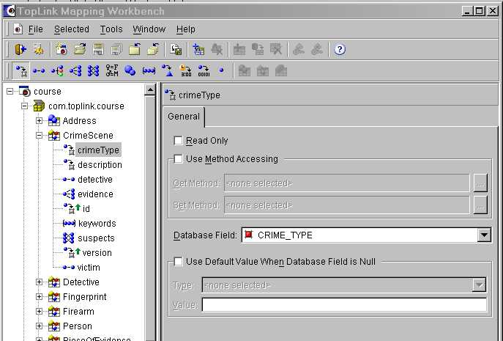
Mapping Workbench (MW)
For graphically assembling and managing metadata information, a user inputs information that is required to store or retrieve objects from database.
Notes:
Mapping Workbench (MW)
The Mapping Workbench is written in Java and is supported on all platforms that contain a Java Runtime Environment.
The Mapping Workbench provides a comprehensive user interface to:
Start with an object model and design a new database schema
Start with a database schema and derive an object model
Take an existing object model and map it to an existing database
Most realistic scenario (also most challenging to map)
Enables both good object and database design principles to be used
It insulates the developer from database details but allows database features to be used and leveraged. It also provides a visual environment to map descriptors.

Slide 7
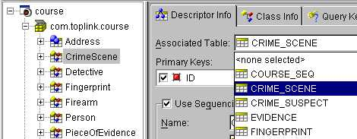
Associating a Class to a Table
Multiple-table mapping is supported.
Notes:
Associating a Class to a Table
To associate a class to a table:
Select the class
Select associated table in Descriptor Info tab
Multiple tables must use the Multi-Table Info advanced property tab.
<Class> > Advanced Properties > Multi-Table Info
A new Multi-Table Info tab appears in the Properties window: use this window to add other tables.

Slide 8
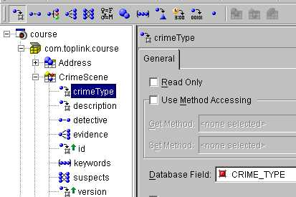
Mappings in Workbench
  1. Select the attribute.
  2. Select the mapping type.
  3. Enter the mapping information.
2
1
Mapping properties
3
Notes:
Mappings in Workbench
Preconditions: The class must be associated with a table before any of its data members can be mapped, because the MW must narrow down the list of database fields that an attribute can map to.
You must perform the steps that are required to map data members in the specified order.
The diagram illustrates an example of how the crimeType attribute of CrimeScene is mapped. First select the attribute, choose the type of mapping, and then choose the database field that the attribute represents in the database.

Slide 9
ORM Metadata
<attribute-mapping
xsi:type="toplink:one-to-one-mapping">
<attribute-name>detective</attribute-name>
<reference-class>
com.toplink.Detective
</reference-class>
<foreign-key>
<field-reference>
<source-field
table=“CRIME_SCENE”
name=“DETECTIVE_ID" xsi:type="column"/>
<target-field
table=“DETECTIVE“
name=“ID"
xsi:type="column"/>
</field-reference>
…

Slide 10
Simple Object Model
Customer
id: int
name: String
creditRating: int
1:1 Relationship
Address
id: int
city: String
zip: String

Slide 11
Typical 1-1 Relationship Schema
CUST
ID
NAME
C_RATING
A_ID
ADDR
ID
CITY
ZIP

Slide 12
Many possible Schemas…
CUST
ID
NAME
C_RATING
A_ID
ADDR
CUST
ADDR
ID
CITY
ZIP
ID
NAME
C_RATE
ID
CITY
ZIP
C_ID
CUST
ADDR
ID
NAME
C_RATING
ID
CITY
ZIP
C_ID
CUST
CUST_ADDR
ID
NAME
C_RATING
CITY
ZIP
C_ID
A_ID

Slide 13
Even More …
CUST
CUST_CREDIT
CUST
CUST_CREDIT
ID
NAME
ID
C_RATING
ID
NAME
A_ID
ID
C_RATING
ADDR
ADDR
ID
CITY
ZIP
ID
CITY
ZIP
C_ID
CUST
CUST_CREDIT
CUST
CUST_CREDIT
ID
NAME
ID
C_RATING
A_ID
ID
NAME
ID
C_RATING
ADDR
ID
CITY
ZIP
ADDR
ID
CITY
ZIP
C_ID
CUST
CUST_CREDIT
ID
NAME
CC_ID
ID
C_RATING
A_ID
ADDR
ID
CITY
ZIP

Slide 14
Mapping Summary
Just showed nine valid ways a 1-1 relationship could be represented in a database
Without good support, designs will be forced
Imagine the flexibility needed for other mappings like 1-M and M-M
TopLink gives J2EE developers and DBAs the flexibility to do what they need to do

Slide 15
Challenges of Persistence
Performance—data access is expensive
Persistence framework APIs have a habit of working their way into the domain model and business logic.
Object References
  References map to foreign key relationships
How can we ensure that read-only or shared objects are not accidentally modified?
How can we control when queries are executed in response to operations on the domain model?

Slide 16
Using TopLink
Map Java objects to database using Mapping Workbench
Write queries using Mapping Workbench
Output: XML metadata and Java objects
Concerns have already been separated
OR HAVE THEY?!?!!!?!!

Slide 17
Separable Concern: Indirection
Defers expensive joins to infrequently used data from slowing down the overall performance of an application.
The entire state of an object is not necessarily required at the point when it is first retrieved.
We may only want basic fields to be retrieved with relationships to other persistence objects resolved only when they are accessed.
Notes:
Indirection let’s us introduce Lazy Cloning.

Slide 18
One-to-one
public class DomainA {
ValueHolderInterface relation;
public DomainB getRelation() {
return (DomainB) relation.getValue();
}
public void setRelation(DomainB newRel) {
relation.setValue(newRel);
}
}

Slide 19
Lazy Loading of Collections
Traditional Solution: introduce proxy collection
  The persistence manager transparently introduces proxies to handle lazy loading of collection relationships.
  Non-intrusive—but domain objects must define collection attributes as interfaces (e.g., List), not concrete classes.
Metadata used successfully for years to introduce advice on: technique predates Java
This technique has been used successfully for years using to modify object structure transparently!

Slide 20
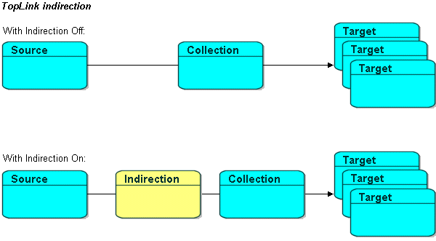
Transparent One-to-Many Lazy Loading

Slide 21
Still tangled for one-to-ones
public class DomainA {
ValueHolderInterface relation;
public DomainB getRelation() {
return (DomainB) relation.getValue();
}
public void setRelation(DomainB newRel) {
relation.setValue(newRel);
}
}

Slide 22
Lazy One-to-One with Aspects
Java source free of persistence code
Choice of Lazy or Active loading of one-to-one relationships is orthogonal to application behavior—persistence concern
Benefits of Aspect approach
  Aspects replace hard coded behavior with a declarative specification
  Persistence performance tuning usually involves adjusting loading behavior

Slide 23
Typical user code
public void calcDateRange() {
// …
Date startDate = this.start;
// …
this.start = newStart;
// …
}

Slide 24
Relevant Join Points
Method Joinpoints
  around advice on method execution pointcuts can be leveraged to implement lazy loading
  Many programmers don’t “self-encapsulate” field access
Field Joinpoints
  Field interception is the most effective way of providing transparent persistence operations.
  Field interception may introduce unintended side effects for performance or data consistency.
  Field join point usage is often discouraged for new AOP developers.

Slide 25
Higher level concerns
Session management
Transaction demarcation
Application profiles
  Read only
  Read mostly

Slide 26
“Read Mostly” Problem
Most use cases are “read mostly”
  Read 1000 objects, modify one and commit
Persistence is never free
TopLink approach
  Client session for reads
  UnitOfWork for writes

Slide 27
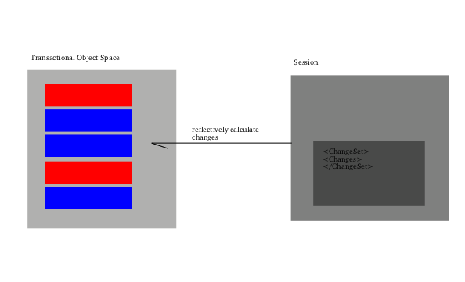
Historic Approach

Slide 28
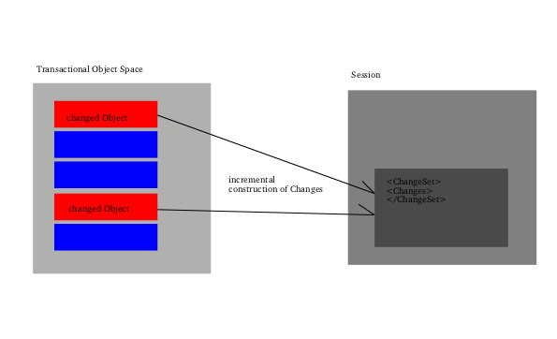
Aspect Approach

Slide 29
Change Tracking Advice
public void setValue(String value) {
this.value = value;
markFieldDirty();
}

Slide 30
Read Only Profile
How to ensure maximum performance in the read only case?
  What about caching?

Slide 31
Enforcing Read Only Semantics
Caches in persistence frameworks are essential standard components that help to maximize performance.
Shared caches are vulnerable to data corruption.
Protection aspects may be implemented to ensure that read-only objects stay that way.
  Putfield join point

Slide 32
The Challenge
Separate persistence concerns from domain model without changing core TopLink behavior or implementation
Leverage existing TopLink object-relational metadata to generate aspects so the customer doesn’t have to
Provide a solution that is transparent for most customers

Slide 33
Writing Persistence Aspects
Persistence advice needs access to low level/internal apis that are not typically useful for developers.
  The method calls to correctly synchronize this work with the persistence manager are likely internal and certainly not portable.
Meta-data identifies all relevant joinpoints and allows us to know what is the correct advice—existing meta data is enough—didn’t need to add anything to current TL meta-data.
  Evaluating the relationship in an aspect and assigning it to the domain object will confuse the persistence manager when it looks for modified objects.
Aspects are still the right answer, but the question is who should be providing them.

Slide 34
AspectJ Solution
Wrote tool to generate AspectJ aspects from XML metadata
Pro: Easy to develop, leverages existing technology
Con: Not transparent, requires build changes

Slide 35
Custom Solution
Customer interests best reflected through Load Time Weave architecture
No desire to produce yet another AOP framework
Fixed set of aspects implemented most efficiently through a custom weaver

Slide 36
LTW Challenges
Lifecycle of persistent objects is different
  Objects are frequently serialized
  Serialized objects may be reified in an unmanaged environment
LTW integration requires custom solution for each deployment environment
  Application server integration
  Two tier client (primarily for testing)
Compile time weave still required for certain deployment scenarios

Slide 37
The Future
Initial reaction has been positive
Exploring other persistence aspects
Tracking evolution of AOP frameworks in hope of moving away from custom weaver

Slide 38
Summary
Provides improvements in performance and simplification of application design.
Does not reflect any major change in TopLink direction
  Persistence still metadata driven
Aspect-based persistence is an option alongside traditional reflection-based solution
  Aspects not (currently) accessible to user
  “Just an implementation technique”

