Slide 1

comparison of
the leading aop tools
report on February developerWorks articles
Mik Kersten
University of British Columbia

Slide 2
Selecting the leading tools
Which tools are suitable for commercial dev?
  Over a dozen tools are listed on aosd.net
  Early adopters harden new technologies
  How active are the user communities of each?
project | posts | list (november’04 posts) | url
AspectJ | 150..210 each | aspectj-users at eclipse.org | eclipse.org/aspectj
AspectWerkz |  | user at aspectwerkz.codehaus.org | aspectwerkz.codehaus.org
JBoss AOP |  | aspects/jboss forum | jboss.org/products/aop
Spring AOP |  | springframework-user | www.springframework.org
abc | 1..30 | abc-users at comlab.ox.ac.uk | abc.comlab.ox.ac.uk
aspect# |  | aspectsharp-users | aspectsharp.sourceforge.net
AspectC++ |  | aspectc-user at aspect.org | aspectc.org
JAC |  | jac-users at objectweb.org | jac.objectweb.org

Slide 3
Selecting the leading tools
Which tools are suitable for commercial dev?
  Over a dozen tools are listed on aosd.net
  Early adopters harden new technologies
  How active are the user communities of each?
project | posts | list (november’04 posts) | url
AspectJ | 150..210 each | aspectj-users at eclipse.org | eclipse.org/aspectj
AspectWerkz |  | user at aspectwerkz.codehaus.org | aspectwerkz.codehaus.org
JBoss AOP |  | aspects/jboss forum | jboss.org/products/aop
Spring AOP |  | springframework-user | www.springframework.org
abc | 1..30 | abc-users at comlab.ox.ac.uk | abc.comlab.ox.ac.uk
aspect# |  | aspectsharp-users | aspectsharp.sourceforge.net
AspectC++ |  | aspectc-user at aspect.org | aspectc.org
JAC |  | jac-users at objectweb.org | jac.objectweb.org

Slide 4
What each has in common
Join points
  Where the main program and aspects meet
Enabling mechanisms
  Pointcuts: identify sets of join points
  Advice: specify what action to take
  Inter-type declarations: declare members
  Aspects: contain aspect declarations
  Composition: combine simple pointcuts
  Naming: facilitates readability and composition
  Abstraction: enables reuse
  Exposing state: access executing program

Slide 5
1. language mechanisms
2. development environments
3. summary of tradeoffs

Slide 6
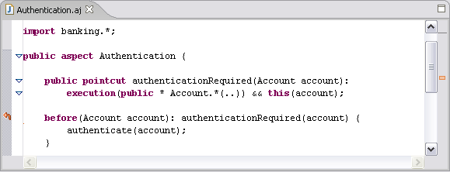
AspectJ
Account authentication policy example, need
  Pointcut to capture authenticated methods
  Means of referring to Account
  Advice to invoke the authentication

Slide 7
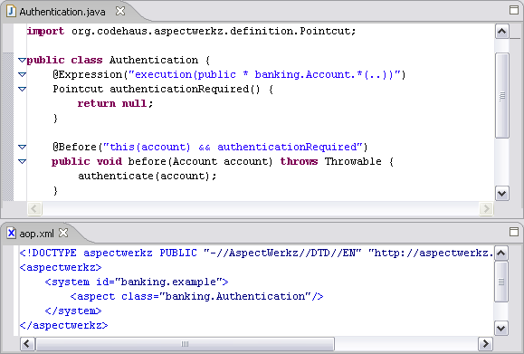
AspectWerkz

Slide 8
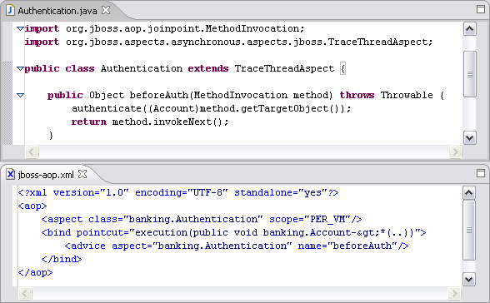
JBoss AOP

Slide 9
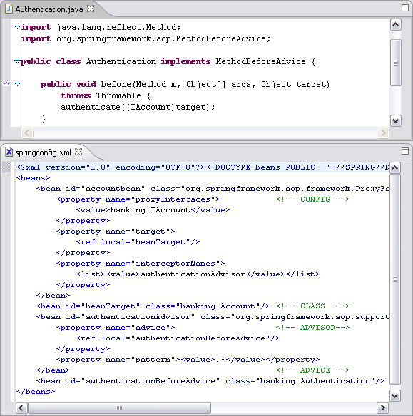
Spring AOP

Slide 10
Syntactic comparison
Different styles: code, annotation, XML
Consider editing advice involves in each
  Pointcuts as strings vs. code
  Localization of aspect declarations
 | aspect declarations | inter-type decls | advice bodies | pointcuts | static enforcement | configuration
AspectJ | code |  |  |  | declare error/warning | .lst inclusion list
Aspect Werkz | annotation or xml |  | java method | string value | - | aop.xml
JBoss AOP |  |  |  |  |  | jboss-aop.xml
Spring AOP | xml |  |  |  |  | springconfig.xml

Slide 11
Code style vs. annotations and XML
Leverages familiarity with Java code and results in less typing and fewer errors
Pointcuts are first-class entities, which makes them easier to work with
For some declarative programming in XML is more familiar than Java language extensions
Advice to pointcut bindings cannot be controlled by the developer

Slide 12
Back to join points
Kinds of join points, and their pointcuts
  Invocation: code elements are called or executed
  Initialization: of types and objects
  Access: fields are read or written
  Exception handling: of exceptions and errors
Kindless pointcuts:
  Control flow: within certain program control flows
  Containment: places in the code contained within certain classes or methods
  Conditional: at which a specified predicate is true

Slide 13
Join points and pointcuts
Join points and pointcuts comparison
 | join point kinds and kinded pointcuts |  |  |  | kindless pointcuts
 | invocation | initialization | access | exception handling | control flow | containment | condi-tional
AspectJ | {method, constructor, advice} x {call, execution} | instance, static, pre-init | field get/set | handler | cflow, cflowbelow | within, withincode | if
Aspect Werkz |  | instance, static |  |  |  | within, withincode, has method/field | -
JBoss AOP |  | instance |  | (via advice) | (via specified call stack) | within, withincode, has method/ field, all | (via Dynamic CFlow)
Spring AOP | method execution | - | - | (via advice) | cflow | - | custom pointcut

Slide 14
Expressiveness vs. simplicity
More to learn
Only a few pointcuts are required for coarse-grained crosscutting and auxiliary aspects
Many aspects cannot be expressed without fine-grained pointcuts
The learning curve for using new pointcuts is pay as you go

Slide 15
Join points and pointcuts
Semantics Comparison
 | pointcut matching | pointcut composition | advice forms | dynamic context | instantiated per | exten-sibility
AspectJ | signature, type pattern, subtypes, wild card, annotation | &&, ||, ! | before, after, after returning, after throwing, around | this, target, args, (all statically typed) | vm, target, instance, cflow/below | abstract pointcuts
Aspect Werkz |  |  |  |  | vm, class, instance, thread | overriding, advice bindings
JBoss AOP | signature, instanceof, wild card, annotation |  | around | via reflective access | vm, class, instance, join point
Spring AOP | regular expression | &&, || | before, after returning, around, throws |  | class, instance

Slide 16
1. language mechanism
2. development environments
3. summary of tradeoffs

Slide 17
Building AOP programs
What’s it like to adopt AOP on an existing project?
 | source | compiler | checking | weaving | deployment | run
AspectJ | extended .java, or .aj | incremental aspectj compile | full static checking | compile and load-time, produce bytecode | static deployment | plain Java program
Aspect Werkz | plain .java, .xml | java compile, post processing | minor static checking, none of pointcuts |  | hot deployable
JBoss AOP |  |  |  | runtime interception and proxies |  | framework invoked & managed
Spring AOP |  | java compile | -

Slide 18
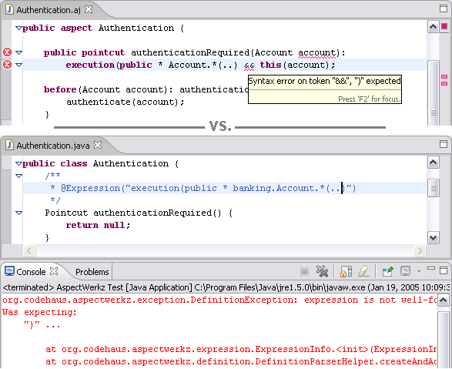
Static checking example
Simple syntax error in pointcut

Slide 19
Language extension tradeoffs?
Tools that expect plain Java source must be extended to work on aspect code
Requires using a different compiler
Extended Java compiler provides full static checking of all aspect code
Writing and debugging pointcuts is much easier

Slide 20
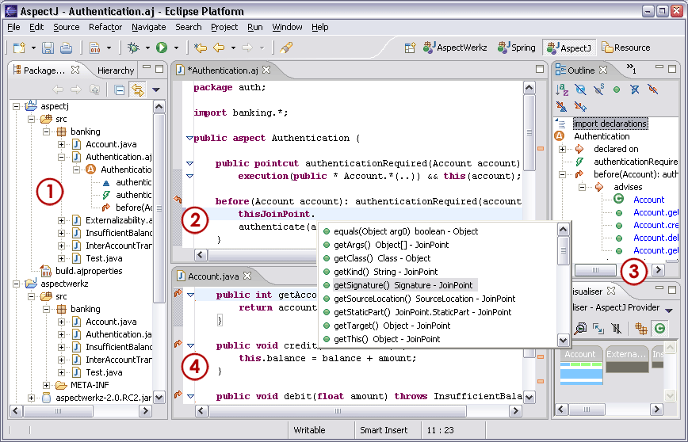
IDE support: AJDT

Slide 21
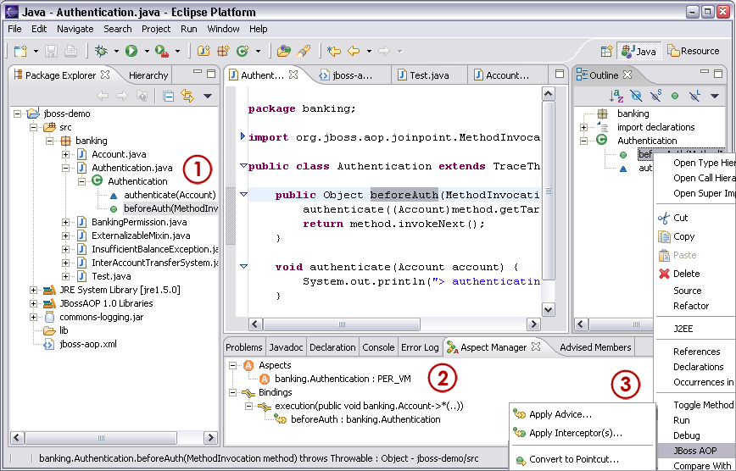
IDE support: JBoss Eclipse plug-in

Slide 22
IDE support, libs, and docs
 | ide | editor | views | debugger | other | libs | docs
AspectJ | eclipse, jdeveloper, jbuilder, netbeans | highlighting, content assist, advice links | outline, visualizer, cross references | plain Java | ajdoc, ajbrowser | - | ++++
Aspect Werkz | eclipse | advice links | - |  | - | - | ++
JBoss AOP |  | advice links, UI for pointcut creation | aspect manager, advised members |  | dynamic deployment UI, jboss framework integration | ++++ | ++
Spring AOP |  | - |  |  | spring framework integration | +++ | +

Slide 23
1. language mechanisms
2. development environments
3. summary of tradeoffs

Slide 24
AspectJ
Language extension requires the use of an extended compiler and related tools
Lack of libraries
Concise aspect declarations and static checking for pointcuts
Mature IDE integration
Extensive documentation

Slide 25
AspectWerkz
Less concise aspect and pointcut declarations
Lack of static checking for pointcuts
Lack of libraries
Similar mechanisms as AspectJ without the language extension
Support for hot deployment of aspects

Slide 26
JBoss AOP
Lack of static checking for pointcuts
Advanced IDE features not yet supported
Rich set of enterprise aspects libraries are available and integrated with JBoss and JEMS
IDE support lowers adoption and reduces need to hand-code XML
Support for dynamic deployment of aspects

Slide 27
Spring AOP
Not suitable for fine-grained aspects
Lack of IDE support for working with aspects
Simple join point model is well suited to coarse-grained aspects and easier to learn
Spring framework integration, portability and ease of adoption for existing Spring users

Slide 28
1. language mechanisms
2. development tools
3. summary of tradeoffs
questions

Slide 29
Around the corner: tools
Better tool IDE support
  Seamless integration
    Code model integration, search, refactoring, …
  Crosscutting is explicit across all views
    Type hierarchy, call graph, synchronize
  AOP centric features
    Pointcut queries, pointcut editing, library extension
Join points and pointcuts
  Use in other tools, e.g. debuggers, profilers

Slide 30
Around the corner
AspectJ and AspectWerkz
  AspectJ 5 will feature support for generics in pointcuts. The @AspectJ syntax will support the AspectWerkz annotation style
JBoss AOP
  Static typing for parameters, performance improvements, libraries, and more IDE support features
Spring AOP
  Performance improvements, interoperability with AspectJ's pointcuts, and packaging of some Spring AOP services as AspectJ aspects

Slide 31
AOP vs. hand-coded crosscutting
Advanced IDE features such as refactoring are not yet supported
Aspects are inherent in complex systems, and without an AOP tool an implementation can become brittle and hard to evolve
Crosscutting becomes explicit, easy to reason about and change

Slide 32
Weaving
Build time
  Part of the standard compile if OOP compiler has been extended to AOP, or a post-compile step
Load time
  Identical to the compile-time weaving of aspect bytecodes, but done when classes are loaded
Run time
  Interception and proxy-based mechanisms provide a means for matching pointcuts to determine when advice should be invoked

Slide 33
Performance trade-offs of interception
Advice invocation overhead at run time, needed to determine pointcut matching
Negligible memory and time overhead when building

