Slide 1
The Power of Modularity:
The Financial Consequences of Computer and Code Architecture
Carliss Y. Baldwin
Harvard Business School
AOSD 06
March 22, 2006

Slide 2
Unmanageable Designs—What They Are and their Financial Consequences
Carliss Y. Baldwin
Harvard Business School
AOSD 06
March 22, 2006

Slide 3
Three Points to begin
Large, complex, evolving designs
  Are a fact of modern life
  Need design architectures—
    “Description of the entities in a system and their relationships”
    Way of assigning work (Parnas)
Designs create value
  Value operates like a force in the economy
  We fight to create it and to keep it—using strategy
Design Architecture and Strategy
  How can you create and capture value in a large, complex evolving set of designs?
  Subject of this talk

Slide 4
In the economy, value acts like a force
Value = money or the promise of money
Consider the computer industry…

Slide 5
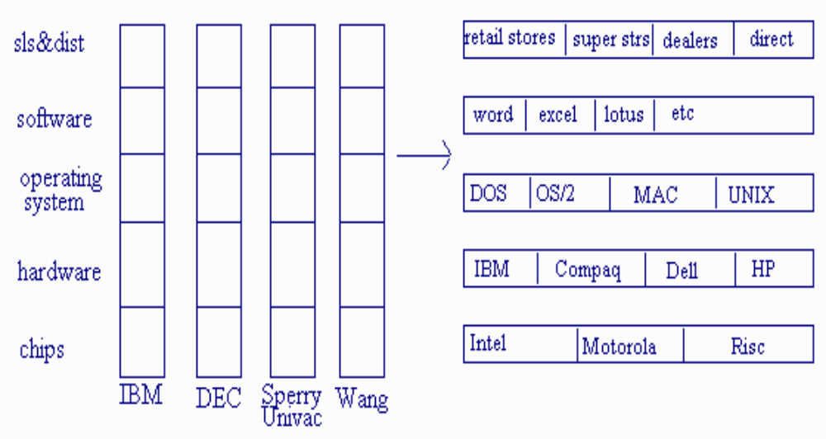
The changing structure of the computer industry
Andy Grove described a vertical-to-horizontal transition in the computer industry:
1980-“Vertical Silos”
1995-“Modular Cluster”

Slide 6
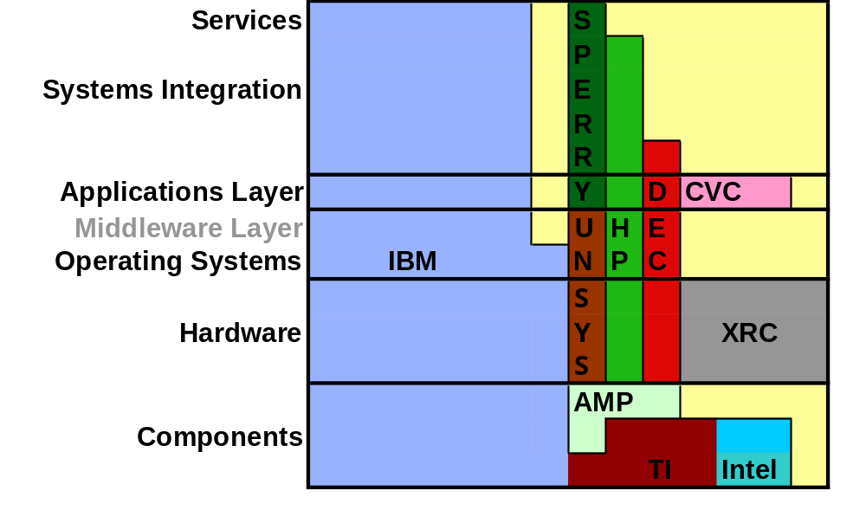
Andy’s Movie
Stack View in 1980
Top 10 Public Companies in US Computer Industry
Area reflects Market Value in Constant US $

Slide 7
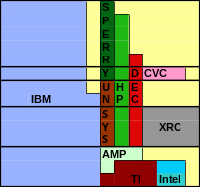
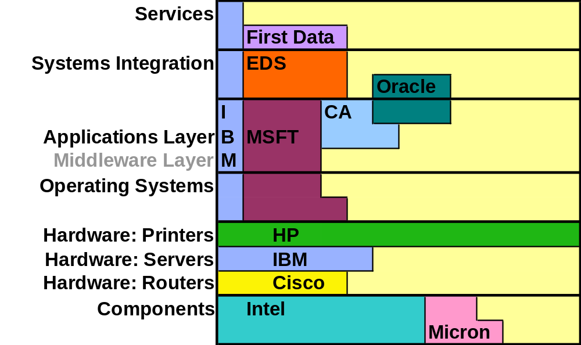
Andy’s Movie
Stack View in 1995
Top 10 Public Companies in US Computer Industry
Area reflects Market Value in Constant US $

Slide 8
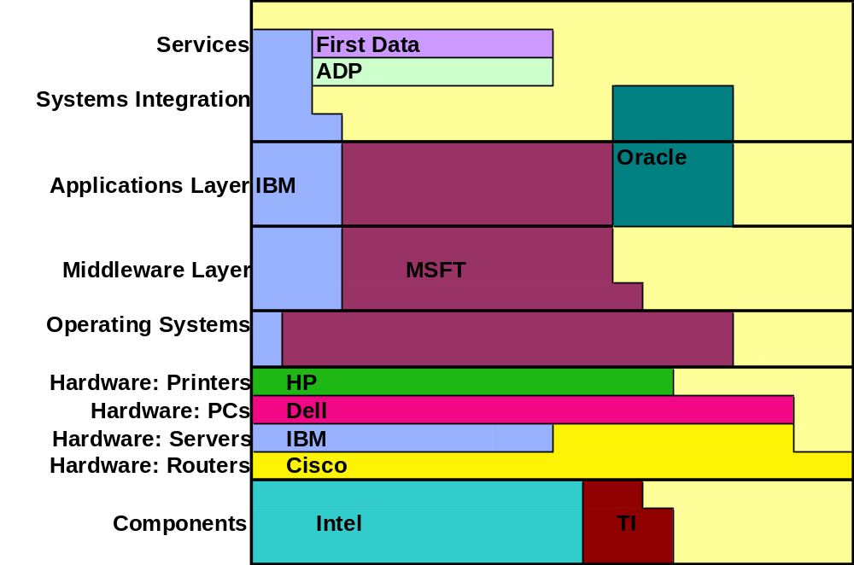
Andy’s Movie—the Sequel
Stack View in 2002
Top 10 Public Companies in US Computer Industry
Area reflects Market Value in Constant US $

Slide 9
Turbulence in the Stack
Departures from Top 10:
Xerox (~ bankrupt)
DEC (bought)
Sperry (bought)
Unisys (marginal)
AMP (bought)
Computervision (LBO)
Arrivals to Top 10:
Microsoft
Cisco
Oracle
Dell
ADP
First Data
Sic Transit Gloria Mundi
… Sic Transit

Slide 10
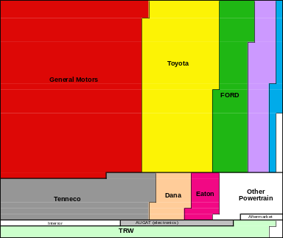
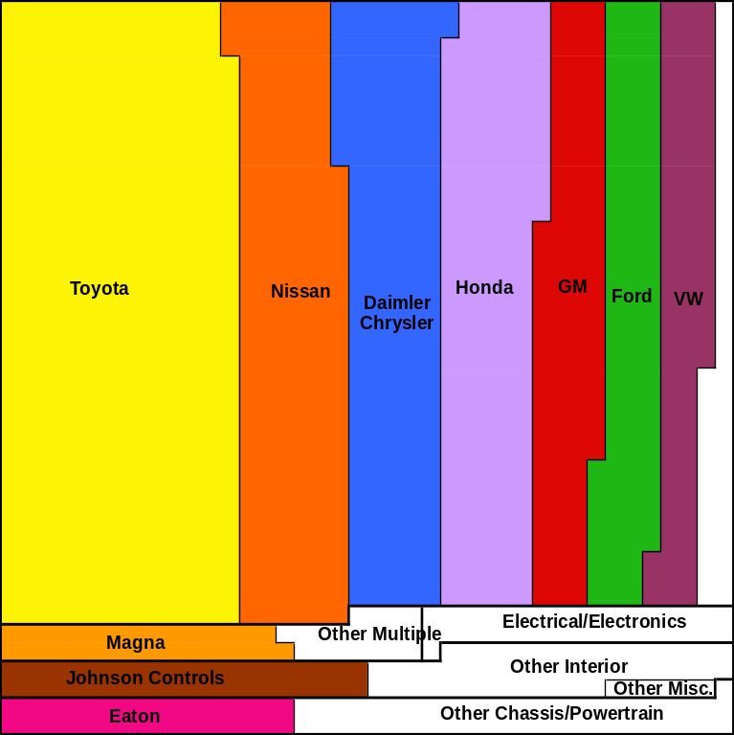
Contrast to the Auto Industry
1982
2003
Top 10 Public Companies in US Auto Industry
Area reflects Market Value in Constant US $
Value stayed in one layer!

Slide 11
Two patterns
“Manageable” designs = auto industry
“Unmanageable” designs = computer industry
What makes computer designs so unmanageable?
This was the question Kim Clark and I set out to answer in 1987.

Slide 12
After studying the history of computer designs and correlating their changes with value changes
We concluded that modularity was part of the answer…

Slide 13
Modularity is
The degree to which a set of designs (or tasks) is partitioned into components, called modules, that are
highly dependent within a module, nearly independent across modules
A property of architecture, somewhat under the architect’s control

Slide 14
Modularity in computers—
IBM System/360
First modular computer design architecture (1962-1967)
  Proof of concept in hardware and application software
  Proof of option value in market response and product line evolution
  System software was NOT modularizable
    Fred Brooks, “The Mythical Man Month”
    Limits of modularity

Slide 15
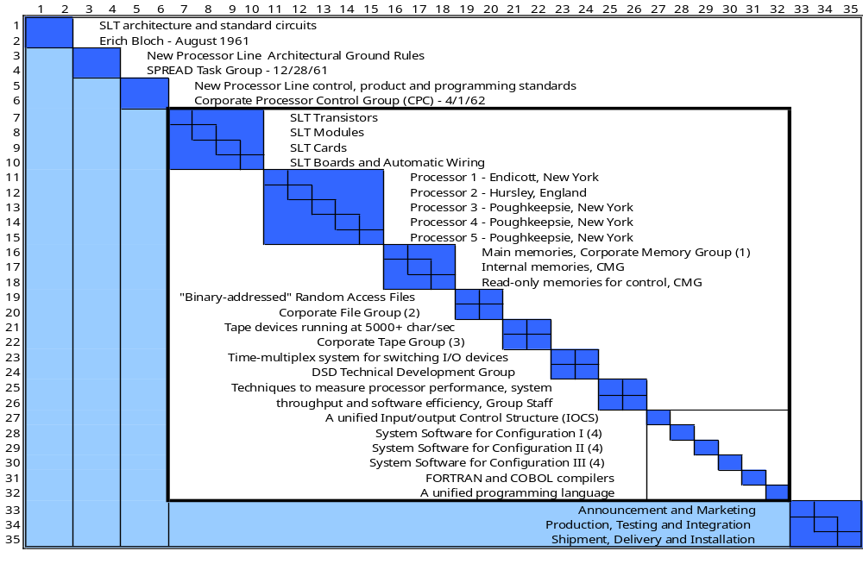
Strategically—IBM wanted to be the sole source of all of System/360’s Modules

Slide 16
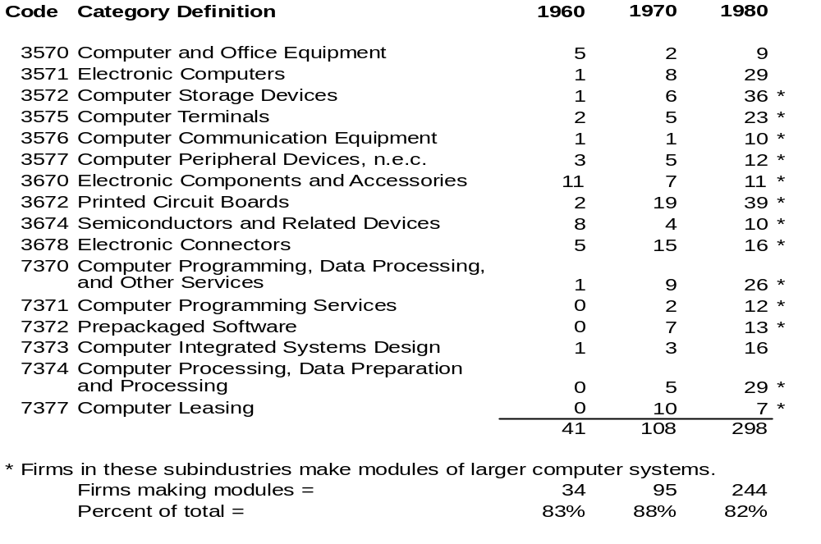
By 1980, 100s of firms made S/360 “plug-compatible” components

Slide 17
Modularity and Option Value Interact
IBM did not understand the option value it had created
Did not increase its inhouse product R&D
Result: Many engineers left
  to join “plug-compatible peripheral” companies
San Jose labs —> Silicon Valley
Unmanageable!

Slide 18
Modularity in computers, cont.
Bell and Newell, Computer Structures (1971)
  General principles of modular design for hardware
  Basis of PDP-11 design—another ORMDA
Thompson and Ritchie, Unix and C (1971-1973)
  Modular design of operating system software (contra Brooks Law)
Parnas (1972) abstract data structures, info hiding
  Object-oriented programming, C++, Java
Mead and Conway, Intro to VLSI Systems (1980)
  Principles of modular design for large-scale chips

Slide 19
Modularity in computers (cont.)
IBM PC (1983)
  DEC PDP-11 minimalist strategy (exclude and invite)
  + Intel 8088 chip
  + DOS system software
  + IBM manufacturing
  + Lotus 1-2-3
  A modular design architecture with a mass market
Unmanageable!

Slide 20
Creating a modular architecture
Notes:
Mention large literature, recent contributions by Sullivan et al, Cai-Sullivan, Lopez-Bajracharya,

Slide 21
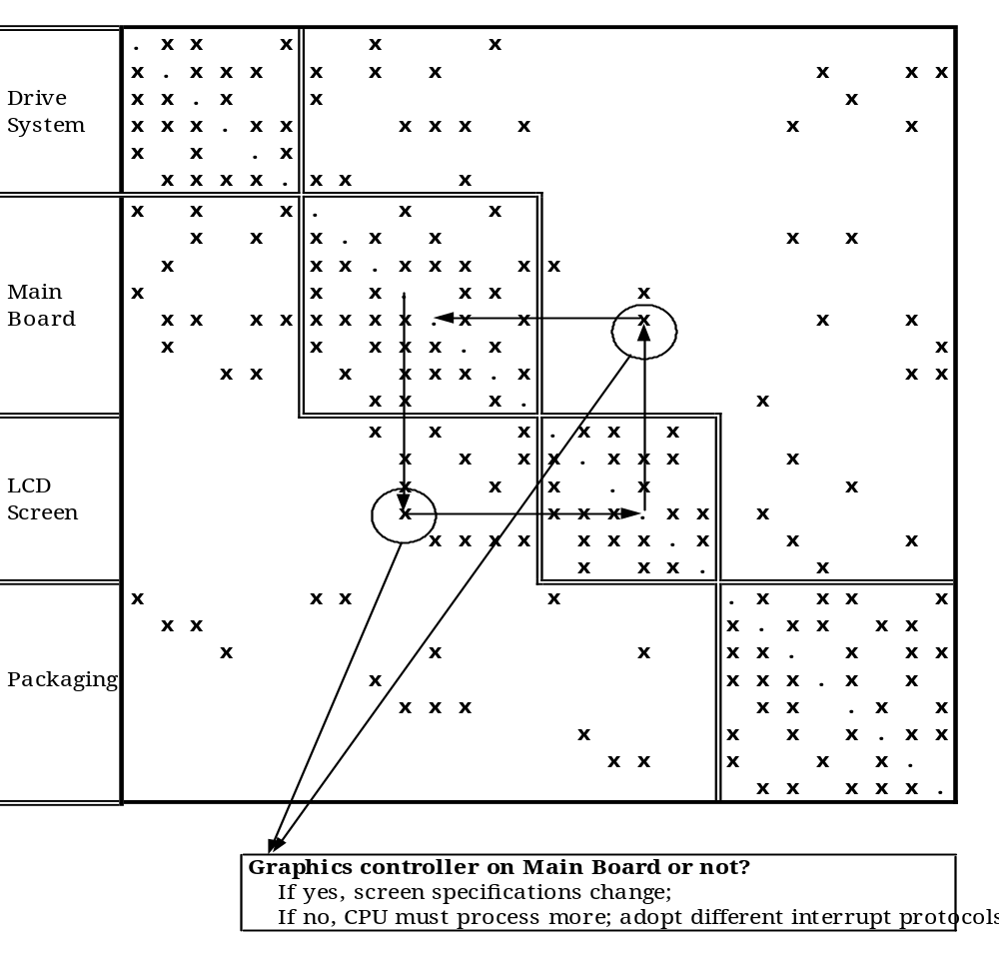
Design Structure Matrix Map of a Laptop Computer

Slide 22
Every important cross-module interdependency must be addressed via a design rule.
This is costly
Modularization may not pay

Slide 23
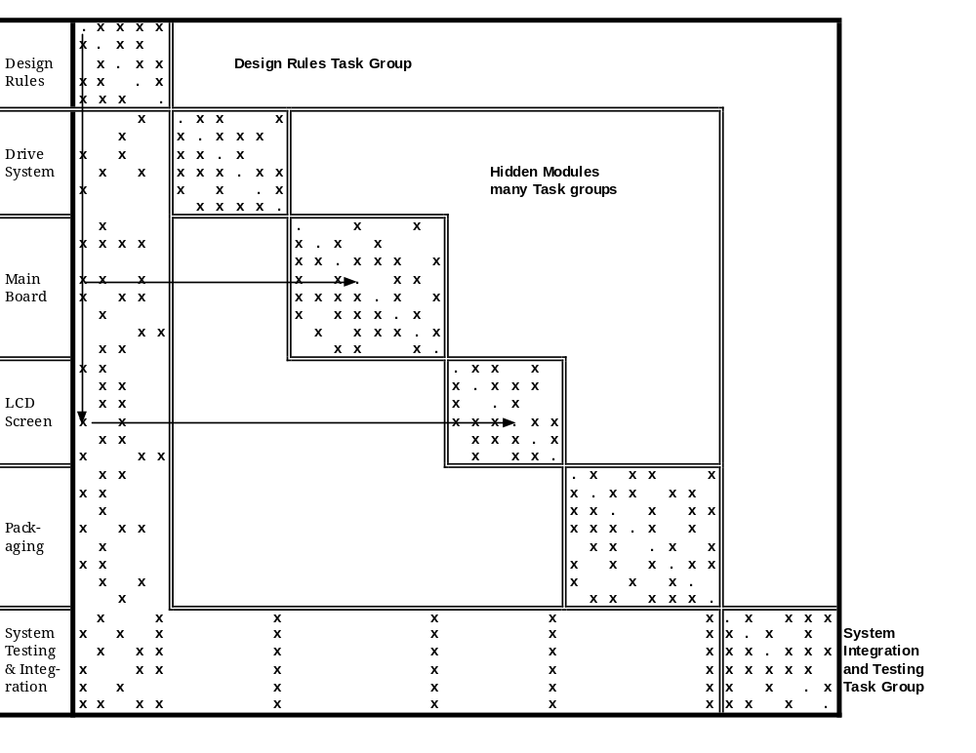
Design Structure Matrix of a Modular Laptop Computer

Slide 24
Measuring modularity

Slide 25
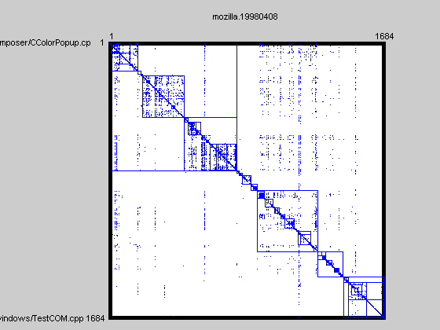
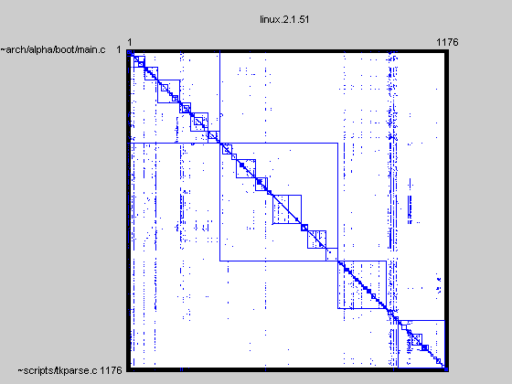
Comparison of different software systems with DSM tools
Mozilla just after becoming open source
Linux of similar size
Coord. Cost = 30,537,703
Change Cost = 17.35%
Coord. Cost = 15,814,993
Change Cost = 6.65%
© Alan MacCormack, Johh Rusnak and Carliss Baldwin, 2006

Slide 26
Conway’s Law: Different organizations deliver different architectures
Mozilla just after becoming open source
Linux of similar size
One Firm, Tight-knit Team, RAD methods
Distributed Open Source Development
Coord. Cost = 30,537,703
Change Cost = 17.35%
Coord. Cost = 15,814,993
Change Cost = 6.65%
© Alan MacCormack, Johh Rusnak and Carliss Baldwin, 2006

Slide 27
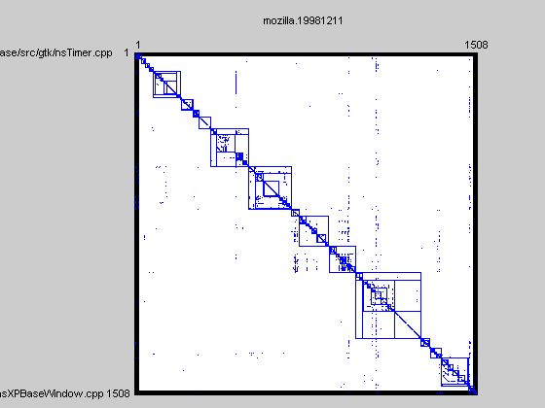
Refactoring for modularity
Mozilla Before Redesign
Mozilla After Redesign
Change Cost = 17.35%
Change Cost = 2.38%
© Alan MacCormack, Johh Rusnak and Carliss Baldwin, 2006

Slide 28
What about Aspects?

Slide 29
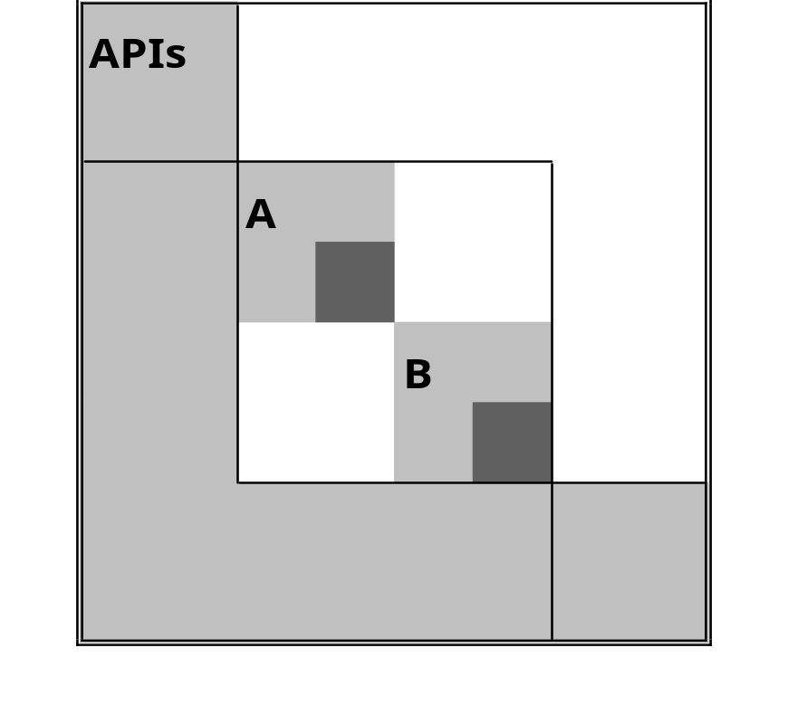
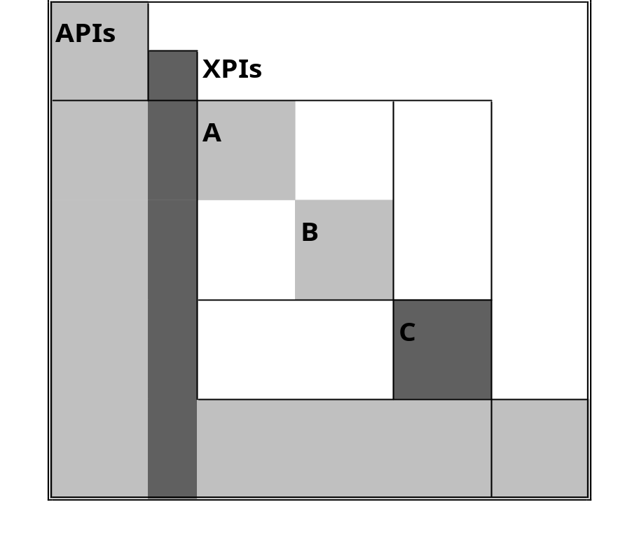
Creating an Aspect Module
Design Rules = APIs only
Design Rules = APIs and XPIs
Cross-cutting concern
Imagine 100s of A’s and B’s!
Modular Operator “Inversion”

Slide 30
What is the Aspect worth?
If no change ever, Aspect is worthless
Reasons to change the Aspect sub-blocks
  Achieve consistency
  Better approaches
  Changes in policy
Option value = the value of an unforeseen change

Slide 31
An Option is
The right but not the obligation to take an action
  Action = Use a new design
  If new is better than old, use new;
  Otherwise, keep the old.

Slide 32
An Aspect changes the “Net Option Value” (NOV) of the codebase
Without Aspect:
Net Option Value (NOV) =
Change Benefit – 100 Change Costs
With Aspect:
Net Option Value (NOV) =
Change Benefit – 1 Change Cost
If Change Benefit > 100 Change Costs
NOV = 99 Change Costs
As Change Benefit decreases, NOV goes down:
If Change Benefit= 0, NOV = 0

Slide 33
To justify an Aspect (to your CFO)
You need to argue:
  Change Benefit is high
    consistency, better approaches, policy
  Difference in Change Costs is high
    “99 changes vs. 1”
  Cost of refactoring is low
    “You are going to have to refactor anyway, so do it right… .”
The NOV approach attempts to quantify the elements of this argument
  Option value resides in “Change Benefit”
  This is the bleeding edge of our science

Slide 34
What is this elusive property that gives rise to option value?
Where does it arise?
Can we measure it?

Slide 35
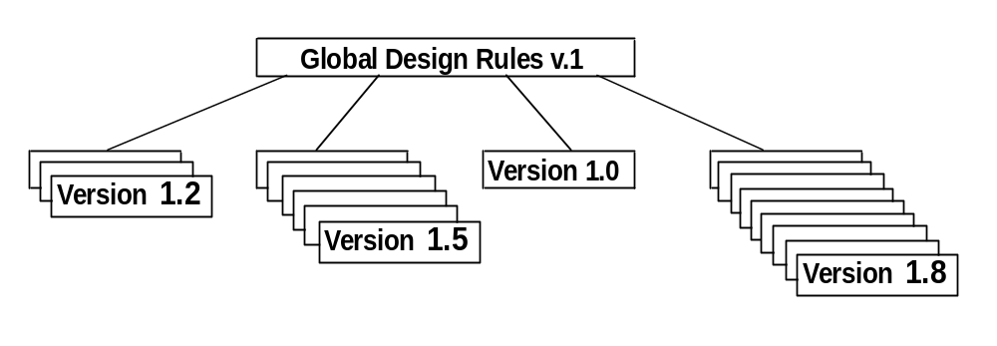
Measuring Option Potential
Successive, improving versions are evidence of option potential being realized over time—after the fact
Designers see option potential before the fact
What do they see?
σ = Low Medium Zero High

Slide 36
Major challenge in research and practice right now
Science may not be able to deliver tools to measure ex ante option potential reliably
But ex ante estimates are what’s needed

Slide 37
σ /Option potential is like dark matter in the universe
Scientists can measure its effects but we can’t measure “it”
“Wizards” can perceive σ /option potential
  But wizards don’t talk to scientists!
Thus we lack ways to measure σ /option value scientifically
  It is a “research frontier”

Slide 38
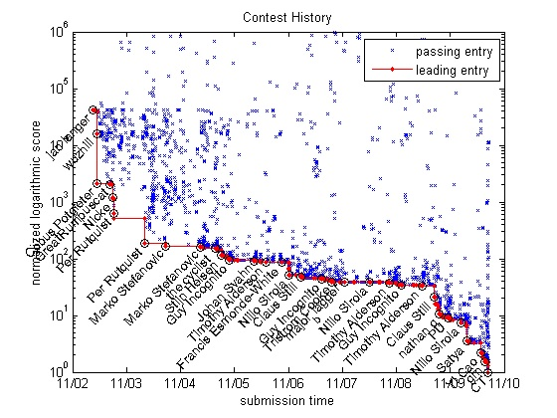
σ /Option potential at work—
Matlab programming contest

Slide 39
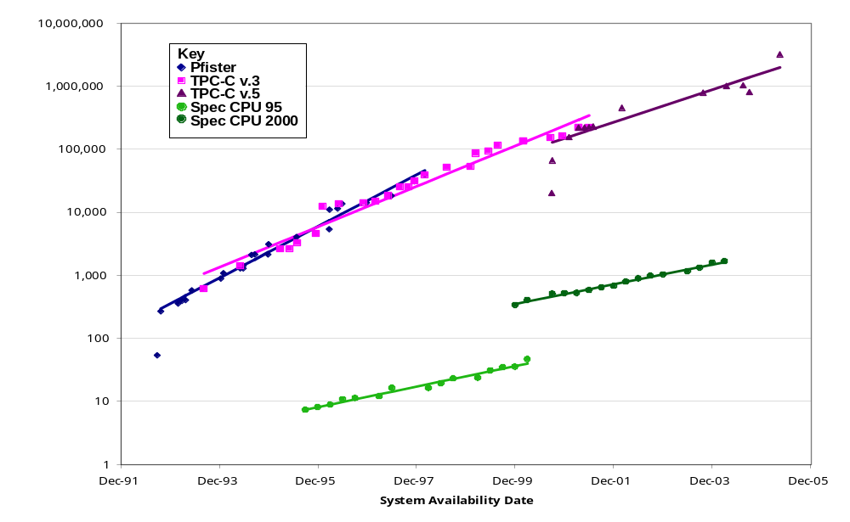
σ /Option potential at work—
Transaction Processors and CPUs
Architectural experimentation
Component experimentation

Slide 40
Sources of σ /option value
Physics—
  Moore’s Law (dynamics of miniaturization) applies to MOSFET circuits and systems (Mead and Conway)
  Power and heat systems vs. logic systems (Dan Whitney)
User innovation
  Users’ discovery of their own needs
  “Killer apps”
Architecture
  Experimenting with different relationships among components

Slide 41
But you might not want to tell your CFO that …
High option value makes designs unmanageable …
Call your venture capitalist, instead!

Slide 42
High option potential induces entry => industry structure change
Autos
Computers

Slide 43
High σ’s are what make designs unmanageable
“Unmanageable” = Cannot be confined in a single company or supply chain
There are modular design architectures that are very manageable
  Example: Toyota Production System (TPS)
If System/360 had had low σ /option potential, IBM would be like Toyota
It would be a different world…

Slide 44
Recapping the argument
Designs create value
  Value operates like a force in the economy
  Changes the structure of industries
Designs have architectures
  Modularity and σ /Option value are the key economic properties of a design architecture
  Modularity + High σ /Option value => Unmanageable
    Why computers are not like autos
    Why IBM is not Toyota
We have NOT talked about—
How do you capture value in a modular, high-σ design?

Slide 45
How can you capture value?
Architectural/Technological question:
  Where/when does modularization stop?
Business/Strategic question:
  How do you make money in a modular, high-σ world?

Slide 46
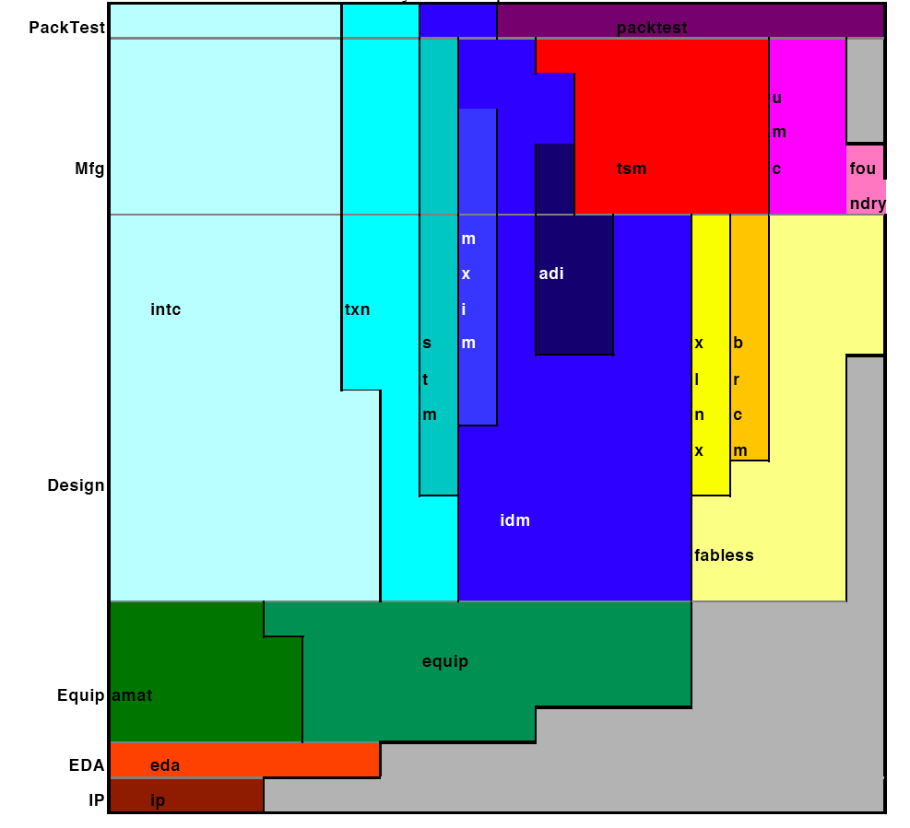
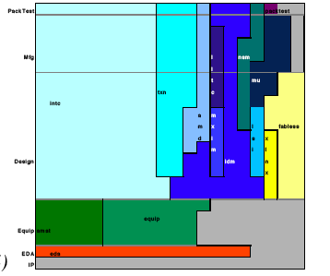
Where does modularization stop?
Strojwas (2005)
Semiconductor Industry
Top 10 Firms:
1994 and 2004

Slide 47
How do you make money in a high-σ world?
Old paradigm
  “Plunge in”
  “Get lucky”
  “Watch out for Microsoft”
  “Get bought by HP”

Slide 48
How do you make money in a high-σ world?
A new paradigm…
  Expect a cluster
  Use M&A to be the “lead firm” in some slice(s) of the stack
  Use design architecture to reduce your “footprint” in each slice => high ROIC
  Use open source methods to clone your complementor’s products => price and innovation discipline

Slide 49
Our research strategy—Look for
Stable patterns of behavior involving several actors operating within a consistent framework of ex ante incentives and ex post rewards
==> Equilibria of linked games with self-confirming beliefs (Game theory)

Slide 50
How a “stable pattern” works
Anticipation of $$$ (visions of IPOs)
Lots of investment
Lots of design searches
Best designs “win”
Fast design evolution => innovation
Lots of real $$$ (an actual IPO)
“Rational expectations equilibrium”

Slide 51
Three Stable Patterns
“Blind” Competition
  PCs in the early 1980s
High ROIC on a Small Footprint
  Sun vs. Apollo
  Dell vs. Compaq (and HP and …)
Lead Firm Competition
  Monopoly—MSFT
  Mergers & Acquisitions—Cisco, Intel …

Slide 52
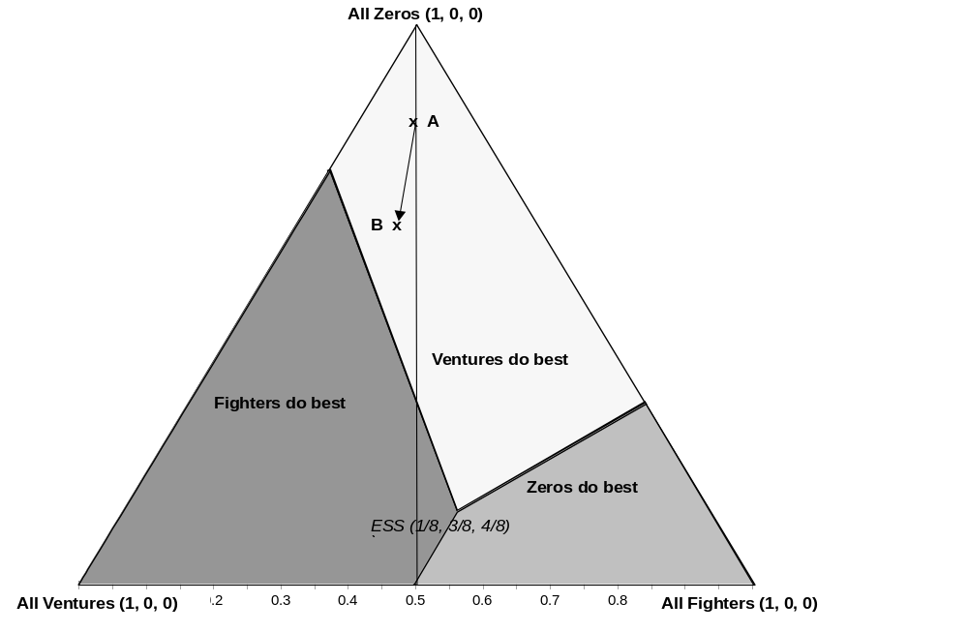
“Blind” Competition

Slide 53
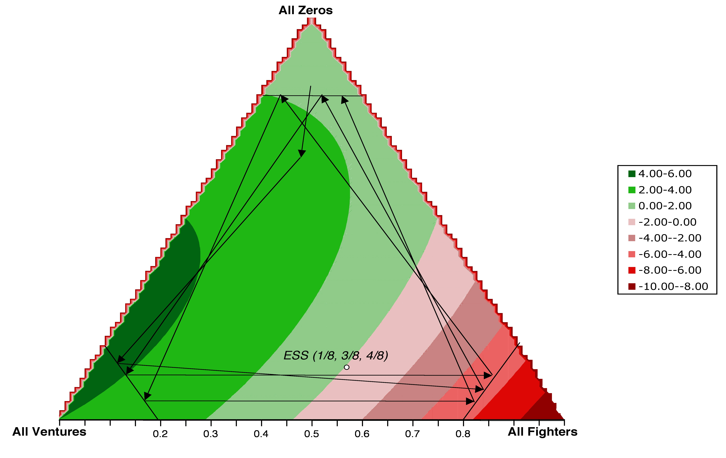
“Blind” Competition

Slide 54
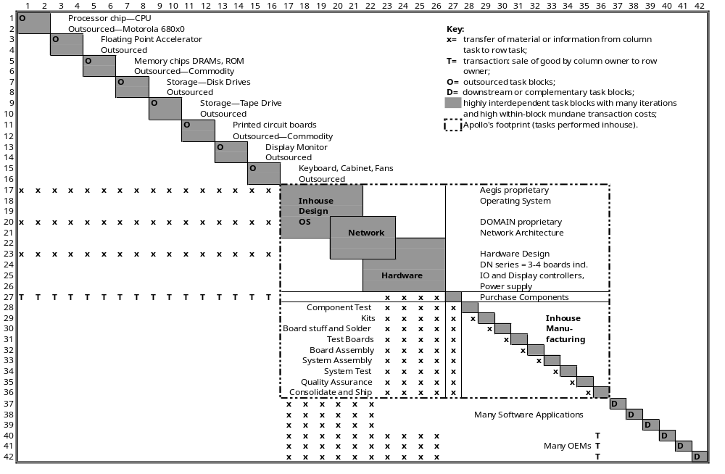
“Footprint” Competition—Apollo
Keeps Design Control

Slide 55
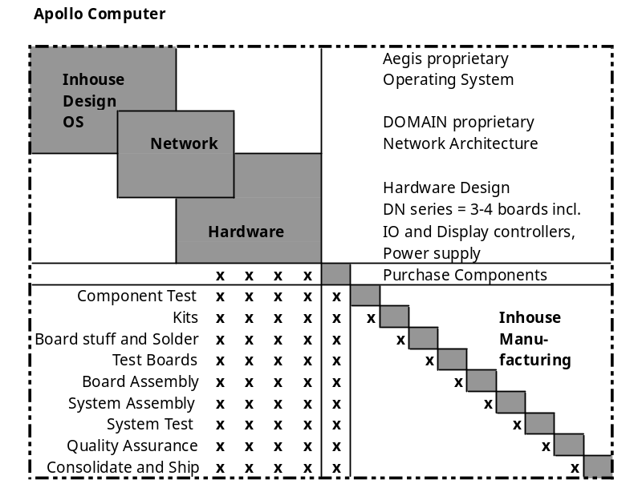
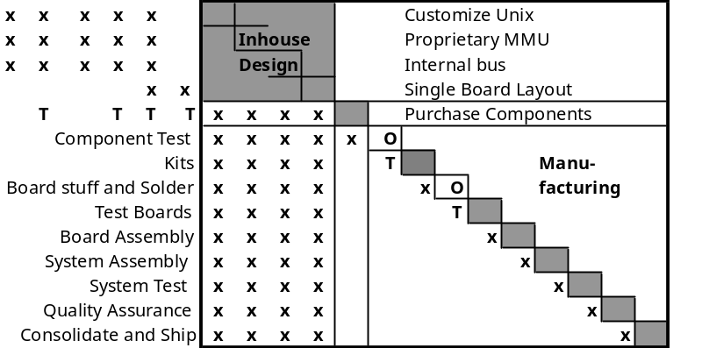
Then Sun came along…
And did even less!
How?

Slide 56
Then Sun came along…
Design Architecture for high performance with a small footprint
Public Standards for outsourcing
And did even less!
How?

Slide 57
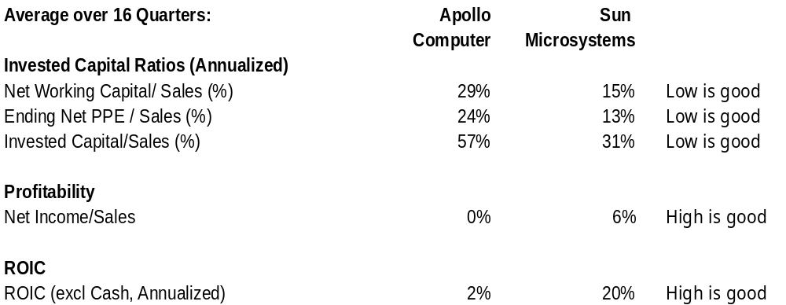
Result: ROIC advantage to Sun
Sun used its ROIC advantage to drive Apollo out of the market
Apollo was acquired by HP in 1989

Slide 58
Compaq vs. Dell
Dell did to Compaq what Sun did to Apollo …
Dell created an equally good machine, and
Used design architecture to reduce its footprint in production, logistics and distribution costs
  Negative Net Working Capital
  Direct sales, no dealers
Result = Higher ROIC

Slide 59
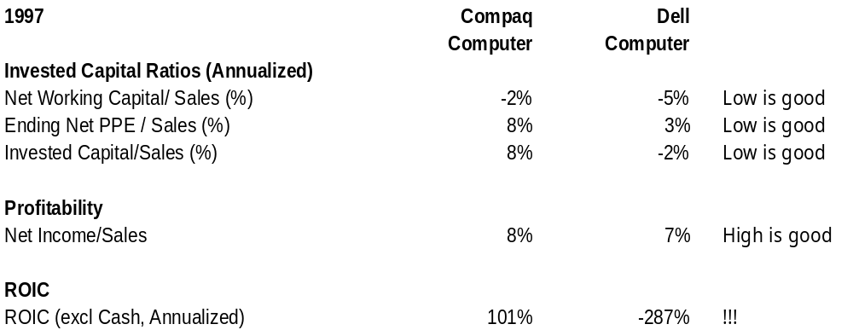
Higher ROIC always wins!
Dell started cutting prices; Compaq struggled, but in the end had to exit.
Compaq was acquired by HP in 2002

Slide 60
Competition and Beliefs
“Blind” competitors
  don’t know others exist
“Footprint” competitors
  Don’t expect to influence others—just compete
“Lead firms”
  Must influence the beliefs of their competitors
  FUD — “Fear, uncertainty and doubt”
  Others cannot be blind!

Slide 61
“Lead Firm” Competition
Monopolist needs to deter all potential entrants with threats of price war
  Very fragile equilibrium
  Potentially expensive to create “enough” FUD
M&A Lead Firm does not try to deter all entry in the design space
  Expects to buy most successful entrants ex post
  More robust equilibrium
  Maybe more advantageous, when you count the cost of FUD

Slide 62
Thank you!

