Slide 1
Enterprise Aspect-Oriented Programming with AspectJ
Ron Bodkin
rbodkin@newxas pects .com
New Aspects of Software
Copyright is held by the author/owner(s).
OOPSLA'05, October 16–20, 2005, San Diego, California, USA.
2005 ACM 05/0010.
Notes:
©©

Slide 2
This talk is about...
Aspect-Oriented Programming
  Concepts
  Tools and integration
Applications of AOP
  Development-Time
  Infrastructure
  Domain-Specific
Conclusion

Slide 3
The Crosscutting Problem
Auxiliary concerns are scattered and tangled
  data security
  audit trail and logging
  business rules
  error handling
80% of problems come from this 20% of code
  inflexibility
  DRY … inconsistency
  incomprehensibility
  complexity

Slide 4
The AOP Solution
Crosscutting is natural
  can’t decompose requirements in one-dimension
The problem is a lack of support
Aspects provide modular support for crosscutting
Evolutionary step for software development:
  structured → objects → aspects

Slide 5
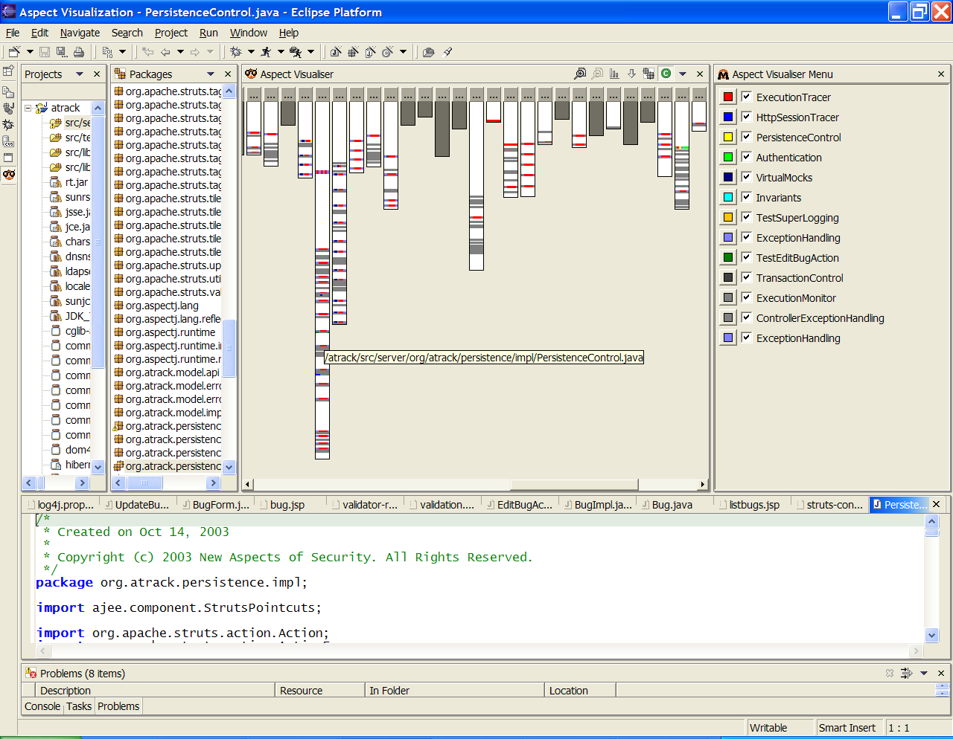
AspectJ Demo
Notes:
Deploy Song app to Tomcat using Ant
Edit code and browse crosscutting structure
Hot-deploy new aspect
Attach debugger to remote application

Slide 6
Example: Online Music Service
Online music streaming
Playlists have Songs
Both Songs and Playlists can be played by a User
BillingService
<<interface>>
Playable
+ play()
Playlist
*
*
Song
+ play()
+ play()
+ showLyrics()
Inspired by the “Implementing Observer in .NET” example at MSDN
and Figures from the original AspectJ tutorial

Slide 7
New Requirement: Metering User Activity
When using titles
  Individual songs …including lyrics
  Playing play lists
Should track usage to allow charging user account
Exact billing may vary on a number of factors

Slide 8
Join Points
key points in dynamic call graph
: Client
: Playlist
: Song
: Song
play()
Playlist.play()
execution
play()
return
play
call
play()
Song.play()
call
Song.play()
execution
return
return

Slide 9
Pointcuts: Queries over Join Points
Name and Parameters
Execution of Song.play() method
or
pointcut useTitle() :
execution(public void Song.play()) ||
execution(public void Song.showLyrics());
Execution of Song.showLyrics() method
This pointcut captures the method execution join points of play() and showLyrics()

Slide 10
Advice
Code that runs before, after, or instead of a join point
: Playlist
Playlist.play()
execution
pointcut useTitle() :
execution(void Song.play()) ||
execution(void Song.showLyrics());
after() returning : useTitle(){
//code to run after using a title
}
play()
Song.play()
call

Slide 11
An Aspect
Metering 1
public aspect MeteringPolicy {
  pointcut useTitle() :
  execution(public void Song.play()) ||
  execution(public void Song.showLyrics());
  after() returning : useTitle() {
  MeteringService.trackUse();
  }
}
An aspect is a special type
  Like a class
  That crosscuts other types
  Can contain constructs like pointcuts and advice

Slide 12
Expanding the Aspect
Metering 2
public aspect MeteringPolicy {
  pointcut useTitle() :
  execution(public void Playable.play()) ||
  execution(public void Song.showLyrics());
  after() returning : useTitle(){
  MeteringService.trackUse();
  }
}
Aspect now applies to Playlist and any other Playables (including Song)

Slide 13
Exposing Context
Metering 3
public aspect MeteringPolicy {
  pointcut useTitle(Playable playable) :
    this(playable) &&
    (execution(public void Playable.play()) ||
    execution(public void Song.showLyrics()));
  after(Playable playable) returning :
  useTitle(playable){
  MeteringService.trackUse(playable);
  }
}
This version exposes the currently executing object at each join point (i.e. the Playlist or Song) using this()

Slide 14
Java Implementation
Metering 1
class PlayList{
private String name;
private List<Song> songs =
new ArrayList<Song>();
public void play() {
for (Song song : songs) {
song.play();
}
}
}
class Song{
private String name;
public void play() {
// play song
MeteringService.trackUse();
}
public void showLyrics(){
// show lyrics
MeteringService.trackUse();
}
}

Slide 15
Java Implementation
Metering 2
class PlayList{
private String name;
private List<Song> songs =
new ArrayList<Song>();
public void play() {
for (Song song : songs) {
song.play();
}
MeteringService.trackUse();
}
}
class Song{
private String name;
public void play() {
// play song
MeteringService.trackUse();
}
public void showLyrics(){
// show lyrics
MeteringService.trackUse();
}
}

Slide 16
Java Implementation
Metering 3
class PlayList{
private String name;
private List<Song> songs =
new ArrayList<Song>();
public void play() {
for (Song song : songs) {
song.play();
}
MeteringService.trackUse(this);
}
}
class Song{
private String name;
public void play() {
// play song
MeteringService.trackUse(this);
}
public void showLyrics(){
// show lyrics
MeteringService.trackUse(this);
}
}
Billing code scattered through domain objects
No module captures intent and implementation of billing policy
Evolution of billing behavior cumbersome
  Each caller must be changed
  Easy to introduce bugs

Slide 17
AspectJ Implementation
class PlayList{
private String name;
private List<Song> songs =
new ArrayList<Song>();
public void play() {
for (Song song : songs) {
song.play();
}
}
}
class Song{
private String name;
public void play() {
// play song
}
public void showLyrics(){
// show lyrics
}
}

Slide 18
AspectJ Implementation
Metering 1
class PlayList{
private String name;
private List<Song> songs =
new ArrayList<Song>();
public void play() {
for (Song song : songs) {
song.play();
}
}
}
class Song{
private String name;
public void play() {
// play song
}
public void showLyrics(){
// show lyrics
}
}
aspect MeteringPolicy {
pointcut useTitle() :
  execution(public void Song.play()) ||
  execution(public void Song.showLyrics());
after() returning : useTitle(){
  MeteringService.trackUse();
}
}

Slide 19
AspectJ Implementation
Metering 2
class PlayList{
private String name;
private List<Song> songs =
new ArrayList<Song>();
public void play() {
for (Song song : songs) {
song.play();
}
}
}
class Song{
private String name;
public void play() {
// play song
}
public void showLyrics(){
// show lyrics
}
}
aspect MeteringPolicy {
pointcut useTitle() :
  execution(public void Playable.play()) ||
  execution(public void Song.showLyrics());
after() returning : useTitle() {
  MeteringService.trackUse();
}
}

Slide 20
AspectJ Implementation
Metering 3
class PlayList{
private String name;
private List<Song> songs =
new ArrayList<Song>();
public void play() {
for (Song song : songs) {
song.play();
}
}
}
class Song{
private String name;
public void play() {
// play song
}
public void showLyrics(){
// show lyrics
}
}
aspect MeteringPolicy {
pointcut useTitle(Playable playable) :
this(playable) &&
execution(public void Playable.play()) ||
  execution(public void Song.showLyrics());
after(Playable playable) returning :
useTitle(playable) {
  MeteringService.trackUse(playable);
}
}
Billing code centralized in MeteringPolicy
  Intent of billing behavior is clear
  Changes to policy only affect aspect
  Modular evolution

Slide 21
Aspects Crosscut Classes
Aspect modularity cuts across class modularity
BillingService
<<interface>>
Playable
+ play()
MeteringPolicy
Playlist
*
*
Song
+ play()
+ play()
+ showLyrics()

Slide 22
What is AspectJ?
The leading AOP implementation for Java
  Language extension, @AspectJ annotation, and XML definition options
  Java platform compatible
Tool support
  Compiler, linker, and classloader-based weaving
  IDE support: Eclipse, JBuilder, JDeveloper, NetBeans
  Ant, Maven, ajdoc, Java debugger
Open source: http://eclipse.org/aspectj
Notes:
[NDL]

Slide 23
AspectJ Mechanisms
Javac/ajc
Song
(.java source)
Song (bytecode)
ajc (weave)
Song (modified bytecode)
ajc
Runtime system
MeteringPolicy (.aj/.java-source)
Billing Policy (bytecode)
Relies on bytecode modification of aspect-affected classes
Weave can happen at compile, post-compile, or load time
Can package as class files, jars, or in memory bytecodes

Slide 24
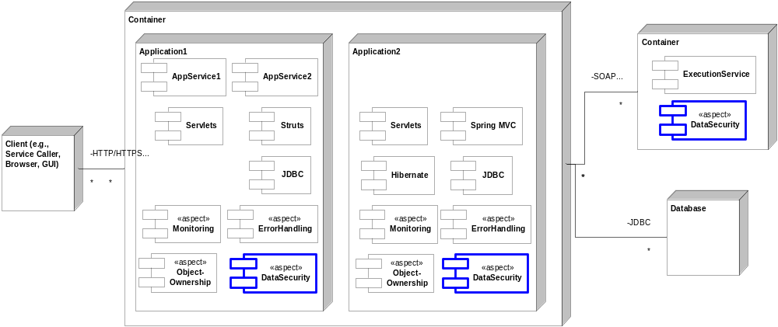
Deploying Aspects

Slide 25
Double Billing
Don’t want to bill twice for songs played within the context of playing a Playlist
Can accomplish using control flow pointcuts

Slide 26
Control Flow Pointcuts
: Client
: Playlist
: Song
: Song
play()
These join points are in the cflowbelow the original play call
Playlist.play()
execution
play()
return
play
call
play()
Song.play()
call
Song.play()
execution
return
return
All these join points are in the control flow of the original play call

Slide 27
Using the cflowbelow() Pointcut
aspect MeteringPolicy {
public pointcut useTitle(Playable playable) :
this(playable) &&
(execution(public void Playable.play()) ||
execution(public void Song.showLyrics()));
public pointcut topLevelUse(Playable playable) :
useTitle(playable) &&
!cflowbelow(useTitle(Playable));
after(Playable playable) returning :
topLevelUse(playable) {
MeteringService.trackUse(playable);
}
}
Not within the control flow of another use
cflowbelow() selects only join points within the control flow of another join point

Slide 28
Configuring Metering
Thus far we’ve assumed a single metering service
But metering can depend on
  Rate plans for user’s account
    all you can eat, daily pass, pay per use
  Outsourced metering partner(s)
  Publisher or title
How can we accommodate this?

Slide 29
Abstract Metering: Reusable Base Aspect
public abstract aspect MeteringPolicy {
public pointcut useTitle(Playable playable) :
<as before>
public pointcut topLevelUse(Playable playable) :
<as before>
public abstract MeteringService getMeteringService();
after(Playable playable) returning : topLevelUse(playable) {
getMeteringService().generateChargeFor(playable);
}
}

Slide 30
Per User Metering
public aspect UserMeteringPolicy extends MeteringPolicy percflow(
ServletPointcuts.requestExec(*, *, *)) {
private MeteringService meteringService;
private AccountManager accountManager;
private MeteringManager meteringManager;
before(HttpServletRequest request) :
ServletPointcuts.requestExec(*, request, *) {
meteringService = getService(request);
}
public MeteringService getMeteringService() {
return meteringService;
}
public void setMeteringManager(MeteringManager mgr) { … }
public void setAccountManager(AccountManager mgr) { … }
public MeteringManger getMeteringManager() { … }
public AccountManager getAccountManager() { … }
…
Creates one instance per control flow
Reuse library definition

Slide 31
percflow() Aspect Lifecycle
Aspect instantiated
servlet
: Playlist
: Song
: Song
doGet()
play()
play()
Aspect active. Holds state and advice can
run in any join point.
return
play()
return
return
return
Aspect eligible for garbage collection

Slide 32
Service Initialization
private MeteringService getService(HttpServletRequest request) {
HttpSession session = request.getSession();
MeteringService service = (MeteringService)session.
getAttribute(METERING_SERVICE);
if (service == null) {
service = findService(request.getRemoteUser());
session.setAttribute(METERING_SERVICE, service);
}
return service;
}
private MeteringService findService(String user) {
Account account = accountManager.getForUser(user);
return meteringManager.getForAccount(account);
}
}

Slide 33
Configuring the Aspect with Spring IoC
public aspect MeteringPolicyConfig {
declare @type: *MeteringPolicy: @Bean;
}
Beans.xml:
<beans>
<bean name="UserMeteringPolicy">
<property name="accountManager">
<ref bean="accountManager"/>
</property>
<property name="meteringManager">
<ref bean="meteringManager"/>
</property>
</bean>
<bean name="meteringManager"
class="music.service.metering.MeteringManagerImpl">
<property name="sessionFactory">
<ref bean="sessionFactory"/>
</property>
</bean>…
Uses Colyer’s Spring configuration aspects
Adds an annotation to all metering policy aspects so they will be auto-configured upon initialization

Slide 34
Per Title Metering
public aspect PerTitleMeteringPolicy extends MeteringPolicy
perthis(topLevelUse(*)) {
private MeteringService meteringService;
before(Playable playable) : topLevelUse(playable) {
meteringService = getService(playable);
}
public MeteringService getMeteringService() {
return meteringService;
}
…
}
One instance per
playable in top level use

Slide 35
More on Metering…
Tracking user per request can be refactored into a separate aspect
Consuming externally defined services can be hard because of variations
Aspects are a great way to integrate variations, e.g., metering can
  interact at different points: check credit before use, after completing play, when connecting
  require different context: check recent use or recent purchase, have ads been viewed, regulatory variations
  support affiliate assertions
Adding to mainline code gets tangled very quickly

Slide 36
Part II: Development Time Aspects
Architectural enforcement
Testing

Slide 37
Architectural Enforcement
Compile time checking
  declare error, declare warning
Only for statically determinable pointcut designators
  execution, initialization, staticinitalization, within, withincode, get, set, call
Dynamic cases addressed later (in testing)
Prevent code rot and enforce consistent policy
  E.g., enforcing EJB restrictions
Often a first step; even better is using aspects to consistently implement …

Slide 38
Use Logger, don’t print
Warn developers using System.out, System.err and printStackTrace
public aspect EnforceLogging {
pointcut scope():
within(com.example..*) && !within(TestCase+);
pointcut printing():
get(* System.out) || get(* System.err) ||
call(* printStackTrace());
declare warning: scope() && printing():
"don't print, use the logger";
}

Slide 39
Architectural Layering
Persistence
Layer 4
Model
Layer 3
View
Layer 2
Controller
Layer 1

Slide 40
Mapping packages to layers…
aspect Architecture {
pointcut inView() : within(view..*);
pointcut inModel() : within(model..*);
pointcut inController() : within(controller..*);
pointcut inPersistence() : within(persistence..*);
…

Slide 41
PCD’s for external calls into layers
…
pointcut viewCall(): call(* view..*(..)) && !inView();
pointcut modelCall(): call(* model..*(..)) && !inModel();
pointcut controllerCall():
call(* controller..*(..)) && !inController();
pointcut persistenceCall():
call(* persistence..*(..)) && !inPersistence();
pointcut jdbcCall() :
call(* java.sql..*(..)) || call(* javax.sql..*(..)) ;
…
Notes:
Deals with calls.
Indirect dependencies (session/context global state) not addressed – requires runtime enforcement.
First expression says model & view can’t call controller or utility.
Second expression says controller can’t call utility
If we had an “AboveX” hierarchy in parallel with the below one, would be able to specify the upcall rule to any layer above you, not just the one immediately above.
In many architectures, some upcalls to principled points are allowed… extend with “&& !target(Layer2Callback)
The number of layers is usually small (less than 5 say) so enumerating in this way is not burdensome.

Slide 42
Compiler warnings for illegal calls
…
declare warning : controllerCall() :
"No calls into controller";
declare warning : viewCall() && !inController() :
"Only controller can call view";
declare warning : modelCall() && !(inController() || inView()) :
"Only view and controller can call model";
declare warning : persistenceCall() && !inModel() :
"Only model can access persistence layer";
declare warning : jdbcCall() && !inPersistence() :
"Persistence layer handles all db access";
}

Slide 43
Testing: Database Errors
…
public void testDatabaseFailure() {
try {
from.transfer(2.25, to);
fail("no exception");
} catch (ModelException e) {
assertEquals(SQLException.class,
e.getCause().getClass());
// success
}
}
…
Account should convert a SQLException to a ModelException
How to generate a SQLException?
Notes:
- We can even ‘program’ the infrastructure to test otherwise difficult to create error paths. Here we specify that when the save method is called we should throw an SQLException.

Slide 44
Using Simple Virtual Mocks
public aspect AccountTestFailureInjection {
pointcut inFailureTest():
cflow(execution(* TestAccount.*Failure(..)));
before() throws SQLException:
call(* save()) && target(DAO) && inFailureTest() {
throw new SQLException("can't reach database");
}
}

Slide 45
Testing: Web Service Errors with ajMock
…
private VirtualMock mockCreditCheck;
public void setUp() {
mockCreditCheck = virtualMock("call(* "+
CreditService.class.getName()+".getCreditScore(..))");
}
public void testCreditCheckFailure() {
mockCreditCheck.expects(atLeastOnce()).will(
throwException(new RemoteException("can't connect")));
try {
account.applyForLoan(1000.);
fail("no exception");
} catch (ModelException e) {
assertEquals(RemoteException.class,
e.getCause().getClass());
// success
}
}
…
Notes:
- We can even ‘program’ the infrastructure to test otherwise difficult to create error paths. Here we specify that when the save method is called we should throw an SQLException.

Slide 46
Testing: Disconnected from Service
…
public void testOkCredit() {
final int GOOD_CREDIT = 500;
mockCreditCheck.expects(atLeastOnce()).will(
returnValue(GOOD_CREDIT);
account.applyForLoan(1000.);
// assert conditions for successful application
}
…
Allows testing without generating stubs, and without wiring up dummies
Does not replace end-to-end integration tests
But is useful for faster testing in isolation
Similarly for testing service implementation outside of container
Notes:
- We can even ‘program’ the infrastructure to test otherwise difficult to create error paths. Here we specify that when the save method is called we should throw an SQLException.

Slide 47
Part III: Infrastructure Aspects
Monitoring
Error Handling
Transaction Management

Slide 48
Performance Management
Performance is also a crosscutting concern
  Increasing integration and architectural complexity
  Intermittent failures often detected by help desk calls
AOP can help to
  Monitor performance and issues early on
  Identify bottlenecks (when optimizing/tuning)
  Improve performance
AOP complements:
  Good system architecture
  Good (improved) algorithms
  Profilers

Slide 49
Goal: Detect Problems Automatically
Step one: capturing key system statistics like
  How many requests?
  How long do they take?
  How much time is spent in database calls?
  Which requests are slow?
  What happens when the system is slow?
Can be used for
  Real-time alerts
  Management consoles
  Offline analysis
  Low-overhead tuning

Slide 50
Problems
Lots of boilerplate code
Need to correlate information across layers
  What is causing the bad query?
  Where do I generate a bad service request?
  What bean handles this request?
Need to revise
  Want to adapt monitoring based on experience
But it’s already painful to add monitoring once
Performance monitoring is crosscutting

Slide 51
Basic Request Monitoring
public aspect HttpServletMonitor {
public pointcut monitoredOperation(Object operation) :
execution(void HttpServlet.do*(..)) && this(operation);
void around(Object operation) :
monitoredOperation(operation) && if(enabled) {
long start = getTime();
proceed(operation);
PerfStats stats = lookupStats(operation);
stats.recordExecution(start, getTime());
}
public long getTime() { return System.currentTimeMillis(); }
public static class PerfStats { … }
private Map<StaticPart,PerfStats> perfStatMap = //…
private boolean enabled;
…

Slide 52
Database Monitoring Per Request
public aspect MonitorDatabaseRequests percflow(topLevelOperation()) {
public pointcut topLevelOperation() :
monitoredOperation(*) && !cflowbelow(monitoredOperation(*));
void around(Object operation) :
monitoredOperation(operation) && if(enabled) {
stats = lookupStats(operation);
long start = getTime();
proceed(operation);
stats.recordExecution(start, getTime());
}
…
Captures statistics at top level request entry & exit
!cflowbelow() prevents the aspect from double
counting requests invoked by this request

Slide 53
Database Monitoring Per Request
Object around() : databaseOperation() {
long start = getTime();
Object ret = proceed();
stats.recordNestedExecution(DATABASE, start, getTime());
return ret;
}
public pointcut databaseOperation() : call(* java*.sql..*(..));
…
private PerfStats stats;
}
Accumulates database time for each request
Notes:
The CLEAN approach is to have an abstract monitor aspect since we are really doing monitoring twice
Could show a demo here of a more general purpose version, integrated with JMX

Slide 54
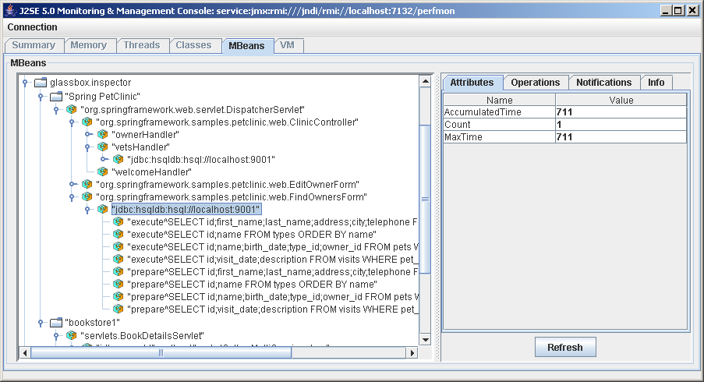
Looking Inside the Glassbox Inspector
Open source: https://glassbox-inspector.dev.java.net/
Notes:
demo

Slide 55
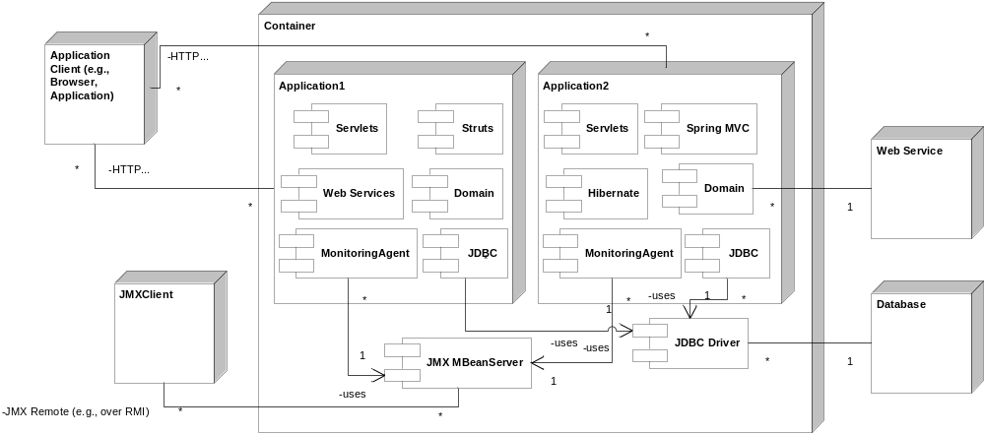
Monitoring Architecture

Slide 56
AOP to Improve Performance
Caching
  Storing previously calculated values
Prefetching
  Retrieving information before it’s required
Changing Concurrency
  Altering locking or conflict detection for parallel use
Changing query strategy
  Using indexes or simpler queries in a common case
Batching distributed requests
  Sending many updates in one message
Notes:
Note: sometimes you want to just prototype or will refactor partially

Slide 57
A Constant Cache
public aspect CacheTaxCalculation {
private Double Account.cachedTaxRate;
double around(Account account) :
execution(double calcTaxRate(..)) && this(account) {
double value;
if (account.cachedTaxRate == null) {
value = proceed(account);
account.cachedTaxRate = new Double(value);
} else {
value = account.cachedTaxRate.doubleValue();
}
return value;
}
}

Slide 58
An Event-Based Invalidating Cache
public aspect CacheTaxCalculation {
private Object Account.cachedTaxRate;
double around(Account account) :
// same as before…
before(Account account) : set(* Account+.*) &&
target(account) && !within(CacheTaxCalculation) {
account.cachedTaxRate = null;
}
}
Invalidate the cache if Account changes state
  i.e. if a field within Account changes
Could can extend to use observer (e.g., if TaxRegulation changes)

Slide 59
A Time-Based Invalidating Cache
public aspect CacheTaxCalculation {
private Double Account.cachedTaxRate;
private long Account.cacheWriteTime;
private static int INVALIDATION_TIME = 5000; // 5s
double around(Account account) :
execution(double calcTaxRate(..)) && this(account) {
double value;
if (!account.hasValidCache()) {
account.cachedTaxRate = new Double(proceed(account));
account.cacheWriteTime = System.currentTimeMillis();
}
return account.cachedTaxRate.doubleValue();
}
…
Notes:
Note that sometimes event-based isn’t realistic

Slide 60
Checking Cache Expiry
…
public boolean Account.hasValidCache() {
return account.cachedTaxRate != null &&
account.cacheWriteTime + INVALIDATION_TIME >
System.currentTimeMillis();
}
}

Slide 61
A Reusable Caching Aspect
Example inspired by Adrian Colyer’s blog
  http://www.aspectprogrammer.org/blogs/adrian/2004/06/implementing_ca.html
Two parts:
  abstract aspect: defines abstract methods and pointcuts, concrete advice
  concrete reuse:
  supplies methods and pointcuts

Slide 62
Abstract Caching Aspect
public abstract aspect BaseCache {
private Map cache = new WeakHashMap();
public void invalidate(Object key) { … }
abstract pointcut cachedOperation(Object key);
Object around(Object key) : cachedOperation(key) {
Object value;
if (cache.containsKey(key)) {
value = cache.get(key);
} else {
value = proceed(key);
cache.put(key,value);
}
return value;
}
}

Slide 63
Concrete Reuse
public aspect CacheTaxCalculation extends BaseCache {
pointcut cachedOperation(Object key) :
execution(double Account.calcTaxRate(..)) &&
this(key);
// invalidate as before…
}
Abstract aspect could be further extended to add an “invalidation” pointcut

Slide 64
AOP Performance Studies
Micro-benchmarks
  AOP Benchmark from AspectWerkz
  abc compiler benchmarks
  AspectJ internal benchmark suite
  Haupt & Mezini: micro-measurements
System Benchmarks
  Hugunin & Hilsdale: XSLTMark tracing
    22% slower when tuned for basic policy
    24% faster with static field optimization
  Zhang & Jacobsen: ORBacus refactoring
    8% slower with all aspects included
    6% faster without unnecessary aspects
Notes:
XXX Cite here!!!

Slide 65
Performance Results Summary
AspectJ performance usually within 5% of hand-written equivalent logic
  Typical advice overhead 10-80 ns/invocation
  If it’s important, test and tune
  AOP can often make crosscutting optimizations…
Small caveats
  Use of inefficient methods (e.g., Class.getName())
  Generally performance issues can be resolved (and AOP also enables better optimization)
  Older AspectJ lacks some optimizations (pertypewithin, lazy thisJoinPoint, cflow)
  Build or weave times noticeably slower

Slide 66
Error Handling Challenges
Duplicate logic
Keeping consistent
  Appropriate exception types
  Not swallowing
  Logging exactly once … with enough context to fix
Added as an afterthought
Hard to change
Presenting error information to users
User support (what really went wrong?)
Contain Auxiliary Errors

Slide 67
Error Handling: Within Model
aspect ModelErrorConversion {
pointcut modelExec() : execution(* model..*(..));
after() throwing (SQLException e): modelExec() {
convertException(e, thisJoinPoint);
}
after() throwing (NamingException e): modelExec() {
convertException(e, thisJoinPoint);
}
declare soft: SQLException: modelExec();
declare soft: NamingException: modelExec();
private void convertException(Exception e, JoinPoint jp) {
ModelException me = new ModelException(e);
me.setObject(jp.getThis());
me.setArgs(jp.getArgs());
throw me; // unchecked exception
}
}
Notes:
The model converts exceptions to ModelException at top level executions (i.e., for callers of the model) and softens them.
This again follows our thread from SQLException. Our policy is to log the cause of exceptions when exiting the model layer. And we can capture additional context information about what caused an error as we leave a method that caused it.

Slide 68
Error Handling: Calls to Model
aspect ModelErrorHandling {
pointcut modelEntry() :
call(* model..*(..)) && !within(model..*);
after(Object caller) throwing (ModelException e) :
modelEntry() && this(caller) {
handleModelError(e, caller);
}
after(Object caller) throwing (ModelException e) :
modelEntry() && !this(*) {
handleModelError(e, null);
}
private void handleModelError(ModelException e, Object caller) {
// force transaction rollback
// log caller, executing object, and args
}
}
Notes:
The model converts exceptions to ModelException at top level executions (i.e., for callers of the model) and softens them.
This again follows our thread from SQLException. Our policy is to log the cause of exceptions when exiting the model layer. And we can capture additional context information about what caused an error as we leave a method that caused it.

Slide 69
UI Error Handling
aspect UIErrorHandling {
pointcut actionMethod(ActionMapping mapping) :
execution(ActionForward Action.execute(..)) &&
args(mapping, ..);
ActionForward around(ActionMapping mapping) :
actionMethod(mapping) {
try {
return proceed(mapping);
} catch (NoRemoveInUseException e) {
errors.add(ActionErrors.GLOBAL_ERROR,
new ActionError("error.noremoveinuse",
((BusinessObj)e.getContext()).getName(),
((BusinessObj)e.getContext()).getKey()));
return mapping.getInputForward();
} catch (ModelException e) {
return handleError(e, mapping);
}
…
Notes:
Finally, we handle these errors in the controller by logging them, if need be… We can access additional context information that was stored at lower levels about this exception. This is a struts example; you’d do something similar in other servlet, JSP, or templating technologies.

Slide 70
UI Error Handling (cont.)
…
catch (InvocationTargetException e) {
logger.error("populating form ", e);
return handleError(e, mapping);
}
catch (Throwable t) {
logger.error("unknown throwable ", t);
return handleError(t, mapping);
}
}
ActionForward handleError(Exception e, ActionMapping mapping) {
session.setAttribute(Constants.MESSAGE_TEXT,
translate(e.getMessage()));
session.setAttribute(Constants.EXCEPTION, e);
return mapping.findForward(Constants.ERROR_PAGE);
}
}
Notes:
Then store a translated error message, and the original exception (for storage in an HTML comment). Finally, redirect to an error page.
We would also surely want to add error handling for JSP pages.

Slide 71
Error Isolation – for before & after advice
aspect AspectErrorHandling {
public pointcut handlingScope():
scope() && adviceexecution();
declare soft: Exception: handlingScope();
void around() : handlingScope() {
try {
proceed();
} catch (Throwable e) {
// log but don't rethrow – to contain errors
handleError(e, thisJoinPointStaticPart);
}
}
public synchronized void handleError(Throwable t) {
// log 1st and then every 1000 times
}
}

Slide 72
Simple Transaction Management
public aspect TransactionManagement {
protected pointcut transactionPoint() :
execution(public * org.sample.model..*(..));
// could also use annotation to define pointcut…
public pointcut topLevelTransaction():
transactionPoint() && !cflowbelow(transactionPoint());
Object around() : topLevelTransaction() {
Object returnValue = null;
try {
returnValue = proceed();
transaction.commit();
} catch (ModelException ex) {
transaction.rollback();
throw ex;
}
return returnValue;
}
}
Notes:
Aspects have many uses in persistence and transactions, in all tiers. E.g., capturing metadata for updates.
Or setting auto commit or not for servlet updates to a database. Here is a high level example of how an aspect can manage transaction control.

Slide 73
Part IV: Business Logic Aspects
Security
Account Suspension

Slide 74
AOP for Security Promises…
Correct implementation
Separation of policy from implementation
Defense in depth
Auditability
Fine-grained control
Integration
Pluggability (across services)

Slide 75
Example Business Model
Employee
EmpRegulation
+ address
+ salary
1
+ calcTax()
*
Manager
US_Regulation
CanadaRegulation
+ bonus
+ ssn
+ state
+ calcTax()
+ sin
+ province
+ calcTax()
0..1

Slide 76
Role-Based Authorization
…
before() : sensitiveOperations() {
Permission permission =
getPermission(thisJoinPointStaticPart);
AccessController.checkPermission(permission);
}
private Permission getPermission(String methodName) {
// config or database lookup
}
}

Slide 77
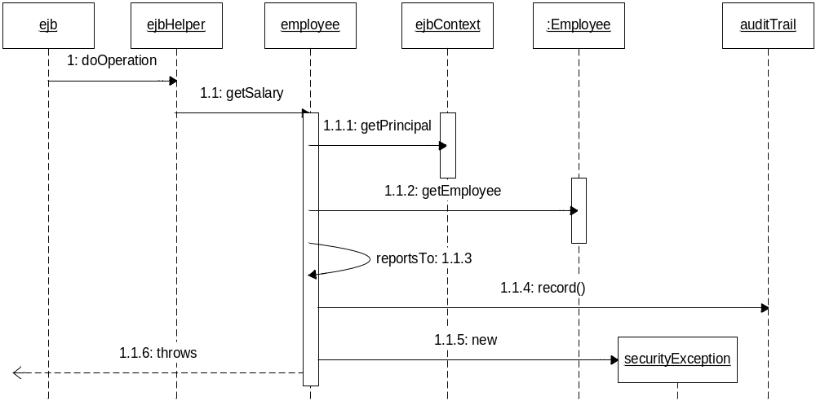
Data-Driven Authorization
EmployeeDataAuthorization Aspect

Slide 78
Data Authorization Aspect
public aspect SensitiveDataAuthorization {
pointcut readSensitiveEmployeeData(Employee employee):
this(employee) && (
execution(* getSalary()) || execution(* getAddress()) ||
execution(* getBonus()));
pointcut securityContext(Subject subject, Action action):
cflow(execution(* Subject.doAs*(Subject, Action, ..)) &&
args(subject, action));
before(Subject subject, Employee employee) :
readSensitiveEmplData(employee) &&
securityContext(subject, *) {
checkAccess(subject, employee);
}
…
Notes:
This uses the sample DefaultEJB aspect and associated ManagedSessionBean interface from the Timer example.

Slide 79
Data Authorization Access Check
…
void checkAccess(Employee employee, Worker worker) {
Employee caller =
Employee.getEmployee(worker.getSubject());
if (caller==null || !employee.reportsTo(caller))) {
// record attempted security violation
throw new AuthorizationException("…");
}
// and log data access to audit trail
}
…
Notes:
This uses the sample DefaultEJB aspect and associated ManagedSessionBean interface from the Timer example.

Slide 80
Data Authorization Aspect: Helper
…
pointcut sensitiveRegOp(Employee_Regulation reg):
this(reg) && (
execution(* get*()) || execution(* calcTax()));
before(Subject subject, Employee_Regulation reg,
Employee employee) :
sensitiveRegOp(reg) && securityContext(subject, *) &&
cflow(execution(* Employee.*(..)) && this(employee)) {
if (!reg.equals(employee.getRegulation())) {
employee = RegMgr.lookupEmployee(reg);
}
checkAccess(subject, employee);
}
}
Notes:
This uses the sample DefaultEJB aspect and associated ManagedSessionBean interface from the Timer example.

Slide 81
Refactoring Auditing Out
public aspect SecurityAuditing {
pointcut securityCheck() :
// better: @annotation
within(ajee.security..Authorization*) &&
adviceexecution();
after() returning:
securityCheck() && authenticated(worker) {
auditor.recordAccess(worker.getSubject(),
getAdvisedJp());
}
after() throwing (SecurityException se):
securityCheck() && authenticated(worker) {
auditor.recordViolation(worker.getSubject(),
getAdvisedJp(), se);
}
…
}

Slide 82
P3P Annotation, Permissions…
public aspect P3PDataAuthorization {
pointcut readP3pData(P3P prefs) :
get((* @P3P) *.*) && @annotation(prefs);
pointcut writeP3pData(P3P prefs) :
set((* @P3P) *.*) && @annotation(prefs);
before(P3P prefs) : readP3pData(prefs) {
AccessController.checkPermission(new
P3P_Permission(prefs, Operation.READ));
}
before(P3P prefs) : writeP3pData(prefs) {
AccessController.checkPermission(new
P3P_Permission(prefs, Operation.MODIFY));
}
}

Slide 83
Database Filtering…
public aspect ToplinkQuerySecurityFilter {
pointcut readingObject(Class clazz, Expression expression) :
(call(* Session.readObject(..)) ||
call(* Session.readAllObjects(..))) &&
args(clazz, expression);
Object around(Class aClass, Expression expression,
AbstractJaasAuthentication.Worker worker) :
readingObject(aClass, expression) &&
AbstractJaasAuthentication.authenticated(worker) {
if (aClass == Employee.class) {
Subject subject = worker.getSubject();
Manager mgr = ManagerDao.findManager(subject);
Vector employees = mgr.getEmployees();
expression = expression.and(new
ExpressionBuilder().get("id").in(employees));
}
return proceed(aClass, expression, worker);
}

Slide 84
Account Suspension
Example business aspect
Rule: no business transaction may be performed on any suspended account
  Many different types of accounts
  Attempts should fail and give an error
  The UI should not offer unavailable operations…
  just as with security rules

Slide 85
Telecom Example
Account
Service
+ bill()
+ cancel()
…
1
*
+ placeCall()
+ addFeature()
ConsumerAcct
SME_Acct
Mobile
Local
+ doNotCall()
…
+ analyze()
…
+ setVoicemail()
…
+ conference()
…

Slide 86
Simple Implementation: Account
public aspect AccountSuspension {
private boolean Account.suspended = false;
public void Account.setSuspended() { … }
public boolean Account.isSuspended() { … }
pointcut suspendedAccountBusinessTrans(Account account):
this(account) && if(account.suspended) &&
execution(* *(..)) && BPM.inBusinessTrans();
before(Account account) :
suspendedAccountBusinessTrans(account) {
// record attempted access
throw new SuspendedAccountException("…");
}
// exceptions caught by UI/interaction tier
}

Slide 87
Simple Implementation: Service
public aspect ServiceSuspension {
pointcut suspendedServiceBusinessTrans(Service service):
if(service.getAccount().isSuspended()) &&
this(service) && execution(* *(..)) &&
BPM.inBusinessTrans();
before(Service service) :
suspendedServiceBusinessTrans(service) {
// record attempted access to service.getAccount()
throw new SuspendedAccountException("…");
}
}

Slide 88
Interesting Questions
Defining business transactional operations:
use of annotations or stable properties?
Restore (or close) suspended account:
is this a business transaction? Pointcut exception?
Allowing non-transactional operations on suspended:
not common in practice?
Proactive checking for suspension in UI
  Challenge: avoiding redundant rules while decoupling
  Some UI designs/frameworks can simplify
  Use of annotations may facilitate (possibly with declare annotation)

Slide 89
Business Aspects
Many other possibilities
  Object ownership
  Account limits
  Account authorization
  Metering (extending our online music store)
  Publishing business events
  Detecting business exceptions (real-time monitoring)
  Feature management
    for specific partners/customers etc.
  Object history/versioning
As many business aspects as business objects

Slide 90
Part V: Conclusion …
The state of AOP
Use throughout development lifecycle
Adoption strategy

Slide 91
The State of AOP
AspectJ 5: the leader
  Java 1.1 through 5.0 support
  Power & tools integration of AspectJ
  Load-time weaving of AspectWerkz
  Libraries emerging
  IBM & BEA leading development
Spring, JBoss
  Integrated AOP with aspect libraries
Emerging for .NET, C++, PHP, Ruby …

Slide 92
Aspect-Oriented Software Development
Build on OO methods
Good OO practices help apply AO
  And vice-versa: good AO encourages and rewards good OO
Treat Aspects as modules (analog to classes)
UML extensions
  Naïve/Stereotypes, Theme/UML, Jacobson, …

Slide 93
Requirements and Analysis
Identify crosscutting requirements separately
  Not scattered and tangled throughout use cases
Identifying Aspects (Colyer)
  From adjectives and adverbs: “sensitive data”…
  Compare to using nouns and verbs for objects
  Temporal statements: “before calling service, check cache”
  Policy statements: “whenever a trade exceeds $1 million”
Analysis Aspects
  Represent key concepts
  Have high-level responsibilities (key advice, operations, state)

Slide 94
Design Aspects
Focus on ARC:
aspect, responsibilities, collaborators
Sequence diagrams natural for interactions
Pointcuts are key: describe stable properties (e.g., whenever state changes), not using today’s AOP pointcut languages nor using enumeration
  Many patterns: template pointcuts, public pointcut describing properties, private pointcuts for implementation needs), …
Advice: @name to describe what not how
Inter-Type Declarations: design like state/methods for class

Slide 95
Detailed Design and Development
Refactoring aspects is natural
Test-Driven Development is useful to flesh out detailed requirements
  Build on standard tools like JUnit, jMock
  E.g., virtual mocks with jMock, aUnit for aspects
Aspects should be unit tested
  Test drivers mock collaborators (generate join points)
  Testing crosscutting concerns in isolation is new
Aspects are also tested in integration tests

Slide 96
A Phased Adoption Strategy
reward
time & confidence

Slide 97
Don't run before you can walk
reward
Risky Space
time & confidence

Slide 98
Phases of Adoption
reward
AO Analysis, Design,
Strategic Implications
auxiliary /
infrastructure
core /
business
exploration
enforcement
time & confidence

Slide 99
Within the Phases
local
individual
project
team
product
spread
team
library
company
platform

Slide 100




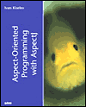




Conclusion
AOP is rapidly gaining adoption in the enterprise
  AspectJ is the clear leader: 20,000 downloads/mo.
Analysis and design approaches emerging
Incremental adoption works best
These slides at http://www.newaspects.com/presentations
Training, consulting, and support available
Notes:
[NDL] Added two books

Slide 101
Thank You
Ron Bodkin rbodkin@newxas pects .com
New Aspects of Software
Thanks to my former colleagues on the AspectJ team at PARC for pioneering how to teach AOP, and to my fellow AspectMentor members.
Some slides in this presentation were created by or in collaboration with Gregor Kiczales, IBM, Nicholas Lesiecki, Ramnivas Laddad, or Dion Almaer, and are used with permission. The copyright notice on this presentation refers to the slides created by New Aspects of Software and this assembly into a whole.

