Slide 1
Extending AJDT
Charles Zhang
University of Toronto

Slide 2
Building an extension of AJDT
Tap into the AspectJ compilation:
  Passive/Proactive
Obtain the syntactic information
  ASTs of aspect, advice, pointcut declarations
Obtain the structural information
  Relations between advices and matched Java program elements
Produce consistent presentations
  Icons and markers

Slide 3
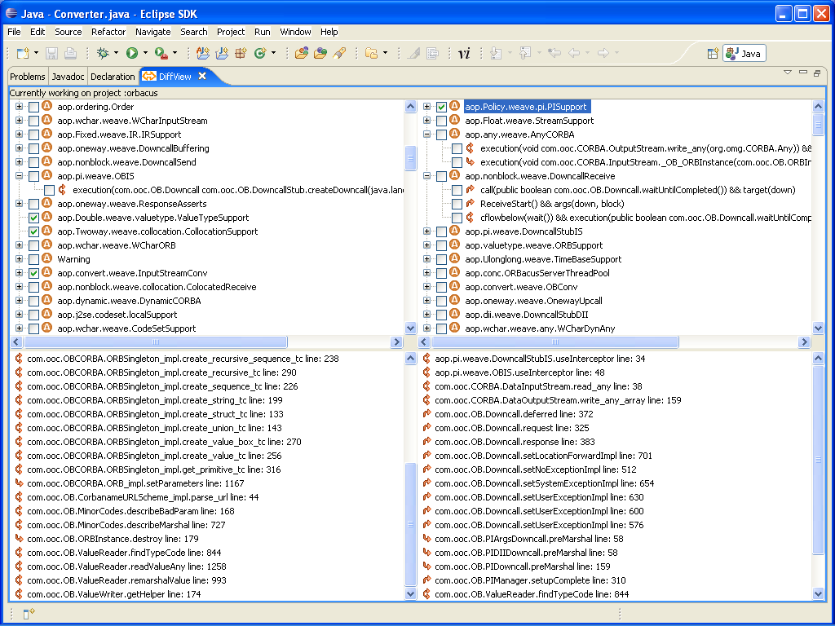
Example: Shadow comparison
AST information about aspects:
Kinds, names
Joinpoint information:
Type name, source location, advice kind
Consistent L&F

Slide 4
Visiting ASTs of AspectJ
Extend the AspectJ AST visitor:
  class MyVisitor extends AsmHierarchyBuilder{
  public boolean visit(TypeDeclaration t, CompilationUnitScope s) { …}
  public boolean visit(MethodDeclaration m,ClassScope s) {…}
  }
Visit passively: for compilation issued by Eclipse.
  Register the ASTWalker: org.aspectj.ajdt.internal.core.builder.AjBuildManager.setAsmHierarchyBuilder(MyVisitor);
  Monitor the build process:
    extend “org.aspectj.ajde.BuildListener”
    register the build listener:
      Ajde.getDefault().getBuildManager().addListener();
    Be aware of the racing condition: your stuff might be initialized before AJDT
Visit proactively: programmatically invoke the AspectJ compiler outside of Eclipse:
  Get the classpath right: org.aspectj.ajde.NullIdeManager.init(String path);
  Register the ASTWalker the same way
  Invoke the compiler:
    In Java. Ajde.getDefault().getBuildManager().build(File buildlist)
    Through ant.

Slide 5
AST Walking:
Getting pointcuts and advices
Analyzing aspects:
public boolean visit(TypeDeclaration td, CompilationUnitScope scope) {
super.visit(typeDeclaration, scope);
  if(td instanceof AspectDeclaration){
SourceTypeBinding source = td.binding;
String filename = new String(source.getFileName());
  String aspectname_= ((AspectDeclaration)typeDeclaration).typeX.getName();
}
return true;
}
Analyzing advices and pointcuts:
public boolean visit(MethodDeclaration md, ..) {
if (md instanceof AdviceDeclaration || ) {
String name = ((AdviceDeclaration)md).pointcutDesignator.getPointcut().toString();
}
if (md instanceof PointcutDeclaration) {
String name = ((PointcutDeclaration)md).pointcutDesignator.getPointcut().toString();
}
}

Slide 6
Structural model walking:
Getting matched joinpoints
Extend “org.aspectj.asm.HierarchyWalker”
  public void preProcess(IProgramElement node) {
  if(node.getKind().equals(IProgramElement.Kind.ADVICE)){
  String key = node.getBytecodeName();
  }
  if (node.getKind().equals( IProgramElement.Kind.DECLARE_WARNING)) {
  node.getBytecodeName(),node;
  }
  }
Trigger the walk of the structures:
  AsmManager.getDefault().getHierarchy().getRoot().walk(new MyWalker());
Obtain matched joinpoints:
  RelationshipMap mapper = (RelationshipMap)AsmManager.getDefault().getRelationshipMap();
  List relations = mapper.get(node);
  Object o = relations.get(i).getTargets().get(j);
  IProgramElement element = hierarchy.findElementForHandle(o.toString());

Slide 7
Create AJDT Look and Feel
Extend ILabelProvider
class MyLabelProvider implements ILabelProvider {
  public Image getImage(Object element) {
  if(handle.value_.toString().indexOf("around")>0)
  return AspectJImages.instance().AROUND_ADVICE.getImageDescriptor().createImage();
  if(handle.value_.toString().indexOf("before")>0)
  return AspectJImages.instance().BEFORE_ADVICE.getImageDescriptor().createImage();
  if(handle.value_.toString().indexOf("after")>0)
  return AspectJImages.instance().AFTER_ADVICE.getImageDescriptor().createImage();
  }

Slide 8
More information
The wiki is the most up to date resource on how to interact with AJDT and the compiler:
  http://wiki.eclipse.org/index.php/Developer%27s_guide_to_building_tools_on_top_of_AJDT_and_AspectJ
  (Tiny URL: http://tinyurl.com/ywsgl6 )
AspectJ and AJDT FAQs:
  http://www.eclipse.org/aspectj/doc/released/faq.php
  http://www.eclipse.org/ajdt/faq.php

